Slide 1
NIKE
BRAND IDENTITY SYSTEM

Slide 2
Introduction 01
Brand Story 03
Brand Colors 05
Visual Language 07
Applications 09
Brand Purpose 02
Logo 04
Typography 06
Brand Voice 08
INDEX
01

Slide 3
The following brand identity system for Nike is thoughtfully crafted to present our brand in an international, engaging, consistent, recognisable and proprietary way. Unique in form, versatile in its application and unified by a fundamental principle.
Industry: Sportswear, Footwear, Apparel, Lifestyle & Fitness
Target Audience: Athletes, Fitness enthusiasts, Sports teams, Urban youth, Lifestyle-focused consumers, Fashion-conscious individuals, Professional and amateur athletes, People seeking performance-driven and stylish sportswear.
INTRODUCTION
02

Slide 4
Distinctive Sportswear, Footwear, Apparel, Lifestyle & Fitness solution focused on Athletes, Fitness enthusiasts, Sports teams, Urban youth, Lifestyle-focused consumers, Fashion-conscious individuals, Professional and amateur athletes, People seeking performance-driven and stylish sportswear.
BRAND PURPOSE
03

Slide 5
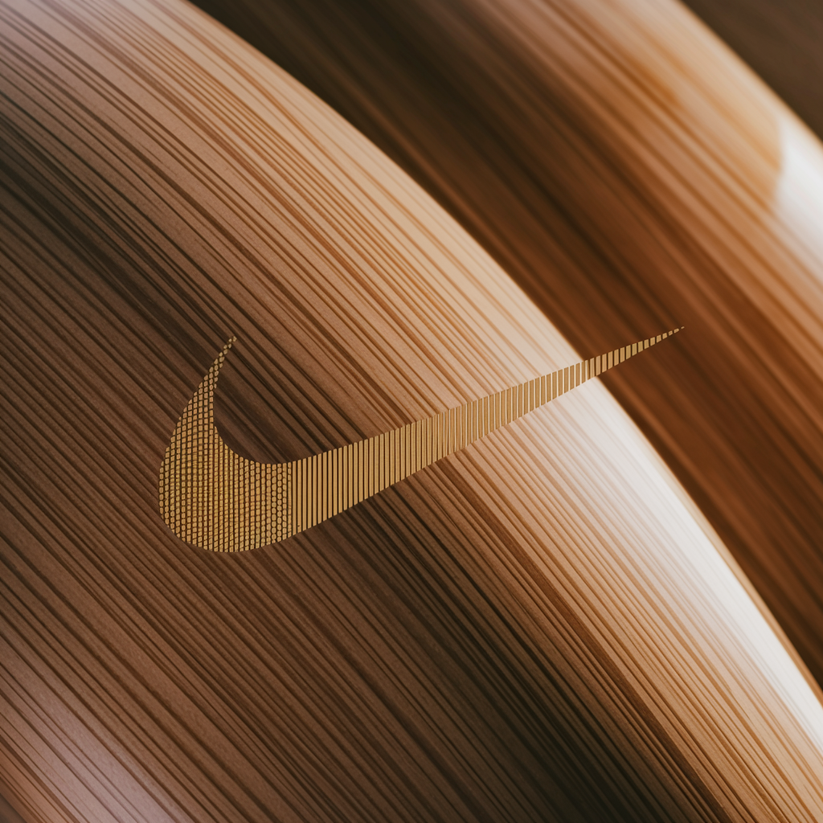

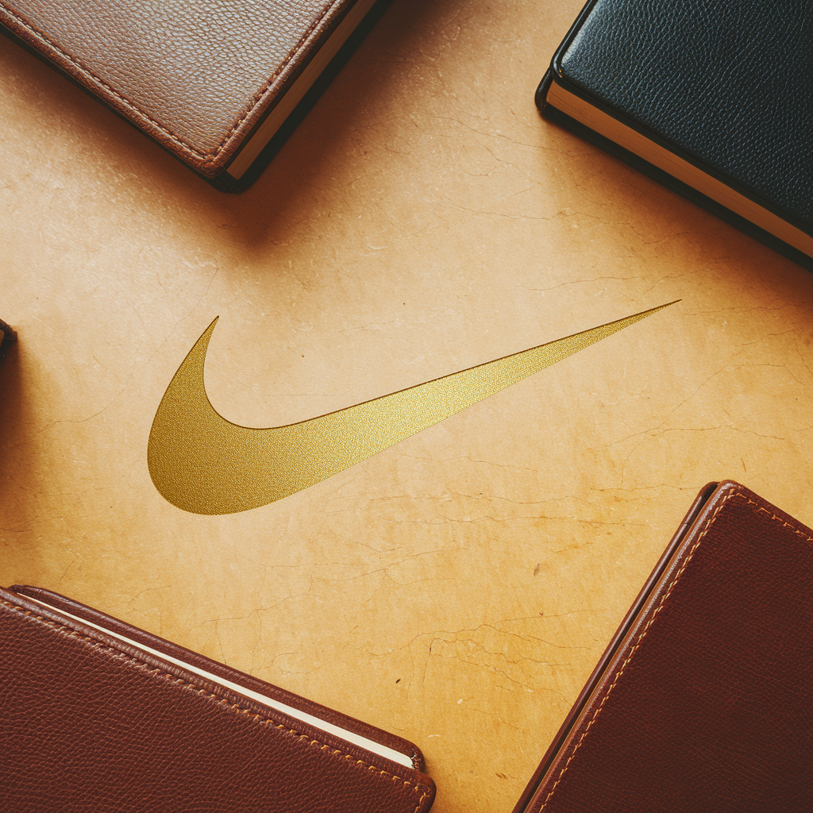
LOGO
04

Slide 6
PRIMARY
#2563EB
SECONDARY
#4B5563
ACCENT
#FCD34D
BRAND COLORS
05

Slide 7
Primary Font: Archivo
Secondary Font: Work Sans
Research-driven bold selection
TYPOGRAPHY
06

Slide 8
Nike's brand voice is dynamic, inspiring, and empowering. It reflects a passion for innovation, performance, and excellence, while also celebrating diversity, sustainability, and authenticity. The tone is confident, energetic, and determined, resonating with athletes, fitness enthusiasts, sports teams, urban youth, lifestyle-focused consumers, and fashion-conscious individuals.
Nike's messaging is authoritative, motivating individuals to push their limits and achieve their goals. It is also supportive and inclusive, fostering a sense of community and empowerment. The brand communicates with a sense of authenticity, showcasing real stories of determination and success.
Overall, Nike's
BRAND VOICE
07

