Slide 1
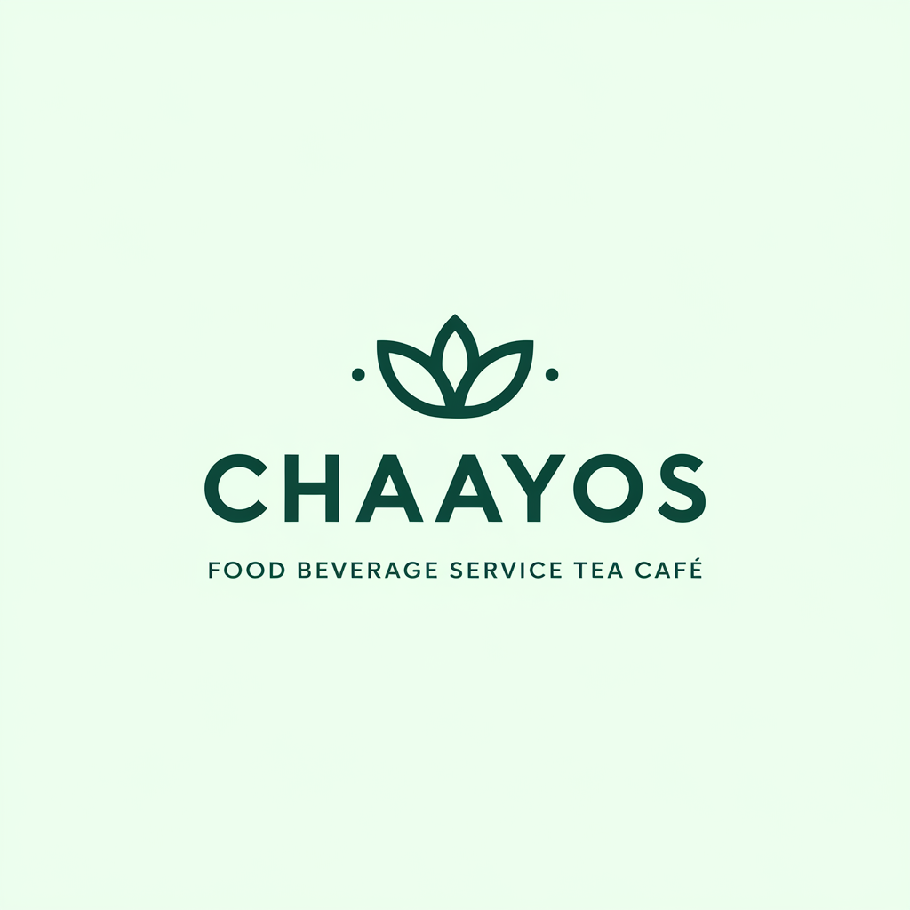
Brand Identity System

Slide 2
INDEX
Introduction
01
Brand Purpose (Values)
04
Brand Colors
07
Brand Purpose (Vision)
02
Brand Story
05
Primary Colors
Secondary Colors
Color Usage 1/2
Brand Purpose (Mission)
03
Logo Variations
06
Color Usage 2/2
Variation 1
Typography
08
Variation 2
Variation 3
Brand Font
Font Usage
Text Hierarchy
Imagery & Visuals
09
Illustrations
Iconography
Merchandise

Slide 3
Welcome to Chaayos's brand identity system, where tradition meets innovation in the modern tea café experience. As pioneers in the premium beverage segment, we've crafted a distinct identity that seamlessly blends authentic chai culture with cutting-edge personalization technology. Our comprehensive system delivers an internationally appealing, consistently engaging, and uniquely recognizable brand presence across all touchpoints. By harmonizing age-old chai wisdom with contemporary café culture, we create memorable experiences for urban professionals and tea enthusiasts who value both heritage and innovation in their daily chai ritual.
INTRODUCTION

Slide 4
At Chaayos, our vision is to redefine the tea experience for Urban working professionals, college students, and tea aficionados by creating a hub of innovation and relaxation. We aspire to be the beacon of premium, customizable chai solutions that cater to the diverse tastes of our health-conscious and tech-savvy customers, setting new standards for hygienic and personalized tea experiences.
BRAND PURPOSE (VISION)

Slide 5
Chaayos is dedicated to providing a distinctive Food & Beverage / Quick Service Tea Café experience that blends tradition with innovation. We aim to empower our customers by offering high-quality, personalized tea options in a hygienic environment while leveraging user-centric design to continuously enhance their chai experience. Our mission is to be the go-to destination for those seeking a premium and trustworthy tea café experience.
BRAND PURPOSE (MISSION)

Slide 6
At Chaayos, we embody a culture that celebrates Personalization through our customizable tea offerings, ensuring Quality in every sip, and fostering Innovation in our menu and service offerings. We prioritize Hygiene to provide a safe and clean environment for our customers, while focusing on enhancing Customer Experience through reliable and trustworthy service. Grounded in Tradition, we strive to create a space where our customers can Relax and unwind while enjoying their favorite cup of chai.
BRAND PURPOSE (VALUES)

Slide 7
In the bustling streets of urban India, where the aroma of chai fills the air and the clinking of cups signals a moment of pause in the chaos, there stands a haven for tea enthusiasts - Chaayos. Imagine a place where every cup tells a story, where tradition meets innovation, and where each sip is a journey through flavors and memories. This is where urban working professionals, college students, and tea lovers from all walks of life come together to experience a chai revolution like no other. At Chaayos, we believe in the power of personalization.
BRAND STORY (1/2)

Slide 8
We understand that every tea lover is unique, with their own preferences and tastes. That's why we offer a wide range of customizable chai options, from classic Masala Chai to exotic blends like Kashmiri Kahwa, allowing our customers to create their perfect cup of tea, just the way they like it. But it's not just about the tea; it's about the experience. From the moment you step into a Chaayos café, you are greeted with warmth and a sense of familiarity. Our cozy ambiance and friendly staff make you feel right at home, whether you're catching up with friends, studying for exams, or taking...
BRAND STORY (2/2)

Slide 9
Choose for maximum impact and brand recognition in primary applications.
Logo Variation 1

Slide 10
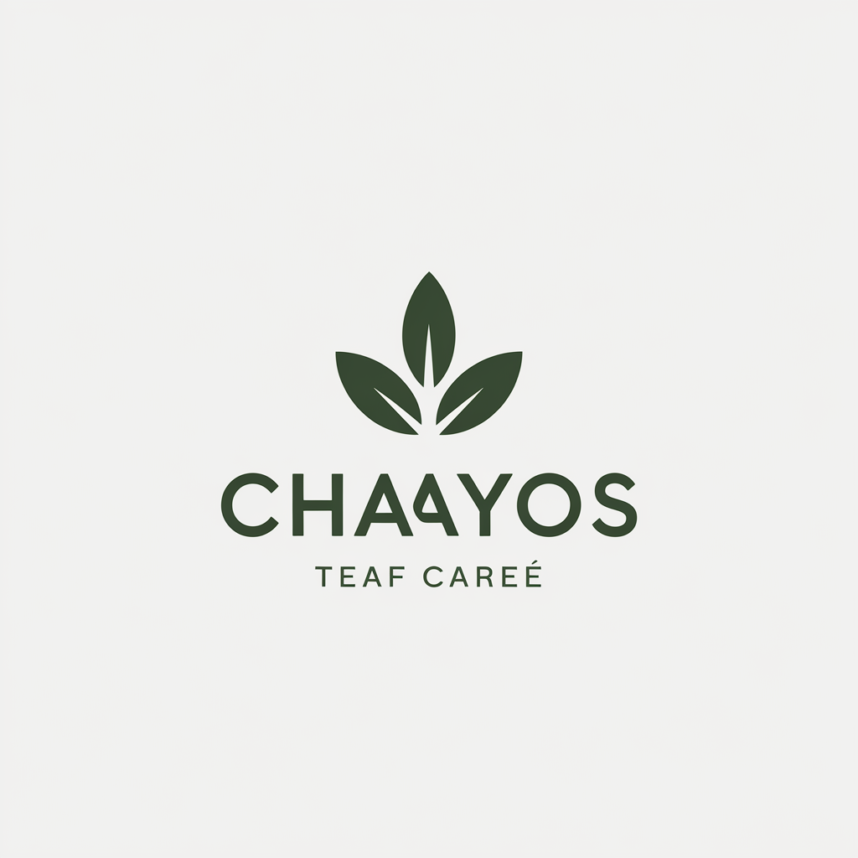
Perfect for constrained spaces while maintaining professional brand presence and clarity.
Logo Variation 2

Slide 11
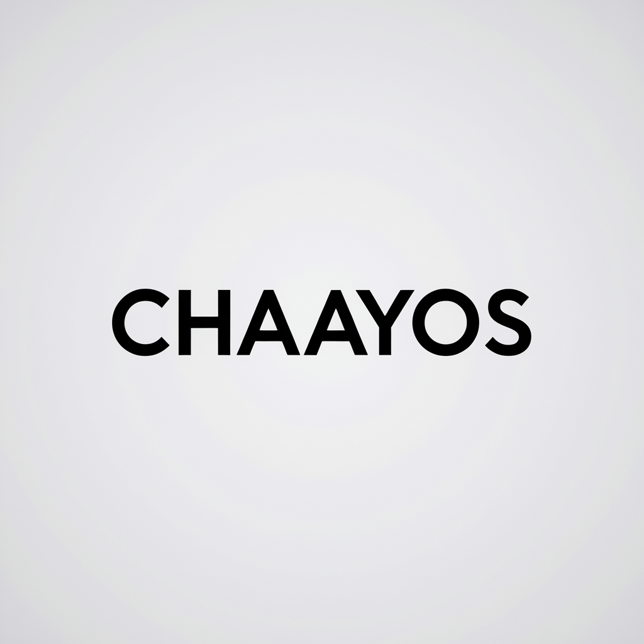
Ideal for small sizes, watermarks, and applications requiring simplified brand representation.
Logo Variation 3

Slide 12
Chaayos Green
#065F46
RGB(6, 95, 70)
CMYK(93, 0, 26, 62)
Use Light Text
Masala Chai Brown
#A0522D
RGB(160, 82, 45)
CMYK(0, 48, 71, 37)
Use Light Text
Earl Grey Blue
#5E819D
RGB(94, 129, 157)
CMYK(40, 17, 0, 38)
Use Dark Text
Golden Brew
#D4AF37
RGB(212, 175, 55)
CMYK(0, 17, 74, 16)
Use Dark Text
Primary Colors

Slide 13
Mint Green
#7ED5B8
Use Dark Text
Terracotta
#C15B32
Use Dark Text
Steel Blue
#4B6F8E
Use Light Text
Mustard Yellow
#DCC268
Use Dark Text
Charcoal
#333333
Use Light Text
Secondary Colors

Slide 14
Primary Color Usage
Use for brand-critical elements:
• Logos and main brand marks
• Headlines and key text
• CTA buttons and navigation
• Hero sections
Colors: Chaayos Green, Masala Chai Brown, Earl Grey Blue, Golden Brew
Best Practices:
- Maximum brand recognition
- Consistent application
- Sufficient contrast
- Accessibility compliance
Color Usage 1/2

Slide 15
Secondary Color Usage
Use for supporting elements:
• Backgrounds and subtle accents
• Secondary text
• Borders and dividers
• Hover states and icons
Colors: Mint Green, Terracotta, Steel Blue, Mustard Yellow, Charcoal
Best Practices:
- Create visual hierarchy
- Support, don't compete
- Maintain readability
- Use sparingly
Color Usage 2/2

Slide 16
Primary Font: Inter
Secondary Font: Source Sans Pro
Font Hierarchy:
• Headlines: Inter - Bold, 28-32pt
• Subheadlines: Inter - Bold, 20-24pt
• Body Text: Source Sans Pro - Regular, 16-18pt
• Caption Text: Source Sans Pro - Regular, 12-14pt
TYPOGRAPHY

Slide 17




Visual 1
Visual 2
Visual 3
Visual representation of how Chaayo...
How Chaayos drives innovation and p...
The customer journey and experience...
Visual 4
Future vision and growth trajectory...
USAGE NOTES: These illustrations define the visual storytelling style of the brand. Use them consistently across presentations, reports, and marketing materials to maintain brand coherence.
BRAND ILLUSTRATIONS

Slide 18














Chaayos - Core Functional Icons
ICONOGRAPHY

Slide 19








Chaayos - Food & Beverage / Quick Service Tea Café Industry Icons
ICONOGRAPHY

Slide 20
Style: Minimalist design
Color: #065F46 on black background
Size Requirements:
• Minimum: 16px web, 0.5" print
• Recommended: 24px+ web, 0.75"+ print
Spacing:
• Clear space: 50% of icon width
• Consistent grid alignment
USAGE GUIDELINES

Slide 21
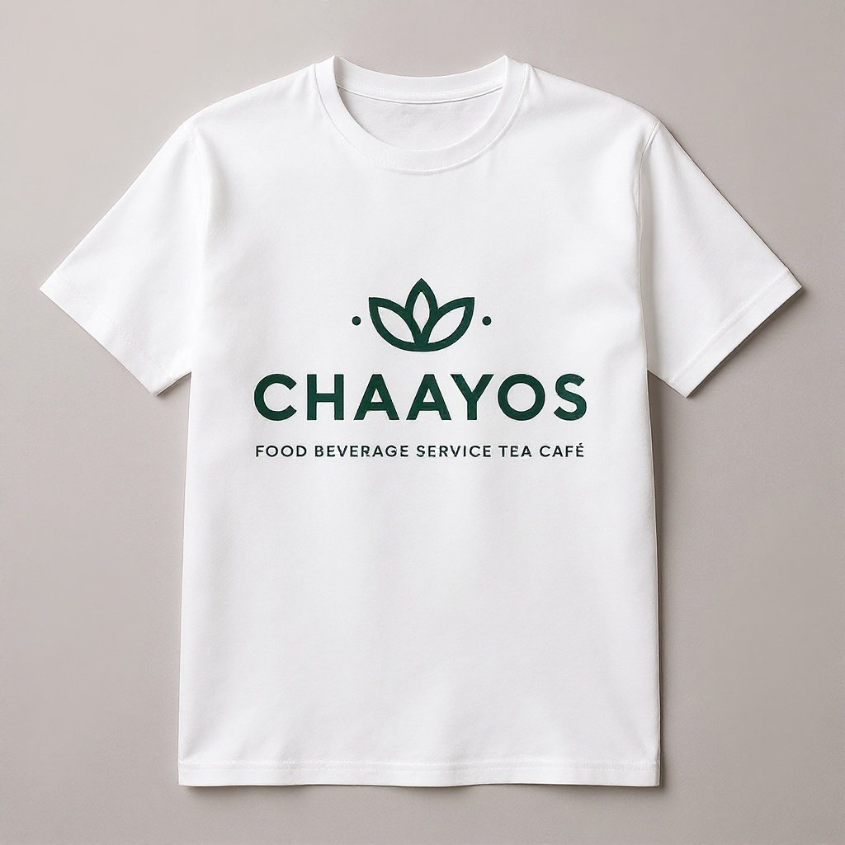
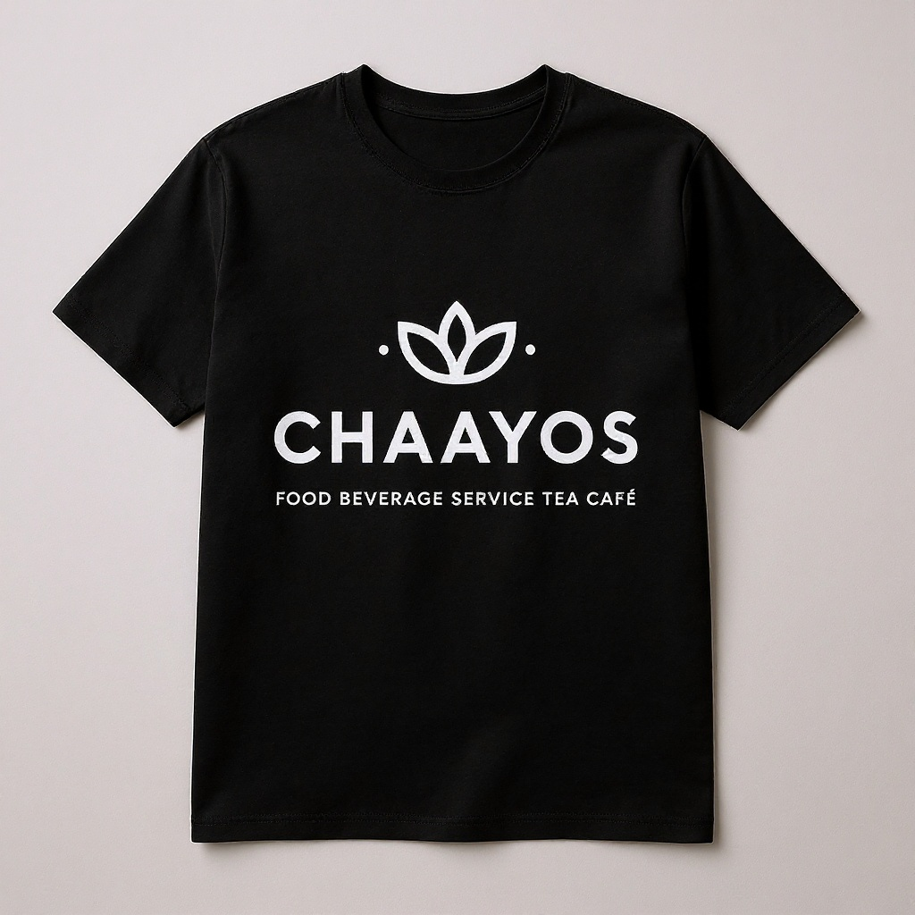
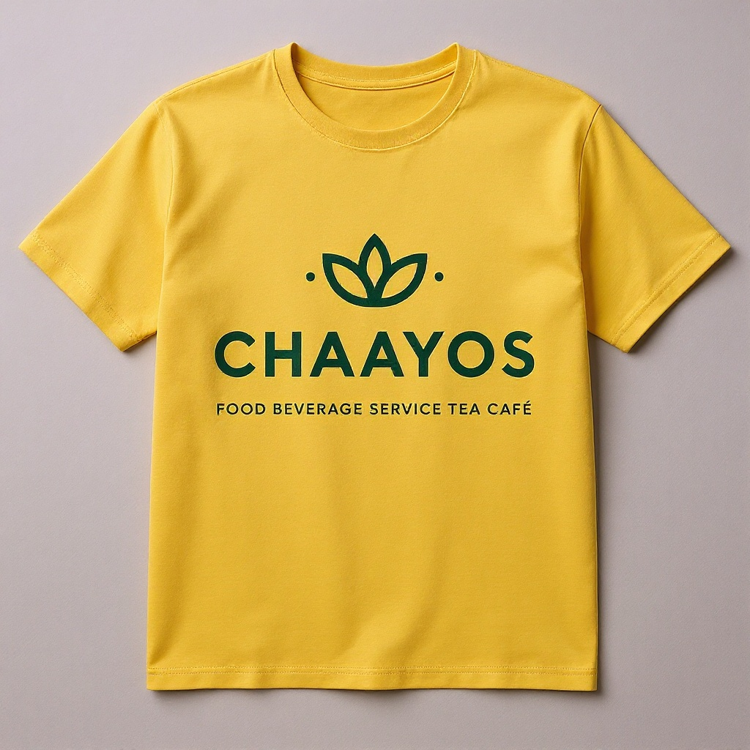
BRAND APPAREL

Slide 22
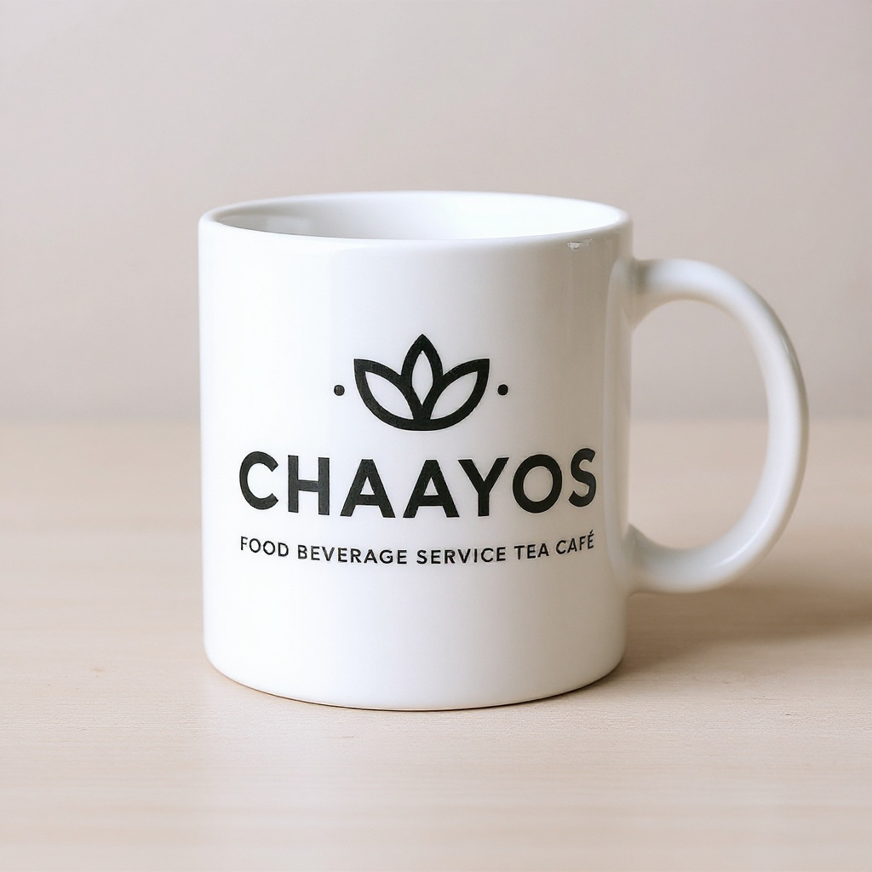
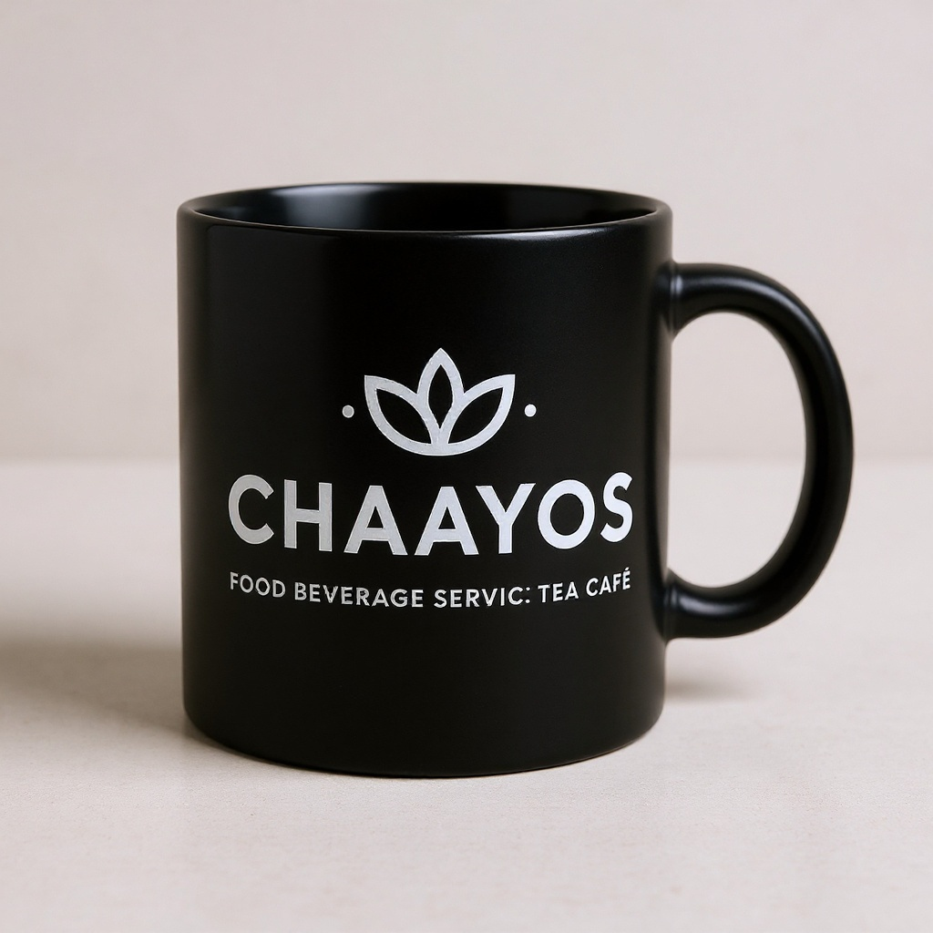
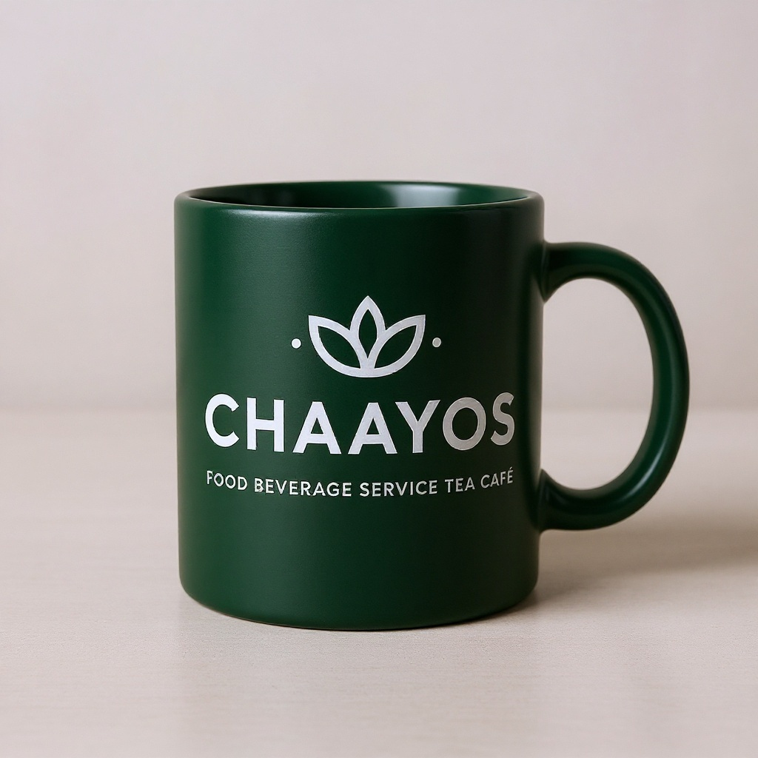
BRAND MUGS

