Slide 1
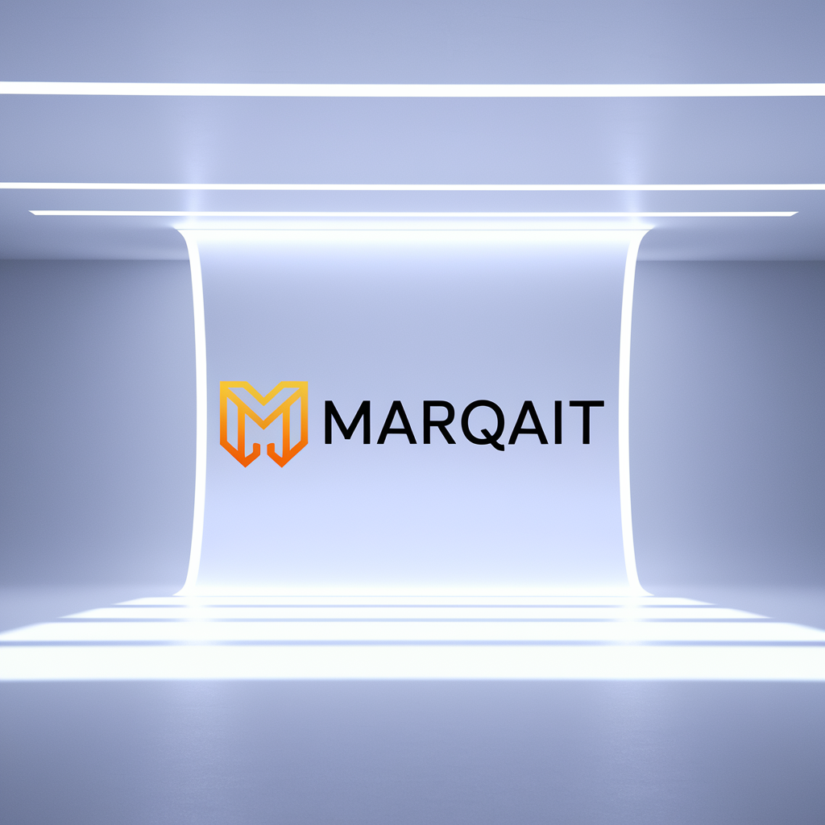
Brand Identity System

Slide 2
INDEX
Introduction
01
Brand Purpose (Values)
04
Brand Colors
07
Brand Purpose (Vision)
02
Brand Story
05
Primary Colors
Secondary Colors
Color Usage 1/2
Brand Purpose (Mission)
03
Logo Variations
06
Color Usage 2/2
Variation 1
Typography
08
Variation 2
Variation 3
Brand Font
Font Usage
Text Hierarchy
Imagery & Visuals
09
Iconography
Illustrations
Merchandise

Slide 3
Discover MARQAIT, where cutting-edge AI marketing automation meets intuitive simplicity. Our comprehensive brand identity system delivers a powerful, internationally recognized presence that resonates across digital landscapes. Built on the pillars of accessibility, empowerment, agility, and measurable results, MARQAIT transforms how startups, growing businesses, and marketing teams harness AI-powered technology. We've crafted a distinctive and consistent brand experience that stands out in the MarTech ecosystem, empowering modern businesses to achieve their marketing goals with unprecedented efficiency and precision.
INTRODUCTION

Slide 4
MARQAIT's vision is to revolutionize the marketing landscape by empowering Startups, Small-to-mid-sized businesses, Marketing teams, Entrepreneurs, and Digital brands with cutting-edge AI-Powered Marketing Automation solutions. Our ultimate goal is to drive unparalleled success and growth for our clients, setting new benchmarks in the industry through innovation and forward-thinking strategies.
BRAND PURPOSE (VISION)

Slide 5
At MARQAIT, we are dedicated to providing tailored AI-Powered Marketing Automation Platform solutions that simplify complex marketing processes, enhance user experiences, and deliver measurable results. Our mission is to enable Startups, Small-to-mid-sized businesses, Marketing teams, Entrepreneurs, and Digital brands to harness the power of AI-driven strategies to achieve their marketing goals effectively and efficiently.
BRAND PURPOSE (MISSION)

Slide 6
In every aspect of our work, we embody the core values of Innovation, Simplicity, AI-Driven Strategy, Accessibility, Empowerment, Agility, and Results. We innovate relentlessly to stay at the forefront of technology, simplify intricate processes for seamless user experiences, and empower our clients with accessible tools that drive tangible results. Our AI-driven strategies reflect our commitment to agility and delivering measurable outcomes, ensuring that every interaction with MARQAIT is a step towards success.
BRAND PURPOSE (VALUES)

Slide 7
In a world where digital marketing is the heartbeat of success, there exists a beacon of innovation and empowerment – MARQAIT. Born from the minds of visionary entrepreneurs and seasoned marketing experts, MARQAIT stands as a testament to the power of AI-driven strategy in transforming the way businesses connect with their audiences. Imagine a world where startups, small-to-mid-sized businesses, and ambitious entrepreneurs could harness the power of cutting-edge technology to elevate their marketing efforts. This is where MARQAIT steps in, offering a revolutionary AI-Powered Marketing Automation Platform that redefines the rules of engagement in the digital landscape.
BRAND STORY (1/2)

Slide 8
At the core of MARQAIT's mission lies a commitment to simplicity and accessibility. We believe that every business, regardless of size or budget, deserves the opportunity to thrive in the digital sphere. Our platform is designed to empower marketing teams and digital brands with the tools they need to succeed, without the complexity and exorbitant costs often associated with traditional marketing solutions. MARQAIT is more than just a platform – it's a partner in your journey towards success. Our team of AI experts and industry veterans are dedicated to providing unparalleled support and guidance, ensuring that our clients achieve tangible results and unlock...
BRAND STORY (2/2)

Slide 9
Choose for maximum impact and brand recognition in primary applications.
Logo Variation 1

Slide 10

Perfect for constrained spaces while maintaining professional brand presence and clarity.
Logo Variation 2

Slide 11
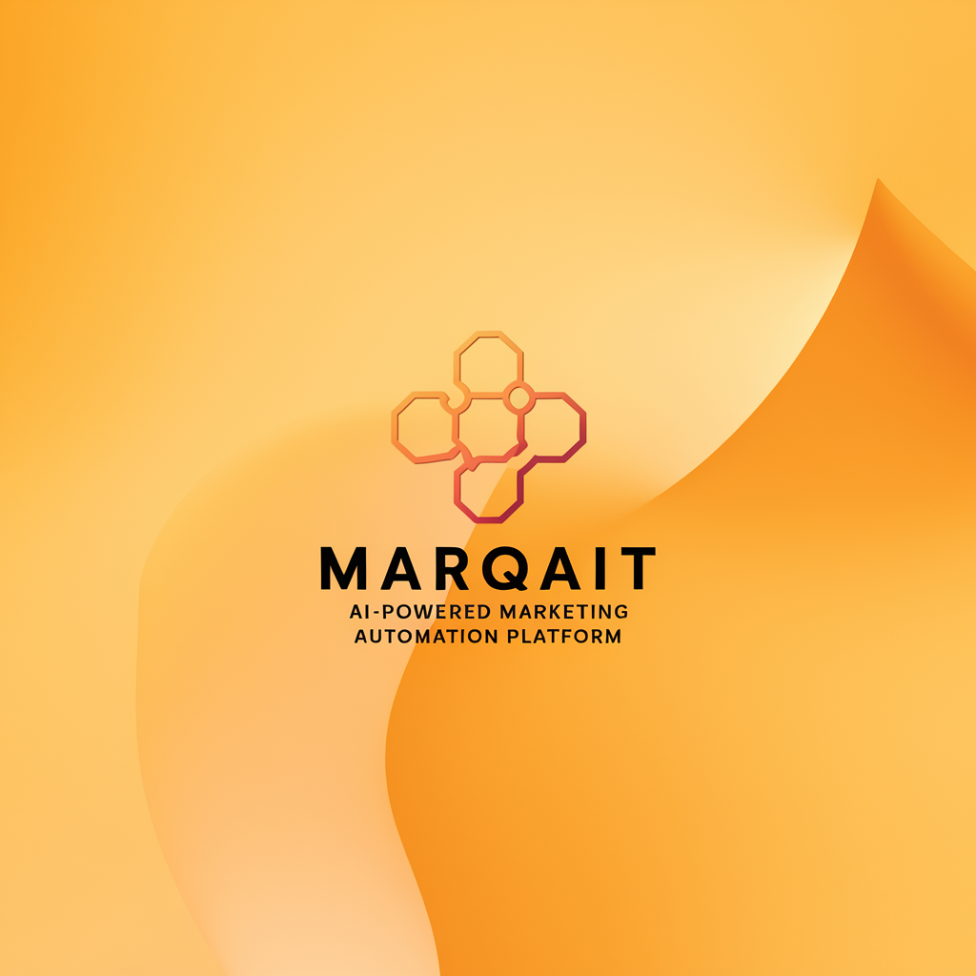
Ideal for small sizes, watermarks, and applications requiring simplified brand representation.
Logo Variation 3

Slide 12
Innovation Purple
#6C5B7B
RGB(108, 91, 123)
CMYK(12, 26, 0, 51)
Use Light Text
Empowerment Green
#4A9363
RGB(74, 147, 99)
CMYK(49, 0, 32, 42)
Use Dark Text
Agility Yellow
#FFD166
RGB(255, 209, 102)
CMYK(0, 18, 60, 0)
Use Dark Text
Simplicity Gray
#A5A58D
RGB(165, 165, 141)
CMYK(0, 0, 14, 35)
Use Dark Text
Primary Colors

Slide 13
Soft Lilac
#A992B9
Use Dark Text
Moss Green
#6E985E
Use Dark Text
Sunflower Yellow
#FFC857
Use Dark Text
Slate Blue
#5A6D8D
Use Light Text
Dusty Rose
#B07B85
Use Dark Text
Secondary Colors

Slide 14
Primary Color Usage
Use for brand-critical elements:
• Logos and main brand marks
• Headlines and key text
• CTA buttons and navigation
• Hero sections
Colors: Innovation Purple, Empowerment Green, Agility Yellow, Simplicity Gray
Best Practices:
- Maximum brand recognition
- Consistent application
- Sufficient contrast
- Accessibility compliance
Color Usage 1/2

Slide 15
Secondary Color Usage
Use for supporting elements:
• Backgrounds and subtle accents
• Secondary text
• Borders and dividers
• Hover states and icons
Colors: Soft Lilac, Moss Green, Sunflower Yellow, Slate Blue, Dusty Rose
Best Practices:
- Create visual hierarchy
- Support, don't compete
- Maintain readability
- Use sparingly
Color Usage 2/2

Slide 16
Primary Font: Source Sans Pro
Secondary Font: Inter
Font Hierarchy:
• Headlines: Source Sans Pro - Bold, 28-32pt
• Subheadlines: Source Sans Pro - Bold, 20-24pt
• Body Text: Inter - Regular, 16-18pt
• Caption Text: Inter - Regular, 12-14pt
TYPOGRAPHY

Slide 17
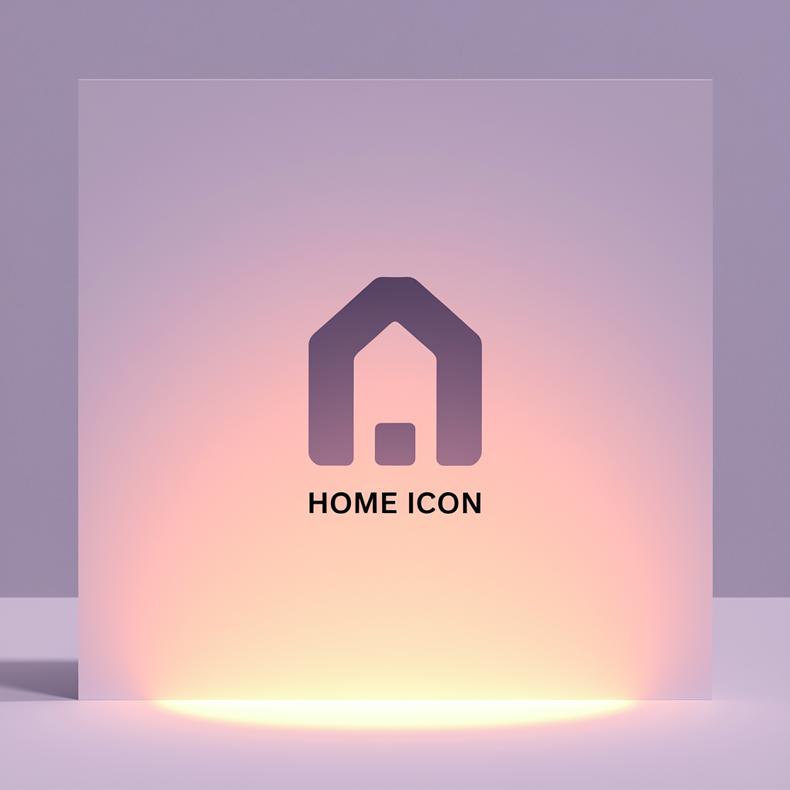

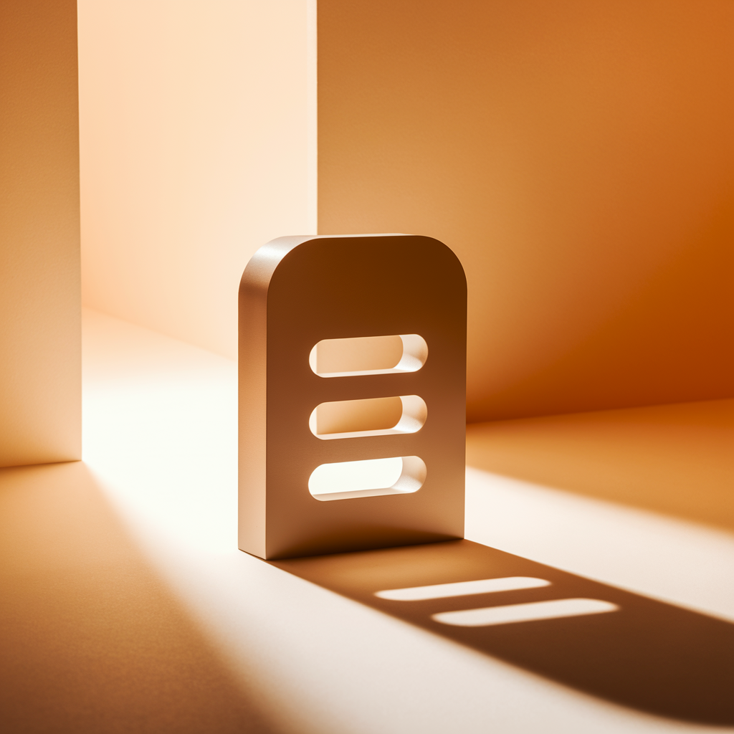



MARQAIT - Core Functional Icons Icons
Home Icon
Search Magnifying Glass Icon
Menu Hamburger Lines Icon
Settings Gear Icon
User Profile Person Icon
Notification Bell Icon
ICONOGRAPHY

Slide 18




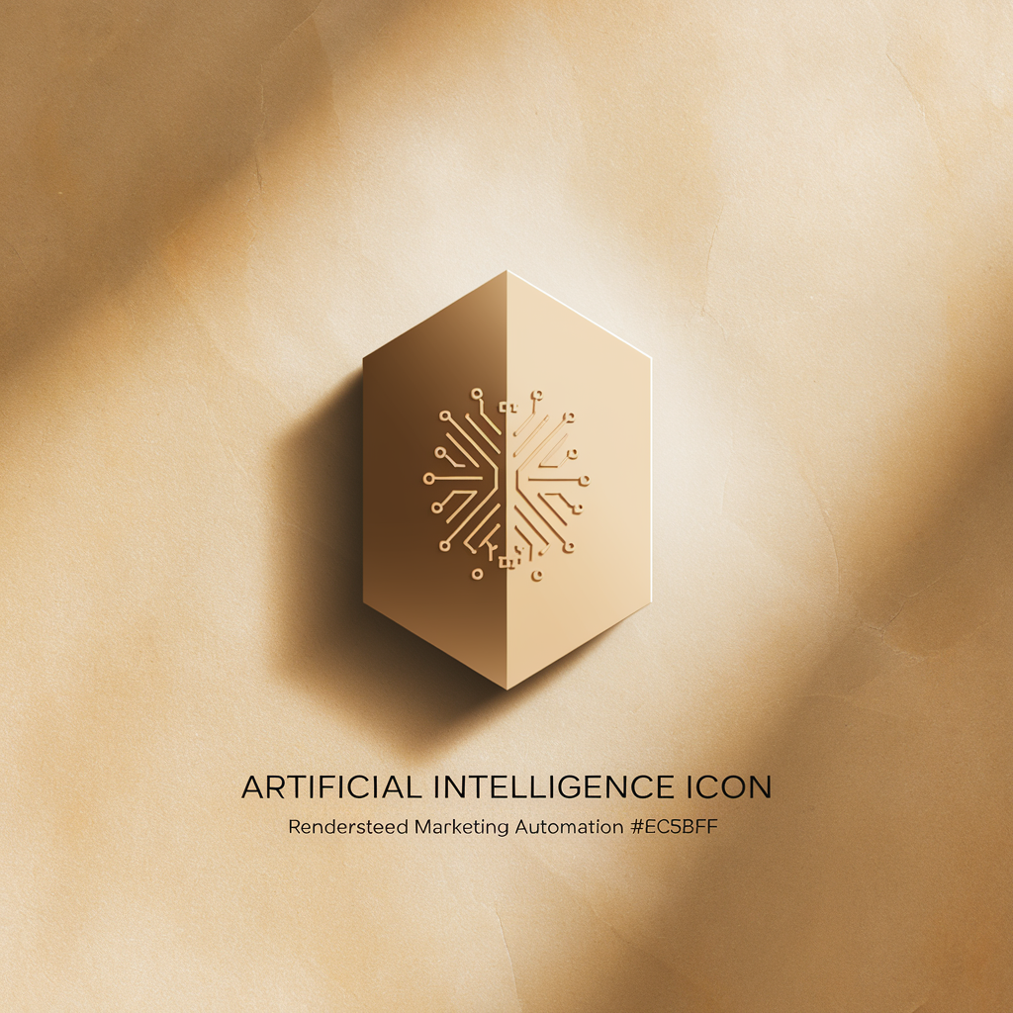

MARQAIT - Ai-Powered Marketing Automation Platform (Marketing Technology) Industry Icons Icons
Cloud Computing Icon
Server Database Icon
Programming Code Icon
Network Connection Icon
Artificial Intelligence Icon
Security Lock Icon
ICONOGRAPHY

Slide 19
Style: Minimalist design
Color: #6C5B7B on black background
Size Requirements:
• Minimum: 16px web, 0.5" print
• Recommended: 24px+ web, 0.75"+ print
Spacing:
• Clear space: 50% of icon width
• Consistent grid alignment
USAGE GUIDELINES

Slide 20
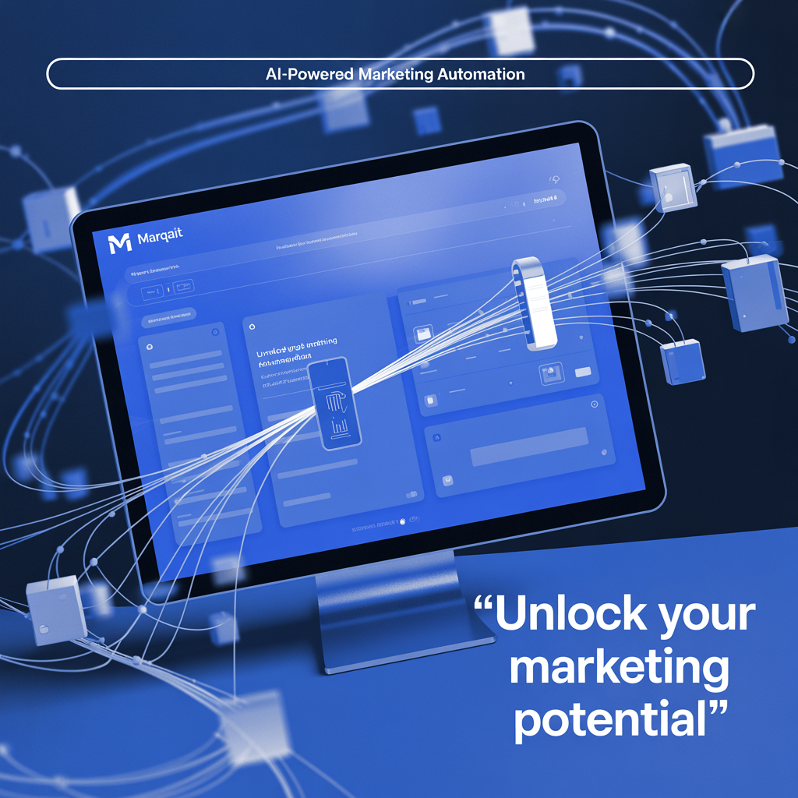
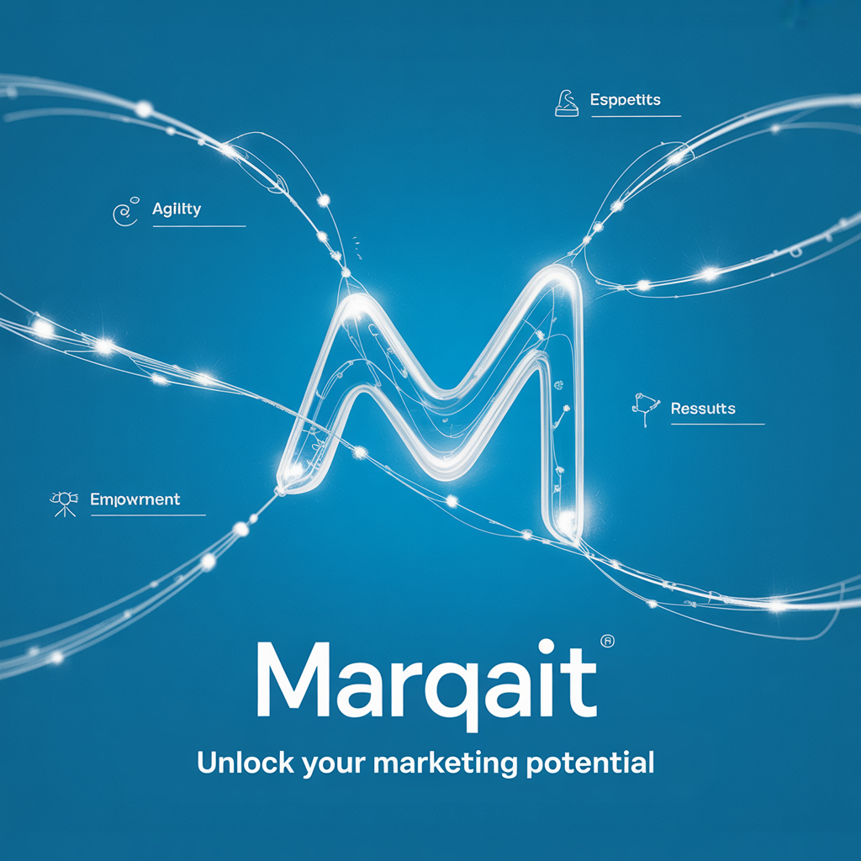
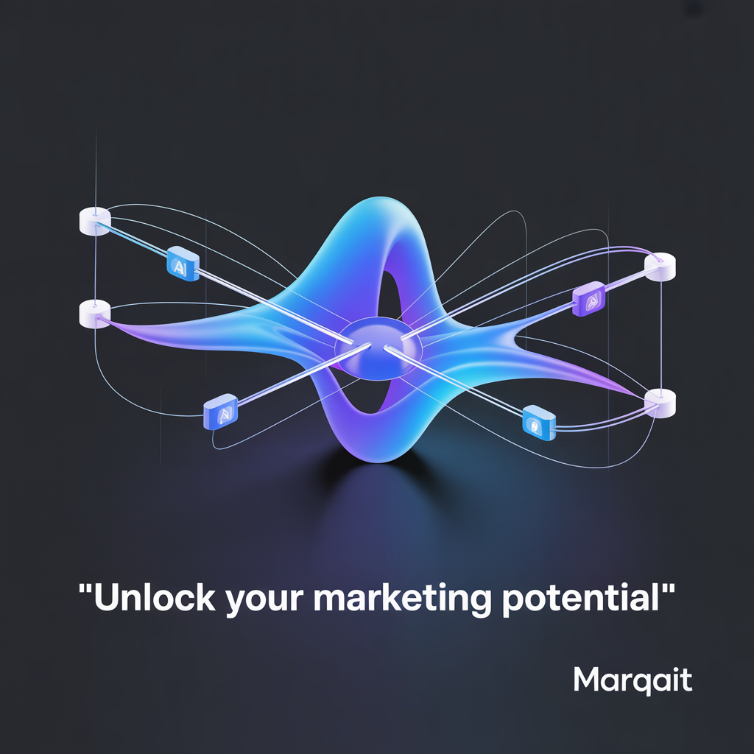
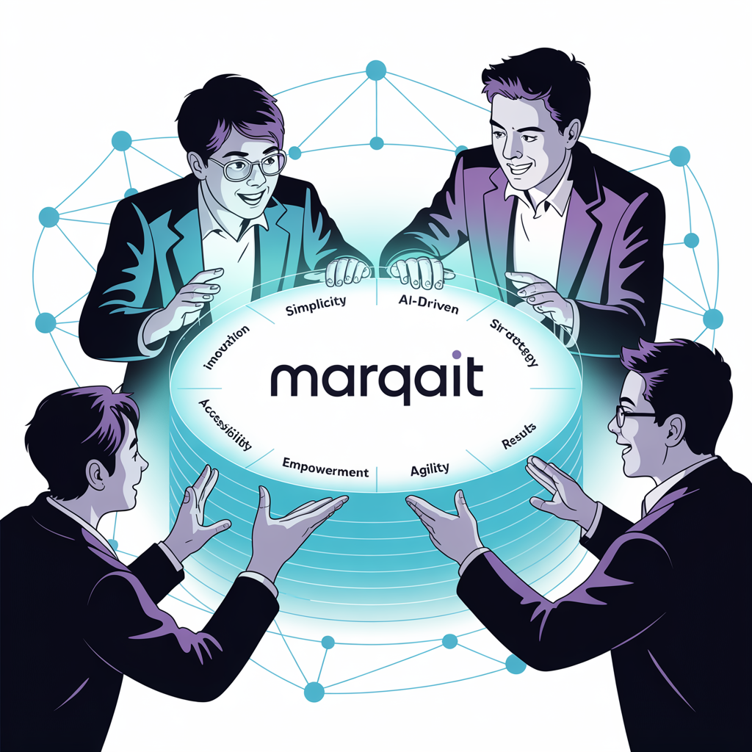
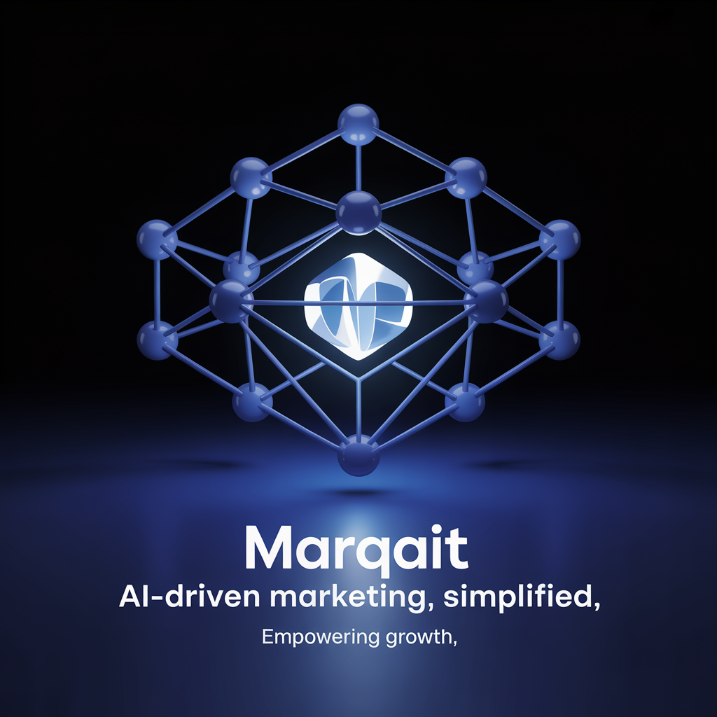
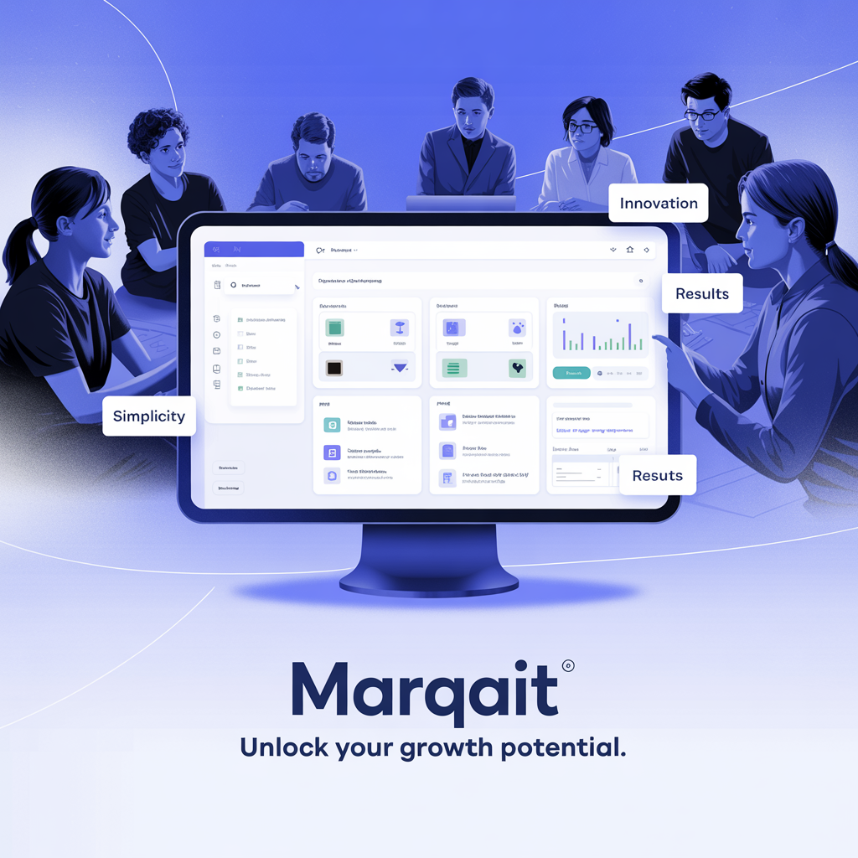
External Focus
External Focus
External Focus
Digital innovation in AI-Powered Ma...
Collaborative excellence in AI-Powe...
Professional excellence in AI-Power...
Internal Focus
Internal Focus
Internal Focus
Collaborative teamwork and company ...
Innovative solutions for AI-Powered...
Strategic growth and development in...
USAGE NOTES: These illustrations define the visual storytelling style of the brand. Use them consistently across presentations, reports, and marketing materials to maintain brand coherence.
BRAND ILLUSTRATIONS

