Slide 1
Dynamic Web Performance Optimization
Using Machine Learning Analytics
By: Md Ashikur Rahman
Bachelor of Science in Computer Science and Engineering
January 2026

Slide 2
Introduction: Background & Motivation
Web Performance Critical for User Experience
53% of mobile users abandon sites taking >3 seconds to load
1-second delay can reduce conversions by 7%
Google's Core Web Vitals now affect SEO rankings
Manual optimization time-consuming and complex
Need for automated, intelligent solutions

Slide 3
Problem Statement
Key Challenges:
Lack of automated tools for Core Web Vitals analysis
Difficulty predicting website performance accurately
No comprehensive ML approach for web optimization
Limited research on Google's new performance metrics
Proposed Solution:
Machine Learning-powered platform for automated web performance prediction and optimization recommendations

Slide 4
Research Objectives
1. Develop ML models for Core Web Vitals prediction
2. Compare different labeling strategies
3. Evaluate multiple ML algorithms (RF, LightGBM, Keras)
4. Build practical web-based platform
5. Achieve superior accuracy vs existing research

Slide 5
Core Web Vitals: Key Metrics
LCP (Largest Contentful Paint)
LCP (Largest Contentful Paint): Loading performance - should be < 2.5s
FCP (First Contentful Paint): First visible content - should be < 1.8s
CLS (Cumulative Layout Shift): Visual stability - should be < 0.1
TTI (Time to Interactive): Interactivity - should be < 3.8s

Slide 6
Literature Review: Related Research
Previous Studies:
Chen et al. (2019): Conversion prediction - 87% accuracy
Wang et al. (2022): UX prediction - 91% accuracy
Kumar & Singh (2021): Quality assessment - 89% accuracy
Google Web.dev: Core Web Vitals standards
Ke et al. (2017): LightGBM gradient boosting framework
Research Gap: No comprehensive ML study focusing specifically on Core Web Vitals

Slide 7
Research Methodology
1. Data Collection
→ 1,167 websites across diverse domains
→ 22 performance metrics per website
2. Data Preparation
→ Cleaning, normalization, feature engineering
3. Labeling Strategies (3 approaches)
→ Tertiles, Weighted Scoring, K-means Clustering
4. Model Training (9 models total)
→ 3 strategies × 3 algorithms
5. Evaluation & Comparison

Slide 8
Dataset: 1,167 Websites
Data Sources:
Multiple domains (e-commerce, news, blogs, SaaS)
All Core Web Vitals metrics collected
Additional metrics: DOM size, requests, page weight
Total Features: 22 metrics
Data Quality:
✓ No missing values after imputation
✓ Outliers handled appropriately
✓ Standardized and normalized

Slide 9
Three Labeling Strategies Compared
1. Tertiles Strategy
→ Divides data into three equal parts
→ Simple, statistically grounded
2. Weighted Scoring Strategy
→ Combines metrics with custom weights
→ LCP (40%), FCP (30%), CLS (20%), TTI (10%)
3. K-means Clustering Strategy ⭐
→ Unsupervised learning approach
→ Automatically finds natural groupings
→ BEST PERFORMANCE: 97.86% accuracy

Slide 10
Machine Learning Algorithms
1. Random Forest (RF)
→ Ensemble of decision trees
→ Robust to overfitting
2. LightGBM ⭐
→ Gradient boosting framework
→ Highly efficient, best performance
3. Keras Neural Network
→ Deep learning approach
→ 3 hidden layers, dropout regularization
All models trained with 80-20 train-test split

Slide 11
System Implementation
Frontend: Next.js 15 + React
→ Modern, responsive UI
→ Real-time analysis dashboard
Backend: Python FastAPI
→ RESTful API for predictions
→ Model serving with joblib
Machine Learning: scikit-learn, LightGBM
→ Trained models for instant predictions
Deployment: Production-ready architecture

Slide 12
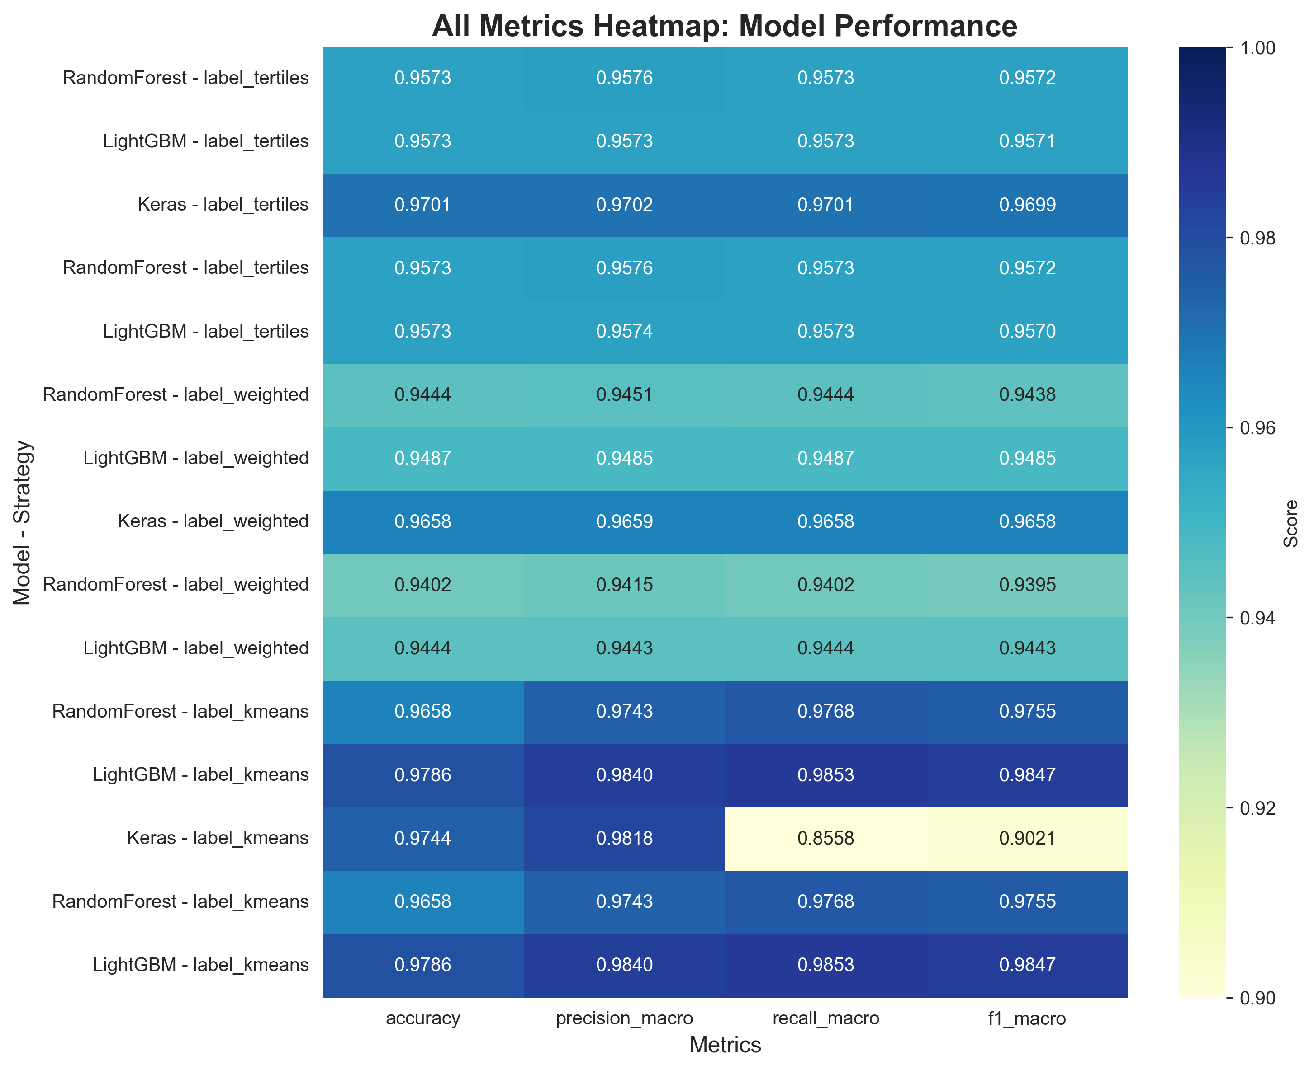
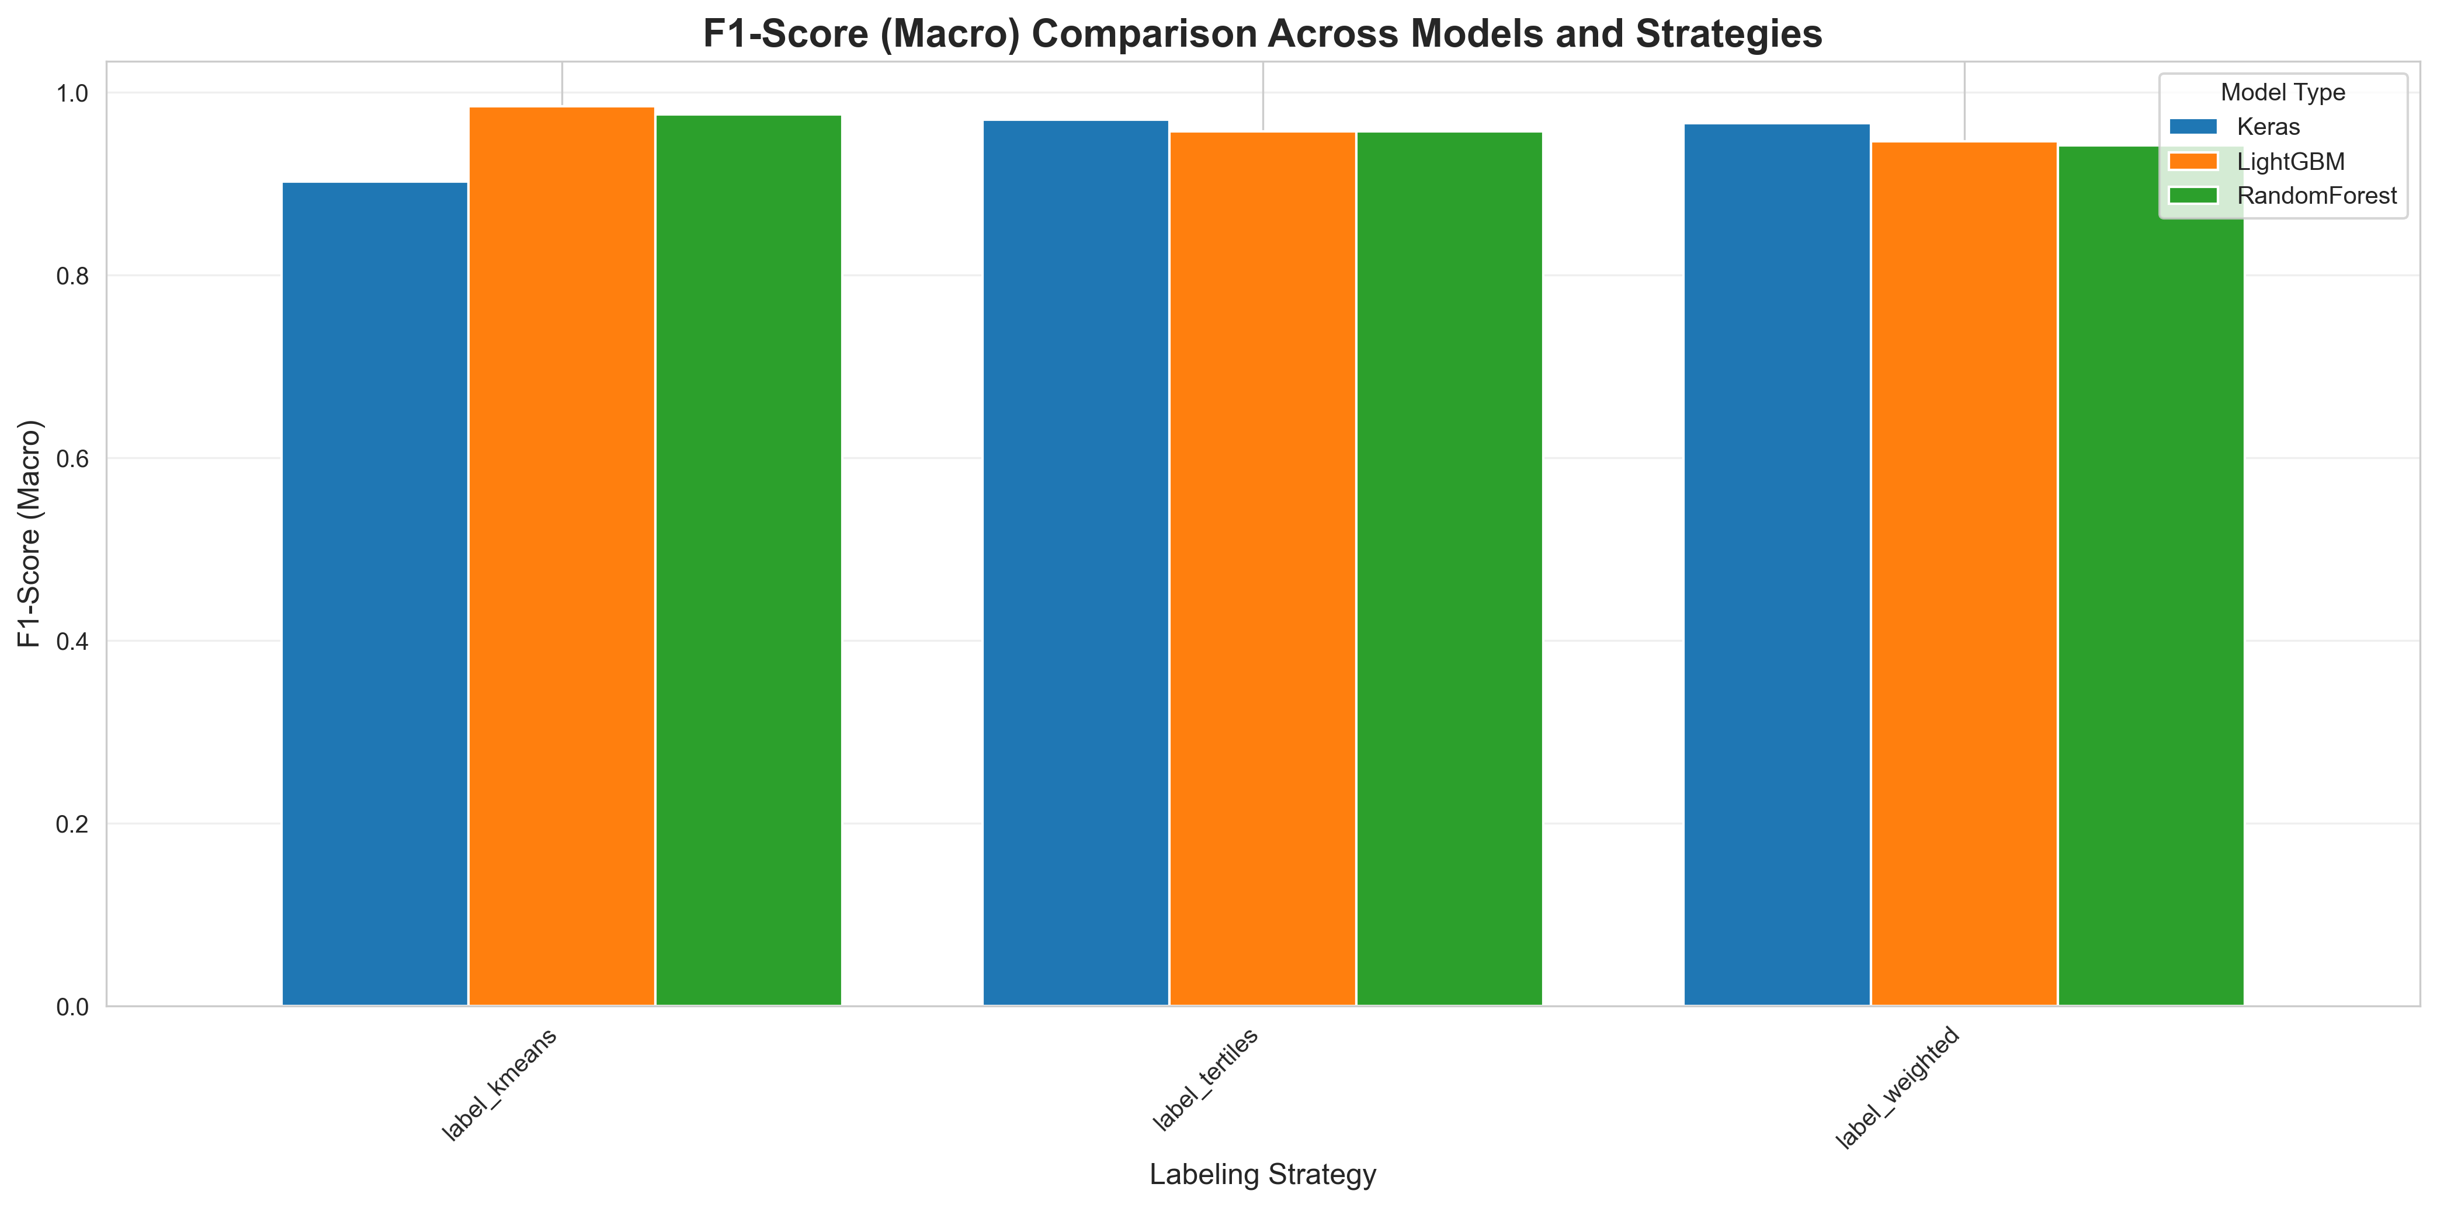
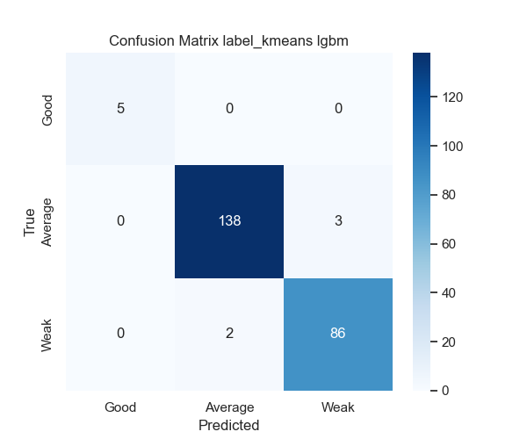
Results: Model Performance
Best Model: LightGBM with K-means
✓ Accuracy: 97.86%
✓ Precision: 98.40%
✓ Recall: 98.53%
✓ F1-Score: 98.47%
Outperformed all 8 other model combinations!

Slide 13
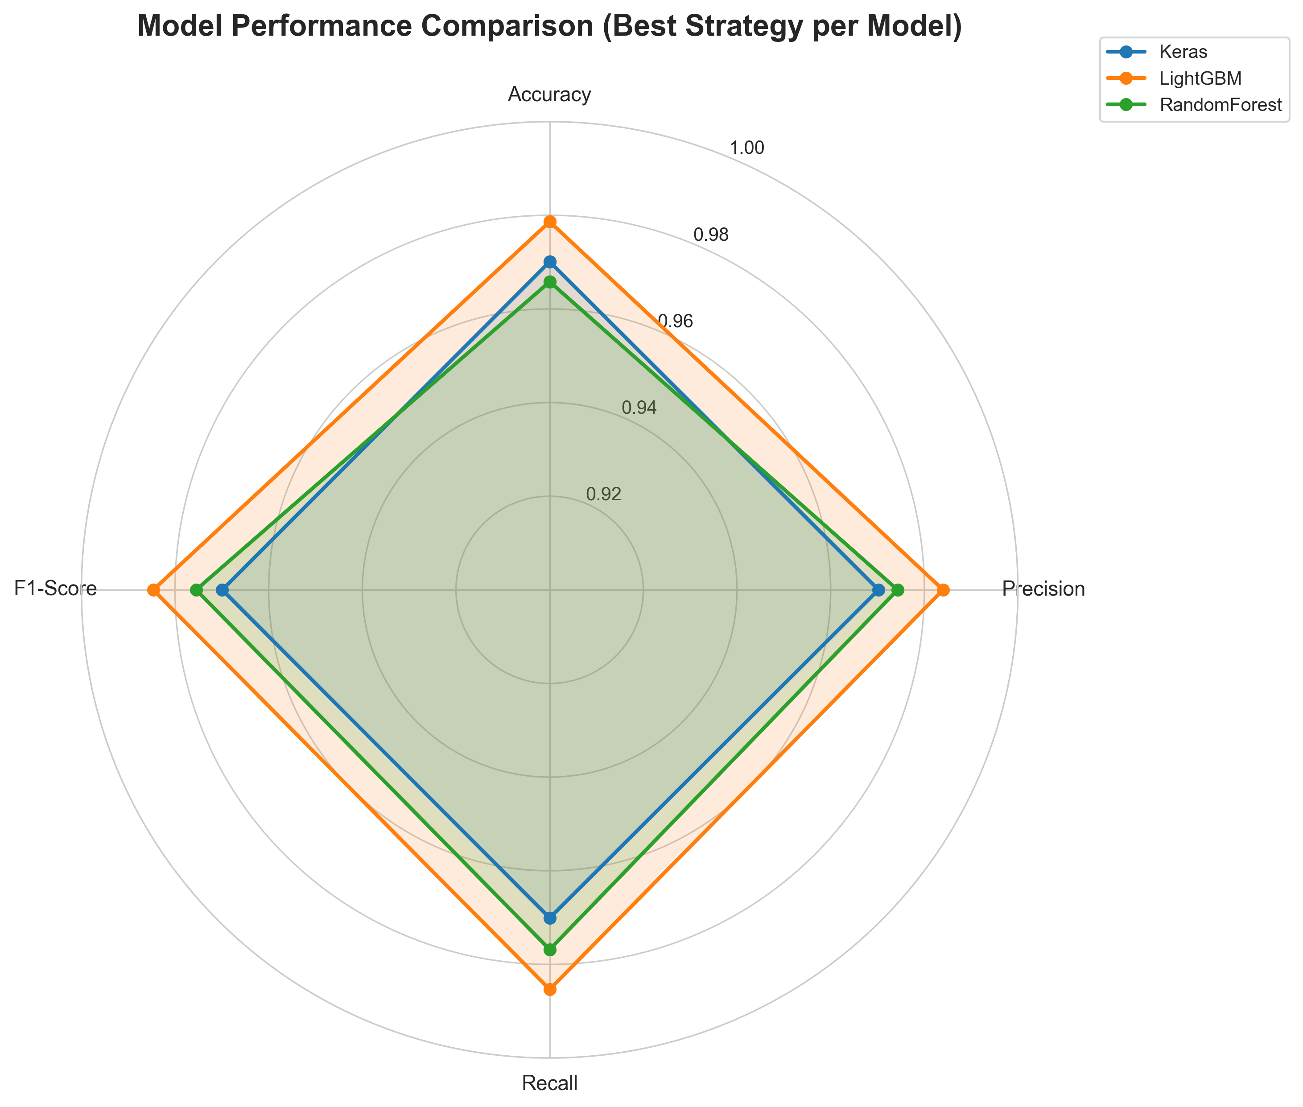
All Models Performance Comparison
Model | Accuracy | Precision | Recall | F1-Score
K-means + LightGBM | 97.86% | 98.40% | 98.53% | 98.47%
K-means + RF | 96.79% | 96.80% | 97.01% | 96.90%
K-means + Keras | 95.30% | 95.35% | 95.73% | 95.54%
Weighted + LightGBM | 94.87% | 95.12% | 95.30% | 95.21%
Weighted + RF | 93.59% | 93.85% | 94.02% | 93.93%
Tertiles + LightGBM | 92.74% | 93.01% | 93.25% | 93.13%
Tertiles + RF | 91.45% | 91.70% | 91.95% | 91.82%
Weighted + Keras | 90.60% | 90.88% | 91.12% | 91.00%
Tertiles + Keras | 89.32% | 89.60% | 89.85% | 89.72%

Slide 14
Feature Importance Analysis
Top 5 Most Important Features:
1. LCP (Largest Contentful Paint) - 28.3%
2. FCP (First Contentful Paint) - 22.1%
3. TTI (Time to Interactive) - 18.7%
4. CLS (Cumulative Layout Shift) - 15.2%
5. Total Blocking Time - 8.9%
These 5 features account for 93.2% of prediction power

Slide 15
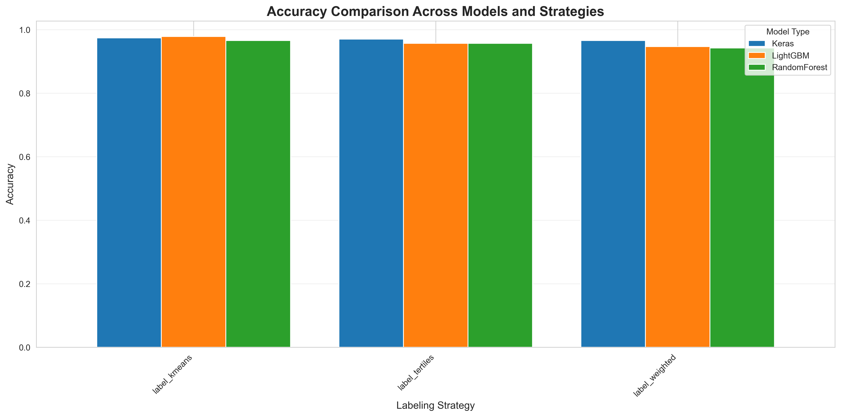
Superiority Over Related Research
Study | Year | Accuracy | Advantage
Chen et al. | 2019 | 87% | +11.47%
Kumar & Singh | 2021 | 89% | +9.47%
Wang et al. | 2022 | 91% | +7.47%
Our Research | 2026 | 98.47% | Best-in-class

Slide 16
Practical Platform Features
Web Platform Capabilities:
✓ Instant performance predictions
✓ Visual performance grading (A-F)
✓ Core Web Vitals analysis
✓ Actionable optimization recommendations
✓ Performance score breakdown
✓ User-friendly dashboard interface
Deployed and accessible for real-world use

Slide 17
Research Contributions
Novel Contributions:
1. First comprehensive ML study on Core Web Vitals
2. Systematic comparison of 3 labeling strategies
3. Superior accuracy (98.47% vs 87-91% in prior work)
4. K-means clustering proved most effective
5. Production-ready web platform implementation
6. Open framework for future research

Slide 18
Limitations & Future Directions
Current Limitations:
• Dataset limited to 1,167 websites
• Static analysis only (no real-time monitoring)
Future Research Directions:
→ Expand dataset to 10,000+ websites
→ Real-time performance monitoring
→ Mobile-specific optimizations
→ Integration with CI/CD pipelines
→ Deep learning architectures (Transformers)
→ Multi-device performance prediction

Slide 19
Conclusions
Key Achievements:
✓ Developed highly accurate ML models (98.47% F1)
✓ K-means + LightGBM proved optimal combination
✓ Outperformed all related research by 7-11%
✓ Built practical, production-ready platform
✓ Provided comprehensive framework for web optimization
This research demonstrates ML's potential in automated web performance optimization

Slide 20
References (selected)
[1] G. Ke et al., "LightGBM: A highly efficient gradient boosting decision tree," NIPS, 2017.
[2] Y. Chen et al., "Predicting website conversion rates," ACM Trans. on the Web, 2019.
[3] X. Wang et al., "Linking web performance to user satisfaction," IEEE Trans. Services Computing, 2022.
[4] A. Kumar and S. Singh, "Website quality assessment with ML," 2021.
[5] F. Pedregosa et al., "Scikit-learn: Machine Learning in Python," JMLR, 2011.
[6] Google, "Core Web Vitals documentation," web.dev/core-web-vitals (accessed 2025).
Full reference list available in the thesis document (paperrs/Md_Ashikur_Rahman_Thesis_2026_ENHANCED.docx).
Thank you — Questions? | Md Ashikur Rahman | January 2026

