Slide 1
Customer Shopping Behavior
Analytics Project

Slide 2
Customer Shopping Behavior Analysis
Executive Summary
This report analyses 3,900 customer transactions to explain how customers shop, what drives revenue, and where growth opportunities sit. The deliverable includes analytical findings and an interactive Power BI dashboard (report date: 18 October 2026). Nine business questions were answered covering revenue drivers, discounts, subscriptions, shipping, product performance and loyalty.
Headline findings: Male customers generated $157,890 (67.7%) of $233,081 total revenue while females generated $75,191 (32.3%) even though avg. spend per transaction is nearly identical ($59.54 male vs $60.25 female). Discounts do not shrink baskets: 839 discounted customers still spent above the $59.76 average (avg $79.79). Subscribers (27% of customers) do not spend more per purchase. The base is mature: only 83 new customers (2.1%), 1,882 Returning and 1,935 Loyal. Express shipping customers spend slightly more ($60.48 vs $58.46). Repeat buyers show only marginally higher subscription rates (27.6% vs 22.4%).

Slide 3
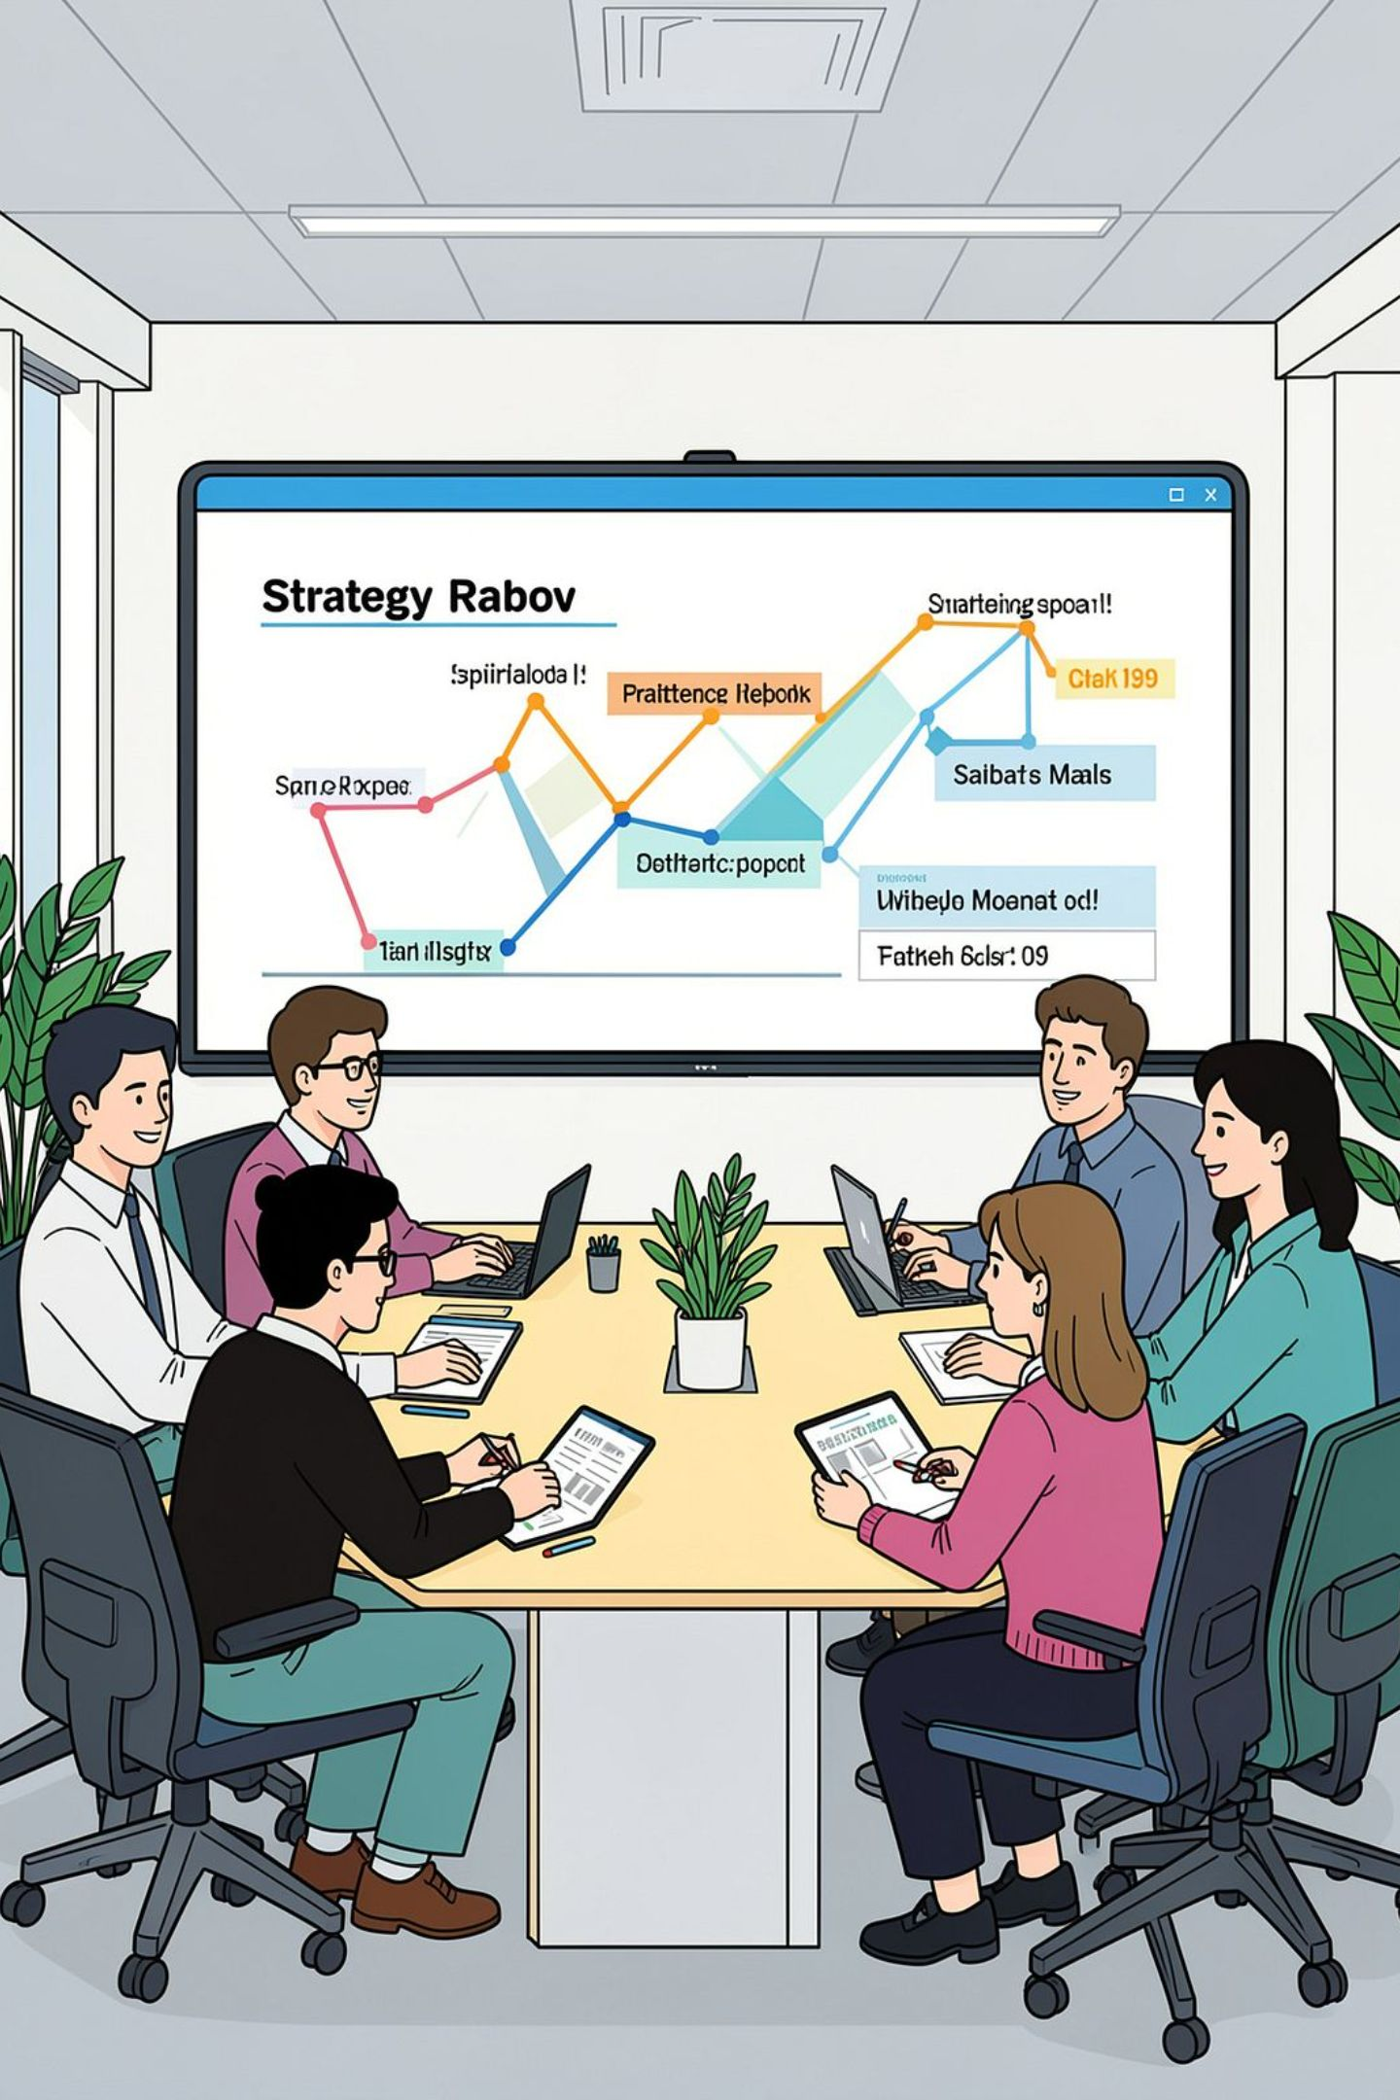
Business Problem & Objectives
Background
Core Question
A leading retailer sees shifting purchase patterns by demographics, category and channel and needs to know which factors (discounts, reviews, seasons, payment preferences) influence purchase decisions and repeat buying.
How can the company leverage customer shopping data to identify trends, improve engagement, and optimise marketing and product strategies?
Primary Objective
Convert raw data into actionable insight to guide marketing, product and customer-engagement decisions and deliver an interactive Power BI dashboard for stakeholders.

Slide 4
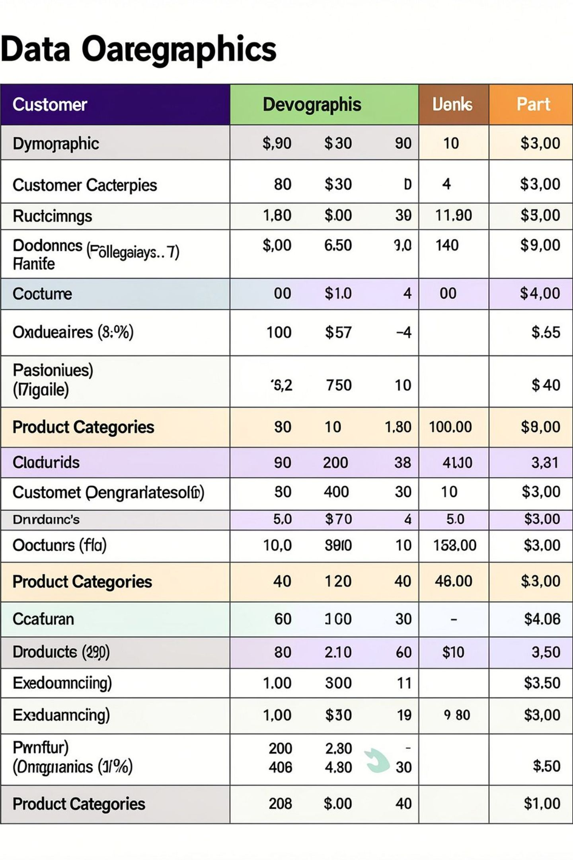
Dataset Overview — What’s Inside
Dataset Scope
The dataset has 3,900 transactions (one per customer) with 18 attributes grouped into five areas: Customer profile (age, gender, location), Product (item, category, size, colour), Purchase (amount, season, payment, shipping), Engagement (rating, subscription status, discount, previous purchases, frequency). Key metrics: total revenue $233,081; avg purchase $59.76 (range $20–$100); avg review 3.75/5; customers aged 18–70 (avg 44); gender: Male 68% (2,652), Female 32% (1,248); category mix: Clothing 44.5%, Accessories 31.8%, Footwear 15.4%, Outerwear 8.3%; subscribers 27%; transactions with discount 43%.

Slide 5





Approach — How We Answered the Questions
Step 1 — Define
Step 2 — Collect & Prepare
Step 3 — Analyze
Clarified business questions and objectives with stakeholders.
Assembled and cleaned the dataset (duplicates checked; <1% missing ratings handled); created age bands and frequency measures.
Performed analysis with Python and SQL to answer business questions and generate visualizations.
Step 4 — Dashboard
Step 5 — Translate
Built a Power BI dashboard to let stakeholders explore KPIs, filters and charts interactively.
Produced findings and tested recommendations for marketing, promotions, subscription and product actions.

Slide 6
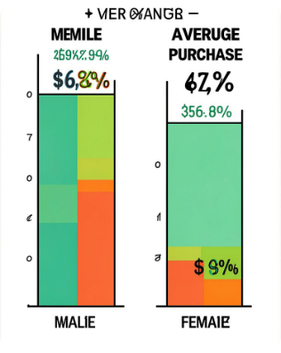
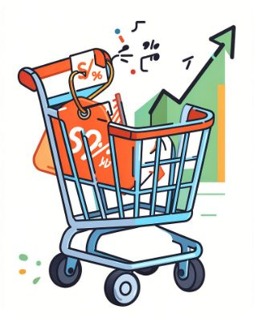
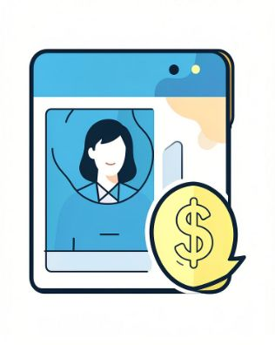
Key Findings — Revenue, Discounts & Subscriptions
Gender & Revenue
Discounts
Subscribers
Male customers: $157,890 (67.7%) vs Female: $75,191 (32.3%). Avg purchase nearly identical ($59.54 male, $60.25 female). Gap driven by volume, not spend per order — opportunity to grow female base.
839 customers used discounts and still spent above the $59.76 avg (avg $79.79). Discounts do not shrink baskets and represent a low-risk conversion lever.
Subscribers (1,053; 27.0%) average $59.49 vs non-subscribers $59.87. Subscription does not currently lift spend per order; judge the programm on retention and frequency.

Slide 7
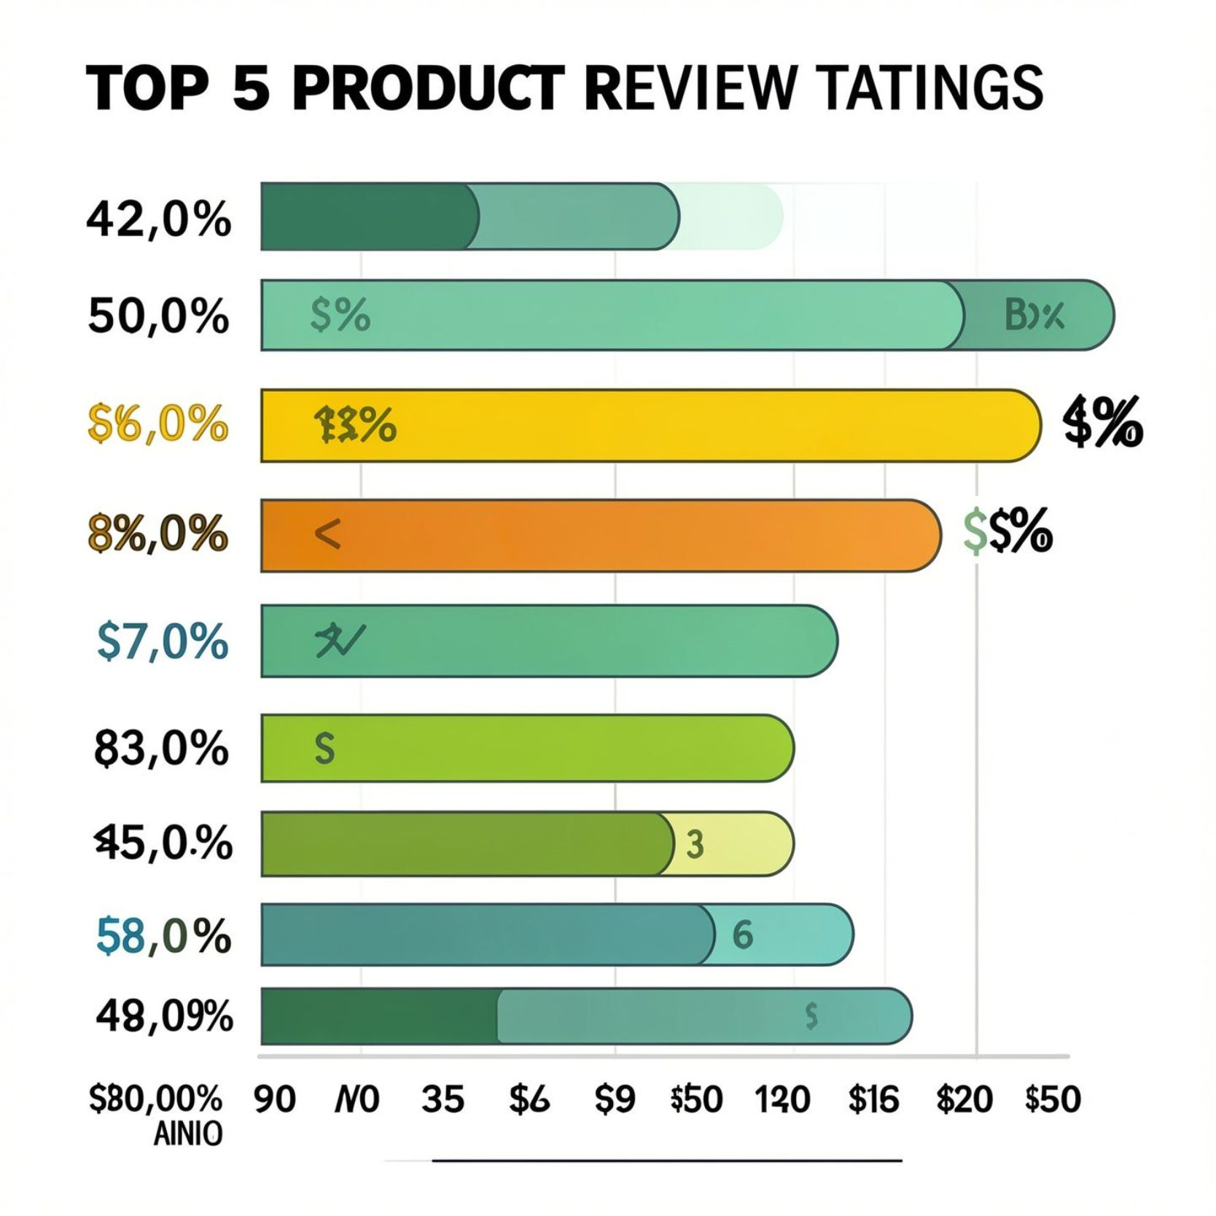
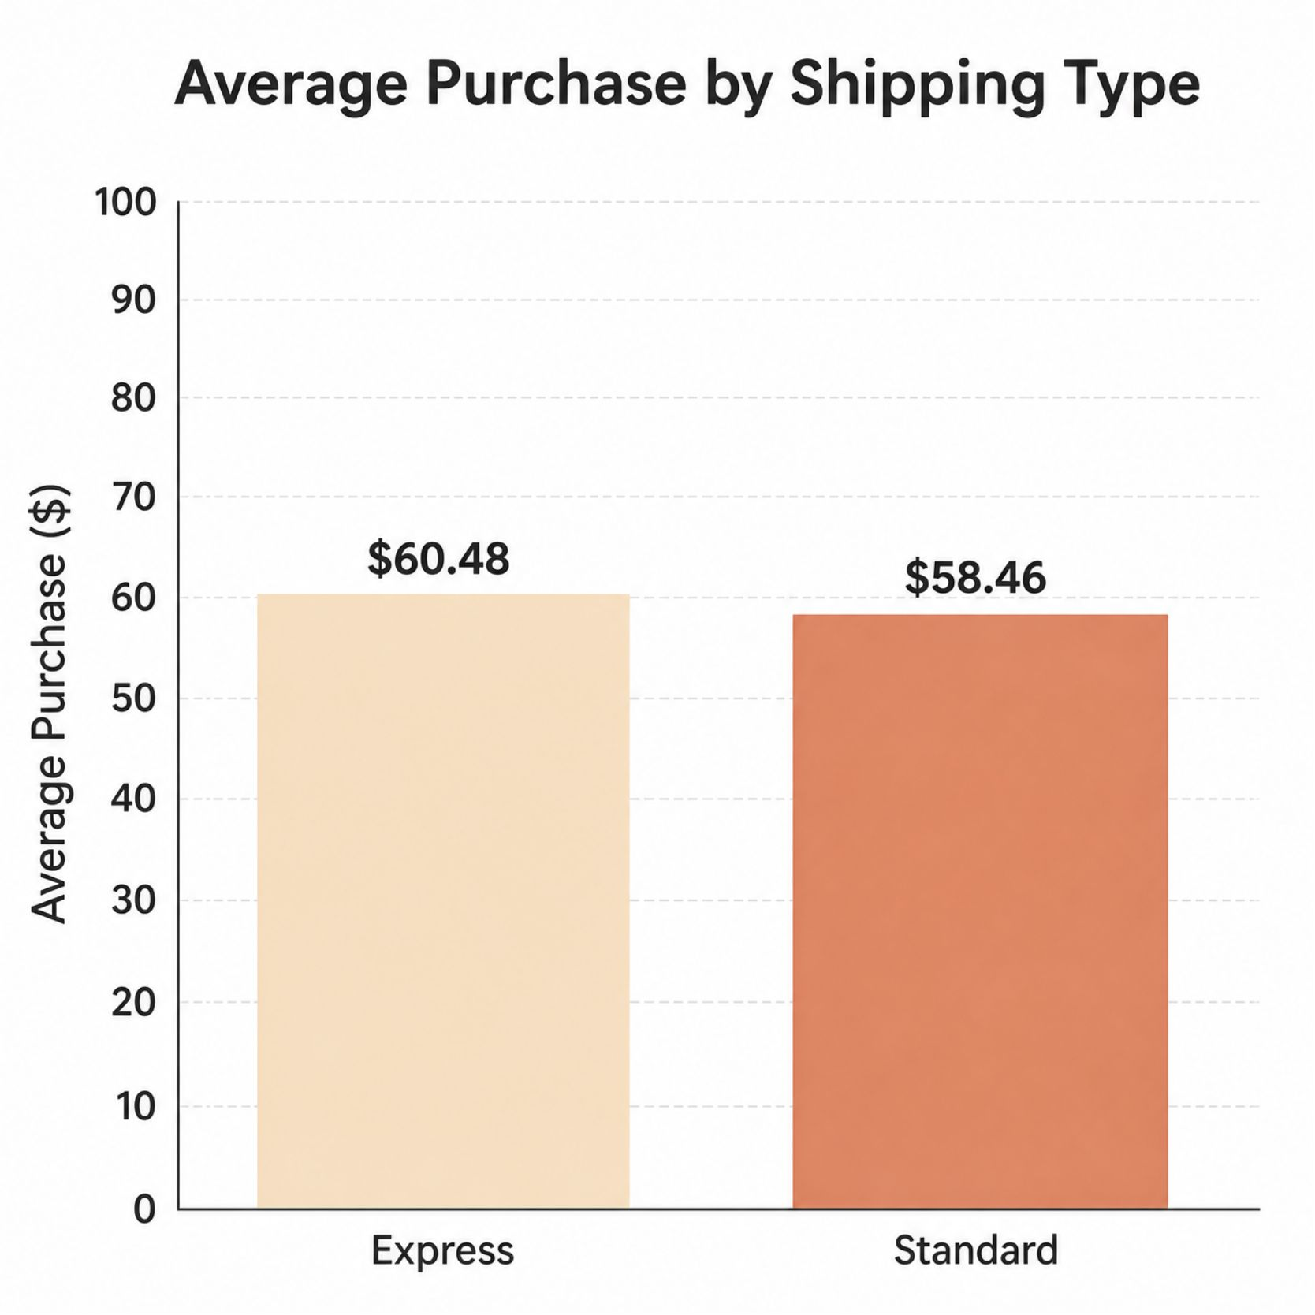
Product Performance & Shipping Insights
Top-rated products
Shipping
Top 5 by average review: Gloves 3.86, Sandals 3.84, Boots 3.82, Hat 3.80, T‑shirt 3.78. Overall spread is narrow (close to 3.75), indicating consistent satisfaction.
Express customers spend $60.48 vs Standard $58.46 (+$2.02, ~3.5%). Paying for speed signals slightly higher commitment — promote Express at checkout or as a threshold incentive.

Slide 8
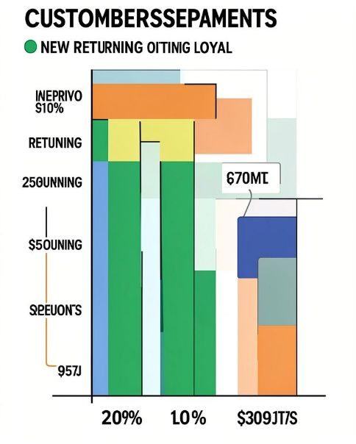
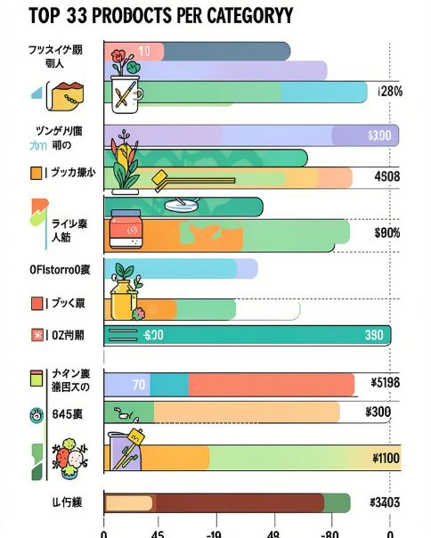
Customer Segments & Top Products by Category
Segmentation
Top products
New 83 (2.1%), Returning 1,882 (48.3%), Loyal 1,935 (49.6%). Nearly 98% have made at least two purchases — the problem is acquisition, not retention. No VIPs (0 with >50 purchases); recalibrate VIP thresholds if needed.
Top sellers: Accessories — Jewelry, Sunglasses, Belt (≈171/161 each). Clothing — Pants, Blouse, Shirt (≈171/169). Footwear — Sandals, Shoes, Sneakers (≈160/150/145). Outerwear — Jacket, Coat (163/161). No single hero product dominates; demand is evenly spread.

Slide 9
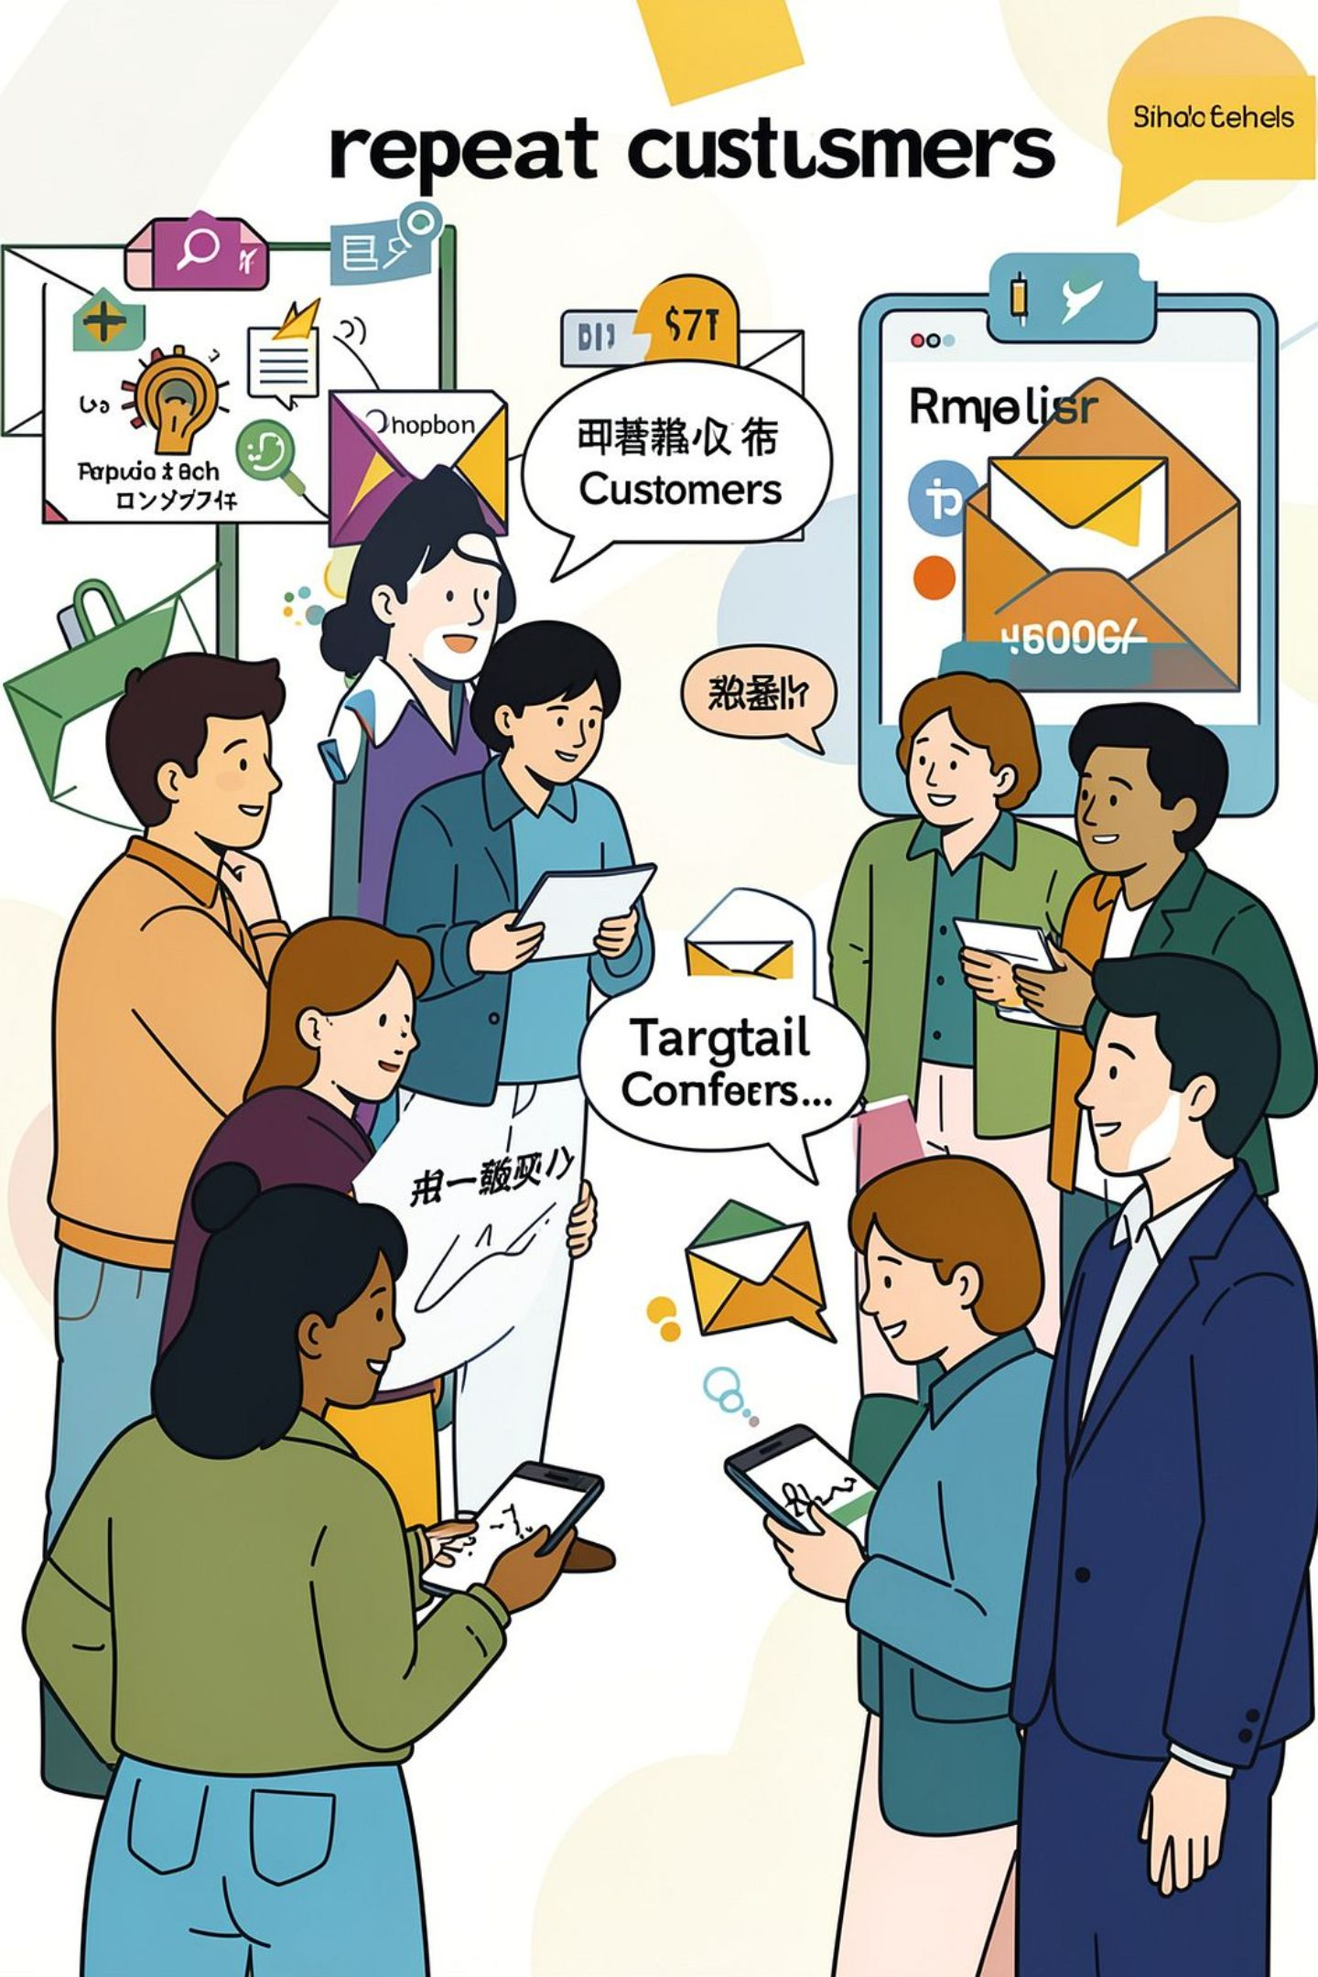
Repeat Buyers & Subscription Opportunity
Repeat buyers (more than 5 previous purchases) total 3,476. Among them 958 subscribe (27.6%) while customers with 5 or fewer purchases have a 22.4% subscription rate. In absolute terms there are roughly 2,500 repeat buyers who are not subscribed — the most obvious target for a subscription acquisition campaign.
Insight
Subscription penetration among repeat buyers is only marginally higher than among less frequent buyers, so loyalty is not translating into subscriptions at scale.
Action
Run targeted subscription offers to repeat (but unsubscribed) buyers and test redesigned benefits (free/Express shipping, early access, bundles) to lift spend and retention.

Slide 10
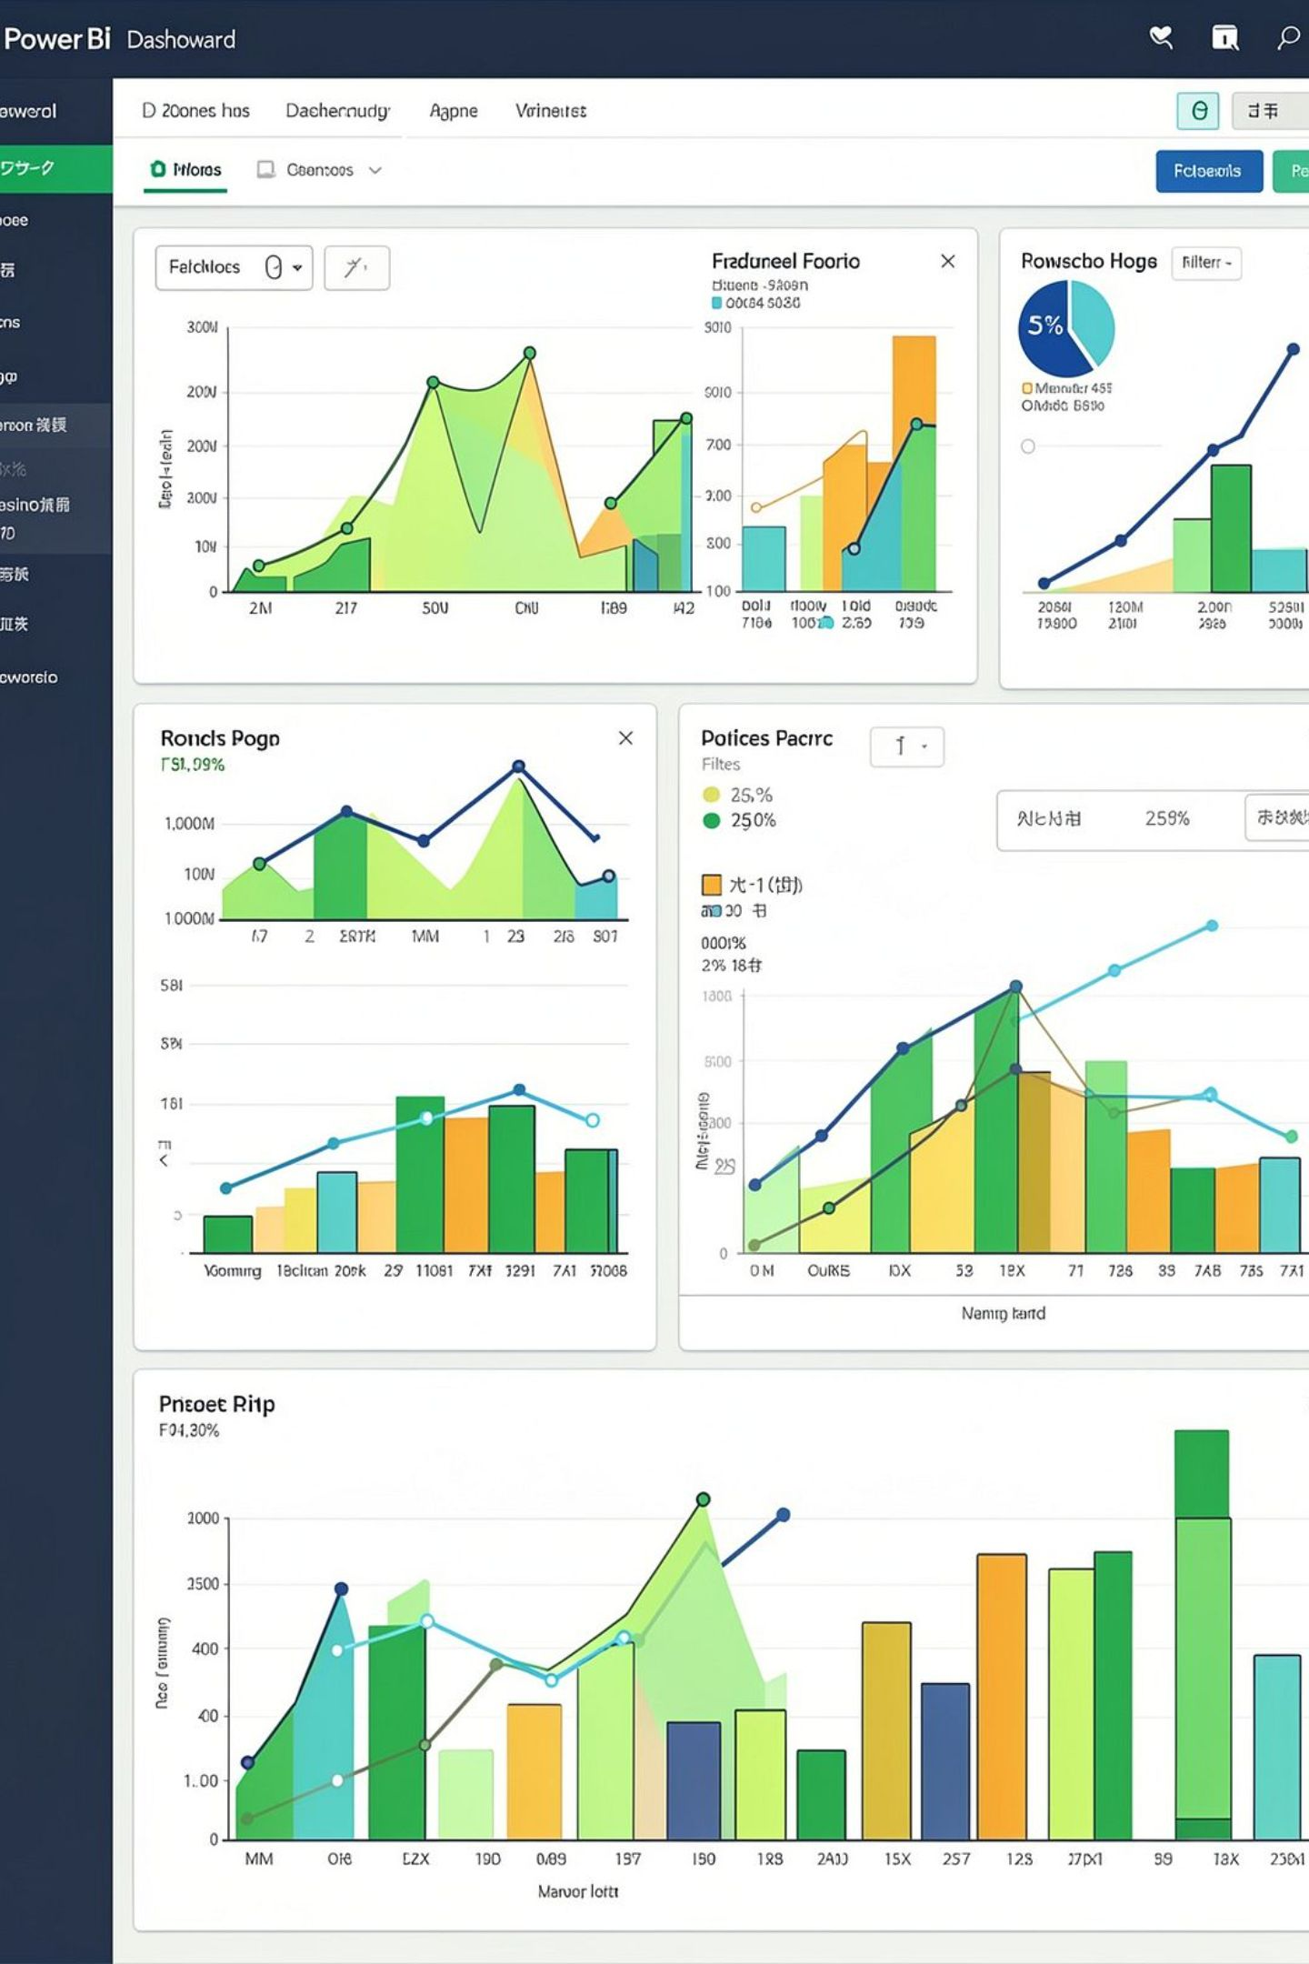
Power BI Dashboard — Structure & Use
An interactive Customer Behavior Analytics Dashboard was built with headline KPI cards (3.9K customers; avg purchase $59.76; avg rating 3.75), slicers (Gender, Subscribers, Category, Shipping) and visualisations: subscription donut, revenue by category, revenue across shipping types, revenue by age band, and payment-method trends. Revenue by category: Clothing $104,264; Accessories $74,200; Footwear $36,093; Outerwear $18,524. Shipping revenue is spread across six options with Free Shipping largest at $40,777. Payment methods cluster around $37–$40K each.
Stakeholders can filter by segment to inspect KPIs, spot under-performing groups, and test hypotheses without technical support.

Slide 11


Conclusions, Recommendations & Next Steps
Summary Conclusion
Key Recommendations
Limitations & Next Steps
The customer base is loyal and mature but narrow: male-driven revenue is a volume effect; discounts and subscriptions do not meaningfully change spend per transaction; new-customer inflow is weak. Highest-impact opportunities are acquisition, growing the female segment, converting unsubscribed repeat buyers and redesigning subscription benefits.
Invest in acquisition and referral campaigns to increase new customers.
Target marketing to grow the female customer base (assortment and promotions).
Keep discounts but target high-spend discount users and review discount dependence for certain SKUs (Hat, Sneakers, Coat, Sweater, Pants).
Launch a subscription campaign aimed at ~2,500 unsubscribed repeat buyers and redesign subscriber benefits (free/Express shipping, early access, bundles).
Promote Express shipping at checkout to capture slightly higher spend and review Outerwear assortment (only two items).
Limitations: small differences lack statistical tests; no transaction dates (no time-series or CLV); no channel or margin data. Next steps: add date, channel and margin data; run statistical testing; expand dashboard with trends and segment views; explore predictive models (subscription propensity, churn) once time-based data is available.
Priority next step: target the ~2,500 unsubscribed repeat buyers with a measured subscription offer and A/B test redesigned benefits.

