Slide 1



International Business Machines Corporation
HR
Analytics
Employee Attrition & Performance Analysis
Executive HR Analytics Dashboard
Md Avesh
mdavesh.analytics@gmail.com

Slide 2
Executive Summary
Project Overview
The IBM HR Analytics Dashboard was developed using Microsoft Excel to transform raw HR data into actionable business insights.
This interactive dashboard enables HR teams and business leaders to monitor workforce performance, analyze employee attrition, evaluate salary trends, and support data-driven decision-making through dynamic KPIs, Pivot Tables, Pivot Charts, Power Query, and Slicers.
Project Snapshot
Project Type: HR Analytics Dashboard
Industry: Human Resources
Tool: Microsoft Excel
Dataset: IBM HR Analytics
Records: 1,470 Employees
Dashboard Type: Interactive Executive Dashboard

Slide 3
Key Features
Interactive KPIs
Dynamic Slicers
Pivot Charts
Power Query
Executive Dashboard
Business Insights

Slide 4
Business Problem
Organizations often struggle to understand why employees leave, which departments experience higher attrition, and how factors such as salary, overtime, job satisfaction, and experience influence workforce stability.
Traditional HR reports are static and time-consuming, making it difficult for decision-makers to identify trends quickly and take proactive actions.
An interactive HR Analytics Dashboard helps transform employee data into meaningful insights, enabling faster, data-driven workforce decisions.
Business Challenges
🔴High Employee Attrition
🔴Manual Reporting
🔴Poor Workforce Visibility
🔴Time-Consuming Analysis
🔴Limited Decision Support
🔴Lack of Interactive Insights

Slide 5
Business Impact
🟢Faster HR Reporting
🟢Better Employee Retention
🟢Improved Workforce Planning
🟢Smarter Business Decisions

Slide 6
Business Objectives
The primary objective of this project is to develop an interactive HR Analytics Dashboard that enables organizations to monitor workforce performance, understand employee attrition patterns, and support strategic HR decision-making through data-driven insights.
Key Objectives
🟠Monitor Workforce
🟠Analyze Employee Attrition
🟠Evaluate Salary Trends
🟠Measure Job Satisfaction
🟠Track Employee Experience
🟠Support HR Decision Making
Expected Business Outcomes
⚫Improve employee retention, ⚫Enable faster HR reporting, ⚫Identify workforce trends, ⚫Support strategic planning
⚫Enhance business decisions

Slide 7
Dataset Overview
Dataset Information
Dataset Name: IBM HR Analytics Employee Attrition & Performance
Source: IBM HR Analytics Dataset
Industry: Human Resources
Total Records: 1,470 Employees
Total Columns: 35 Features
Data Categories
⚫Employee Information
⚫Workforce Metrics
⚫Compensation
⚫Performance
⚫Job Details

Slide 8
Major Columns Used
⚫Employee Number
⚫Age
⚫Gender
⚫Department
⚫Job Role
⚫Monthly Income
⚫Business Travel
⚫Overtime
⚫Job Satisfaction
⚫Years at Company
⚫Attrition

Slide 9
Project Scope
This project focuses on analyzing workforce data to understand employee attrition, workforce demographics, compensation, experience, and job satisfaction.
The dashboard provides an executive-level overview using interactive visualizations and dynamic filtering to support HR managers and business leaders.
Scope Includes
🟢Data Cleaning
🟢Power Query
🟢Pivot Tables
🟢Pivot Charts
🟢Interactive Dashboard
🟢Business Insights

Slide 10
Project Deliverables
🔵Interactive HR Dashboard
🔵Executive KPI Cards
🔵Department Analysis
🔵Job Role Analysis
🔵Attrition Analysis
🔵Business Recommendations

Slide 11
Data Cleaning & Preparation
The raw HR dataset was reviewed and prepared in Microsoft Excel to ensure data consistency, accuracy, and usability before analysis.
Data Preparation Steps
01 — Data Inspection
Reviewed columns, data types, and overall dataset structure.
02 — Data Quality Check
Checked for missing values, duplicates, and inconsistent entries.
03 — Data Transformation
Prepared fields and standardized data for analysis.
04 — Feature Validation
Validated key HR metrics such as Attrition, Income, Age, and Years at Company.
05 — Analysis Ready
Prepared the final dataset for Pivot Tables and dashboard reporting.
Raw HR Data → Clean Data → Analysis-Ready Dataset

Slide 12
Analytics Workflow
RAW DATA
IBM HR employee dataset
↓
DATA PROFILING
Reviewed structure and data quality
↓
DATA CLEANING
Prepared consistent analytical fields
↓
POWER QUERY
Data transformation and preparation
↓
PIVOT TABLES
Aggregated HR metrics
↓
↓
PIVOT CHARTS
Visualized workforce trends
↓
Dashboard
KPI CARDS
Interactive HR decision-support tool
Summarized executive metrics

Slide 13
Dashboard Development
01 — KPI Layer
🔵Total Employees
🔵Attrition Count
🔵Attrition Rate
🔵Average Age
🔵Average Monthly Income
🔵Average Years at Company
02 — Analysis Layer
🔵Department
🔵Gender
🔵Job Role
🔵Salary
🔵Experience
🔵Job Satisfaction
🔵Overtime
03 — Interaction Layer
🔵Department Slicer
🔵Gender Slicer
🔵Job Role Slicer
🔵Education Field
🔵Business Travel
🔵Attrition
Clean • Interactive • Insight-Driven
The dashboard was designed to provide management with a quick,
interactive view of workforce performance and employee attrition

Slide 14
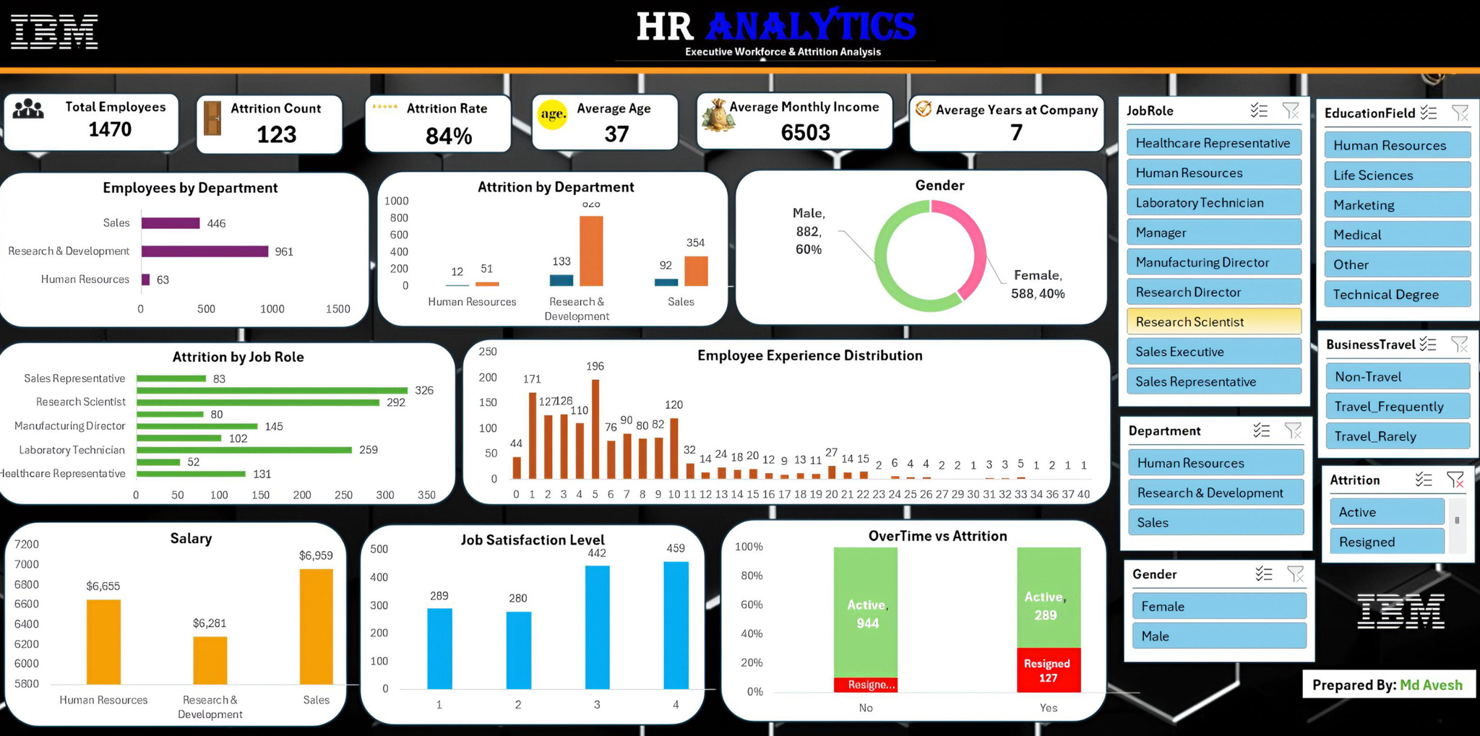
Executive HR Analytics Dashboard
An interactive Excel dashboard designed to monitor workforce,
attrition, compensation, experience, and employee satisfaction.

Slide 15
Key Business Insights
What the data reveals about workforce and employee attrition
Insight 1 — Workforce Distribution
Finding-
Research & Development represents the largest employee population,
followed by Sales and Human Resources.
Business Impact-
RRetention and workforce planning should prioritize larger employee groups
while maintaining adequate staffing across critical functions.
Insight 2 — Employee Attrition
Finding-
Employee attrition is concentrated within specific departments
and job roles rather than being evenly distributed across the workforce.
Business Impact-
HR can focus targeted retention strategies on high-attrition
departments and roles instead of applying one approach to all employees.
Insight 3 — Overtime
Employees working overtime show a stronger association with
employee attrition than employees who do not work overtime.
Finding-
Business Impact-
Monitoring workload and overtime can help reduce employee burnout
and improve workforce retention.

Slide 16
Insight 4 — Early-Career Employees
Finding-
Employees with relatively short tenure represent an important
segment for attrition monitoring.
Business Impact-
Stronger onboarding, mentoring, and career-development programs
can improve early-stage employee retention.
Insight 5 — Job Satisfaction
Finding-
Employee satisfaction varies across workforce segments,
creating opportunities for targeted engagement initiatives.
Business Impact-
Regular employee feedback and satisfaction monitoring can help
identify potential retention risks earlier.
Insight 3 — Overtime
Employees working overtime show a stronger association with
employee attrition than employees who do not work overtime.
Finding-
Business Impact-
Monitoring workload and overtime can help reduce employee burnout
and improve workforce retention.

Slide 17
Priority Areas for HR
🔴 Priority 01
Employee Attrition Identify high-risk departments and job roles.
🟠 Priority 02
Overtime & Workload Monitor excessive overtime and workload pressure.
🔵 Priority 03
Employee Experience Track job satisfaction and engagement indicators.
🟢 Priority 04
Career Development Strengthen growth opportunities for employees with shorter tenure.
Data-driven workforce monitoring can help HR move from
reactive reporting to proactive employee-retention strategies.

Slide 18
Management Recommendations
Turning workforce insights into actionable HR strategies
🔴 Recommendation 01 — Strengthen Retention
Attrition is concentrated within specific employee groups.
Insight
Recommendation
Develop targeted retention programs for high-attrition departments and job roles.
Expected Impact
Lower avoidable employee turnover
🟠 Recommendation 02 — Manage Overtime
Insight
Overtime is associated with higher employee attrition.
Recommendation
Monitor overtime patterns and rebalance workloads where sustained overtime is observed.
Expected Impact
Reduced burnout and improved retention
🔵 Recommendation 03 — Improve Career Growth
Employees with shorter tenure require closer retention attention.
Insight

Slide 19
Recommendation
Strengthen onboarding, mentoring, training, and career-development opportunities.
Higher employee engagement and longer tenure
Expected Impact
🟢 Recommendation 04 — Monitor Employee Experience
Insight
Job satisfaction varies across workforce segments.
Recommendation
Introduce regular employee feedback and satisfaction monitoring programs.
Earlier identification of retention risks
Expected Impact

Slide 20
HR Action Framework
Turning workforce insights into actionable HR strategies
01 — Identify
Use workforce data to identify high-risk employee segments.
↓
02 — Intervene
Apply targeted retention, engagement, and workload strategies.
↓
03 — Monitor
Track attrition and workforce KPIs to measure improvement over time.
Data → Action → Measurement
A continuous analytics-driven approach can help HR teams move from reactive reporting to proactive workforce management.

Slide 21
Expected Business Impact
👥 Workforce Planning
Better visibility into workforce composition
📉 Attrition Management
More targeted employee-retention strategies
💼 Employee Experience
Improved understanding of workforce engagement
📊 Decision Support
Faster and more data-driven HR decisions

Slide 22
Technical Skills Demonstrated
Technical Skills Demonstrated
01 — Microsoft Excel
Advanced Excel
Data Analysis
Dashboard Development
↓
02 — Power Query
Data Cleaning
Transformation
Preparation
03 — Pivot Tables
Data Aggregation
KPI Calculation
Workforce Analysis
04 — Pivot Charts
Data Visualization
Trend Analysis
Comparison

Slide 23
05 — Slicers
Interactive Filtering
Dynamic Analysis
06 — KPI Design
Executive Metrics
Performance Monitoring
07 — Dashboard Design
Executive Layout
Visual Storytelling
08 — Business Analysis
Insights
Recommendations
Decision Support

Slide 24
End-to-End Analytics Workflow
From raw employee data to actionable HR insights
01 — Data
IBM HR Analytics Dataset
↓
02 — Clean
Data quality checks
↓
03 — Transform
Power Query
↓
04 — Analyze
Pivot Tables
↓
05 — Visualize
Pivot Charts + KPIs
↓
↓
06 — Insight
07 — Action
HR Recommendations
Attrition & Workforce Analysis

Slide 25





International Business Machines Corporation
Thank
You
Contact Us
mdavesh.analytics@gmail.com
GitHub
Linkedin
Click Here
Linkedin
Click Here
Prepared By- Md Avesh
GitHub

