Slide 1






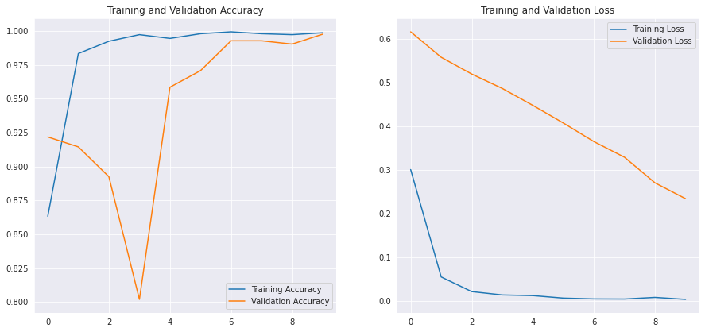

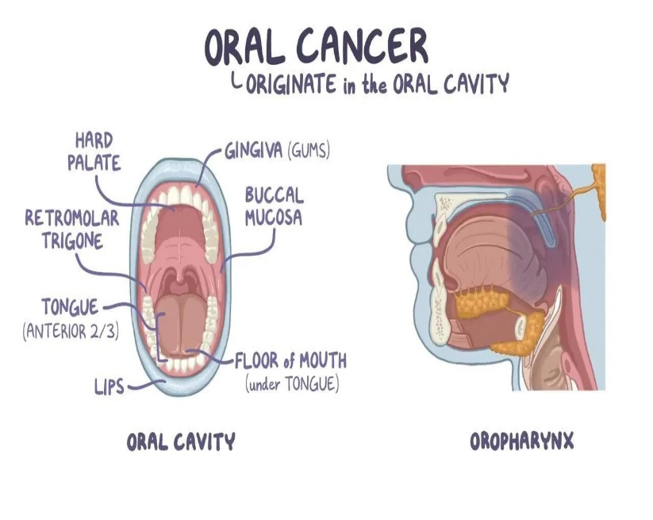
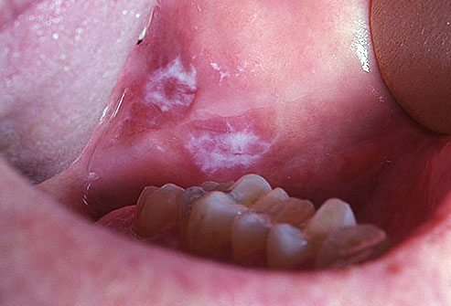
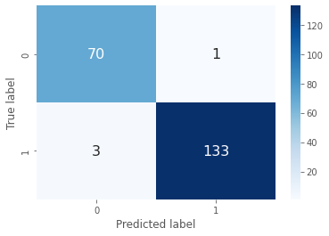
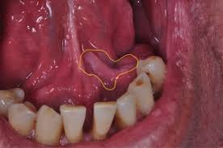



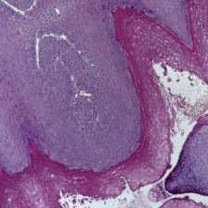
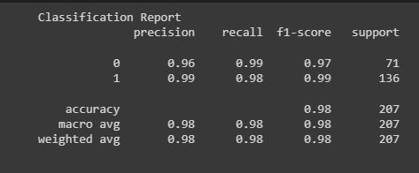
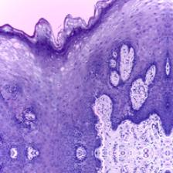
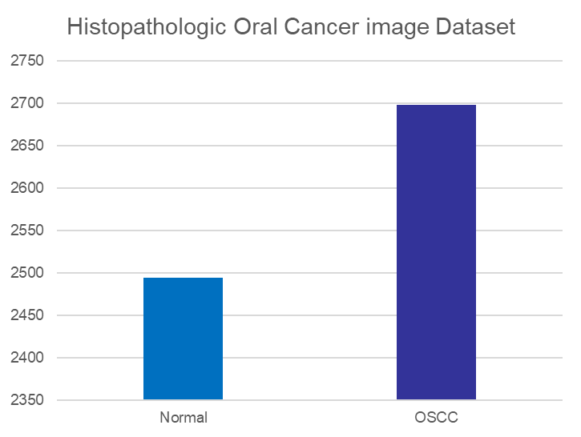

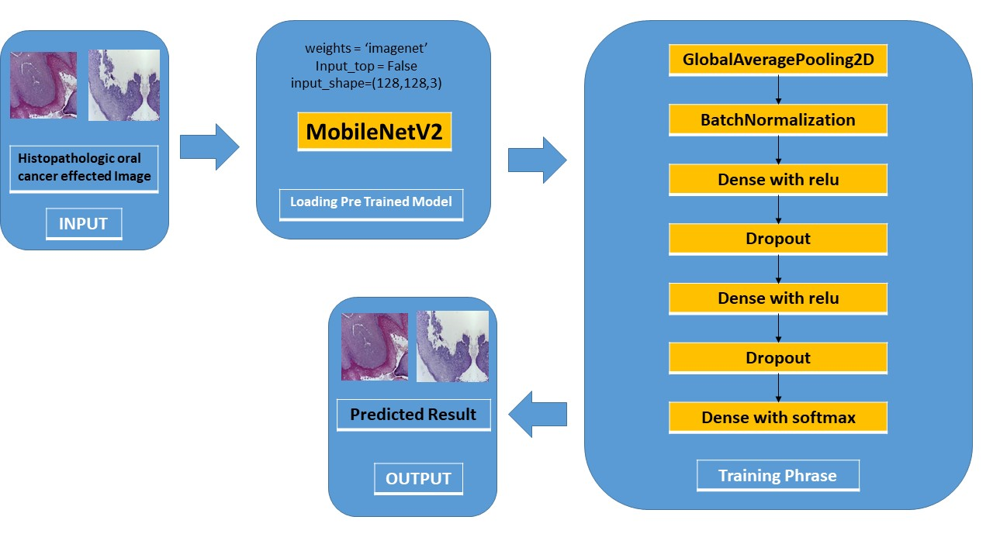


Detection of Oral Cancer Using Deep Learning Methods
Md. Imtiaz Hoque, Md. Jahirul Islam and Md. Azmi Siddique
Supervisor: Dr. Mohammad Monirujjaman Khan
Department of Electrical and Computer Engineering
North South University, Bashundhara, Dhaka-1229
1
Introduction
4
Results and Analysis
The goal of this study is to classify oral cancer using deep learning methods.
For testing and generalization of the deep learning approach, a convolutional neural network (CNN) model was developed using the publicly accessible dataset.
The deep learning approach is used to train, validate, and evaluate the MobileNetV2 model.
The model has overall accuracy of 98%, f1 score is 99% and the cohen kappa score is 95%
2
Background
Validation accuracy is higher than training accuracy, and training loss is less significant than validation loss.
Oral cancer is a tumor that develops in any part of the mouth. It is difficult, widespread cancer with a higher death ratio.
The Confusion matrix shows the prediction outcome. MobileNetV2 model predict 203 images correctly and 4 images incorrectly.
To detect oral cancer we used deep learning method. Deep learning is a sort of machine learning and artificial intelligence (AI) that simulates how humans acquire certain types of knowledge.
Oral Cancer Effected Images
3
Dataset and System Architecture
5
Classification Report and Model
Accuracy
This System’s dataset contains 5192 Histopathologic images. 2494 of Normal Histopathologic images and 2698 images of oral cancer effected Histopathologic images were used on this system. Data were spitted in three sections 70% for training, 20% for validation and 10% for testing.
To extract features, a CNN model is applied. Deep learning performs in complicated tasks that frequently demand dealing with large amounts of unstructured data, such as picture classification, natural language processing, or audio recognition, among others. The pre-trained model was generated using MobileNetV2, with minor modifications to the final layers, and a head model was developed from the basic model.
Histopathologic oral cancer effected Image
Classification Report of MobileNetV2
Histopathologic normal Image
Cohen Kappa Score
6
Conclusions
On ImageNet, a CNN with pre-learned weights was developed utilizing deep learning.
CNN and MobileNetV2model performed brilliantly on the dataset.
We have claimed 98% accuracy on our system.
Our system can rapidly detect the oral cancer and patient can take precaution at early stages.
Epoch 10 Batch Size 64 Activation Functions are relu, Softmax

