Slide 1
NSU EKYC SYSTEM
NAME – ID
MD. Imtiaz hoque 1811330042
MD. Azmi Siddique 1812307042
md. Najmus sakib 1813345642
Zarin tasnim 1831423642

Slide 2
Things we will be covering:
● Abstract
● HLD
● ER-diagram
● UML-diagram
● Theme Design

Slide 3
ABSTRACT
What we will develop?
What’s the purpose to develop?
What are the features for admin?
What are the features for customer?

Slide 4
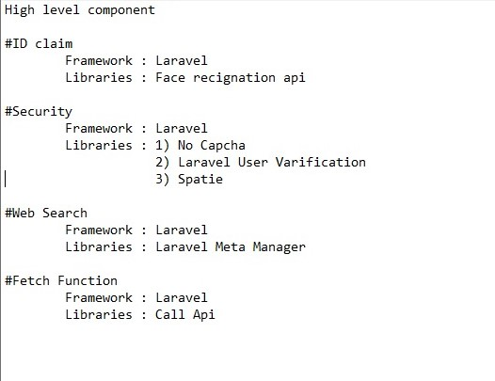
HIGH LEVEL DESIGN
Brief description of high level design:
1) Id claim
2) Security
3) Web search
4) Fetch function

Slide 5
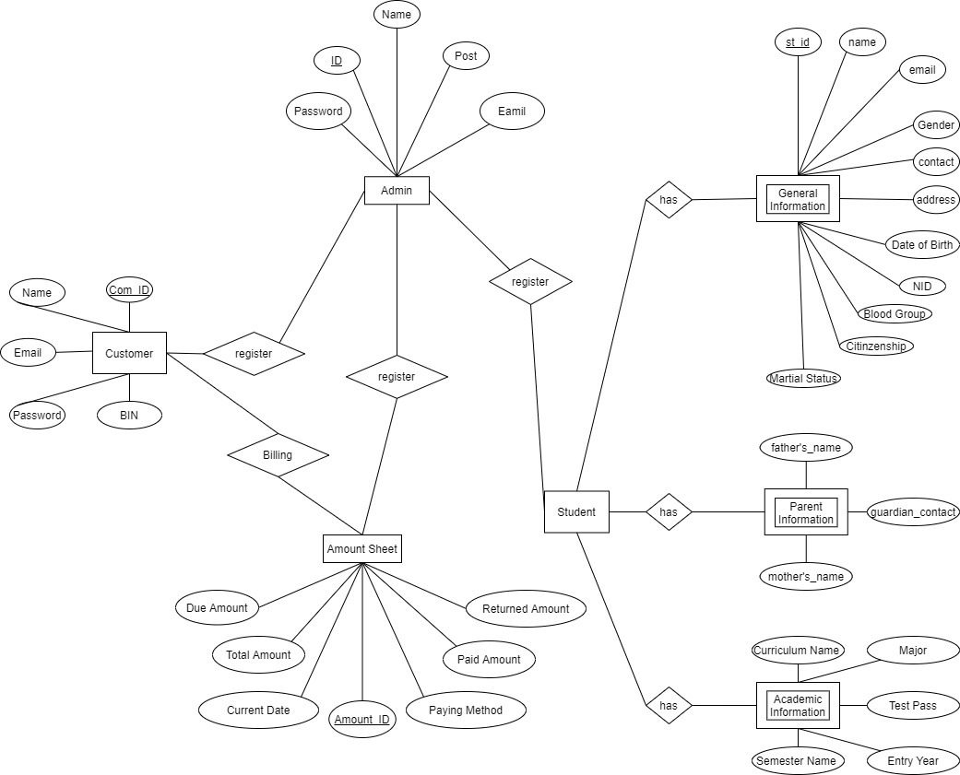
ER- DIAGRAM
► What’s a ER diagram?
Now, lets have look to our E-r diagram.

Slide 6
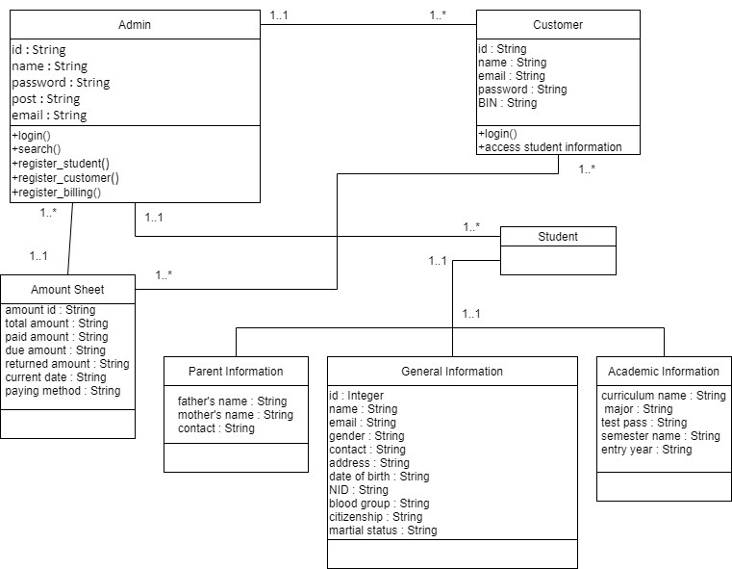
UML DIAGRAM
► What’s a UML diagram?
Now, lets have look to our E-r diagram.

Slide 7
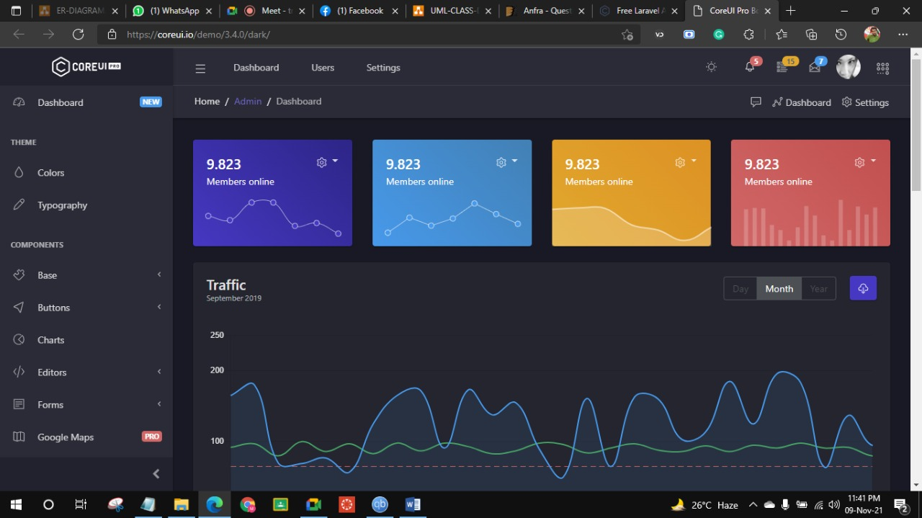
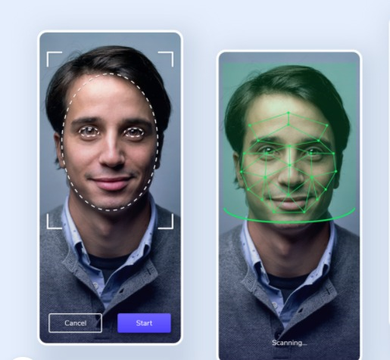
THEME DESIGN

Slide 8
Reference:
●[1]"Free Laravel Admin Templates · CoreUI", Coreui.io, 2021. [Online]. Available: https://coreui.io/laravel/. [Accessed: 09- Nov- 2021]
● [2]"Face Recognition designs, themes, templates and downloadable graphic elements on Dribbble", Dribbble.com, 2021. [Online]. Available: https://dribbble.com/tags/face_recognition. [Accessed: 09- Nov- 2021]s

