Slide 1


YOUR DREAM
OUR RESPONSIBILITY
WELCOME TO FAMILY

Slide 2
LOG IN
SIGN UP
USERNAME/EMPLOYEE ID
PASSWORD
LOGIN

Slide 3
LOG IN
SIGN UP
FULL NAME
MOBILE NUMBER
EMAIL
USERNAME
PASSWORD
SIGN UP

Slide 4





MD. FAHIM BHUIYAN
PROFILE
CAR
SETTINGS
PROFILE UPDATE
CAR SEAL STATEMENT

Slide 5

TATA PUNCH
Mahindra Thar
Maruti Suzuki Ertiga
Tata Tiago
Honda City
Skoda Octavla
CAR SEAL STATEMENT

Slide 6
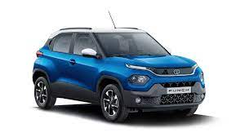
TATA PUNCH
Manufacturing Price
$ 22,000
Sale Price
$ 61,160

Slide 7

Mahindra Thar
Manufacturing Price
$ 27,000
Sale Price
$ 75,060

Slide 8

Maruti Suzuki Ertiga
Manufacturing Price
$ 30,000
Sale Price
$ 83,400

Slide 9
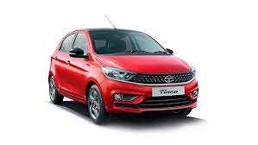
Tata Tiago
Manufacturing Price
$ 34,000
Sale Price
$ 94,520

Slide 10
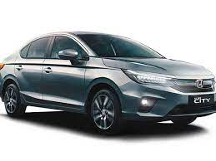
Honda City
Manufacturing Price
$ 20,000
Sale Price
$ 55,600

Slide 11

Skoda Octavla
Manufacturing Price
$ 33,000
Sale Price
$ 91,740

Slide 12
CAR SEAL STATEMENT
CAR MODEL
SEGMENT
COUNTRY
UNIT SOLD
SOLE PRICE
DISCOUNT
DATE
PRINT

Slide 13
Md. Fahim BHuiyan
Download Your Invoice
Download
CANCEL

Slide 14
MD. FAHIM BHUIYAN
CUSTOMER/PROFILE
Employee ID
CA22000001
FULL NAME
MD. FAHIM BHUIYAN
AGE
20
GENDER
MALE
POST
CEO
SALARY
$20,000
EDIT PROFILE

Slide 15
MD. FAHIM BHUIYAN
PROFILE UPDATE
PROFILE UPDATE
Empolyee ID
CA22000001
Full Name
Md. Fahim Bhuiyan
Age
Gender
Post
Salary
UPDATE

Slide 16
MD. FAHIM BHUIYAN
SETTINGS
Auto Settings
ON
Start On Boot
ON
Activation Message
ON
Notification Buttons
OFF
Hide Notification
OFF

Slide 17
Md. Fahim BHuiyan
Are you sure you want to log out?
We can’t notify you of new
matches if you do.
LOG OUT
CANCEL

