Slide 1



Machine Learning and Bioinformatics Approaches for Lung Cancer Diagnosis and Staging: Using TCGA Dataset
Presented by
Supervised by
Md. Abul Basar
ID: IT-21619
Session: 2020-21
M.Sc (Engg.) in ICT
Department of ICT, MBSTU.
Dr. Monir Morshed
Professor & Chairman
Department of ICT, MBSTU.
Department of Information and Communication Technology (ICT)
Mawlana Bhashani Science and Technology University
Santosh, Tangail-1902, Bangladesh

Slide 2



Outlines
Introduction
Problem Statement
Motivation
Research Question
Objectives
Rationale of the Research
Literature Review
Proposed Methodology
Result Analysis
References
2

Slide 3
Introduction
Lung cancer is one of the most prevalent and deadly cancer globally, representing a significant public health challenge.
According to the Global Cancer Observatory, there were an estimated 2.1 million new cases and 1.8 million deaths due to lung cancer in 2020, making it the leading cause of cancer-related mortality [1].
Biomarkers aid in early detection, prognosis, and targeted therapies, as well as accurate staging is essential for treatment planning and patient management.
The advancement of machine learning and bioinformatics techniques are integrated for identifying robust biomarkers and improving staging accuracy in lung cancer using GEO and TCGA data.
3

Slide 4

Problem Statement
Lung cancer remains high mortality due to late-stage detection and limited biomarkers.
Conventional techniques are invasive, costly, and time-consuming.
Lack of robust and reliable biomarkers for early detection and prognosis.
Existing staging systems often fail to capture molecular heterogeneity. Misclassification leads to inaccurate treatment decisions.
Advanced machine learning and bioinformatics techniques are required to identify novel biomarkers, improve diagnosis and staging accuracy, and support personalized treatment strategies.
4

Slide 5
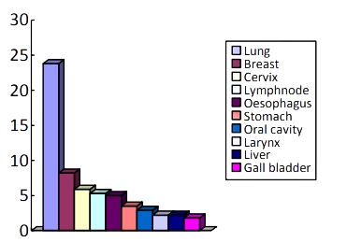
Motivation and Relevance to Bangladesh’s Development
Lung cancer cases are on the rise in Bangladesh, with the rise in the number of smokers and air pollution levels.
According to the report, a total of 76,543 new patients attended the outpatient department of the National Institute of Cancer Research and Hospital (NICRH), Dhaka. Of them, some 35,369 had confirmed or provisional diagnosis of cancer and they were included in the final analysis [2].
Among patients with the worst grade of lung cancer, if diagnosed at stage I, the 5-year survival rate for those aged 45 and 84 years is 85% and survivable with appropriate treatment, while the 5-year survival rates at stages II, III and IV are about 57%, 28% and 7%, respectively [3].
Fig: Top 10 Cancers by Incidence
5

Slide 6



Research Question
RQ1: How can we efficiently identify differentially expressed genes (DEGs) in lung cancer using publicly available transcriptomic data?
RQ2: How to find out the target biomarkers and stage classification?
RQ3: What are the most effective system biology methodologies for integrating multi-omics data (e.g., genomes and proteomics) to gain complete knowledge of lung cancer?
RQ4: How can bioinformatics techniques be integrated with machine learning algorithms to identify reliable biomarkers for lung cancer?
6

Slide 7

Objectives
To collect and preprocess datasets and identify differentially expressed and co-expressed genes using mRMR, SVM-RFE, and WGCNA.
To perform pathway enrichment and PPI network analysis for hub gene discovery.
To develop and evaluate ML models (MLP, XGBoost, SVM, RF, AdaBoost) for staging classification.
To validate the diagnostic and prognostic potential of identified biomarkers through survival and expression analyses.
To explore drug–target interactions via molecular docking studies.
7

Slide 8

Rationale of the Research
The outcomes of this research could potentially lead to improved lung cancer diagnosis and treatment in Bangladesh.
This research could ultimately improve patient outcomes and contribute to the larger goal of reducing the burden of lung cancer in Bangladesh.
8

Slide 9
Literature Review
No. | Year | Works | Techniques | Limitations
1. | 2024 | Islam et al. – Genetic links between common lung diseases and lung cancer | Shared DEGs in LUAD + 5 lung diseases Hub genes: SPTBN1, KCNA4, SCN7A, KCNQ3, GRIA1, SDC1 Pathways: vitamin B6, cAMP; validated with TCGA/HPA | No ML-based gene selections no experimental validation No clinical validation.
2. | 2024 | Rojani M.V. et al.- Non-Small Cell Lung Cancer - Tumor Biology | Use GEO datasets Find DEGs of lung cancer Use system biology approaches to identify most vital genes. | No ML-based gene selections There is no hub-gene validations No stage classifications
3. | 2024 | Raha et al. – Smoking, COVID-19, and lung cancer | Overlapping DEGs: smoking, COVID-19, LUAD Hub genes: SLC22A18, CHAC1,ROBO4, TEK, CD24, SOX2, PITX2, GMDS | No ML-based gene selections There is no hub-gene validations No stage classifications
9

Slide 10
Literature Review
No. | Year | Works | Techniques | Limitations
4. | 2024 | Hossain et al. – Smoking, COVID-19, and lung cancer. | Identified 76 shared genes ten hub genes validated by WGCNA, survival, and ML as therapeutic targets. | No ML-based gene selections No experimental assays clinical validation missing.
5. | 2024 | Zhao et al. – Prognostic lncRNAs in LUAD | WGCNA revealed lncRNA–mRNA modules predictive of survival identified novel transcriptomic biomarkers. | No ML-based gene selections No experimental clinical validation.
10

Slide 11
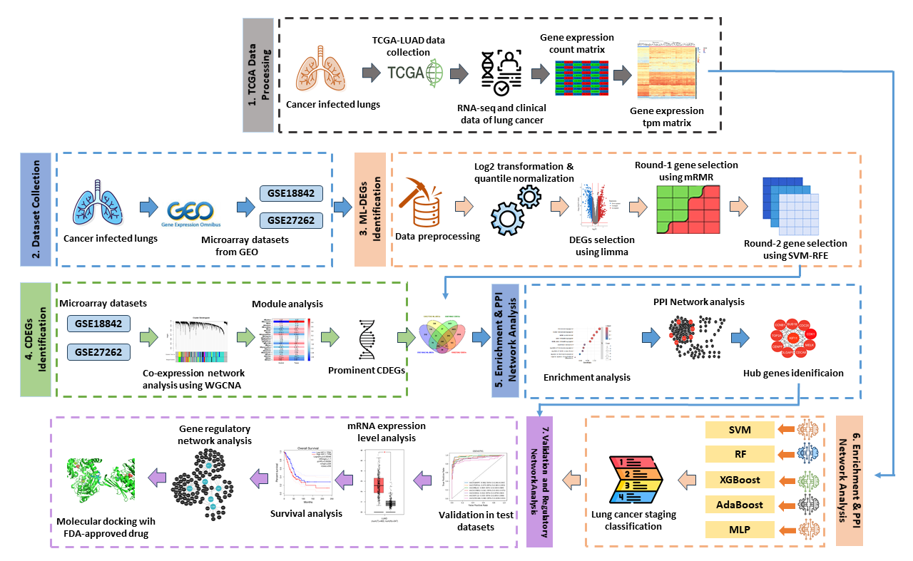
Methodology
Datasets Acquisition
Data Preprocessing
ML-based gene selection
Identification & Validation of hub genes
Stage classifications
Model deployment
Train
Cross Validation
Fig.1: Overview of the proposed framework for biomarker discovery and stage classification of lung Adenocarcinoma
11

Slide 12
Methodology Cont…
Datasets Acquisition
Datasets | Platform | Tumor | Normal | Total Samples
GSE18842 | GPL570 | 46 | 45 | 91
GSE27262 | GPL570 | 25 | 25 | 50
GSE33532 | GPL570 | 80 | 20 | 100
GSE40791 | GPL570 | 94 | 100 | 194
TCGA-LUAD | - | 541 | 59 | 600
Train
Cross Validation
Table.1: Overview of the gene expression datasets utilized in this study including platform information, number of tumor and normal samples, and total samples.
12

Slide 13
Methodology Cont…
Data Preprocessing (Limma & ML-Based)
Find DEGs using limma package
In this study, the raw expression data obtained from the GEO and TCGA were processed and analyzed using the limma package.
Genes with an adjusted P-value < 0.05 and an absolute |log2 FC| > 1 were identified as differentially expressed genes (DEGs) and analyzed using R software.
DEGs with log2 FC < −1 were classified as downregulated, while those with log2 FC > 1 were considered upregulated.
Train
Cross Validation
13

Slide 14
Methodology Cont…
ML-based DEGs Selection
First-step gene selection using mRMR
Differentially expressed genes (DEGs) are typically identified using empirical Bayes moderated tests with FDR adjustments. While effective, this method doesn’t address redundancy among genes.
mRMR, improves feature selection by balancing relevance and minimize redundancy.
Widely used in machine learning and multi-omics research, mRMR enhances the quality of selected gene subsets.
Second-step gene selection using SVM-RFE
SVM-RFE is a supervised feature selection method that ranks genes by iteratively training an SVM model and removing the least important features.
It identifies the most predictive genes, improving classification accuracy and interpretability.
SVM-RFE ranks genes based on their influence on the decision boundary and progressively eliminates less important genes.
Train
Cross Validation
14

Slide 15
Result Analysis
15

Slide 16
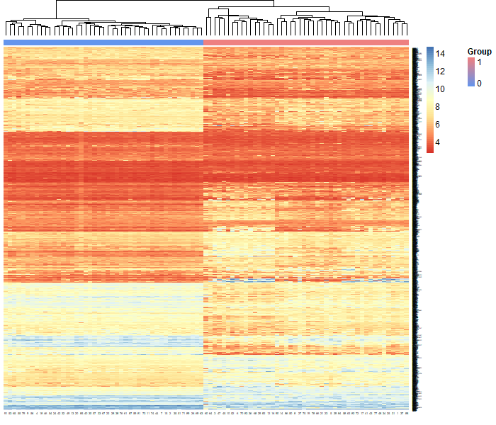
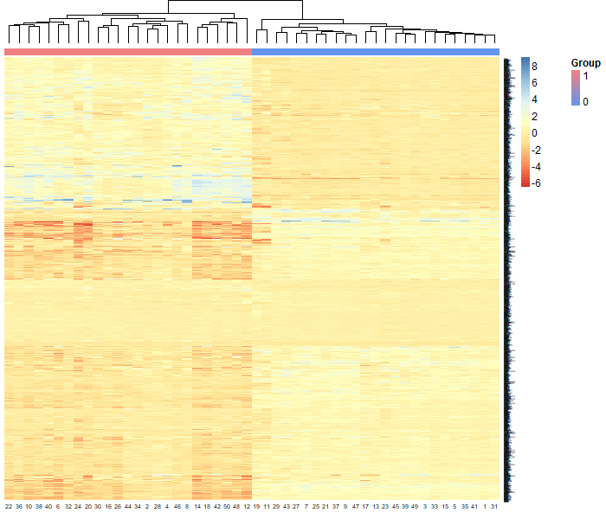
Visualization of Datasets
Fig. 2. Visual representation of differentially expressed genes in lung cancer datasets heatmap for GSE18842 and GSE27262.
16

Slide 17
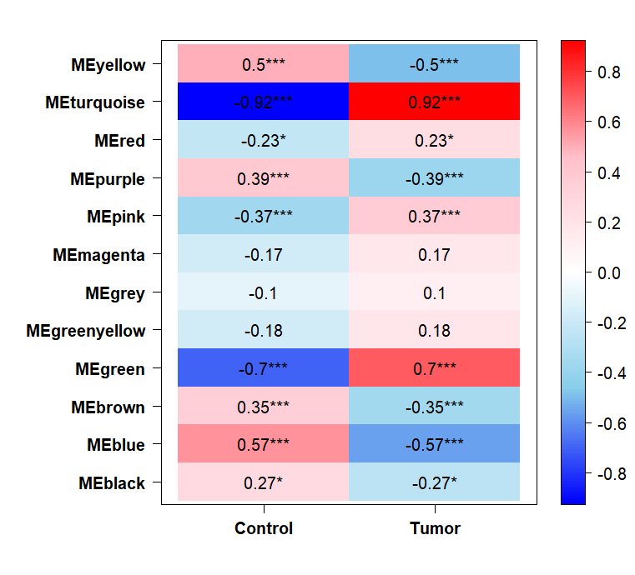
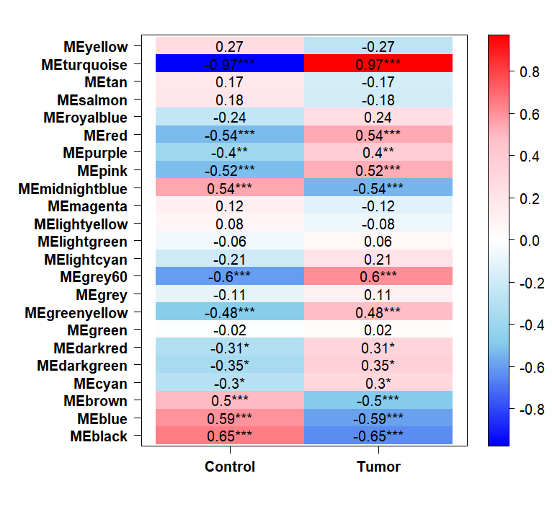
Weighted gene co-expression network analysis (WGCNA)
Fig.3: Assessment of module–trait associations. (a) Associations between gene co-expression modules and clinical
features in the GSE18842 dataset; (b) Relationships between gene modules and phenotypic traits in the GSE27262 dataset.
17

Slide 18
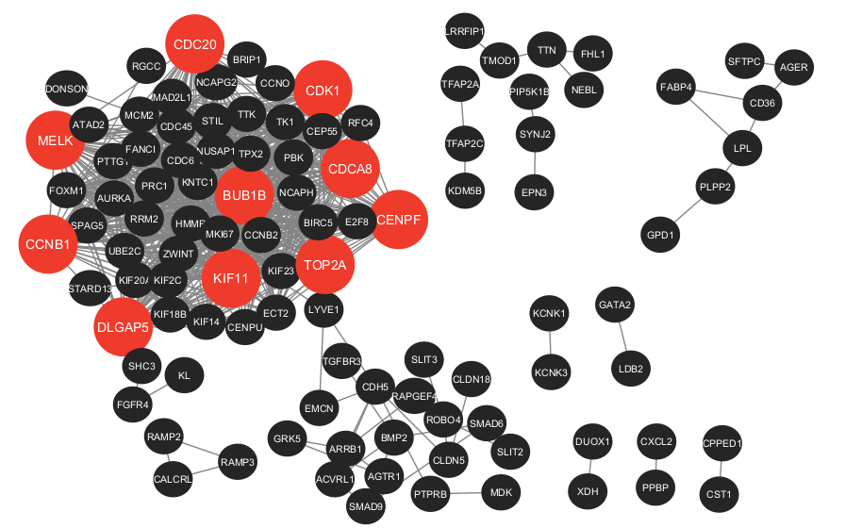
Protein-protein Interaction
Fig. 4: Interaction analysis of common genes, PPI network constructed from 240 common genes, comprising 105 nodes and 784 edges.
18

Slide 19
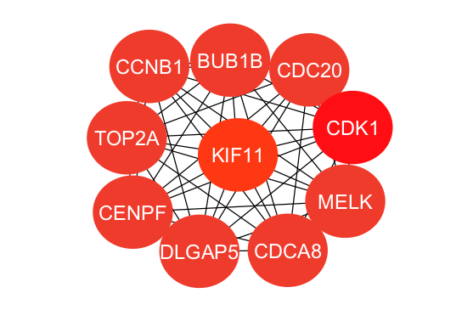
Hub gene
Fig. 5. Subnetwork highlighting the top ten hub genes identified using the Degree centrality method
19

Slide 20
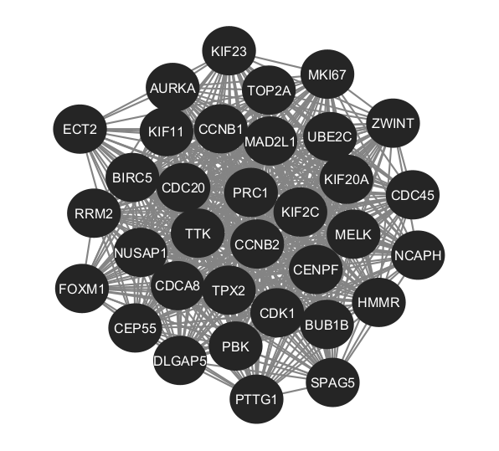
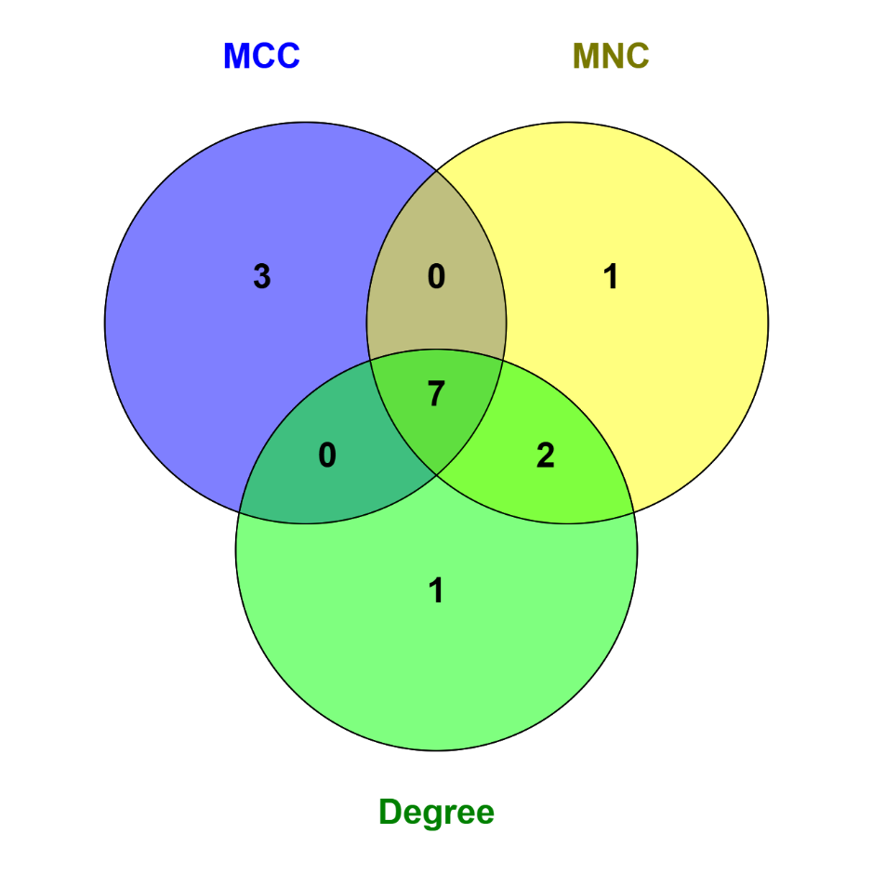
Module Network and Common Hub
Fig. 6. Most significant module detected by MCODE, containing 34 nodes and 539 edges; Venn diagram illustrating five common hub genes shared across MCC, MNC, and Degree centrality methods.
20

Slide 21
Validation of Hub genes
There are 3 types of analysis to validate the identified hub genes
Diagnostic potential evaluation of the hub genes
mRNA expression level analysis
Survival analysis
21

Slide 22
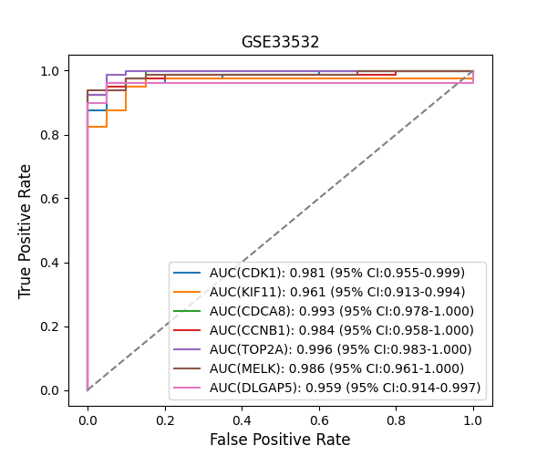
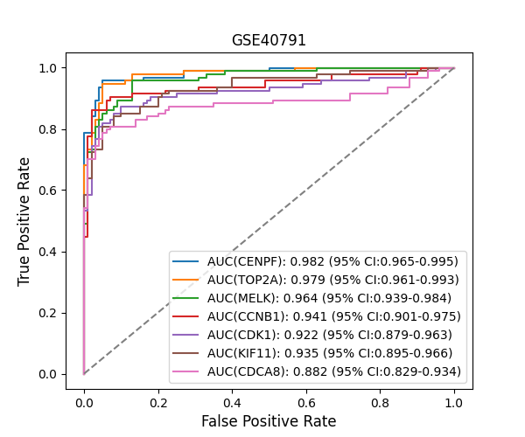
Diagnostic potential evaluation of the hub genes
Fig. 7. The diagnostic accuracy of the candidate genes was thoroughly evaluated using ROC curve analysis. (a) ROC curves for the common hub genes in the GSE33532 dataset; (b) ROC curves for the same genes in the GSE40791 dataset. The analysis demonstrates the ability of these genes to distinguish between tumor and normal samples, supporting their potential as robust diagnostic biomarkers.
22

Slide 23
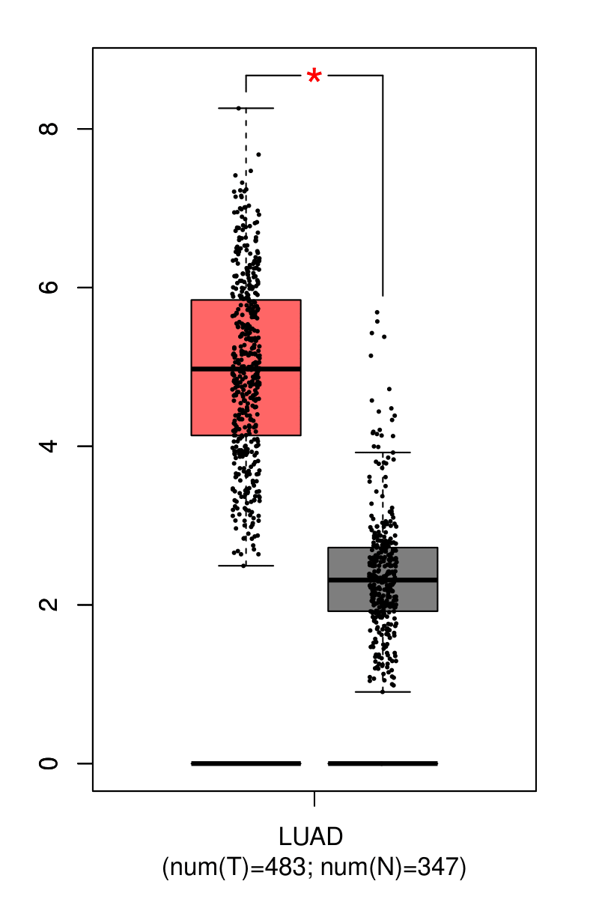
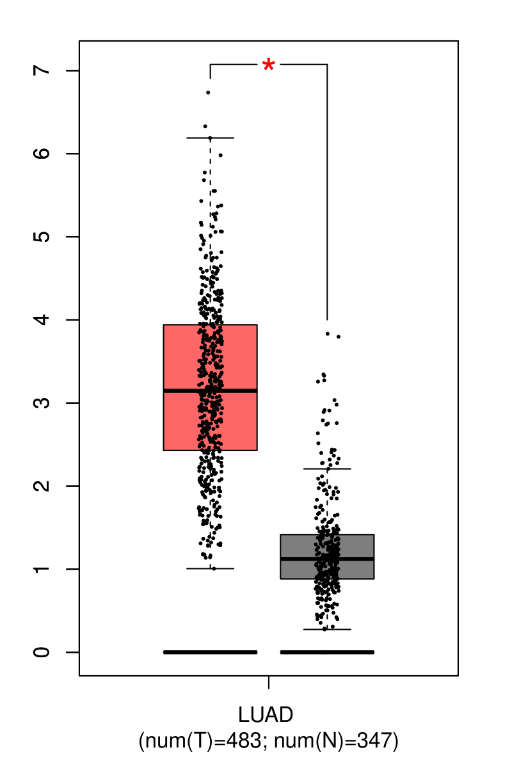
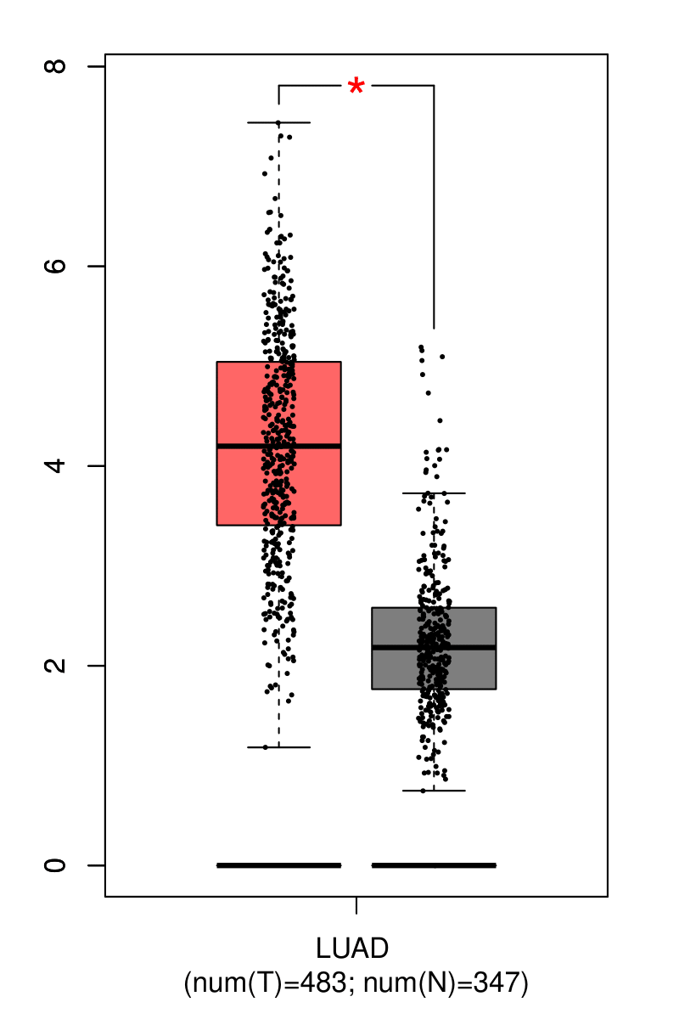
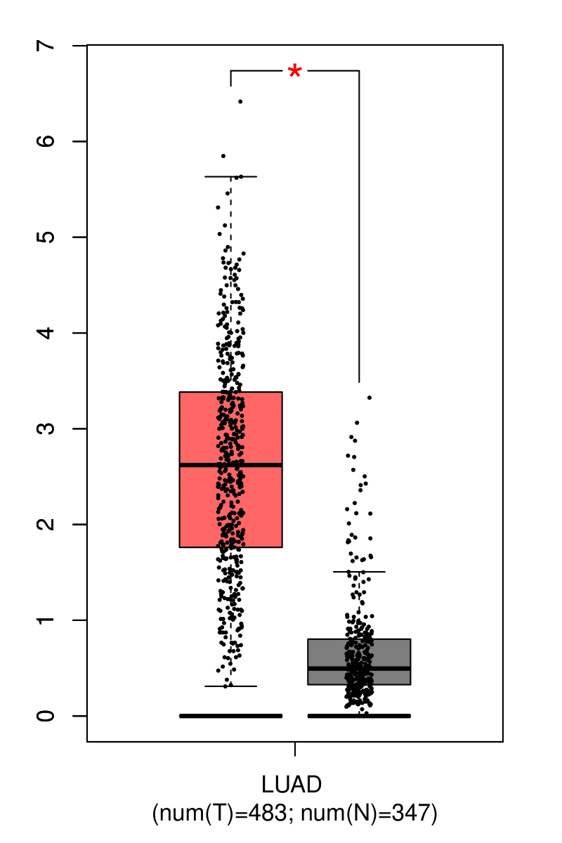
mRNA expression level analysis
CCNB1
CDCA8
CDK1
DLGAP5
Fig. 8: Comparison of mRNA expression levels between LUAD tumor tissues (T, n = 483) and adjacent normal tissues (N,
n = 347) for the identified hub genes. (a) CCNB1, (b) CDCA8, (c) CDK1, (d) DLGAP5, (e) KIF11, (f) MELK, and (g) TOP2A. The analysis demonstrates significantly higher expression of tumor samples and normal tissues, supporting their potential roles in lung adenocarcinoma development and progression. Statistical significance was determined using appropriate differential expression analysis methods.
23

Slide 24
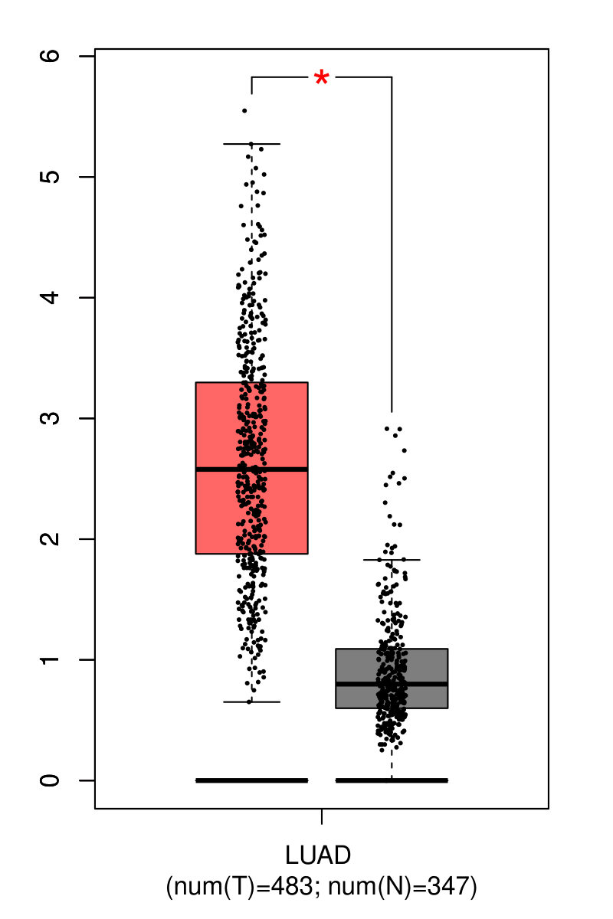
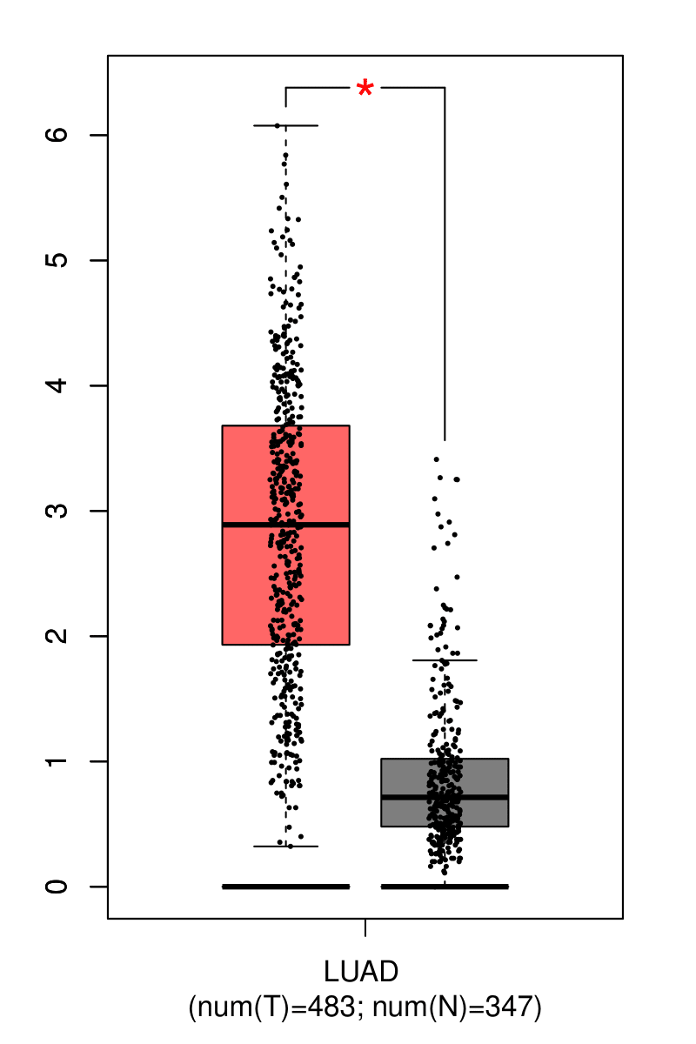
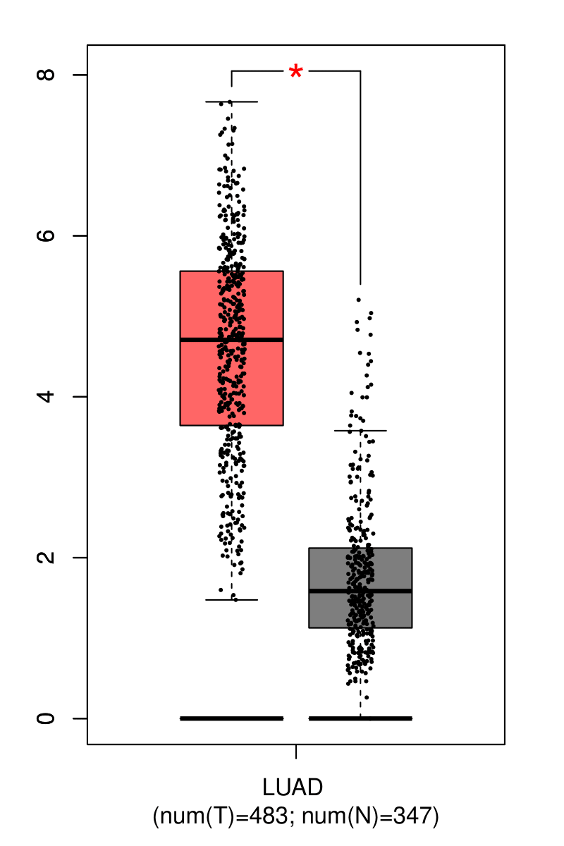
mRNA expression Cont…
KIF11
MELK
TOP2A
Fig. 8: Comparison of mRNA expression levels between LUAD tumor tissues (T, n = 483) and adjacent normal tissues (N, n = 347) for the identified hub genes. (a) CCNB1, (b) CDCA8, (c) CDK1, (d) DLGAP5, (e) KIF11, (f) MELK, and (g) TOP2A. The analysis demonstrates significantly higher expression of tumor samples and normal tissues, supporting their potential roles in lung adenocarcinoma development and progression. Statistical significance was determined using appropriate differential expression analysis methods.
24

Slide 25
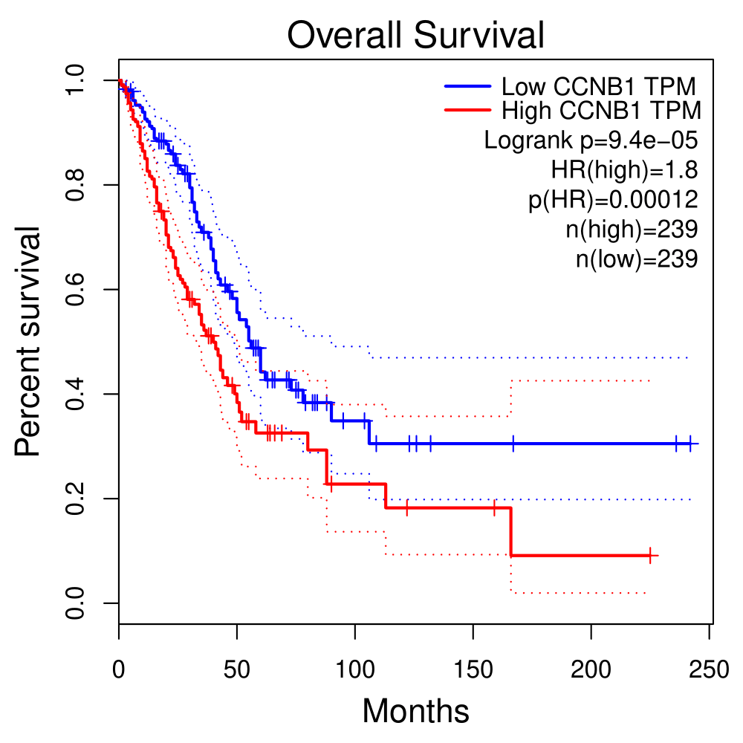
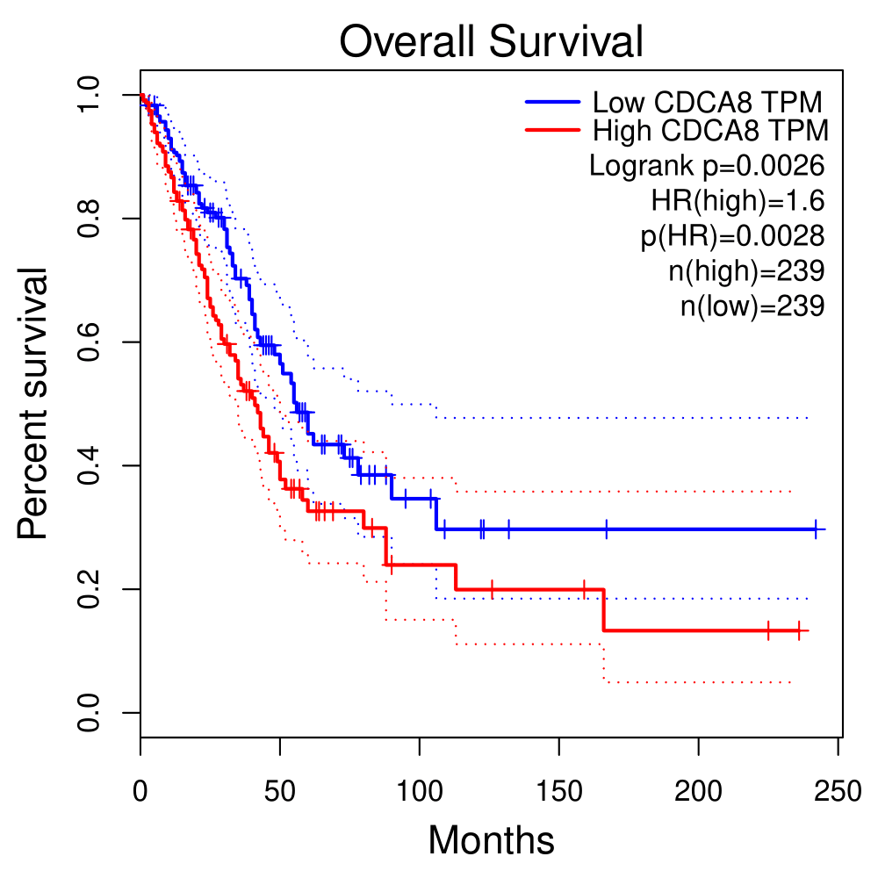
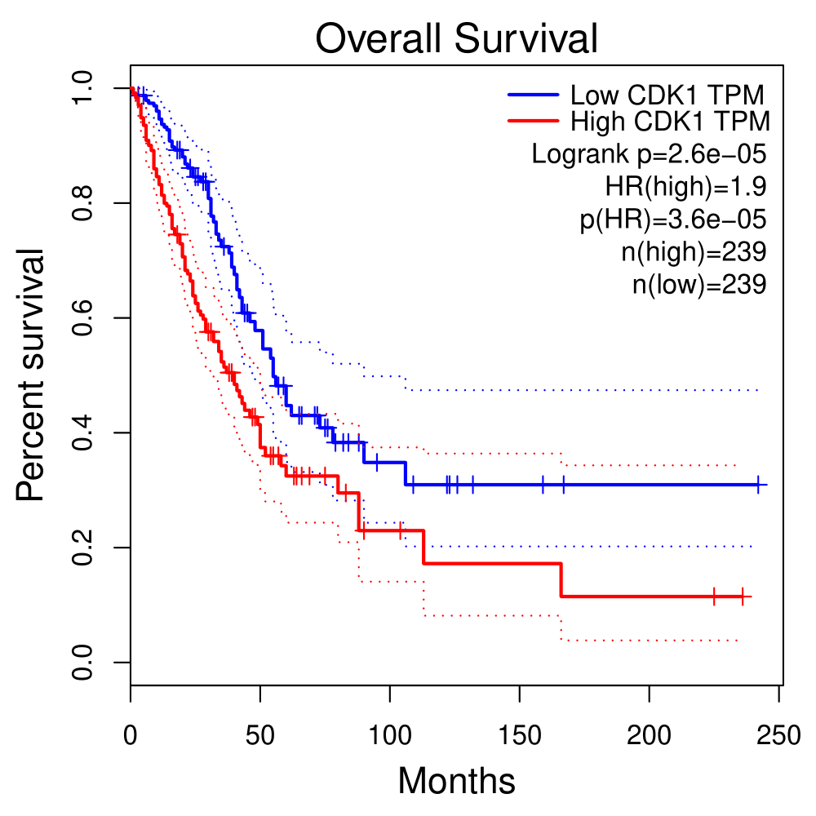

Survival analysis
CCNB1
CDCA8
CDK1
DLGAP5
Fig.9: Survival analysis was conducted on the selected hub genes in patients with LUAD: (a) CCNB1, (b) CDCA8, (c) CDK1, (d) DLGAP5, (e) KIF11, (f) MELK, and (g) TOP2A. Kaplan–Meier survival curves were used to assess the prognostic value of each gene based on overall survival in lung adenocarcinoma patients. Elevated expression levels of these genes were typically linked to worse survival outcomes, highlighting their potential as prognostic biomarkers in LUAD.
25

Slide 26

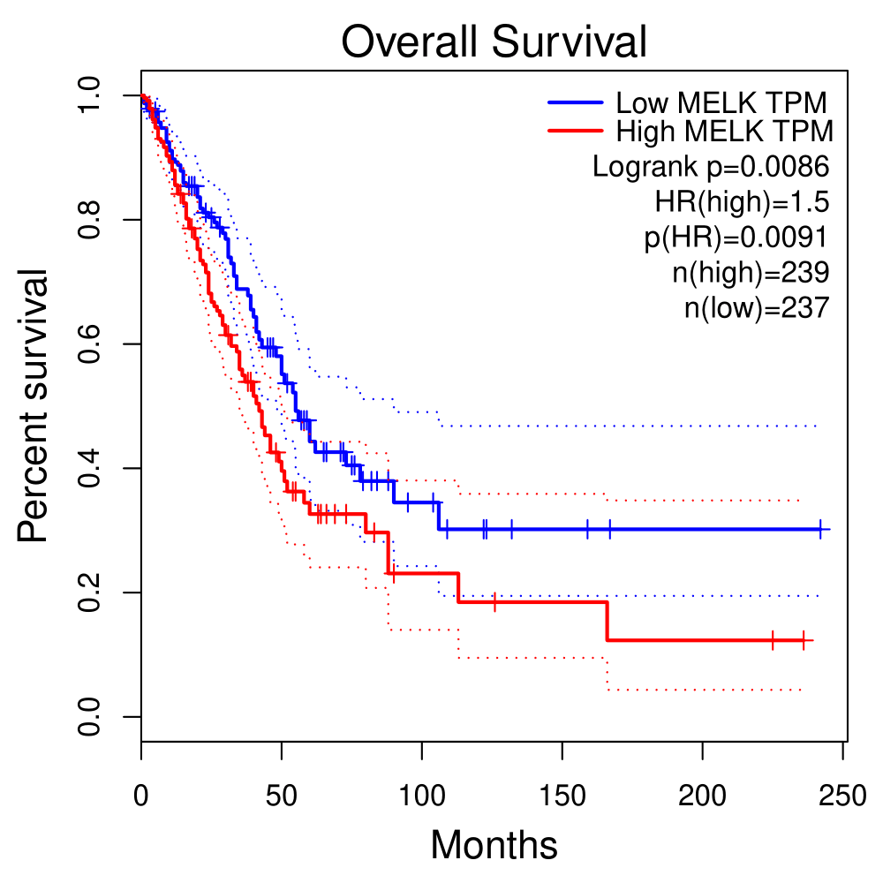
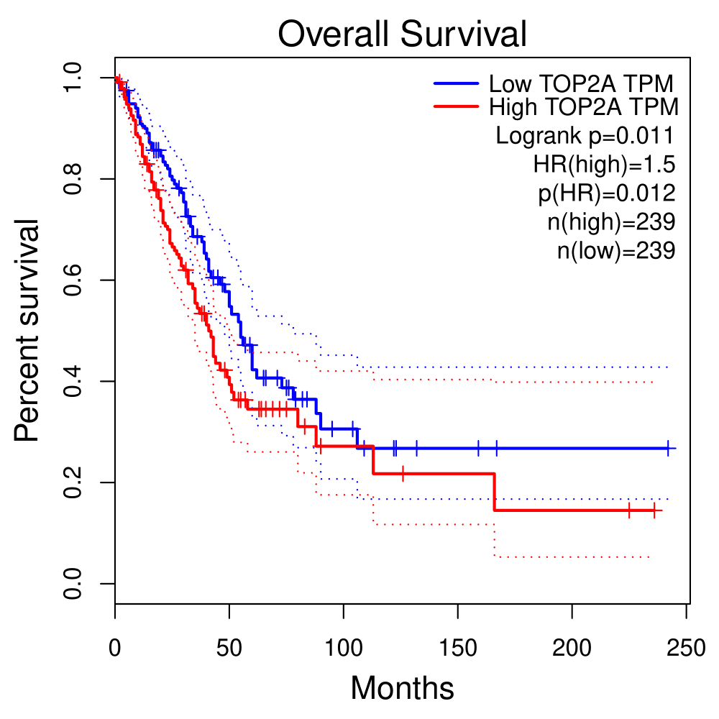
Survival Analysis Cont…
KIF11
MELK
TOP2A
Fig.9: Survival analysis was conducted on the selected hub genes in patients with LUAD: (a) CCNB1, (b) CDCA8, (c) CDK1, (d) DLGAP5, (e) KIF11, (f) MELK, and (g) TOP2A. Kaplan–Meier survival curves were used to assess the prognostic value of each gene based on overall survival in lung adenocarcinoma patients. Elevated expression levels of these genes were typically linked to worse survival outcomes, highlighting their potential as prognostic biomarkers in LUAD.
26

Slide 27
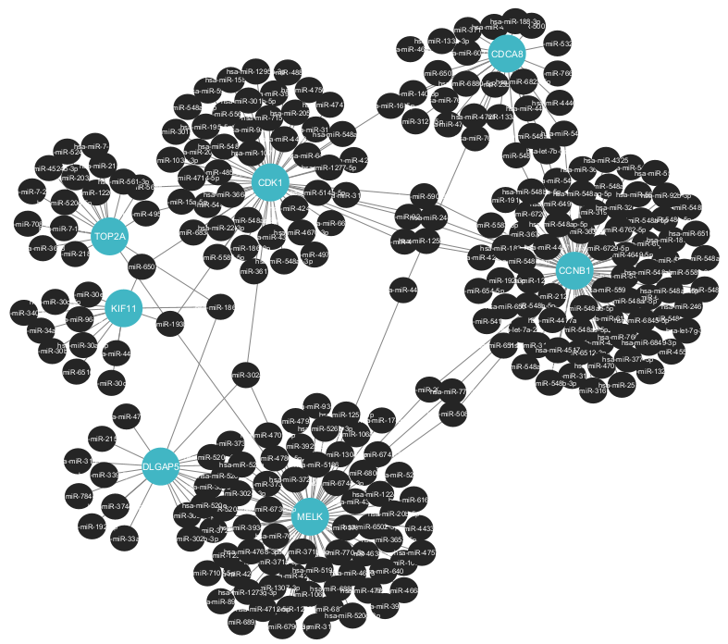
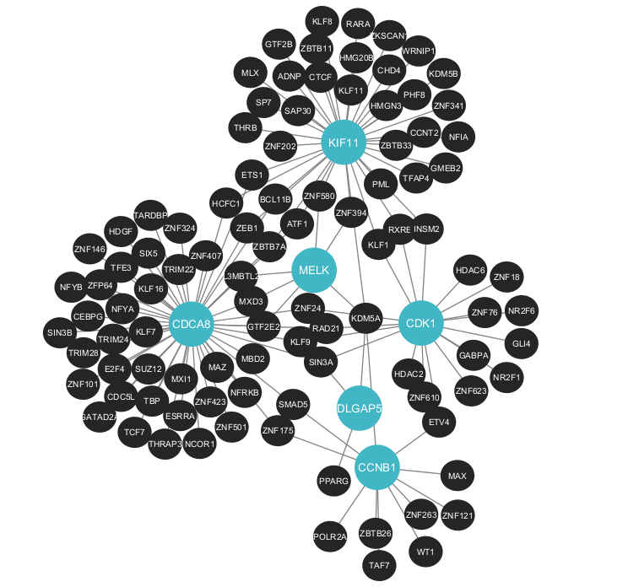
Gene-regulatory network
Fig.10: Gene regulatory network analysis of common hub genes. (a) Gene–miRNA interaction network showing regulatory relationships between hub genes and their associated microRNAs. (b) Transcription factor (TF)–gene interaction network illustrating key TFs predicted to regulate the expression of the identified hub genes. These networks highlight the post-transcriptional and transcriptional regulation involved in lung.
27

Slide 28
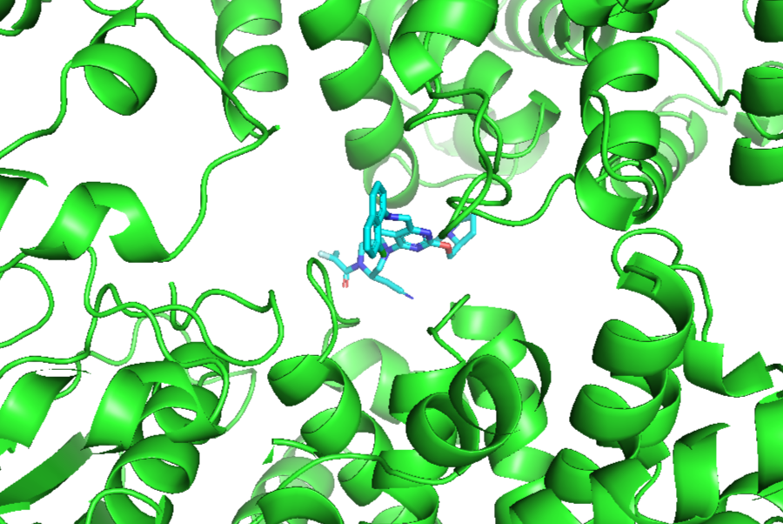
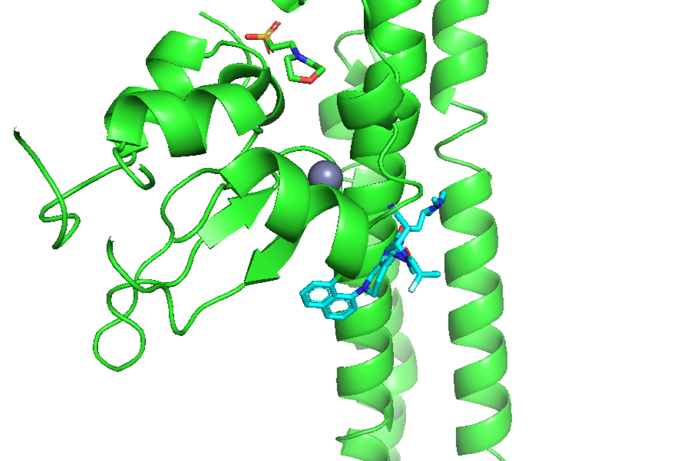
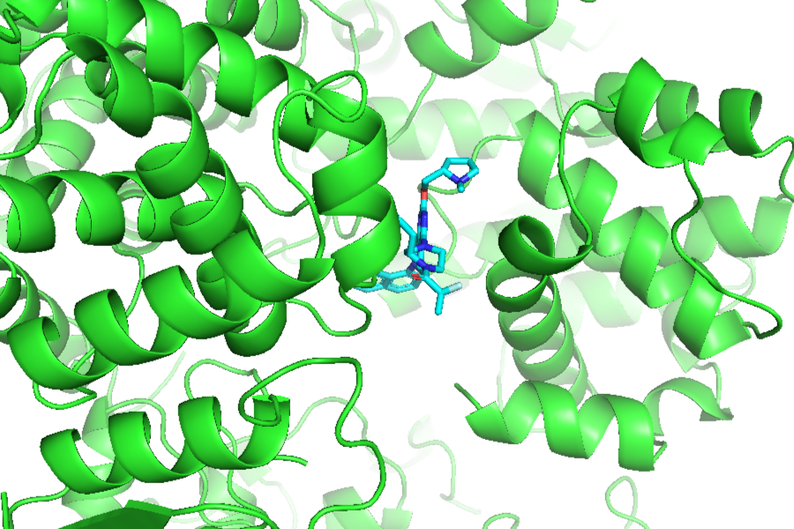
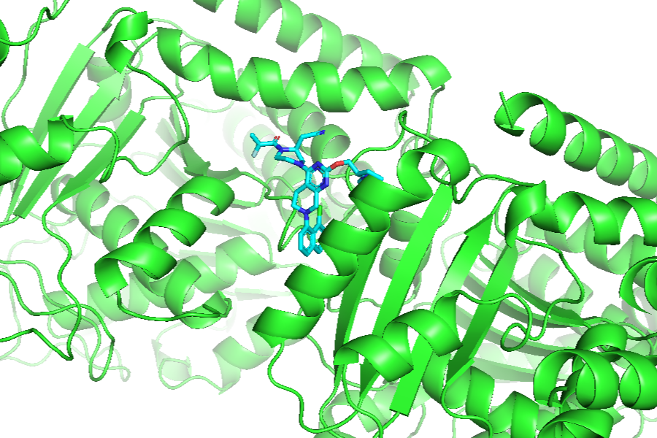
Molecular docking
CCNB1
CDCA8
CDK1
DLGAP5
Fig.11: Molecular docking configuration of six identified hub genes with the FDA-approved drug Adagrasib. (a) CCNB1; (b) CDCA8; (c) CDK1; (d) DLGAP5; (e) KIF11; (f) MELK; (g) TOP2A. Protein structures are displayed in green, and the docked ligand (Adagrasib) is shown in blue.
28

Slide 29
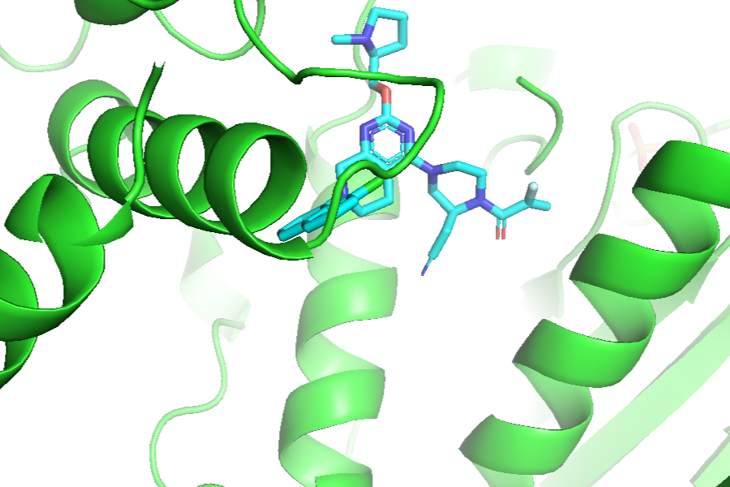
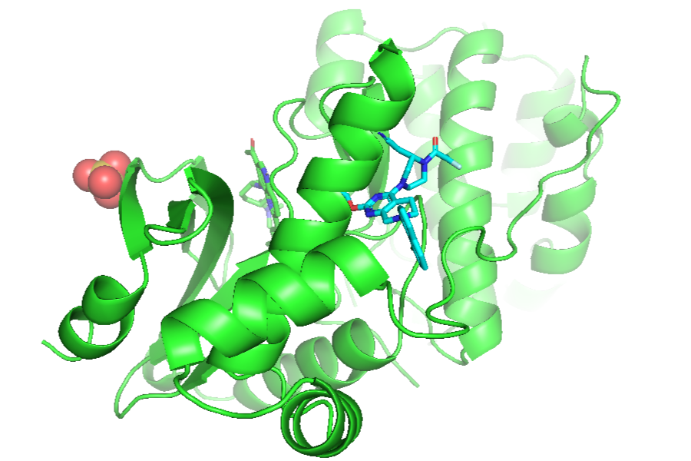
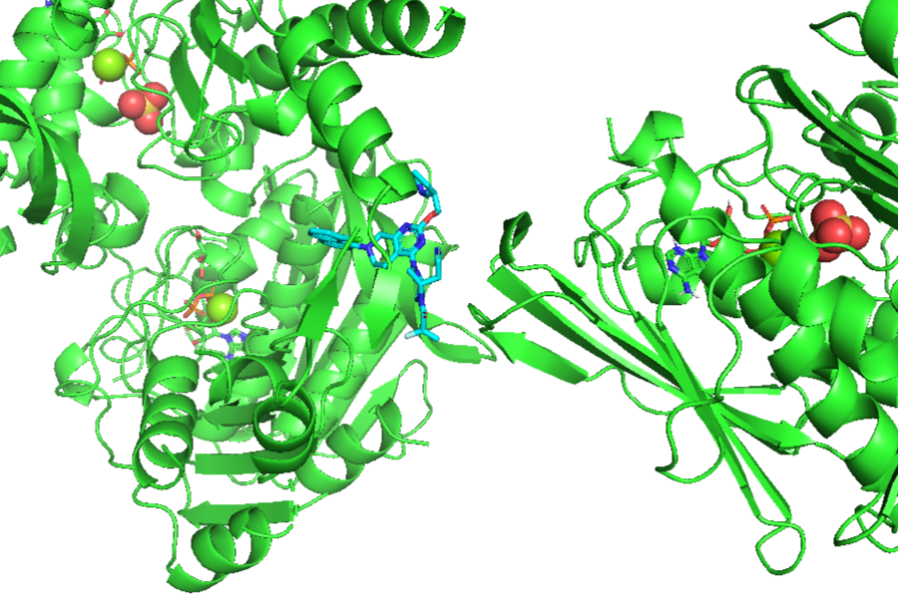
Docking Cont…
KIF11
MELK
TOP2A
Fig.11: Molecular docking configuration of six identified hub genes with the FDA-approved drug Adagrasib. (a) CCNB1; (b) CDCA8; (c) CDK1; (d) DLGAP5; (e) KIF11; (f) MELK; (g) TOP2A. Protein structures are displayed in green, and the docked ligand (Adagrasib) is shown in blue.
29

Slide 30
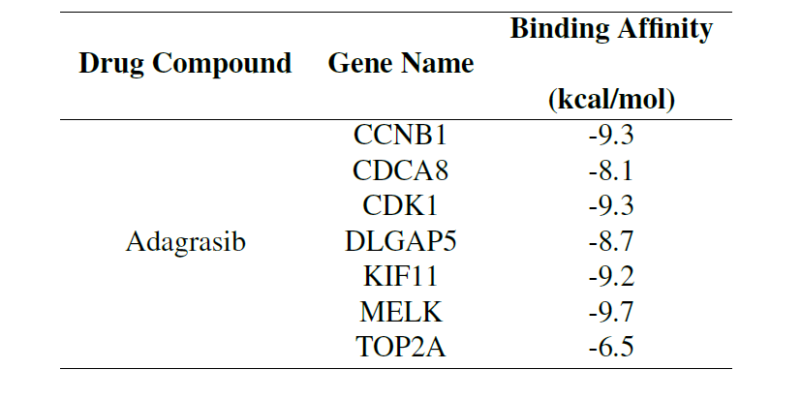
Docking Results
Table.2: Binding affinities between the FDA-approved lung cancer drug Adagrasib and the seven common hub proteins CCNB1, CDCA8, CDK1, DLGAP5, KIF11, MELK, and TOP2A were evaluated through molecular docking analysis to explore their potential as therapeutic targets.
30

Slide 31
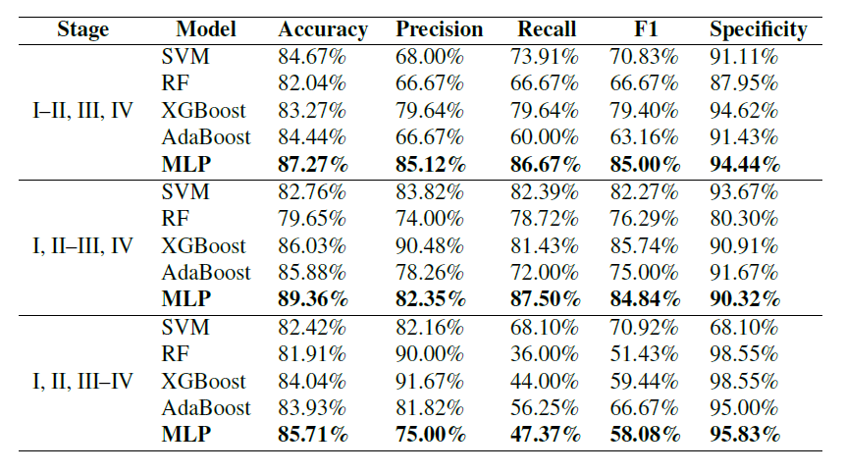
Machine Learning Models
Table.3: Performance comparison of machine learning models for lung cancer staging using gene expression data. The staging classifications combine different stages and measure performance. Models evaluated include SVM, RF, XGBoost, AdaBoost, and Multilayer Perceptron. Performance metrics reported are Accuracy, Precision, Recall, F1-score, and Specificity. The MLP model consistently shows superior performance across most staging classifications.
31

Slide 32
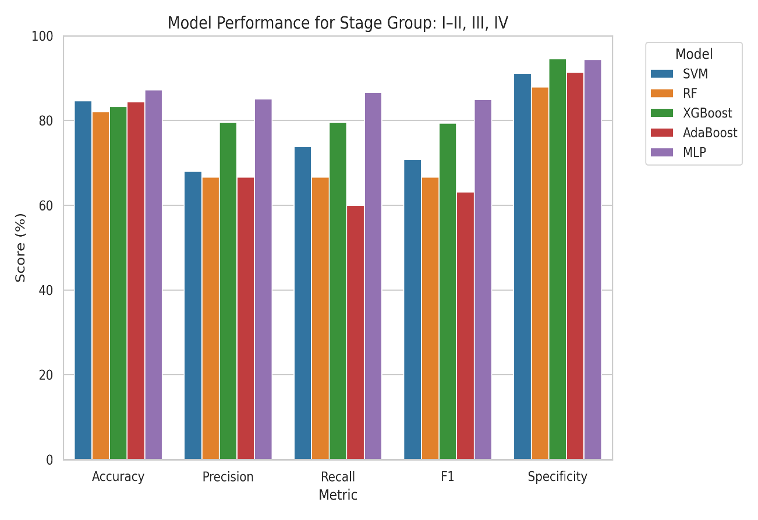
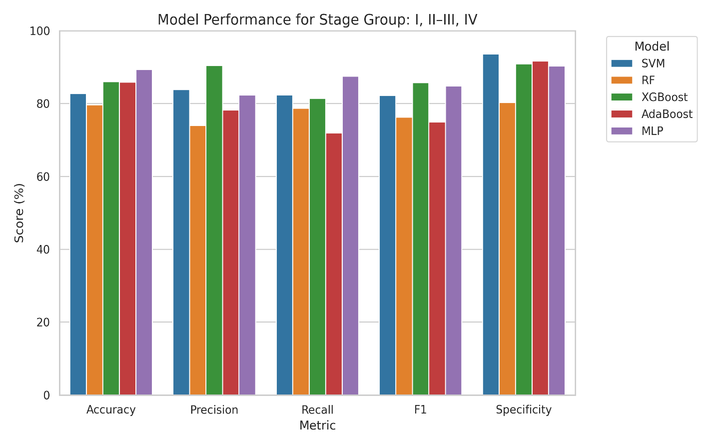
Model Results
Fig.12: Bar plots illustrating the performance of different machine learning models—SVM, Random Forest (RF), XGBoost, AdaBoost, and Multilayer Perceptron (MLP)—in classifying lung cancer stages across three grouping schemes: (a) I–II, III, IV; (b) I, II–III, IV; and (c) I, II, III–IV. Each bar represents the score (%) for Accuracy, Precision, Recall, F1-score, and Specificity. The MLP model shows consistently high performance across all metrics and stage groupings.
32

Slide 33
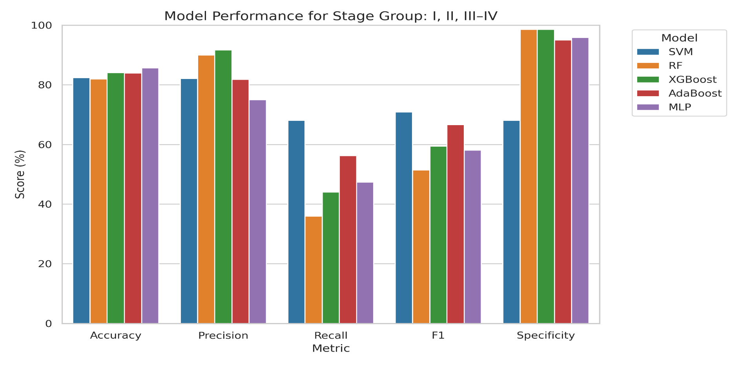
Results Cont…
Fig.12: Bar plots illustrating the performance of different machine learning models—SVM, Random Forest (RF), XGBoost, AdaBoost, and Multilayer Perceptron (MLP)—in classifying lung cancer stages across three grouping schemes: (a) I–II, III, IV; (b) I, II–III, IV; and (c) I, II, III–IV. Each bar represents the score (%) for Accuracy, Precision, Recall, F1-score, and Specificity. The MLP model shows consistently high performance across all metrics and stage groupings.
33

Slide 34
Conclusion
This research has successfully developed and validated a comprehensive Bio-ML framework that integrates bioinformatics analyses with machine learning techniques to identify key biomarkers, molecular pathways, and clinical stages of lung cancer.
Advanced feature selection techniques such as differential expression analysis, mRMR, SVM-RFE, and WGCNA enabled the extraction of biologically relevant genes, which were further validated through PPI network construction, hub gene analysis, and functional enrichment.
The prognostic value of hub genes was confirmed using survival analysis, while molecular docking simulations explored potential therapeutic targets.
In parallel, five machine learning models were trained to classify cancer stages, with the MLP model achieving a high accuracy of 89.36%.
34

Slide 35
References
[1] Sung, H., Ferlay, J., Siegel, R.L., Laversanne, M., Soerjomataram, I., Jemal, A. and Bray, F., 2021. Global cancer statistics 2020: GLOBOCAN estimates of incidence and mortality worldwide for 36 cancers in 185 countries. CA: a cancer journal for clinicians, 71(3), pp.209-249.
[2]Lung cancer on the rise in Bangladesh: Report, Accessed: June 26, 2024 [Online], Available: https://www.tbsnews.net/bangladesh/health/lung-cancer-rise-bangladesh-report-191032.
[3] https://ncci.canceraustralia.gov.au/outcomes/relative-survival-rate/relative-survival-stage-diagnosis-lung-cancer
[4] Rojiani, M.V. and Rojiani, A.M., 2024. Non-Small Cell Lung Cancer—Tumor Biology. Cancers, 16(4), p.716.
[5] Kasinathan, G. and Jayakumar, S., 2022. Research Article Cloud-Based Lung Tumor Detection and Stage Classification Using Deep Learning Techniques.
[6] Maqsood, S., Damaševičius, R. and Maskeliūnas, R., 2022. TTCNN: A breast cancer detection and classification towards computer-aided diagnosis using digital mammography in early stages. Applied Sciences, 12(7), p.3273.
[7] Su, Y., Tian, X., Gao, R., Guo, W., Chen, C., Chen, C., Jia, D., Li, H. and Lv, X., 2022. Colon cancer diagnosis and staging classification based on machine learning and bioinformatics analysis. Computers in biology and medicine, 145, p.105409.
[8] Hyer, J.D. and Silvestri, G., 2000. Diagnosis and staging of lung cancer. Clinics in chest medicine, 21(1), pp.95-106.
35

Slide 36


Thank You
36

Slide 37

37

