Slide 1


FS–RFE: Exploring the Multi Neuro-Dysfunction Risk Module of Dementia Diseases Through a Combined Feature Selection Algorithm by Integrating Fisher Score and RFE.
Submitted By
M. A. Murad
Student Id: 212-16-577
Supervised By
Md. Faruk Hosen
Lecturer (Senior Scale)
Department of Computing and Information System
Faculty of Science and Information Technology
Daffodil International University
Submission Date: 21st October 2025

Slide 2
Table of Agenda
01
02
03
04
05
06
07
08
Background
Research Objective
Literature Review
Methodology
Datasets
Feature Selection
ML Application
Analysis

Slide 3
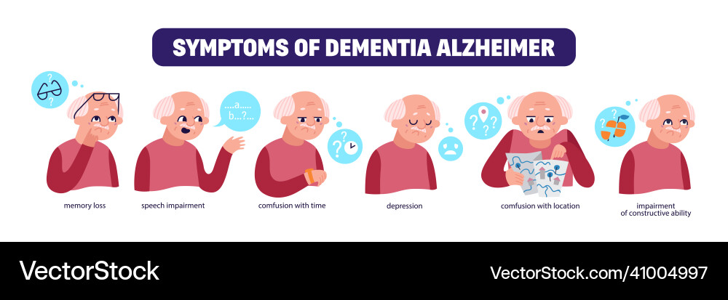
Background
Dementia
what?
Types
Fact
Novelty
Dementia causes progressive decline in memory and cognition.
Alzheimer’s (AD), Vascular Dementia (VaD), Lewy Body Dementia (DLB), and Frontotemporal Dementia (FTD).
These diseases share overlapping genetic and molecular mechanisms.
Identifying shared biomarkers can improve diagnosis and treatment.

Slide 4
Research Objective
Use Attention-based LSTM for robust gene classification and validation.
Identify common DEGs (Differentially Expressed Genes) among multiple dementia datasets.
Perform biological enrichment, PPI network, and drug-binding analysis.
Develop a hybrid feature selection framework (FS–RFE) combining Fisher Score (filter method) and Recursive Feature Elimination (RFE) (wrapper method).

Slide 5
Literature Review
Author (Year) | Methodology / Model Used | Dataset / Focus | Key Findings / Results | Accuracy / Performance
Shigemizu et al. (2019) | Penalized Regression, Random Forest, SVM, Gradient Boosting Decision Tree | Lewy Body Dementia (DLB) | Identified significant association between BCL2L1 and PIK3R2 with DLB; developed predictive model for dementia classification. | Accuracy 0.829 on independent test set
María et al. (2017) | Machine Learning (Random Forests) | Alzheimer’s Disease (AD) | Found genes highly correlated with AD; MYNN proposed as potential diagnostic biomarker. | High predictive efficacy (no % stated)
Fangchao et al. (2024) | miRNA & lncRNA Regulation via ML Models | Vascular Dementia (VaD) | Identified hub genes and regulatory RNA pathways; potential for clinical treatment targets. | AUC 0.81 – 0.92
Sunghong et al. (2024) | Graph-based Machine Learning Model (GPN) | Dementia Subtype Diagnosis | Protein interaction-based approach; improved subtype differentiation. | 10.4% higher performance than existing methods

Slide 6
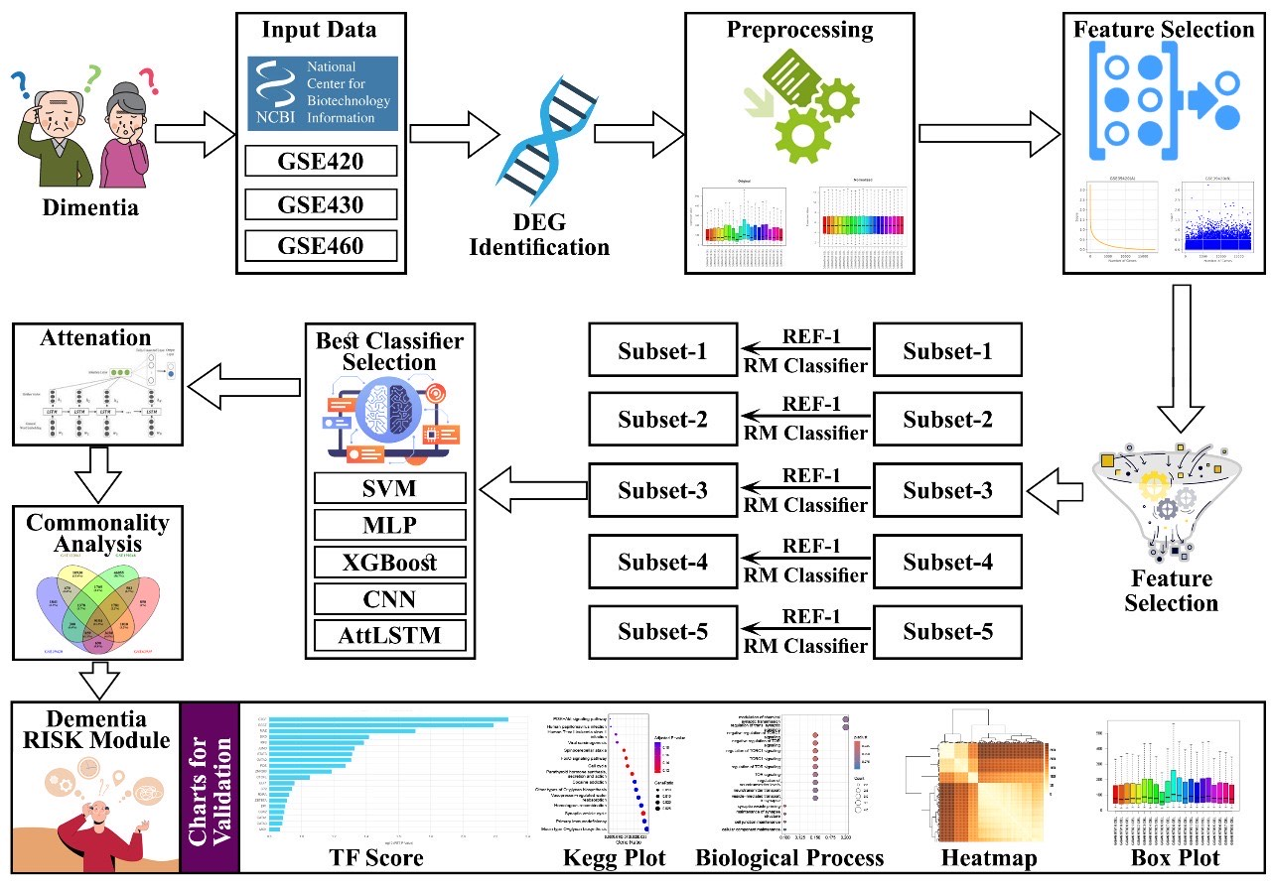
Methodology Overview

Slide 7

Datasets Used
GSE39420
GSE122063
GSE190348
GSE62935
Alzheimer’s disease Control - 7 Infected - 14
Vascular dementia Control - 11 Infected - 20
Lewy Body dementia Control - 16 Infected - 15
Frontotemporal dementia Control - 16 Infected - 15

Slide 8
Preprocessing and Quality Control
.Cel file
Imported raw CEL files from GEO datasets.
Background Correction
Applied statistical models to remove noise and adjust for non-specific hybridization signals.
Normalization
Used Robust Multi-Array Average (RMA) for normalization.
Series Matrics
Apply Geo2r and aggregate with gene symbol and PValue Form series matrics where gene as row .
Transpose
Transpose the series matrics as genes as columns.

Slide 9
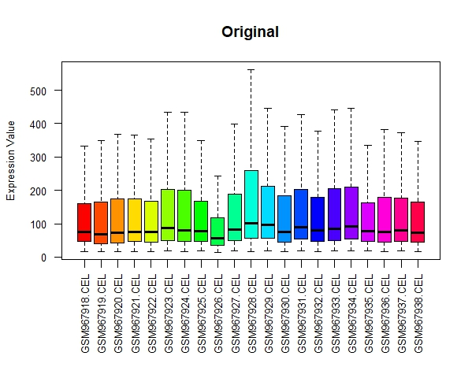
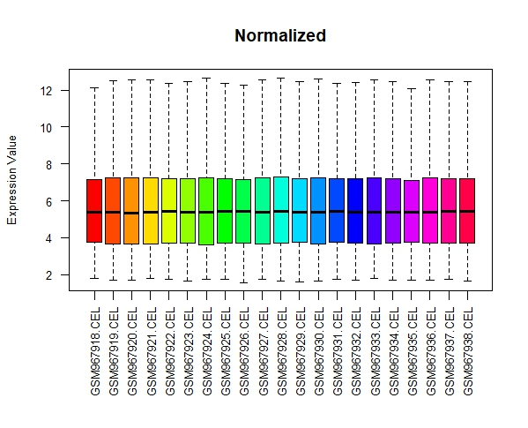
Preprocessing and Quality Control

Slide 10
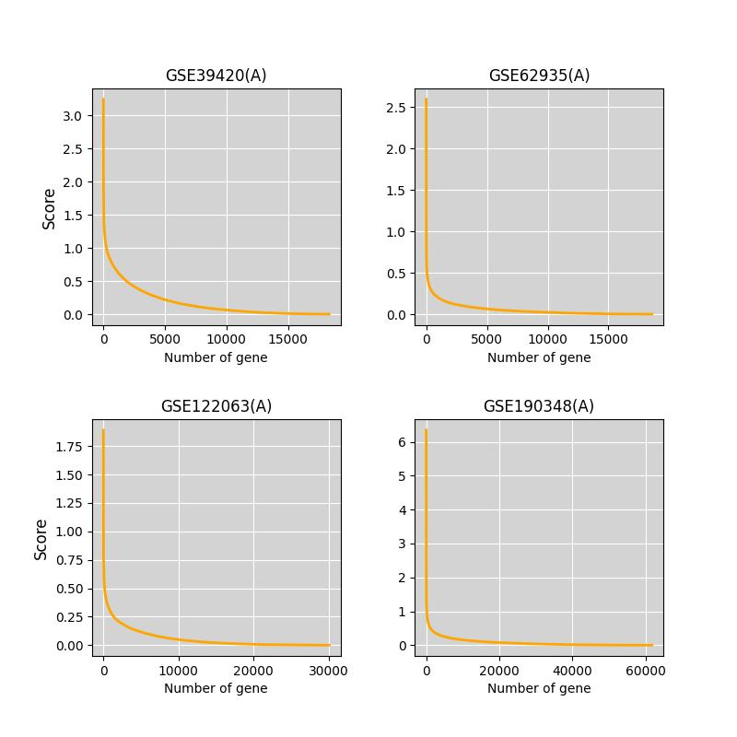
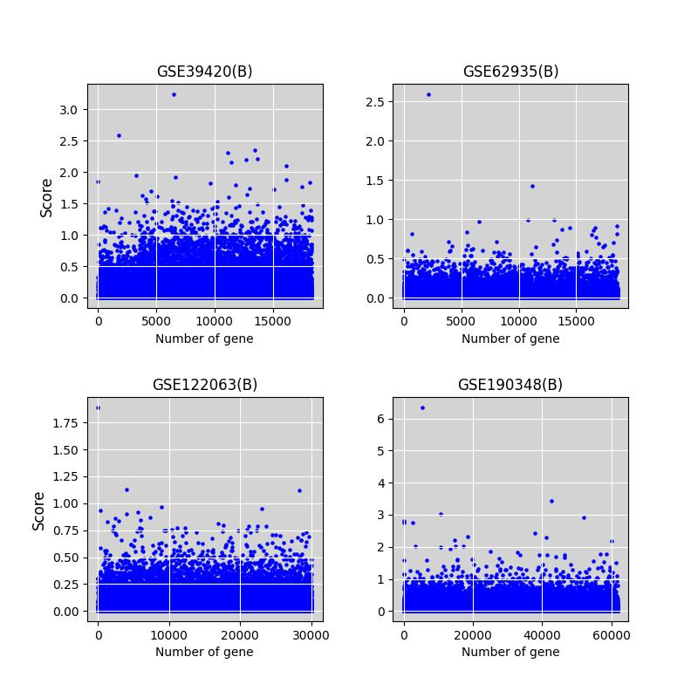
Feature Selection Framework
Apply Fisher Score to rank features(Genes).
Apply RFE to iteratively remove irrelevant genes.

Slide 11
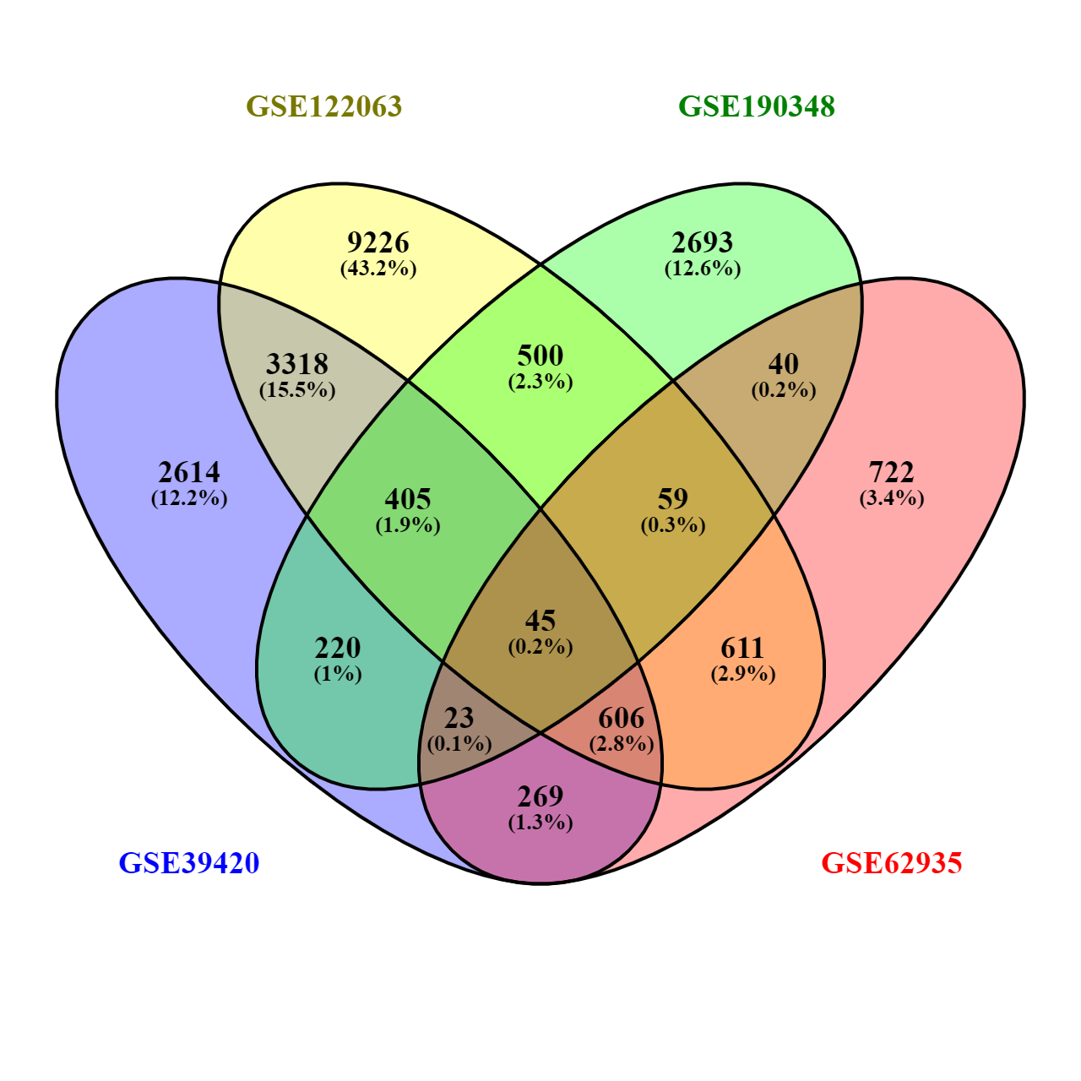
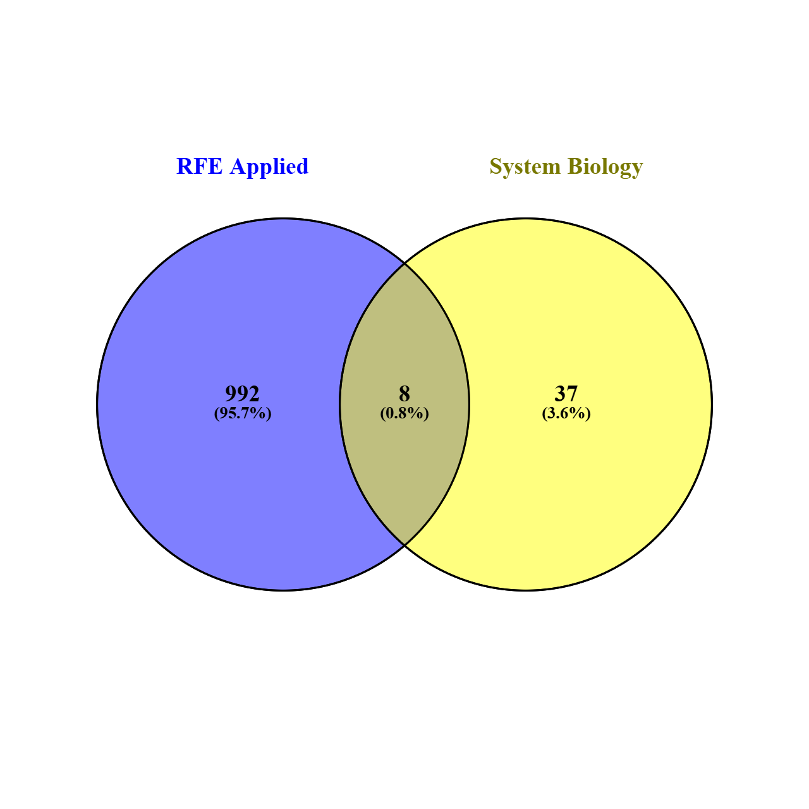
Feature Selection Framework
Select optimal subset of genes.
Common Gene Through System biology Approach
Common Gene between mACHINE learning System biology Approach

Slide 12
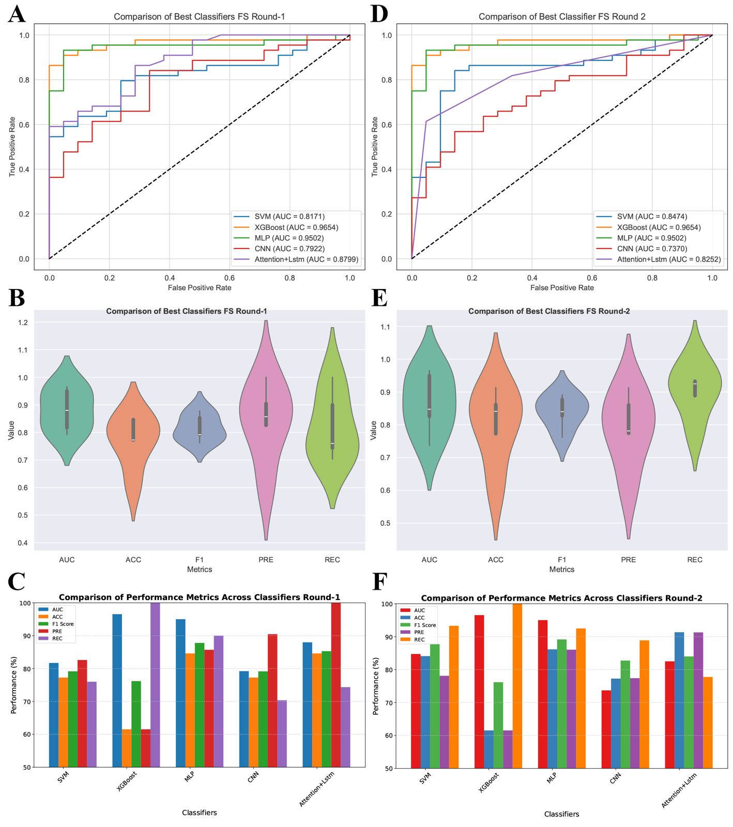
Best Classifier Selection

Slide 13
Functional Analysis
22 DEGs
45 common DEGs were identified, which were further refined to 22 across the four datasets.
Gene Ontology
KEGG pathway
Three types of Gene Ontology (GO) analyses were performed using Enrichr: biological process (molecular activities), cellular component (gene regulatory functions), and molecular function (molecular-level activities)
PPI, TF–miRNA networks.
Analyzing the gene regulatory interaction network.
Molecular Docking
evaluate the binding strength and specific interactions between target proteins and candidate ligands

Slide 14
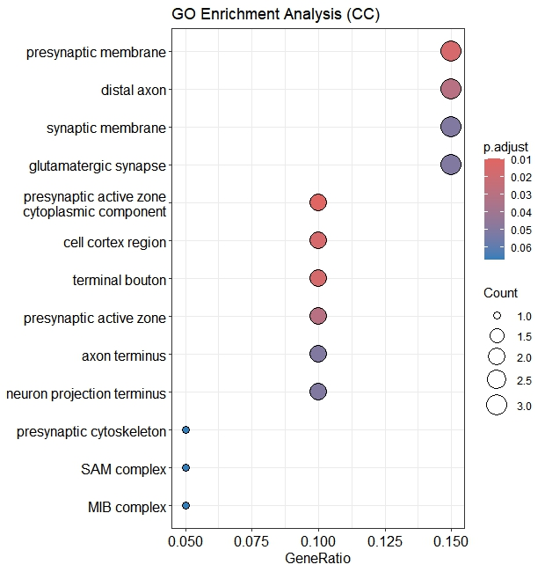
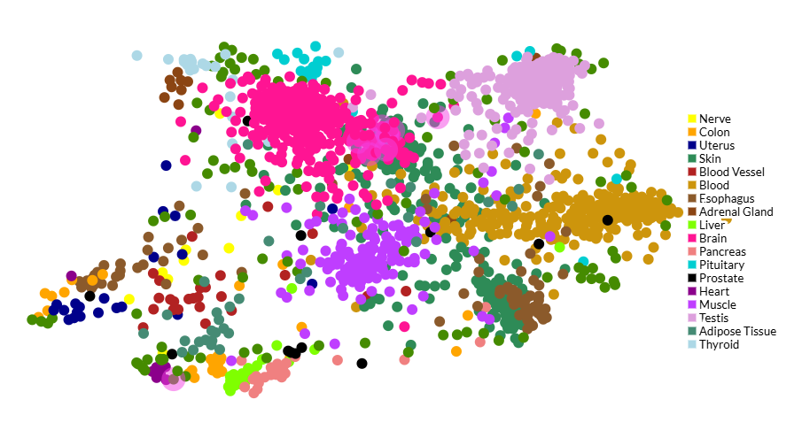
Functional Analysis Visualization
CheA3
GO Analysis

Slide 15
Proposed FS–RFE Framework
Fs-RFE
Fisher Score
RFE
Output
Evaluation
Removes noisy, irrelevant genes.
Selects best predictive genes.
Reduced gene subset ( 22 core genes).
Using AttLSTM classifier for dementia risk prediction.

Slide 16
Classifier Performance
Phase | Classifier | AUC | ACC | F1 score | PRE | REC
Without FS | SVM | 76.30% | 68.18% | 73.08% | 70.37% | 76.00%
 | XGBoost | 84.74% | 59.26% | 74.42% | 59.26% | 1.00%
 | MLP | 77.38% | 73.85% | 81.32% | 72.55% | 92.50%
 | CNN | 57.79% | 68.18% | 78.78% | 66.66% | 96.29%
 | Attention+Lstm | 71.54% | 77.27% | 83.87% | 74.28% | 96.29%
FS Round 1 FS | SVM | 81.71 % | 77.27% | 79.17% | 82.61% | 76.00%
 | XGBoost | 96.54 % | 61.54% | 76.19% | 61.54% | 1.00%
 | MLP | 95.02 % | 84.62% | 87.80% | 85.71% | 90.00%
 | CNN | 79.22 % | 77.27% | 79.16% | 90.47% | 70.37%
 | AttLSTM | 87.99% | 84.61% | 85.29% | 1.00% | 74.35%
FS Round 2 RFE | SVM | 84.74% | 84.09% | 87.72% | 78.12% | 93.29%
 | XGBoost | 96.54 % | 61.54% | 76.19% | 61.54% | 1.00%
 | MLP | 95.02 % | 86.15% | 8916% | 86.05% | 92.50%
 | CNN | 73.70% | 77.27% | 82.75% | 77.41% | 88.88%
 | AttLSTM | 82.52% | 91.35% | 84.00% | 91.30% | 77.77%

Slide 17
Functional Enrichment Results
GO and KEGG revealed shared pathways in: Neuroinflammation, synaptic signaling, axon guidance
Identified 22 key genes linked to multi-dementia processes.
Hub genes: ATM, CD84, NLK, YWHAG.

Slide 18
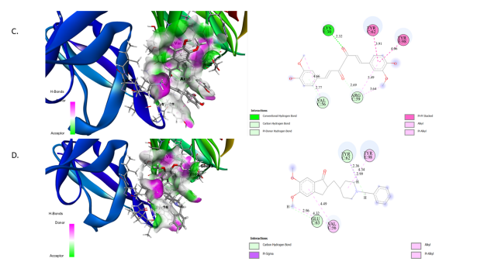
Molecular Docking & Drug Prediction
Proteins used: ATM, CD84, YWHAG, NLK.
Phytochemical: Berberine showed highest binding affinity.
Outperformed FDA-approved Donepezil in docking score.
Suggests Berberine as a promising therapeutic candidate.

Slide 19
Key Findings
Integrated FS–RFE efficiently reduced dimensionality.
AttLSTM achieved 91.35% accuracy for dementia classification.
Identified shared biomarkers across four dementia types.
Revealed potential drug targets and phytochemical therapies.

Slide 20
Conclusion
FS–RFE is a powerful hybrid method for high-dimensional biomedical data.
Revealed molecular overlaps among dementia diseases.
Suggests novel biomarkers and treatment insights.
Future work: expand dataset and apply 3D molecular simulations.

Slide 21
References
1.Shigemizu, D., Akiyama, S., Asanomi, Y., Boroevich, K. A., Sharma, A., Tsunoda, T., ... & Niida, S. (2019). A comparison of machine learning classifiers for dementia with Lewy bodies using miRNA expression data. BMC medical genomics, 12, 1-10.
2.Zheng, W., Lin, D., Shi, S., Ren, J., Wu, J., Wang, M., & Wan, S. (2024). Identifying shared diagnostic genes and mechanisms in vascular dementia and Alzheimer's disease via bioinformatics and machine learning. Journal of Alzheimer's Disease Reports, 8(1), 1558-1572.
3.Jiang, L., Wang, Q., Jiang, Y., Peng, D., Zong, K., Li, S., ... & Huang, Z. (2024). Identification of diagnostic gene signatures and molecular mechanisms for non-alcoholic fatty liver disease and Alzheimer’s disease through machine learning algorithms. Clinica Chimica Acta, 557, 117892.
4.Holman, A. G., & Gabuzda, D. (2012). A machine learning approach for identifying amino acid signatures in the HIV env gene predictive of dementia. PLoS One, 7(11), e49538.
5.Martínez-Ballesteros, M., García-Heredia, J. M., Nepomuceno-Chamorro, I. A., & Riquelme-Santos, J. C. (2017). Machine learning techniques to discover genes with potential prognosis role in Alzheimer’s disease using different biological sources. Information Fusion, 36, 114-129.
6.Ren, J., Zhang, B., Wei, D., & Zhang, Z. (2020). Identification of methylated gene biomarkers in patients with Alzheimer’s disease based on machine learning. BioMed Research International, 2020(1), 8348147.

Slide 22
Thank You

Slide 23
Q & A

