Slide 1
Introduction to Neural Networks
Md. Aukerul Moin Shuvo
CSE, RUET
8 November 2022

Slide 2
Outline
    Human Brain
    Biological Neuron
    Learning in Biological Systems
    Basic Neuron Model
    Neural Network Architecture
    Applications, Advantages and Disadvantages of Neural Networks

Slide 3
Objectives
To know about the human brain.
To understand important concepts and theories of neural networks (NNs).
To visualize how NNs can be designed and trained.
To have an appreciation of some of the limitations and possibilities of NNs.

Slide 4
Neural Computing is a problem solving methodology which attempts to mimic how human brain functions.
Figure: Learning a new language by a person establishes a neural circle in the brain.

Slide 5
Human Brain
The human brain is composed of approximately 100 billion neurons.
Each neuron may be connected to up to 10,000 other neurons.
Figure: The Human Brain

Slide 6
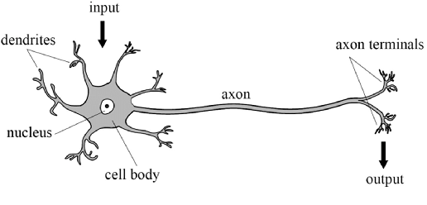
Biological Neuron
Figure: The Basic Features of a Biological Neuron

Slide 7
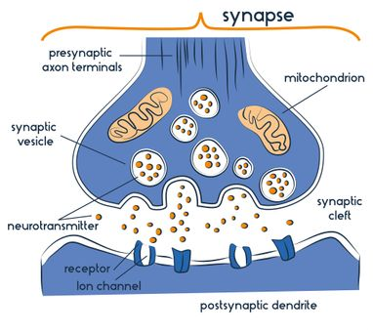
    Learning in Biological Systems
Neurotransmitters released from the synaptic vesicles diffuse across the synaptic cleft and trigger the receptors on the dendrite.
Figure: Schematic Representation of Synapse

Slide 8
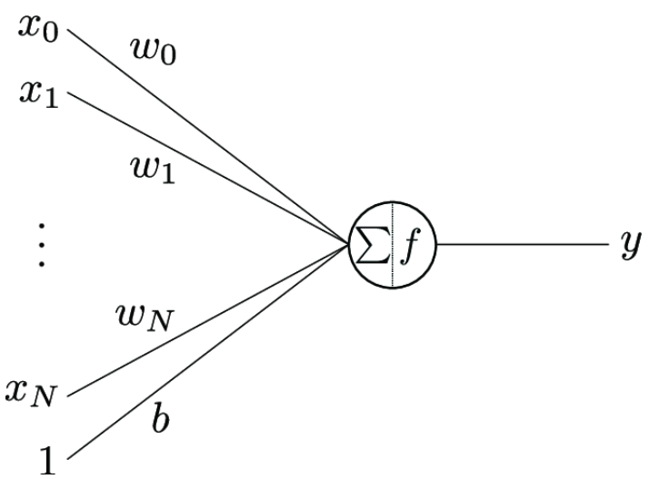
Basic Neuron Model
The model is composed of—
a set of inputs x₀, ..., x_{N},
input weights w₀, ..., w_{N},
bias b,
activation function f and
output y.
Here the bias b is considered the weight of a fixed unit input.
Figure: Illustration of a Basic Neuron Model

Slide 9
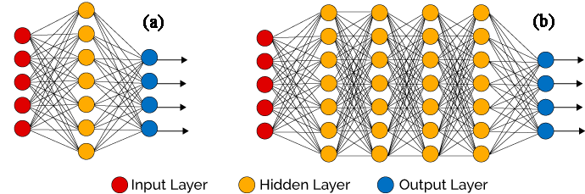
Neural Network Architecture
Figure: (a) Simple neural network architecture; (b) Simple architecture of deep neural network

Slide 10
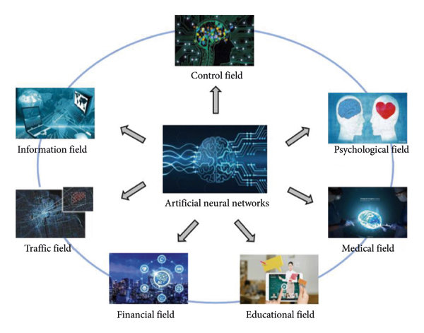
Applications of Neural Networks (NNs)
Text classification and categorization,
Paraphrase detection,
Image processing,
Medical diagnosis,
Forecast etc.
Figure: Applications of Neural Networks or Artificial Neural Networks (ANNs)

Slide 11
Advantages and Disadvantages of NNs
It has a parallel processing ability and numerical strength that performs more than one task at the same time.
Failure of one element of the network does not affect the working of the whole system. This characteristic makes it fault-tolerant.
A neural network learns from the experience and does not need reprogramming.
Its black-box nature is the most prominent disadvantage. It does not give the proper explanation of determining the output and reduces trust in the network.
The duration of the development of the network is unknown.
There is no assurance of proper network structure. There is no proper rule to determine the structure.

Slide 12
Related Terms
Input Layer is composed of artificial input neurons and brings the initial data into the system for further processing by subsequent layers of artificial neurons.
Output Layer is the final layer in the neural network where desired predictions are obtained.
Hidden Layer is a layer in between input layers and output layers, where artificial neurons take in a set of weighted inputs and produce an output through an activation function. layers.
Weights are the parameters within a neural network that transforms input data within the network's hidden.
Bias can be defined as the constant which is added to the product of features and weights.
Activation Functions are put at the end of or in between neural networks to help deciding if the neuron would fire or not.

Slide 13
References
“Neural computing - an introduction” by R Beale, T Jackson
“Introduction to Neural Networks and Their Applications” by Arron Gilbert [https://slideplayer.com/slide/8075724/]
Artificial Neural Network – Applications, Algorithms and Examples [https://techvidvan.com/tutorials/artificial-neural-network/]

Slide 14
Thank You!
Any Question?

