Slide 1

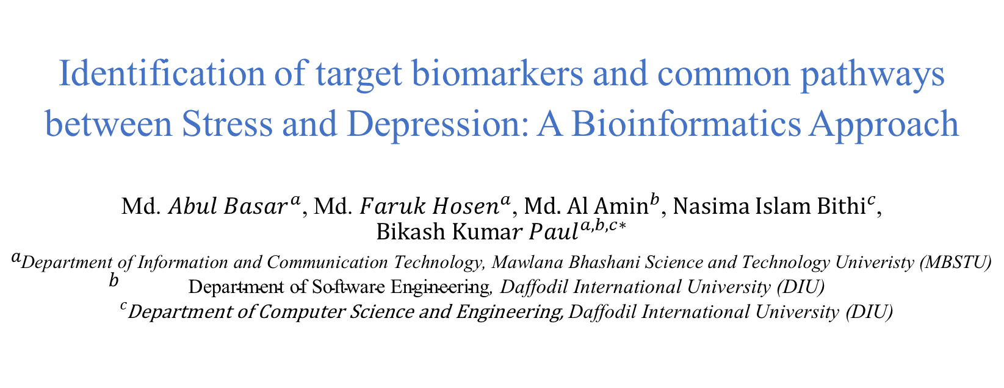
8th IEEE international Women in Engineering (WIE) Conference on Electrical and Computer Engineering
Identification of target biomarkers and common pathways between Stress and Depression: A Bioinformatics Approach
${\text{Md}\text{. }Abul Basar}^{a}$,${ \text{Md}\text{. }Faruk Hosen}^{a}$,${ \text{Md}\text{. }\text{Al} \text{Amin}}^{b}$,${ \text{Nasima} \text{Islam} \text{Bithi}}^{c}$, ${\text{Bikash} \text{Kuma}r Paul}^{a,b,c∗}$
$$a_{\text{Department} \text{of} \text{Information} \text{and} \text{Communication} \text{Technology}\text{, }\text{Mawlana} \text{Bhashani} \text{Science} \text{and} \text{Technology} \text{Univeristy}\text{ (}\text{MBSTU}\text{)}} \\ b_{\begin{aligned}\text{Department} \text{of} \text{Software} \text{Engineering}\text{, }\text{Daffodil} \text{International} \text{University}\text{ (}\text{DIU}\text{)} \\ c_{\text{Department} \text{of} \text{Computer} \text{Science} \text{and} \text{Engineering}\text{, }\text{Daffodil} \text{International} \text{University}\text{ (}\text{DIU}\text{)}}\end{aligned}}$$
Paper ID- 79
IEEE WIECON-ECE 2022
1

Slide 2
8th IEEE international Women in Engineering (WIE) Conference on Electrical and Computer Engineering
OUTLINE
Problem statement
Motivation
Workflow
Methodology
Result
Discussion
Conclusion
References
Paper ID-79
2

Slide 3
8th IEEE international Women in Engineering (WIE) Conference on Electrical and Computer Engineering
Problem Statement
Stress can be defined as any type of change that causes physical, emotional or psychological strain. [1].
The American Institute of Stress reports that 33% of people experience extreme stress and 73% of people experience stress that affects their mental health. [2].
Stroke can increase anxiety disorders and major depressive disorders [3].
The damage caused by Stress to a depressive patient is not examined significantly in any kind of research so far.
According to the references mentioned in this paper, show a valid interconnection between stress and depression.
Paper ID-79
3
3

Slide 4
8th IEEE international Women in Engineering (WIE) Conference on Electrical and Computer Engineering
Motivation
According to the World Health Organization, depression disorder affects around 350 million individuals of every age worldwide [4].
The American Institute of Stress reports that 77% of people experience stress that affects their physical health.[3].
Patients with stress are responsible for the increased risk of developing depression.
Experiments have been accomplished regarding the genome sequence of stress sample that has found similarities with the sample of depression.
Paper ID-79
4

Slide 5
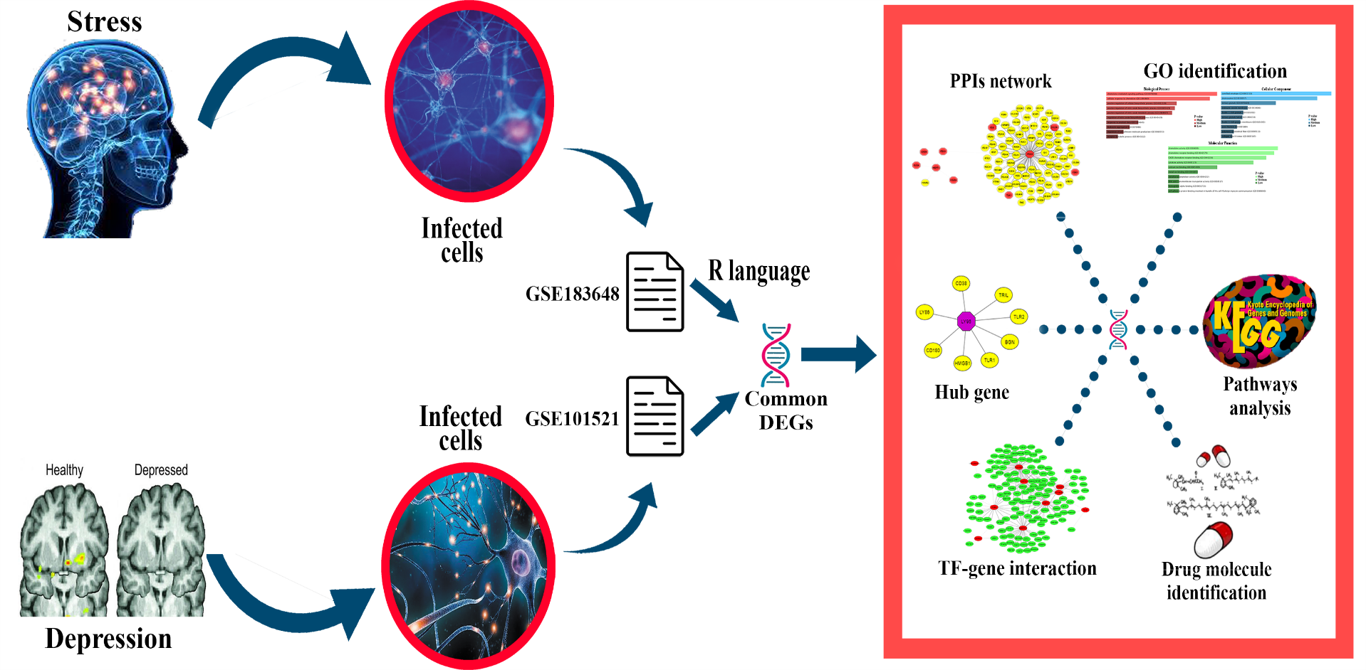
8th IEEE international Women in Engineering (WIE) Conference on Electrical and Computer Engineering
Workflow
Fig: Workflow of the current study
Paper ID-79
5

Slide 6
8th IEEE international Women in Engineering (WIE) Conference on Electrical and Computer Engineering
Workflow Cont..
The complexities of stress and depression is immense and GSE183648 and GSE101521 datasets are used to have a comparative genomic analysis on both stress and depression.
Differentially expressed genes (DEGs) were identified from both GSE183648 and GSE101521 datasets to identify the common genes between stress and depression sample.
According to the common DEGs a Protein-protein interactions (PPIs) network is designed.
Applying topological algorithms, hub nodes were identified.
Finally the drug compounds were suggested for the corresponding common DEGs.
Paper ID-79
6

Slide 7
8th IEEE international Women in Engineering (WIE) Conference on Electrical and Computer Engineering
Methodologies
Information of datasets
GSE183648 and GSE101521 datasets are used to, which have been obtained from Gene Expression Omnibus (GEO) database.
GEO database contains microarray and high throughput sequencing datasets, which is under the platform of National Center for Biotechnology Information (NCBI).
GSE183648 that shows the complex infected samples of stress sample and GSE101521 represents depression patient sample.
Paper ID-79
7

Slide 8
8th IEEE international Women in Engineering (WIE) Conference on Electrical and Computer Engineering
Methodologies Cont..
Identification of DEGs and common gene
GEO2R tool that uses limma package of R programming language is used to identify the DEGs for GSE183648 and GSE101521 datasets.
Adjusted p-value < 0.05 and log2 fold change (absolute) > 1.0 were used as a preprocessing steps for both the datasets as a cutoff criteria.
Benjamini-Hochberg was accomplished as a false discovery rate (FDR) handling methodology.
After the identification of DEGs, the common DEGs between GSE183648 and GSE101521 datasets were achieved using R programming language.
Paper ID-79
8

Slide 9
8th IEEE international Women in Engineering (WIE) Conference on Electrical and Computer Engineering
Methodologies Cont..
Design of Protein-protein interactions (PPIs) network and hub
gene identification
According to the common genes, Protein-protein interactions network is designed using Search Tool for the Retrieval of Interacting Genes (STRING).
A medium confidence score of 0.400 were selected for obtaining the total PPIs network.
The visualization of the PPIs network is customized using Cytoscape software.
Topological degree algorithm was applied on the PPIs network to identify the hub genes and Cytohubba plugin was used for the purpose of analysis.
Paper ID-79
9

Slide 10
8th IEEE international Women in Engineering (WIE) Conference on Electrical and Computer Engineering
Methodologies Cont..
Drug Compounds Prediction
Associative drug compounds according to the stress and depression sample were identified using the Drug Signature database (DSigDB) database.
The drug compounds were predicted under the platform of web tool Enrichr.
Paper ID-79
10

Slide 11
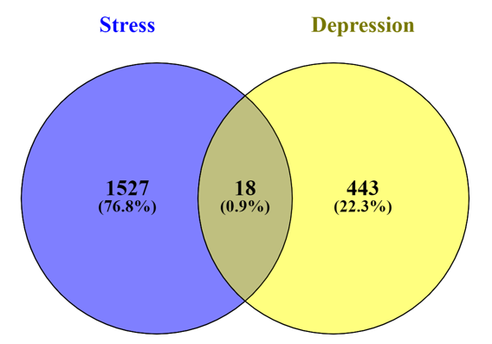
8th IEEE international Women in Engineering (WIE) Conference on Electrical and Computer Engineering
Results
Common Gene Identification
Stress contains total of 1545 DEGs and the bipolar disorder sample contains total of 461 DEGs. Among them 18 Genes were identified as common DEGs.
Paper ID-79
11

Slide 12
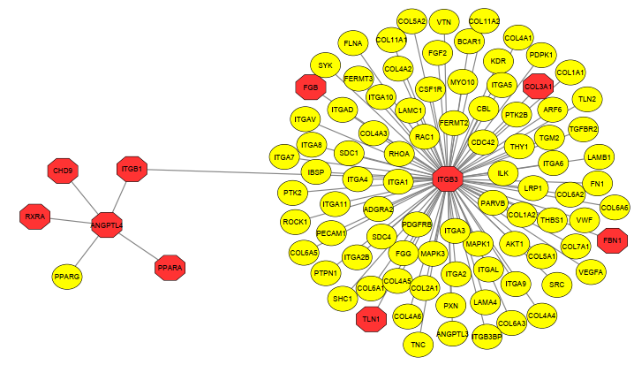
8th IEEE international Women in Engineering (WIE) Conference on Electrical and Computer Engineering
Results Cont..
Protein-protein interactions (PPIs) network
PPIs network for 18 common DEGs. The genes which are in purple color are the hub genes. The network contains 95 nodes and 94 edges.
Paper ID-79
12

Slide 13
8th IEEE international Women in Engineering (WIE) Conference on Electrical and Computer Engineering
Results Cont..
Hub gene analysis
Hub genes indicate the nodes in a network that have the maximum number of connections.
Top 10 hub genes form the PPIs network.
ITGB3, ANGPTL4, ITGB1, PPARA, RXRA, CHD9, COL3A1, FGB, TLN1, and FBN1 are the top common DEGs.
Paper ID-79
13

Slide 14
8th IEEE international Women in Engineering (WIE) Conference on Electrical and Computer Engineering
Results Cont..
Drug Compounds Prediction
Top drug compounds according to common DEGs
Name of drugs | P-value | Adjusted p-value | Genes
Clofop [ISO] CTD 00000269 | 0.000584744 | 0.09262142 | SLCO1B1; ANGPTL4
3,7,12- Trihydroxycholan-24-oic acid CTD 00007320 | 0.010749535 | 0.170450445 | SLCO1B1
Sulfobromophthalein CTD 00006810 | 0.010749535 | 0.170450445 | SLCO1B1
glycerol CTD 00006038 | 0.011640389 | 0.170450445 | AQP10
urea CTD 00006965 | 0.011640389 | 0.170450445 | AQP10
Paper ID-79
14

Slide 15
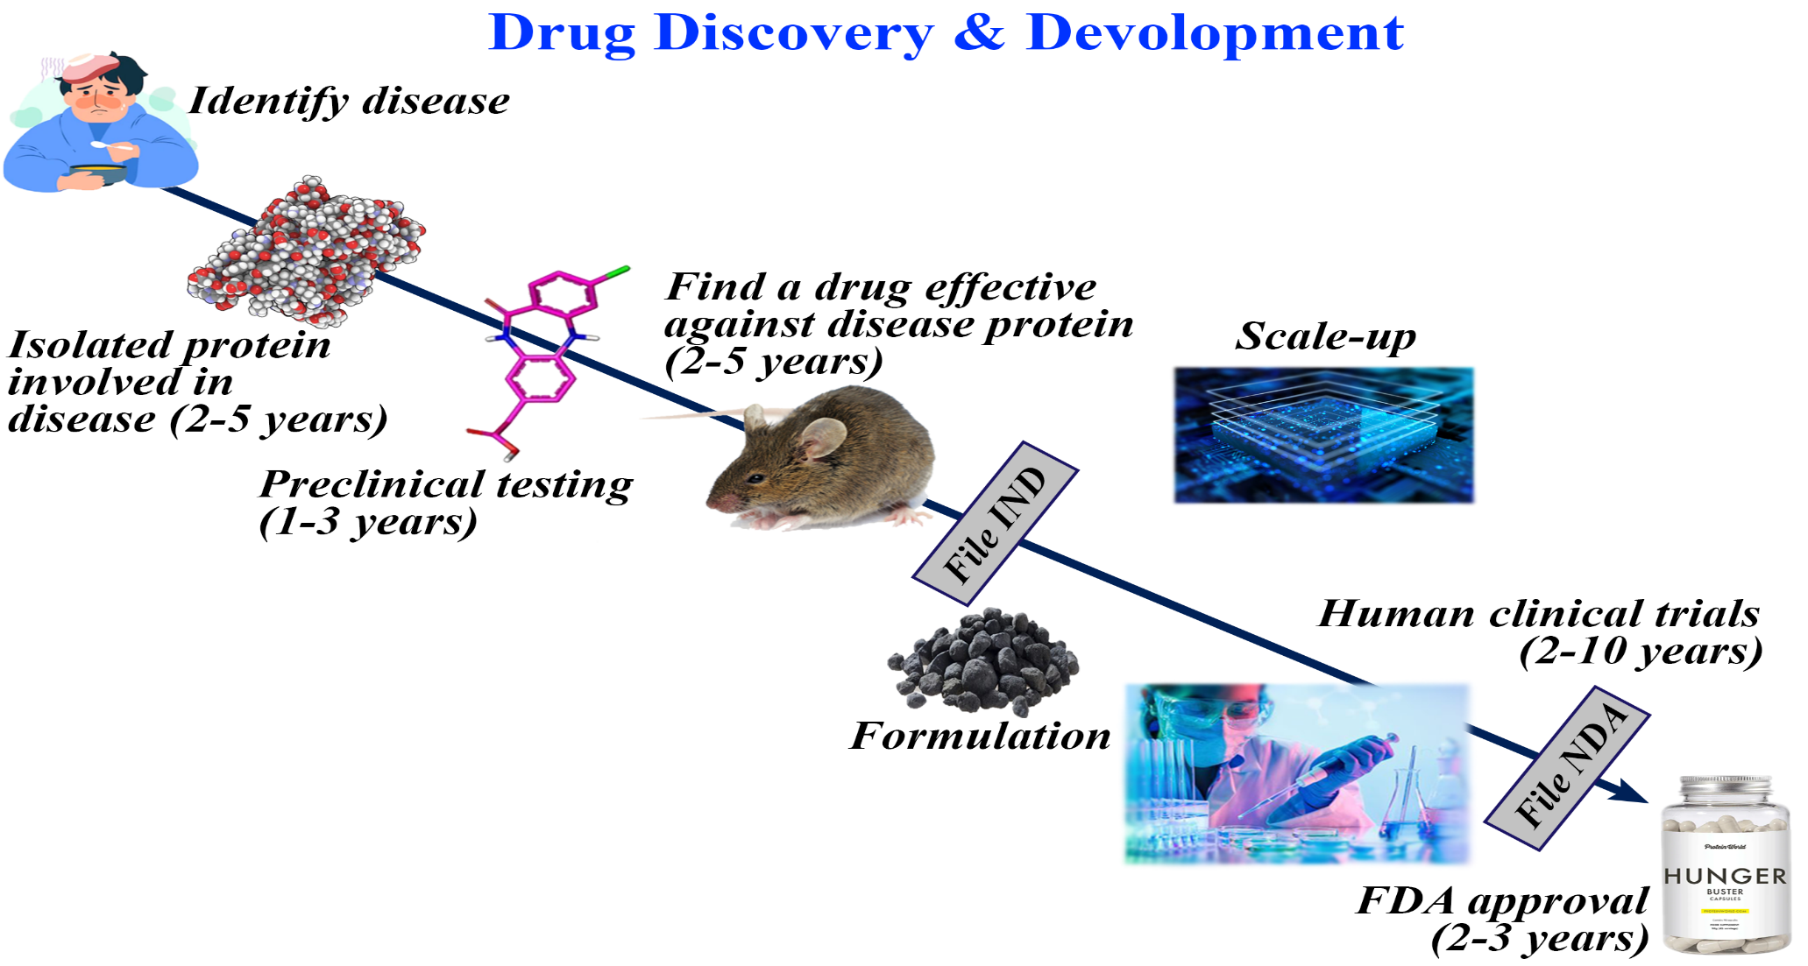
8th IEEE international Women in Engineering (WIE) Conference on Electrical and Computer Engineering
Drug Discovery & Development
Paper ID-79
15

Slide 16
8th IEEE international Women in Engineering (WIE) Conference on Electrical and Computer Engineering
Conclusions
The transcriptomic result obtained from this study is immense compare to other studies that have been achieved so far regarding stress and depression samples. Methodologies of data mining such as filtering the dataset is achieved. In this research by identifying the Differentially expressed genes (DEGs) and common DEGs. Based on the DEGs, PPIs network is designed which eventually leads to hub gene identification. Then candidate drugs are predicted.
Paper ID-79
16

Slide 17
8th IEEE international Women in Engineering (WIE) Conference on Electrical and Computer Engineering
References
[1]. Selye, H., 1976. Stress without distress. In Psychopathology of human adaptation (pp. 137-146). Springer, Boston, MA.
[2]. Islam, M.R., Ahmed, M.L., Paul, B.K., Bhuiyan, T. and Ahmed, K., 2019. Potential therapeutic drugs for ischemic stroke and stress disorder: A bioinformatics analysis. Informatics in Medicine Unlocked, 17, p.100259.
[3]. Ferrari, A.J., Charlson, F.J., Norman, R.E., Flaxman, A.D., Patten, S.B., Vos, T. and Whiteford, H.A., 2013. The epidemiological modelling of major depressive disorder: application for the Global Burden of Disease Study 2010. PloS one, 8(7), p.e69637.
[4]. Busch, Y. and Menke, A., 2019. Blood-based biomarkers predicting response to antidepressants. Journal of Neural Transmission, 126(1), pp.47-63.
Paper ID-79
17

Slide 18
8th IEEE international Women in Engineering (WIE) Conference on Electrical and Computer Engineering
Thank you all for your kind attention.
Welcome to Q & A session!!!
Paper ID-79
18

