Slide 1
BuildTrust AI
Construction costs
and payment review
Clear evidence for construction finance.
2026 Shenzhen FinTechathon · International Track · Topic E
BuildTrust AI · Fictional sandbox demonstration
01
Notes:
0:00–0:40. BuildTrust AI helps construction teams check costs and review payments. This is a working local app, not a set of sample screen designs. Its records and calculations are real application operations, but the projects and transfers are fictional. No bank is connected. A visitor can start the separate public demo and use the four passwords in the README. Explain that people approve financial actions. Give the audience a moment to read the product name. Sources: README.md; features.md; prompt/prompt.md.

Slide 2
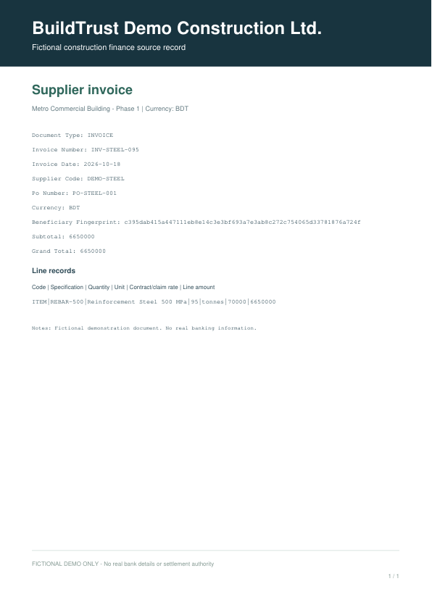
Four records before payment
The records must agree
BOQ: the approved quantities.
PO and receipt: order and delivery.
Invoice: a claim to check.
BuildTrust AI · Fictional sandbox demonstration
02
Notes:
0:40–1:30. A bill of quantities lists approved quantities. A purchase order records what was ordered and at what rate. A delivery receipt records accepted supply. An invoice states what the supplier wants to be paid. These records answer different questions. The invoice alone cannot prove that goods arrived or that the amount is authorized. Point to the pictured fictional invoice, then explain that the app keeps the original file and its source references. Uploaded words such as approved do not grant authority. Sources: prompt/prompt.md; demo/fixtures/scenario-a-inflated.pdf; docs/financial-rules.md.

Slide 3
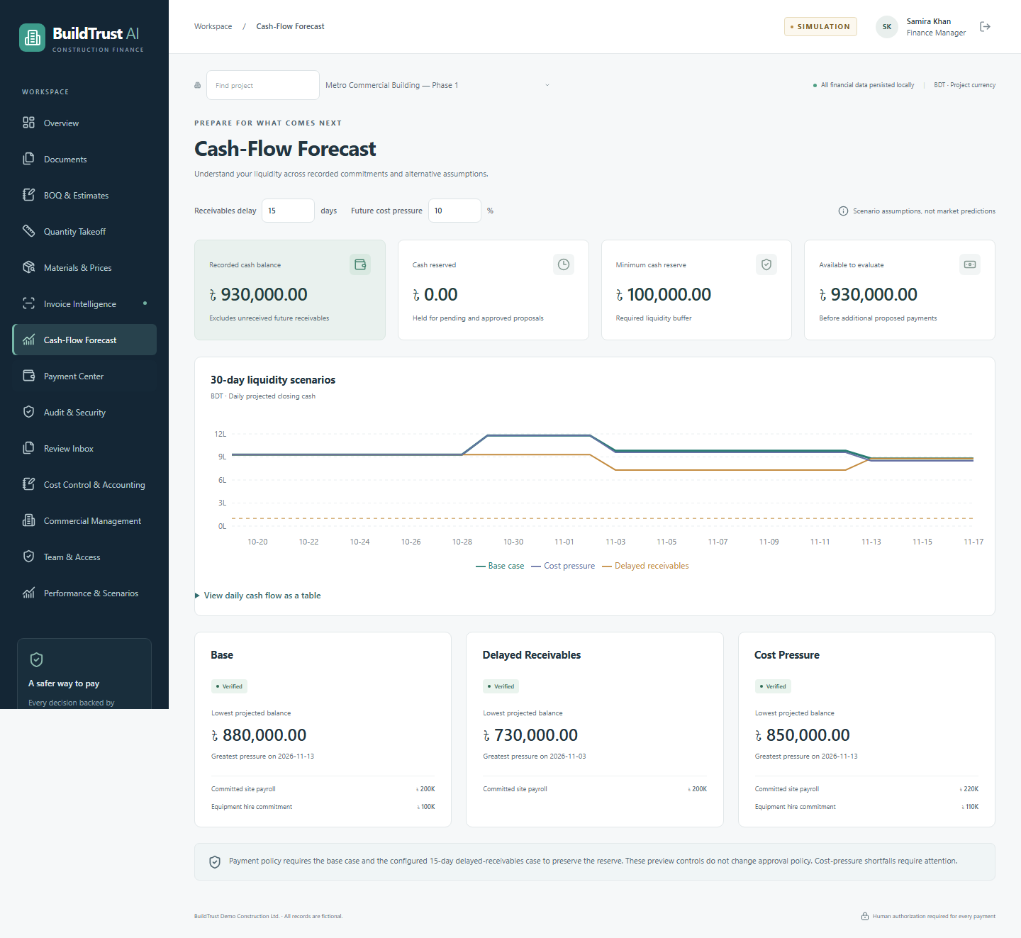
Cash and the minimum reserve
A correct invoice may
need to wait for cash.
BDT 100,000
Minimum cash kept in the demo
Base and delayed receipts must pass.
Higher future costs show a warning.
BuildTrust AI · Fictional sandbox demonstration
03
Notes:
1:30–2:20. A valid invoice can still be unsafe to pay today. The app checks recorded cash and daily forecasts. Both the base forecast and the delayed-customer-receipts forecast must keep the required reserve. In the stress example, cash is BDT 150,000 and the invoice is 70,000. Paying would leave 80,000, below the 100,000 reserve, so payment is blocked. Future expected receipts are not cash already received. Explain the three visible scenarios and the matching daily table. The pictured chart comes from a separate actual test run. Sources: scenario-e.json; screenshots/05-cashflow.png; docs/financial-rules.md.

Slide 4
Payment review
Approved quantities + Order + Delivery + Invoice
Read files → Compare records → Check risks and cash
Exact proposal → Approval by a different person
Recheck → Simulated payment → Receipt, ledger and audit
BuildTrust AI · Fictional sandbox demonstration
04
Notes:
2:20–3:15. Follow the saved steps from documents to payment. The app reads actual files, compares approved records and checks risks and cash using fixed rules. If everything passes, it prepares an exact proposal and reserves the required cash and delivery quantity. It then waits. A different authorized person must review and approve. Execution needs another explicit confirmation and fresh checks. A failed transaction rolls back its financial changes. The receipt, ledger and audit provide evidence of the outcome. Pause at the approval stage to emphasize that automation cannot cross it. Sources: backend/app/workflow.py; docs/technical-documentation.md; scenarios A and B.

Slide 5
How the app works
React / TypeScript
Financial workspace
FastAPI
Role and project checks
SQLite + audit
Exact money
→
→
↓
↑
Saved workflow
Steps and evidence
Rule-based checks
Claims, risk and cash
Human approval
Payment record
→
→
AI can explain the evidence. People approve financial actions.
BuildTrust AI · Fictional sandbox demonstration
05
Notes:
3:15–4:10. The browser has fourteen connected areas. It sends requests to FastAPI, which checks login, current role and project access. Saved workflows call document, quantity, pricing and finance services. The server uses Decimal calculations and stores money as integer minor units. SQLite keeps the records and private files keep the source evidence. Payment, cash, ledger and success audit are saved in one transaction. Optional AI only explains evidence and falls back to built-in text if unavailable. It cannot approve or execute. Point through the diagram and answer where the human decision sits. Sources: docs/architecture.md; docs/architecture.mmd; backend source.

Slide 6
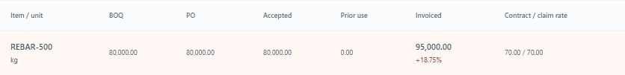
An inflated steel invoice
Record | Tonnes
Approved BOQ | 80
Purchase order | 80
Accepted delivery | 80
Supplier invoice | 95
BDT 1,050,000
Extra claim: 18.75% above supported quantity. Payment blocked.
BuildTrust AI · Fictional sandbox demonstration
06
Notes:
4:10–5:30. Walk through the table slowly. Approved quantities, the order and accepted delivery each support 80 tonnes. The invoice claims 95 at BDT 70,000 per tonne. Supported value is 5,600,000 and the claim is 6,650,000. Subtracting gives 1,050,000. The extra 15 tonnes divided by 80 gives 18.75 percent. The app blocks the unsupported claim and shows the source comparison. Point to the actual UI screenshot and explain its kilogram display conversion. No delivery quantity is consumed by a blocked invoice. The screenshot and HTTP evidence are separate runs with the same verified arithmetic. Sources: scenario-a.json; screenshots/08-four-way-focus.png; docs/financial-rules.md.

Slide 7
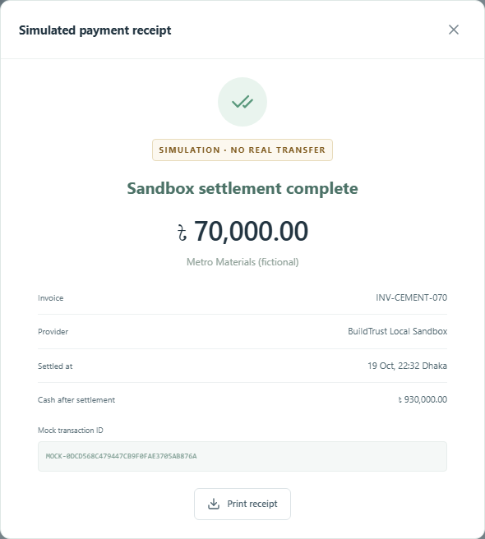
One approved payment
BDT 70,000
One approved simulated payment
1,000,000 → 930,000
Recorded cash in BDT
Repeat request: same receipt
Cash changes only once
BuildTrust AI · Fictional sandbox demonstration
07
Notes:
5:30–6:40. The separate cement invoice passes the quantity, price, supplier and cash checks. An Operator prepares it and a different Finance Manager approves BDT 70,000. A person confirms execution. Cash changes from 1,000,000 to 930,000 once. The mock receipt identifies the simulation. Explain the retry rule: the same request key returns the same result instead of another cash deduction. Amount and beneficiary come from the approval, not a new browser value. All financial updates either save together or roll back together. The receipt screenshot and HTTP scenarios have different run IDs. Sources: scenario-b.json; scenario-h.json; screenshots/09-receipt-focus.png.

Slide 8
Checks and limits
Independent approval
Exact saved evidence
One payment transaction
Local audit verification
Executed validation | Passed
Backend tests | 203
Frontend tests | 8
Browser workflows | 16
HTTP scenarios A–H | 8
A full database owner can rewrite the local audit chain.
BuildTrust AI · Fictional sandbox demonstration
08
Notes:
6:40–7:50. The table shows actual local results: 203 backend tests, 8 frontend tests, 16 browser workflows and eight original HTTP scenarios. Separate public-demo checks verify four documented logins and preserve the private profile. Tests cover denied roles, changed approvals, expiry, duplicate quantities, competing execution, rollback and retries. Fresh installation checks use a source copy. A passing suite is evidence for tested behavior, not complete security assurance. The audit chain can find inconsistent retained events, but a full database owner can rewrite it. Independent security and assistive-technology reviews remain separate. Sources: verification-summary.json; test logs; public-demo-install.json; docs/security-self-assessment.md.

Slide 9
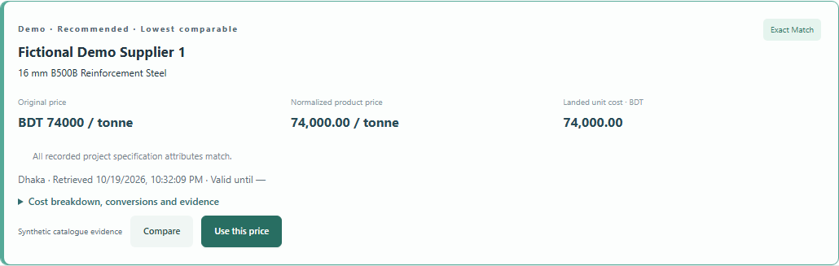
Price and estimate changes
BDT 80,000
Extra cost for the fictional 20 tonnes
600,000 to 520,000
Forecast cash in BDT. Recorded cash stays at 2,000,000.
More tools: quantities, contracts, installments and reviewed corrections.
BuildTrust AI · Fictional sandbox demonstration
09
Notes:
7:50–8:50. In the fictional upgrade project, 20 tonnes at 70,000 cost 1,400,000. Selecting an eligible 74,000 rate changes cost to 1,480,000, an increase of 80,000. The scheduled cash forecast drops from 600,000 to 520,000, but recorded cash stays 2,000,000. The wrong grade cannot be selected. A different Manager checks the estimate and a separate Admin approves. Other areas cover quantities, accounting, contracts, installments and separate correction reviews. Paid search, real documents and professional acceptance need their own evidence. The public demo and complete source are available through the README and authorized GitHub repository. Sources: docs/completion-verification.md; upgrade screenshots; verification-summary.json; README.md.

