Slide 1
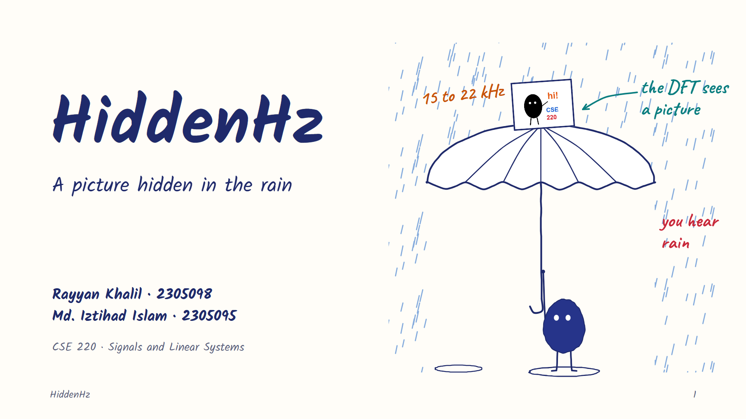
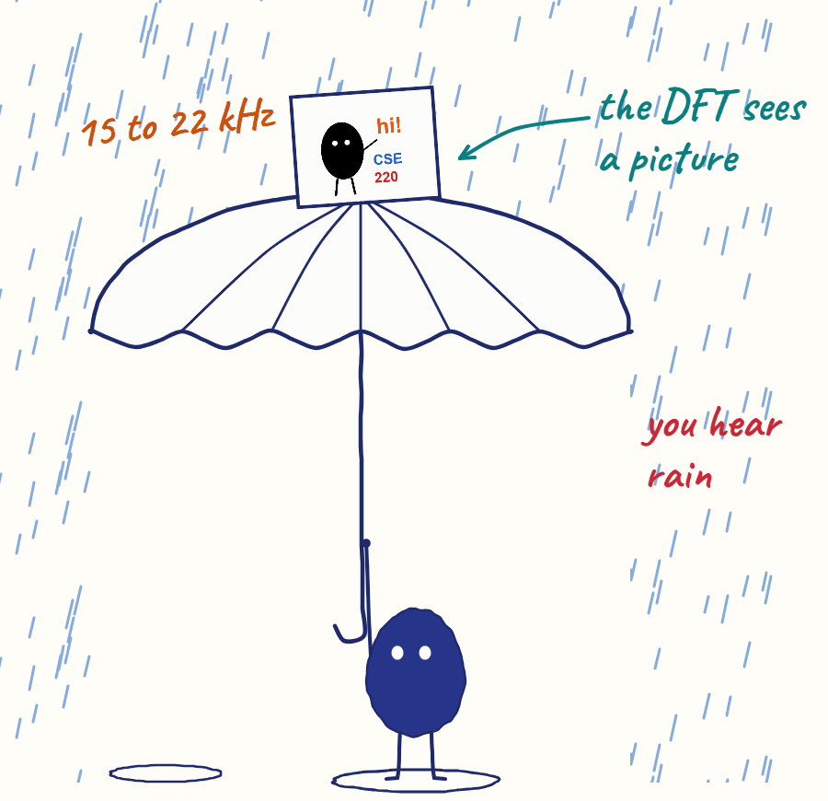
Notes:
[Rayyan · 0:00] Good morning. I'm Rayyan Khalil, and this is Md. Iztihad Islam. Our project is HiddenHz. It turns a picture into sound and hides it inside a recording, like rain. People hear rain, and the right password brings the picture back.

Slide 2
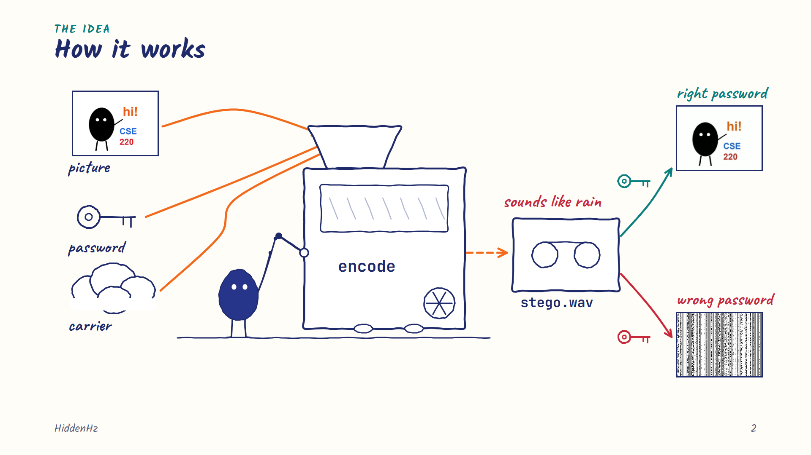
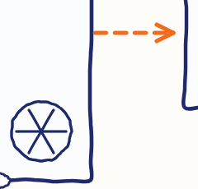
Notes:
[Rayyan · 0:15] Three things go in: a picture, a password and a carrier sound. The encoder gives back a WAV file that still sounds like the carrier. Decode it with the same password and the picture comes back. A wrong password gives noise, and the app rejects it.

Slide 3
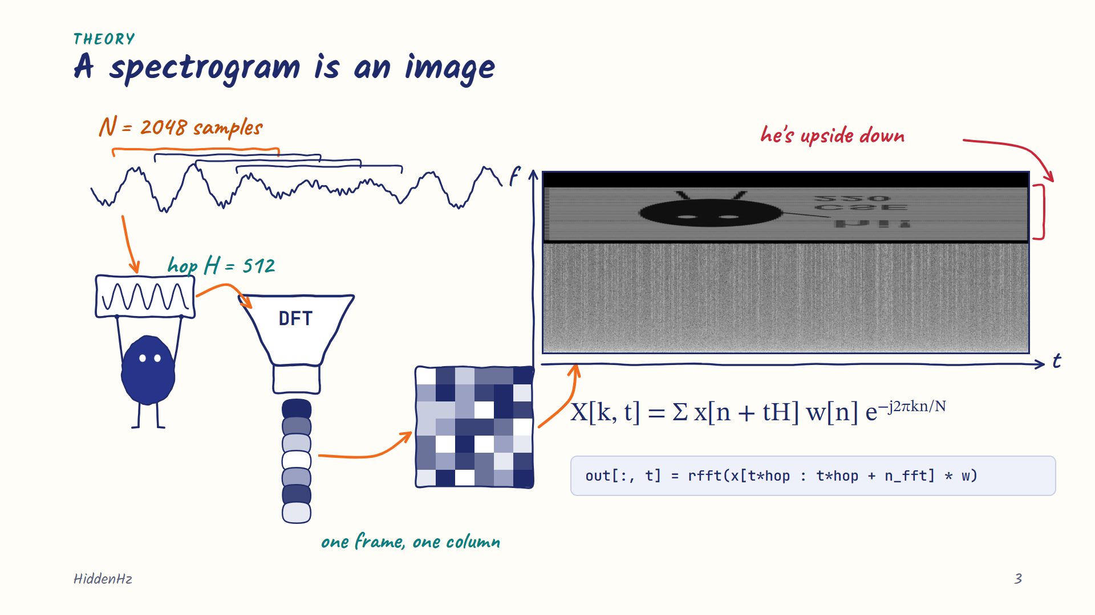
Notes:
[Rayyan · 0:37] A DFT tells us which frequencies are in a sound, but not when they happen. So we cut the sound into frames of 2048 samples, 512 samples apart, and take a DFT of each one. Each frame becomes one column. That's the STFT, and its magnitude, the spectrogram, is already an image. So we choose the image first and then build the sound that has it. This is our real file with the password shuffle switched off. The rain is at the bottom, and our character is at the top, upside down, because image row 0 goes to the lowest tone.

Slide 4
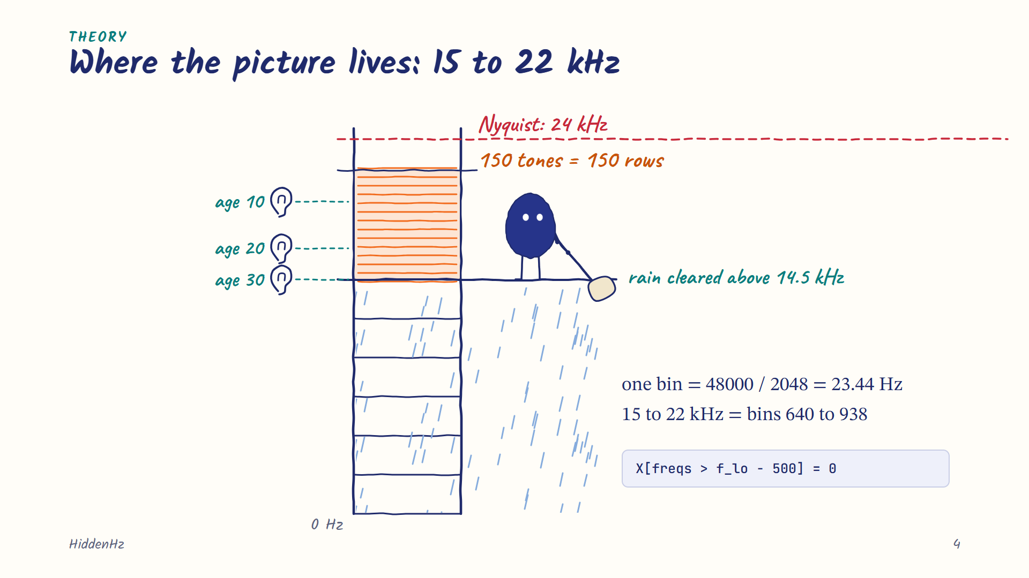
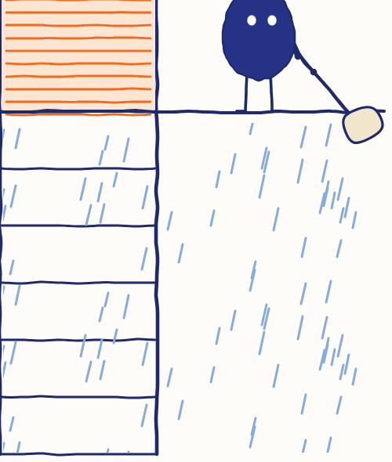
Notes:
[Rayyan · 1:17] At 48 kilohertz and N of 2048, one bin is 23.44 hertz, so 15 to 22 kilohertz is bins 640 to 938. Nyquist allows up to 24. Most adults can't hear much above 15 to 17 kilohertz. We use every second bin, which gives 150 rows. Rain also has sound up there, so we clear the carrier above 14.5 kilohertz before mixing.

Slide 5
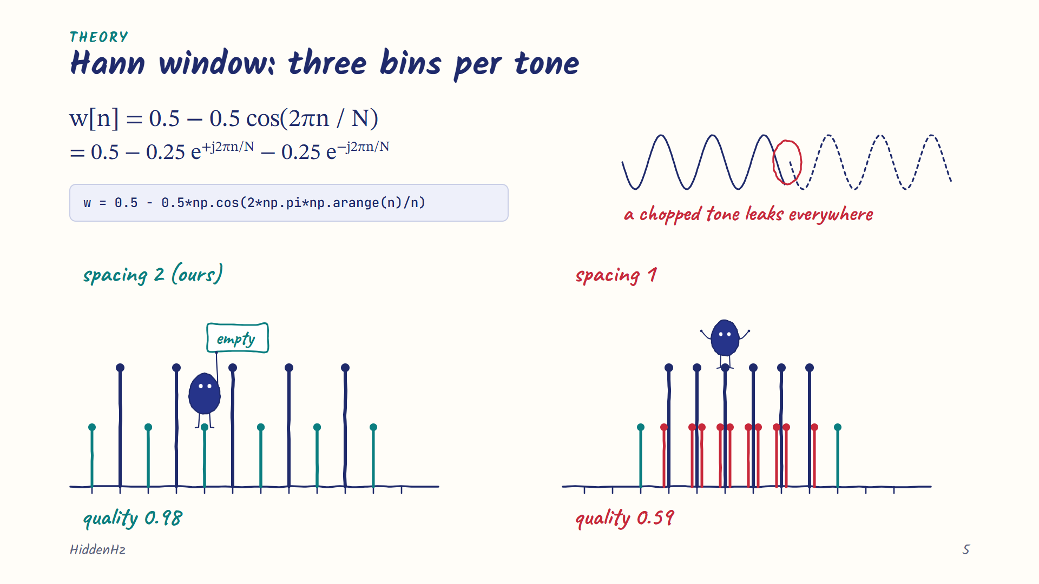
Notes:
[Rayyan · 1:44] Why every second bin? The DFT assumes a frame repeats forever, so a chopped tone has a jump at the edge, and that jump leaks into every bin. A Hann window tapers the edges. Written with Euler's formula it's three exponentials, so a windowed tone sits in exactly three bins: 0.5, 1, 0.5, and zero everywhere else. With tones two bins apart, the leaks land on empty bins. One bin apart, they land on each other, and quality drops from 0.98 to 0.59.

Slide 6
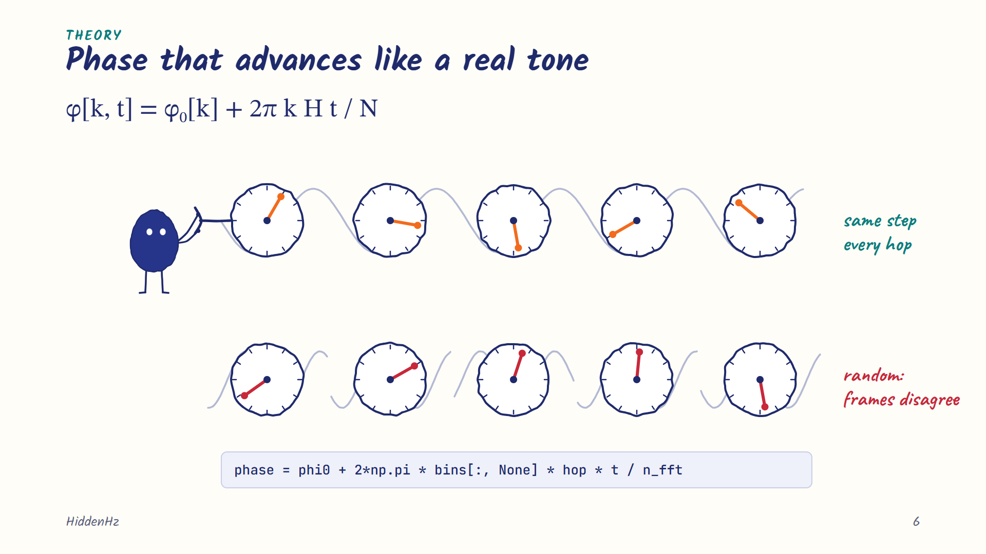
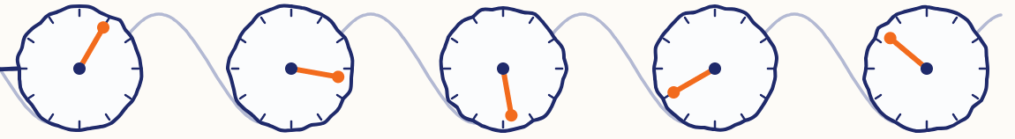
Notes:
[Rayyan · 2:19] Frames overlap by 75 percent, so four frames describe the same samples and have to agree. A steady tone moves forward by 2π k H over N every hop, so we set the phase that way. The password only picks the starting angle. Random phase in every frame would give an STFT that no real signal has.

Slide 7
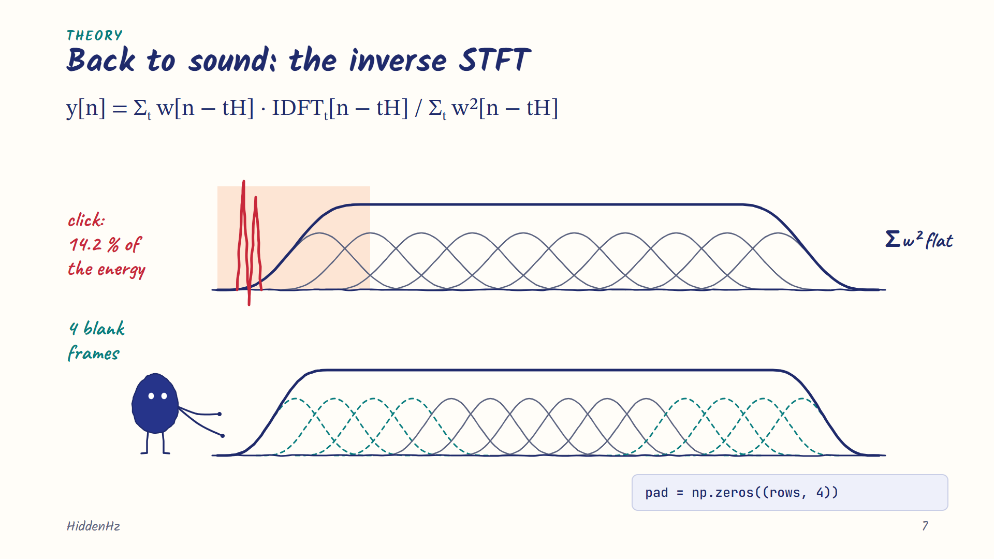
Notes:
[Rayyan · 2:42] To get sound back, we inverse-transform each column, window it again, overlap-add, and divide by the sum of the squared windows. With Hann at a quarter-frame hop that sum is flat. At the edges it starts from zero, and dividing by a tiny number made a click with 14.2 percent of the payload energy. Four blank frames at each end fixed it.

Slide 8
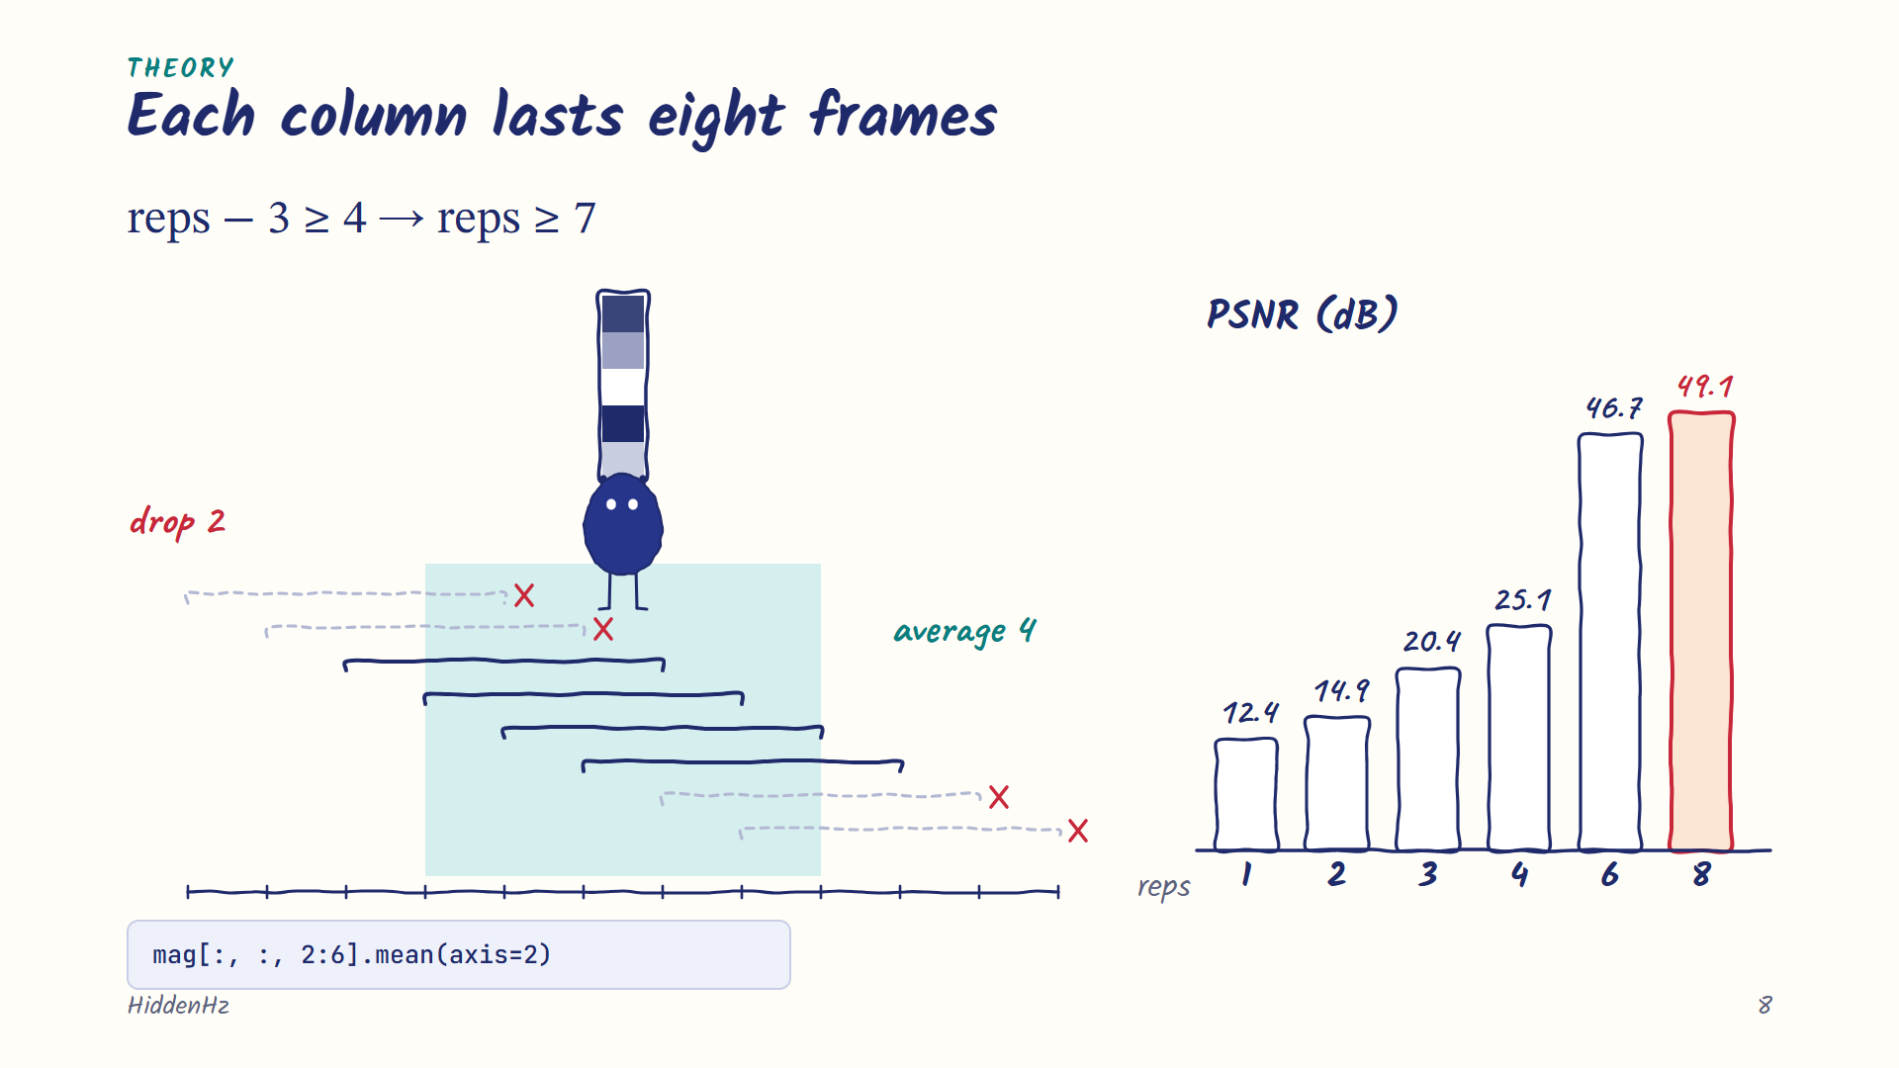
Notes:
[Rayyan · 3:07] Each sample falls in four frames. If the picture changed every frame, each frame would see a mix of columns. A column has to outlast one frame, and the count on the slide says at least seven frames. We hold each column for eight, and the decoder averages the middle four. That took us from 25 to 49 decibels. Iztihad will take the decoder side.

Slide 9
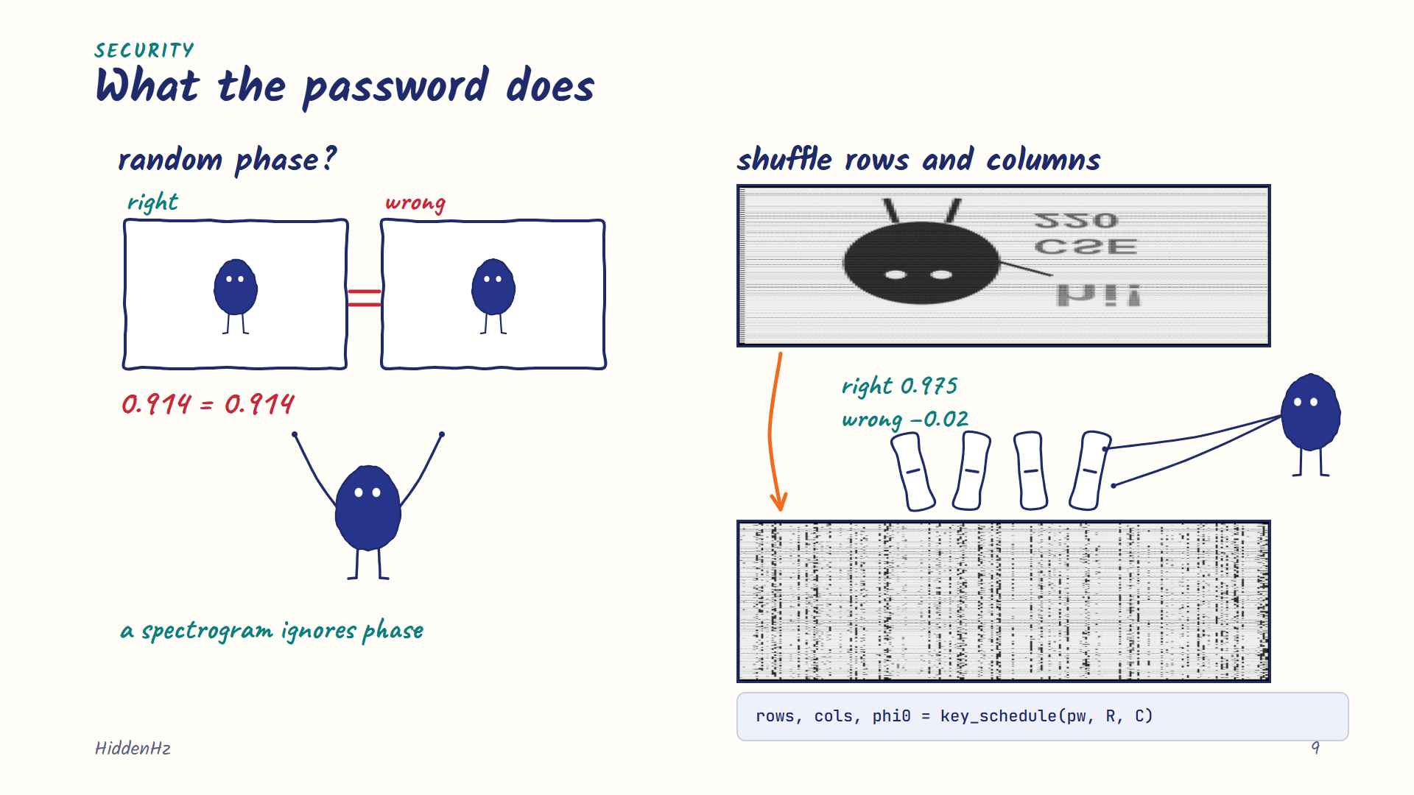
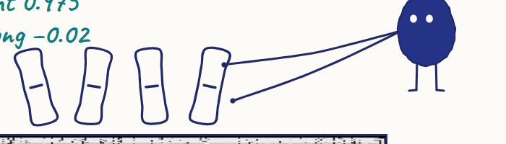
Notes:
[Iztihad · 3:32] Our first idea was a random phase seeded by the password. That fails, because a spectrogram only shows the magnitude. We measured the same 0.914 correlation with the right and the wrong password. So the password shuffles the picture instead: rows inside each column, then the columns in time. With the right password we get 0.975, and with a wrong one about zero. PBKDF2 also makes every guess cost a tenth of a second.

Slide 10
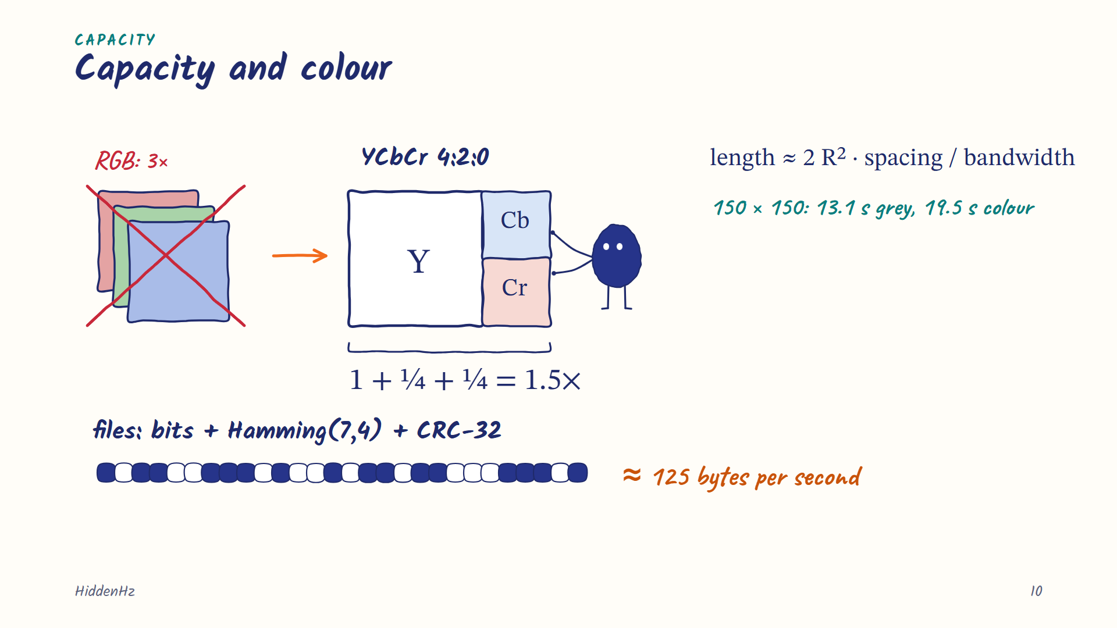
Notes:
[Iztihad · 4:02] Rows come from bandwidth and columns from time, so audio length grows with R squared over bandwidth. A 150 by 150 picture needs about 13 seconds. For colour we convert to YCbCr and send the colour planes at half size, like JPEG, so colour costs 1.5 times, not 3. Files go in as bits with Hamming codes and a CRC, at about 125 bytes per second.

Slide 11
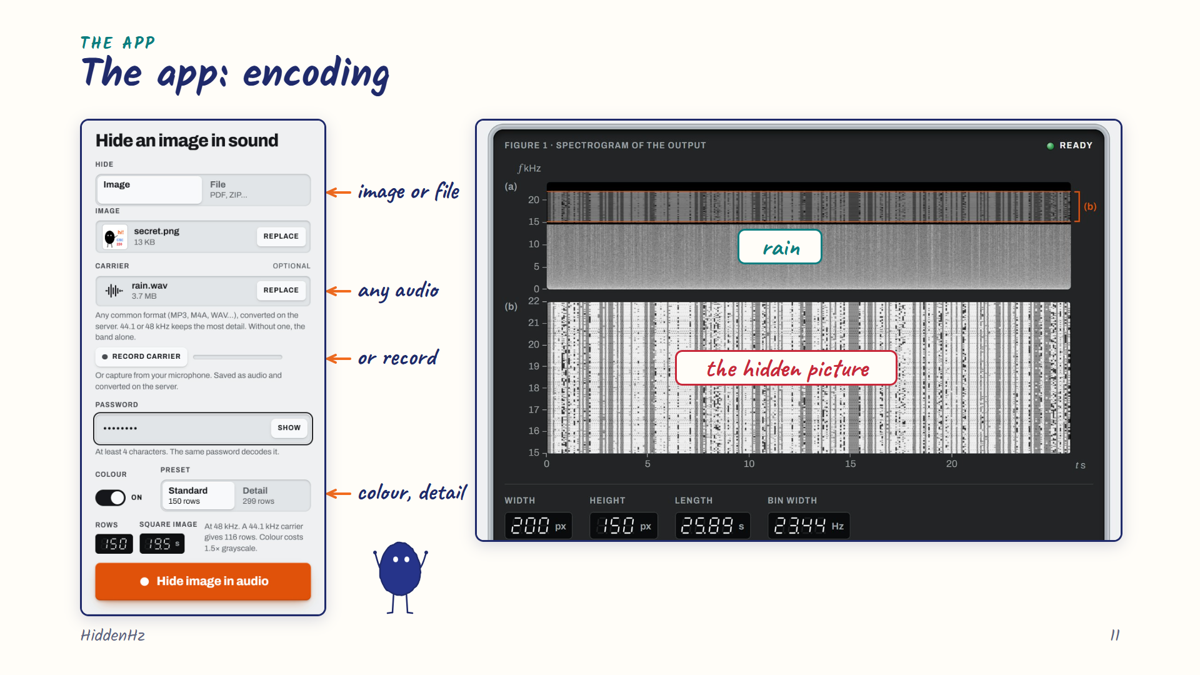
Notes:
[Iztihad · 4:29] This is the encoder. You can hide an image or a file. The carrier can be almost any audio format, or you can record one. You pick colour and the detail level, and the app shows the audio length before encoding. On the right is the result: rain below 15 kilohertz and the shuffled picture above it.

Slide 12
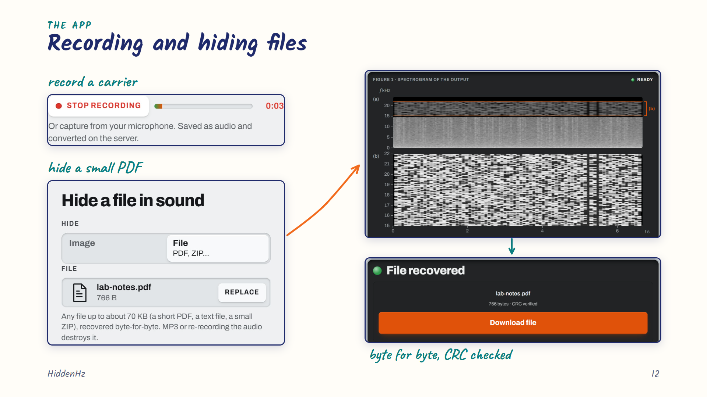
Notes:
[Iztihad · 4:54] Here's the recorder, and here's a small PDF being hidden. A file is sent as bits, so its band looks like dense noise. On the decode side the file comes back byte for byte, and the CRC confirms it.

Slide 13
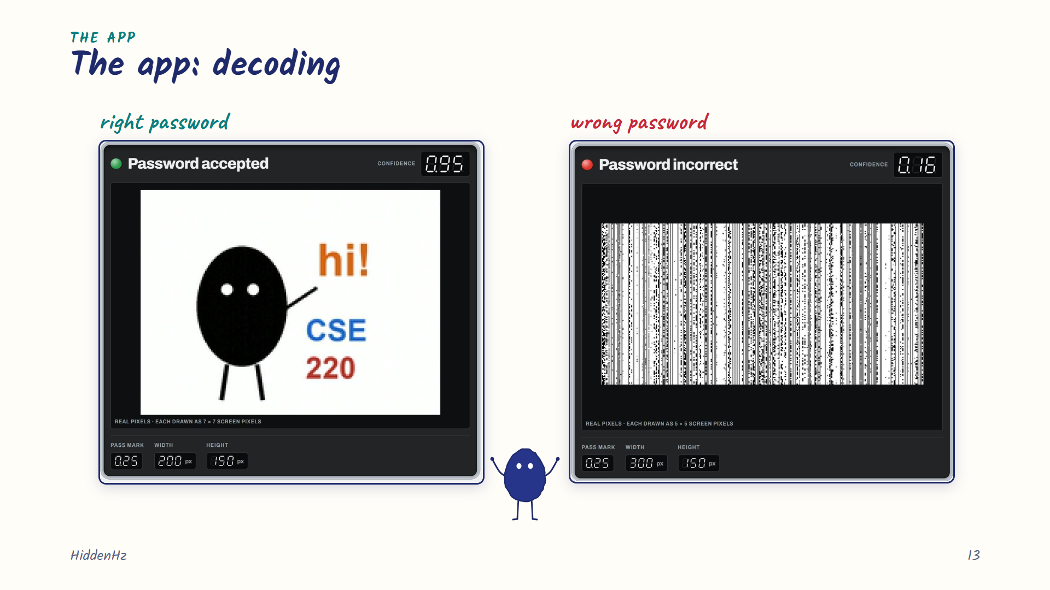
Notes:
[Iztihad · 5:12] Decoding needs only the password. The app reads the preset and the layout from the file itself. The right password gives confidence 0.95 and the picture. A wrong one gives 0.16, below the 0.25 pass mark, so the app rejects it.

Slide 14
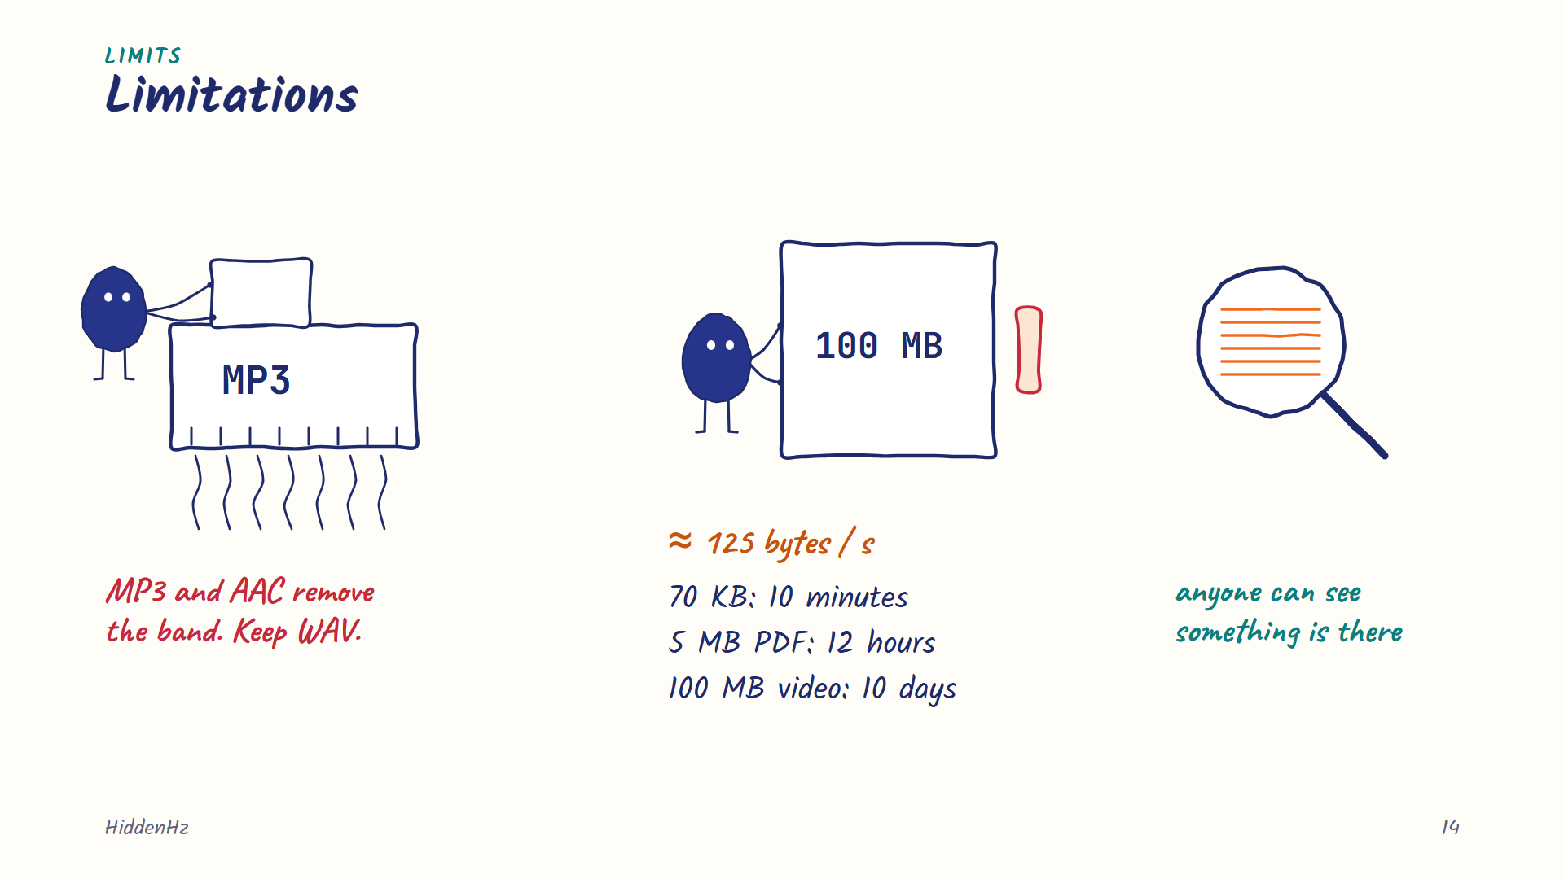
Notes:
[Iztihad · 5:31] There are limits. MP3 and AAC remove exactly the band we use, so the file has to stay WAV or FLAC. Capacity is about 125 bytes per second, so the app stops at ten minutes of audio, around 70 kilobytes. A 5 megabyte PDF would need about 12 hours, and a 100 megabyte video about ten days. And anyone who looks above 15 kilohertz can see that something is there, even if they can't read it.

Slide 15
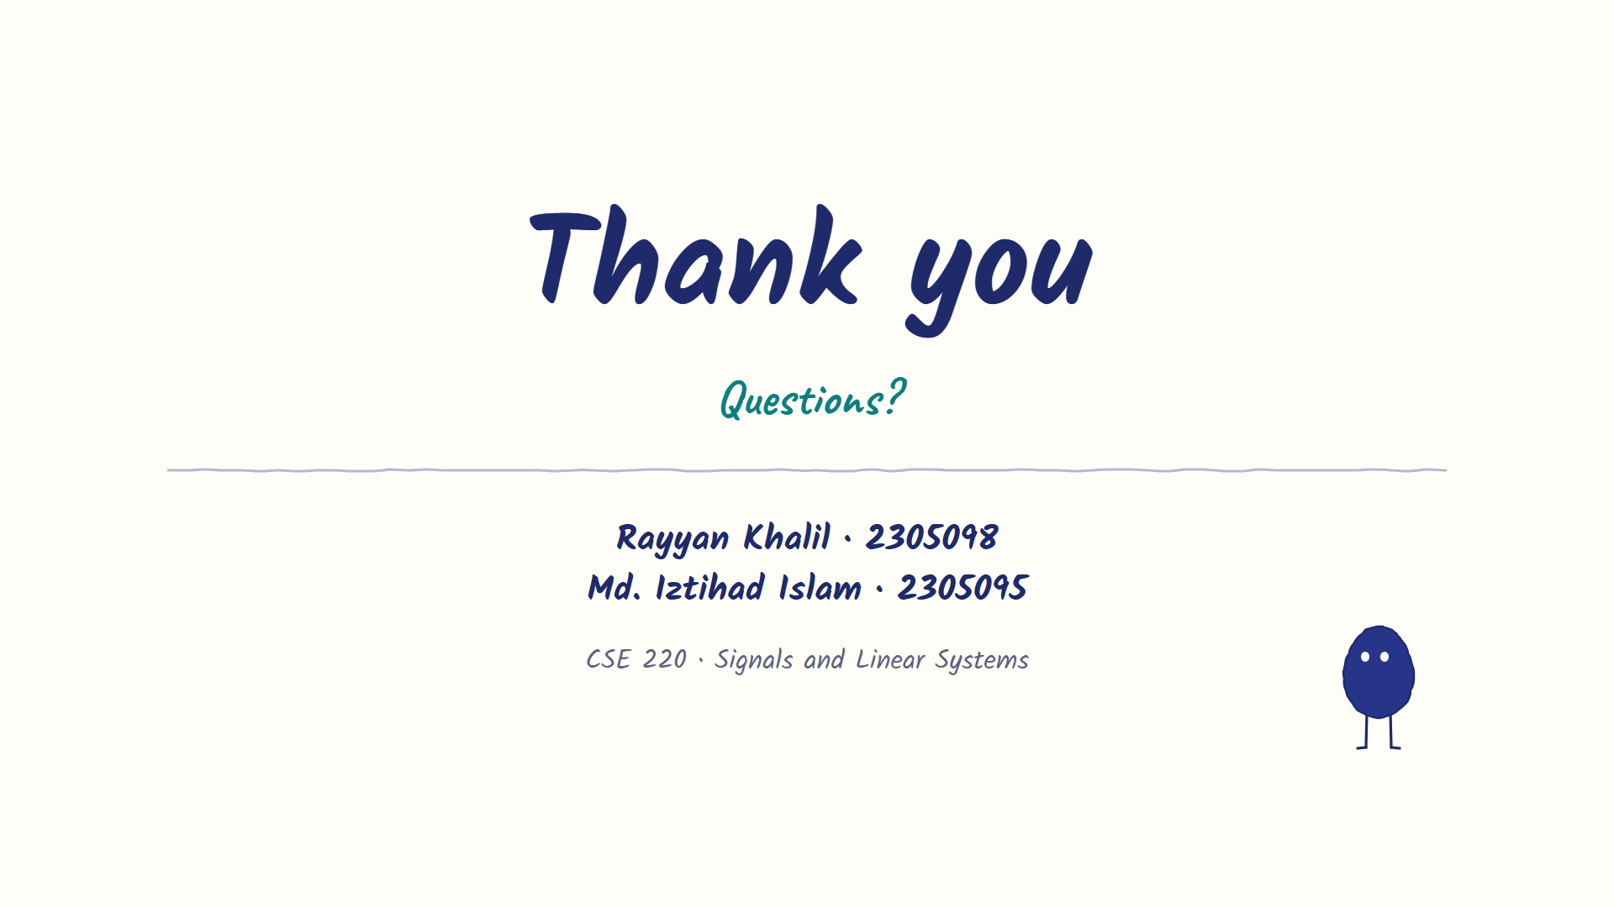
Notes:
[Iztihad · 6:03] Thank you. We're happy to take questions.

