Slide 1
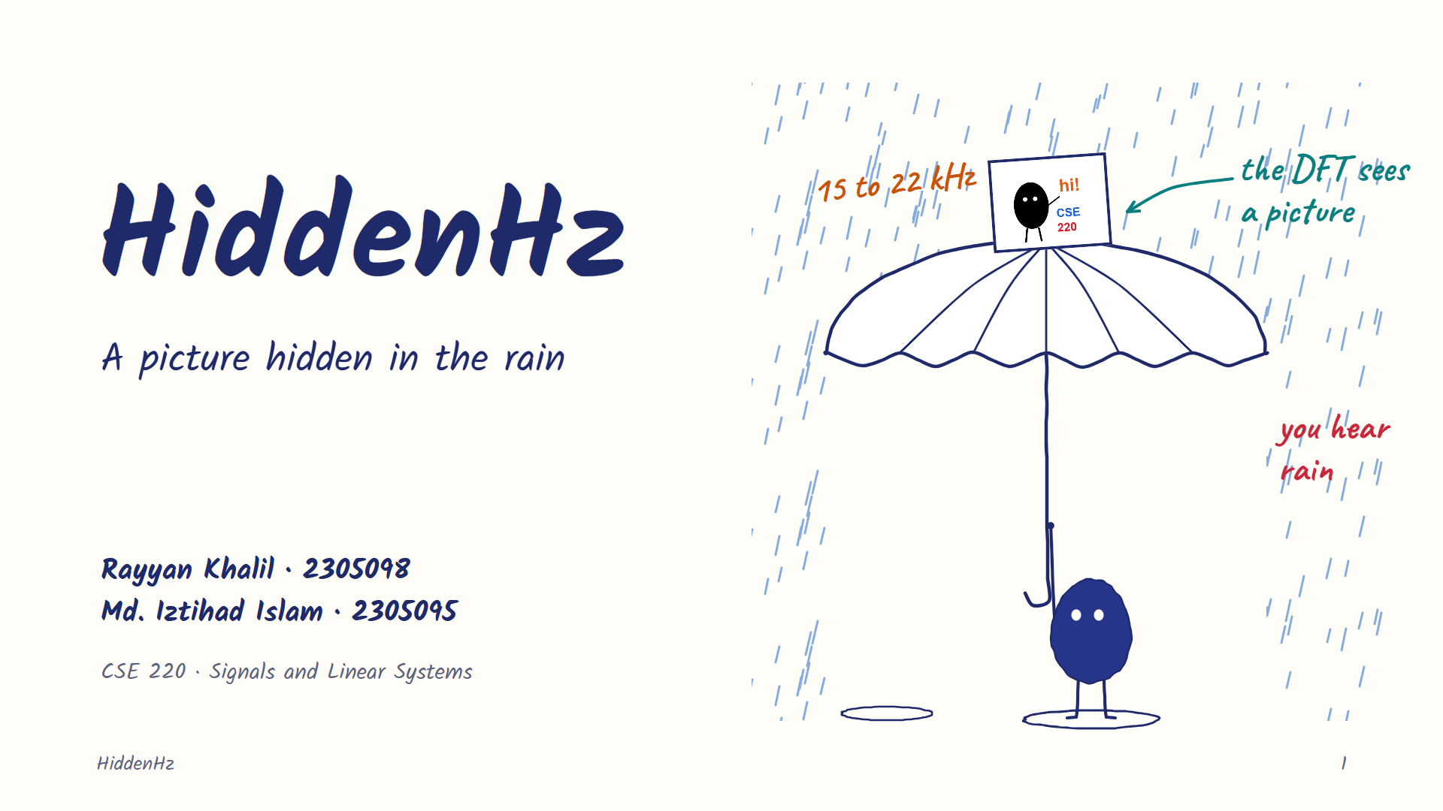
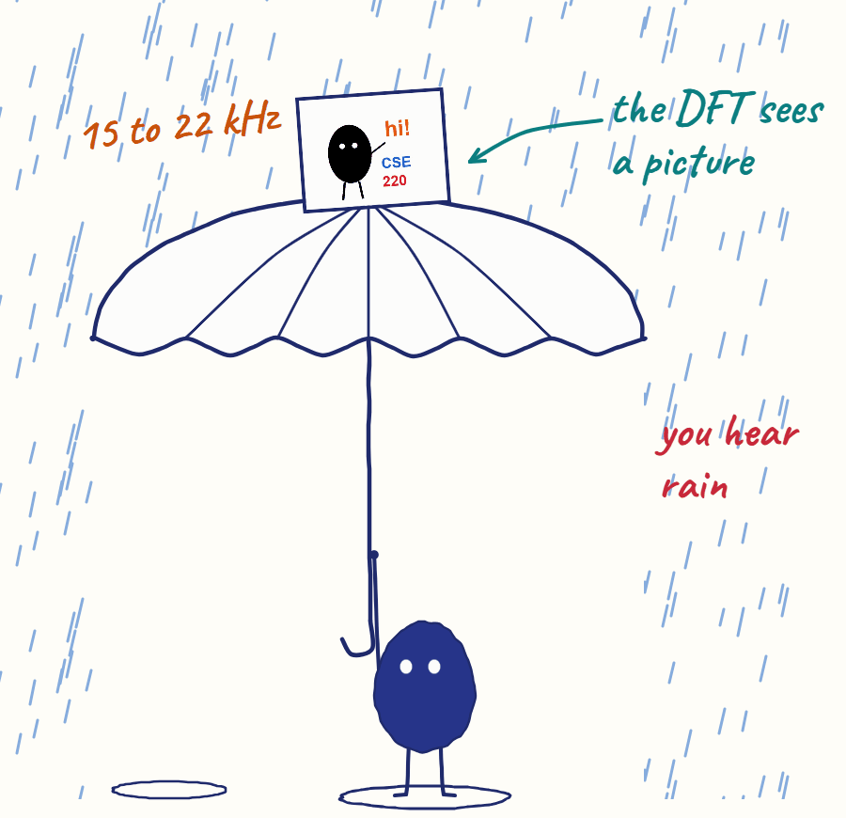
Notes:
[Rayyan · 0:00] Hi everyone. I'm Rayyan, and this is Iztihad. This is HiddenHz. We hide a picture inside a normal sound, like rain. You hear rain. With the right password, you get the picture back.

Slide 2
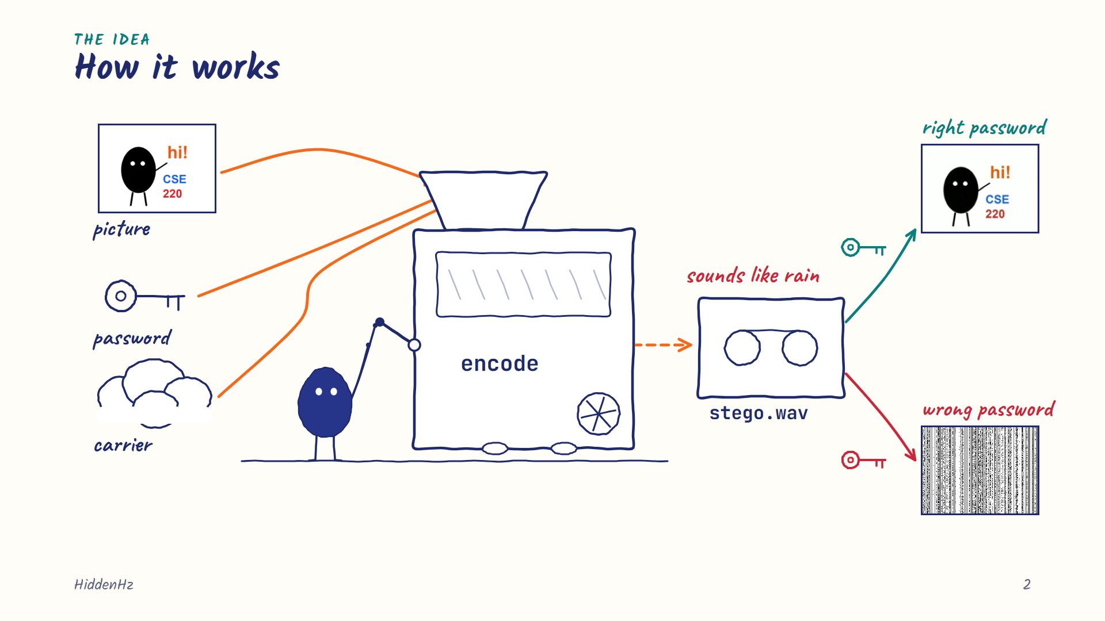
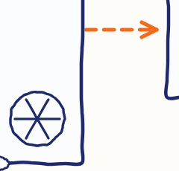
Notes:
[Rayyan · 0:16] We give it a picture, a password and a sound. Out comes a WAV file that still sounds like rain. Same password, and the picture comes back. Wrong password, and you get noise.

Slide 3
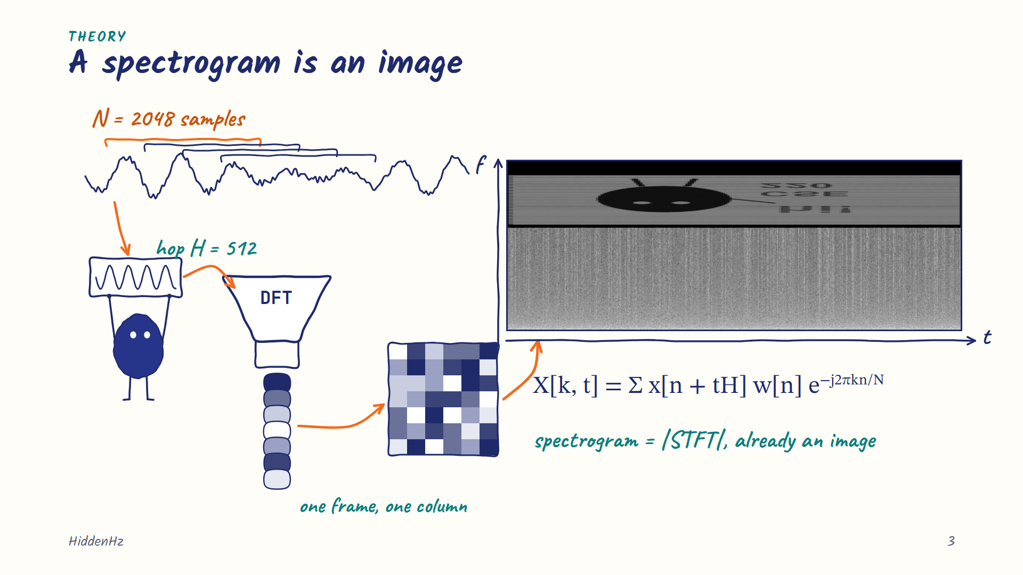
Notes:
[Rayyan · 0:32] The main idea is the spectrogram. We cut the sound into short pieces and run an FFT on each one. Each piece becomes one column, and side by side they make a picture of the sound. So we work backwards: start with the picture, then make the sound.

Slide 4
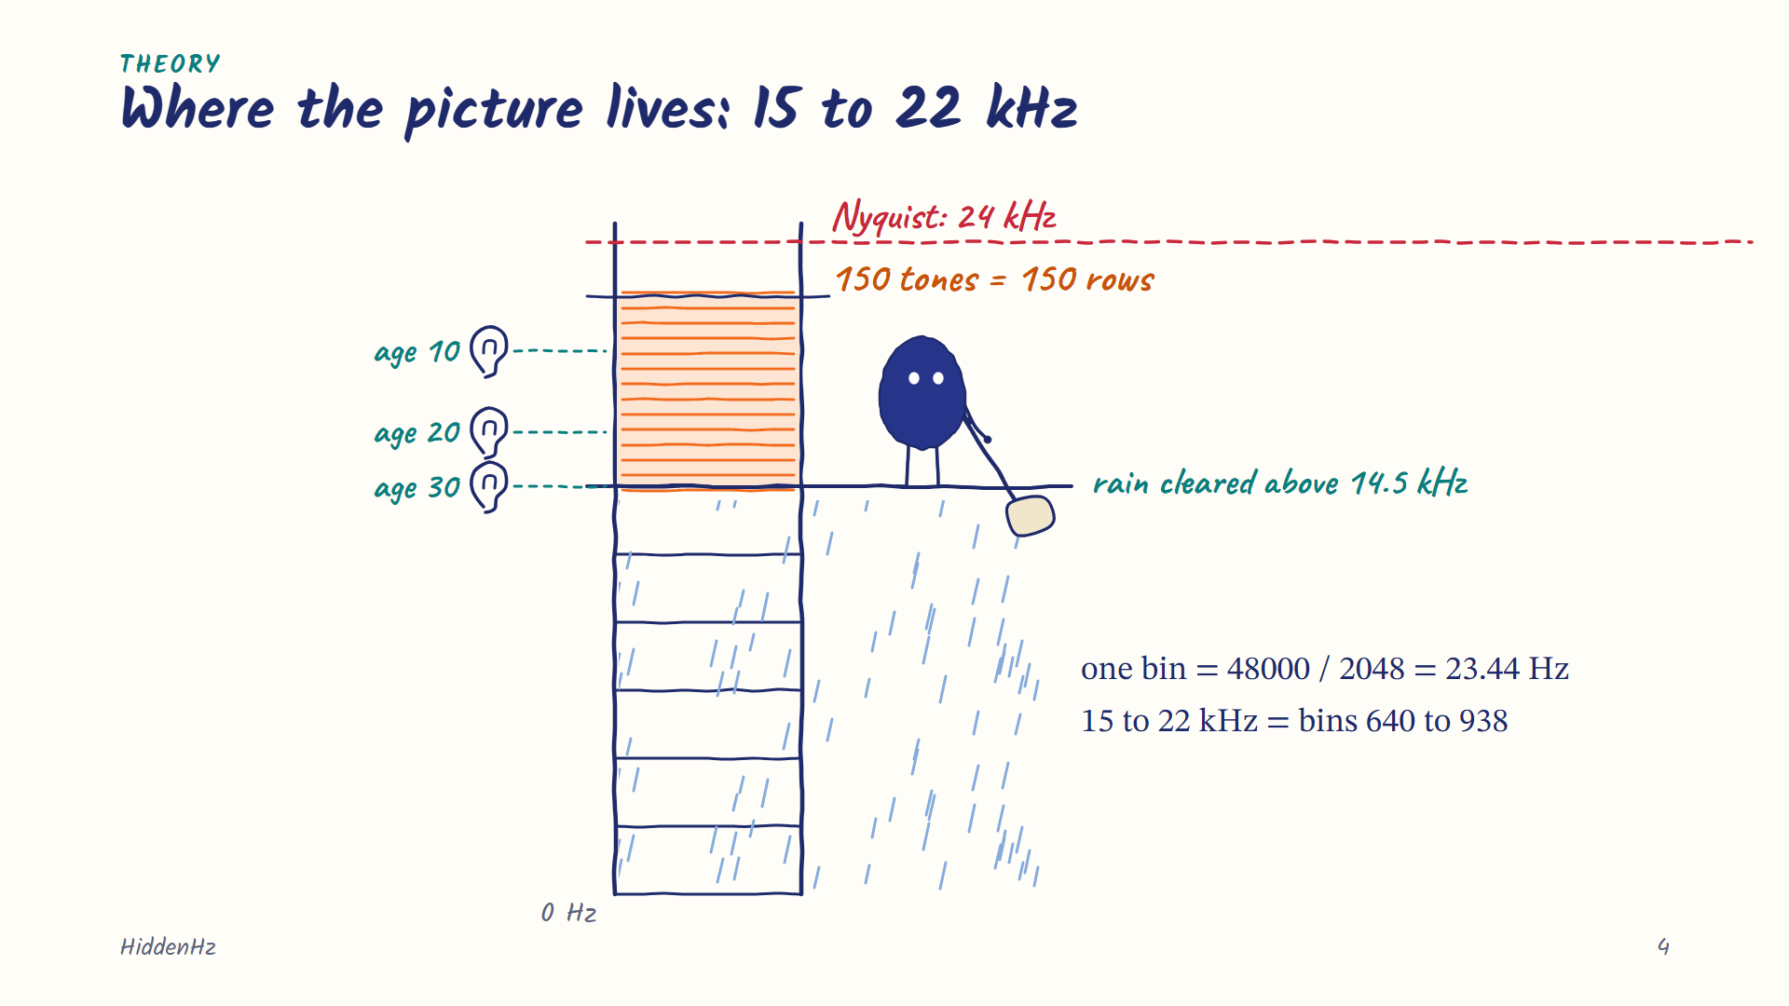
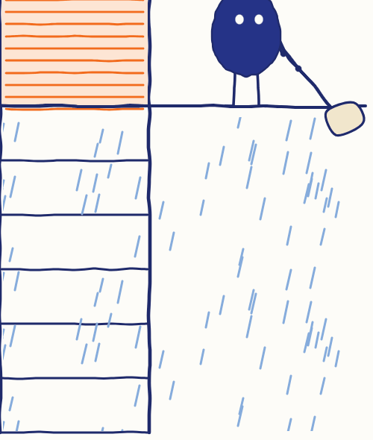
Notes:
[Rayyan · 0:55] We put the picture between 15 and 22 kilohertz, too high for most adults to hear. That band fits 150 tones, one for each row of the picture. We also cut the rain up there, so it doesn't cover the picture.

Slide 5
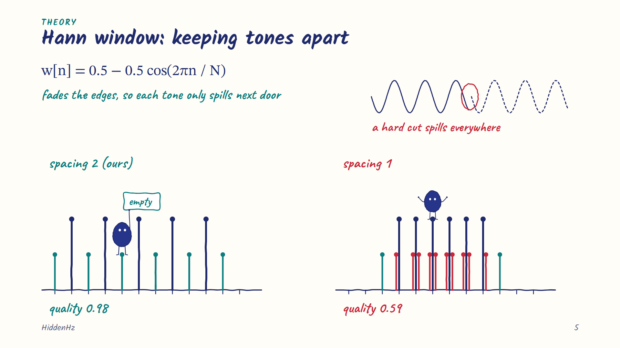
Notes:
[Rayyan · 1:14] Why the gaps between tones? To take an FFT, we chop the sound into short pieces, and the edges of each piece are hard cuts. A hard cut makes a tone spill into nearby frequencies, like ink bleeding on paper. The Hann window fades each piece in and out, so a tone only spills into the two slots right next to it. Leave one empty slot between tones, and the spill lands there. Pack them tight, and quality drops from 0.98 to 0.59.

Slide 6
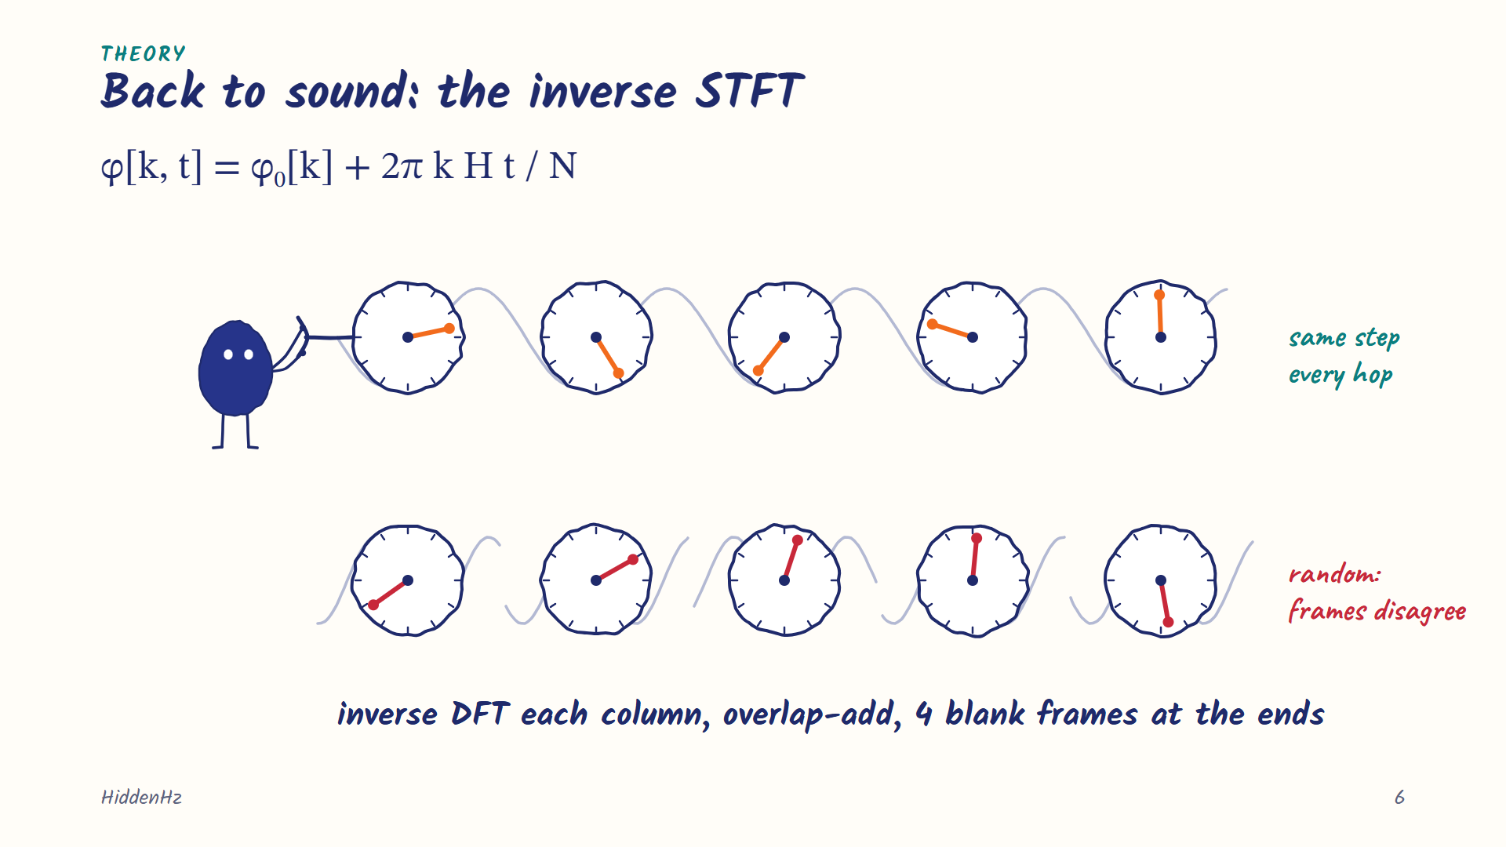
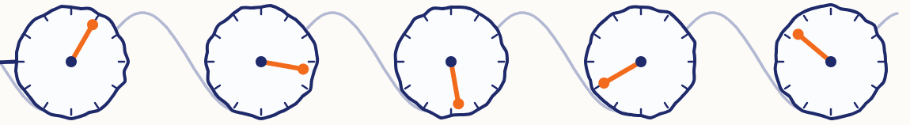
Notes:
[Rayyan · 1:53] To get sound back, we run the FFT in reverse on every column and blend them. Each tone keeps a steady phase, like a real note, and a bit of silence at both ends stops a click. Iztihad will take it from here.

Slide 7
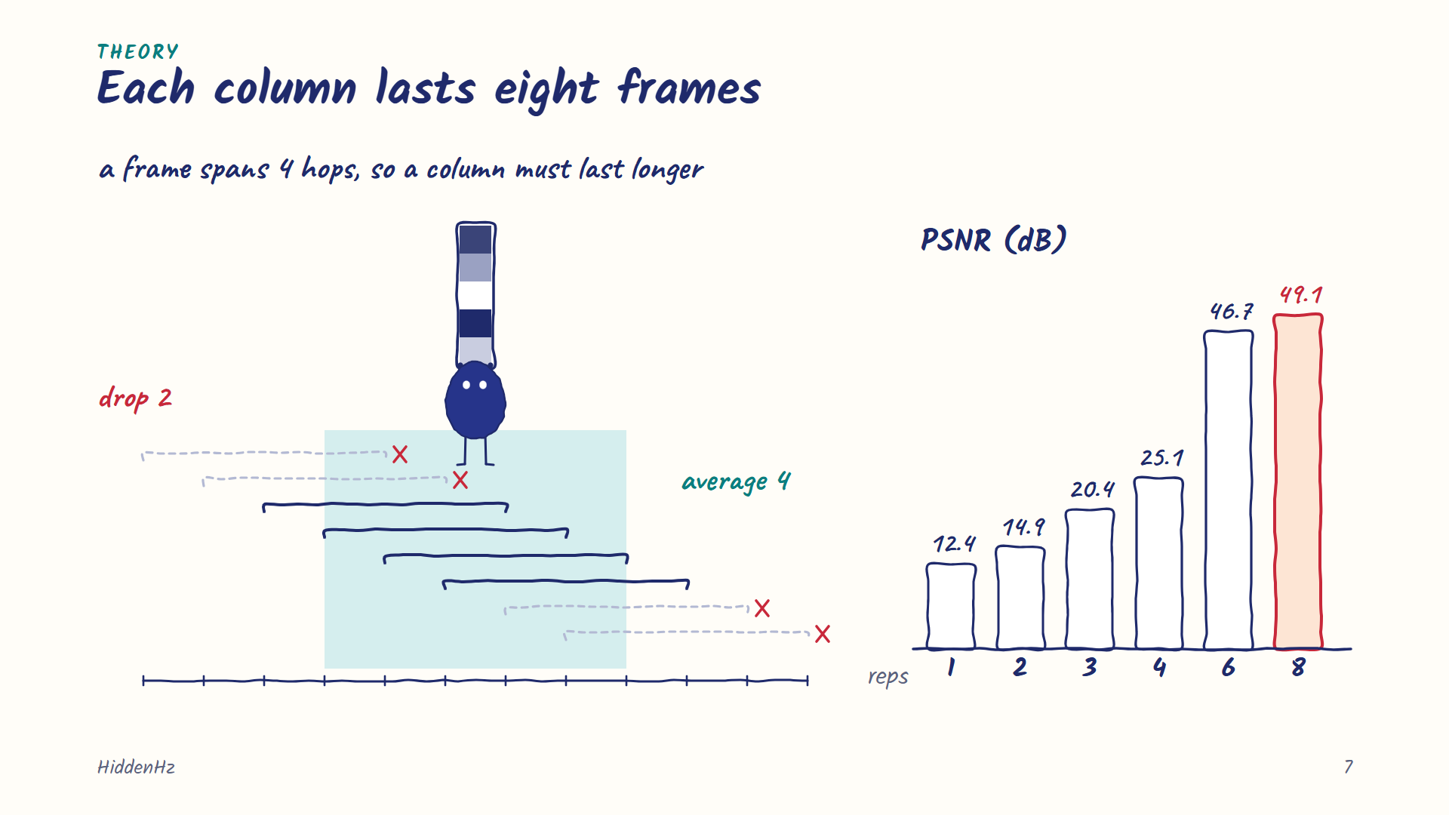
Notes:
[Iztihad · 2:13] Thanks. When we read it back, the pieces overlap, so a column that changes too fast gets blurred. So we hold each column for eight frames and read only the clean middle four. That took quality from 25 to 49 decibels.

Slide 8
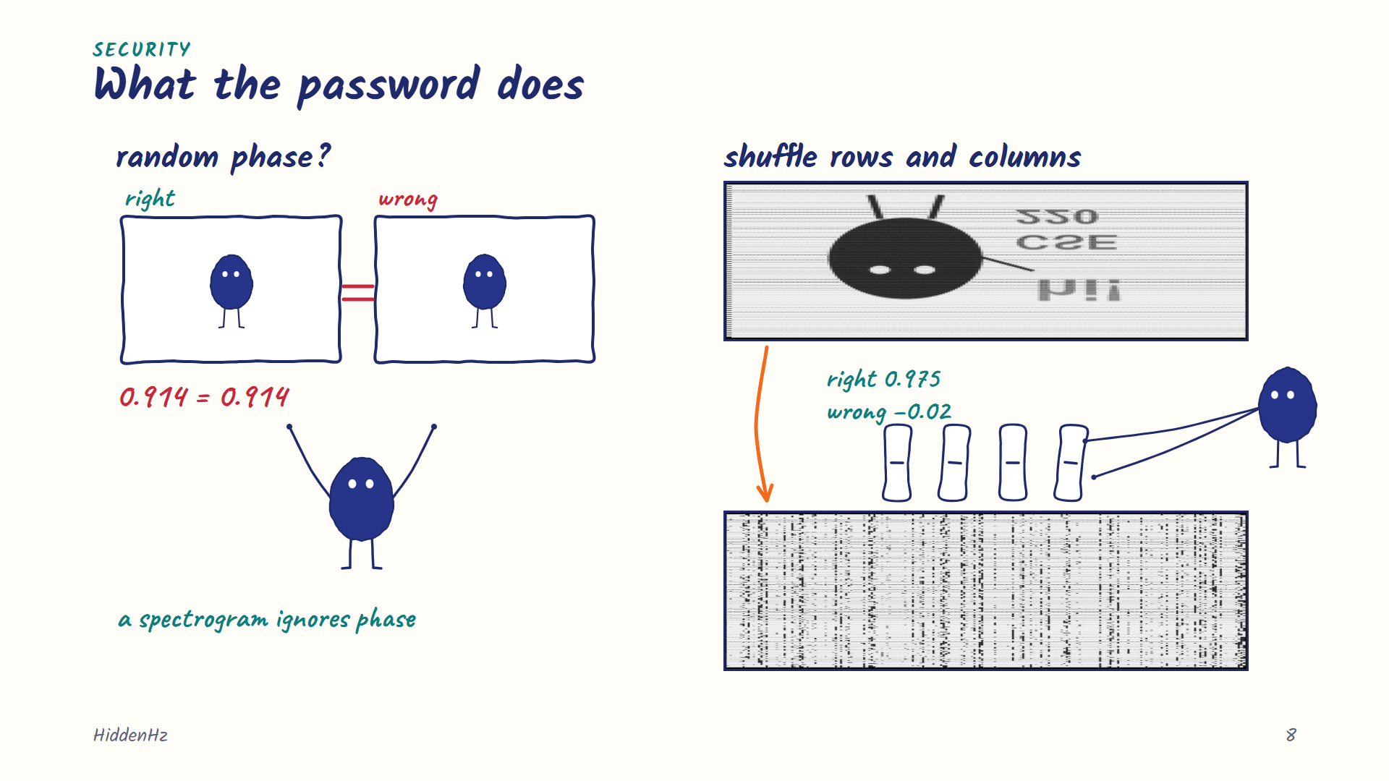
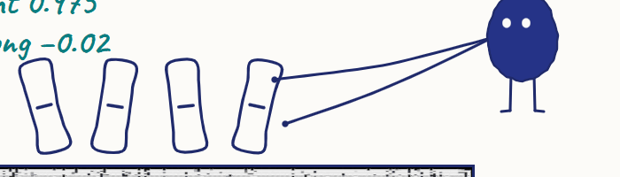
Notes:
[Iztihad · 2:33] Our first idea was to use the password on the phase. But a spectrogram ignores phase, so a wrong password still showed the picture. Now the password shuffles the pixels, rows then columns. Right password: 0.975. Wrong one: about zero.

Slide 9
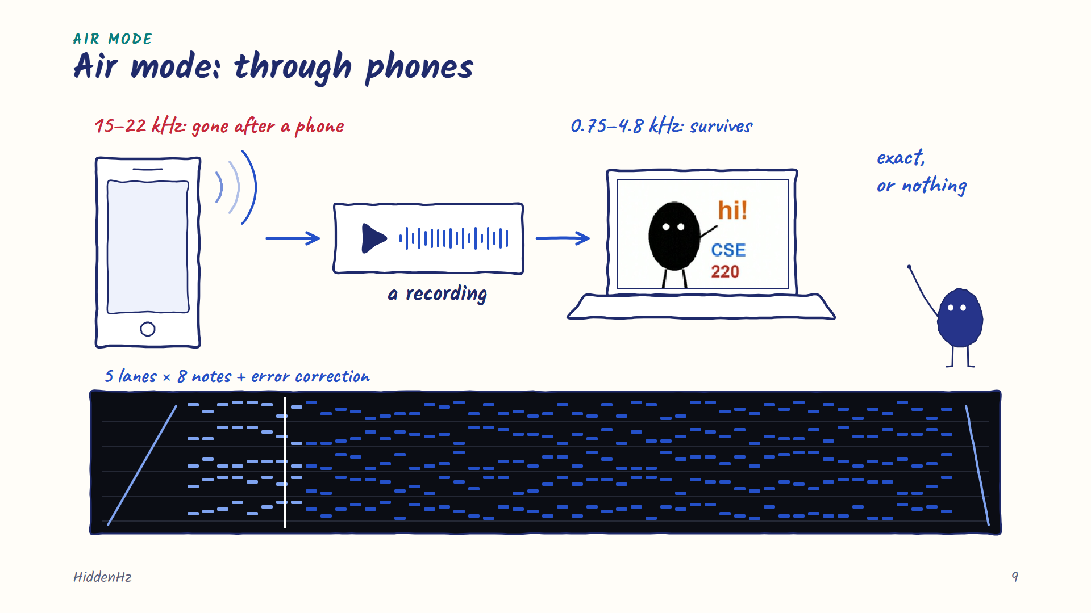
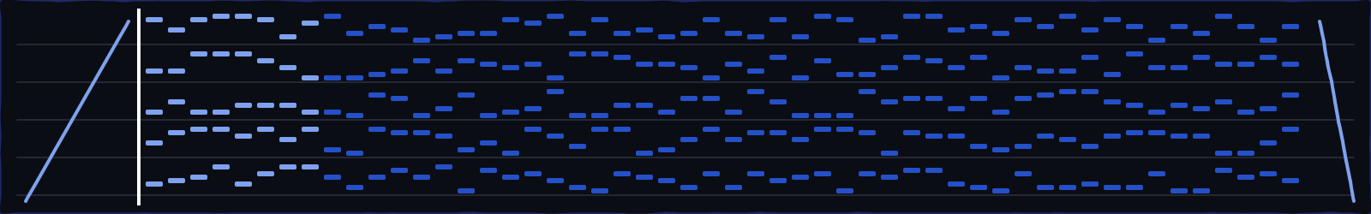
Notes:
[Iztihad · 2:52] Hidden mode has one weakness: phones and messaging apps squash sound, and the high band goes first. So we built Air mode. It sends the data as notes between one and five kilohertz, with error correction. You can hear it, but it survives a phone speaker and a recording.

Slide 10
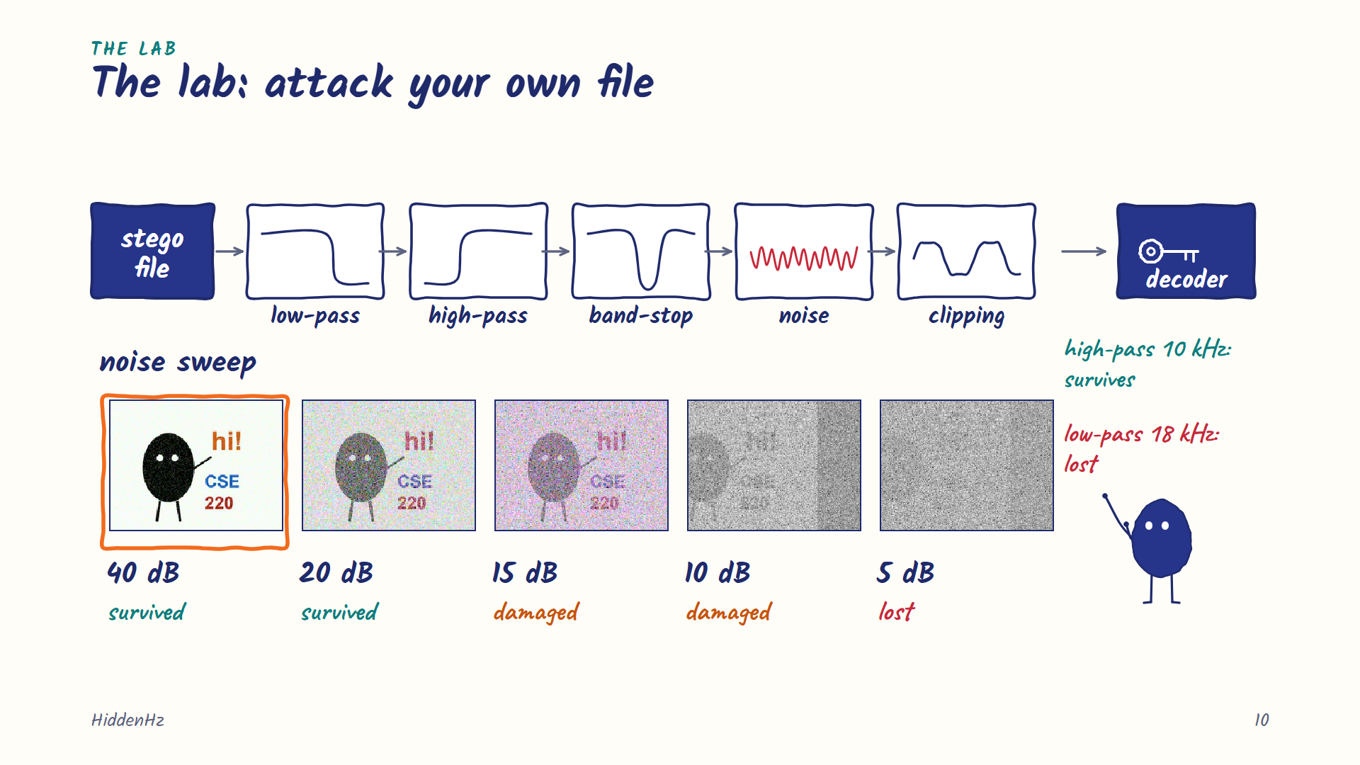
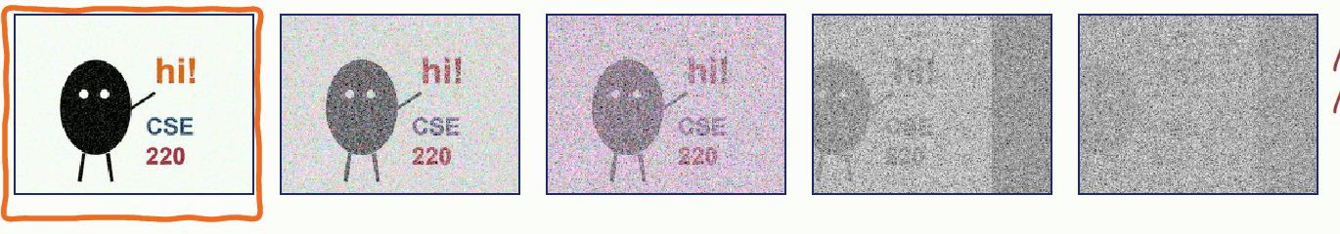
Notes:
[Iztihad · 3:16] We also built a lab to attack our own files. With noise, the picture survives, then gets damaged at 15 decibels, and is lost at 5. A high-pass filter only removes the rain. A low-pass at 18 kilohertz wipes the picture out.

Slide 11
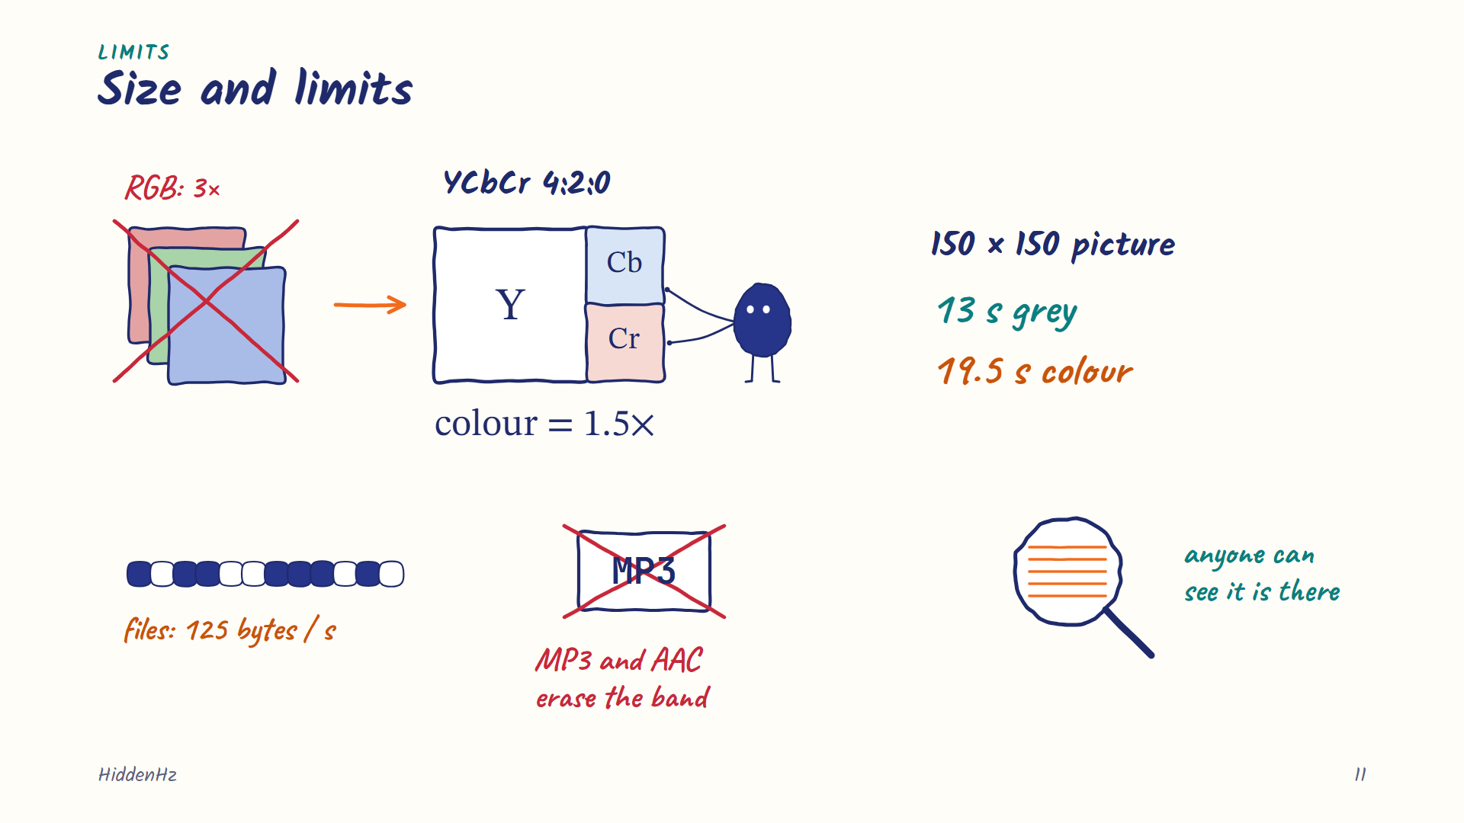
Notes:
[Iztihad · 3:36] A 150 by 150 picture needs about 13 seconds of audio, colour about 20. The limits: MP3 deletes our band, so Hidden mode needs WAV. And anyone who looks at the spectrogram can see something is there.

Slide 12
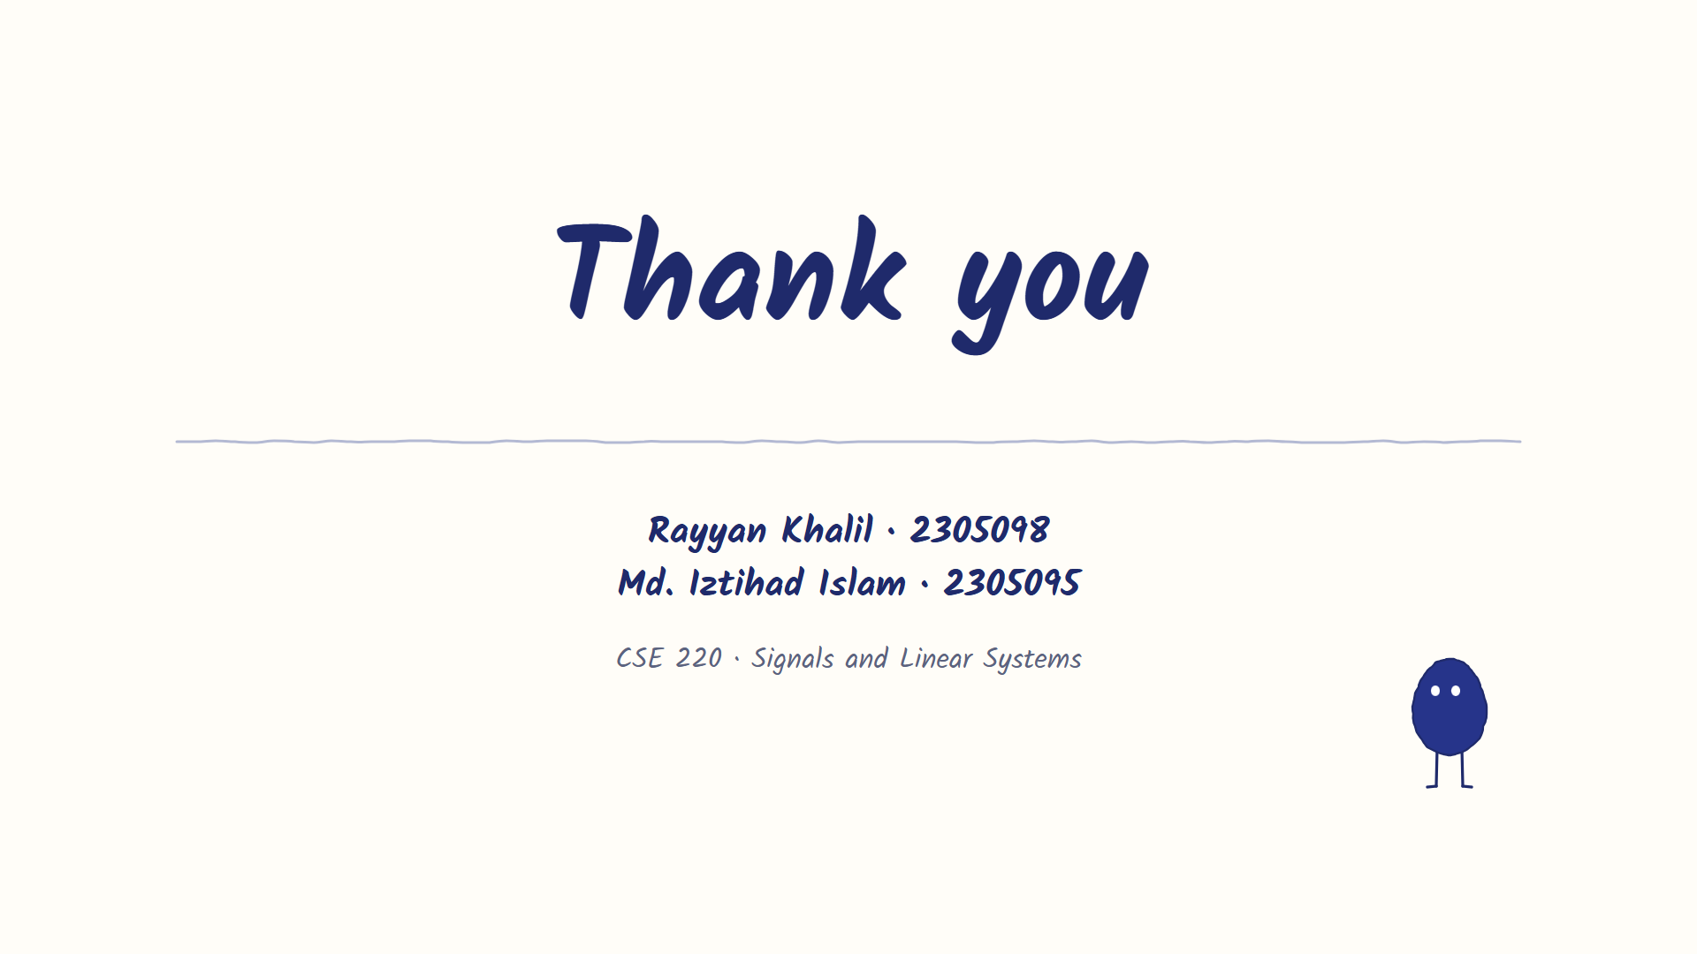
Notes:
[Iztihad · 3:54] That's the idea. Now let's show you the app.

