Slide 1
Efficient Concept Induction for Description Logics
Md Kamruzzaman Sarker Wright State University
Pascal Hitzler Wright State University

Slide 2
Problem
Generate concept description from individual/instance data as quickly as possible.
Formally: Generating complex description logic class expressions S from
a given description logic knowledge base (or ontology) O and
sets P and N of instances, understood as positive and negative examples,
such that O ⊨ S(a) for all a ∈ P, and O ⊭ S(b) for all b ∈ N.

Slide 3
Related work
DL-Learner¹: One of the prominent system.
1. Create solution using refinement operator (upward/downward).
2. Call external reasoner to calculate accuracy/coverage score.
3. It’s variant fast instance check calculate approximate accuracy and relatively faster but
accuracy is low.
OWL-Miner²: We found it after our submission to AAAI.
1. Construct context graph for each atomic class.
2. Use those context graphs only to find solution using refinement operator.
-- system is not available publicly.

Slide 4
Our Approach
We are assuming ontology is star shaped.
Create complex concept using only
Disjunction (⊔)
Conjunction (⊓)
Negation (¬)
And invoke reasoner as less as possible.

Slide 5
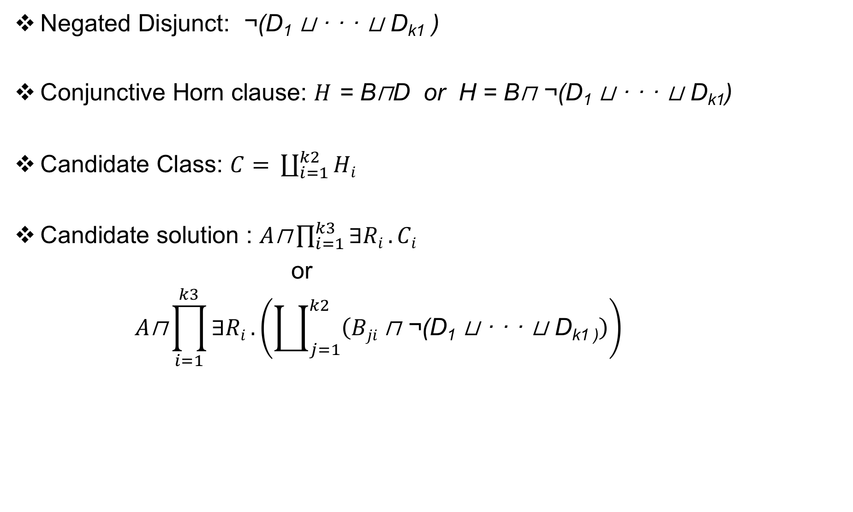
Preliminary
Negated Disjunct: ¬(D₁ ⊔ · · · ⊔ D_{k1} )
Conjunctive Horn clause: $H$ = B⊓D or H = B⊓ ¬(D₁ ⊔ · · · ⊔ D_{k1})
Candidate Class: $C= \coprod_{i=1}^{k2}{Hi}$
Candidate solution : $A\text{⊓}\prod_{i=1}^{k3}{∃Ri}.Ci$
or
$$A\text{⊓}\prod_{i=1}^{k3}{∃Ri}.\left(\coprod_{j=1}^{k2}{\left(Bji \text{⊓ ¬(}\text{D}\text{1}\text{ ⊔ · · · ⊔ }\text{Dk}\text{1}\text{ )}\right)}\right)$$

Slide 6
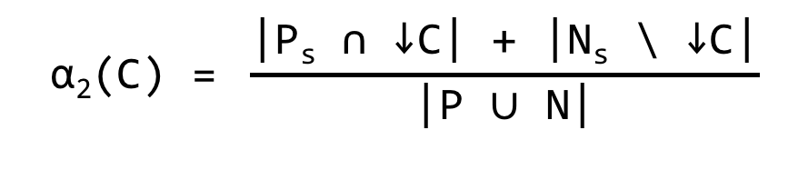
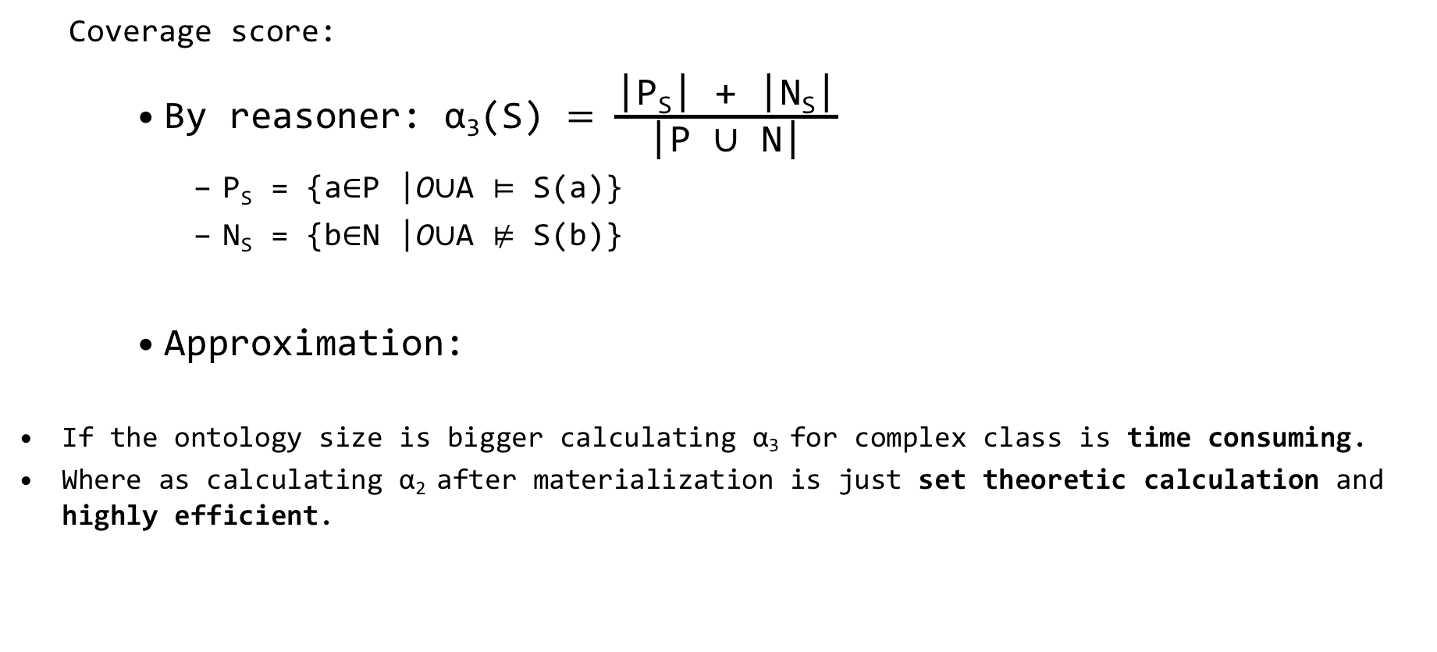
Score calculation
Coverage score:
By reasoner: α₃(S) $= \frac{\text{|}\text{PS}\text{| + |}\text{NS}\text{|}}{\text{|}\text{P}\text{ ∪ }\text{N}\text{|}}$
$\text{P}\text{S}\text{ = \{}\text{a}\text{∈}\text{P}\text{ |}\text{O}\text{∪}\text{A}\text{ ⊨ }\text{S}\text{(}\text{a}\text{)\} }$
$\text{N}\text{S}\text{ = \{}\text{b}\text{∈}\text{N}\text{ |}\text{O}\text{∪}\text{A}\text{ ⊭ }\text{S}\text{(}\text{b}\text{)\} }$
Approximation:
If the ontology size is bigger calculating α₃ for complex class is time consuming.
Where as calculating α₂ after materialization is just set theoretic calculation and highly efficient.
$$\text{α}\text{2}\text{(}\text{C}\text{) = }\frac{\text{|}\text{Ps}\text{ ∩ ↓}\text{C}\text{| + |}\text{Ns}\text{ \backslash ↓}\text{C}\text{|}}{\text{|}\text{P}\text{ ∪ }\text{N}\text{|}}$$

Slide 7
Algorithm
Input from the user:
Ontology
Positive individuals (P)
Negative individuals (N)
Configuration/Limiting parameters
K1 = max number of negative concepts in a conjunctive horn Clause (D_{i})
k2 = max number of conjunctive horn Clause of a single object property (H_{i})
k3 = max number of object properties in a candidate class (R_{i})
k4 = max size of the conjunctive horn clauses list. (i.e. select top k4 conjunctive horn clauses to make the combination of conjunctive horn clauses)
k5 = max size of candidate classes list. (i.e. select top k5 candidate class to make the combination of candidate classes.)
removeCommonTypes = true/false

Slide 8
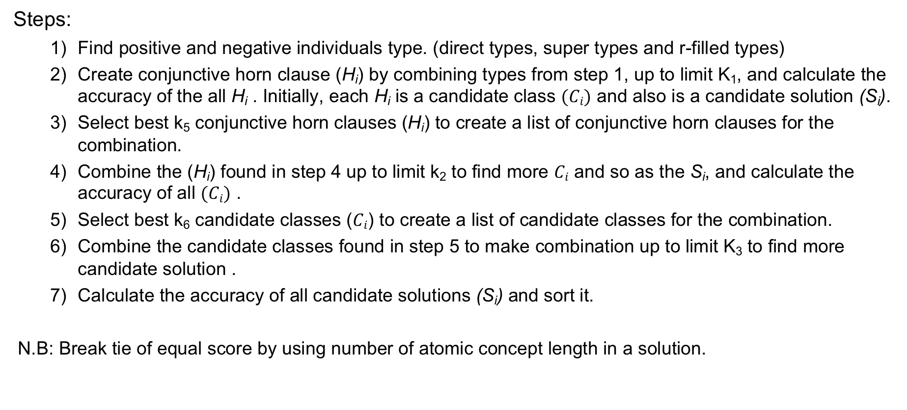
Algorithm Steps
Steps:
Find positive and negative individuals type. (direct types, super types and r-filled types)
Create conjunctive horn clause (H_{i}) by combining types from step 1, up to limit K₁, and calculate the accuracy of the all H_{i} . Initially, each H_{i} is a candidate class $(Ci)$ and also is a candidate solution (S_{i}).
Select best k₅ conjunctive horn clauses (H_{i}) to create a list of conjunctive horn clauses for the combination.
Combine the (H_{i}) found in step 4 up to limit k₂ to find more $Ci$ and so as the S_{i}, and calculate the accuracy of all $(Ci)$ .
Select best k₆ candidate classes ($Ci$) to create a list of candidate classes for the combination.
Combine the candidate classes found in step 5 to make combination up to limit K₃ to find more candidate solution .
Calculate the accuracy of all candidate solutions (S_{i}) and sort it.
N.B: Break tie of equal score by using number of atomic concept length in a solution.

Slide 9
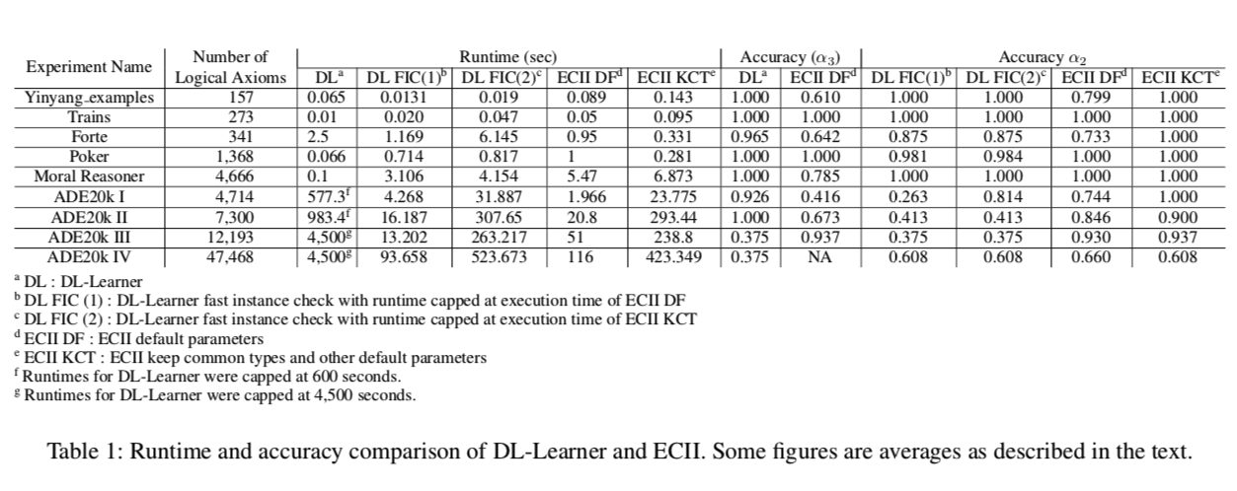
Experimental-Evaluation

Slide 10
Dataset & Result: Yinyang
Yinyang family relationship: Describe Father, Mother, Sibling, Brother, GrandParent etc.. from the dataset which consists of several family relation (hasChild, hasParent, hasSibling).
No. of axioms : 157
Father :
ECII: ∃ hasChild.Person , accuracy α₃ and α₂ Both are 1.
DL-Learner: ∃ hasChild.Person, accuracy 1.
Grandmother:
ECII: Female ⊔ Person ⊔ (¬Male), accuracy α₃ is 0.8 and α₂ is 0.65
DL-Learner: Female and (hasChild some (hasChild some Person)), accuracy 1
Reason we don’t have object chain.
Averaged accuracy α₃ is 0.61 and α₂ is 0.79, DL-Learner accuracy is 1.
Runtime was comparable for ECII and DL-Learner system (0.089s and 0.065s respective in).

Slide 11
Dataset & Result: Forte Family
Describe uncle from the dataset which consists of several family relation (married, sibling, parent).
No. of axioms: 341, ECII system slightly better than DL-Learner.
One solution:
ECII : male ⊔ (¬female)
accuracy α₃ is 0.534 and α₂ is .732
dl-learner: (married some (sibling some (married some female)))
accuracy .93
Reason: common types was removed from the candidate types at first.
ECII is better in terms of runtime.
ECII: 0.95 Second.
DL-Learner: 2.5 seconds.

Slide 12
Dataset & Result: Michalski train
Various attributes of train (shape, load size, wheel size etc is given).
Example involves 5 eastbound trains and 5 westbound trains.
Learns simple rule which distinguishes between eastbound and westbound trains.
Has 273 axioms.
DL-Learner outperforms ECII.
Solutions:
ECII: ∃ hasCar.(OpenCar ⊔ (¬LongCar))
accuracy α₃ is 1 and α₂ is also 1
DL-Learner: hasCar some (ClosedCar and ShortCar)
accuracy 1
DL-Learner outperforms ECII in terms of runtime.
ECII: 0.01 Second.
DL-Learner: 0.089 seconds.

Slide 13
Dataset & Result: Moral Reasoner
Moral Reasoner: Various attributes of harmful behavior is described using 102 positive and 102 negative instances. The model was intended to simulate how an ordinary person reasons about harm-doing. It has 4,666 axioms.
Solutions:
ECII: notaccident ⊔ (¬foreseeable), guilty ⊔ (¬foreseeable)
accuracy α₃ is .785 and α₂ is 1.
DL-Learner: severity_harm and (responsible or vicarious) and (not (benefit_victim))
accuracy 1
ECII outperforms DL-Learner in terms of runtime.
ECII: 0.1 Second.
DL-Learner: 5.47 seconds.
Reason: DL-Learner stopped as soon as it found 100% accuracy but ECII was run until finish.

Slide 14
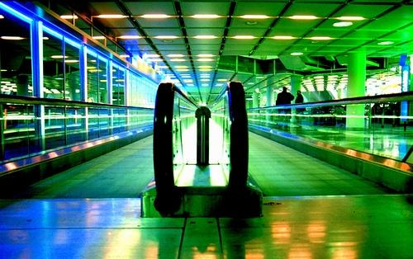
Dataset & Result: ADE20K
ADE 20K : More than 20,000 images classified into different classes and annotation added by human. We created ontology from the annotations and merged it with Suggested Upper Merged Ontology (SUMO). Created 4 different type of problem by varying the no of axioms size.
Attributes:
001 # 0 # 0 # wall #
003 # 0 # 0 # floor, flooring #
004 # 0 # 0 # ceiling #
005 # 0 # 0 # conveyer belt #
007 # 0 # 0 # bannister, banister #
010 # 0 # 0 # pane, pane of glass #
015 # 0 # 0 # column, pillar #
Create Axioms:
indiv1 imageContains obj1
obj1 rdf:Type wall

Slide 15
Dataset & Result: ADE20K I
Axioms size 4,714. Total 15 experiments.
Example: Airport terminal vs other 14 individuals from 14 classes.
Solutions:
ECII: ∃ imageContains.(Region ⊔ (¬Furniture) ⊔ (¬Physical))
accuracy α₃ is 1 and α₂ is also 1.
DL-Learner: (not (Advertisement)) and (imageContains some WN_Ceiling)
accuracy 0.87
ECII outperforms DL-Learner in terms of runtime.
ECII: 1.96 Second.
DL-Learner: 577 seconds.

Slide 16
Dataset & Result: ADE20K II
Axioms size 7,300. Total 5 experiments.
Example: Warehouse vs Workroom
Solutions:
ECII: ∃ imageContains.(StationaryArtifact ⊔ (¬Holder))
accuracy α₃ is 1 and α₂ is also 1.
DL-Learner: imageContains only ((not (Furniture)) and (not (Wastebasket)))
accuracy 1
ECII outperforms DL-Learner in terms of runtime.
ECII: 20.8 Second.
DL-Learner: 983 seconds.

Slide 17
Dataset & Result: ADE20K III
River vs other concepts in validation data.
Axioms size 12,193.
Example: River_validation vs other concepts starting with r letter.
Solutions:
ECII: ∃ imageContains.(Trees ⊔ (¬Device) ⊔ (¬Object))
accuracy α₃ is .516 and α₂ is also .937.
DL-Learner: Thing
accuracy 0.37
ECII outperforms DL-Learner in terms of runtime.
ECII: 116 Second.
DL-Learner: 4500 seconds.
River vs other concepts in training data produces same result.

Slide 18
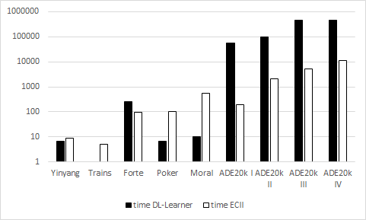
Runtime Comparison

Slide 19
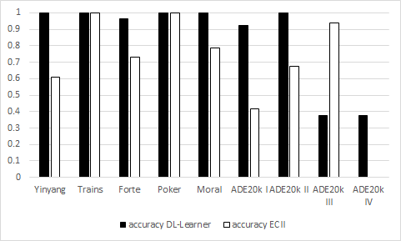

Accuracy Comparison ($α3$)

Slide 20
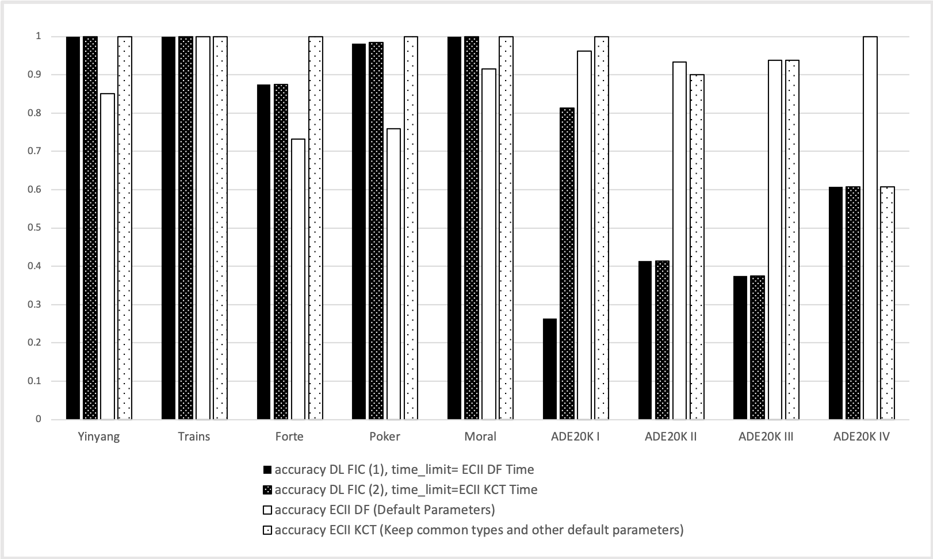

Accuracy Comparison ($α2$)

Slide 21
Question
Questions ?

Slide 22
Thanks
Thanks

