Slide 1
WELCOME TO OUR PRESENTATION

Slide 2
TEAM MEMBERS NAME :
1.Md Likhon Hossain (191-15-12605)
2.Md Zahirul islam mehadi (191-15-12223)
2.Md Mahfuzur Rahman (191-15-12378)
4.Arko Roy Badhon (191-15-12399)
5.Md Sarwar ahmed (191-15-12513)

Slide 3
We are going to make a project
On
TO DO LIST

Slide 4
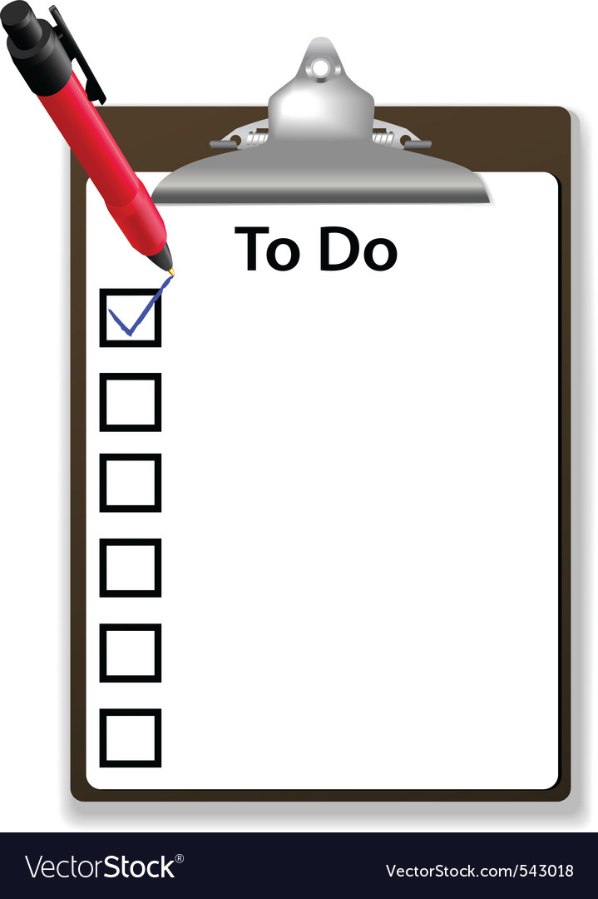
Introduction:
This To Do List help student to gather information about courses
then they can easily register them self in our system and they can know about the class information and course.

Slide 5
Problem Statement :
1. When we didn't use the online TO-DO list, it was a big problem to remember our class tasks.
2. When we add a task in to-do list , we do not receive any notifications. Or can't add alarm.
3. The control system is not very good in the To-Do list we are using now.

Slide 6

Motivation:
1.When you write a to-do item for someone else to read
you tell them what actually has to happen, but when
you write it for yourself, you leave yourself a cryptic
note.
2. The primary purpose of a to-do list is to set your mind at ease that you know what your responsibilities are. That's the main reason you should keep one. A close second is that is this: a to-do list helps prevent your most urgent things from slipping through the cracks—it prevents you from dropping any major balls.

Slide 7
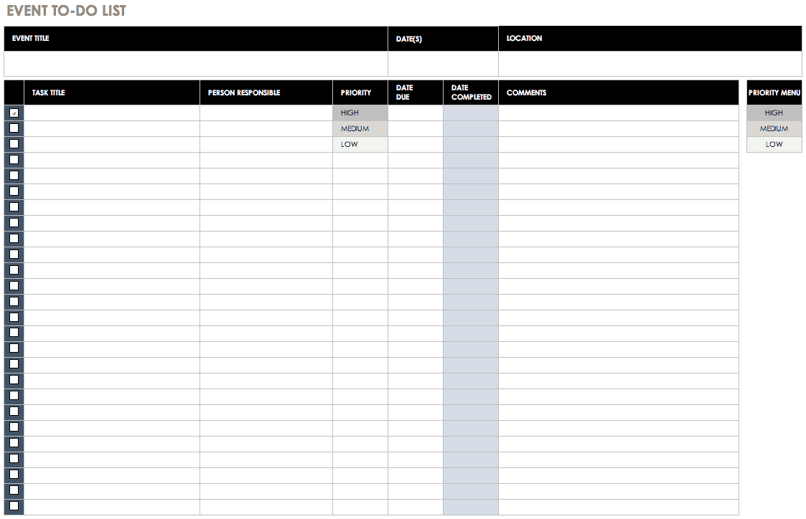
Proposed Methodology:
In this System we have two account facilities( CR & student).
If you have not any account this site ,you can create account.
When student or CR create account ,
system take some information : name,
username, email, password, gender.
CR and student have different username
and email.
By the TO DO LIST, we can know class schedule,
exam routine , quize time, assignment, lab task,
Home work,notification

Slide 8

Proposed Methodology:
CR can publish any thing to the list and
He can update the List any time
Student can’t publish any thing to the list
If student want to publish any course ,
student must convert account into CR account.
Student can view only .
If student feel any problem , they can comment on it

Slide 9
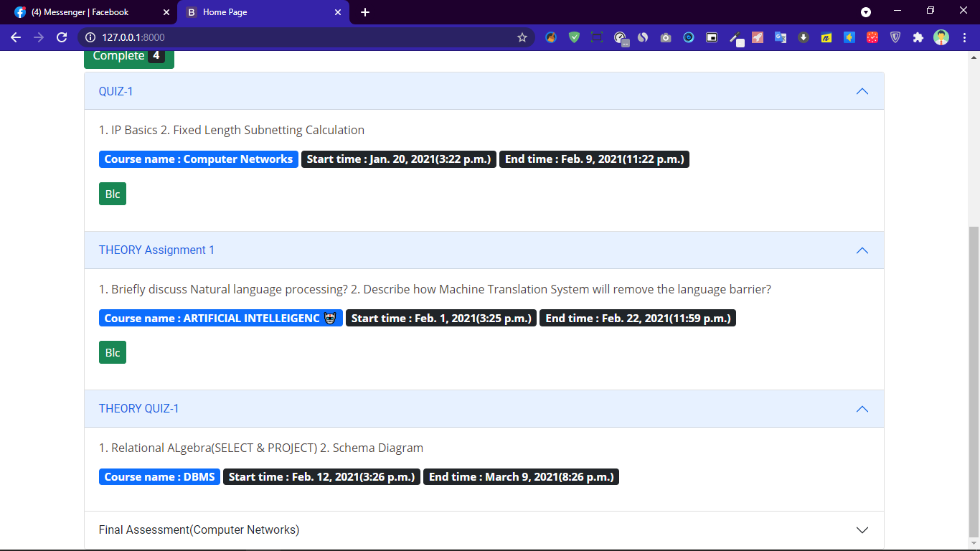
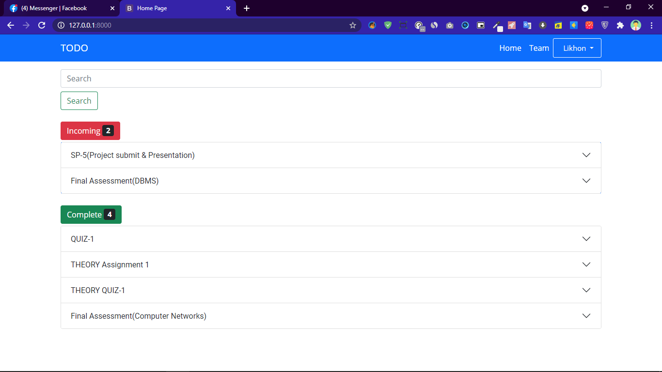
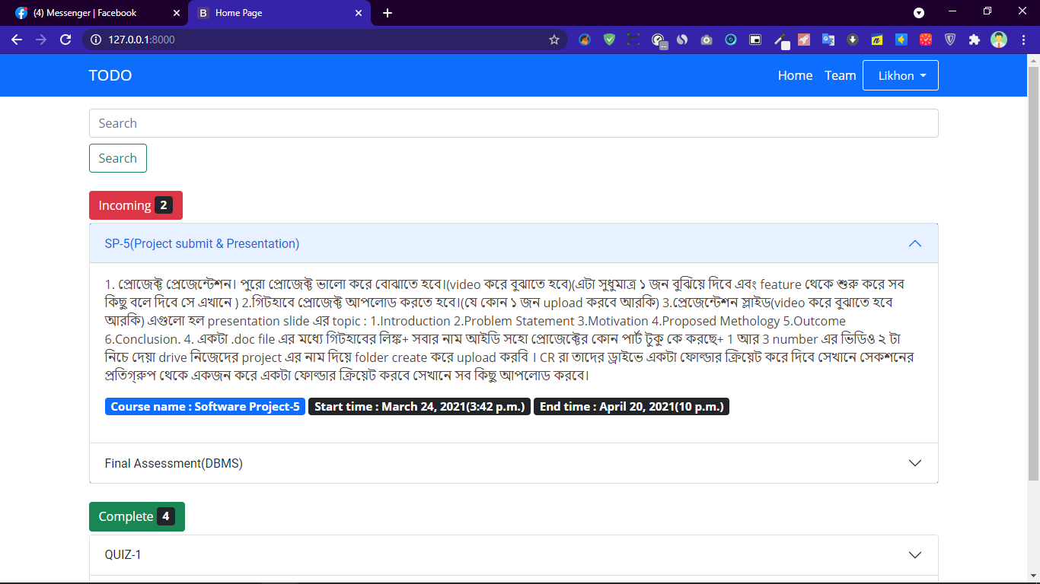
Here is Some Screenshot:

Slide 10
Outcome:
1. To-do lists reduce flexibility
2. You don’t need a list because you
can remember what you need to-do
3.It will help you feel good
4.It will help you achieve big goals
5.It will let you save time
6.It will help you be more reliable

Slide 11
Conclusion:
Software todo-list performs very efficient comparing to competitor. There is a space for further developments with regards of keeping app small and quick. It would be optimal to use dedicated html, CSS and continuing using JavaScript.
To-do-app can be developed as a sole Software as well as a very efficient module to be combined in a larger project. One of the key challenges is to chose appropriate storage solution, that will allow to maintain its biggest advantages.

Slide 12
THANK YOU

