Slide 1

Six attributes of unhealthy conversations
Presented by
Saiadul Arfain ID: 18301007
Md. Minhajul Islam ID: 19201117

Slide 2
INTRODUCTION
Comments compiled in UCC(Universal Comments Corpus)
Six sub-attributes identified among unhealthy online conversations
Results in online bullying and reduced online participation
Objective of the research is to encourage a safer digital space for users through NLP

Slide 3
Literature review
The datasets deployed in the research are namely – UCC(Universal Comments Corpus) and SFU comments corpus.
Comments selected from Globe Mail News site (Sample of SFU and UCC) (kolhatkar et al., 2019).
Comments of 250 characters or less selected at a random for further annotation and scoring for unhealthy sub-attributes.
Use of the BERT model ( Devil et al., 2019) to produce refined classifiers with incremental results.

Slide 4
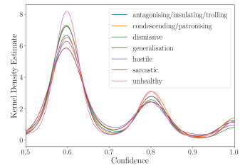
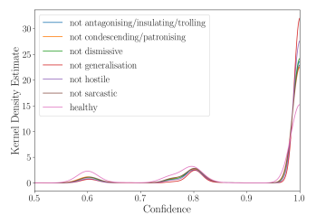
DATASET ANALYSIS
Attribute | Proportion
Antagonistic/Insulting/Trolling Condescending/Patronising Dismissive (Unfair) Generalisation Hostile Sarcastic Unhealthy | 4.7% 5.5% 3.1% 2% 2.5% 4.3% 7.5%
The Dataset comprises of 44,355 comments.
confidence scores
labelled as ’yes’
confidence scores labelled as ’no’

Slide 5
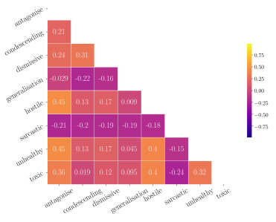
Inter-attribute correlations
Attribute | K-α
Antagonistic/Insulting/Trolling Condescending/Patronising Dismissive (Unfair) Generalisation Hostile Sarcastic Unhealthy | 0.39 0.36 0.31 0.35 0.36 0.34 0.26
Krippendorff’s alpha by attribute

Slide 6
Models and Results
A pre-trained machine learning model BERT and fine-tuning on the dataset.
Comparison of BERT model with human model.
Estimate variability of judgements and average the results.
Attribute | Human AUC | BERT AUC
Antagonistic Condescending Dismissive Generalisation Hostile Sarcastic Unhealthy | 0.71 0.72 0.68 0.73 0.76 0.72 0.62 | 0.82 0.78 0.82 0.74 0.84 0.64 0.69

Slide 7
Conclusion
Practical efficiency of the research.
Exploring unintended biases.
Future works on detecting early signs of conversational failure.

