Slide 1
Writing and Completing Business Reports and Proposals

Slide 2
Three-Step Writing Process
Planning
Writing
Completing
Analyze the Situation
Investigate the Topic
Adapt to the Audience
Organize the Message
Compose the Message
Revise the Message
Produce the Message
Proofread the Message
Notes:
Once you’ve planned out your document (see Chapters 3 and 10), you’re ready to begin Step 2, writing business reports and proposals. Since so much of Step 2 is discussed in Chapter 4, the following sections cover only those aspects of writing that differ for reports and proposals. Think carefully about all the relevant tasks as you organize and compose your reports and proposals.

Slide 3
Organizing Reports and Proposals
Format
FLOS
Collected
Material
Length
Business
Document
Order
Structure
Notes:
Before you can compose a business report or proposal, you must organize the material you've collected, arranging it in a logical order that meets your audience's needs. Carefully choose the format, length, order, and structure for your report or proposal before drafting even the first word.

Slide 4

Selecting
Format and Length
Preprinted Form
Letter
Memorandum
Manuscript
mPLm
Notes:
At times, the decision about format and length will be made for you by the person who requests the report. This is often the case with monitor/control reports, procedural reports, proposals, progress reports, and compliance reports. When selecting a format for your report, you have four options:
Preprinted form. Used for fill-in-the-blank reports. Most are relatively short (five or fewer pages) and deal with routine (often numerical) information. Use this format when it's requested by the person authorizing the report.
Letter. Commonly used for reports of five or fewer pages that are directed to outsiders. These reports include all the normal parts of a letter, but they may also have headings, footnotes, tables, and figures.
Memo. Commonly used for short (fewer than 10 pages) informal reports distributed within an organization. Like longer reports, they often have internal headings and sometimes include visual aids. Memos exceeding 10 pages are sometimes referred to as memo reports to distinguish them from their shorter cousins.
Manuscript. Commonly used for reports that require a formal approach, whether a few pages or several hundred. As length increases, reports in manuscript format require more elements before the text (prefatory parts) and after (supplementary parts).

Slide 5
Choosing an Approach
Direct Approach
Indirect Approach
Receptive
Hostile
Open-Minded
Skeptical
Audience
Notes:
The direct approach is by far the most popular and convenient order for business reports, saving time and making the report easier to follow. It also produces a more forceful report because stating your conclusions confidently in the beginning makes you sound sure of yourself. However, if your readers have even slight reservations about either you or your material, making strong statements at the beginning may intensify reader resistance. Also, confidence may sometimes be misconstrued as arrogance—especially if you're a junior member of a status-conscious organization.
If your audience is skeptical or hostile, you may want to use the indirect approach, introducing your complete findings and discussing all supporting details before presenting your conclusions and recommendations. The indirect approach gives you a chance to prove your points and gradually overcome your audience's reservations.
The longer the message, the less effective an indirect approach is likely to be. Also, an indirect argument is harder to follow than a direct one. Therefore, carefully consider report length before deciding on the direct or indirect approach.
Both direct and indirect approaches have merit, so businesspeople often combine them, revealing their conclusions and recommendations as they go along, rather than treating them first or last.

Slide 6
Structuring
Informational Reports
Importance
Sequence
Chronology
Csis gc
Spatial
Orientation
Geography
Category
Notes:
Informational reports are the easiest to organize because they provide nothing more than facts. When writing informational reports, reader reaction is not usually an issue. Most readers will presumably respond unemotionally to your material, so you can present it in the most direct fashion possible. What you do need to be concerned about is reader comprehension; therefore, information must be presented logically and accurately.
Informational reports use a topical organization, arranging material according to one of these following topics:
Importance. If you're reviewing five product lines, you might organize your study according to the sales for each product line, beginning with the line that produces the most revenue and proceeding to the one that produces the least.
Sequence. If you're studying a process, discuss it step by step.
Chronology. When investigating a chain of events, organize the study according to what happened in January, what happened in February, and so on.
Spatial orientation. If you're explaining how a physical object works, describe it left to right, top to bottom, outside to inside.
Geography. If location is important, organize your study according to geography, perhaps by region of the United States or by area of a city.
Category. If you're asked to review several distinct aspects of a subject, look at one category at a time, such as sales, profit, cost, or investment.

Slide 7
Structuring
Analytical Reports
Audience
Receptive
Unreceptive
Focusing on
Conclusions
Focusing on
Recommendations
Focusing on
Logical Arguments
Direct
Indirect
Notes:
When writing for people who are likely to be receptive to your conclusions, structure your report around conclusions using a direct approach.
When structuring a report around recommendations, use the direct approach as you would for a report that focuses on conclusions. Then, unfold your recommendations using a series of five steps:
1. Establish the need for action in the introduction, generally by briefly describing the problem or opportunity.
2. Introduce the benefit that can be achieved, without providing any details.
3. List the steps (recommendations) required to achieve the benefit, using action verbs for emphasis.
4. Explain each step, giving details on procedures, costs, and benefits.
5. Summarize the recommendations.
If you expect your audience to be unreceptive, use the indirect approach and arrange your ideas around the reasoning behind your report’s conclusions and recommendations. Organize your material to reflect the thinking process that will lead readers to your conclusions.

Slide 8
Structuring Proposals
Solicited
Unsolicited
Receptive Audience
Recognized Problem
Identified Solution
Skeptical Audience
Unrecognized Problem
Proposed Solution
Rri sup
Notes:
Just as with reports, your choice of structural approach for proposals depends on whether you expect your audience to be receptive. In general, your audience may be more receptive with solicited proposals since the problem and the solution have already been identified. The writer submits a proposal for the work specified in the RFP that is issued by the prospective client, and structures the proposal using a direct approach, focusing on the recommendation.
The indirect approach may be a better choice for unsolicited proposals. You must first convince the audience that a problem exists and establish your credibility if you are unknown to the reader. Unfold your solution to the problem by focusing on your logical argument. As you unfold your solution, (1) try to persuade readers to accept your idea and award you a contract, and (2) spell out the terms of your proposal in the report’s content.

Slide 9
Selecting Visual Aids
BAR FOT PIL
Tables
Line and
Surface Charts
Bar Charts
Pie Charts
Flowcharts
Organization
Charts
Notes:
Once you've selected which points to illustrate visually, your next step is to select the type of visual that will present your data most clearly and effectively to your audience. Keep in mind that most visuals are not interchangeable. Some types of visuals depict certain kinds of data better than others:
To present detailed, exact values, use tables.
To illustrate trends over time, use a line chart or a bar chart.
To show frequency or distribution, use a pie chart, segmented bar chart, or area chart.
To compare one item with another, use a bar chart.
To compare one part with the whole, use a pie chart.
To show correlations, use a line chart, a bar chart, or a scatter (dot) chart.
To show geographic relationships, use a map.
To illustrate a process or a procedure, use a flowchart or a diagram.

Slide 10
The Parts of a Table
Multicolumn Head*
Single
Column
Head
Single
Column
Head
Stub head
Subhead
Subhead
Row head
Row head
Subhead
Subhead
Total
XXX
XX
XX
XXX
XXX
XXX
XXX
XXX
XX
XX
XX
XX
XX
XX
XX
XX
Source: (In the same format as a text footnote).
*Footnote (for explanation of elements in the table).
Notes:
When you have to present detailed, specific information, choose a table, a systematic arrangement of data in columns and rows. Tables are ideal when the audience needs the information that would be either difficult or tedious to handle in the main text.
Most tables contain the standard parts illustrated above.

Slide 11
Preparing Tables
Use common, clearly identified units
Use the same units for all items in a column
Label column headings
Separate rows and columns
Document data sources
Sul du
Notes:
Many tables are strictly numerical. When preparing such tables, observe the following guidelines:
Use common, understandable units, and clearly identify the units you're using: dollars, percentages, price per ton, or whatever.
Express all items in a column in the same unit, and round off for simplicity.
Label column headings clearly, and use a subhead if necessary.
Separate columns or rows with lines or extra space to make the table easy to follow.
Document the source of the data using the same format as a text footnote.

Slide 12
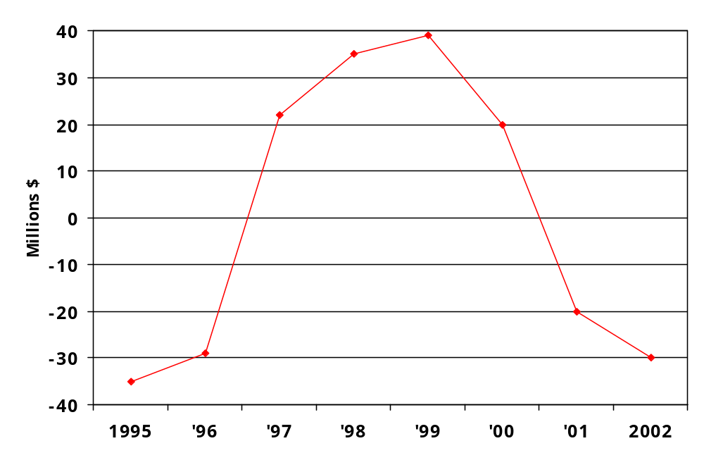
Line Chart: Net Operating Income/Loss of Santa Monica Studios
Notes:
A line chart illustrates trends over time or plots the relationship of two variables. In line charts showing trends, the vertical, or y, axis shows the amount, and the horizontal, or x, axis shows the time or the quantity being measured.
The line chart above illustrates the dramatic fluctuation in operating income at a fictional company, Santa Monica Studios.

Slide 13
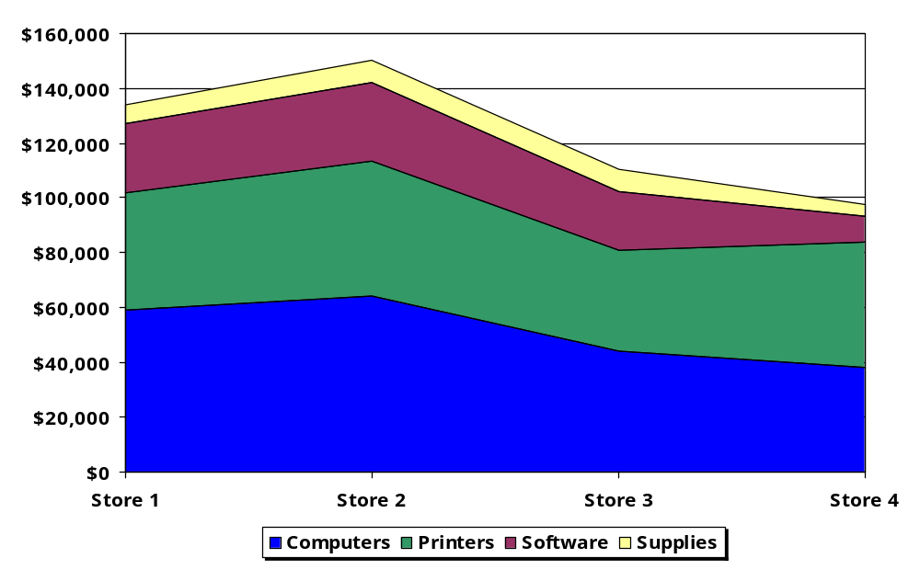
Surface Chart: Average Monthly Sales at Computer Land
Notes:
A surface chart, also called an area chart, is a form of line chart with a cumulative effect; all the lines add up to the top line, which represents the total. This form of chart helps you illustrate changes in the composition of something over time. When preparing a surface chart, put the most important segment against the baseline, and restrict the number of strata to four or five.
The surface chart above illustrates average monthly sales at a fictional company, Computer Land.

Slide 14
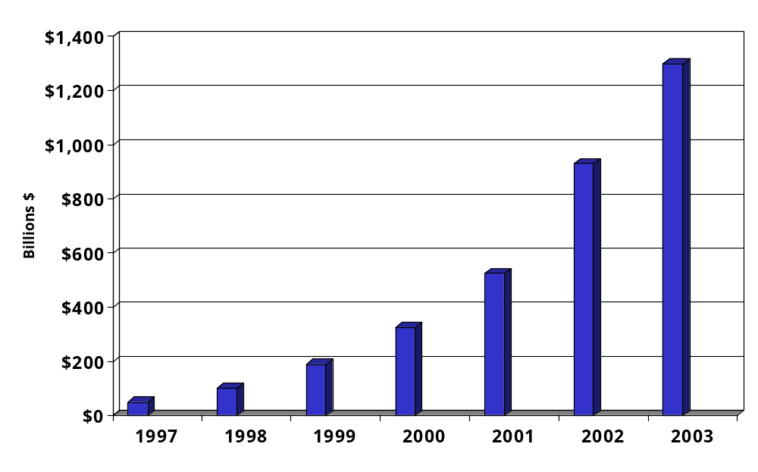
Bar Chart: Total Internet Sales 1997-2003
Notes:
A bar chart portrays numbers by the height or length of its rectangular bars, making a series of numbers easy to read or understand. Bar charts are particularly valuable when you want to
Compare the size of several items at one time
Show changes in one item over time
Indicate the composition of several items over time
Show the relative size of components of a whole
You can be creative with bar charts in many ways. You can align the bars either vertically or horizontally. But be careful to keep all the bars in the chart the same width; otherwise, you seem to mislead viewers by implying a relative importance for various bars. Also space the bars evenly and place them in a logical order such as chronological or alphabetical.
The bar chart above illustrates the dramatic increase in sales volume on the Internet, over time.

Slide 15
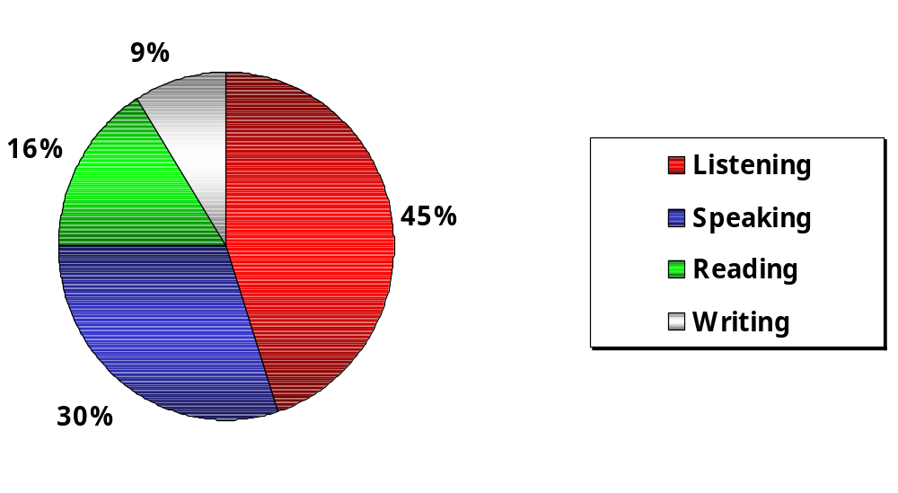
Usage of Business Communication Channels
Notes:
Like segmented bar charts and area charts, a pie chart shows how parts of a whole are distributed. Each segment represents a slice of a complete circle, or pie. Pie charts are an effective way to show percentages or to compare one segment with another.
When composing pie charts, restrict the number of slices. Otherwise, the chart looks cluttered and is difficult to label. If necessary, lump the smallest pieces together in a "miscellaneous" category. Ideally, the largest or most important slice of the pie, the segment you want to emphasize, is placed at the twelve o'clock position; the rest are arranged clockwise either in order of size or in some other logical progression.
Use different colors or patterns to distinguish the various pieces. If you want to draw attention to the segment that is of the greatest interest to your readers, use a brighter color for that segment, draw an arrow to the segment, or explode it; that is, pull the segment away from the rest of the pie. In any case, label all the segments and indicate their value in either percentages or units of measure so that your readers will be able to judge the value of the wedges. Remember, the segments must add up to 100 percent if percentages are used or to the total number if numbers are used.
The pie chart above illustrates the typical usage of channels in typical business communication.

Slide 16
Flow Chart: The Report Writing Process
Keyboard
Input
First
Hard Copy
Next
Hard Copy
Edit
Edit
OK?
Yes
Yes
Submit
Report
No
Add?
Keyboard
Input/Edit
Keyboard
Input/Edit
No
Style and
Spelling
Style and
Spelling
Notes:
If you need to show physical or conceptual relationships rather than numerical ones, you might want to use a flowchart, illustrating a sequence of events from start to finish. Flow charts are indispensable when illustrating processes, procedures, and sequential relationships.
The flow chart above diagrams the report-writing process. It shows that the various elements in the process you want to portray may be represented by pictorial symbols or geometric shapes.

Slide 17
Organization Chart
Chief Executive
Officer
Executive
Vice President
President
Executive
Vice President
Vice
President
Vice
President
Vice
President
Vice
President
Vice
President
Region
1
Region
2
Region
3
Region
4
Region
5
District
A
District
B
District
C
District
D
District
E
District
F
District
G
Notes:
As the name implies, an organization chart illustrates the positions, units, or functions of an organization and the way they interrelate. An organization's normal communication channels are almost impossible to describe without the benefit of an organization chart like the one above.

Slide 18
Using Computers to Create Visuals
Advantages
Challenges
Speed
Image
Accuracy
Message
Ease of Use
Audience
Notes:
Professional-looking graphics used to be extremely expensive and time-consuming to produce, but personal computer technology has changed all that. Instead of relying on graphic designers, businesspeople are turning out their own professional-looking visual aids with computer graphics: visuals created and produced using a computer program.
Using computer graphics gives you several advantages, including speed, accuracy, ease of use. You also gain the ability to save the results and use the visuals over and over again in various reports. But before using any computer-graphics tools, think about the kind of image you want to project. The style of your visuals communicates a subtle message about your relationship with your audience. The image you want to project should determine the visual you use, whether it’s a simple, hand-drawn diagram for a working meeting or full-color visuals for a formal presentation or report.

Slide 19
Composing Reports and Proposals
Text and Content
TD TN
Degree of Formality
Time Perspective
Navigational Clues
Notes:
As you compose your report or proposal, use the writing process discussed in Chapter 5: Control your style and tone, select the best words, and create effective sentences and paragraphs. When writing reports, additional tasks include developing the text, drafting the content for your reports and proposals, using a proper degree of formality, sticking with a consistent time perspective, and providing clues to help readers navigate your document.

Slide 20
Successful Reports
Accurate
Complete
Balanced
Structured
Documented
sabcd
Notes:
The content and quality of your reports will likely influence your professional success, because they show how well you think, gather and analyze data, draw conclusions, and develop and support your recommendations. Your credibility and future success is on the line with every business report you write. You’ll create more successful reports if your content is as follows:
Accurate. Information presented in a report must be factually correct and error free. When writing reports, be sure to double-check your facts and references in addition to checking for typos.
Complete. To help colleagues or supervisors make a decision, include all the information necessary for readers to understand the situation, problem, or proposal. Support all key assertions using illustrations, explanations, and facts. Tell your readers what they need to know, in a way that meets their needs.
Balanced. Present all sides of the issue fairly and equitably, and include all the information necessary. Omitting relevant information or facts can make your report biased.
Structured clearly and logically. Clear sentence structure and good transitions are essential. Identify the ideas that belong together, and organize them in a way that's easy to understand.
Documented properly. If you use primary and secondary sources for your report or proposal, properly document and give credit to your sources.

Slide 21

Successful Proposals
Demonstrate your knowledge
Provide concrete examples
Research the competition
Prove that your proposal is workable
Adopt a “you” attitude
Package your proposal attractively
DAP PRP
Notes:
The general purpose of any proposal is to persuade the readers to do something. Your proposal must sell your audience on your ideas, product, service, methods, and company. Just as with any persuasive message, you use the AIDA plan to gain attention, build interest, create desire, and motive action. Here are some additional strategies to strengthen your argument:
Demonstrate your knowledge. Everything you write should show your reader that you have the knowledge and experience to solve the problem.
Provide concrete examples. Avoid vague, unsupported generalizations. Instead, provide quantifiable details. Spell out your plan and give details on how the job will be done. Such concrete examples persuade readers; unsupported generalizations don’t.
Research the competition. This strategy is especially important if you are competing against others for a job.
Prove that your proposal is workable. Your proposal must be appropriate and feasible for the audience.
Adopt a “you” attitude. Relate your product, service, or personnel to the reader’s exact needs.
Package your proposal attractively. Make sure your proposal is letter perfect, inviting, and readable.

Slide 22
The Introduction
somc
Context
or Problem
Subject
or Purpose
Main Ideas
Overall
Tone
Notes:
In the introduction, prepare your readers for the information that follows. Invite them to continue reading by telling them what the report is about, why the audience should be concerned, and how the report is organized.
In proposals, use the introduction to present the problem you want to solve and to summarize your solution. Orient readers to the remainder of the text. In a solicited proposal, refer to the RFP in your introduction; in an unsolicited one, mention any factors that led you to submit your proposal.
In a report or proposal, your introduction should accomplish four tasks:
Tie the report or proposal to a problem or an assignment.
Introduce the report’s subject (purpose) and why it is important.
Preview the main ideas and the order in which they’ll be covered.
Establish the tone of the document and your relationship with the audience.

Slide 23
The Body Chapters
Present
pais
Analyze
Interpret
Support
Notes:
In the body of your reports and proposals, include the major divisions or chapters that present, analyze, and interpret the information you gathered during your investigation. Give complete details of your proposed solution and specify what results you anticipate. The body contains the "proof," the detailed information necessary to support your conclusions and recommendations.

Slide 24

The Closing Section
Emphasizes the Main Points
Summarizes the Benefits
esrb
Reinforces the Structure
Brings Action Items Together
Notes:
The close is the final section of the text in your report or proposal. Leave a strong and lasting impression. This is your last chance to make sure that your report says what you intended. In proposals, the close is your last opportunity to persuade readers to accept your suggestions. In both formal and informal proposals, be brief, assertive, and confident. Your close should accomplish four goals:
1. Emphasize the main points of the message.
2. Summarize reader benefits (if some change or action is suggested).
3. Refer to all the pieces and remind readers how those pieces fit together.
4. Bring all the action items together in one place and give details about who should do what, when, where, and how.

Slide 25
Additional
Report-Writing Tasks
Formality
Time Frame
Overall Structure
Notes:
If you know your readers reasonably well and if your report is likely to meet with their approval, you can generally adopt a fairly informal tone. Use a more formal tone for longer reports, especially those dealing with controversial or complex information, and for reports that will be sent to other parts of the organization or to customers or suppliers. Also, communicating with people in other cultures often calls for more formality.
By switching from tense to tense throughout your report, you only confuse your readers. They wonder whether the shift is significant or whether you are just being sloppy. Eliminate such confusion simply by using tense consistently. Also be careful to observe the chronological sequence of events in your report.
Readers have no concept of how the various pieces of your report are related. Give them a sense of the structure of your document by using three tools:
Headings. These brief titles cue readers about the content of a section. Subheadings (lower-level headings) show which ideas are more important.
Transitions. These words or phrases tie ideas together and show how one thought is related to another.
Previews and reviews. Preview sections introduce an important topic, helping readers get ready for new information. Review sections come after a body of material and summarize the information for readers, helping them absorb details while keeping track of the big picture.

Slide 26
Completing Reports and Proposals
Revising
Rpp
Producing
Proofreading
Notes:
The best business communicators know how to communicate quickly and courteously. They know how to refrain from putting into writing anything that could come back to haunt them. And they know how important it is to proofread e-mail messages before sending them. Following basic e-mail etiquette means being courteous, brief, and careful.

Slide 27
Components of Formal Reports
Type of
Report
pts
Prefatory
Parts
Text of
the Report
Supplementary
Parts
Audience
Needs
Report
Length
Type of
Company
Notes:
A formal report's manuscript format and impersonal tone convey an impression of professionalism. A formal report can be either short (fewer than 10 pages) or long (10 pages or more). It can be informational or analytical, direct or indirect. It may be written for internal or external audiences. What sets it apart from other reports is its polish.
The parts included in a report depend on the type of report you are writing, the requirements of your audience, the organization you're working for, and the length of your report. The components fall into three categories, depending on where they are found in a report: prefatory parts, text of the report, and supplementary parts.

Slide 28
Prefatory Parts
Cover
Letter of
Authorization
List of
Illustrations
CTL LLT LSE
Title Fly
or Title Page
Letter of
Transmittal
Synopsis
or Abstract
Letter of
Authorization
Table of
Contents
Executive
Summary
Notes:
Many companies have standard covers for reports. If your company has no standard covers, look for a cover that is appropriate to the subject matter.
The title fly is a plain sheet of paper with only the title of the report on it. You don't really need one, but it adds a touch of formality.
The title page includes four blocks of information: (1) title of the report; (2) name, title, and address of the person, group, or organization that authorized the report; (3) name, title, and address of the person, group, or organization that prepared the report; and (4) date on which the report was submitted.
The letter or memo of authorization is a document requesting that a report be prepared. The letter or memo of acceptance acknowledges the assignment to conduct the study and to prepare the report. The letter or memo of transmittal conveys your report to your audience.
The table of contents indicates in outline form the coverage, sequence, and relative importance of the information in the report.
Some reports refer to all visual aids as illustrations or exhibits. In some, tables are labeled separately from figures. Regardless of the system used to label visual aids, the list of illustrations gives their titles and page numbers.
A brief overview of a report's most important points is called a synopsis (or abstract in technical or academic reports). An executive summary is a fully developed "mini" version of the report.

Slide 29
Text of the Report
Introduction
Body
Closing
Notes:
Although reports may contain a variety of components, the heart of a report is always composed of three main parts: an introduction, body, and conclusion.
A good introduction helps the reader follow and comprehend the information that follows. It invites the audience to continue reading by telling them what the report is about, why the audience should be concerned, and how the report is organized.
This section contains the information that supports your conclusions and recommendations as well as your analysis, logic, and interpretation of the information. Most inexperienced writers have a tendency to include too much data in their reports or place too much data in paragraph format instead of using tables and charts. Such treatment increases the chance of boring or losing the audience. If you find yourself with too much information, include only the essential supporting data in the body, use visuals, and place any additional information in an appendix.
In very general terms, you want the closing of your report to summarize the main idea of your report, highlight your conclusions or recommendations, and list any courses of action you expect the reader to take.

Slide 30
Supplementary Parts
BIA
Appendixes
Bibliography
Index
Notes:
Supplementary parts follow the text of the report and provide information for readers who seek more detailed discussion. Supplements are more common in long reports than in short ones, and typically include the appendixes, bibliography, and index.
An appendix contains materials related to the report but not included in the text because they're too lengthy or bulky or because they lack direct relevance. Frequently included in appendixes are sample questionnaires and cover letters, sample forms, computer printouts, statistical formulas, financial statements and spreadsheets, copies of important documents, and complex illustrations; a glossary may be put in an appendix or may stand as a separate supplementary part. The best place to include visual aids is in the text body nearest the point of discussion. But if any visuals are too large to fit on one page or are only indirectly relevant to your report, they too may be put in an appendix.
You have an ethical and a legal obligation to give other people credit for their work. A bibliography is a list of secondary sources consulted when preparing the report.
An index is an alphabetical list of names, places, and subjects mentioned in the report, along with the pages on which they occur (see the index for this book). An index is rarely included in unpublished reports.

Slide 31

Components of
Formal Proposals
Proposal
Cover
Title Fly
Title Page
Table
of Contents
Pttt lrel
List of
Illustrations
Request
for Proposal
Executive
Summary
Letter of
Transmittal
Notes:
The cover, title fly, title page, table of contents, and list of illustrations are handled the same as in other formal reports. However, other prefatory parts are handled quite differently, such as the copy of the RFP, the synopsis or executive summary, and the letter of transmittal.
Instead of having a letter of authorization, a formal proposal may have a copy of the request for proposal (RFP), which is a letter or memo soliciting a proposal or a bid for a particular project.
You may include a synopsis or an executive summary; however, they are often less useful in a formal proposal than in a formal report. If your proposal is unsolicited, your transmittal letter will already have caught the reader's interest. It may also be pointless if your proposal is solicited, since the reader is already committed to studying your proposal to find out how you intend to satisfy the terms of a contract.
The way you handle the letter of transmittal depends on whether the proposal is solicited or unsolicited. If the proposal is solicited, the transmittal letter follows the pattern for good-news messages, highlighting those aspects of your proposal that may give you a competitive advantage. If the proposal is unsolicited, the transmittal letter follows the pattern for persuasive messages. The letter must persuade the reader that you have something worthwhile to offer, something that justifies the time required to read the entire proposal.

Slide 32
Text of the Proposal
Solicited
Introduction
Body
Closing
Formal
Informal
Unsolicited
Notes:
Just as with reports, the text of a proposal is composed of three main parts: an introduction, body, and conclusion. The content and depth of the parts depend on whether the proposal is solicited or unsolicited, formal or informal.
Introduction. This section presents and summarizes the problem you intend to solve and your solution to that problem, including any benefits the reader will receive from the solution.
Body. This section explains the complete details of the solution: how the job will be done, how it will be broken into tasks, what method will be used to do it (including the required equipment, material, and personnel), when the work will begin and end, How much the entire job will cost (including a detailed breakdown), and why your company is qualified.
Closing. This section emphasizes the benefits that readers will realize from your solution, and it urges readers to act.

