Slide 1
The Google File System
Group - 7
Md Akibur Rahman Khan | 18301050
Tahmid Ashrafee Promit | 18301068
Md Ibrahim Ratul | 18301113
Fahmim Tanjila | 18301118
Md Mostafa | 18301132

Slide 2
Introduction : GFS (Google File System)
A scalable distributed file system for large distributed data-intensive applications.
Reexamined traditional choices and explored radically different points in the design space.
The file system consists of hundreds or even thousands of storage machines built from inexpensive commodity parts and is accessed by a comparable number of client machines.
Files are huge by traditional standards so I/O operation and block sizes have to be revisited.
Most files are mutated by appending new data rather than overwriting existing data.
Co-designing the applications and the file system API benefits the overall system by increasing our flexibility.
This system proposed a relaxed GFS consistency model to vastly simplify the file system without imposing an onerous burden on the applications.

Slide 3
Design Overview
The system constantly monitors itself and detects, tolerates, and recovers promptly from component failures on a routine basis.
The system stores a modest number of large files and small files must be supported but no need to be optimized.
The workloads primarily consist of two kinds of reads: large streaming reads and small random reads.
The proposed system must efficiently implement well-defined semantics for multiple clients that concurrently append to the same file.
For an individual read or write high sustained bandwidth is more important than low latency

Slide 4
Interface and Architecture
Interface : In this proposed system files are organized hierarchically in directories and identified by path names. It also supports snapshot and record append operations.
Architecture: This system has a single master and multiple chunk servers which can be accessed by multiple clients. To run a user level server process a commodity Linux machine system is used. Files are divided into unique 64 bit chunk handles assigned by the master at the time. The master maintains system metadata.

Slide 5
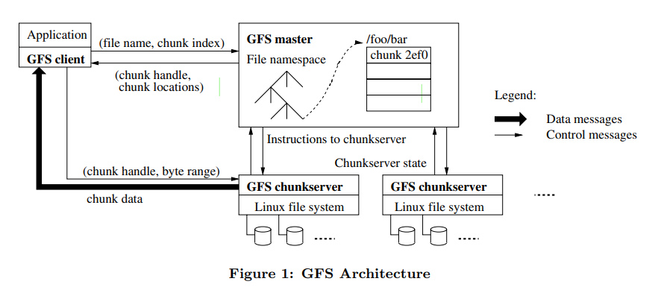
GFS Architecture

Slide 6
Metadata
In-Memory Data Structures
In the master's memory three main types of metadata are stored.
The file and chunk namespaces.
The mapping from the files to chunk.
The locations of each chunk’s replicas.
A log system helps the master to update the state simply, reliably, and without running the danger of inconsistent updates in the event of a master crash.
Operations of the master is very fast because the data are stored in the memory.
For each 64 MB chunk, the mass storage device keeps metadata in less than 64 bytes.
If a larger file system is required, at a very minimal cost the storage capacity can be updated. And this advantage is due to storing the metadata in the memory.

Slide 7
Metadata
Chunk locations
With regular HeartBeat the master controls all chunk placement and monitors chunkserver status regularly, for this it always stays up-to-date.
The chunk location information is requested from the chunk servers at startups, for this the chunk servers and master are not required to stay in sync.
Operation log
It contains a record of critical metadata changes.
With maintaining a constant record of metadata, it also maintains a logical timeline that ensures a concurrent order of operations.
The master maintains a certain size of the log, which helps to minimize the startup time.
Master can create new checkpoints without delaying incoming mutations.
If data is lost, recovery only requires the latest complete checkpoint and related log files.

Slide 8
Consistency Model
Guarantees by GFS :
If all clients consistently view the same data, regardless of which replicas they read from, then a file region is consistent.
Data mutations are done by writes or by record appends.
If a series of successful mutations occurs then a guarantee can be given that the last mutation data was written.
GFS applies mutations in the same manner to all replicas.
It also uses chunk version numbers to ensure if any replicas has missed mutations due to any problems.
Due to many component failures successful mutations can also be corrupted. So by regular handshaking between the master and all chunk servers the data corruption is checked by checksumming.
Only if GFS doesn’t react within a minute, then the chunk might get lost.

Slide 9
Consistency Model
Implications for Applications
GFS uses some techniques to persist its consistency.
Appending rather than overwriting because appending is more efficient.
Checkpointing: After a writer writes something the data is checked by checkpoints to ensure how much data has been successfully written.
Writing self-validating: Some extra information is added with a record like checksums to help in validation.
Writing self-identifying records.

Slide 10
System Interactions
Leases and Mutations Order
Leases are used to maintain a consistent order of mutations among replicas.
Primary: It is a chunk lease to replicas that the master offers. Primary picks a serial order for all the mutations.
Lease minimizes the overhead at the master as it has a 60 seconds timeout.
Master can also nullify a lease before it expires and can initiate a new lease.
Data Flow
The main goal of GFS is to fully utilize.
Each machine’s network bandwidth: A pipelined approach is used to push data linearly along a well-selected chain of chunk servers.
Avoid network bottlenecks and high-latency links: The data are sent to the closest machine in the network topology that has not received it.
Minimize latency by pipelining because it uses a switched network with full-duplex links.

Slide 11
Atomic Record Appends
Snapshot
GFS provides an atomic append operation called record append.
Record append is heavily used.
Complicated and expensive synchronization.
Primary replica -
Checks if append exceeds max chunk size.
Padding chunks.
Secondaries do the same.
Retiring the operation at next chunk.
The snapshot operation makes a copy of a file or a directory tree.
Revokes outstanding leases
opportunity to create a new copy of the chunk.
The master logs the operation to disk
First write after snapshot operation
Create new chunk C’.
Data can be locally copied.

Slide 12
Namespace Management and Locking
GFS maintains a table mapping pathnames to metadata.
Each node has an associated read-write lock.
Locking scheme allows concurrent mutations in the same directory.
Replica Placement
Replica placement policy serves two purposes
Maximize data reliability
Maximize network bandwidth utilization.

Slide 13
Creation, Re-replication, Rebalancing
Garbage Collection
Creation
Disk space utilization
Limit the number of recent creations on each chunkserver.
Spread replicas of a chunk across racks.
Re-replication
A chunk server becomes unavailable
Replica may be corrupted
Disk disabled due to errors
Replication goal increased
Rebalancing
Master rebalances replicas periodically.
Moves replicas for better disk space and load balancing.
File is renamed to a new name with a deletion timestamp.
Deletes files that have existed for more than three days.
Files can be read under new name
File can be restored by renaming it back.
Erasing orphaned chunks met data through a regular scan.

Slide 14
Stale Replica Detection
Fault Tolerance
The master maintains a chunk version number to distinguish between up-to-date and stale replicas
Increases version number when master grants a new lease on chunk.
Stale replicas are removed in masters regular garbage collection.
Fast Recovery
The master and chunk servers are built to quickly restore their state and resume.
Chunk Replication
Each chunk is replicated on multiple chunk servers on different racks.
Master Replication
The master state is replicated for reliability.
Operation log and checkpoints are replicated on multiple machines.

Slide 15
Fault Tolerance and Diagnosis
Data Integrity
Checksumming is used by each chunkserver to detect corruption in stored data.
Chunk Servers can scan and verify the contents of inactive chunks during idle times.
This enables us to detect corruption in rarely read chunks.
Diagnostic Tools
Extensive and detailed diagnostic logging has greatly aided in problem isolation, debugging and performance analysis while incurring only a minor cost.
GFS servers generate diagnostic logs that record numerous significant events(such as chunkserver uptime and downtime) as well as all RPC requests and responses.
These diagnostic logs can be deleted without affecting the system’s functionality.

Slide 16
Measurements
Micro-benchmarks
Performance is measured by clients ability to read, write and record appending simultaneously in the file system.
Real World Clusters
Google uses two clusters that represents several others like that. Cluster A is used for research and development purposes by many engineers.
Cluster B is mainly used for production data processing purposes.
Both clusters functionality can be divided into several categories such as storage, metadata, read and write rates, master load, recovery time etc.
Workload Breakdown
Here detailed breakdown of workload clusters are given such as-
Methodology and Caveats
Chunkserver Workload
Appends versus Writes

Slide 17
Experiences
Disk and Linux Related Problems
The disks claimed to offer a variety of IDE protocol versions to the linux driver.
However, just responded to the most current ones.
Mismatches lead the drive and kernel to disagree on the state of the drive.
Due to flaws in the kernel, data would be corrupted invisibly.
A single reader-writer lock was another linux issue.
When a thread in an address space pages in from disk (reader-lock) or alters the address space in a nmap() operation, it must keep this value (writer-lock)
The principal network thread was unable to map fresh data into memory due to a single lock.
Solution
The use of checksums to identify data corruption was driven by the first concern.
At the same time, they changed the kernel to handle protocol incompatibilities.
The second difficulty was solved by replacing nmap() with pread(), at the cost of one additional copy.
Because the network interface, rather than memory copy bandwidth, was the system's limiting factor

Slide 18
Related Work
GFS provides a location independent namespace, similar to other distributed file systems such as AFS.
GFS presently relies only on replication for redundancy, requiring more raw storage than xFS or Swift.
GFS does not provide any caching below the file system interface, unlike AFS, xFS, Frangipani, and Intermezzo.
The architecture of GFS most closely mirrors that of the NASD.
GFS employs a permanent file that may be added to concurrently by numerous producers, whereas River uses memory-based queues dispersed across computers and rigorous data flow management.

Slide 19
Conclusion
The GFS displays the characteristics required to run large-scale data processing workloads on commodity hardware.
Delivers fault tolerance through continuous monitoring, data replication, and quick and automatic recovery.
Tolerates chunkserver failures thanks to chunk replication.
The GFS lead creation of an online repair system that fixes the damage and compensates for lost replicas on a regular and transparent basis.
Checksum is used to detect data corruption at the disk or IDE subsystem level
Designed to provide high aggregate throughput to a large number of concurrent readers and writers doing a variety of jobs.

