Slide 1
Online Banking Management System
Atia Sultana Mim
ID: 221-15-5375

Slide 2
Table of contents
List | Application
1 | Introduction
2 | Features
3 | Use Case Diagram
4 | Activity Diagram
5 | Class Diagram
6 | OOP Concept Used
7 | Conclusion

Slide 3
Introduction
Online Banking Management System in Python is a straightforward project designed to simplify banking tasks for users. With essential features like account management, fund transfers, bill payments, loan requests, and more, our system offers a convenient way to handle finances securely. This project serves as an illustration of fundamental online banking operations, providing a user-friendly experience for all.

Slide 4
Features
1
2
3
Account Management
Fund Transfers
Bill Payments
5
4
User Authentication and Security
Loan Requests

Slide 5
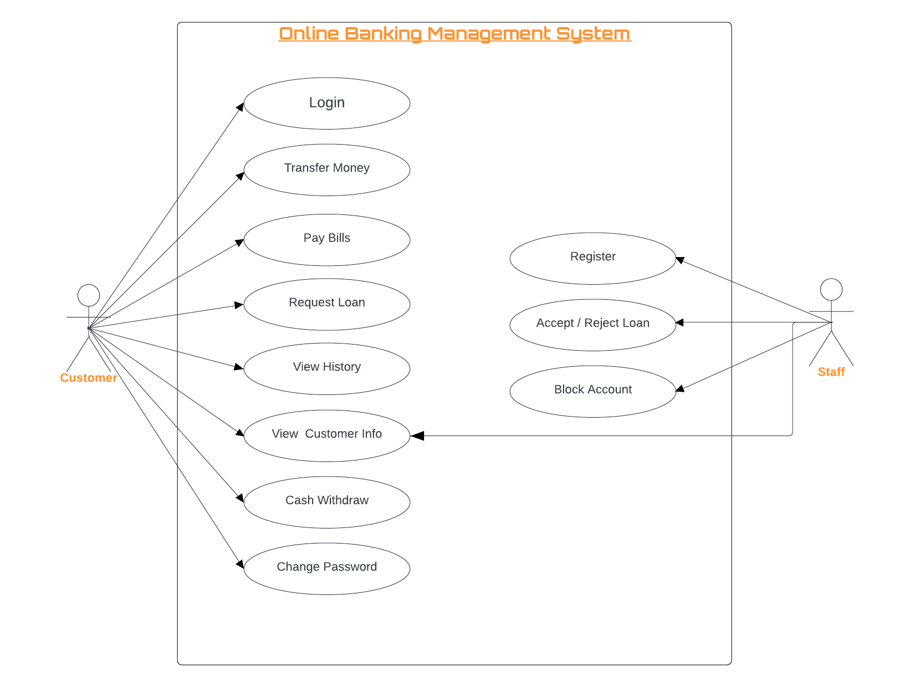
Use Case Diagram

Slide 6
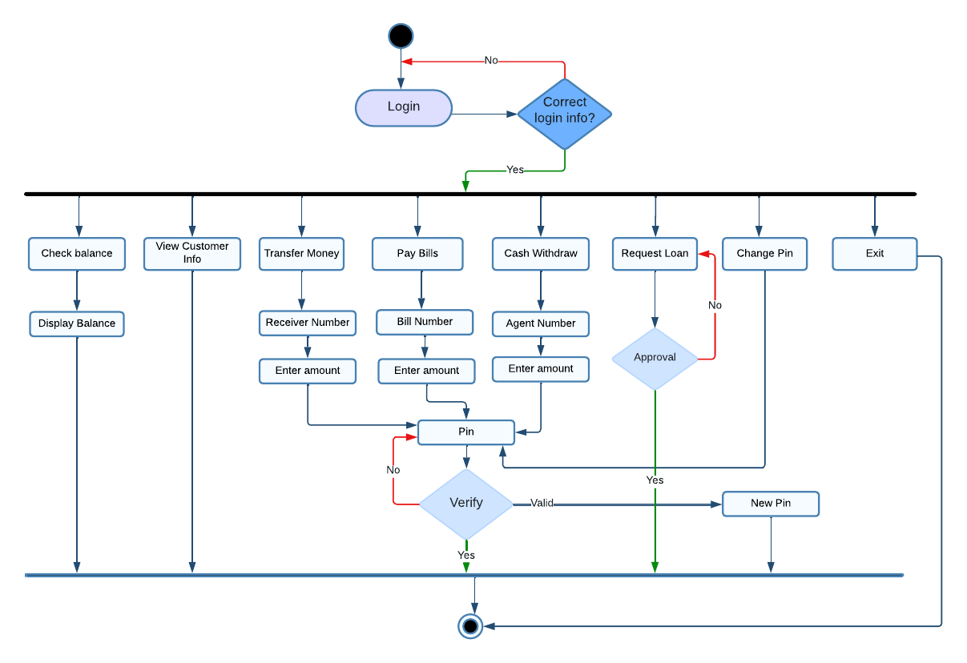
Activity Diagram

Slide 7
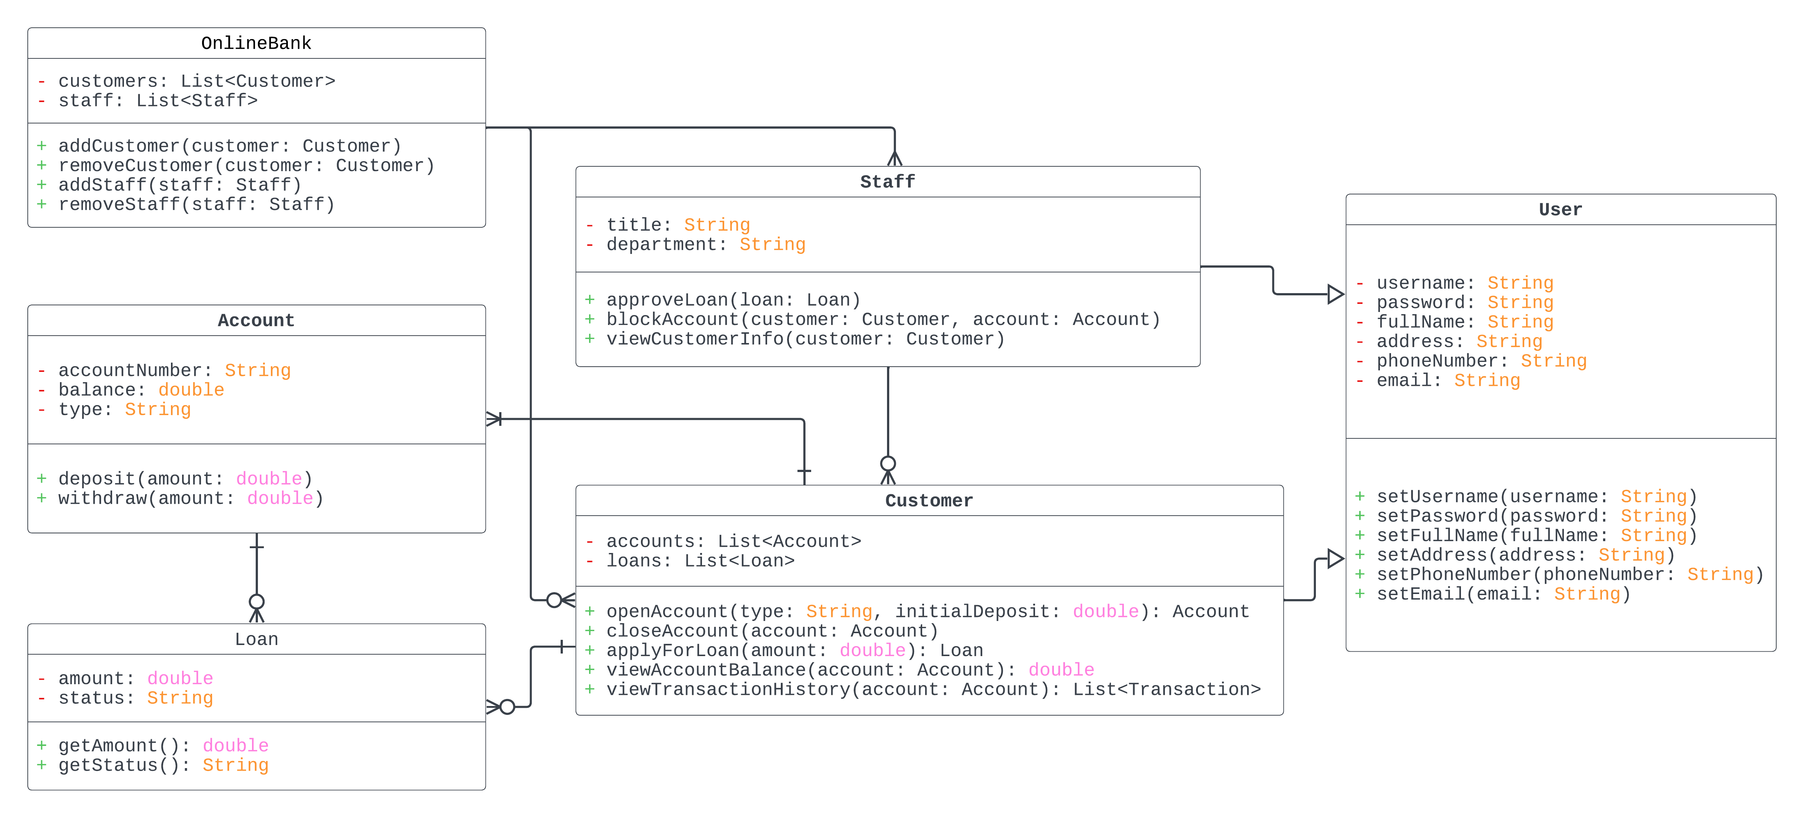
Class Diagram

Slide 8
OOP Concept Used
Encapsulation
Abstraction
Inheritance
Polymorphism
User class encapsulates attributes like username, password, fullName, etc., and methods like setUsername(), setPassword(), etc
setUsername() and setPassword() in the User class, abstracting the underlying operations related to managing user credentials
Customer and Staff classes inherit common attributes and methods from the User class
Customer and Staff may have their own implementations of methods inherited from the User class

Slide 9
Conclusion
Online Banking Management System simplifies banking tasks, providing users with convenient features. With its user-friendly interface and focus on security, in this project offers a modern solution for managing finances.

Slide 10
Thank You!

