Slide 1










Restaurant Management System
Presented by:
Nasima Akter
ID: 221-15-4755
Section: 61_A

Slide 2





Introduction
THE RESTAURANT MANAGEMENT SYSTEM AIMS TO SIMPLIFY AND OPTIMIZE VARIOUS FACETS OF RESTAURANT OPERATIONS.FROM ORDER PROCESSING TO INVENTORY MANAGEMENT, ULTIMATELY ENHANCING CUSTOMER EXPERIENCE AND MAXIMIZING PROFITABILITY. A RESTAURANT MANAGEMENT SYSTEM IS LIKE THE BRAINS BEHIND A RESTAURANT, HELPING TO ORGANIZE EVERYTHING SMOOTHLY.THESE SYSTEMS HELP RESTAURANTS IMPROVE EFFICIENCY, REDUCE ERRORS, ENHANCE CUSTOMER EXPERIENCE, AND MAKE DATA-DRIVEN DECISIONS.

Slide 3






Features
MENU
MANAGEMENT
ORDER MANAGEMENT
RESERVATION SYSTEM
INVENTORY MANAGEMENT
BILLING AND PAYMENT

Slide 4



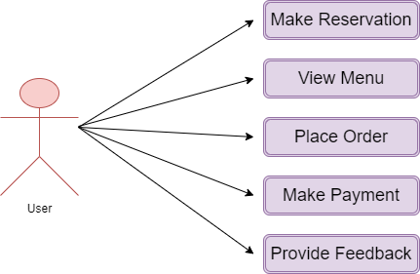




Use Case diagram

Slide 5

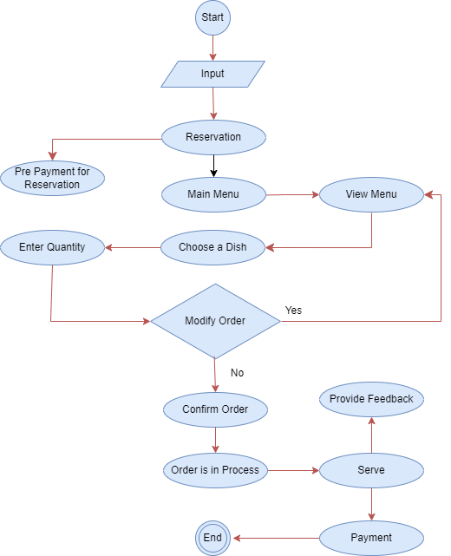

activity Diagram

Slide 6
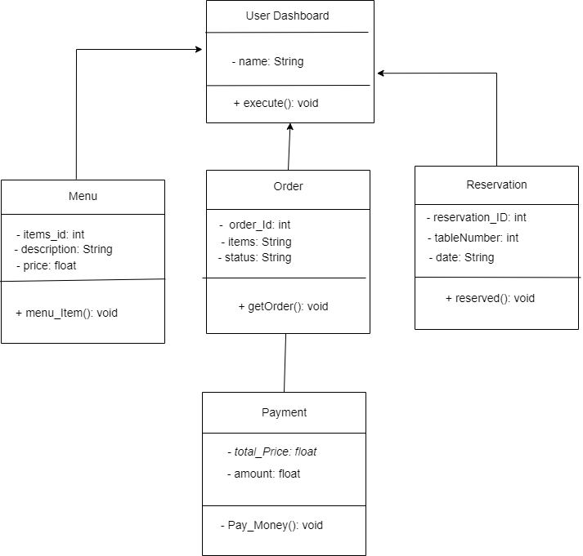

Class diagram

Slide 7




Conclusion
In an increasingly competitive market, the adoption of innovative technologies is essential for restaurants to stay ahead. The Restaurant Management System offers a robust platform for optimizing operations, enhancing customer experiences, and driving sustainable growth in the dynamic food service industry.

Slide 8



Thank
You

