Slide 1

Bank Account Management System
Presented By:
MD. NAJMUS SAKIB
ID: 221-15-5127
Section: 61_A

Slide 2

Introduction
This system represents my exploration into Object-Oriented Programming principles. Through this project, I aim to showcase how this system facilitates convenient management of bank accounts, offering users a seamless experience for transactions, balance inquiries, and account maintenance.

Slide 3
Features
Account Creation
Balance Inquiry
Transaction History
Account Update
Account Deletion

Slide 4
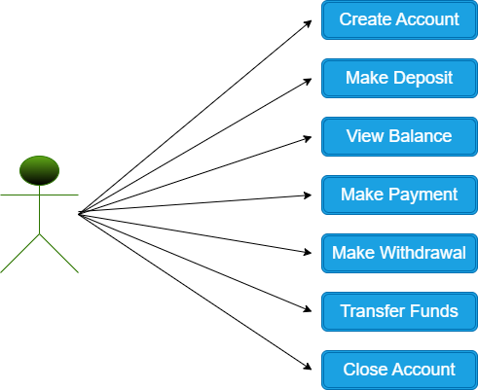
Use Case
Diagram

Slide 5
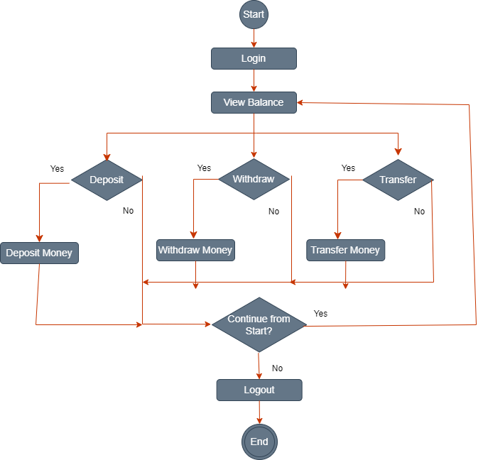
Activity
Diagram

Slide 6
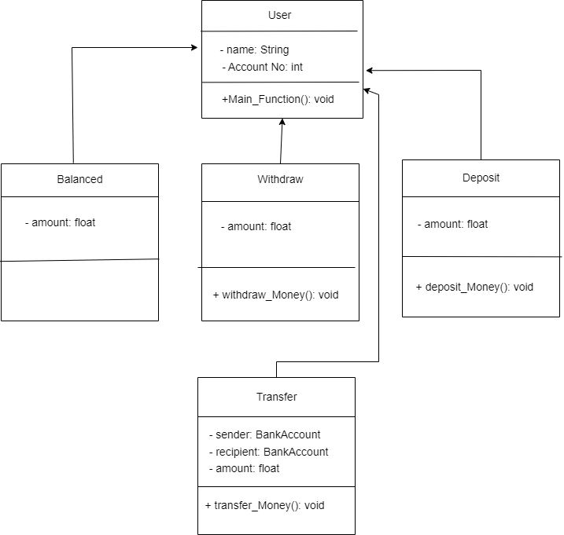
Class
Diagram

Slide 7
Conclusion
In conclusion, this Bank Account Management System provides a user-friendly solution for efficient and secure financial management. By applying Object-Oriented Programming concepts, we've created a system that simplifies transactions and enhances account control. I believe this project demonstrates the practical application of OOP principles in addressing real-world challenges. Thank you for your attention, and we're excited to answer any questions you may have.

Slide 8

Thank You

