Slide 1


WELCOME TO OUR
PRESENTATION
Submitted By:
Md. Najmus Sakib : 221-15-5127
Md. Abir Hasan : 221-15-5459

Slide 2

INFORMATION SECURITY AND
CYBERCRIME
KEEPING YOUR INFORMATION SAFE

Slide 3

WHAT IS INFORMATION SECURITY?
INFORMATION SECURITY MEANS KEEPING YOUR INFORMATION SAFE.
IT'S LIKE LOCKING YOUR DOOR TO KEEP STRANGERS OUT.

Slide 4
WHY IS INFORMATION SECURITY IMPORTANT?
PROTECTS YOUR PERSONAL INFORMATION.
KEEPS YOUR DATA OR MONEY SAFE FROM HACKERS.
MAKES SURE ONLY THE RIGHT PEOPLE CAN ACCESS IMPORTANT THINGS.

Slide 5
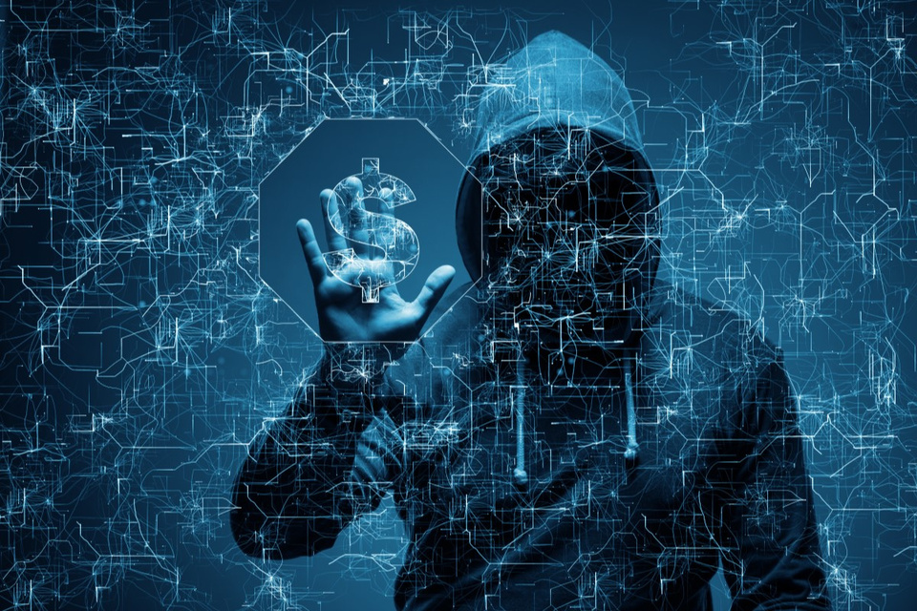
WHAT IS CYBERCRIME?
CYBERCRIME IS WHEN BAD GUYS USE COMPUTERS TO DO BAD THINGS.
THEY MIGHT SNEAK INTO YOUR COMPUTER AND TAKE YOUR THINGS.
CYBERCRIME IS LIKE A SNEAKY DIGITAL THIEF.

Slide 6

TYPES OF CYBERCRIME
ONLINE SCAMS
HACKING
IDENTITY THEFT
CYBERBULLYING
MALWARE ATTACKS

Slide 7

HOW CAN WE PROTECT OURSELF?
USE STRONG PASSWORDS THAT ARE HARD TO GUESS.
DON'T CLICK ON LINKS OR OPEN EMAILS FROM PEOPLE YOU DON'T KNOW.
KEEP YOUR COMPUTER AND APPS UPDATED TO STAY SAFE FROM VIRUSES.

Slide 8
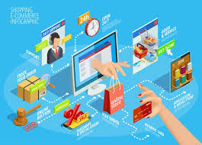
FEATURES OF
E-Commerce technology
Ubiquity
Global reach
Global reach
Richness
Interactivity
Information density
Personalization/Customization
Social technology

Slide 9
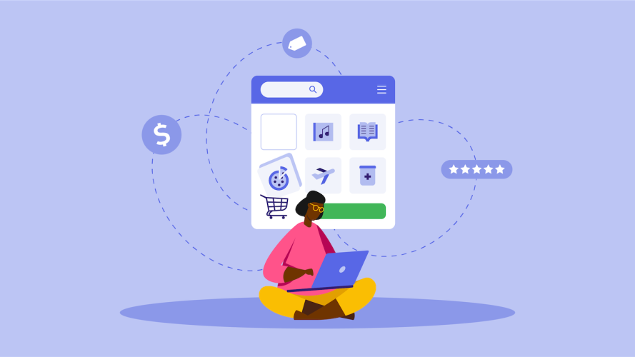
E-COMMERCE: DIGITAL
Markets, Digital Goods
E-commerce is the short form of electronic commerce, refers to the buying and selling of goods and services over the internet. It allows businesses and consumers to interact electronically, without the need for face-to-face contact.

Slide 10
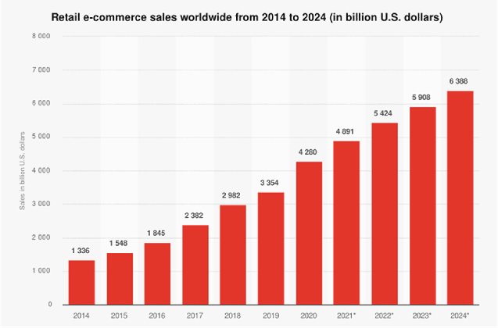
GROWTH OF
E-COMMERCE

Slide 11
FEATURES OF
E-Commerce technology
Ubiquity
Global reach
Global reach
Richness
Interactivity
Information density
Personalization/Customization
Social technology

Slide 12

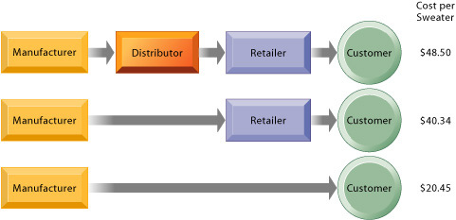
THE BENEFITS OF DISINTERMEDIATION TO the Consumer

Slide 13

WHAT IS
DIGITAL MARKETING?
Digital marketing is the use of the Internet,
mobile devices, social media, search engines,
and other channels to reach consumers.

Slide 14
TYPES OF
ELECTRONIC COMMERCE
BUSINESS-TO-BUSINESS (B2B)
❑ Business-to-consumer (B2C)
❑ Consumer-to-consumer (C2C)
❑ Consumer-to-Business (C2B)

Slide 15

THANK YOU

