Slide 1
Welcome to my presentation
Presented By:
Md. Najmus Sakib
ID: 221-15-5127
Section: 61_A
Dept. of CSE
Daffodil International University

Slide 2
Title
A Comparative Study of Sentiment Classification Models for Greek Reviews

Slide 3
Outline
Introduction
Research Objective
Literature Review
Methodology
Experimental Analysis
Conclusion
Reference

Slide 4
introduction
Sentiment analysis is a crucial task in natural language processing (NLP) that involves determining the sentiment expressed in text, such as positive, negative, or neutral emotions. It plays an important role in understanding customer opinions and improving decision-making for businesses. While sentiment analysis has been extensively studied for English text, research on languages like Greek remains limited, particularly for consumer reviews. This study explores the effectiveness of various sentiment classification models. The objective is to assess whether advanced methods can outperform traditional models in classifying Greek consumer reviews.

Slide 5
Research objective
To evaluate and compare traditional machine learning, artificial neural networks, transfer learning models and large language models for sentiment classification of Greek consumer reviews.
To test the hypothesis that modern methods outperform traditional ML models in analyzing sentiment.
To provide insights into the capabilities of advanced models for sentiment analysis in the Greek language.

Slide 6
Literature review
Study | Focus | Dataset | Methods Used | Key Findings
Markopoulos et al. (2015) | Sentiment analysis of hotel reviews | 1,800 Greek hotel reviews (TripAdvisor) | SVM with TF-IDF | SVM with TF-IDF achieved 95.78% accuracy.
Bilianos (2022) | Sentiment classification of Greek product reviews | 480 reviews | Naïve Bayes, SVM, GreekBERT | GreekBERT outperformed others with 97% accuracy.
Dontaki et al. (2023) | Sentiment classification of Greek tweets on COVID-19 | 61,109 Greek tweets | LR, DT, RF, SVM, XGBoost | Decision Tree (DT) with TextBlob achieved 99.97% accuracy.
Giatsoglou et al. (2017) | Sentiment prediction with emotions and embeddings | MOBILE-PAR Greek dataset | SVM with Word2Vec embeddings | Achieved 83.6% accuracy.
Aivatoglou et al. (2023) | Aspect-based sentiment analysis for low-resource languages | Various Greek datasets | Transformer-based framework | Demonstrated effective aspect-based sentiment analysis.

Slide 7
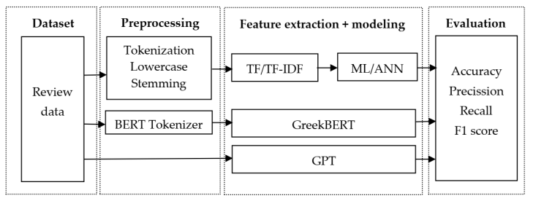
Methodology

Slide 8
Experimental Analysis
Machine Learning Models- SVM, Naïve Bayes, Random Forest, TF-IDF (Term Frequency-Inverse Document Frequency)
Artificial Neural Networks (ANNs)- Multilayer Perceptron (MLP)
Transfer Learning Models- GreekBEAT
Large Language Models (LLMs)- GPT-3.5 and GPT-4

Slide 9
Conclusion
This study demonstrates that advanced models like GreekBERT and GPT-4 outperform traditional machine learning methods in Greek sentiment analysis, with GreekBERT achieving the highest accuracy of 96%. While traditional models provide competitive results, modern approaches offer better contextual understanding and automation. Future work can expand datasets and explore nuanced sentiment categories for deeper insights.

Slide 10
Reference
Michailidis, P.D. "A Comparative Study of Sentiment Classification Models for Greek Reviews." Big Data Cogn. Comput., 2024, 8, 107.
Devlin, J., Chang, M.-W., Lee, K., & Toutanova, K. "BERT: Pre-training of Deep Bidirectional Transformers for Language Understanding." In Proceedings of NAACL-HLT, 2019.
Vaswani, A., et al. "Attention Is All You Need." In Proceedings of NeurIPS 2017.
Hartmann, J., Heitmann, M., Siebert, C., & Schamp, C. "More Than a Feeling: Accuracy and Application of Sentiment Analysis." Int. J. Res. Mark., 2023.
Patsiouras, E., Koroni, I., Mademlis, I., & Pitas, I. "GreekPolitics: Sentiment Analysis on Greek Politically Charged Tweets." In Proceedings of EUSIPCO 2023.

Slide 11
Thank You

