Slide 1


SENTIMENT ANALYSIS IN THE ERA OF LARGE LANGUAGE MODELS: A REALITY CHECK
Presented By:
Nasima Akter
ID: 221-15-4755
Section: 61_A

Slide 2
INSTRUCTOR
Md. Firoz Hasan
Sr. Lecturer
Dept. of CSE
Daffodil International University

Slide 3

OUTLINE
• Introduction
• Research Objective
• Literature Review
• Methodology
• Experimental Analysis
• Conclusion
• Reference

Slide 4

INTRODUCTION
Sentiment analysis (SA) is a key task in natural language processing (NLP) that involves identifying and analyzing opinions, emotions, and sentiments in text. With the rise of large language models (LLMs) like GPT-3 and Flan-T5, there is growing interest in how well these models perform on various SA tasks. While LLMs have shown impressive results in many NLP applications, their effectiveness in sentiment analysis, especially compared to smaller, domain-specific models, remains unclear. This presentation explores the current state of sentiment analysis in the era of Large Language Models.

Slide 5
RESEARCH OBJECTIVE
• Evaluate LLM Capabilities: Investigate the performance of large language models (LLMs) like GPT-3 and Flan-T5 on various sentiment analysis tasks, including sentiment classification, aspect-based sentiment analysis, and multifaceted analysis.
• Compare LLMs and SLMs: Compare the performance of LLMs with smaller, domain-specific language models (SLMs), focusing on zero-shot and few-shot learning scenarios.
• Assess Evaluation Methods: Analyze current evaluation practices for sentiment analysis tasks and propose improvements to better assess LLM performance.
• Propose a New Benchmark: Introduce the SENTIEVAL benchmark for more
comprehensive and realistic evaluation of sentiment analysis models,
addressing the limitations of existing methods.

Slide 6
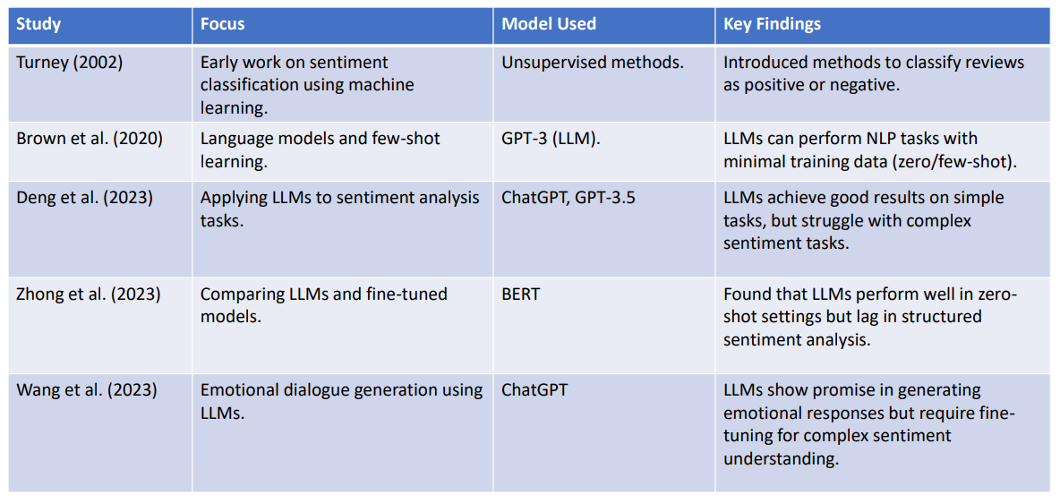
LITERATURE REVIEW

Slide 7
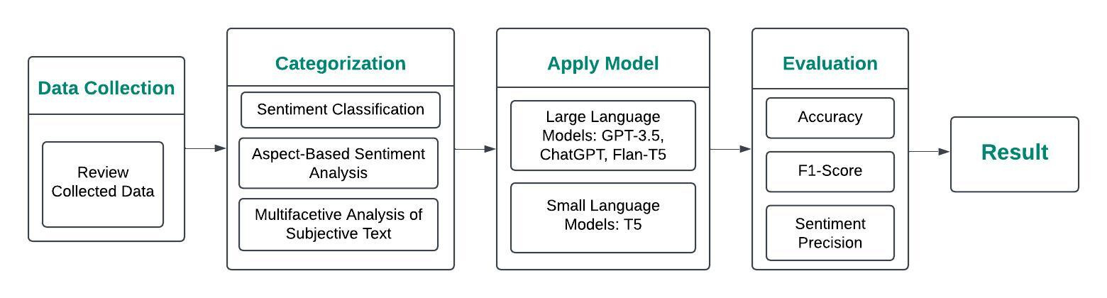
METHODOLOGY

Slide 8
EXPERIMENTAL ANALYSIS
1. Evaluation Setup
•Models: LLMs (GPT-3, ChatGPT, Flan-T5) vs. SLMs (T5).
•Tasks: Sentiment Classification (SC), ABSA, and MAST.
•Learning Modes: Zero-shot and few-shot.
2. Performance Metrics
•Accuracy, F1-Score, Sentiment Precision.
3. Results Summary
•Zero-shot: LLMs perform well on simple tasks but struggle with complex tasks.
•Few-shot: LLMs outperform SLMs, especially with limited data.
4. Insights
•LLMs are strong in general tasks but sensitive to prompt design.
•Few-shot learning helps LLMs with complex, structured tasks.

Slide 9

CONCLUSION
Large Language Models (LLMs) like GPT-3 and Flan-T5 show strong performance in simpler sentiment analysis tasks but face challenges in more complex ones, such as aspect-based sentiment analysis (ABSA) and multifaceted analysis (MAST). While LLMs excel in zero-shot and few-shot learning, small language models (SLMs) outperform them in tasks requiring fine-grained sentiment extraction when trained with domain-specific data. The study emphasizes the importance of prompt design and advocates for a more comprehensive evaluation framework, such as the SENTIEVAL benchmark, to better assess LLM capabilities in sentiment analysis.

Slide 10

REFERENCE
1.Turney, P. D. (2002). Thumbs up or thumbs down? Semantic orientation
applied to unsupervised classification of reviews. ACL.
2. Hu, M., & Liu, B. (2004). Mining and summarizing customer reviews. ACM
SIGKDD International Conference on Knowledge Discovery and Data Mining.
3. Brown, T. B., Mann, B., Ryder, N., et al. (2020). Language models are few-shot learners. Advances in Neural Information Processing Systems (NeurIPS).
4. Zhong, Z., Ding, L., Liu, J., et al. (2023). Can ChatGPT understand too? A
comparative study on ChatGPT and fine-tuned BERT. CoRR.
5. Wang, J., Xie, Q., Ding, Z., et al. (2023). Is ChatGPT a good sentiment
analyzer? A preliminary study. CoRR.

Slide 11
Thank
You

