Slide 1
Natural Language to Dashboard
A Safe AI-Assisted Reporting and Widget Generation System
Md. Riaz
Department of CSE, Pundra University

Slide 2
The Problem: Reporting is Slow
Organizations have data, but non-technical staff can't access it easily.
Average wait time for a new report: 3.2 days.
61% of requests are just variations of old questions.
Traditional AI (Text-to-SQL) is risky: it can make mistakes or expose data.

Slide 3
The Goal: SafeDash
Turn plain English into persistent, reusable widgets.
Focus on safety: The AI understands the question, but templates build the SQL.
Dynamic and refreshable: Save once, use every day.
No manually written synonyms needed.

Slide 4
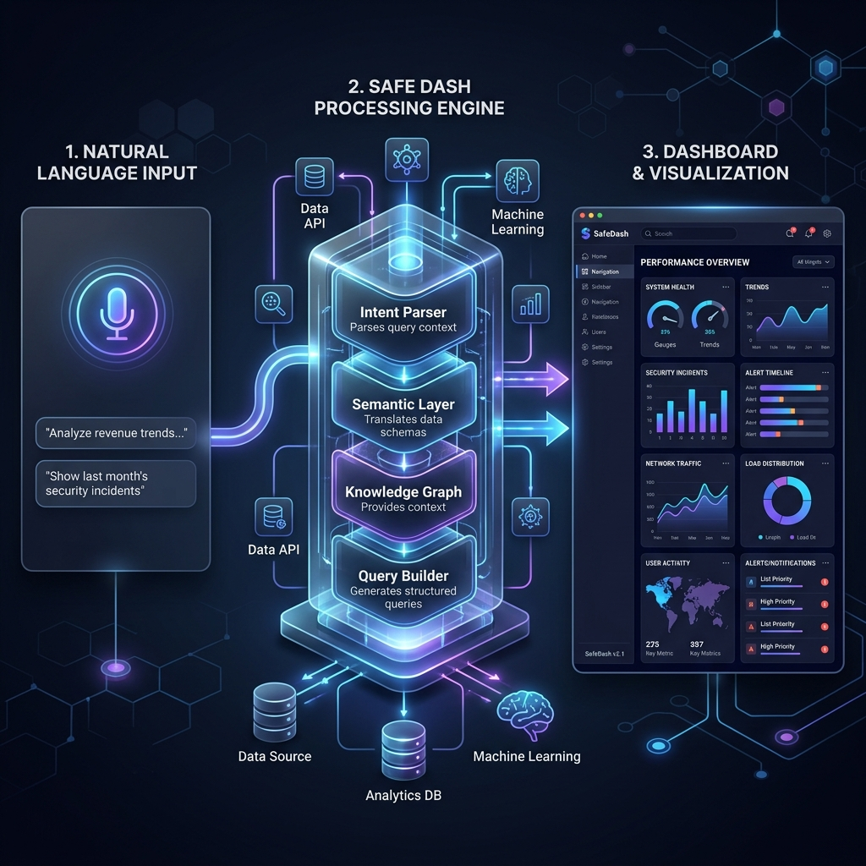
System Architecture
1. User asks a question in plain English.
2. AI Parser extracts intent and business terms.
3. Semantic Layer maps terms to database logic.
4. Safe Compiler builds SQL from approved templates.
5. Widget Engine saves the result for reuse.

Slide 5
The Heart: Semantic Layer
Defines Metrics: Revenue, Profit, Order Count.
Defines Dimensions: Category, Time, Department.
Join Paths: Pre-approved ways to connect tables.
Security: Who is allowed to see what.
Vocabulary Injection: AI sees these terms directly.

Slide 6
Vocabulary Injection
Traditional way: Write long synonym lists (fragile).
SafeDash way: Inject approved names + descriptions into the prompt.
AI maps 'earnings' -> 'revenue' automatically.
Zero maintenance: New metrics are instantly available.
Results: 100% coverage with 0 manual synonyms.

Slide 7
Safe SQL Generation
AI never writes raw SQL strings.
System uses Parameterized Templates (Ranking, Trend, KPI).
AST Validation: Final check for forbidden commands (e.g., DELETE).
structural impossibility of SQL injection.
Reliable output every time.

Slide 8
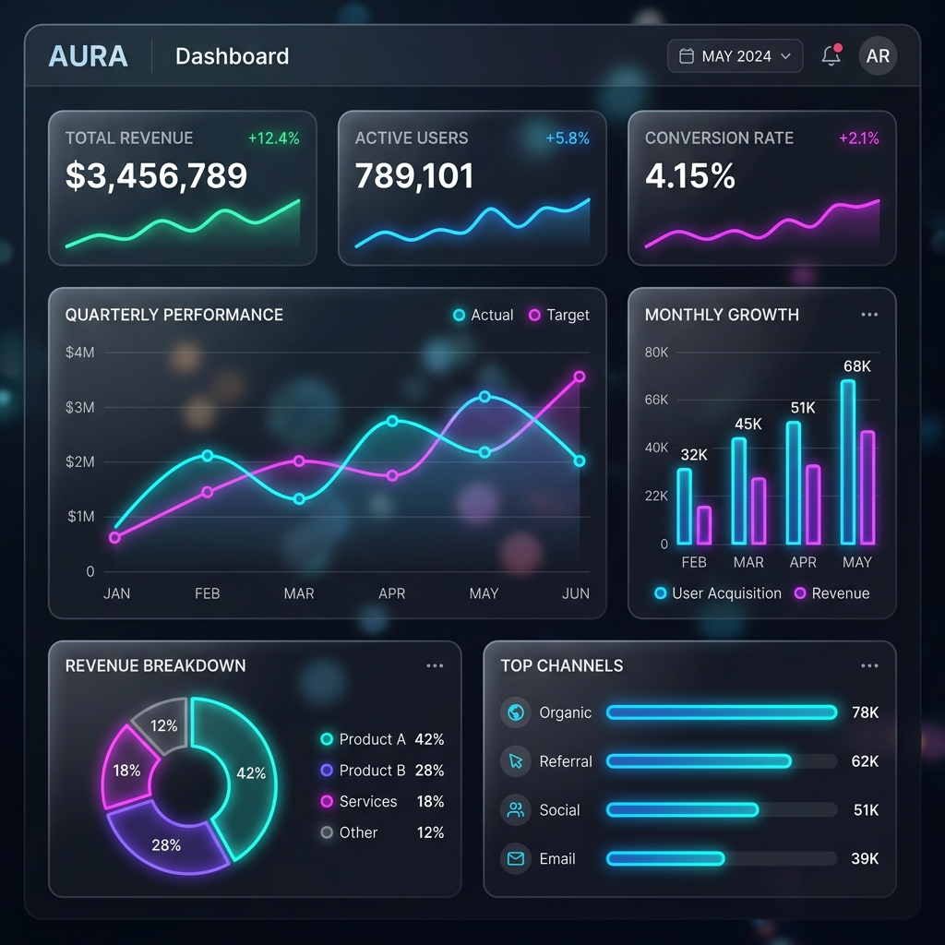
Dashboard & Widgets
Widgets are first-class citizens.
Saved with: Analysis Plan, SQL, Chart Settings.
Reuse: System finds similar past widgets automatically.
Refreshable: Data updates without asking the AI again.
Premium UI: Glassmorphic and responsive.

Slide 9
How SafeDash Compares
Most systems only do Text-to-SQL (Spider/BIRD).
Some only do Visualization (nl4dv).
SafeDash covers the full pipeline: NL -> SQL -> Vis -> Widget.
First system to combine Semantic Layer + LLM + Persistence.

Slide 10
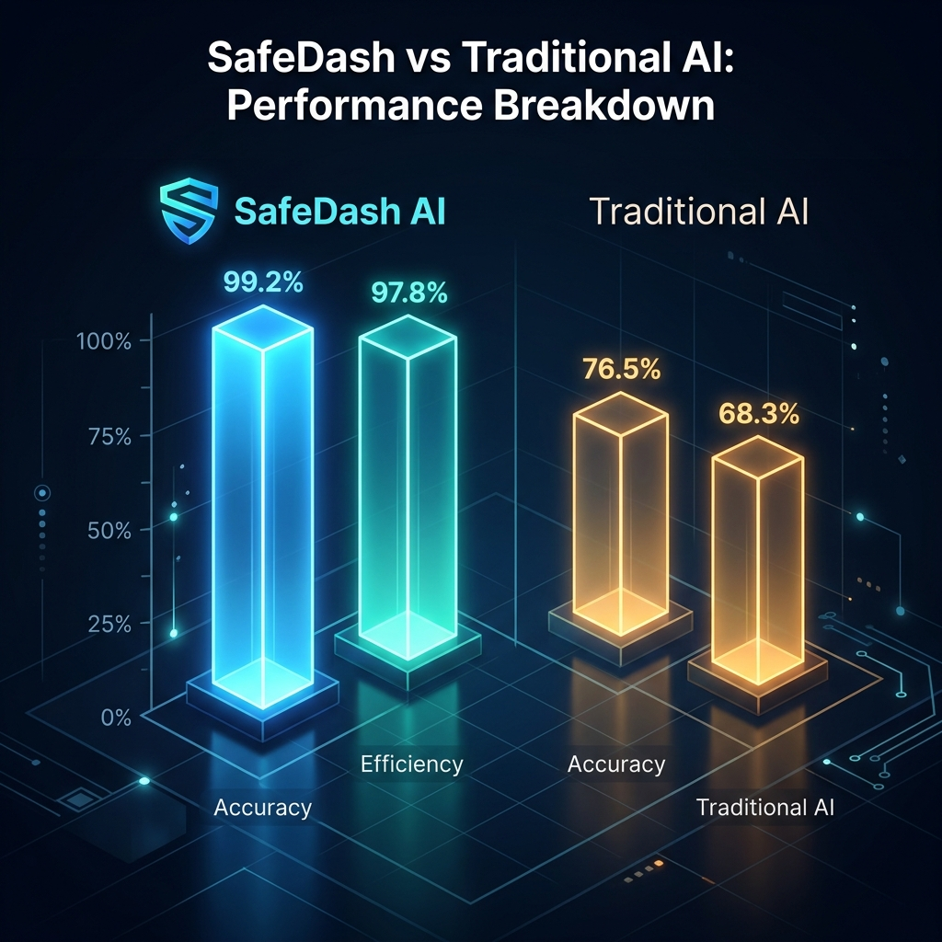
Evaluation: 100-Query Benchmark
Tested on real e-commerce data (nopCommerce).
100% Execution Validity.
100% Query Coverage.
0% Unsafe Queries (Baseline AI was 4.0% unsafe).
Zero manual synonyms required.

Slide 11
Future Work
Support for multi-turn conversations.
Automated semantic layer expansion from query logs.
Support for cross-entity causal analysis.
Mobile dashboard companion app.

Slide 12
Conclusion
SafeDash makes reporting safe, accurate, and easy.
System design > Smarter AI for safety.
Vocabulary injection removes the need for synonym lists.
Widgets make analytics part of the daily workflow.
Thank you! Any questions?

