Slide 1
Natural Language to Dashboard
A Safe AI-Assisted Reporting and Widget Generation System
Final Year Thesis Proposal Presentation on
Department of Computer Science & Engineering
Pundra University of Science & Technology, Bogura – 5800
Supervised By: Mst. Sahela Rahman (Lecturer, Dept. of CSE, PUB)
Presented By: Md. Riaz
ID: 0322310105101024 | Batch: 16th | Semester: 7th
Saturday, April 25, 2026
Department of Computer Science & Engineering, PUB

Slide 2
Outline
Introduction
Problem Statement
Objectives
Literature Review/ Related Work
What the thesis proposes
Methodology
System Structure
Example
Conclusion & Future Work
References
Saturday, April 25, 2026
Department of Computer Science & Engineering, PUB

Slide 3
Introduction
Most software dashboards are predefined and developer-dependent.
Non-technical users cannot translate insights into SQL steps.
Free-form LLM-generated SQL is flexible but unsafe.
Need for a safe natural-language-driven reporting workflow.
Traditional reporting delays decision-making.
Saturday, April 25, 2026
Department of Computer Science & Engineering, PUB

Slide 4
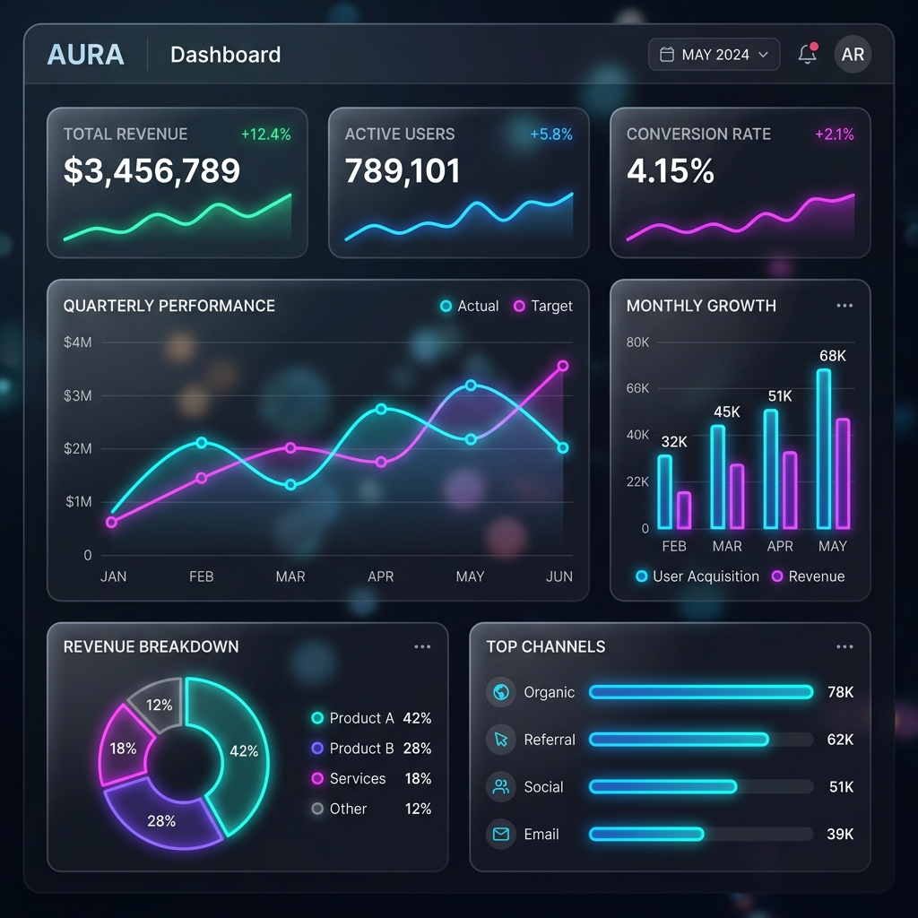
Introduction (Con..)
Reporting needs fit into small set of analytics primitives:
• Trend → sales over time
• Rank → top 5 products
• Compare → this month vs last month
• Segment → sales by category
• KPI → total revenue today
Controlled combinations of trusted reporting patterns.
Saturday, April 25, 2026
Department of Computer Science & Engineering, PUB

Slide 5
Problem Statement
Unsafe & Unscalable: Raw SQL exposes sensitive data.
Unpredictable: AI-generated SQL ignores business definitions.
Ambiguity: Users struggle to express intent clearly.
Lack of Persistence: Focus is on query generation, not reusable widgets.
No complete end-to-end workflow exists.
Saturday, April 25, 2026
Department of Computer Science & Engineering, PUB

Slide 6
Objectives
Design a natural language interface for reporting.
Predefined semantic layer of trusted business concepts.
Extract structured intent using LLMs.
Safe query compiler using approved templates.
Generate outputs as reusable widgets.
Evaluate correctness, safety, and usability.
Saturday, April 25, 2026
Department of Computer Science & Engineering, PUB

Slide 7
Literature Review
Author/Source | Technique | Findings
NaLIR (2014) | Rule-based NL→SQL | Heavy reliance on clarification
G-SQL (2025) | Schema-aware NL→SQL | Poor complex schema generalization
TriSQL (2026) | Multi-stage LLM SQL | Struggles with complex queries
Conversational BI | Chat-based assistant | Limited scaling/ambiguity
DashBot (2022) | RL for Dashboards | Limited real-world use
Saturday, April 25, 2026
Department of Computer Science & Engineering, PUB

Slide 8
Evolution Path
1. NLIDB (Rule-Based) -> NaLIR (2014)
2. Text-to-SQL (ML/DL) -> NLI4DB (2025)
3. LLM-based SQL -> TriSQL (2026)
4. Conversational BI -> IJERT (2025)
Saturday, April 25, 2026
Department of Computer Science & Engineering, PUB

Slide 9
What This Thesis Proposes
Constraint-based natural language reporting system.
AI for understanding, System for execution.
Structured analysis plan instead of raw SQL.
Compiled using: Approved metrics, dimensions, and relationships.
Output: Widget-ready results (KPI, Table, Chart).
Saturday, April 25, 2026
Department of Computer Science & Engineering, PUB

Slide 10
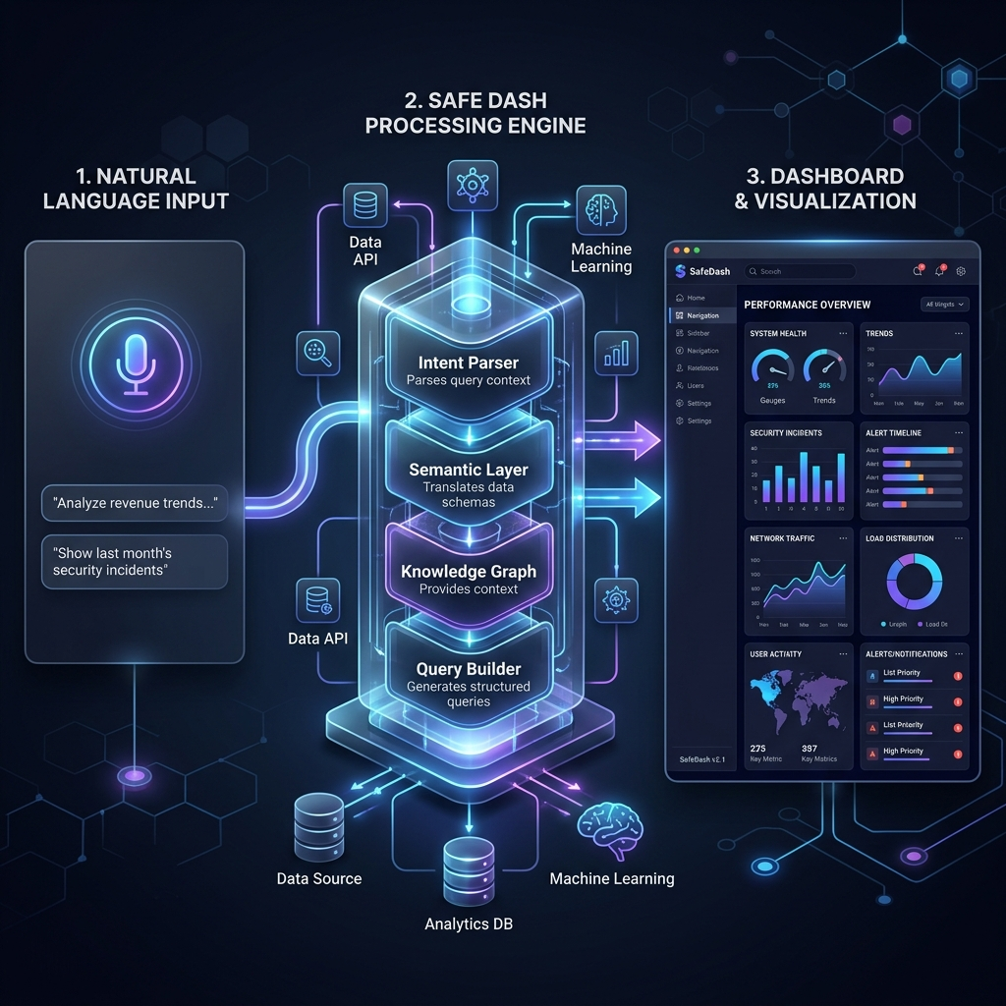
Methodology
Query Interface -> LLM Intent Parser
Semantic Layer -> AI Analysis Planner
Safe Query Compiler -> Visualization Selector
Widget Engine -> Final Dashboard
Saturday, April 25, 2026
Department of Computer Science & Engineering, PUB

Slide 11
System Architecture
Relational Schema (e.g., University Management).
Semantic Layer: Metrics, Dimensions, Filters.
Pattern Library: Ranking, Trend, Comparison.
LLM API: Intent extraction (Structured JSON).
Safe Query Compiler & Widget Engine.
Evaluation: Accuracy, Safety, Satisfaction.
Saturday, April 25, 2026
Department of Computer Science & Engineering, PUB

Slide 12
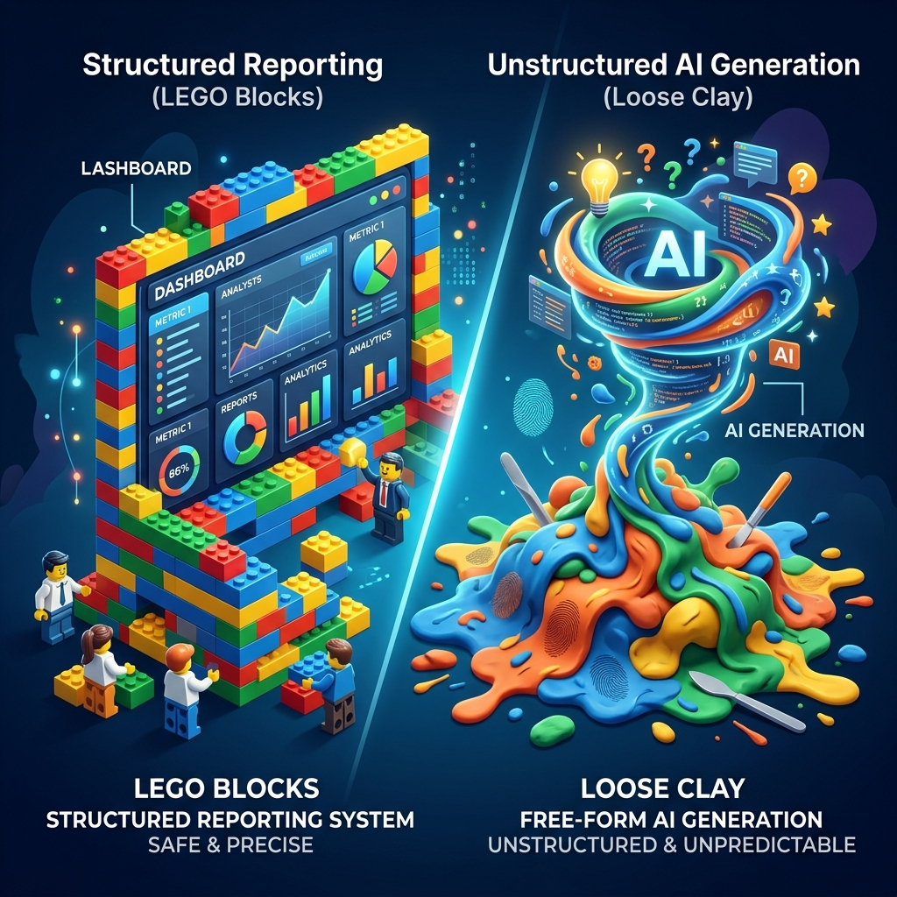
Structure: LEGO blocks, not Clay
Metrics: What you measure.
Dimensions: How you slice.
Time Rules & Relationships.
User asks: 'Top 5 products by sales last month'
Maps to: total_sales, product, last_month, rank.
Output: Bar Chart.
Saturday, April 25, 2026
Department of Computer Science & Engineering, PUB

Slide 13
AI Freedom in Interpretation
AI CAN: Rephrase intent, infer context, suggest follow-ups.
AI CANNOT: Invent joins, bypass permissions, hit raw tables.
Freedom of thinking, not acting.
Saturday, April 25, 2026
Department of Computer Science & Engineering, PUB

Slide 14
Designed for Extension
Add new metrics/dimensions easily.
Primitives are rare and stable.
Growth by extension, not reinvention.
Similar to Power BI or Tableau evolution.
Saturday, April 25, 2026
Department of Computer Science & Engineering, PUB

Slide 15
University Example
Prompt: 'Show top 5 departments with highest unpaid tuition this semester'
Intent: Ranking
Metric: due_amount (Unpaid tuition)
Dimension: department_name
Time Rule: current_semester
Output: Compiled SQL + Bar Chart + Saved Widget
Saturday, April 25, 2026
Department of Computer Science & Engineering, PUB

Slide 16
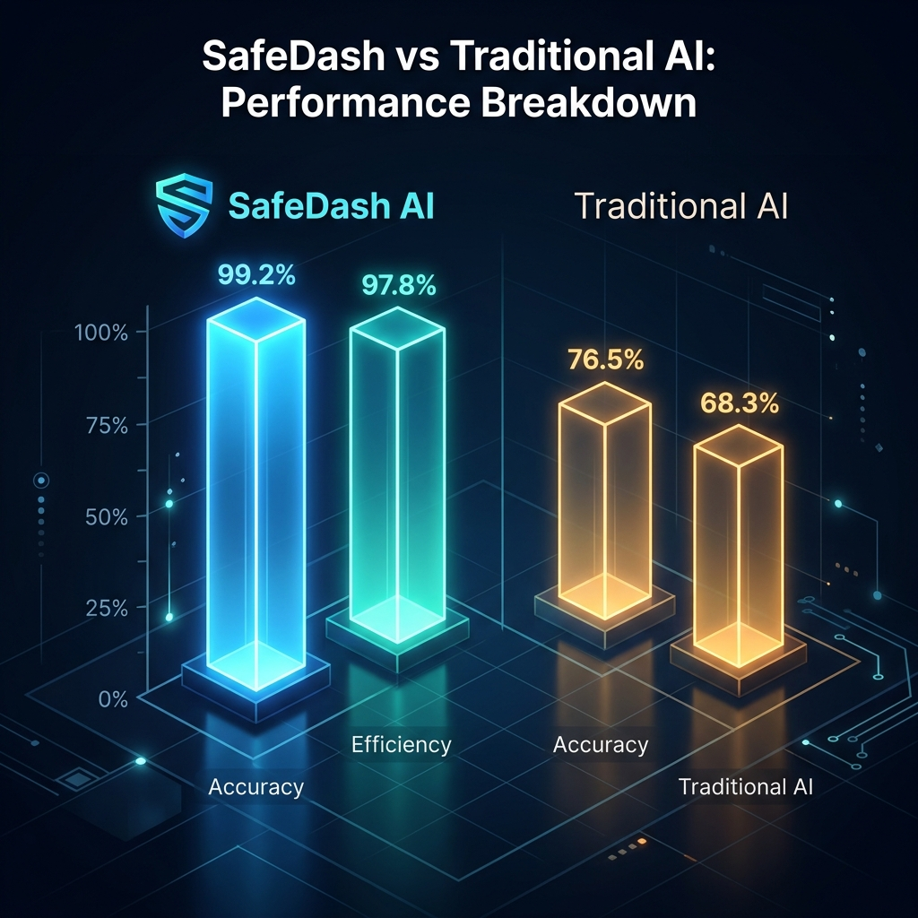
Conclusion & Future Work
Safe architecture for natural-language analytics.
AI assists interpretation without controlling execution.
Future: Implement prototype, RAG integration.
Voice controls & Automated alerts.
Saturday, April 25, 2026
Department of Computer Science & Engineering, PUB

Slide 17
References & Questions
[1] Li & Jagadish (2014) NaLIR
[2] Shalaan et al. (2025) G-SQL
[3] Su et al. (2026) TriSQL
[4] Shailesh et al. (2025) Conversational BI
[5] Deng et al. (2023) DashBot
Thank You. Any Questions?
Saturday, April 25, 2026
Department of Computer Science & Engineering, PUB

