Slide 1

AEGIS: A Constraint-Based Architecture for Safe
LLM-Assisted Natural Language Analytics
Final Defense Presentation
Presented By
Supervised By
Md. Riaz
Program: B.Sc. in CSE (Diploma)
ID: 0322310105101024
Batch: 16th
8th Semester / 4th Year
Session: Spring - 2023
Mst. Sahela Rahman
Lecturer
Dept. of CSE, PUB
Department of Computer Science & Engineering
Pundra University of Science & Technology, Bogura - 5800
Notes:
Good morning/afternoon respected chairperson and committee members. I am presenting the final defense of AEGIS, a constraint-based architecture for safe LLM-assisted natural language analytics.

Slide 2
Outline
1. Introduction and Problem Statement
2. The Idea in One Picture
3. Literature Review and Research Gap
4. Objectives and Methodology
5. AEGIS Architecture (Stages 1-7)
6. Semantic Layer and Compiler
7. Query-to-SQL Walkthrough, Including Joins
8. Prototype Implementation
9. Evaluation: 500 Questions and 20 Admin Reports
10. Limitations, Conclusion, and Future Work
11. Appendix: Schema, Semantic Layer, Compiler Code

Slide 3
Introduction
Motivation:
- E-commerce systems store rich operational data, but built-in dashboards answer only a fixed set of questions.
- When users need new analytical combinations, the request usually depends on a developer or BI person to translate it into report logic.
- Natural language analytics can reduce that delay for managers, sales teams, and administrators.
Central Tension:
- Direct LLM-to-SQL systems are flexible, but the model writes executable database code.
- A safe analytics system should understand the question without giving the model authority to create arbitrary SQL.
AEGIS Direction:
- Use the LLM for intent extraction only.
- Use deterministic semantic mapping and SQL compilation for execution.

Slide 4
Problem Statement
Current Generative NL2SQL approaches have 3 structural vulnerability classes:
1. Structural Injection Risk
Adversarial prompt manipulation can bypass model instructions, causing neural models to output data-modifying DML/DDL statements (DROP, DELETE, UPDATE).
2. Unbounded Schema Hallucination
Probabilistic token generation leads to hallucinated table joins, non-existent entity relations, and invalid column attributes.
3. Access Control & Context Bypass
Direct query generation bypasses application-level multi-tenant boundaries and row-level security scopes.

Slide 5
The Idea in One Picture
In a restaurant, the waiter writes down what you want — the dish, how many plates. The waiter never walks into the kitchen and cooks it.
Waiter takes the order
Order form fixed fields only
Kitchen cooks the dish
In the restaurant | In AEGIS | What it cannot do
The waiter | The language model | Cannot write or run SQL
The order form | The Intent Object | Cannot hold a table or column name of its own
The kitchen | The SQL compiler | Cannot accept anything outside the approved list
In plain terms: The model chooses names from an approved list. It never writes the database query itself.

Slide 6
Literature Review
Work | Main focus | Control approach | Gap for AEGIS
NaLIR [1] | Interactive NLIDB | Parse and refine intent with grammar and DB mapping | Limited dashboard and modern LLM risk handling
nl4dv [2] | NL to visualization specs | Extract analytic attributes; not SQL-centered | Visualization focus, not safe database execution
DashBot [3] | Dashboard generation | Insight-driven dashboard selection | Does not solve arbitrary SQL authority risk
PICARD [4] | Constrained decoding | Parser-level SQL validity during token generation | Model still generates SQL text
G-SQL [5] / TriSQL [6] | Robust Text-to-SQL | Schema-aware generation with rules, repair, and refinement | Safety depends on controlling generated SQL
AEGIS | Safe NL analytics | Intent extraction only; SQL compiled from semantic layer | Trades open SQL for auditable analytics intent validation

Slide 7
Research Gap
Observed Gap in Existing Systems:
- Many systems improve SQL generation accuracy, but still let executable SQL be authored by the model.
- Visualization systems help users express analysis, but do not fully address database execution safety.
- Parser and repair methods can reject invalid syntax, yet syntactically valid SQL can still be unsafe or semantically wrong.
AEGIS Research Gap:
- A practical architecture is needed where natural language is accepted, but executable SQL is produced only from an explicit semantic layer and deterministic compiler.

Slide 8
Objectives and Contributions
Objective | Contribution
Reduce execution risk | Separate natural-language understanding from SQL creation.
Make analytics auditable | Define metrics, dimensions, filters, join paths, and output shapes in a semantic layer.
Support real e-commerce reports | Implement AEGIS over a seeded nopCommerce [7] MySQL database.
Evaluate against an independent oracle | Measure breadth on 500 fixed natural-language questions, and fidelity against nopCommerce's own twenty admin reports.

Slide 9
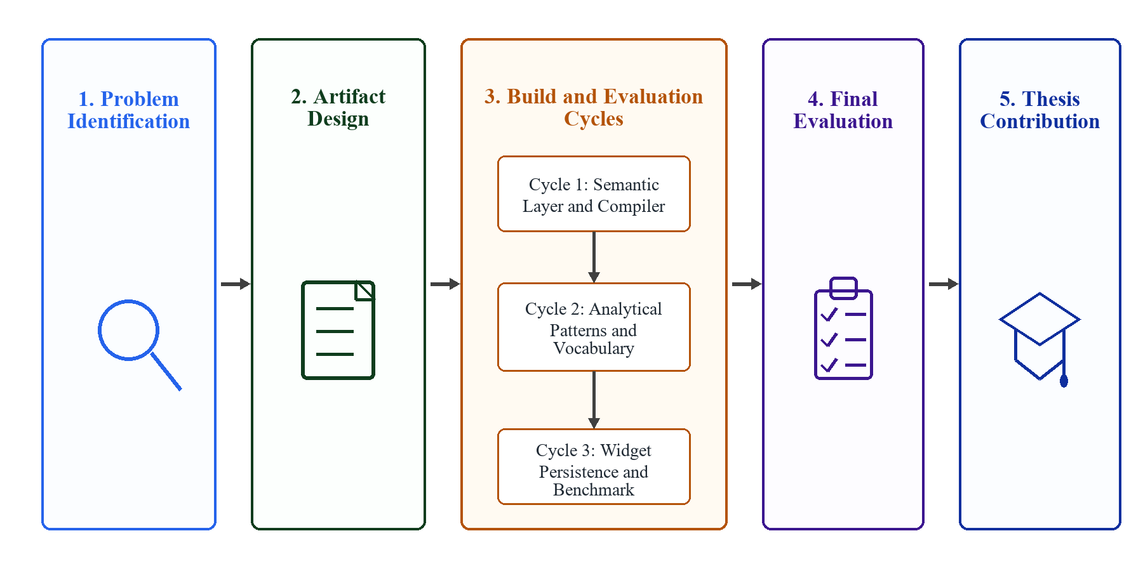
Research Methodology

Slide 10
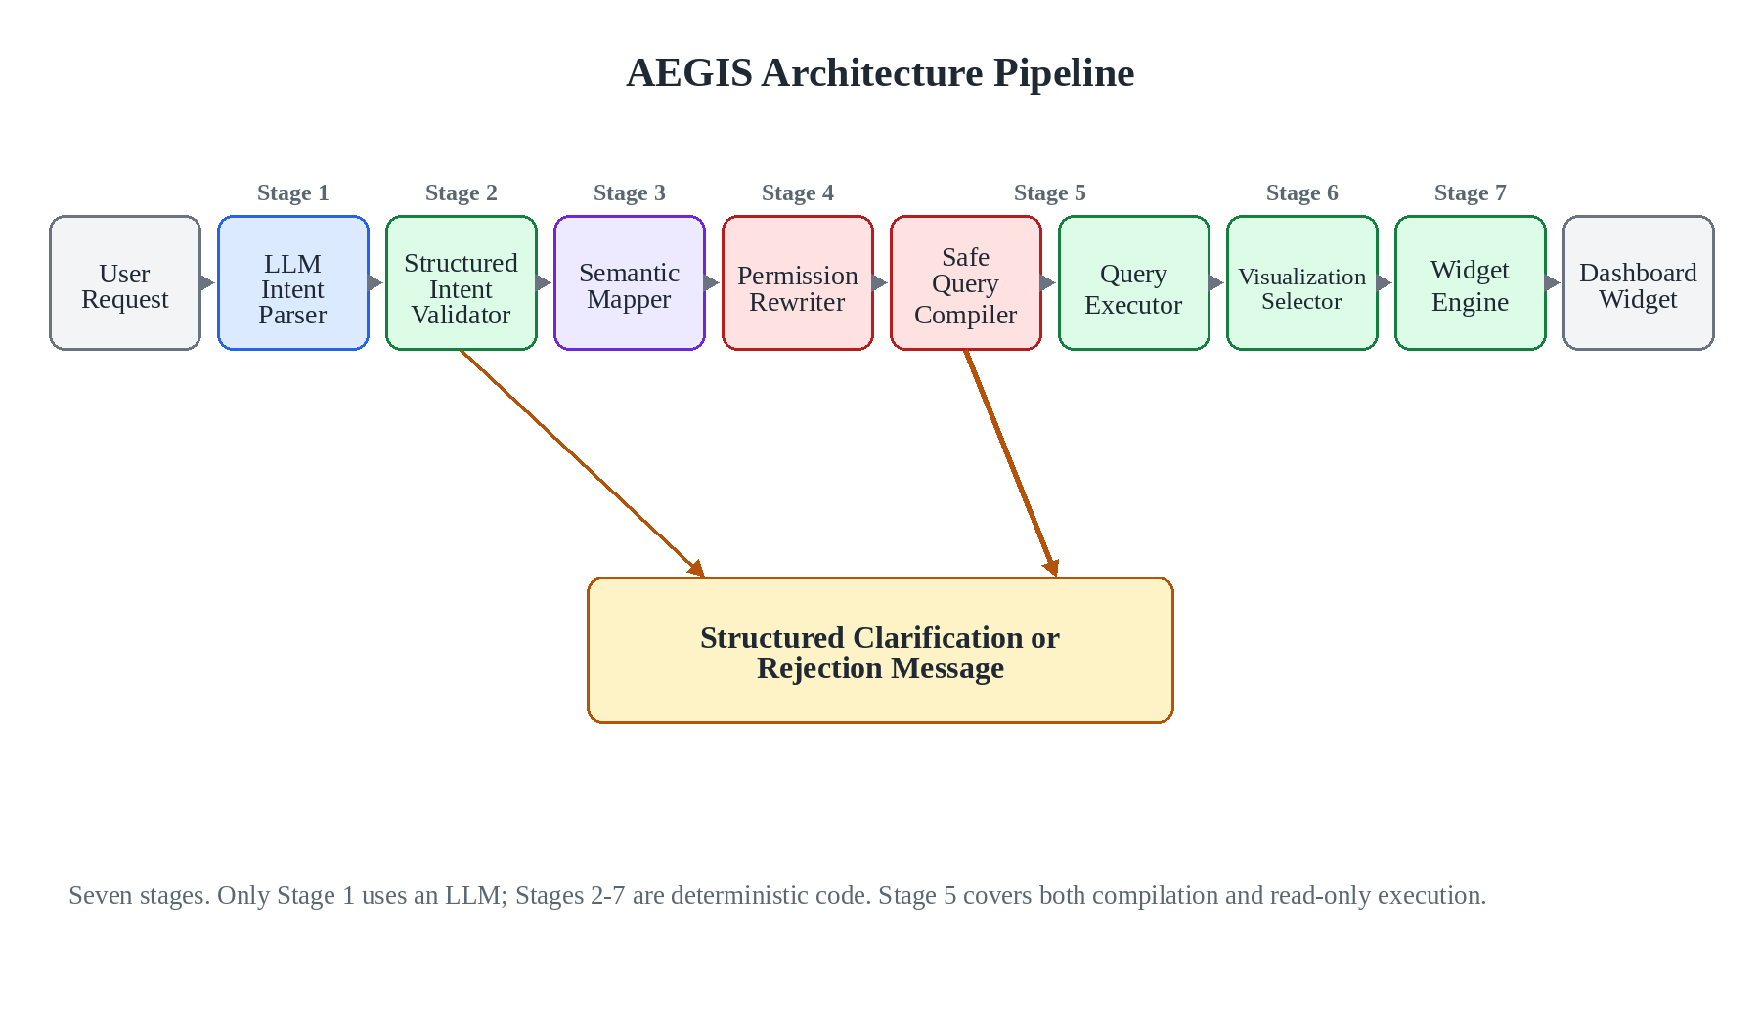
Proposed AEGIS Architecture

Slide 11
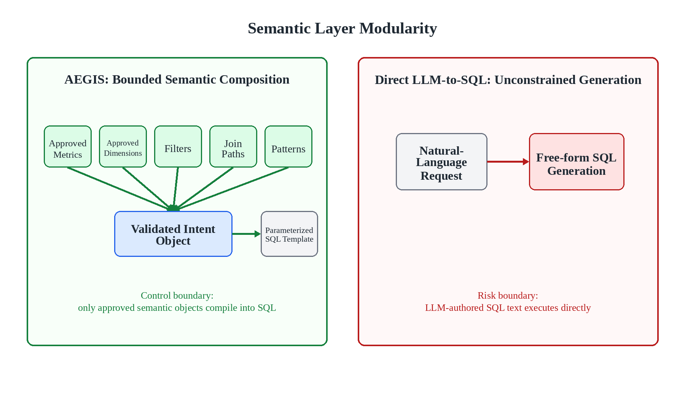
Semantic Layer Implementation
Implemented per target system:
- Business vocabulary: synonyms for metrics, dimensions, filters, and time periods.
- Metric definitions: SQL expressions such as order count, revenue, average order value, and customer count.
- Dimension definitions: status, customer, product, manufacturer, category, date, and geography.
- Join policy: allowed tables and join paths from the nopCommerce [7] schema.
- Output contracts: table, matrix, KPI, and chart-ready shapes.

Slide 12
Intent Extraction Boundary
Stage 1 of 7
1. User asks a business question
2. Prompt exposes approved vocabulary
3. LLM returns an Intent Object
Example:
Show order average by status
Vocabulary excerpt:
- Metrics: revenue, order_count, avg_order_value
- Dimensions: order_status, category, country
- Output: kpi, table, matrix, chart
{
"intent_class": "segment",
"metric_term": "avg_order_value",
"dimension_term": "order_status",
"output_shape": "table"
}
Stage | Allowed | Not allowed
LLM | Choose approved ids from vocabulary | Raw SQL, joins, table names, writes
AEGIS | Bind ids to semantic definitions | Unknown ids, silent fallback, unsafe execution
In plain terms: The model picks names from a list we wrote. It never sees a table name, and never writes SQL.

Slide 13
The Intent Object, and What It Selects
Stages 1 and 2 of 7
IntentObject (aegis/server/models.py)
intent_class selects the compilation path
class IntentObject(BaseModel):
intent_class: IntentClass # required, 11-value enum
metric_term: Optional[str] # an approved metric id
dimension_term: Optional[str] # an approved dimension id
time_term: Optional[str] # a phrase, not a date
filters: List[Filter] # field / operator / value
limit: Optional[int]
confidence: Confidence = LOW # absence is not confidence
unmapped_terms: List[str] # what it could not account for
# There is no sql field. The type cannot express one.
intent_class | Compiler path taken
kpi, summary | aggregate, no LIMIT
segment, ranking, comparison, cohort | aggregate + GROUP BY + ORDER BY
trend | date bucket; zero-filled when daily
tabular, exception | row listing, no aggregation
funnel, correlate | aggregate over the stated relation
An id the semantic layer does not define is rejected here, before any SQL exists. There is no path from an unknown id to a query.
In plain terms: The answer form is chosen from eleven fixed shapes, not invented per question.

Slide 14
Semantic Mapping Under the Hood
Stage 3 of 7
Intent Object metric_term=avg_order_value dimension_term=order_status
Lookup in semantic layer METRICS + DIMENSIONS
Analysis Plan pattern=segment shape=table
Slot | Resolved id | Business meaning | SQL expression | Binding
Metric | avg_order_value | Average revenue per order | AVG(COALESCE(o.OrderTotal, 0)) | Order as o
Dimension | order_status | Readable order status label | CASE o.OrderStatusId ... END | Order as o
Rule | mandatory | Ignore soft-deleted orders | o.Deleted = 0 | WHERE
Intent Object vs Analysis Plan: the Intent Object is what the model said. The Analysis Plan is what AEGIS was able to bind it to — it adds the pattern, the join path, the resolved SQL expressions, and the evidence for each binding. Only the Plan reaches the compiler.
In plain terms: The model said 'average order value'. The definition behind that name was written by the administrator.

Slide 15
Template-Based SQL Compilation
Stage 5 of 7
Compiler template
Filled from semantic layer
Compiled safe SELECT
SELECT {dimension_expr} AS label,
{metric_expr} AS value
FROM {base_table}
{join_clauses}
WHERE {mandatory_predicates}
GROUP BY {dimension_group_expr}
ORDER BY value DESC;
- dimension_expr: CASE order status mapping
- metric_expr: AVG(order total)
- base_table: Order o
- joins: none required here
- predicates: o.Deleted = 0
SELECT CASE o.OrderStatusId
WHEN 10 THEN "Pending"
WHEN 20 THEN "Processing"
WHEN 30 THEN "Complete"
WHEN 40 THEN "Cancelled"
END AS label,
AVG(COALESCE(o.OrderTotal, 0)) AS value
FROM `Order` o
WHERE o.Deleted = 0
GROUP BY CASE o.OrderStatusId ... END
ORDER BY value DESC;
The template controls SQL structure; the semantic layer supplies approved identifiers and expressions; user text is never inserted into the query.
In plain terms: The query's shape is fixed in advance. Only approved names are dropped into the blanks.

Slide 16
Walkthrough: A Question That Needs Four Joins
Stages 1 to 5 of 7
NQ257 "Show product revenue by category."
Intent Object from the model
Compiled SQL, executed read-only
{
"intent_class": "segment",
"metric_term": "line_item_revenue",
"dimension_term": "category_name"
}
SELECT c.Name AS label, SUM(oi.PriceExclTax) AS value
FROM `Order` o
LEFT JOIN `OrderItem` oi ON o.Id = oi.OrderId
LEFT JOIN `Product` p ON oi.ProductId = p.Id
LEFT JOIN `Product_Category_Mapping` pcm ON p.Id = pcm.ProductId
LEFT JOIN `Category` c ON pcm.CategoryId = c.Id
WHERE 1=1
AND o.Deleted = 0
AND p.Deleted = 0
GROUP BY c.Name
ORDER BY value DESC
LIMIT 100
Join path resolved by BFS, not by the model
Product -> OrderItem -> Order
-> Product_Category_Mapping
-> Category
Also worth seeing | What actually happens | Why it matters
"stock less than 10" | compiles to p.StockQuantity < @p0 with params {p0: 10} | The number is bound, never pasted into the SQL text
"revenue from Google Ads" | declined: traffic_source is not in the semantic layer | No guess, no nearest-match substitution

Slide 17
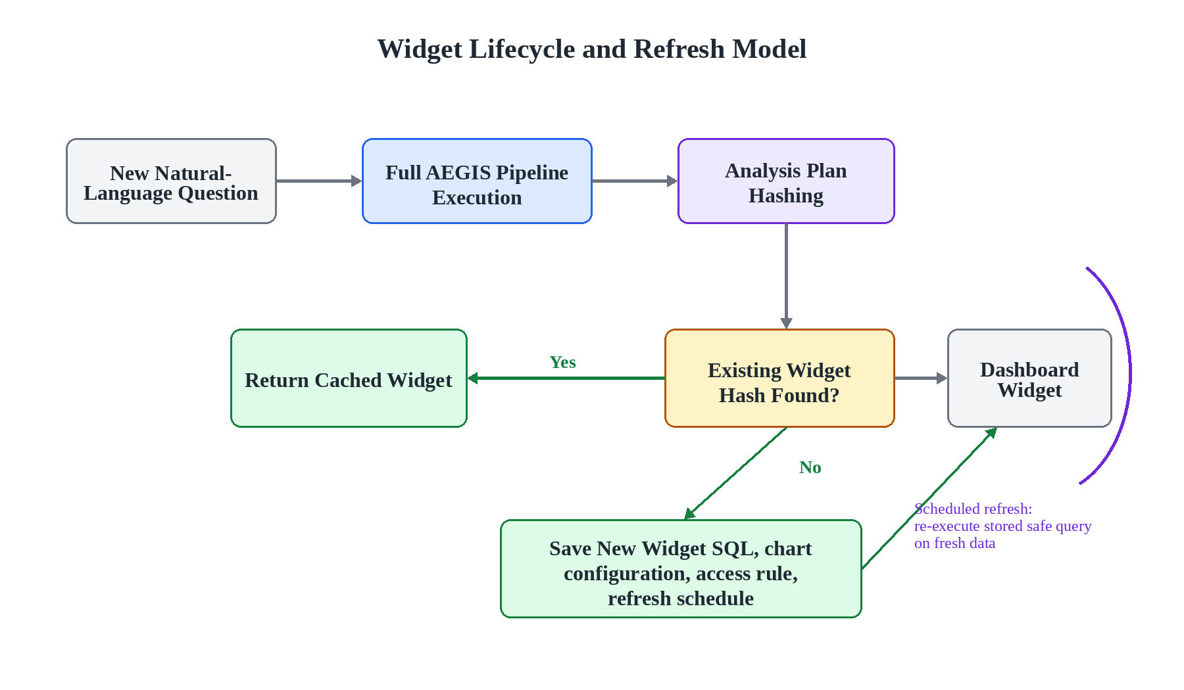
Output Generation
Output is based on result shape, not model narration:
- KPI: one numeric value with label.
- Table: row/column data with responsive scrolling in the prototype.
- Matrix: period columns such as today, week, month, year, and all time.
- Chart-ready output: categories and values are produced from query results.
This lets the prototype show both the answer and the evidence path used to produce it.

Slide 18
Prototype Implementation
Prototype stack:
- FastAPI backend for NL analytics requests.
- MySQL seeded with nopCommerce-style [7] commerce data.
- OpenAI-compatible LLM API for intent extraction.
- Semantic-layer files define metrics, dimensions, filters, and output shapes.
- Frontend shows answer output plus AEGIS stage evidence.
Seeded Data Used in Live Prototype
Order items
6320
Orders
2500
Customers
1200
Products
17
Reproducibility:
- Docker build includes app, database seed scripts, and smoke checks.
- Local health test verified database connection and seeded counts.

Slide 19
Evaluation Track 1: 500 Natural-Language Questions
425 questions the semantic layer should answer, 75 realistic e-commerce questions it should decline. The same corpus is executed two ways, and they answer different questions.
Measure | Deterministic run (no model in the loop) | End-to-end run (live parser)
Parser produced an intent | not applicable | 499/500 (99.8%)
Supported questions answered | 425/425 (100.0%) | 423/425 (99.5%)
Compiled SQL executed | 425/425 (100.0%) | 422/425 (99.3%)
Intent matched the annotation | not applicable | 313/425 (73.6%)
Out-of-scope questions declined | 75/75 (100.0%) | 72/75 (96.0%)
The left column has no model in it: committed intent annotations are fed straight to the mapper, so it tests the compiler, not the pipeline. Only the right column is an end-to-end result, and it is the one to quote.
Declining is only meaningful next to answering: a system that refuses everything scores 100% on the last row.
In plain terms: It answers the questions it was built for, and says no to the ones it was not — on purpose.

Slide 20
Where the Time Goes
Median and 95th-percentile time per question, measured on the supported questions of the 500-question corpus.
Stage | Who runs it | Median | 95th percentile
1. Intent extraction | The language model | 9,029.89 ms | 19,460.15 ms
2. Semantic resolution | AEGIS | 0.96 ms | 1.46 ms
3. SQL compilation | AEGIS | 0.13 ms | 0.22 ms
4. Database execution | MySQL | 2.89 ms | 20.41 ms
Stages 2-4 combined | Everything after the model | 3.62 ms | 14.02 ms
Almost all of the wall clock is the model reading the question. The part that decides which tables to join, writes the SQL, and runs it takes a few milliseconds — and the model has no influence over any of it.
The model figure is a property of the gateway used here, not of the architecture; the deterministic figures are the ones that would follow AEGIS to another deployment.

Slide 21
Without the Semantic Layer: the Same Model, Unconstrained
The identical model through the identical gateway, asked to write MySQL directly for the same 500 questions.
Measure | AEGIS | Direct LLM-to-SQL
Supported questions whose SQL executed | 422/425 (99.3%) | 365/425 (85.9%)
Out-of-scope questions answered anyway | 3/75 (4.0%) | 25/75 (33.3%)
Queries containing a forbidden construct | 0 — the compiler cannot emit one | 2/500 (0.4%)
What answering an unanswerable question looks like
The question | What the unconstrained model returned
"Forecast next month's total sales." | A query summing past months. It runs, returns a number, and forecasts nothing.
"Which customers are likely to churn?" | A query counting each customer's past orders. No prediction is possible from it.
"Summarize the top complaints in reviews." | Keyword matching over review text, joined with UNION — rejected by the safety scan.
In plain terms: Asked something the data cannot answer, the unconstrained model answers anyway — and the answer looks right.

Slide 22
Evaluation Track 2: nopCommerce's Own 20 Admin Reports
The report list is nopCommerce's own admin menu, and the comparison target is nopCommerce's own report code, read from source at commit 64bdf2ff. Neither was chosen by this project.
Check | Result | What it does and does not show
Report reached an answer and compiled to SQL | 20/20 | Coverage of the report shape. Not correctness — several once passed this while silently wrong.
Result set matched the platform's own query | 15/20 (75.0%) | The check that tests the claim: same database, same rows, same values.
The five reports that did not match, and why
Difference | Reports affected
Row count only — the platform's report carries its own LIMIT (5, 15, 100) | Bestsellers by quantity, Bestsellers by amount, Latest orders, Best customers by order count
Label column — customer name where the platform's query labels by email | Best customers by order total, Best customers by order count
Wrong value | None. Every overlapping row agrees to the last decimal.
In plain terms: Where the numbers differ from nopCommerce's own reports, they do not — only how many rows and which label.

Slide 23
Beneficiaries and Expected Impact
Beneficiary | Current difficulty | AEGIS impact
Business users | Need reports but need new report combinations | Ask natural-language analytics questions and receive controlled table or chart-ready results
Developers / BI teams | Repeated report requests consume implementation time | Reusable semantic definitions reduce one-off SQL writing for common analytics
Database administrators | Model-written SQL is hard to audit and restrict | Only approved metrics, dimensions, joins, and read-only SQL reach the database
Researchers | NL2SQL work often mixes language accuracy with execution authority | Shows an architecture where language understanding and SQL authority are separated
Expected impact: safer self-service analytics for repeated e-commerce reporting, without giving the LLM permission to author executable SQL.

Slide 24
Scope of the Evaluation
Current evaluation scope:
- Implemented and evaluated for nopCommerce [7] analytics on MySQL; the semantic layer is deliberately finite and deployment-specific.
- The layer is per-deployment, so cross-domain benchmarks such as Spider and BIRD do not apply: they test generalisation to unseen schemas, which this architecture does not attempt.
- The gateway resolves a model alias per request, so the run is not pinned to one model. Each result row records what served it.
Not a thesis limitation:
- Multi-turn conversation is out of scope because the work evaluates single-request analytics.

Slide 25
Limitations I Would Raise First
- Correctness at scale is measured on the 20 reports, not on all 425 supported questions. For those I show the SQL runs — not that every answer is right.
- The seeded catalogue is small: 17 products in 8 categories against 2,500 orders. Order-side reports run at realistic volume, but bestsellers and revenue-by-category agree with nopCommerce over short lists — same compiled SQL, weaker test.
- Three of the 75 boundary questions were not declined: one malformed model reply, and the same carrier-comparison question phrased twice. The model flagged "DHL" and "FedEx" as unmapped and AEGIS answered by shipping method anyway — by design, because a model-reported gap is evidence, not a verdict. That keeps false refusals low and costs exactly this.
- Five reports differ from the platform's own output in row count or label column. No report differs in value.
- Other SQL dialects require compiler extensions.

Slide 26
Conclusion
Conclusion:
- AEGIS keeps the LLM useful for language understanding while removing SQL-authoring authority from the model.
- The semantic layer makes analytics definitions explicit, auditable, and reusable for a target system.
- The compiler produces read-only SQL from approved definitions and blocks unsupported execution paths.
- The nopCommerce [7] prototype, the 500-question corpus, and the differential against the platform's own report logic show that the approach can be implemented and evaluated practically.
Main contribution:
- A constraint-based architecture for safe LLM-assisted natural language analytics.

Slide 27
Future Work
Possible extensions:
- Evaluate AEGIS on another e-commerce system by replacing only the semantic layer.
- Add more oracle reports from real admin and business workflows.
- Extend compiler modules for PostgreSQL and SQL Server.
- Improve clarification behavior for ambiguous but answerable user questions.
- Add richer chart recommendation while keeping SQL generation deterministic.

Slide 28
References
[1] Li, F., & Jagadish, H. V. (2014). Constructing an interactive natural language interface for relational databases. PVLDB.
[2] Narechania, A., Srinivasan, A., & Stasko, J. (2021). nl4dv: A toolkit for generating analytic specifications from natural language. IEEE TVCG.
[3] Deng, D., Wu, A., Qu, H., & Wu, Y. (2023). DashBot: Insight-driven dashboard generation. IEEE TVCG.
[4] Scholak, T., Schucher, N., & Bahdanau, D. (2021). PICARD: Parsing incrementally for constrained auto-regressive decoding. EMNLP.
[5] Shalaan, H. S. et al. (2025). G-SQL: A schema-aware and rule-guided approach for robust natural language to SQL translation. IEEE Access.
[6] Su, X. et al. (2026). A robust natural language text-to-SQL generation framework with dynamic strategies based on LLMs. Scientific Reports.
[7] nopSolutions. nopCommerce open-source e-commerce platform. GitHub repository.

Slide 29
Thank You & Discussion
THANK YOU!
Questions & Final Defense Discussion

Slide 30
Appendix A: The Semantic Layer Is a File I Wrote
aegis/server/semantic_layer.py — two of the objects the model is allowed to name:
Metric(
id="avg_order_value",
label="Average Order Value",
description="Average revenue per order",
sql_expr="AVG(COALESCE(o.OrderTotal, 0))",
binding_table="Order",
required_joins=[],
default_visual="kpi_card",
time_anchor="o.CreatedOnUtc",
)
Dimension(
id="order_status",
label="Order Status",
sql_expr="CASE o.OrderStatusId "
"WHEN 10 THEN 'Pending' "
"WHEN 20 THEN 'Processing' "
"WHEN 30 THEN 'Complete' "
"WHEN 40 THEN 'Cancelled' "
"ELSE 'Unknown' END",
binding_table="Order",
datatype="string",
)
The model may return the string "avg_order_value". It cannot return the expression, the table, or the join. Deploying AEGIS on another system means writing this file again — and nothing else.
In plain terms: This list is the whole vocabulary. Anything not written here cannot be asked for.

Slide 31
Appendix B: The Compiler Fills Blanks, It Does Not Write SQL
aegis/server/compiler.py — the function that builds the SELECT clause:
def _assemble_select(self, metric, dimension, extra_metrics=None, plan=None) -> str:
measures = [f"{metric.sql_expr} AS value"]
for extra in extra_metrics or []:
measures.append(f"{extra.sql_expr} AS `{extra.id}`")
projected = ", ".join(measures)
if dimension:
dim_expr = self._dimension_select_expr(dimension, plan)
return f"SELECT {dim_expr} AS label, {projected}"
return f"SELECT {projected}"
# Every interpolated value is an attribute of a semantic-layer object.
# No argument to this function carries user text.
Literal values take a separate route: a filter compiles to a placeholder and a bound parameter (p.StockQuantity < @p0 with {p0: 10}), so a value never becomes part of the SQL text. After assembly, a forbidden-pattern scan rejects any non-SELECT construct before execution.

Slide 32
Appendix C: Why Templates Instead of Constrained Decoding
 | PICARD [4] — constrained decoding | AEGIS — template compilation
What the model emits | SQL text, token by token | A typed Intent Object with no SQL field
What is checked | Each token against a parser, during generation | Each id against the semantic layer, before compilation
What we give up | Nothing — any valid SQL stays reachable | Flexibility: a question outside the semantic layer cannot be answered at all
Constrained decoding guarantees the SQL parses. It does not guarantee the SQL is the query the administrator would have approved — a syntactically perfect query can still join the wrong grain, drop a soft-delete filter, or read a column nobody meant to expose.
The trade is real and worth stating plainly: AEGIS buys auditability by giving up open-ended coverage. That is why 75 of the 500 evaluation questions are ones it must decline.

