Slide 1

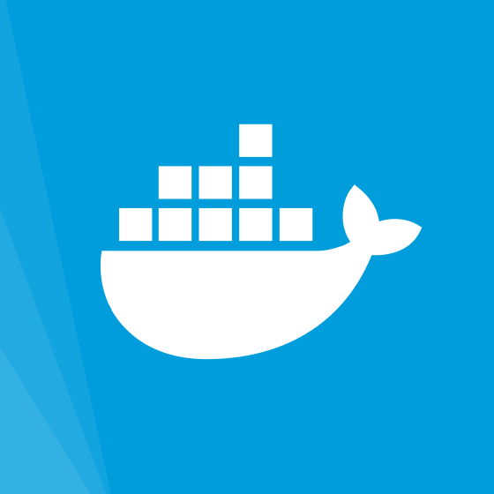




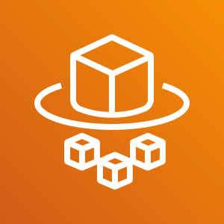
Docker Hub
ALB
1
2
3
Users/Clients
4
5
6
Amazon EKS
AWS Fargate
Infrastructure-less

