Slide 1
INTRODUCTION TO
Session
on
SPSS
Instructor:
Md. Safayet Hossain
Lecturer,
Department of Statistics
Comilla University

Slide 2
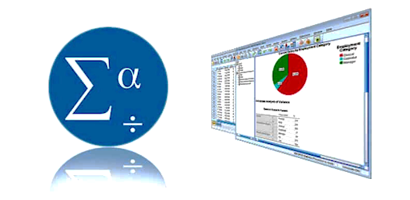

What is SPSS?
SPSS = Statistical Package for the Social Sciences
(Statistical Product and Service Solutions)
SPSS Statistics is a statistical software suite developed by IBM for data management, advanced analytics, multivariate analysis, business intelligence, and criminal investigation.
Developers: Norman H. Nie, Dale H. Bent, C. Hadlai Hull
Initial release: 1968; 58 years ago
Mother company: IBM
Version: (SPSS 1 – 1968 to SPSS 31 - 2025)
Extension: (.dta)
It provides accessible tools for handling and interpreting data.
It is also used by market researchers, health researchers, survey companies, government, education researchers, industries, marketing organizations, data miners, and others.

Slide 3
Application and uses of SPSS
Applications:
Data Management - Enter, organize, and clean large datasets easily
Descriptive Statistics - Calculate mean, median, mode, frequency, std. dev.
Data Analysis - Correlation, regression, hypothesis testing
Data Visualization - Create charts (bar, pie, histogram) for better understanding
Hypothesis Testing - T-test, ANOVA, Chi-square for decision making
Survey & Research Analysis - Analyze questionnaire and Likert-scale data
Health & Social Science Research - Used in public health, psychology, sociology studies
Business & Market Research - Customer analysis, satisfaction, trend analysis
Academic Research - Thesis, dissertations, journal publications⚙️
Predictive Modeling - Forecast outcomes using regression models
Uses:
Education: student and research analysis
Health: patient and clinical data
Business: market and customer analysis
Banking: risk and forecasting
Government: policy and census data
Social science: behavior analysis
Marketing: consumer insights
NGOs: impact evaluation
HR: employee analysis

Slide 4
Advantages and Disadvantages of SPSS
Advantages
User-friendly interface that is easy for beginners to learn
Fast processing of large datasets
Wide range of statistical analysis tools
Built-in options for creating graphs and charts
Efficient data entry, cleaning, and management
Produces accurate and reliable results
Widely accepted in academic and professional research
Allows analysis to be saved and repeated using syntax
Can integrate with other software like Excel, R, and Python
Disadvantages
Expensive software with high licensing cost
Limited flexibility compared to programming tools like R or Python
Less suitable for very advanced or customized analyses
Requires proper understanding to interpret results correctly
Not ideal for handling extremely large or complex datasets
Limited graphical customization compared to modern tools
Dependence on GUI may reduce deeper statistical understanding
Syntax usage is less intuitive for beginners
Updates and extensions are relatively restricted

Slide 5
Advantages of SPSS over Excel, STATA and Programming Language
Aspect | SPSS Advantage over Excel | SPSS Advantage over Stata | SPSS Advantage over Programming Languages
Ease of Use | More statistical tools built-in | Easier GUI interface | No coding required
Data Handling | Better for large datasets | Simpler data import/export | No syntax needed for data management
Analysis Process | Automated procedures available | More user-friendly menus | Direct point-and-click analysis
Learning Curve | Easier for beginners than Excel advanced tools | Less command-based complexity | No programming knowledge required
Output Interpretation | Clear, ready-made tables | More visually structured outputs | Automatic formatted reports

Slide 6
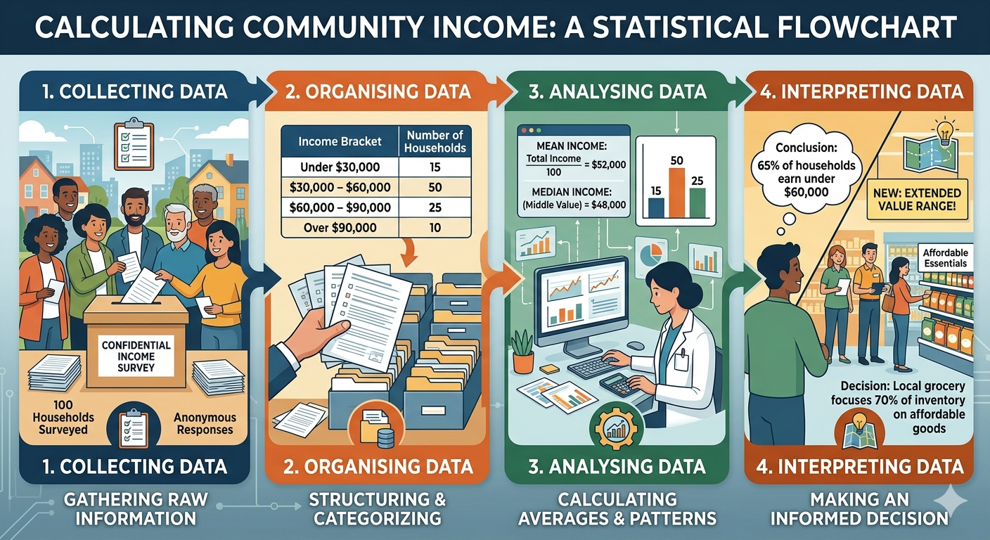
Basic Statistics
Statistics
Statistics, a branch of mathematics, is the science of collecting, organising, analysing, and interpreting data to make an informed decisions.

Slide 7
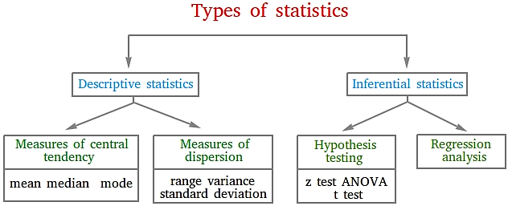
Types of Statistics

Slide 8
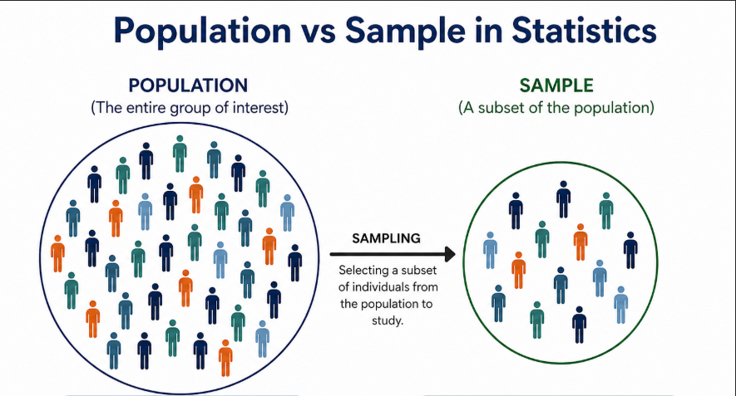
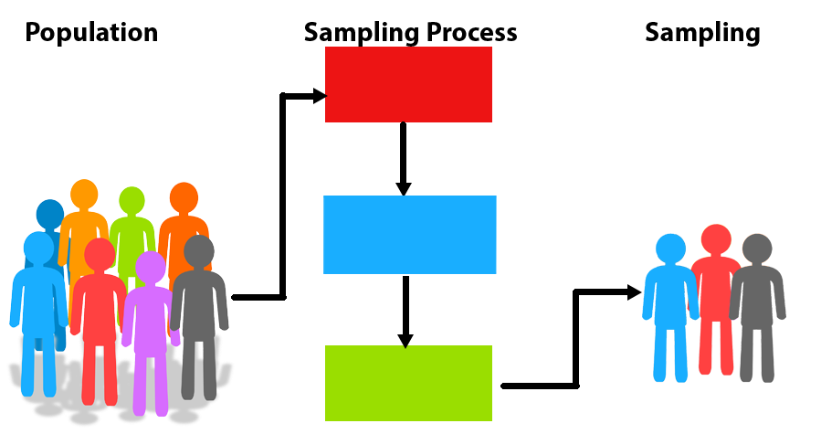
Population, Sample and Sampling
Population: The totality or collection of all objects on which observations are taken
Sample: A representative part or subset of a population
Sampling: Sampling is the process of selecting sample from a representative population.

Slide 9
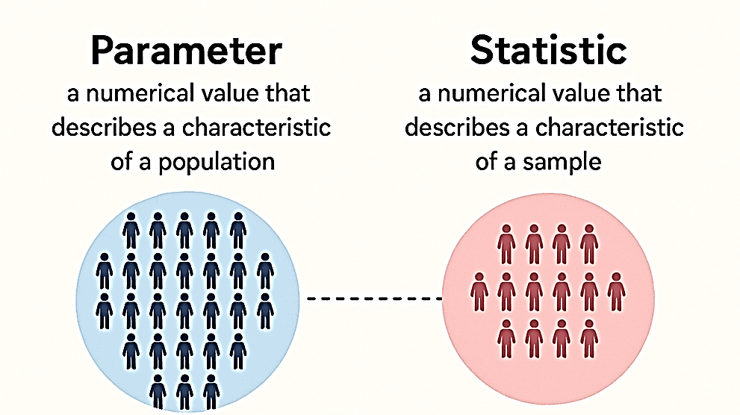
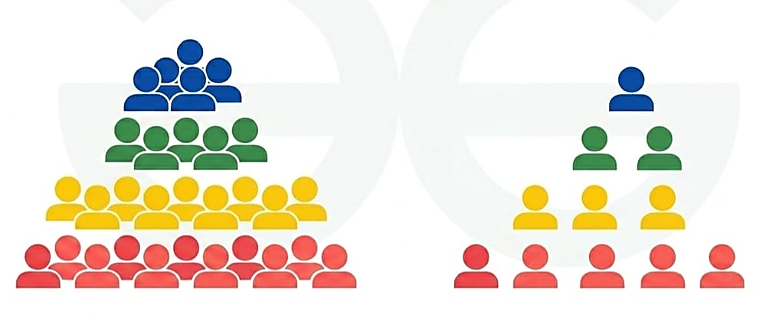
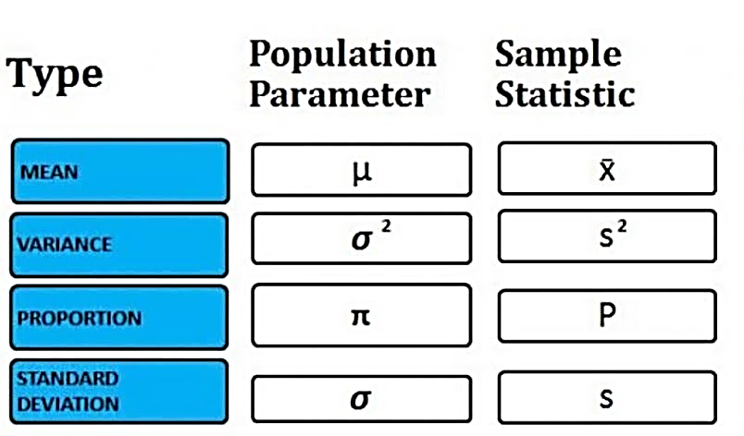
Parameter and Statistic
Parameter: A numerical value that describes a characteristic of an entire population.
Statistic: A numerical value that describes a characteristic of a sample drawn from a population.
Parameter
Statistic

Slide 10
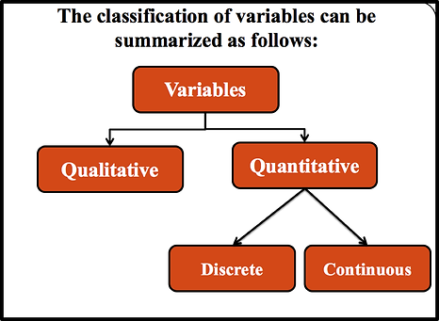
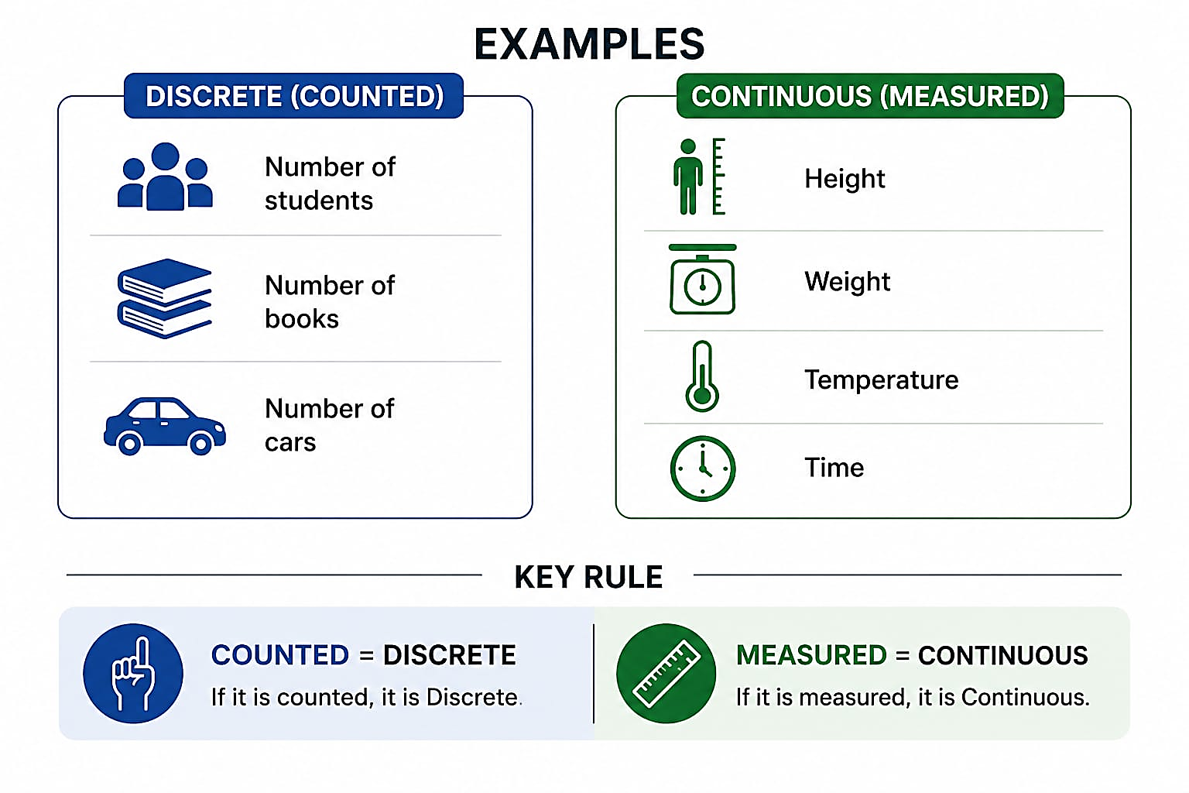
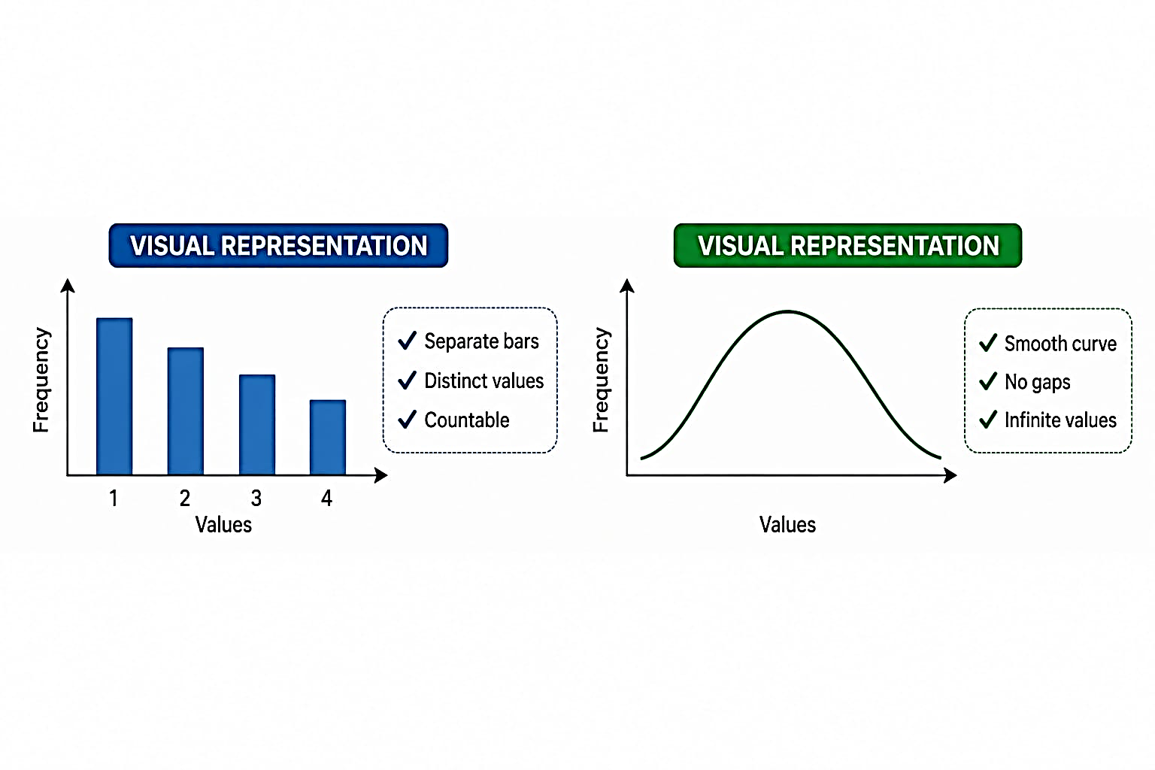
Variable
Variable: A Variable is a changeable characteristic of the experimental units under consideration.
Examples: A worker’s age, Religion, Gender
i. Qualitative: It cannot be measured on a natural numerical, but measures qualitative characteristic on each experimental unit.
Examples: Religion of a student, Gender, Economic status
ii. Quantitative: It measures a numerical quantity or amount on each experimental unit.
Examples: Number of children per family, Daily wage, Systolic BP.
Discrete
Continuous

Slide 11
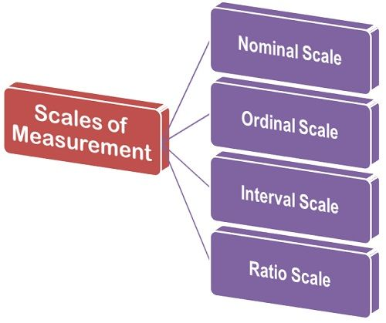
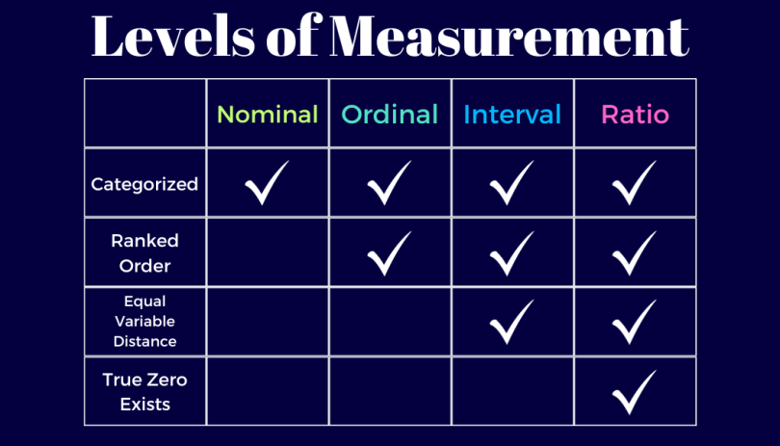
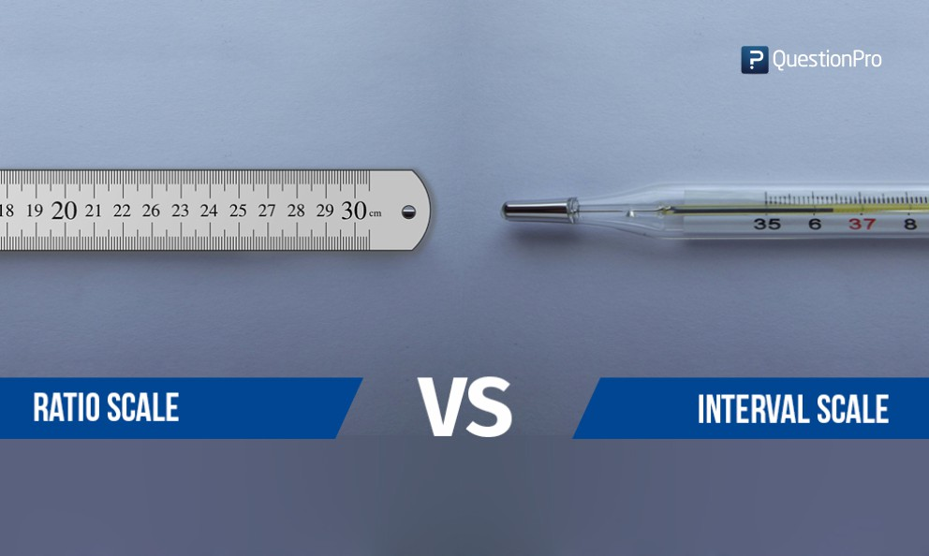
Scale/Levels of Measurement
Scale of measurement: A system for classifying and measuring data based on the nature of values and the level of information they provide.
Qualitative
Quantitative
(Scale)

Slide 12
Overview of SPSS
Toolbar/Menu | Application
File | Open, save, import, export datasets
Edit | Modify data, undo/redo, find/replace
View | Customize display, toolbars, value labels
Data | Sort, select, split, merge, restructure data
Transform | Create new variables, recode, compute values
Analyze | Perform statistical tests and analysis
Graphs | Create charts and visualizations
Utilities | View variable info, file info, system settings
Extensions | Add extra features/plugins
Window | Switch between open files/output
Help | Access guidance and documentation

Slide 13
Variable naming rules

Slide 14
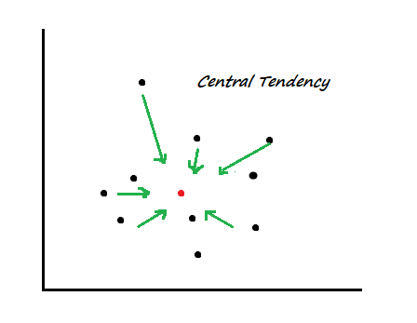
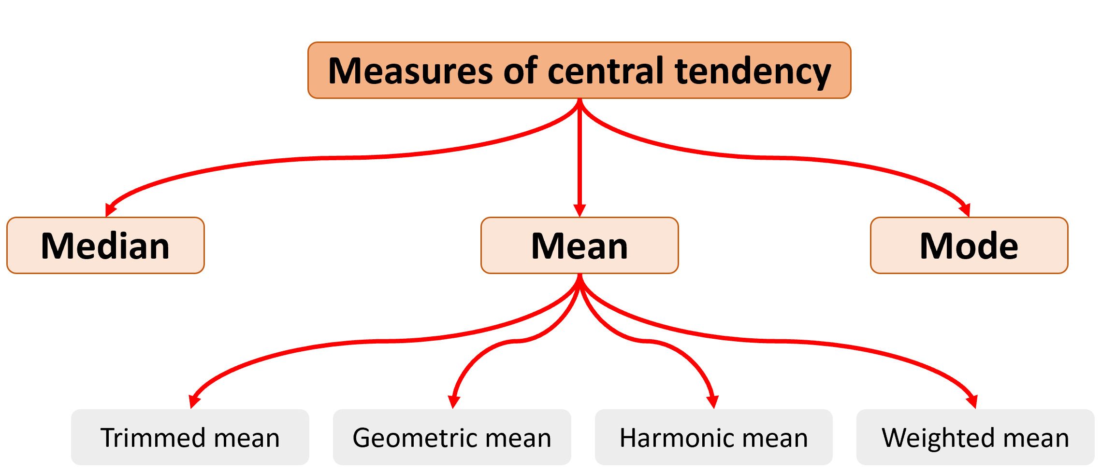
Central Tendency
Central tendency: Central tendency is a statistical concept that describes the central or typical value of a dataset, around which all other observations tend to cluster

Slide 15
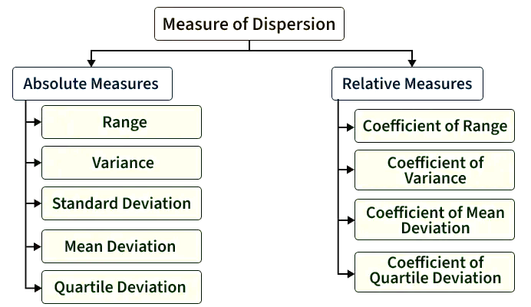
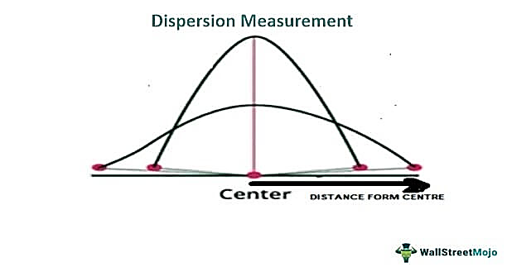
Dispersion
Measures of dispersion: Measures of dispersion describe the spread or variability of data values around a central value (mean, median, or mode). They show how scattered or consistent the data is.
Absolute measures: Absolute measures show the actual amount of variation in the same unit as the data. They express dispersion in original units (kg, years, income, etc.)
Relative measures: Relative measures show the proportional or percentage variation relative to the central value. They are unit-free (standardized)

