Slide 1

Institute of
technology & management
HOTEL MANAGEMENT SYSTEM
REPRESENTED BY :-
1.Mohammad Umair
2.Arjun Kumar Gupta
3.Chandrabhan Gupta
SUBMITTED TO:-
Mr. VIJENDRA SINGH

Slide 2
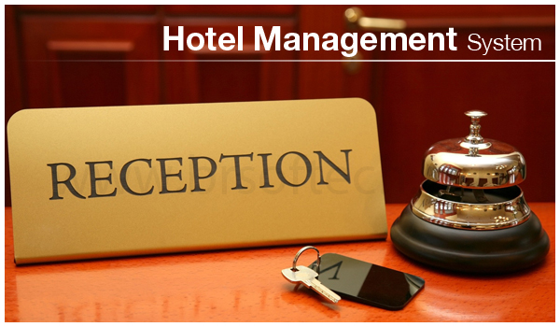

Slide 3
Introduction:-
A hotel is a hive of numerous operations such as front office, booking and reservation, banquet, finance, HR, inventory, material management, quality management, security, energy management, housekeeping, CRM and more. All these activities take place simultaneously and managing these diverse activities manually can be a difficult process. This led to the introduction of property management systems or hotel ERP that automates a host of repetitive functions. Integrated, automated software also means management can optimize hotel operations, gather business intelligence and thus keep a tight control on costs.
Project title “Hotel Management”(a project for keeping customers record and also calculate customer bill slip) the name of project is “Hotel Management”. The purpose of the project is to computerize the system of the hotel . The Hotel Management project keeps the record of various people like customers, managers,etc. but as well as reduce the extensive paper work in present system.
It will make system more versatile and user friendly. This project is based on description about the structure of HOTEL MANAGEMENT SYSTEM.

Slide 4
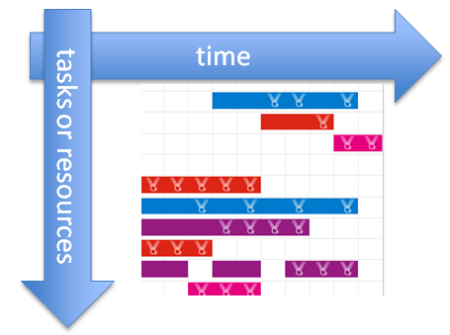
GANTT CHART
Gantt chart is very popular project management tool for planning and scheduling projects.
A Gantt chart is a type of bar chart that illustrates a project schedule .
Gantt chart show the dependency relationship between activities and current schedule .

Slide 5
ADVANTAGES :-
It demonstrates that we know what we are doing.
It helps us to set realistic time frame.
It organizes our thoughts.
Disadvantages :-
They needs to be constantly updated.
The size of bar doesn’t indicate the amount of work.

Slide 6
01 Jan to 30 Jan
31 Jan to 24 Feb
25 Feb to 16 Mar
17 Mar to 20 Apr
21 Apr to lifetime

Slide 7
DECISION TREE
A Decision Tree is a Decision support tool that uses a tree like graph or model of decisions and their possible consequences ,resource costs and utility.
Decision tree provide a framework to consider the probability of decisions which can help us to analyze a decision to make the most informed decision possible.

Slide 8
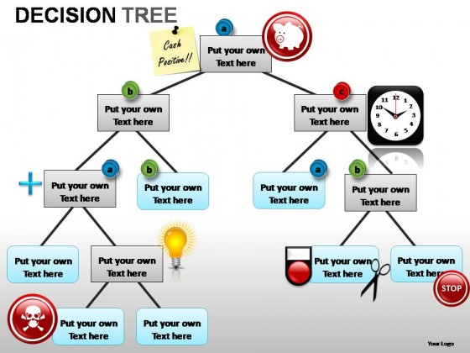
ADVANTAGES :-
Easy to understand.
Easy to generate rules
DISADVANTAGES:-
May suffer from overfitting.
Classifies by rectangular partitioning.

Slide 9
DECISION TREE
Hotel Management
Customer
Staff
Vendor
Facilities
Room Booking
Bill Payment
Food Order
Supplier
Room Booking
Food
Name
Category
Room Status
Room Type
Manager
Receptionist
Chef
Employee
Bill Payment
Room Allocation
Management
Food Cooking
Order Food
Serve Food
Room service
Cleaner
Manage The Security

Slide 10
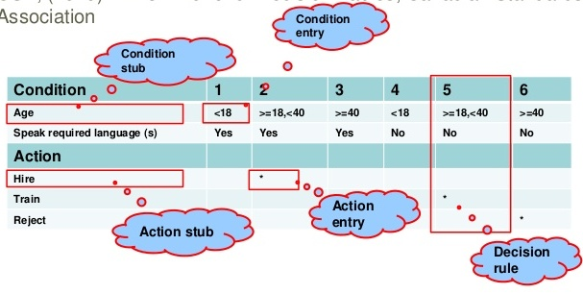
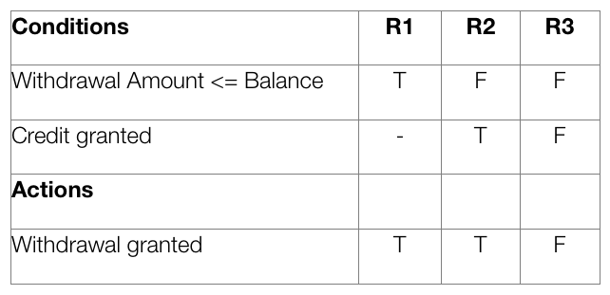
DECISION TABLE
A Decision table is a good way to deal with combinations of things.
Decision tables are a concise visual representation for specifying which actions to perform depending on given conditions.

Slide 11
ADVANTAGES:-
Decision table are declarative. There is no particular order for conditions and actions to occur.
This type of testing also works iteratively.
DISADVANTAGES:-
Can be time consuming.
Constant change in the market makes assumptions difficult.
Danger of either too simplistic or too complicated.

Slide 12
Decision Table
 |  | Rules
Condition | Customer | N | Y | N | Y
 | Employee | N | N | Y | Y
Action | Bill Payment |  | Y |  | Y
 | Preparing Bill |  |  | Y | Y
 | Room Booking |  | Y |  | Y
 | Room Reserve |  |  | Y | Y
 | Food Order |  | Y |  | Y
 | Food Serve |  |  | Y | Y
 | Management, Room Service, Cleaning, Watching |  |  | Y | Y

Slide 13
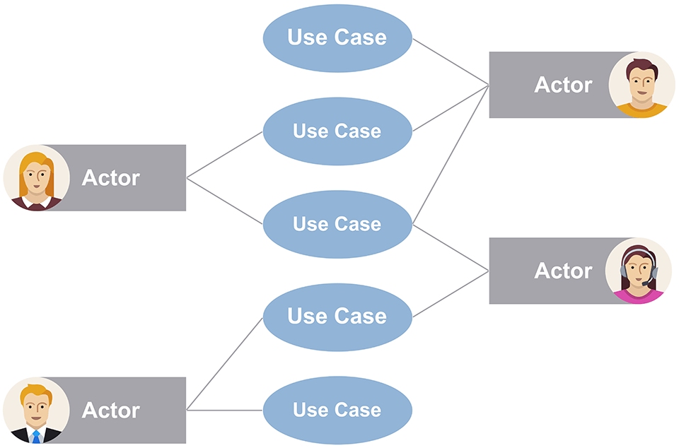
USE CASE DIAGRAM
USE Case diagram shows the relationship between user and the different use cases in which the user is involved.
USE Case diagrams model the functionality of the system using actors & use cases.
USE cases are a set of actions, services & functions that the system needs to perform.

Slide 14
ADVANTAGES:-
Use case diagram provides project planning skeleton.
The extension conditions of each use case provide a framework.
DISADVANTAGES:-
Use cases are not well suited to capturing non-interaction based requirements of a system.
For some products and systems, use cases are complex to write and to understand.

Slide 15
Use Case Diagram
Management
Supplier
Manager
Vender
Room Booking
Bill Payment
Order Food
Receptionist
Customer
Food Cooking
Serve Food
Chef
Room Service
Cleaner
Employee
Manage Security

Slide 16
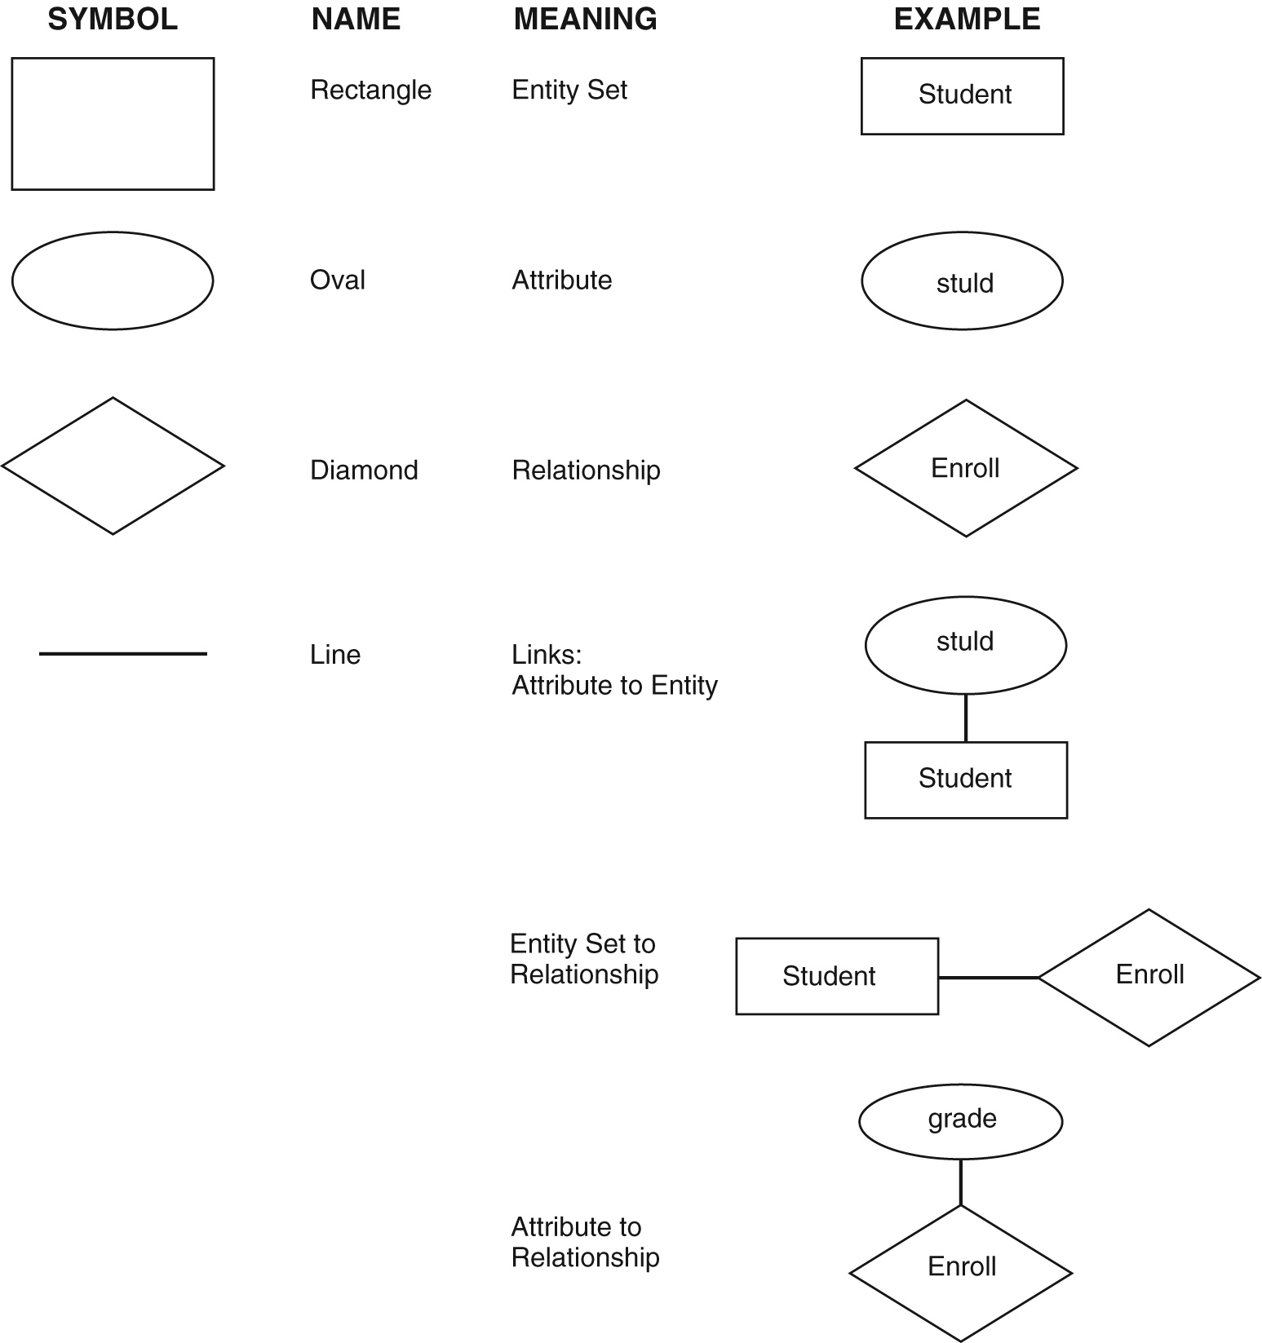
E-R DIAGRAM
E-R diagram is a visual representation of data that describes how data is related to each other.
In E-R diagram we disintegrate data into entities, attributes &setup relationships between entities, all this can be represented visually using the E-R diagram.

Slide 17
ADVANTAGES:-
Visual representation .
Effective communication tool .
DISADVANTAGES:-
Limited relationship representation.
Limited constraint representation.
No data manipulation language.

Slide 18
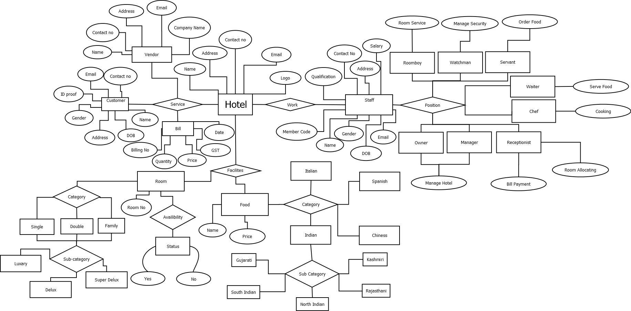
E-R DIAGRAM

Slide 19
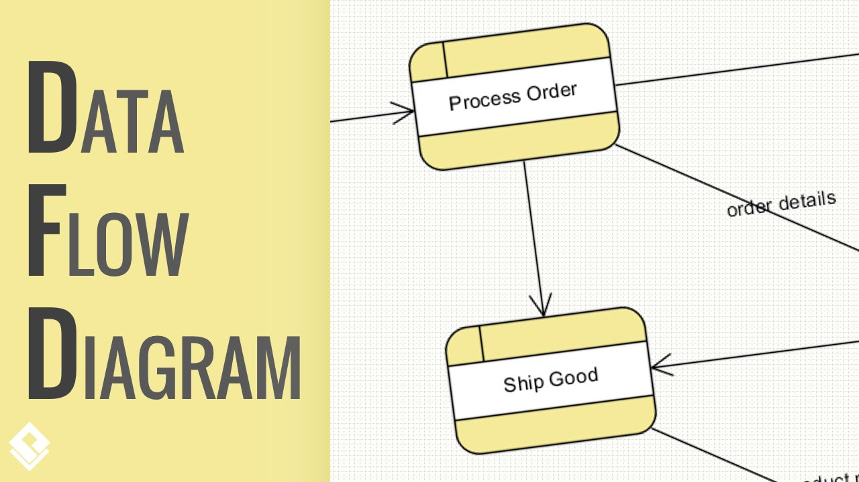
DATA FLOW DIAGRAM:-
Data flow diagram is a graphical representation of the “flow” of data through an information system.
It serves the purpose of clarifying system requirements and identifying major transformation.

Slide 20
ADVANTAGES:-
A good way to communicate the details of a task or processes to others.
An excellent way of documenting each stage of the process.
DISADVANTAGES:-
It make the programmers little confusing concerning the system.
Its simply takes a long time to create.

Slide 21
0-LEVEL DFD
ROOM
BOOKING
SALARY
REQUEST FOR
ROOM
DETAILS
REQUEST FOR
ROOM
FOOD
CANCELLATION
PRODUCTION
REQUEST FOR
OTHER FACILITIES
REQUEST FOR
REQUEST FOR FOOD ORDER
HOTEL
MANAGEMENT
SYSTEM
FACILITIES
CUSTOMER
PAYMENT
WORK
STAFF
CONFIRM THE ROOM
MANAGING
SERVE THE FOOD
COOKING FOOD
REQUEST FOR
FACILITIES
REQUEST FOR
CLEANING ROOMS
CONFIRM OR REJECT
PAYMENT
REQUEST FOR
SALARY
CANCELLATION
ROOM
GOODS
PAYMENT
RECEIVE GOODS ORDER
RECEIPT
RECEIPT
ORDER FOR
VENDOR

Slide 22
1-LEVEL DFD
ROOM
BOOKING
CANCELLATION
1.0
REQ FOR
REQ FOR ROOM
ROOM
ROOM
REQ FOR ROOM
DETAILS
CANCELLATION
CONFIRM THE ROOM
REQ FOR
ROOM
CONFIRM THE ROOM
ROOM BOOKING
DETAILS
ROOM DETAILS
ROOM
DETAILS
DETAILS
BOOKING
ORDER OF FOOD
REQ FOR
ROOM
2.0
REQ FOR
CONFIRM OR REJECT
FOOD DETAILS
ORDER FOR FOOD
FOOD
CUSTOMER
REQ FOR FOOD DETAILS
SERVE FOOD
STAFF
FOOD
DETAILS
SERVE FOOD
FOOD ORDER
DETAILS
DETAILS
FACILITIES DETAILS
FOOD
3.0
CONFIRM FACILITIES
OTHER FACILITIES
FACILITIES
REQ FOR
REQ FOR
OTHER
DETAILS
FACILITY
DETAILS
CONFIRM
REQ FOR
OTHER
FACILITIES
FACILITIES
FACILITIES DETAILS
SALARY
OTHER
REQ FOR
REQ FOR
FACILITIES
DETAILS
4.0
PAYMENT
PAYMENT
RECEIPT
PAYMENT
SALARY
RECEIPT
PRODUCT DEATAILS
GOODS
5.0
PAYMENT
PRODUCTION PRODUCT
RECEIVE
RECEIPT
FOR GOODS
VENDOR
GOODS
ORDERS
RECEIVE
FOR GOODS
ORDERS

Slide 23
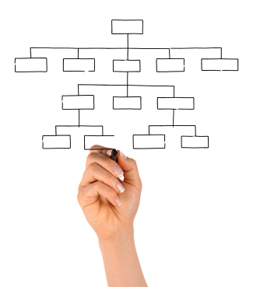
STRUCTURE CHART
Structure chart shows the break down of a system to its lowest manageable levels.
They are used in structured programming to arrange program modules into a tree.
Each module is represented by a box, which contains the modules name.

Slide 24
Structure chart
Hotel Management
Customer
Staff
Vendor
Facilities
Room Booking
Bill Payment
Food Order
Room
Food
Supplier
Manager
Receptionist
Chef
Employee
Bill Payment
Room Allocation
Management
Food Cooking
Order Food
Serve Food
Room service
Cleaner
Manage The Security

Slide 25
CONCLUSION :-
It has been a matter of immense pleasure, honor and challenge to have this
opportunity to take up this project and complete it successfully.
While developing this project I have learnt a lot about hotel management, I
have also learnt how to make it user friendly (easy to use and handle) by
hiding the complicated parts of it from the users.
During the development process I studied carefully and understood the
criteria for making a software more demanding, I also realized the
importance of maintaining a minimal margin for error.

Slide 26
REFERENCE :-
https://en.m.wikipedia.org/wiki/Gantt_chart
https://www.investopedia.com > terms
https://m.economitimes.com > definition
https://www.slideshare.net/skhabib/hotel-management-ppt

Slide 27
THANK
YOU

