Slide 1

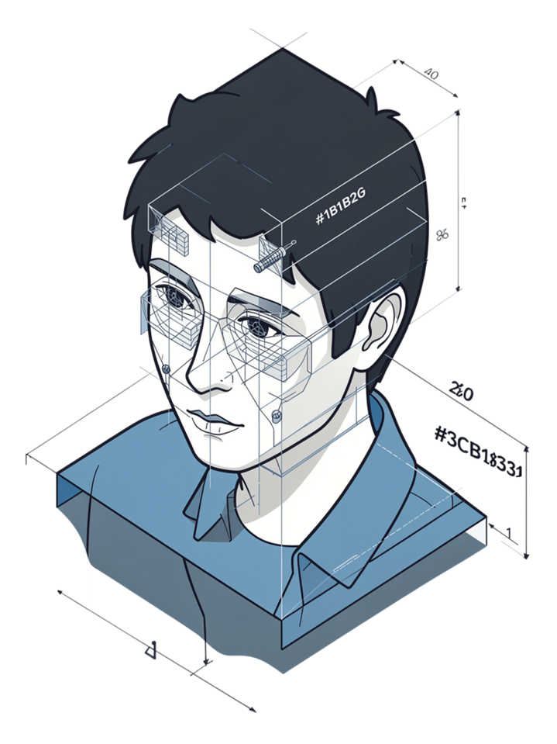
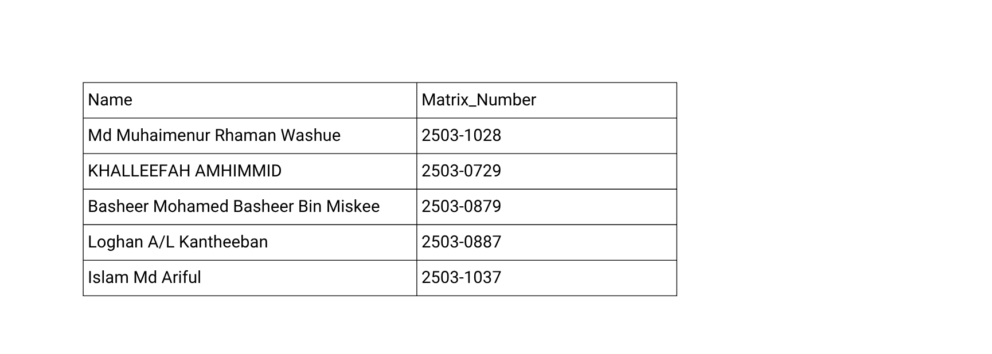
Smart Attendance System: AI-Powered Facial Recognition
An end-to-end biometric solution for automated, accurate, and tamper-proof classroom attendance tracking.

Slide 2
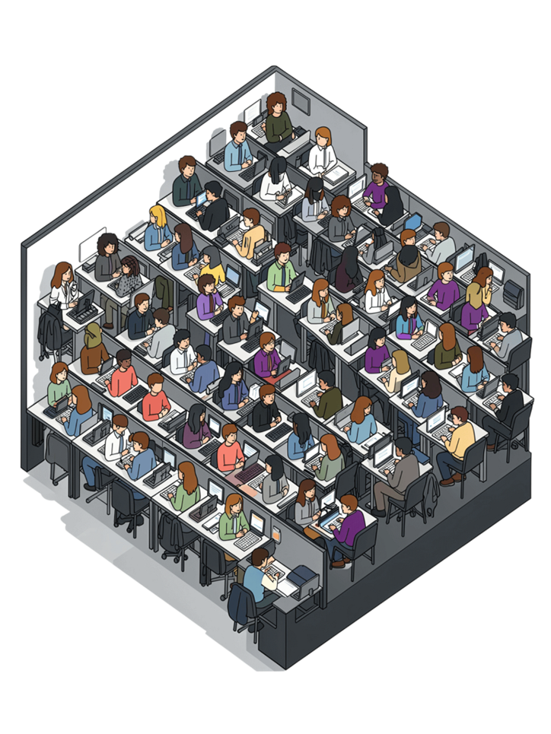

The Problem: Manual Attendance Fails
⏱ Time Lost
Teachers waste 5–10 minutes per class on roll calls adding up to hours each semester.
❌ Error-Prone
Missed names, data entry mistakes, and proxy attendance undermine data integrity.
🏛 Scale Problem
Large lecture halls make manual tracking nearly impossible to manage accurately.
🚫 No Prevention
No reliable mechanism stops students from signing in for absent peers.

Slide 3
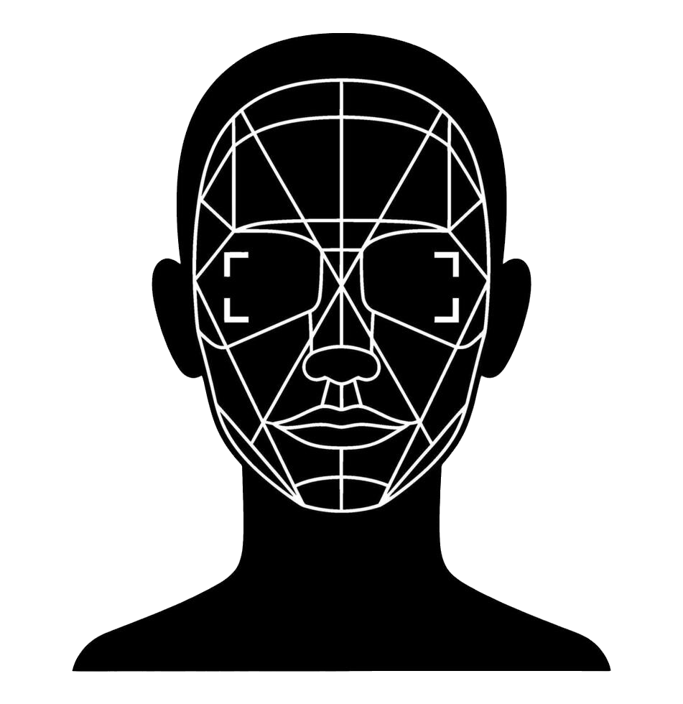
Solution: Automated Biometric Recognition
•Facial recognition identifies students instantly and accurately
•Contactless, non-intrusive biometric verification no physical interaction required
•Automatic timestamp logging eliminates manual data entry entirely
•Prevents proxy attendance impossible to fake another person's face

Slide 4

System Architecture
Frontend
AI Model
React Native mobile app with live camera capture for real-time scanning.
Haar Cascade for face detection + LBPH algorithm for face recognition.
Backend
Database
FastAPI Python server with OpenCV handling image processing and inference.
SQLite for secure, local storage of attendance records and student models.
React Native App
FastAPI
OpenCV
SQLite

Slide 5
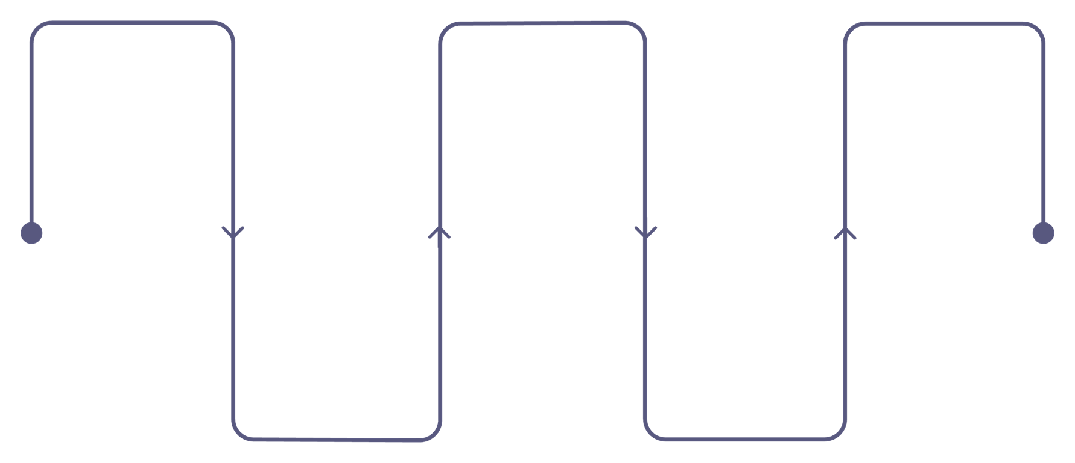
How It Works: The Recognition Pipeline
Initiate Scan
Detect & Extract
Log Result
Teacher starts live on-device scan
Match logs attendance with timestamp. else Unknown
Haar Cascade finds face; LBPH extracts features
Capture Frame
Compare
Camera grabs student face in real-time
Features matched to models with 85% threshold

Slide 6

100% Offline Capability
Pipeline runs entirely on a local network. Zero internet connection required during active scanning sessions.
Required Hardware
Ultra-Low Latency
Maximum Privacy
Instant processing without cloud round-trips.
Biometrics stay on the local network.
Standard Router
Wi-Fi or Ethernet supported
No Dead Zones
Cost Effective
Teacher's Phone
Flawless operation in reception dead zones.
Zero ongoing cloud API hosting fees.

Slide 7


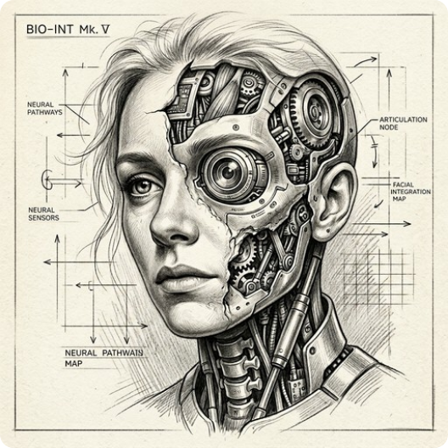


Key Technical Decisions
Grayscale Conversion
Reduces computational complexity while fully preserving discriminative facial patterns.
LBPH Algorithm
Lightweight and robust to lighting variations ideal for variable classroom environments.
Confidence Threshold: 85
Each algorithmic choice was made deliberately to optimize performance within real classroom constraints.
Carefully tuned to balance recognition accuracy against false-positive prevention.

Slide 8
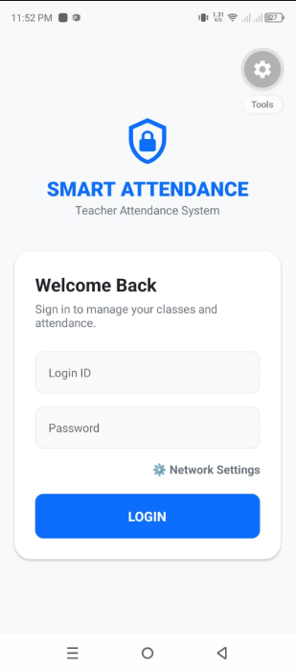
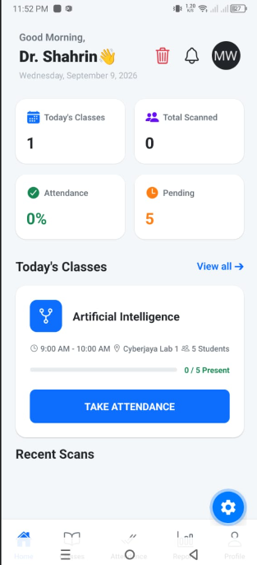
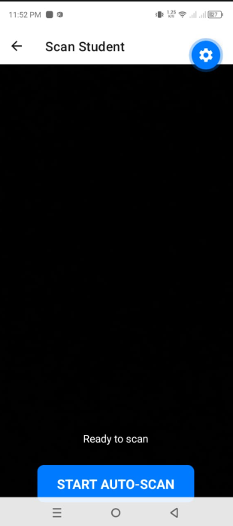

USER EXPERIENCE
Three Core Screens
EDUCATOR-CENTRIC WORKFLOW
Login View status Scan Log result
1
Login
Admin authentication with dynamic network IP configuration.
2
Dashboard
Attendance percentages, recent scans and class overview.
3
Scanner
Live camera feed and one-tap biometric capture.

Slide 9
Challenges & Limitations
Technical Hurdles
Ethical & System Limits
Network Restrictions: Bypassing Android cleartext HTTP limitations.
Liveness Detection: Highly vulnerable to 2D photograph spoofing.
Data Parsing: Rewriting logic to handle multipart/form-data bugs.
Data Privacy: Securing sensitive student biometric records.

Slide 10
Testing & Model Decision
MODEL DECISION THRESHOLD
< 85 • ACCEPT / MATCH ≥ 85 • UNKNOWN
UNIT
Database integrity; parameterized SQL checks
PASS
INTEGRATION
Mobile ↔ backend communication and image transfer
PASS
FUNCTIONAL
Camera permissions, IP configuration and dashboard metrics
PASS
USER ACCEPTANCE
Real-world scanning and alert behavior
PASS

Slide 11




What the Prototype Achieves
END-TO-END
REAL-TIME
AUTO LOGGING
PROXY CONTROL
Mobile app + AI backend + database work together.
Face detection and recognition designed for live scanning.
Attendance is stored securely with a timestamp.
Biometric verification makes simple impersonation difficult.
A practical alternative to repetitive manual tracking using low-cost software components rather than specialized classroom hardware.
CORE VALUE

Slide 12



FUTURE ROADMAP
Risks to Solve Next
POOR LIGHTING
PHOTO SPOOFING
BIOMETRIC PRIVACY
Recognition performance degrades when classroom lighting is weak or inconsistent.
Lack of liveness detection means a 2D photograph may potentially fool the prototype.
Student records require stronger encryption, protection, and responsible handling.
01 Liveness detection
02 Deeper CNN recognition
03 TLS / Scalable cloud DB

Slide 13

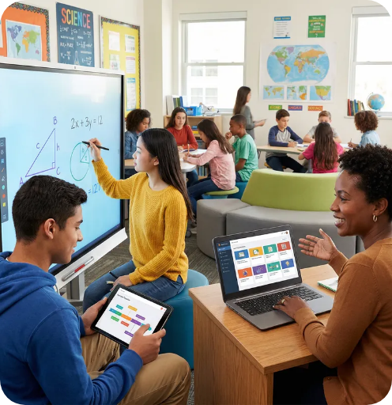
CONCLUSION
From roll call to
smart attendance.
Lightweight computer vision automates attendance, reduces repetitive administrative work, and creates consistent, tamper-proof classroom records.
KEY TAKEAWAY
Capture Recognize Verify Log

Slide 14
A COMMON QUESTION
Why Students Cannot Use This
Proof of Physical Presence
Threat Mitigation
Guarantees actual classroom presence.
Visual supervision blocks 2D spoofing.
Attack Surface Minimization
Network Reliability
Secures local biometric database access.
Prevents concurrent student network congestion.

Slide 15
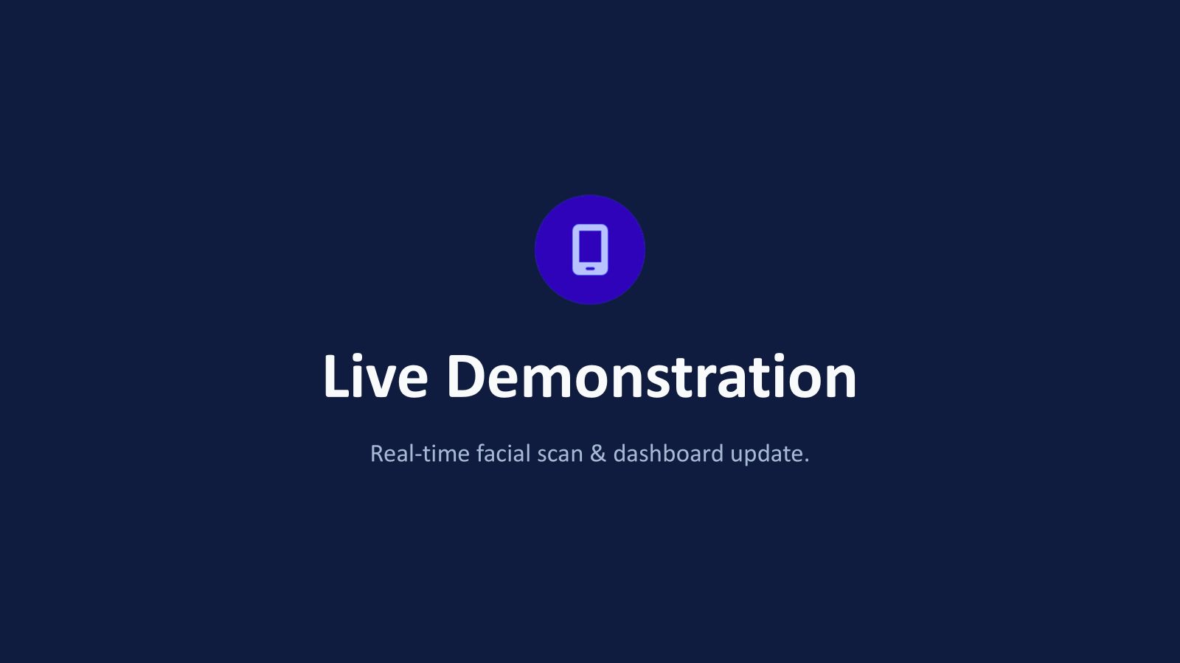

Slide 16
THANK YOU FOR YOUR TIME

