Slide 1

Hierarchical Indexing and Contextual Enrichment in RAG Systems
Author: Mona Davari
Academic Advisor: Prof. Tania Cerquitelli
Company Advisors: Dott. Petrea Tancau, Dott. Michele Veronesi , Dott. Domenico Bulfamente
Date: 2023-24
Notes:
Company => reply => consulting

Slide 2
Introduction to Large Language Models (LLMs)
What are Large Language Models (LLMs)?: very large deep learning models that are pre-trained on vast amounts of data. and it can comprehend and generate human language text.
High performance
More accurate results
Limitations
Hallucinations
Static Knowledge Base for Training
Problem Solving
Inherent Biases
Benefits
Notes:
LLM => benefits / practical example ( generate code that doesn’t make sence . Llm don’t know how to call the api , General issues
The main issue we face was missing custime knolwalges ,

Slide 3

LLMs' Limitations in Business Problems (Coding Companion)
Generation of Non-sense Code
Failure to Find Specific Information
Missing Custom Knowledge

Slide 4
adapting large language models (LLMs) for specific tasks
Prompting Engineering
giving LLM a clear instruction
flexible
Train the model for specific task
Computational efficient
RAG
Strength
Limitations
Fine Tuning
Easy to use
giving LLM access to reference materials alongside the prompt
Time consuming
Strength
limitations
Requires trial and error
not Generalized
Strength
Adapts to specialized Domains/tasks
Leverages pre trained Knowledge
Limitations
Forgetting
Limited by per-training data distribution
Leverages external Knowledge
Improves factual accuracy
Requires external data sources
Introduces irrelevant information
Notes:
Task Focus:
Fine-tuning: tasks requiring high accuracy and control over the LLM's output (e.g., sentiment analysis, code generation).
RAG: Ideal for tasks where access to external knowledge is crucial for comprehensive answers (e.g., question answering, information retrieval).
Prompt Engineering: This is the art of crafting clear instructions for the LLM. It can be used on its own or to enhance fine-tuning and RAG. Well-designed prompts can significantly improve the quality and direction of the LLM's output, even without retraining.
Data Availability:
Fine-tuning: Requires a well-curated dataset specific to your task.
RAG: Works with a knowledge source that may be easier to obtain than a specialized dataset.
Prompt Engineering: This doesn't require any specific data – just your understanding of the LLM and the task.
Computational Resources:
Fine-tuning: Training can be computationally expensive.
RAG: Retrieval and processing can be resource-intensive, but less so than fine-tuning in most cases.
Prompt Engineering: This is the most lightweight approach, requiring minimal computational resources.

Slide 5
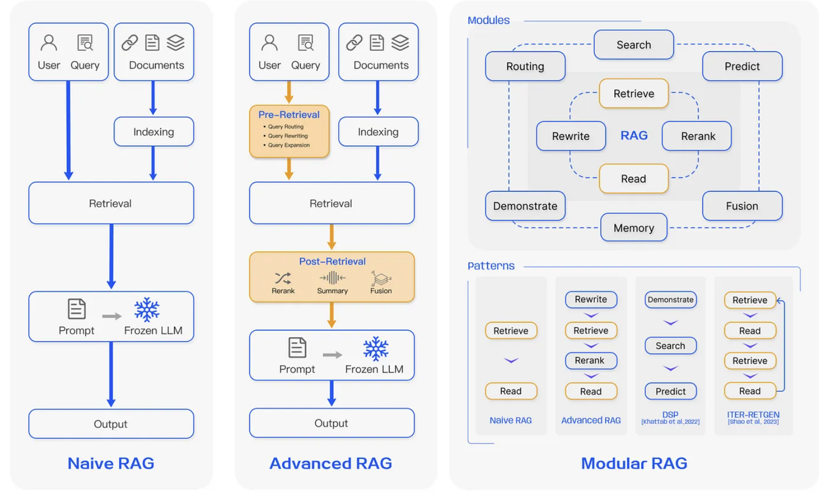
Types of RAG Systems
Notes:
The more niave rag , explain rag sytems. Pa

Slide 6
Stage of RAG Systems
Loading
Indexing
Storing
Querying
Evaluation

Slide 7
My Tasks and Contributions
Image Description Generation
Loading
Indexing
Storing
Querying
Evaluation
Submit File
Transform Docx to HTML
Parse data, clean, standardize
Extract features
Generate image description form image
Preper data for indexing
Notes:
The goal of the task was to remove context gap between text and images stroed in docx files

Slide 8
My Tasks and Contributions
Django Server
Chroma DB
Redis
Celery Queue Manager
Task queue
Kubernetes
Docker
Deployment
EIRE Module
Loading
Indexing
Storing
Querying
Evaluation
Design Modular RAG Elements
(EIRE)
Notes:
Overview archtechture of the EIRE

Slide 9
My Tasks and Contributions
Django Server
Celery
Redis
Docker
MongoDB
EIRE Module
Code Expert
Code Parser
LLM
System Architecture
Hierarchical Indexing for code base expert (Code Expert Agent)
Loading
Indexing
Storing
Querying
Evaluation

Slide 10
My Tasks and Contributions
Root
Package Description
Class Description
Method Description
Class Description
Package Description
Class Description
Method Description
Method Description
Class Description
Method Description
Method Description
Indexing
button-up
Retrieving
top-down

Slide 11
Testing Pipeline
Aggregation
Evaluation Agent
Query
Statement2
Statment3
Document set2
Document set3
Overall set
Query Expansion agent
Question from user
Document set1
Statement1
Overall set
Overall set
Code Expert
score
Notes:
Same pipline the answer to

Slide 12
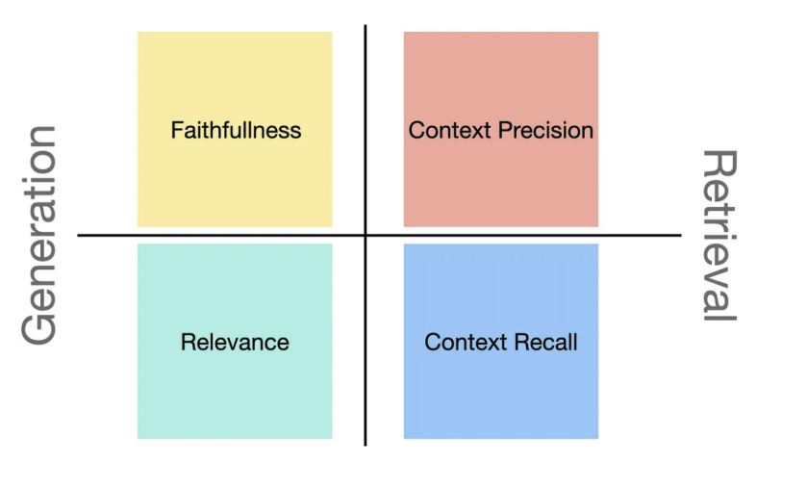
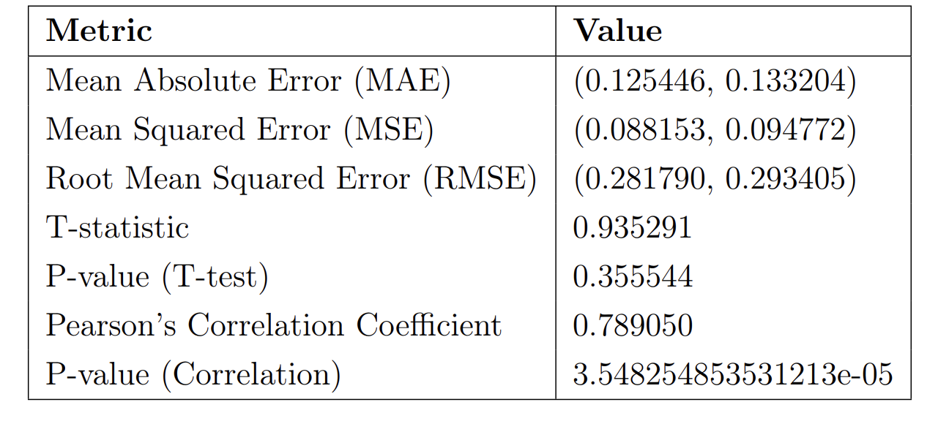
Evaluation Method
Notes:
Techknowlagy I used => evaluating rag systems = > method form literature
Using the llm we need to understand the number of error in are llms
And quality of the scures. And how manually

Slide 13
Results
 | Flat model | Hierarchy 1 | Hierarchy 2 | Hierarchy 3
Settings | Select 8 | n_method_results: 2 n_class_results:2 n_package_results: 2 | n_method_results:1 n_class_results:2 n_package_results: 3 | n_method_results:1 n_class_results:2 n_package_results: 3
Number selection | All of data | All of data | 5 | 8
Sample size | 300 | 300 | 300 | 300
Model for validation | GPT 4-turbo | GPT 4-turbo | GPT 4-turbo | GPT 4-turbo
Value counts: score_context_relevance | 1.0: 89 0.5: 143 0.0: 68 | 1.0: 124 0.5: 85 0.0: 70 | 1.0: 104 0.5: 110 0.0: 86 | 1.0: 108 0.5: 102 0.0: 90
Mean | 0.535 | 0.597 | 0.530 | 0.530
Range acceptable | 0.773 | 0.749 | 0.713 | 0.700
Notes:
Graph =>

Slide 14

Questions & Answers

