Slide 1

Interactive Homelessness Demographics Explorer for Atlanta
By: Dhanush Reddy Pucha and Mathew Dawit
CSC 4730 Data Visualization
Notes:
Dhanush

Slide 2
Problem & Motivation
Broader Context: Homelessness remains a pressing urban challenge in Atlanta.
Why It Matters: Targeted interventions require fine-grained insight into where vulnerable populations concentrate and their demographic makeup.
Gap: Static reports lack interactivity and custom spatial filtering.
Notes:
Dhanush

Slide 3
Research Questions & Claims
Guiding Questions:
  Where are “hotspots” of homelessness in Atlanta?
  What age/sex/ethnicity patterns exist within user-defined areas?
  Can a dynamic tool outperform pre-defined cluster analyses?
Claims:
  Empowering users to draw arbitrary polygons yields richer insights than static clustering.
  Demographic breakdowns change meaningfully with area size and location.
Notes:
Dhanush

Slide 4
Data Sources
Core Datasets Used:
  Geographic Boundaries: 2024 TIGER/Line Census Tracts for Georgia.
  Homelessness Data: Simulated Point-in-Time (PIT) count data (~2,550 incident points representing individuals).
  Simulation included spatial clustering (Downtown/Midtown, Buckhead, East Atlanta) and background noise to mimic real-world distributions.
    Note: Mention if this was simulated or if based on anonymized real data structure.
  Demographics: Attributes associated with PIT counts (e.g., age_group, sex, ethnicity). Initially, only total counts were used, later expanded.
Notes:
Dhanush

Slide 5
Data Processing and Analysis
Data Preparation Steps:
  Clipping: Census tracts clipped to the official Atlanta city boundary.
  Database Loading: All processed data (tract geometries, counts, demographics) loaded into a PostGISdatabase (a spatial extension for PostgreSQL).
    Tables created (e.g., demo.tract_summary with geometry, demo.pit_counts with demographics and counts).
  Spatial Indexing: Applied in PostGIS for efficient spatial querying.
  City-Wide Aggregation: Pre-calculated overall city-wide demographic proportions (age, sex, ethnicity) from the entire simulated dataset (demo.pit_counts) to serve as a baseline for statistical comparison (Chi-Squared test).

Slide 6

Data Processing and Analysis
Database: PostgreSQL with PostGIS extension (for storing spatial data and running efficient location-based queries).
Backend:
  Python: Programming language.
  Flask: Micro web framework (to create the API endpoint).
  Psycopg2: PostgreSQL adapter for Python (to connect Flask to the database).
  Flask-CORS: Handles cross-origin requests between frontend/backend servers during development.
Frontend:
  HTML: Structure of the web page.
  CSS: Styling the page and map elements.
  JavaScript: Core programming language for interactivity in the browser.
  OpenLayers: Powerful mapping library (for displaying the map, boundary, drawing polygons, interactions).
  Chart.js: Library for creating interactive charts (bar charts for demographic visualization).
Servers:
  Python's built-in http.server (for serving static frontend files - HTML/CSS/JS).
  Flask's development server (for running the backend Python API).

Slide 7
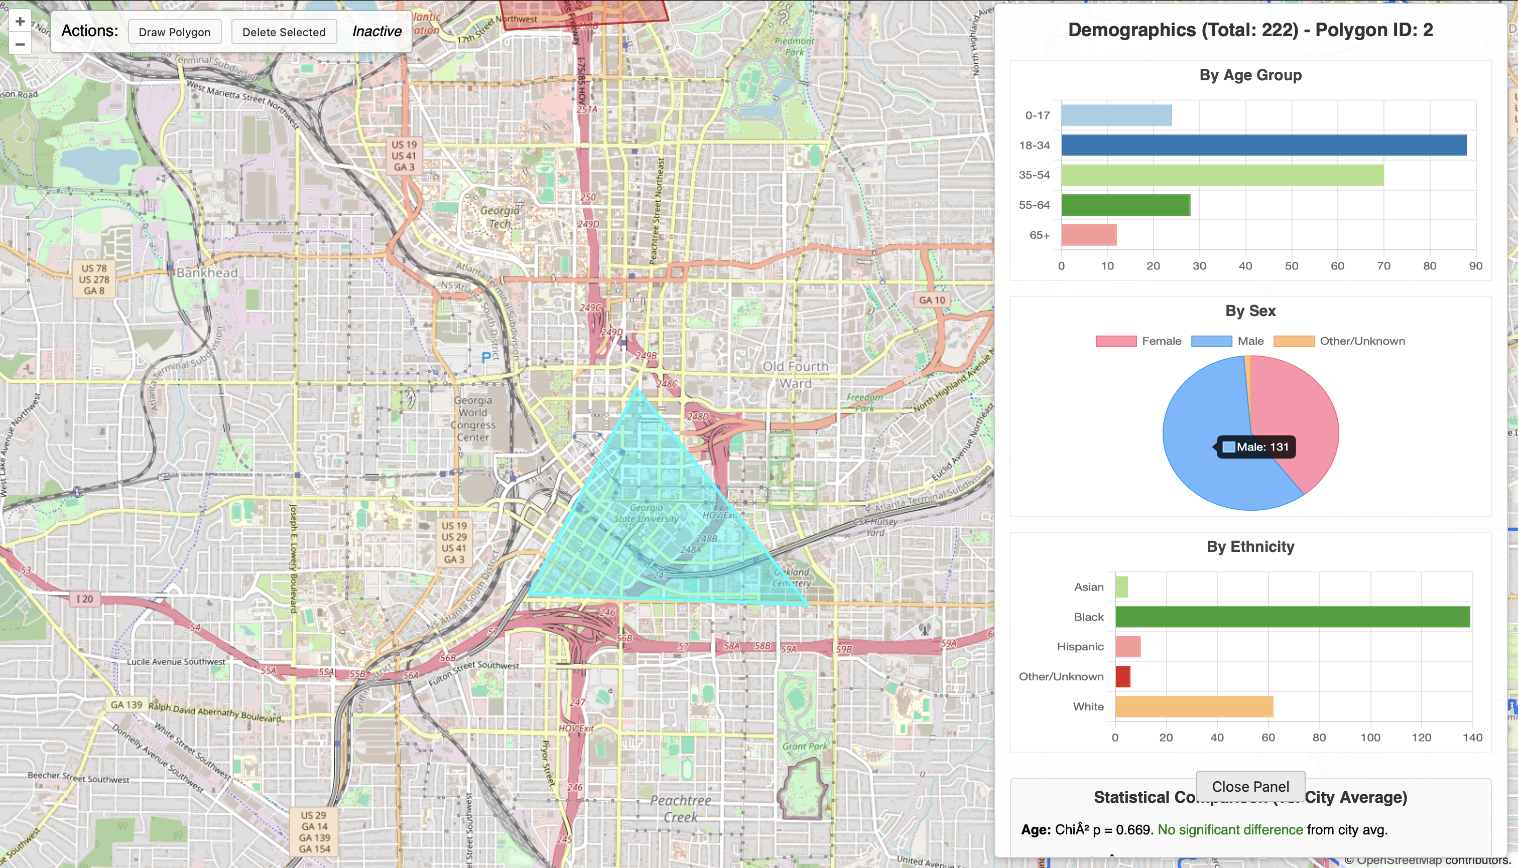
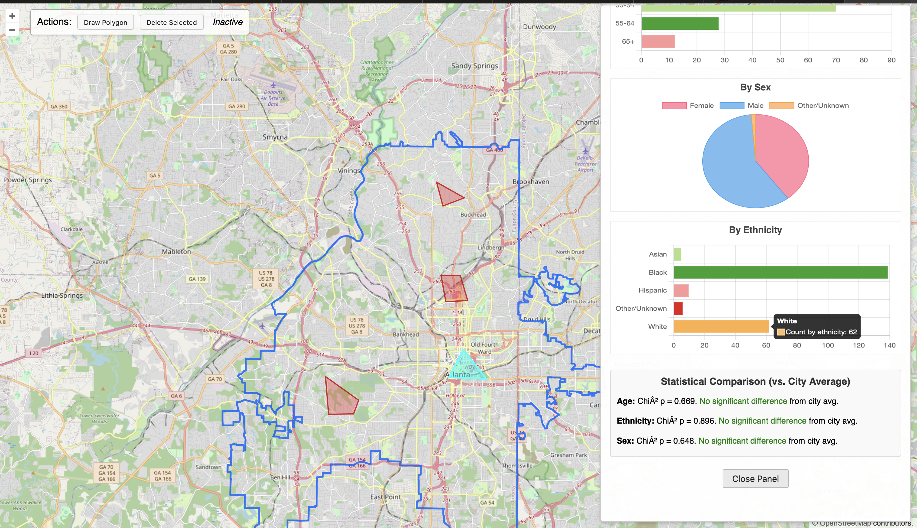
Data Processing and Analysis
Application Workflow:
  User Interaction (Frontend-Browser):
    User draws a polygon on the OpenLayers map interface.
    JavaScript assigns a unique ID to the drawn feature.
  API Request (Frontend -> Backend):
    JavaScript transforms the polygon geometry to EPSG:4326 and converts it to GeoJSON format.
    A POST request containing the polygon's GeoJSON geometry is sent to the Flask backend endpoint (/api/demographics).
  Data Query (Backend - PostGIS):
    Flask receives the GeoJSON geometry.
    Connects to the PostGIS database (atl).
    Executes SQL queries using ST_Intersects and ST_GeomFromGeoJSON to select all individual records from demo.pit_counts (joined with demo.tracts) that fall spatially within the submitted polygon.
  Aggregation (Backend - Python):
    The backend aggregates the results from the SQL query using Python (psycopg2 cursor results).
    It calculates the observed counts for each demographic category (age, sex, ethnicity) specifically within the drawn polygon.
    It also calculates the total number of individuals found within the polygon.
  Statistical Analysis (Backend - Python/SciPy):
    Retrieves pre-calculated city-wide demographic proportions (computed on startup).
    Calculates the expected counts for each demographic category within the polygon, based on the city-wide proportions and the polygon's total observed count.
    Performs a Chi-Squared Goodness-of-Fit test (scipy.stats.chisquare) for each category (age, sex, ethnicity) to compare the observed counts to the expected counts.
    Justification: This test determines if the demographic mix within the selected area is statistically significantly different from the overall city's demographic distribution.
  API Response (Backend -> Frontend):
    Flask constructs a JSON response containing:
      The aggregated counts (e.g., by_age, by_sex, by_ethnicity, total_homeless).
      The stats results (Chi-Squared statistic and p-value for each category, or error messages).
    This JSON response is sent back to the browser.
  Visualization & Interaction (Frontend - JS/Chart.js/HTML):
    JavaScript receives the JSON data.
    Stores the received data locally (in browser memory) associated with the polygon's unique ID.
    Uses Chart.js to dynamically generate/update the bar and pie charts based on the received counts.
    Displays the Chi-Squared stats results (p-values and interpretation) in the dedicated text area below the charts.
    If the user clicks on a previously drawn polygon, the stored data for that polygon's ID is retrieved, and the charts/stats panel is updated accordingly without needing a new API call.

Slide 8
Key Findings
Dynamic Exploration: User-drawn polygons effectively reveal localized demographic variations, often differing significantly from broader tract or cluster patterns.
Demographic Hotspots: Confirmed ability to identify areas with distinct demographic concentrations (e.g., higher proportion of '18-34' age group near downtown cluster).
Statistical Significance: Chi-Squared tests frequently showed statistically significant differences (p < 0.05) between the demographic makeup (especially age and ethnicity) of user-selected dense areas and the overall city average, validating the spatial heterogeneity.
Performance: On-demand PostGIS queries and backend analysis (including stats) remained efficient, typically returning results within milliseconds for interactively drawn polygons using the ~2,550 record dataset.

Slide 9

Interpretation
Significance:
  Flexible spatial querying empowers targeted outreach by identifying specific micro-areas with unique needs.
  Rapid demographic feedback, now including statistical comparison to city averages, promotes data-driven resource allocation and highlights areas requiring distinct interventions.
Unexpected Results / Insights from Stats:
  Some low-count tracts had high proportions of a single age group...
  Example: Statistical tests highlighted significant deviations even in areas with moderate total counts, indicating that relative proportions, not just raw numbers, are crucial.
Limitations:
  Simulation (clustering, demographics, ~2,550 sample size) is an approximation of complex reality.
  Does not reflect temporal patterns.
  Chi-Squared test indicates if a difference exists but doesn't explain why. Further analysis needed for causal factors.

Slide 10
Conclusion & Next Steps
Summary:
Successfully developed an interactive web tool combining web mapping (OpenLayers), a spatial database (PostGIS), a web framework (Flask), and statistical analysis (SciPy/Chi-Squared) to explore simulated homeless demographics within user-defined areas of Atlanta.
Demonstrates a powerful approach for data-driven spatial analysis, offering a flexible alternative to static reports by enabling dynamic exploration and immediate statistical comparison to city-wide averages.
Enhanced usability by allowing users to click on previously drawn polygons to instantly recall and view their associated demographic data and analysis results.
Provides a robust foundation for future work incorporating real data and more advanced analysis.
Future Analysis:
Integrate real Point-in-Time data with time-series playback.
Add proximity tests to services (shelters, clinics).
Incorporate additional demographic variables or survey data if available.
Technical Next Steps (Deployment):
Migrate backend to a production-ready stack (e.g., Nginx/Gunicorn).
Optimize and potentially scale the database for larger datasets or higher traffic.
Further enhance UI/UX (e.g., more refined loading indicators, map layer controls, clearer error handling).
Notes:
Dhanush

