Slide 1
IT307 · MACHINE LEARNING · FINAL PRESENTATION
Fed-GDBD for Heterogeneous Federated Learning:
Reproduction and Agreement-Gated Distillation
An independent re-implementation of Zhang et al. (JKSU-CIS, 2025), evaluated on CIFAR-10 and CIFAR-100 with 20 clients running four different model architectures
Course Instructor: Dr. Nagamma Patil
Presented by
D Maithreya
241AI013
Maharshi Kundu
241AI022
Siddhanth R Naik
241AI040
Department of Information Technology · National Institute of Technology Karnataka, Surathkal
Notes:
Introduce the team and the project. The authors of Fed-GDBD did not release code, so we re-implemented it from the paper's equations, reproduced its headline experiment, fixed an instability we found along the way, and then proposed and tested our own improvement: agreement-gated distillation.

Slide 2
Problem Statement
PROBLEM STATEMENT
Federated learning lets clients train one model together without sharing their raw data. Real clients differ twice over: each holds a skewed slice of the classes (non-IID data), and each may run a different model architecture. With different architectures there are no common weights to average, so FedAvg-style aggregation is impossible and knowledge has to travel in some other form.
Client 0
Client 1
Client 2
Client 3
4-layer CNN
GoogLeNet
MobileNetV2
ResNet18
… 20 clients
Our setting: 20 clients, client i runs architecture i mod 4, and a Dirichlet split with β = 0.1 gives each client only a few dominant classes. Four networks with different weight shapes: there is nothing to average.
Notes:
The problem in one sentence: clients want to learn together but they neither share data nor share an architecture. In our experiments client 0 is a small CNN and client 2 a MobileNetV2; their weights have different shapes, so the usual recipe of averaging weights simply cannot be applied. On top of that the data are strongly skewed: with beta = 0.1 each client sees only a few classes.

Slide 3
Solution & Objectives
PROBLEM STATEMENT
Problem
Heterogeneous federated learning: skewed labels and different architectures, so clients cannot share weights, and any single global classifier fits some clients' features far better than others'.
Paper's idea
Fed-GDBD: clients upload k-means class prototypes; the server trains a global classifier g on them (the global decision boundary), and every client distils g into its own head. Only prototypes and one linear layer travel.
Our objectives
(1) Re-implement Fed-GDBD from its equations (no code was released), on HtFLlib. (2) Reproduce its headline experiment against FedProto and LG-FedAvg. (3) Improve it.
Our novelty
Agreement-gated distillation: distil g only where g is right on the client's own features, scaled per client (AGC) or switched per image (AGS).
Outcome
Baselines within 0.5 pt of the paper; a stability fix (FedGDBD-S) found during reproduction; gates with repeatable per-dataset gains over two seeds (AGC +0.69 pt on CIFAR-100, AGS +0.39 pt on CIFAR-10).
Notes:
This slide is the whole talk in five lines. The paper's idea is to share prototypes instead of weights and to send back a server-trained global boundary. Our objectives were to rebuild it, reproduce it and improve it. Our improvement is to gate the distillation by whether the global boundary actually agrees with the client's own labels.

Slide 4
Existing Approaches to Heterogeneous FL
LITERATURE SURVEY
Method | What clients share | How it handles different models | Limitation
FedAvg [2] AISTATS 2017 | full model weights | it does not: every client must run the same architecture | unusable with mixed models; drifts under non-IID data
LG-FedAvg [3] arXiv 2020 | the classifier head; extractors stay local | heads have one shape, so only they are averaged | one averaged head is a compromise across very different feature spaces
FedProto [4] AAAI 2022 | one mean prototype per class | aligns local features with the global class means | a single mean loses the spread of each class
FedTGP [5] AAAI 2024 | class prototypes; server trains global prototypes | adaptive-margin contrastive learning separates classes | still one point per class; extra server training
FedGH [6] ACM MM 2023 | class-mean features; server trains a global header | the shared header replaces each client's head | built from means only; overrides local heads
Fed-GDBD [1] JKSU-CIS 2025 | v = 5 k-means prototypes per class | server trains boundary g on prototypes; clients distil g, plus self-distillation (IKD) | distils g everywhere at a fixed weight α, even where g is wrong
LG-FedAvg, FedProto, FedTGP and FedGH are implemented in HtFLlib [7], the library we built Fed-GDBD on. Every method except FedAvg keeps the feature extractor private, so the open question is what to share about the classifier.
Notes:
Read the table by the last column. FedAvg needs identical models. LG-FedAvg averages only the heads, which forces one compromise head on very different feature spaces. FedProto, FedTGP and FedGH share class prototypes, but one point per class. Fed-GDBD keeps several prototypes per class and sends back a trained boundary, which is why it does best in the paper; but it applies that boundary with the same weight everywhere.

Slide 5
The Gap: How Our Method Differs
LITERATURE SURVEY
 | Fed-GDBD (paper) | Ours: AGC (per-client gate) | Ours: AGS (per-sample gate)
Teacher | global boundary g | same g | same g
Distilled on | every image of every client | every image, weight scaled per client | only images where g's top class = label
Distillation weight | fixed α = 0.7 | α_i = 0.7 × accuracy of g on client i | α · w, w ∈ {0, 1} per image
Where g is wrong | client is still pulled toward g | pulled less | not pulled on those images
Extra cost | none | one forward pass to measure α_i | none: reuses g(z)
The gap
g is a single linear layer fitted to four different feature spaces. Our gate logs show it classifies 96–97 % of a CNN client's CIFAR-10 training images correctly, but only 49–53 % of a MobileNetV2 client's. Fed-GDBD distils g into both with the same weight, so the clients g misreads are pulled toward a boundary that is wrong for them.
Both gates change only the client update; prototypes, the server and communication are exactly Fed-GDBD's.
Notes:
This is the gap our novelty targets. The global boundary is right most of the time for some architectures and close to a coin flip for others, yet Fed-GDBD distils it with one fixed weight. Our two gates differ only in granularity: AGC scales the weight per client by g's accuracy on that client, AGS switches distillation off on the individual images g gets wrong.

Slide 6
Block Diagram of the Proposed Method
METHODOLOGY
repeat every communication round t = 1 … R
5a
AGC: per-client gate
α_i = α · acc_i(g)
1
Pre-train
2
Local training
3
Prototypes
4
Server: g
6
Evaluate
send g
upload
5 epochs of cross-entropy
on local data
CE + T² · IKD
(teacher = best past self)
k-means++, v = 5
centres per class
init Eq. 5, train on
all prototypes Eq. 12
5b
test accuracy;
keep best model
as IKD teacher
AGS: per-sample gate
distil only where
argmax g(z) = y
5 Global distillation update (Eq. 13), on top of the FedGDBD-S fix
5a AGC measures how often g classifies the client's own training features correctly, acc_i(g), and distils with weight α · acc_i(g) on every image.
5b AGS checks each image: if g's top class matches the label it is distilled as in Fed-GDBD, otherwise it gets plain cross-entropy.
Fed-GDBD (paper) is the same pipeline with a fixed α in step 5. Only prototypes go up and one linear layer g comes down; model weights never leave a client.
Notes:
Walk the diagram left to right. Clients pre-train, then every round they train locally with cross-entropy plus self-distillation from their best past model, cluster their features into five prototypes per class, and upload them. The server initialises g by averaging heads, trains it on all prototypes and sends it back. Step 5 is where the paper distils g with a fixed weight; our two gates, 5a and 5b, decide how much to distil based on whether g agrees with the client's labels. Finally each client is evaluated and its best model is kept as the next teacher.

Slide 7
Fed-GDBD: Local Training, Global Boundary, Distillation
METHODOLOGY
1
Local training (client)
2
Server: global boundary g
3
Client update (Eq. 13)
L_local = CE(h(z), y)
+ T² · KL_nt( p_teacher ‖ p_student )
Prototypes: k-means++ per class
→ v = 5 centres P_c,k
L = (1 − α) · CE(h(z), y)
+ α · T² · KL( σ(g(z)/T) ‖ σ(h(z)/T) )
IKD: the teacher is the client's own best past model. The true-class logit is removed before the softmax (non-target KD), so only the ranking of the wrong classes is distilled; the label is left to cross-entropy.
Eq. 5: g⁰ = Σᵢ (nᵢ / n) · hᵢ
α = 0.7, T = 20, so the distillation term carries weight α·T² = 280. g is frozen; only the client learns.
Eq. 12: min_g Σ_c Σ_k CE( g(P_c,k), c )
g is one linear layer (512 → C), trained 5 epochs with SGD and warm-started each round.
Learn your own data without forgetting what your best past self knew.
Prototypes from all 20 clients mark where each class lives; g draws one boundary through all of them.
Pull each client's boundary toward the global one, measured on the client's own features.
z = client feature (512-d), h = client head, g = global boundary, KL_nt = KL on non-target classes. Per round only 5 × C prototype vectors go up and g comes down.
Notes:
Three equations carry the method. First, local training is cross-entropy plus non-target knowledge distillation from the client's own best past model, which reduces forgetting. Second, the server builds g: it starts as the sample-weighted average of the client heads and is then trained with cross-entropy on all clients' prototypes. Third, each client is updated with a mix of cross-entropy and KL toward g's soft predictions on the client's own features. Note the large weight, alpha times T squared is 280; that matters on the next slide.

Slide 8
Stabilising Eq. 13: FedGDBD-S
METHODOLOGY · FIX MADE DURING REPRODUCTION (MID-EVALUATION)
!
What collapsed
After round 2, whole architectures degrade: CIFAR-100 CNN clients 48.0 → 3.9 %, CIFAR-10 ResNet18 clients 78.7 → 53.3 %.
?
Why (our hypothesis)
g is one linear layer for four feature spaces; on some its logits are far larger than the head's, and α·T² = 280 lets the KD term swamp CE.
1
Fix 1: logit-scale matching
g̃(z) = g(z) · std(h(z)) / std(g(z)), per sample, so the teacher's logits have the student's scale.
2
Fix 2: head-only distillation
The KD term trains only head(z.detach()); cross-entropy still trains the whole model.
Result: stable for all 50 rounds, CNN clients back to 45.6 %, no extra communication. A fix to the reproduction, not our novelty.
The collapse remained after we fixed a masking bug in our own IKD loss, so the instability comes from the literal update, not from that bug.
Notes:
During the reproduction, before the mid-evaluation, we found that Eq. 13 taken literally is unstable. The per-client logs show it is architecture specific: on CIFAR-100 the CNN clients fall from 48 percent to 4 percent, on CIFAR-10 the ResNet18 clients from 79 to 53. Our explanation is the logit scale of g combined with the weight of 280. Two changes fix it: rescale g's logits to the student's scale and let the distillation term train only the head. The chart shows the CNN clients restored. We present this as part of the reproduction; it is the base our novelty builds on.

Slide 9
Agreement-Gated Distillation
METHODOLOGY · OUR NOVELTY
Core idea: distil the global boundary only where it agrees with the client's own labels. Where g misreads a client's features, distilling it teaches the client a wrong boundary.
a
AGC · per-client gate
acc_i = (1/|D_i|) Σ 1[ argmax g(z) = y ]
α_i = α · acc_i
L = (1 − α_i) · CE + α_i · T² · KL
image x
→ features z
g(z)
argmax g(z)
= y ?
A client whose features g misreads gets a weaker pull: on CIFAR-10, α_i ≈ 0.37 for MobileNetV2 clients vs 0.68 for CNN clients.
yes
no
b
AGS · per-sample gate
w = 1[ argmax g(z) = y ] (per image)
L = mean[ (1 − α w) · CE + α w · T² · KL ]
distil g
(1 − α)·CE + α·T²·KL
CE only
Images g gets wrong fall back to cross-entropy; the rest are distilled exactly as before. CIFAR-10 MobileNetV2 clients keep only 36–37 % of images.
AGS applies this test image by image. AGC averages it over all of a client's images and scales α by the result.
Both gates reuse g(z), which the update already computes: no extra communication.
Notes:
This is our novelty. The question we ask is simple: on this client's own features, does g get the label right? If it does, distilling g is useful; if it does not, distilling it pushes the client toward a wrong boundary. AGC answers the question once per client per round and scales alpha by g's accuracy. AGS answers it per image and switches distillation off on the images g gets wrong. Neither needs any extra communication.

Slide 10
Algorithm: One Listing, Four Versions
METHODOLOGY · OUR NOVELTY
1
receive g from the server; g.eval()
all
2
α ← 0.7
all
3
if gate = client: α ← α · acc_i(g) # one pass over D_i
AGC
4
for epoch = 1 … 5, for (x, y) in D_i:
all
5
z ← base(x); out ← head(z); g_out ← g(z) # no grad
all
6
kd_out ← head(z.detach()) # paper: out
S AGC AGS
7
g_out ← g_out · std(kd_out) / std(g_out) # per sample
S AGC AGS
8
if gate = sample: w ← [argmax g_out = y]
AGS
9
L ← mean((1−αw)·CE(out,y) + αw·T²·KL(g_out‖kd_out))
AGS
10
else: L ← (1−α)·CE(out,y) + α·T²·KL(g_out‖kd_out)
paper S AGC
11
SGD step on L (gradient clip 10)
all
Versions: paper = faithful Fed-GDBD (Eq. 13); S = FedGDBD-S, our mid-evaluation fix (lines 6–7); AGC, AGS = our novelty, both built on S.
acc_i(g): share of client i's training images that g classifies correctly. Code: update(), g_agreement() in clientgdbd.py.
Notes:
One listing shows all four versions, mirroring the real update function. Lines 1 to 5 are shared. Lines 6 and 7 are our stability fix: distil into the head only and match g's logit scale. Line 3 is AGC: one evaluation pass to measure g's accuracy on this client, which scales alpha. Lines 8 and 9 are AGS: a per-image mask w that turns distillation off where g's top class is wrong. Line 10 is the loss used by the paper, by FedGDBD-S and by AGC.

Slide 11
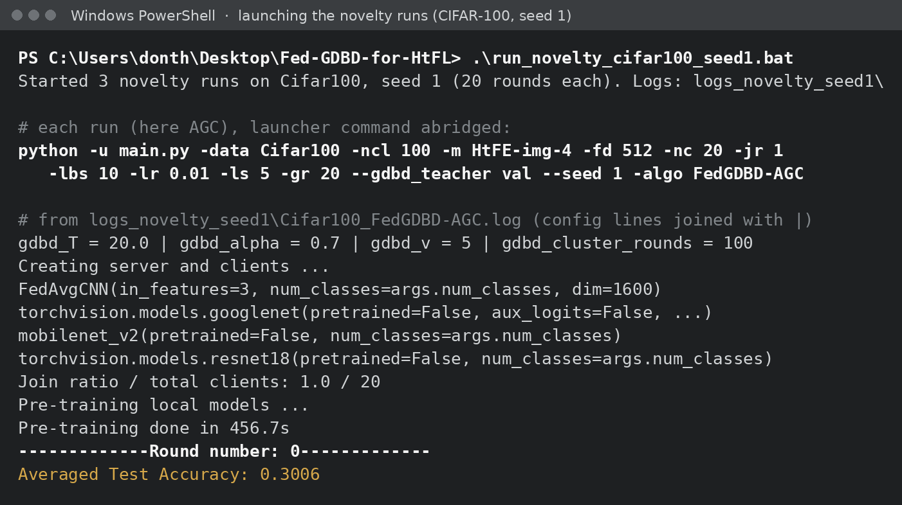
Experimental Setup and Execution
IMPLEMENTATION
 | Paper | Ours
Datasets | CIFAR-10, CIFAR-100, Tiny-ImageNet, Flowers102 | CIFAR-10 (10 classes) and CIFAR-100 (100 classes): 60,000 32×32 colour images each
Split | Dir(β = 0.1) practical + pathological | Dir(β = 0.1): 20 clients, 75 / 25 train / test per client
Clients & models | 20; CNN, GoogLeNet, MobileNetV2, ResNet18 | same; client i runs model i mod 4
Hyper-parameters | batch 10, lr 0.01, E = 5, v = 5, α = 0.7, T = 20 | same
Rounds × seeds | 100 × 3 | reproduction 50 × 1; novelty 20 × 2
Hardware | RTX 3080 server | RTX 3050 6 GB + RTX 5060 8 GB laptops
Launching the CIFAR-100 seed-1 novelty runs: three methods start in parallel on one GPU. The log shows the four architectures, pre-training, then round 0.
Novelty runs pick the IKD teacher on a 10 % validation slice of each client's training data, so no test data influences training.
Rendered from the real run log (logs_novelty_seed1\Cifar100_FedGDBD-AGC.log); launcher command abridged.
setup.bat → run_cifar10.bat / run_cifar100.bat (reproduction)
run_novelty_cifar10.bat, …_seed1.bat → check_novelty.bat (novelty)
Notes:
Our setup keeps everything that defines the method identical to the paper: 20 clients, the same four architectures, the same Dirichlet split and every hyperparameter. We reduced scope to two datasets and fewer rounds and seeds, because the full paper is around 1,500 GPU hours and we had two laptops. On the right is the program running: the launcher starts three runs in parallel, the log lists the four architectures, the pre-training time and the first evaluation.

Slide 12
Reproduced Results: Ours vs Paper
RESULTS & ANALYSIS · REPRODUCTION (MID-EVALUATION) · 1 / 4
 | CIFAR-10 |  |  | CIFAR-100
Method | Ours | Paper | Δ | Ours | Paper | Δ
FedProto | 82.52 | 82.75 | −0.23 | 39.51 | 35.38 | +4.13
LG-FedAvg | 86.36 | 86.64 | −0.28 | 42.79 | 43.30 | −0.51
Fed-GDBD, faithful * | 85.70 | 87.90 | −2.20 | 40.70 | 45.09 | −4.39
FedGDBD-S (our fix) | 87.10 | 87.90 | −0.80 | 43.74 | 45.09 | −1.35
Observations
Both baselines land within 0.5 pt of the paper; FedProto on CIFAR-100 is 4.1 pt above it.
Faithful Fed-GDBD peaks at round 1 / 2, then collapses (next slide), so its best is 2–4 pt below the paper.
With our fix, FedGDBD-S is the best method we ran, 0.8 / 1.35 pt below the paper's Fed-GDBD with half the rounds and one seed.
+0.74 / +0.95
≤ 0.5 pt
FedGDBD-S over the best baseline (LG-FedAvg), CIFAR-10 / CIFAR-100
gap to the paper for both baselines, except FedProto on CIFAR-100 (+4.1)
Mid-evaluation (reproduction) results: practical Dir(0.1), 20 clients, 50 rounds, 1 seed; mean of the 20 clients' local test accuracy at the best round, as in the paper. * best round before the collapse (round 1 / round 2); runs stopped after 9–10 rounds.
Notes:
These are our reproduced results, presented at the mid-evaluation. Both baselines match the paper within half a point, except FedProto on CIFAR-100, which we beat. The faithful Fed-GDBD peaks in the first two rounds and then collapses, so its best number is below the paper. With the stability fix, FedGDBD-S is the best method in our runs, about one point below the paper's reported Fed-GDBD, with half the rounds and one seed.

Slide 13
Accuracy over 50 Communication Rounds
RESULTS & ANALYSIS · REPRODUCTION (MID-EVALUATION) · 2 / 4
1
Stability: Faithful Fed-GDBD peaks at round 1–2, then falls to 75.5 % / 28.0 % by round 9–10. FedGDBD-S stays within ±0.5 pt of its best for all 50 rounds.
2
Speed: Both Fed-GDBD variants are within 1 pt of their best by round 2–5; the baselines need 13–31 rounds (helped by 5 pre-training epochs).
3
Cost: FedGDBD-S takes about 10 min per round vs 5–10 for the baselines: two local passes plus clustering every round.
Mid-evaluation (reproduction) results: 50 rounds, 1 seed; the faithful runs were stopped after 9–10 rounds once the collapse was clear.
Notes:
The convergence curves from the reproduction. The purple line is the faithful Fed-GDBD: best of all methods in the first rounds, then a steady decline, which is why we stopped it. The gold line is FedGDBD-S: it keeps the early lead and stays flat for all fifty rounds. Fed-GDBD converges much faster than the baselines, partly thanks to five epochs of pre-training, but costs more time per round.

Slide 14
Agreement Gating vs the FedGDBD-S Control
RESULTS & ANALYSIS · NOVELTY (20 ROUNDS, 2 SEEDS) · 3 / 4
 | CIFAR-10 |  |  | CIFAR-100
Run | seed 0 | seed 1 | mean | seed 0 | seed 1 | mean
FedGDBD-S (control) | 86.96 | 86.73 | 86.85 | 42.07 | 42.26 | 42.17
FedGDBD-AGC | 86.92 | 87.18 | 87.05 (+0.21) | 42.93 | 42.78 | 42.86 (+0.69)
FedGDBD-AGS | 87.36 | 87.10 | 87.23 (+0.39) | 42.24 | 42.12 | 42.18 (+0.02)
Observations
Verdict: neither gate clears our pre-set bar (≥ +0.5 pt on both datasets), so we claim no general gain.
AGC helps CIFAR-100 in both seeds: +0.86, +0.52.
AGS helps CIFAR-10 in both seeds: +0.40, +0.37.
The control moved only 0.19–0.23 pt between seeds; the per-dataset gains are larger. Two seeds: evidence, not proof.
Unprompted, the gate finds MobileNetV2 as the architecture g reads worst, in every run.
How often g is right on each architecture's own training features (AGC gate, mean over rounds; seed 0 / seed 1)
 | CNN | GoogLeNet | MobileNetV2 | ResNet18
CIFAR-10 | 0.97 / 0.96 | 0.91 / 0.90 | 0.53 / 0.49 | 0.94 / 0.93
CIFAR-100 | 0.75 / 0.76 | 0.81 / 0.80 | 0.42 / 0.44 | 0.80 / 0.79
MobileNetV2 clients gain most (two-seed mean, vs control): CIFAR-10 +0.95 (AGC) / +1.15 (AGS) pt; CIFAR-100 +0.85 (AGC) pt. Other architectures move by under 1 pt.
Best-round mean test accuracy (%), 20 rounds; IKD teacher chosen on a validation slice. Compare only within this table, not with the 50-round reproduction results.
Notes:
The novelty results over two seeds. Being honest about the bar we set before running: neither gate gives at least half a point on both datasets. But the gains repeat: AGC helps CIFAR-100 in both seeds, AGS helps CIFAR-10 in both seeds, and those gains are larger than the seed-to-seed movement of the control. The lower table explains why: g is right on 90 to 97 percent of most clients' images but only about half of a MobileNetV2 client's, and those are exactly the clients that gain most from gating.

Slide 15
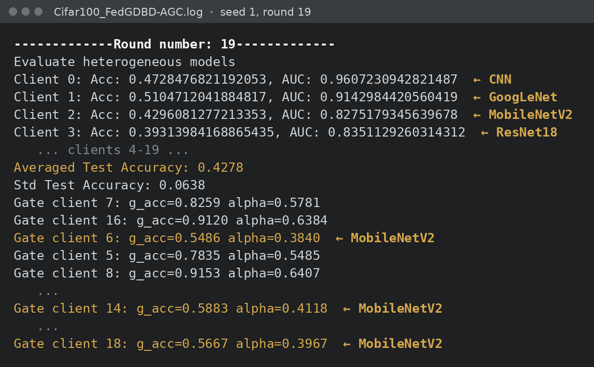
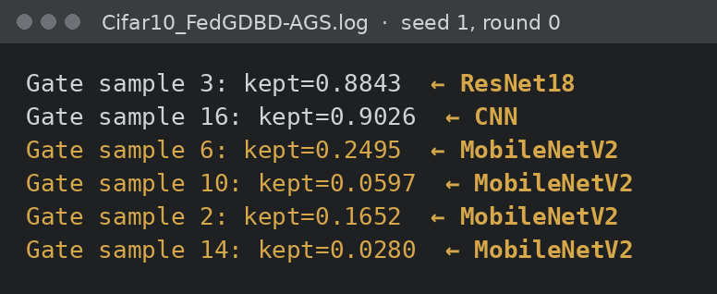
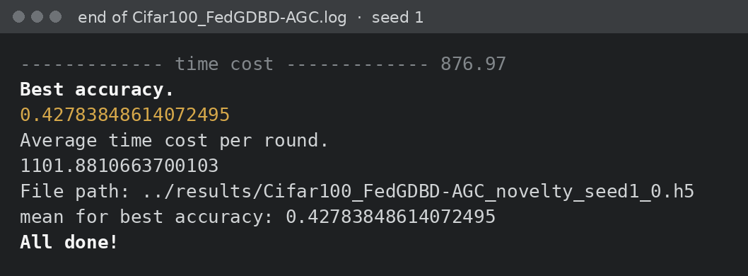
Program Output: Accuracy and Gate Logs
RESULTS & ANALYSIS · PROGRAM OUTPUT · 4 / 4
AGS prints the fraction of images it distilled; at round 0 MobileNetV2 clients keep only 3–25 %.
Each round prints every client's test accuracy, the average (0.4278 here) and, for AGC, one gate line per client with g_acc and the resulting α_i.
End of run: best accuracy 0.4278 is the AGC CIFAR-100 seed-1 entry in the results table.
Real output rendered from experiments/novelty/run2_seed1/ (lines elided with …; gold architecture labels added; client i runs architecture i mod 4). Full logs of every run are on GitHub.
Notes:
This is the program's actual output, rendered from the log files in the repository. On the left, round 19 of the AGC run on CIFAR-100: per-client accuracies, the average, then the gate lines. The low g_acc values, and so the small alphas, all belong to MobileNetV2 clients. Top right, the AGS gate: MobileNetV2 clients keep very few images at round 0. Bottom right, the end of the run, whose best accuracy is the number in our results table. Full logs are on GitHub if anyone wants to check.

Slide 16
Conclusion and Future Work
CONCLUSION & FUTURE WORK
1
Reproduced: Fed-GDBD re-implemented from the paper alone; both baselines within 0.5 pt of the paper (FedProto on CIFAR-100: +4.1).
2
Found and fixed: Eq. 13 taken literally collapses specific architectures; FedGDBD-S (logit-scale matching + head-only KD) keeps it stable at 87.10 / 43.74 %, the best of our runs.
3
Novelty: agreement gating gives repeatable per-dataset gains over two seeds (AGC +0.69 pt on CIFAR-100, AGS +0.39 pt on CIFAR-10) and finds, unprompted, the architecture g serves worst; it does not clear our bar on both datasets.
Future work
5+ seeds
50–100 rounds
Hybrid gate
Pathological split
More datasets
report mean ± SD as the final accuracy
the paper's full training length
AGC where g is often wrong, AGS where it is mostly right
the paper's second heterogeneity setting
Tiny-ImageNet and Flowers102
Reproducibility
python main.py -data Cifar100 -ncl 100 -m HtFE-img-4 \
-nc 20 -gr 20 --gdbd_teacher val --seed 1 \
-algo FedGDBD-AGC # or FedGDBD-AGS / -S
github.com/md25052007/Fed-GDBD-for-HtFL
Code, per-round logs of every run, accuracy curves and setup scripts (Apache-2.0, on HtFLlib).
Notes:
Three conclusions: we reproduced the setup and baselines closely; implementing the paper literally exposed an instability that our two-line fix removes; and our agreement gate gives gains that repeat across seeds on one dataset each, and identifies the architecture the global boundary serves worst, but does not clear the bar we set on both datasets. The obvious next step is more seeds, reported as mean plus or minus standard deviation, and full-length training.

Slide 17
References
REFERENCES
[1]
K. Zhang, J. Wang, W. Wang, T. Zeng, P. Li, X. Wang, T. Zhang, "Federated learning with heterogeneous data and models based on global decision boundary distillation," J. King Saud Univ. – Comput. Inf. Sci., vol. 37, art. 75, 2025. doi:10.1007/s44443-025-00097-0
[2]
B. McMahan, E. Moore, D. Ramage, S. Hampson, B. Agüera y Arcas, "Communication-efficient learning of deep networks from decentralized data," in Proc. AISTATS, 2017.
[3]
P. P. Liang, T. Liu, L. Ziyin, N. B. Allen, R. P. Auerbach, D. Brent, R. Salakhutdinov, L.-P. Morency, "Think locally, act globally: Federated learning with local and global representations," arXiv:2001.01523, 2020.
[4]
Y. Tan, G. Long, L. Liu, T. Zhou, Q. Lu, J. Jiang, C. Zhang, "FedProto: Federated prototype learning across heterogeneous clients," in Proc. AAAI, 2022.
[5]
J. Zhang, Y. Liu, Y. Hua, J. Cao, "FedTGP: Trainable global prototypes with adaptive-margin-enhanced contrastive learning for data and model heterogeneity in federated learning," in Proc. AAAI, 2024.
[6]
L. Yi, G. Wang, X. Liu, Z. Shi, H. Yu, "FedGH: Heterogeneous federated learning with generalized global header," in Proc. ACM Multimedia, 2023.
[7]
J. Zhang et al., "HtFLlib: A comprehensive heterogeneous federated learning library and benchmark," in Proc. ACM SIGKDD, 2025.
[8]
G. Hinton, O. Vinyals, J. Dean, "Distilling the knowledge in a neural network," arXiv:1503.02531, 2015.
[9]
B. Zhao, Q. Cui, R. Song, Y. Qiu, J. Liang, "Decoupled knowledge distillation," in Proc. IEEE/CVF CVPR, 2022.
Notes:
References. The paper we reproduce is reference 1; the baselines and related methods are 2 to 6; HtFLlib, the library we built on, is 7; and the knowledge-distillation papers behind the IKD and global distillation losses are 8 and 9.

