Slide 1
AI/NLP Financial Risk Engine
From news headlines and tweets to index weights and stress losses
D Maithreya
National Institute of Technology Karnataka (NITK), Surathkal
S&P Global & Crisil Campus Hackathon · Case study: real-time risk signals
Notes:
Introduce yourself, then state the one-line idea: unstructured text in, structured risk signals out, used by two downstream modules.

Slide 2
Markets move on text, but risk systems need numbers
The problem
Thousands of headlines and posts a day; a risk desk can read a handful.
Text is unstructured: no field says how bad, what kind, or which asset.
By the time a human has read it, prices have moved.
Input
“Brazil downgraded to junk status by 2nd risk agency, with negative outlook for further downgrades.”
Engine output
Entity | MARKET (market-wide)
Sentiment | −0.96 negative
Event | Credit Event
Impact | 10.0 / 10
Action | Stress test fires → −$466m
My approach
One engine turns every document into a signal: sentiment (−1…+1), event type, impact (1–10).
Two real sources: 20k news headlines + 60k tweets, 2014–2016, replayable as a live stream.
Built both modules: an index rebalancer (A) and a banking-book stress tester (B).
Notes:
Explain the business problem in your own words, then the three-part approach. Walk through the Brazil example: one sentence becomes four fields and a portfolio loss.

Slide 3
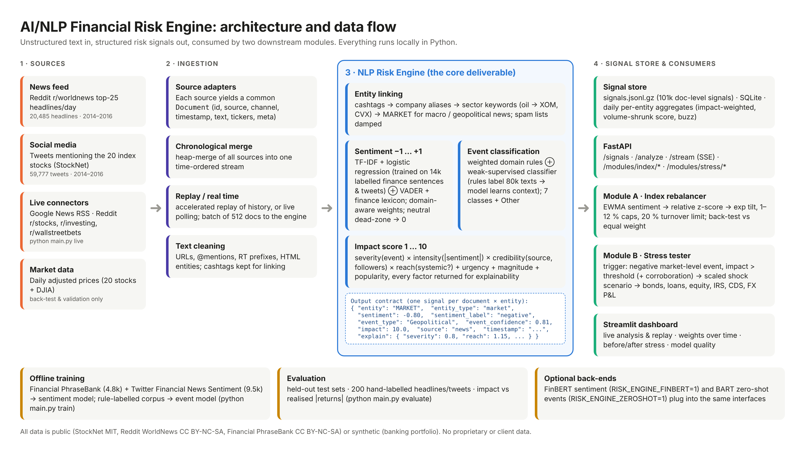
System design: one engine, a signal contract, two consumers
Notes:
Left to right: sources, ingestion into a common Document schema, the NLP engine, the signal store and API, then Module A, Module B and the dashboard. The JSON box is the contract the modules consume.

Slide 4
Implementation highlights and why I chose them
Sentiment
Event type
Impact 1–10
Modules
TF-IDF + logistic regression trained on 14k labelled finance sentences and tweets, blended with a finance-tuned VADER lexicon.
Weighted domain rules + a weak-supervised classifier: rules label 80k unlabelled texts, the model learns the context around them.
severity × intensity × credibility × systemic reach + urgency + magnitude + popularity. Every factor is returned.
A: EWMA → relative z-score → exp tilt, 1–12 % caps, 20 % turnover limit. B: 203-trade book, shock library scaled by impact, sensitivity revaluation.
Why: runs on a laptop in ms, explainable, and the lexicon covers geopolitical text the model never saw. FinBERT plugs in as an option.
Why: no labelled event dataset exists for this period; weak supervision gets coverage without hand-labelling.
Why: risk governance needs to explain a score; each weight is a domain assumption you can challenge.
Why: standard, auditable portfolio and stress-testing mechanics; FastAPI + Streamlit for demo and integration.
Notes:
Spend most time on the design choices: why a light model plus a lexicon, why weak supervision, why a transparent impact formula. Mention 20 unit tests and the optional transformer back-ends.

Slide 5
Results: beats the naive baseline, checked against prices
101,437
67.5%
+0.41% / −0.37%
22.2% / 22.3%
structured signals from 60,388 documents (~1 ms each)
event accuracy on 200 hand-labelled texts
avg same-day return on positive / negative sentiment days
Module A / equal-weight return (23.5% before costs)
Notes:
Left: the engine is about 25 points more accurate than the naive lexicon on both news and tweets. Right: higher impact scores line up with bigger real price moves. Module A tracks equal weight closely; costs eat the small edge, and I say so.

Slide 6
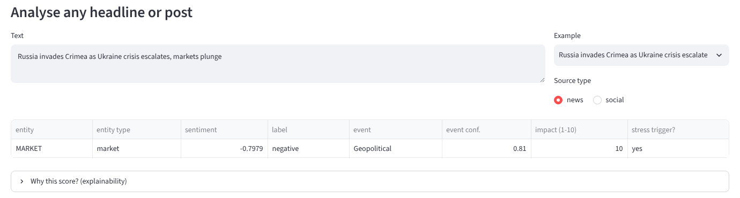
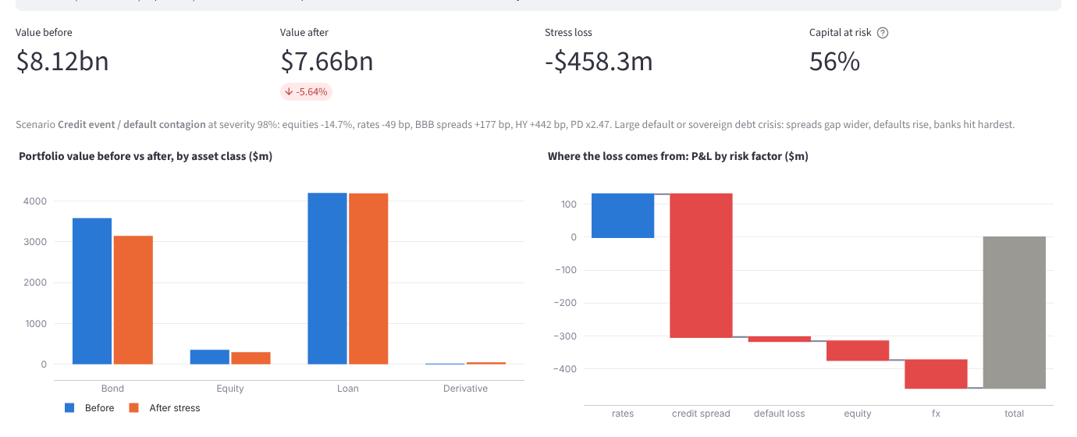
Domain impact: from a headline to capital at risk
1 · A headline is scored live in the dashboard
193 stress triggers on 178 days, including Russia–Ukraine (Mar 2014), the OPEC price war (Nov 2014), the Greek debt crisis and Brazil's junk downgrade (2015).
Losses arrive broken down by risk factor, asset class, sector and trade, in the format risk committees already use.
Every score explains itself, which model validation requires.
2 · The trigger revalues the book: before vs after, P&L by risk factor
Notes:
This is why it matters to a ratings and risk firm: the engine reads everything, flags what matters, and translates it into portfolio losses and active weights.

Slide 7
Limitations and next steps
Out-of-domain sentiment
The supervised model reads geopolitical text poorly (33 %); routing to the lexicon lifts it to 48 %.
Fine-tune FinBERT on labelled world-news headlines.
Noisy news feed
Reddit world-news is not market-focused; market-level impact does not predict DJIA moves.
Add Reuters/GDELT feeds; learn impact weights from realised moves.
Signal ≠ forecast
Sentiment explains same-day returns but not the next day's (Spearman −0.02).
Use as a risk overlay; test intraday timing and cost-aware rebalancing.
Simplified stress model
Linear sensitivities, 1-year PDs, a synthetic book, a 200-text evaluation set.
Full revaluation, scenario correlation, larger multi-rater gold set.
Notes:
Close with honest limitations and concrete next steps. Point to the GitHub repo: python main.py dashboard runs the whole demo.

