Slide 1
Bank CRM Data Analysis
MUHAMMAD SAHANWAJ

Slide 2
INTRODUCTION
Welcome to our project presentation on enhancing the bank's retention strategy through a better understanding of customer behavior. In today's competitive market, leveraging data insights is vital for long-term success and customer loyalty.
This project analyzes customer interactions, financial behaviors, and demographic trends to uncover actionable insights. By examining churn patterns, spending habits, and marketing responses, we aim to develop strategies that retain existing customers and attract new ones.
Using a comprehensive dataset with customer information, transaction details, credit scores, and demographics, we applied advanced analytics and visualization techniques. These insights will guide data-driven decisions to optimize customer satisfaction and drive business growth.
Let's explore the key insights from our data journey that will shape our future strategies.

Slide 3
SUMMARY
This project focuses on analyzing customer churn and retention in a bank, using data-driven insights to uncover trends and patterns that influence customer behavior. By examining demographics, account activity, and product usage, the project aims to identify high-risk customer segments and develop targeted strategies to improve retention. The ultimate goal is to utilize data analytics to enhance customer satisfaction, reduce churn rates, and drive sustainable growth for the bank.

Slide 4
Analytical Methods & Tools
Data Cleaning and Formatting
Utilized Excel for initial data cleaning, such as removing duplicates and ensuring column consistency. Performed data profiling to comprehend the dataset's structure, identify patterns, and evaluate data quality.
Data Storage and Manipulation
Imported the Excel data into an SQL database. Analyzed customer churn by writing SQL queries to correlate customer attributes with churn rates.
Data Analysis and Visualization
Processed the data in Power BI using queries and original files. Developed interactive dashboards to visualize balance details, churn rates, and customer information.

Slide 5
Problem Statement
During the last fiscal year, Capstone Bank faced significant customer churn, leading management to seek analytical specialists for solutions.
Evaluate the profitability of individual customer segments to prioritize high-value clients and customize offerings accordingly.

Slide 6




Customer Summaries
Total Customers
Churn Rate
Total Active Customer
Total Non Active Customer

Slide 7
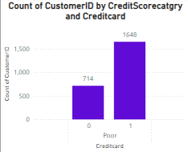
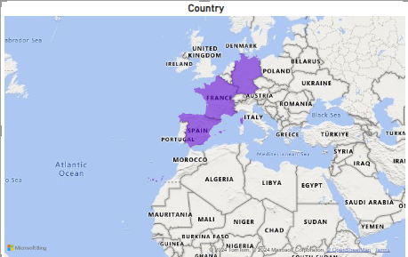
Identify Regions and Genders with Higher Churn Rates

Slide 8
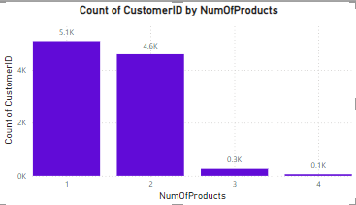
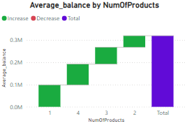
Examining Customer Segments Prone to Churn
The findings indicate that customers who use only one product from the bank are more likely to churn, highlighting a specific vulnerable customer segment.

Slide 9
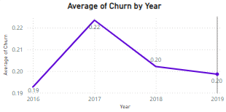
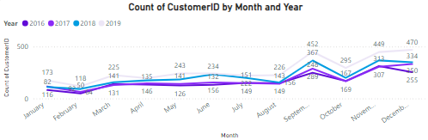
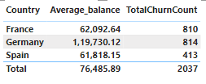
Recommendations to Reduce Churn Rate
The bank is seeing a rise in new customer numbers annually, coupled with a decreasing churn rate. To sustain this positive trend and minimize churn further, prioritizing annual efforts to boost customer acquisition is crucial. Targeted marketing initiatives should specifically address countries like Germany and France, where churn rates are notably high (841 and 810 churned customers, respectively).

Slide 10
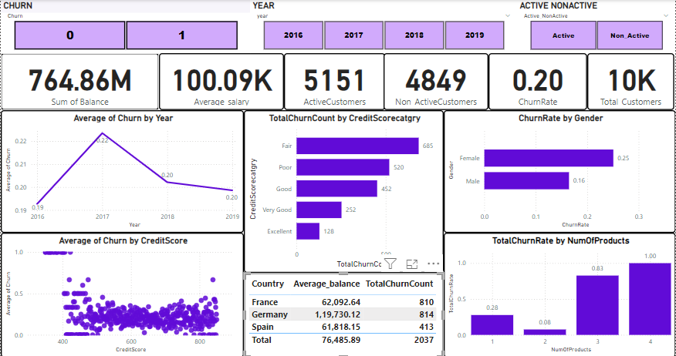
REPORTE VISUALS

Slide 11
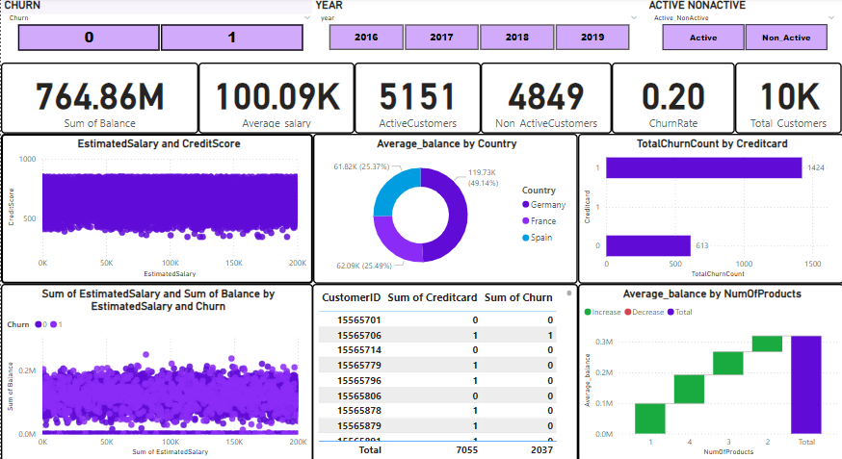
REPORTE VISUALS

Slide 12
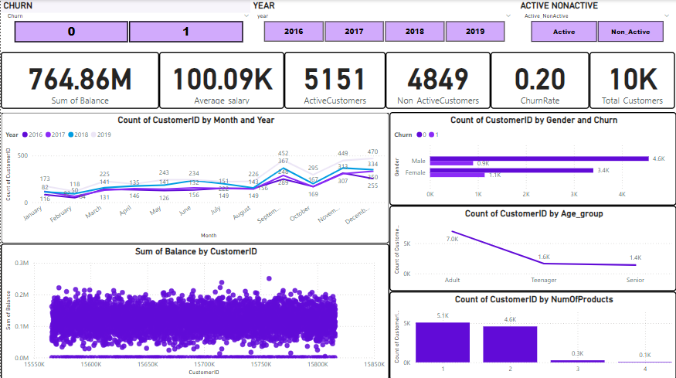
REPORTE VISUALS

Slide 13
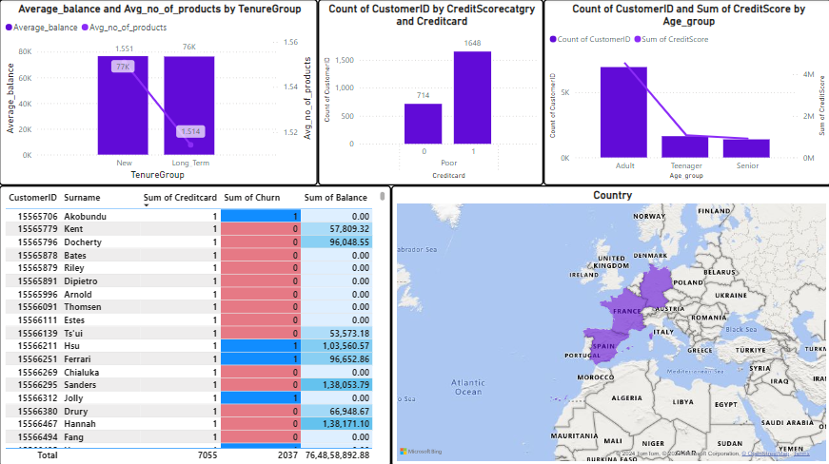
REPORTE VISUALS

Slide 14
Conclusion
Our project focused intensively on analyzing customer churn dynamics within the banking sector, uncovering deep insights into customer behaviors, risk factors, and prevailing market trends. By examining critical metrics such as churn rates, customer demographics, and usage patterns of banking products, we crafted strategic approaches rooted in data to bolster both customer retention and acquisition efforts.
However, it's imperative to recognize that customer churn is a multifaceted phenomenon influenced by factors extending beyond our dataset scope. These include customer experiences, competitive pressures, and broader economic conditions. Therefore, while our analysis provides valuable insights, achieving sustained success in reducing churn and enhancing overall customer satisfaction demands a holistic strategy. This strategy should integrate qualitative data analysis, continuous customer feedback, and vigilant monitoring to dynamically adjust and optimize our approaches over time.

Slide 15
THANK YOU

