Slide 1
Columbia Asia Hospital analysis
Muhammad Sahanwaj

Slide 2
Introduction
Columbia Asia Hospital stands as a beacon of patient-centered care and medical expertise, renowned globally for its commitment to exceptional healthcare. With a presence across multiple countries, the hospital distinguishes itself through state-of-the-art medical equipment, modern amenities, and a team of compassionate, highly skilled professionals. Dedicated to excellence, Columbia Asia Hospital is committed to fostering a healthy society by delivering comprehensive and personalized healthcare solutions tailored to the diverse needs of its communities. At its core, the hospital prioritizes patient needs, ensuring holistic and effective medica

Slide 3
SUMMARY
A dataset from Columbia Asia Hospital was carefully analyzed and guaranteeing data integrity. We looked at popular departments, typical wait times, and patient groups' patterns of healthcare use. We looked at patient trends and determined many different types of aspects by using DAX functions. We looked at how wait times and satisfaction levels relate to one another, how departmental visits are affected by demographics, and how to handle discrimination complaints. We examined the General Practice department's profitability waiting time variations, recommended discount assignment and doctor shift alignments. We demonstrated our technical expertise to adding columns to Power Query using M-query and Power Bl Gateway, The hospital's strategic decision-making, patient experience advancements, and operational improvements are informed by the insights obtained.

Slide 4
Data Overview
I've received two essential files from the team: one containing detailed transactional data on doctor-patient interactions, including patient race, age, appointment fees, appointed doctor, and other pertinent details. The other file, from the Hospital ER, provides comprehensive master data on billing, encompassing total bills, doctor names, patient IDs, and departments.
Both datasets are substantial, each containing over 6000 rows, making them highly valuable for making informed analytical decisions.
To proceed, I imported these datasets into Microsoft Power BI using the Get Data option and conducted initial data transformation steps to ensure cleanliness and relevancy in both tables. This preparation sets the stage for in-depth analysis and actionable insights from the integrated data sources.

Slide 5
Methodology
Analytical Methods: Utilized Power BI for data analysis and visualization.
Tools Used: Power BI Desktop, Power Query Editor, DAX.
Steps Taken:
Data Cleaning: Removed duplicates, handled missing values, and standardized formats using Power Query Editor.
Data Enrichment: Joined datasets to enable comprehensive analysis.
Measure Creation: Developed DAX measures for key performance indicators.
Visualization: Created various visualizations for presenting insights.
Specific DAX Functions: SUM, AVERAGE, RELATED, CALCULATE, etc.
This methodology provides a succinct overview of the analytical approach, tools used, and steps taken in the analysis process, including data cleaning, enrichment, measure creation, and visualization, with a mention of specific DAX functions utilized.

Slide 6
PROBLEM STATEMENT
Hospital is looking for key insights
Insights about suitable departments for new hire.
Strategies and suggestions about patient discount eligibility and criteria.

Slide 7

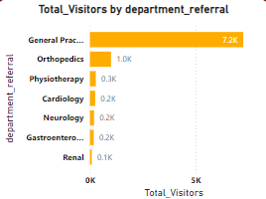
Total Revenue, Department Wise Revenue
The bar chart reveals the distribution of patient visits across
different departments, highlighting significant visit counts as
follows: General Practice leads with 7.2K visits, followed by
Orthopedics (1.0K), Physiotherapy (O.3K), Cardiology (0.2K),
Neurology (O.2K), Gastroenterology (0.2K), and Renal (0.1K).
This graphical representation distinctly shows the popularity
ranking of each department, providing valuable insights for
the hospital's resource allocation and strategic planning
purposes

Slide 8
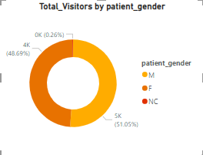
TOTAL VISITORS BY PATIENT GENDER
The pie chart illustrates an equitable gender
distribution among hospital visits, with men
accounting for 51.05% and
women for 48.69% (4487 visits). This
balanced representation underscores
the hospital's inclusive environment,
accommodating a diverse spectrum of patients.

Slide 9
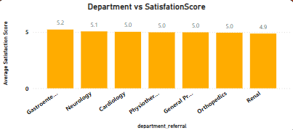
Department wise satisfaction score
Gastroenterology stands out with an impressive average satisfaction rating of 5.2. Neurology and Physiotherapy closely follow with ratings of 5.1 each. Orthopedics and General Practice both maintain solid ratings of 5.0 and 5.0, respectively. Cardiology holds a rating of 5.0, while Renal exhibits a rating of 4.9.

Slide 10
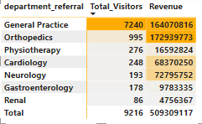
Insights about suitable departments for new hires
Increase Staff: Hire more doctors in general practice
and orthopaedics to handle high patient volumes.
Improve Efficiency: More doctors will reduce wait
times and enhance service delivery.
Boost Revenue: Better staffing can lead to increased
Patient satisfaction and revenue growth.

Slide 11
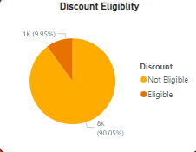
Strategies and suggestion for employee discount
Patient discounts can be based on visit frequency, satisfaction scores, appointment fees, and promoting underutilized departments.
In this case, we consider patient satisfaction scores for offering discounts since we lack cost data for each department. Therefore, appointment fees or department revenue cannot be used as deciding factors.
We'll set the discount eligibility criteria such that patients with a satisfaction score greater than 6 qualify for the discount.

Slide 12
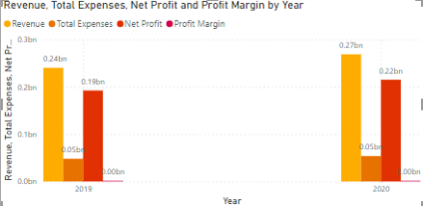
Hospital profitablity
As observed in the graph, the profit margin is 0,indicating that the hospital is not profitable.

Slide 13
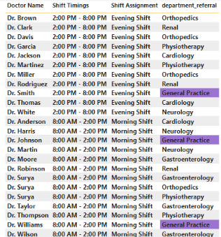
Shift Assignment
Shift Allocation: Dr. Jackson and Dr. Williams will cover the morning shift from
8:00 AM to 2:00 PM, and Dr. Smith will handle the evening shift from 2:00 PM to 8:00 PM.
Optimized Patient Care: This shift allocation addresses higher patient traffic
in the morning, ensuring efficient resource utilization and better patient care.
Improved Patient Flow: Splitting shifts in the General Practice department reduces
wait times and streamlines operations, enhancing patient experience.
Enhanced Revenue: Aligning doctor shifts with peak demand boosts hospital revenue
by optimizing service delivery and addressing high visitor numbers effectively.

Slide 14
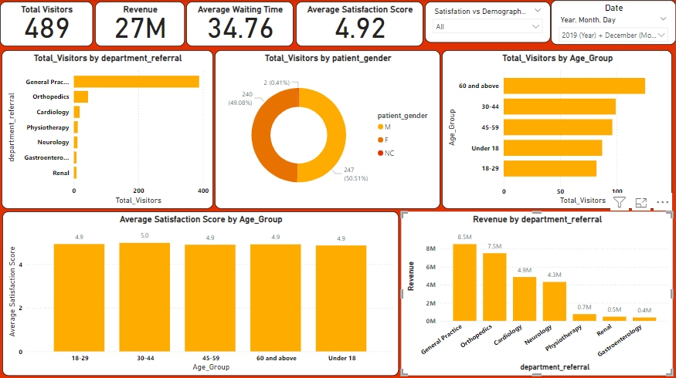
Main

Slide 15
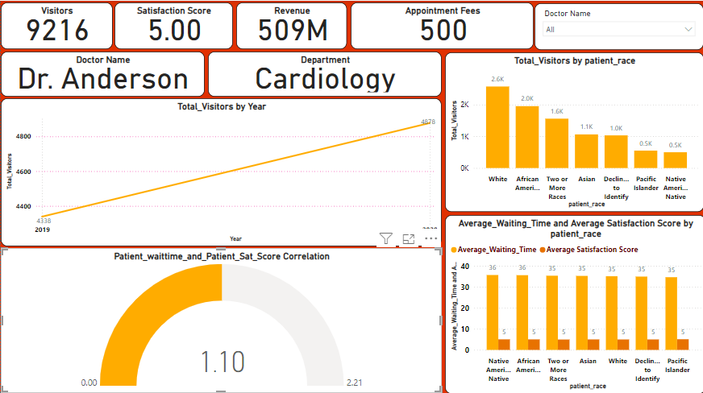
DOCTORS

Slide 16
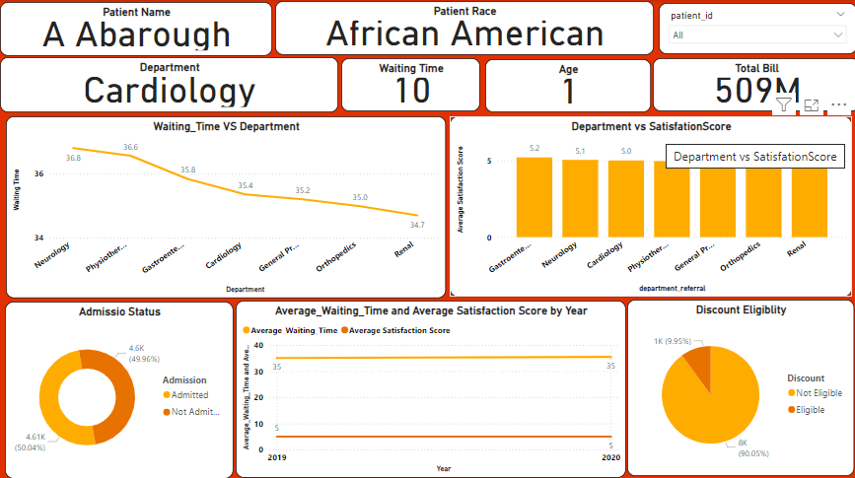
PATIENTS

Slide 17
Conclusion
The analysis of our hospital's dataset provided crucial insights into patient demographics, visitor numbers, revenue, and operational efficiency. Noteworthy findings include:
Understanding visitor demographics allows us to tailor services and marketing efforts for improved patient engagement. Exploring the relationship between visitor numbers and gender informs strategies for inclusive healthcare. Revenue analysis facilitates resource allocation across departments to maximize efficiency. Tracking visitor numbers over time aids in forecasting demand and optimizing staffing. Implementing targeted discounts and adjusting doctor shifts based on patient flow enhances satisfaction and operational efficiency.
In conclusion, these insights drive informed decision-making, optimizing our operations and patient care to ensure sustained growth and exceptional service delivery.

