Slide 1
Trabajo final Arquitectura de computadoras Diseño del Sistema
Cesar Limones
Eduardo Michel

Slide 2
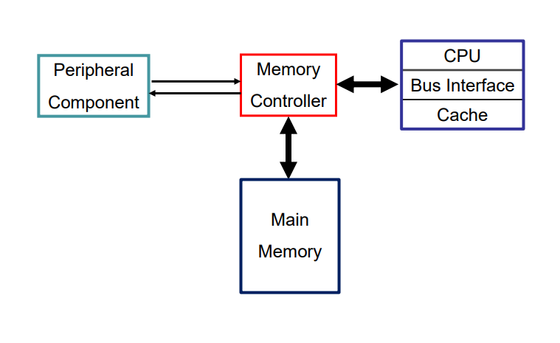
System

Slide 3
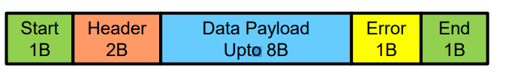

Peripheral component – Block Diagram
Read Data from file
PMC
Decoder
Data
Addr
Bus req
Read
Write
Memory Controller
UART
Peripheral
Send MSG command
From test bench
Data read/write
Error-retry
Ack
Wait-Bus busy
MCP
Decoder
UART

Slide 4
Message codification
reg [15 : 0] iInstruction_tb;
reg [23 : 0] iAddr_tb;
reg [31 : 0] iData_tb;
Header :
from peripheral
read: 0x0001
write 0x0002
from mem controller
wait: 0xFFF1
ACK 0xFFF2
Error – retry 0xFFF3
Start 1B | Header 2B | Data payload 7B = 4B Data 3B Addr| Error 1B| END 1B
oOutputMsg = {8'h0F, iInstruction, iData, iAddr, 7'b0, iError, 8'hF0};

Slide 5
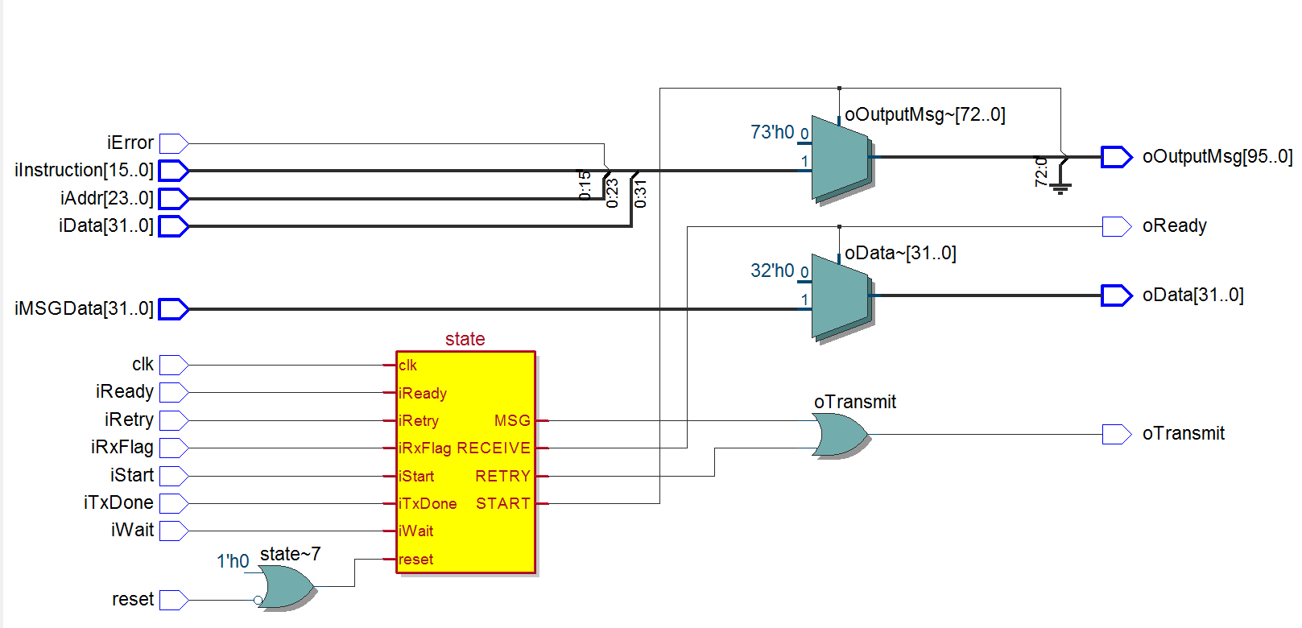
Peripheral component – Synthesis
oOutputMsg = {8'h0F, iInstruction, iData, iAddr, 7'b0, iError, 8'hF0};
Message is concatenated for UART
Instructions/data/addr from TB
Output to UART
Output to TB
Data decoded from MCP decoder
Output to TB
Flags from decoder and UART
UART control

Slide 6
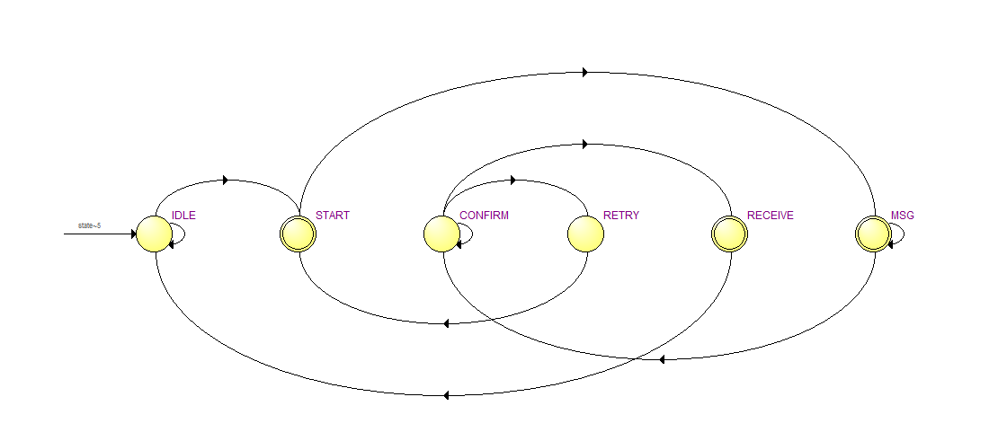
Peripheral component FSM – Synthesis
RETRY: If MC replies with WAIT or ERROR-Retransmit, retry goes to MSG again, latched messga is sent again. If MC replies with ACK , goes to RECEIVE.
CONFIRM: waits for MC Message (decoded by MCP decoder)
iStart
START: Latches Data, ADDR, Instr and Error from TB
MSG: Sends msg to UART, waits for UART ACK TxDone and goes to CONFIRM
RECEIVE: Latches DATA & ready if READ instruction or Ready if WRITE instruction. And goes to IDLE.

Slide 7
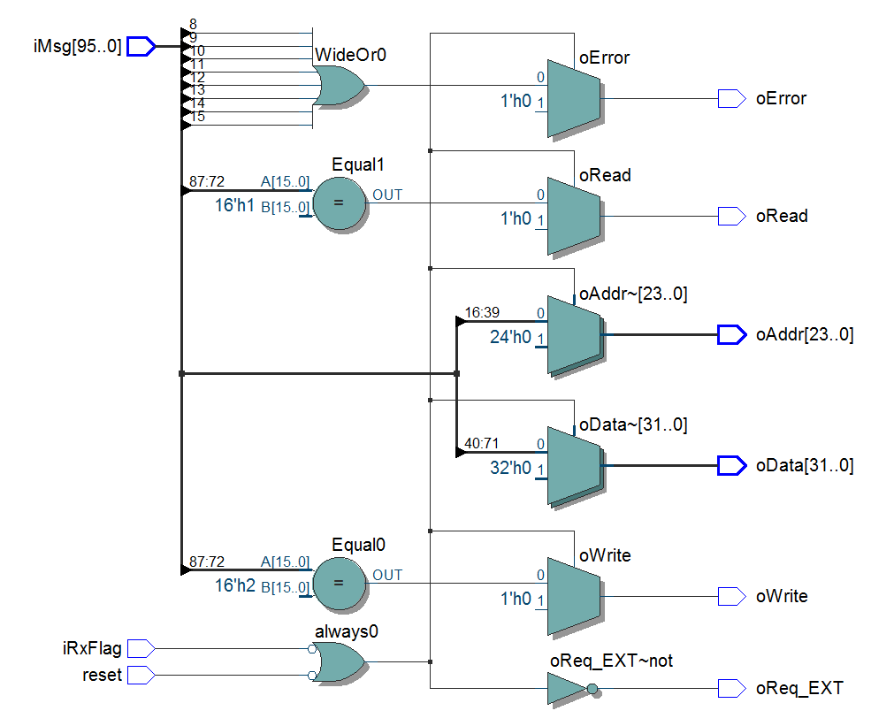
Decoder PMC
iMsg = {8'h0F, iInstruction, iData, iAddr, 7'b0, iError, 8'hF0}; from UART
Error flag if any of the error bits is asserted
Read request to MC
Instruction decode
ADDR to MC
Instruction decode
Data to MC
Write request to MC
UART control
BUS request to MC

Slide 8
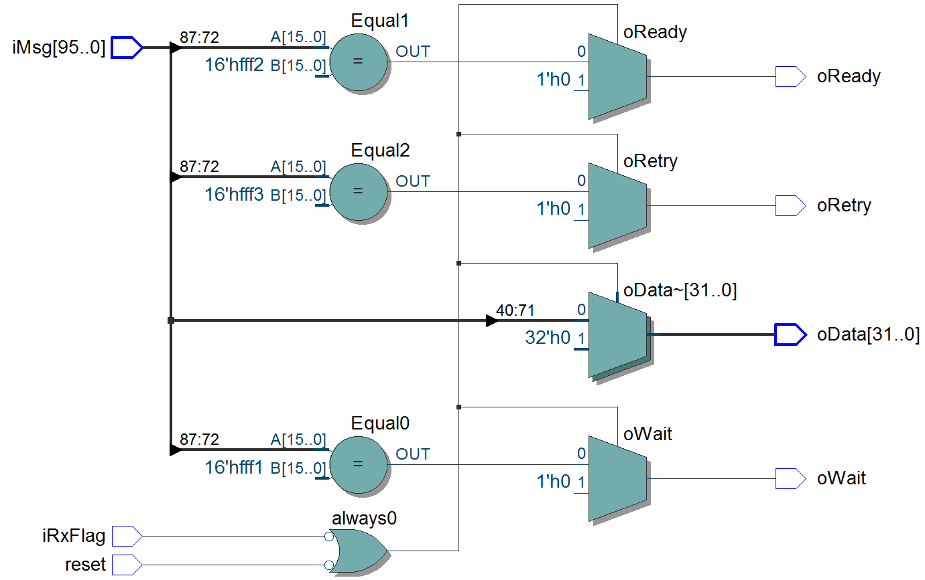
Decoder MCP
iMsg = {8'h0F, iInstruction, iData, iAddr, 7'b0, iError, 8'hF0}; from UART
Instruction decode
ACK flag if read or write transaction is successful
Instruction decode
Retry flag, Peripheral will retry same message until ACK is received
Data to Peripheral, MC will reply with data read or written peripheral will process accordingly.
Instruction decode
UART control
Wait flag – Bus is busy, Peripheral will retry same message until ACK is received

Slide 9
Peripheral component – Verification cases
Peripheral memory read – No error, cache miss/ cache hit clean
Peripheral memory write – No error, cache miss/ cache hit clean
Peripheral memory read – No error, cache hit Modified with retry
Peripheral memory write – No error, cache hit Modified with retry
Peripheral memory read – Error
Peripheral memory write – Error
Peripheral tries to read/write but bus held by MC.
Peripheral tries to read/write but bus held by CPU, thru MC.

Slide 10
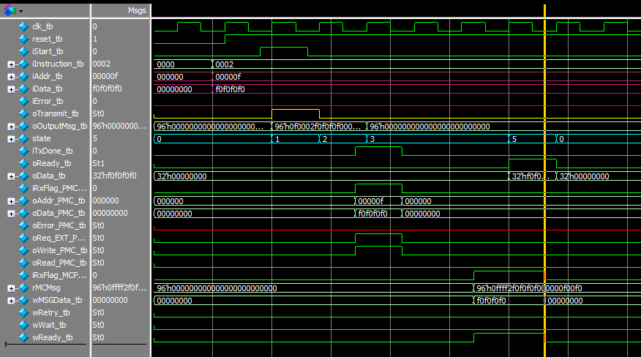
Peripheral memory write – No error, cache miss/ cache hit clean

Slide 11
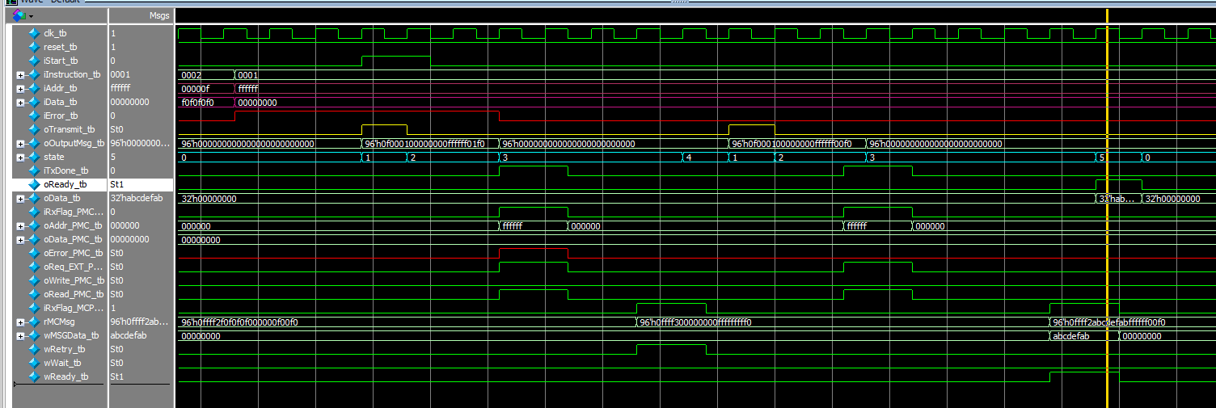
Peripheral memory Read–error: retry message from MC, successful retry

Slide 12
Main Memory
Address/data Bus to Memory controller
Main Memory
Implement single port RAM with WE and MESI bits
Write Enable

Slide 13
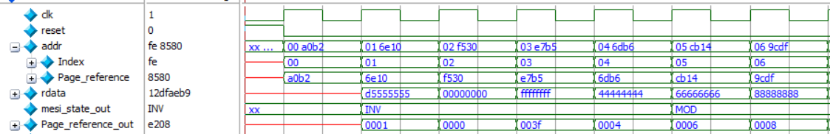
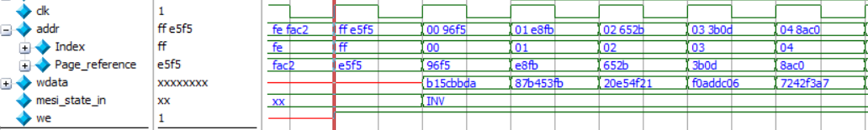
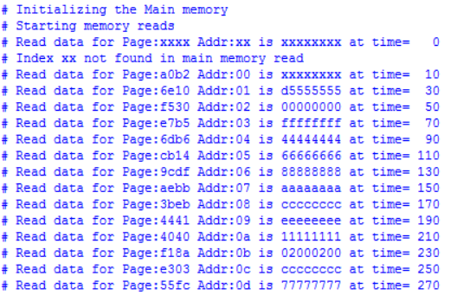
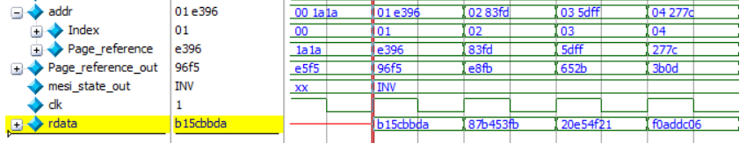
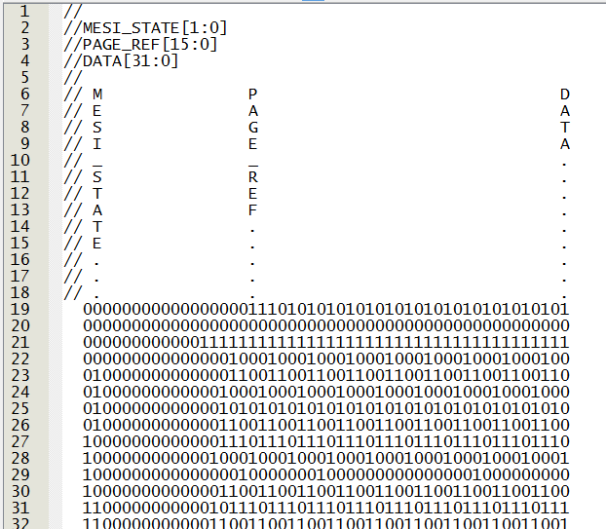
Main memory TB
Reading main memory from initialized file:
Writing random data to main memory :
Structure used in file to initialize the memory

Slide 14
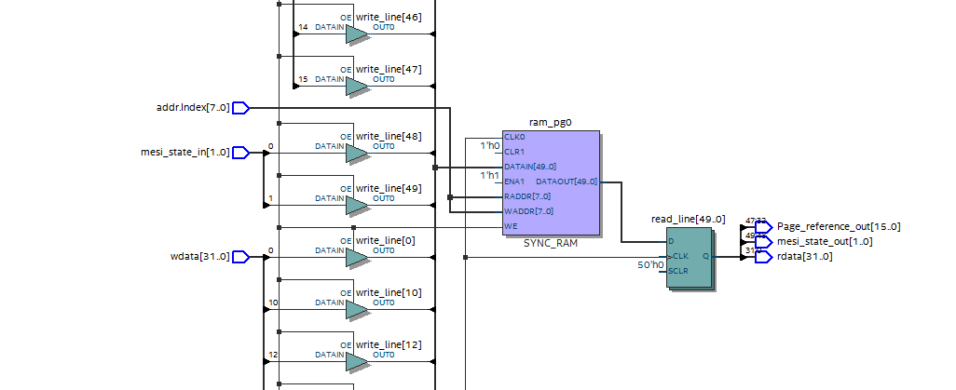
Main memory RTL

Slide 15
Memory controller
Memory Controller
Serial communication with peripheral
To CPU:
Address/data Bus
Control Signals Bus
Address/data Bus to Main Memory

Slide 16
Memory controller – Control signals
AHOLD – address hold: maintain memoryconsistency
• EADS# - external address strobe: external; informs the processor of a valid address on its local bus to be snooped (internal cache lookup)
• input INV – invalidate: external; informs the processor to leave cache line valid or mark it invalid on a snoop hit
• inout HIT# - hit on internal cache – notify other processors that information is shared by another cache
• inout HITM# - hit modified line: hit to a modified line incache, write-back required
PBGNT# - private bus grant: asserted to grant bus ownership
• inout PBREQ# - private bus request: asserted to request bus ownership

Slide 17
Memory controller– Verification cases CPU
Cache Snoop – miss
Cache Snoop – Hit Clean
Cache Snoop – Hit Modified.
Write back.
Test all control signals.

Slide 18
Memory controller– Verification cases Peripheral
Reject peripheral request, bus held by CPU or MC.
Handle Peripheral memory write – No error, cache miss/ cache clean hit
Handle Peripheral memory read– No error, cache miss/ cache clean hit
Handle Peripheral memory read – No error, cache hit Modified with retry
Handle Peripheral memory write – No error, cache hit Modified with retry
Handle Peripheral memory read – Error
Handle Peripheral memory write – Error

Slide 19
CPU
CPU
To Memory controller:
Address/data Bus
Control Signals Bus

Slide 20
Peripheral component – Block Diagram
TB
CPU
addr_from_program
wdata_to_mm
req_CPU
we_to_mm
Hit/hitm
Memory Controller
ss
CPU
UART
Main Memory

Slide 21
CPU – Memory Controller - Verification cases
Parse files
Read from Cache
Read from main memory
Write to cache
Write to main memory

Slide 22
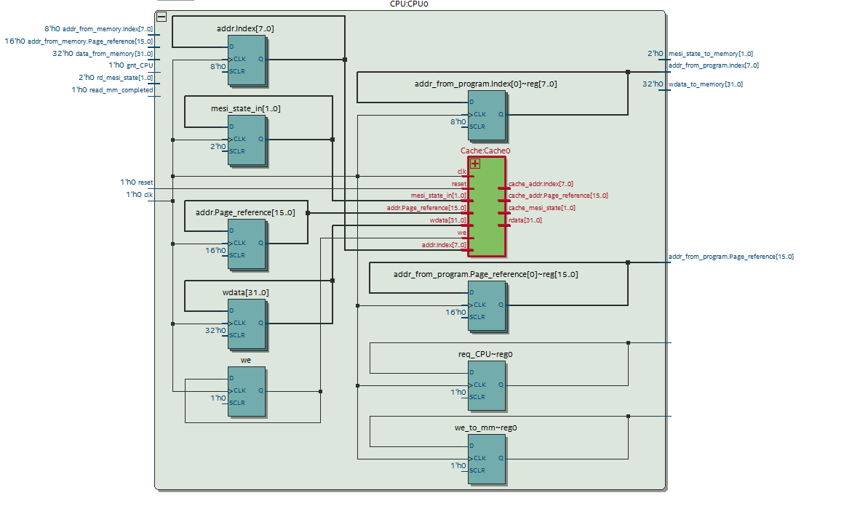
CPU RTL

Slide 23
Global Verification case
Case 1 – Peripheral periferico escribe y hay un cache hit modified (paso por paso)
Case 2 – CPU load (read) - cache miss
Case 3 – CPU load – hit
Case 4 – CPU store (write to main memory) miss
Case 5 – CPU store hit
Case 6 – CPU bus request denied.

Slide 24
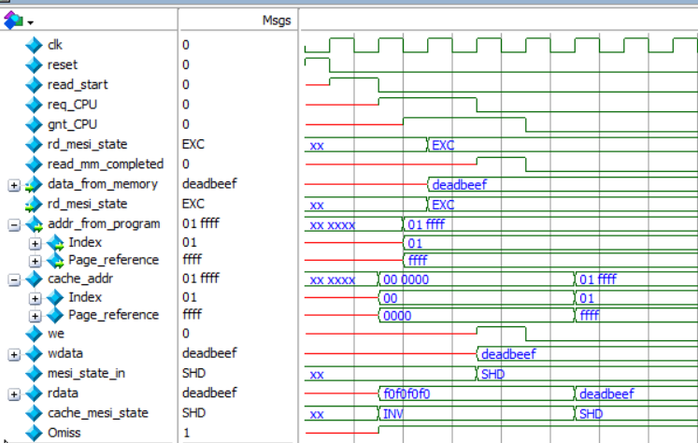
CPU load – cache miss

Slide 25
Cache
Cache
To Memory controller:
Address/data Bus
Cache design is practically given in the final project description.
Control Signals Bus

Slide 26
Global Verification case
Case 1 – Peripheral periferico escribe y hay un cache hit modified (paso por paso)
Case 2 – CPU load (read) - cache miss
Case 3 – CPU load – hit
Case 4 – CPU store (write to main memory) miss
Case 5 – CPU store hit
Case 6 – CPU bus request denied.

Slide 27
System Verification Case
Peripheral request MM read using serial comm msg.
MC controller triggers snoop operation from CPU cache
Cache returns HIT and HITM asserted
MC replies to peripheral a WAIT to allow write back from CPU cache.
Peripheral initiates wait pattern retrying msg until ack is successful.
CPU requests BUS grant
MC grants bus access and performs write back.
MESI state from Cache changes from M to S
Data is written back to MM and MESI sate changes from E to S.
MC returns retry msg to peripheral.
Peripheral retries Read operation.
MC returns data to peripheral and ACK message
Peripheral receives data requested.

Slide 28
Backup

Slide 29
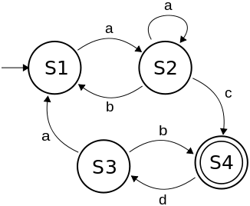
CPU
CPU reads file from computer that contains instructions to:
read/write - header
addresses
Data
Error bits generated arbitrarily
CPU state machine parses data from file simulating processing outputs and coordinates with Memory controller using control Bus signals to read/write from main memory.

Slide 30
Peripheral component
Peripheral reads file from computer that contains instructions to:
read/write - header
addresses
Data
Error bits generated arbitrarily
Peripheral state machine parses data and forms message as per format below.
Waits for send command.
Send command moves message to UART and sends to Mem Controller.
MSG
Buffer
UART
To memory controller

Slide 31
Memory controller
MC state machine parses message from Peripheral.
If conflict with address bus request, gives access to CPU and notifies Peripheral to resend msg after waiting.
If Bus is free sends address to Cache to start snoop operation and reads control signals.
Serial from peripheral
UART

Slide 32
Global Verification case
Case 1 – Peripheral periferico escribe y hay un cache hit modified (paso por paso)
Case 2 – CPU load (read) - cache miss
Case 3 – CPU load – hit
Case 4 – CPU store (write to main memory) miss
Case 5 – CPU store hit
Case 6 – CPU bus request denied.

