Slide 1
Electoral Bond analysis and insights
By MD Arsalan Rasheed

Slide 2
Process
Data Modelling
Data Collection
Data Cleaning
Data analysis
Insights & Conclusion
Dashboard

Slide 3
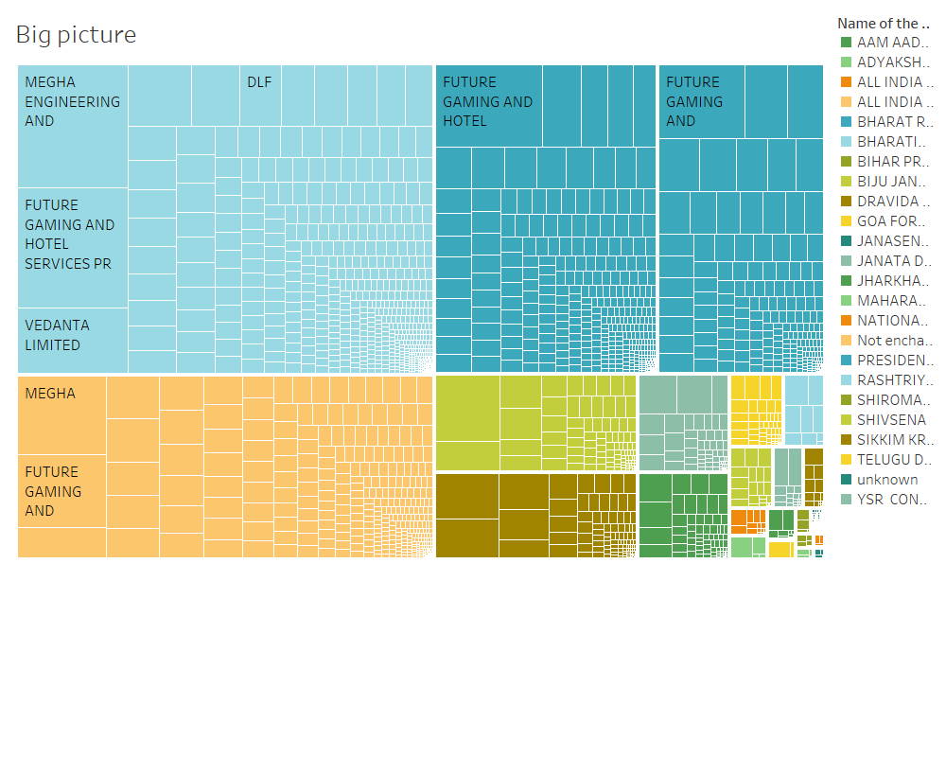
Fig:1 Big Picture of Electoral Bonds

Slide 4
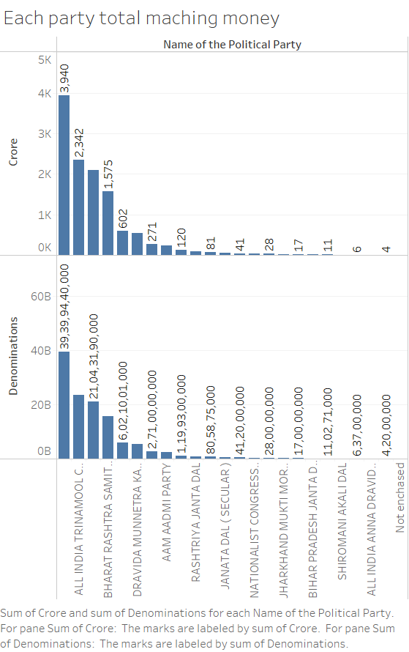
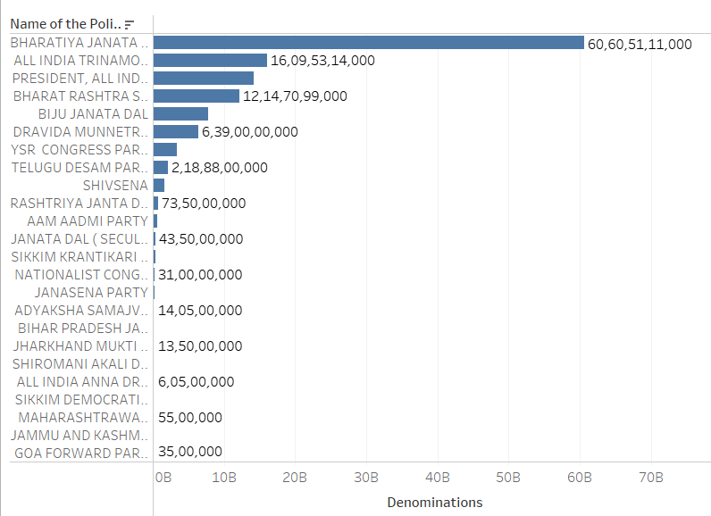
Fig :- 2 Matched with Purchasers Names and the Political parties
Fig:-3 Total Amount by each party

Slide 5
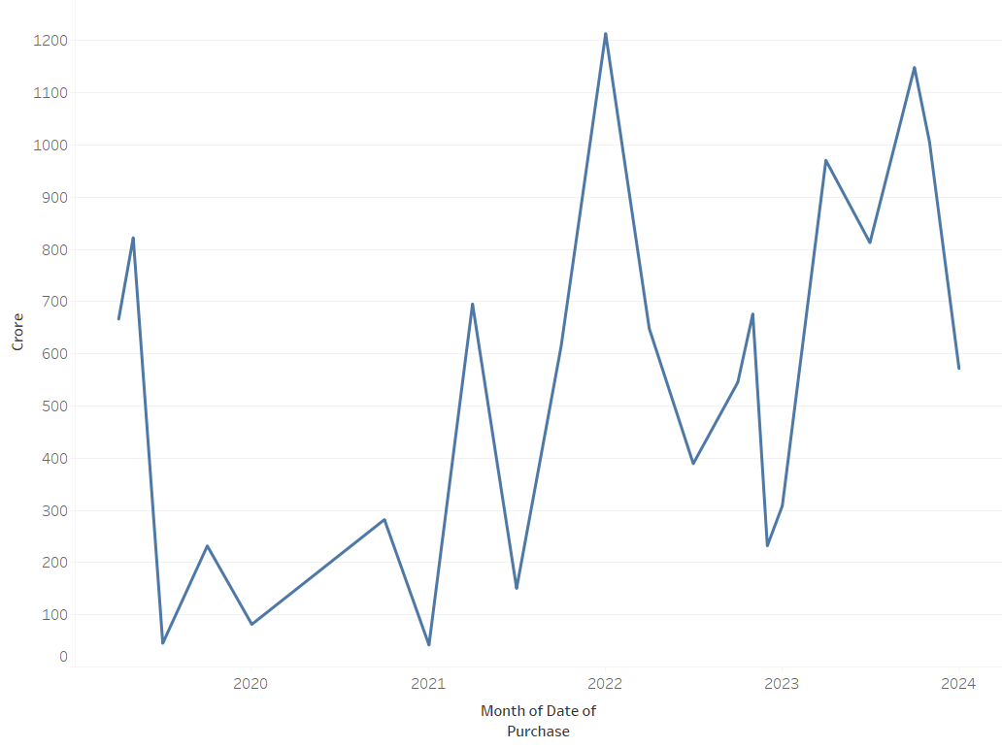
Fig :- Bonds Purchase monthly

Slide 6
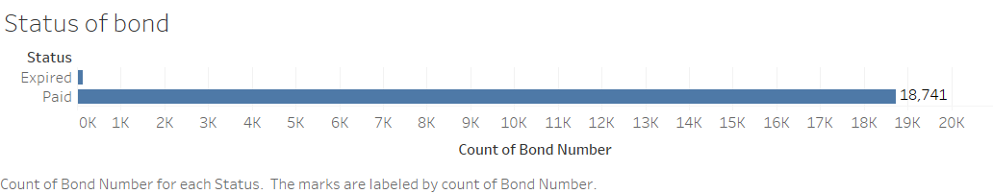
Most bond were encashed by the political parties
Not all bonds were able to matched with the political but I made a subset of matched bond number used it gain insights

Slide 7
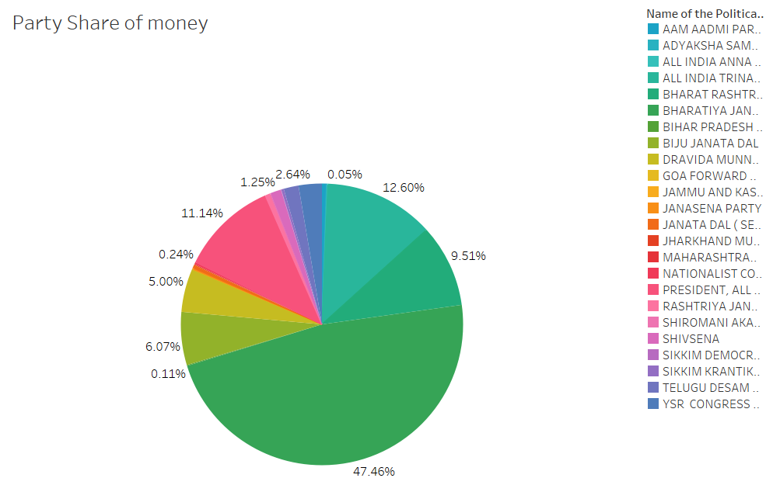
Fig:- Percentage of share of political Party

Slide 8
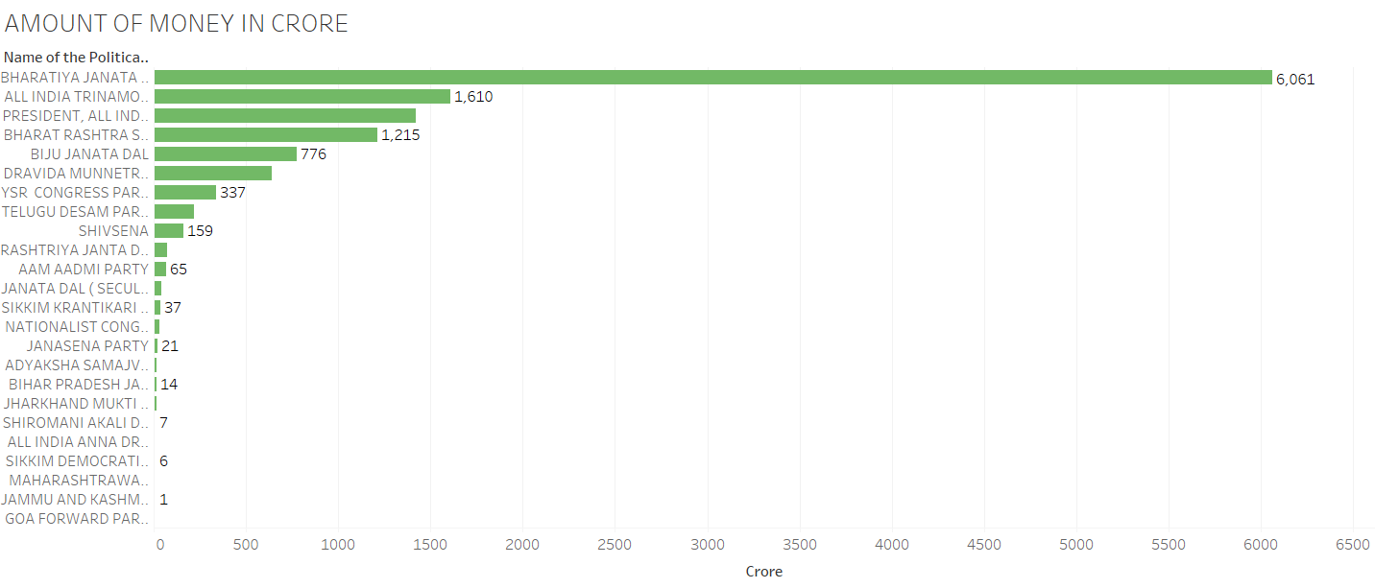
Fig :- Amount each Party received from year 2018 to 2024

Slide 9
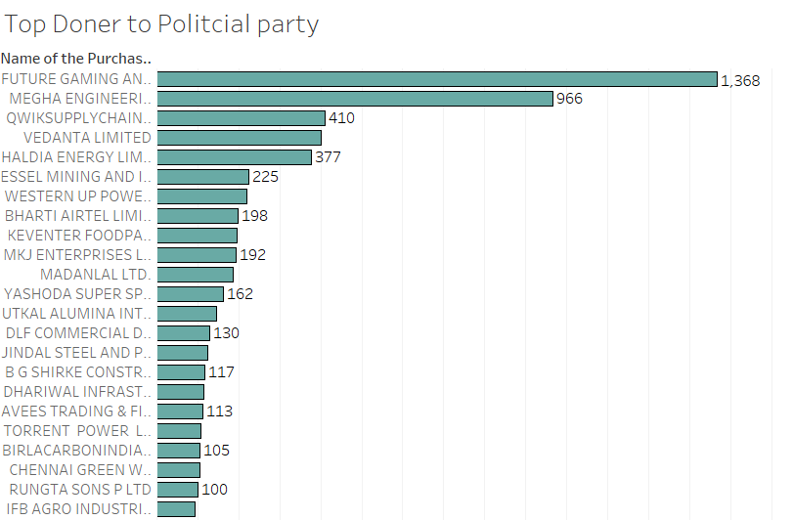
Fig:- Top doner to political parties

Slide 10
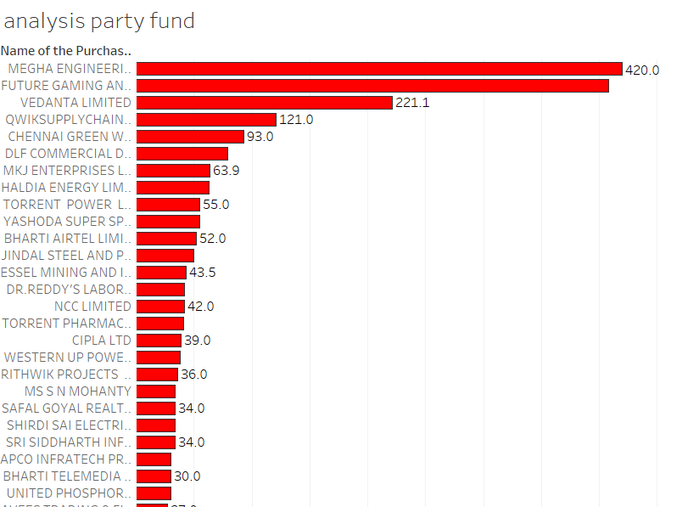
Fig 4:- Top Doners to BJP

Slide 11
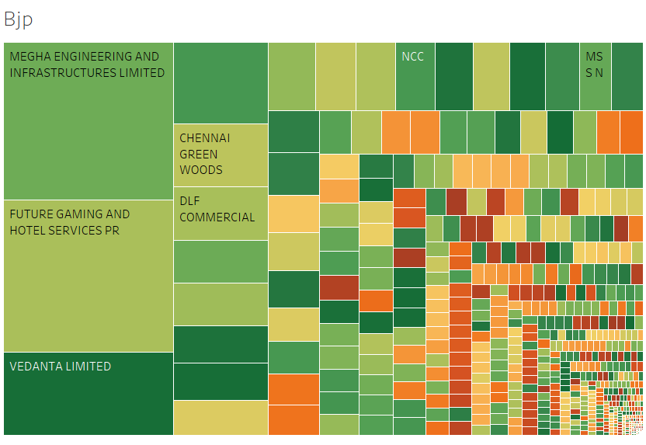

Slide 12
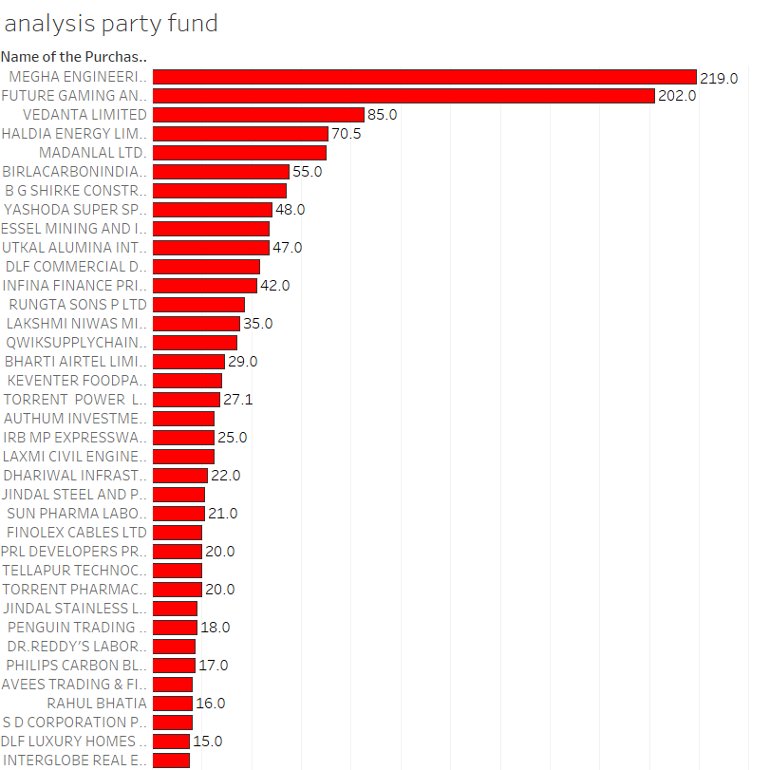
Fig:- 5 Top doners to TMC

Slide 13
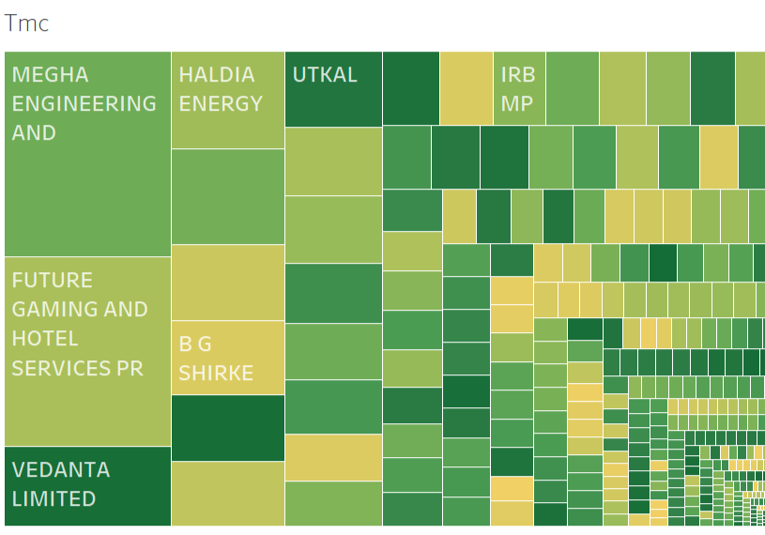

Slide 14
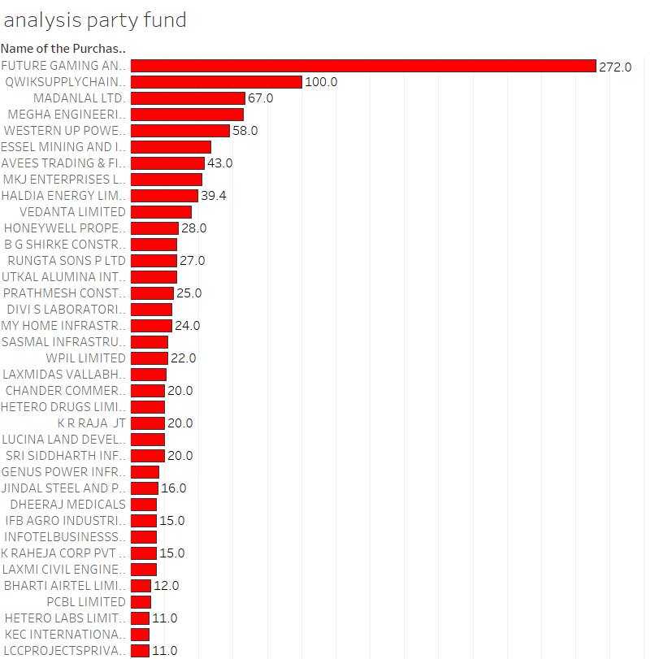
Fig:-6 Top Doners to Congress

Slide 15
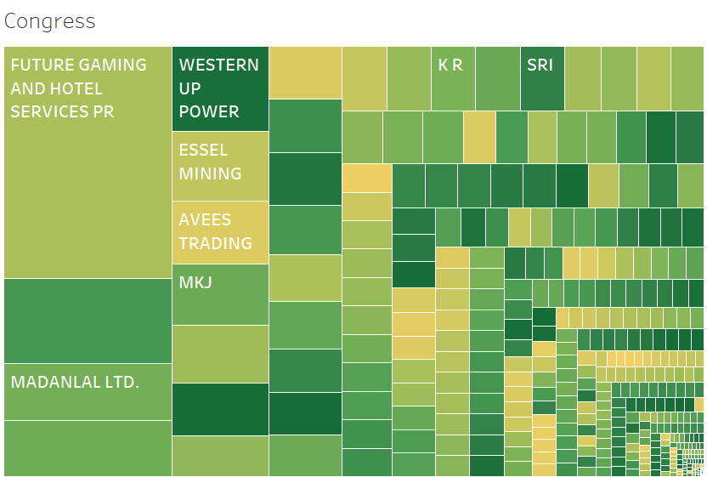

Slide 16
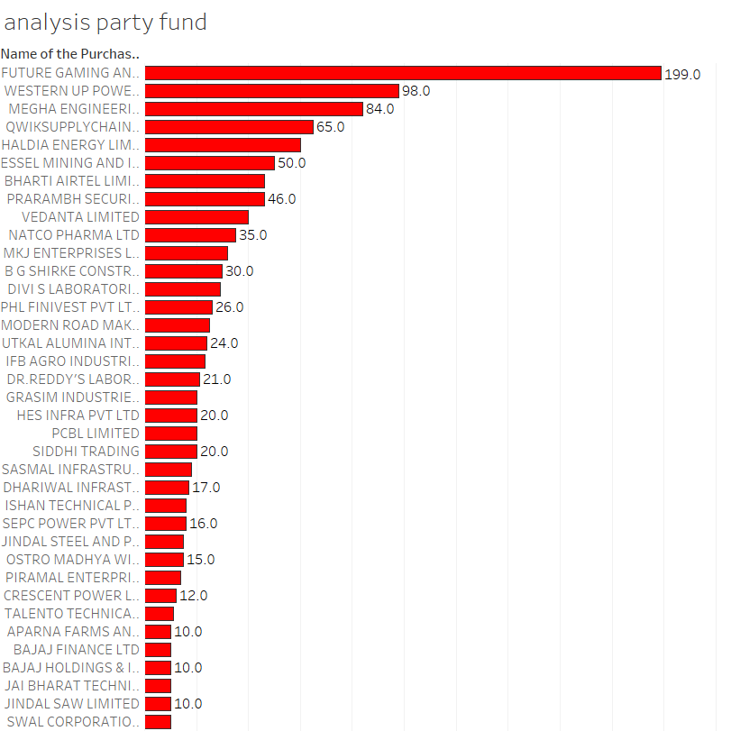
Fig:- 7 Top Doners to BRS

Slide 17
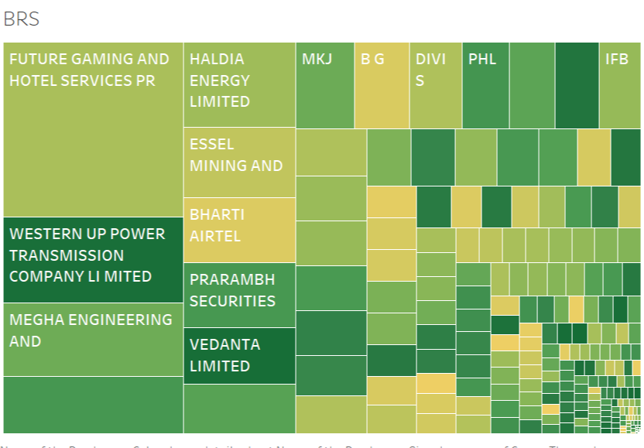
Fig:- 7 Top Doners to BRS

Slide 18
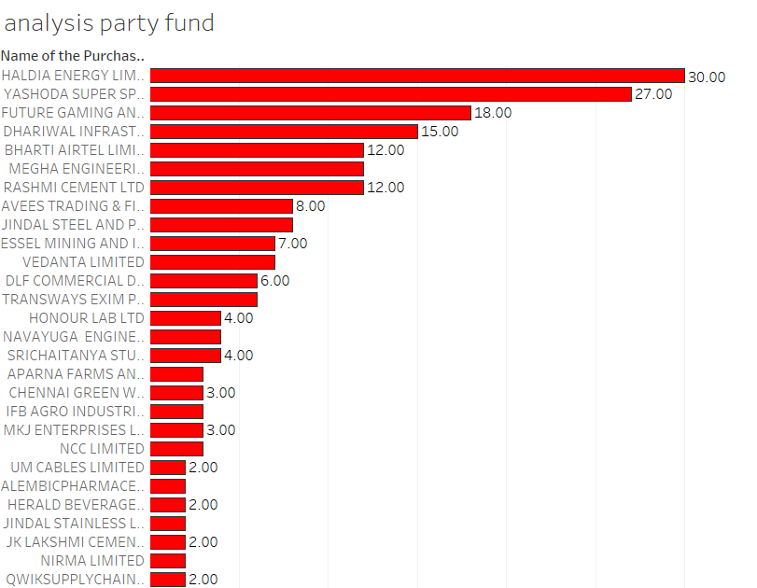
Fig :- Top Doners to AAP

Slide 19
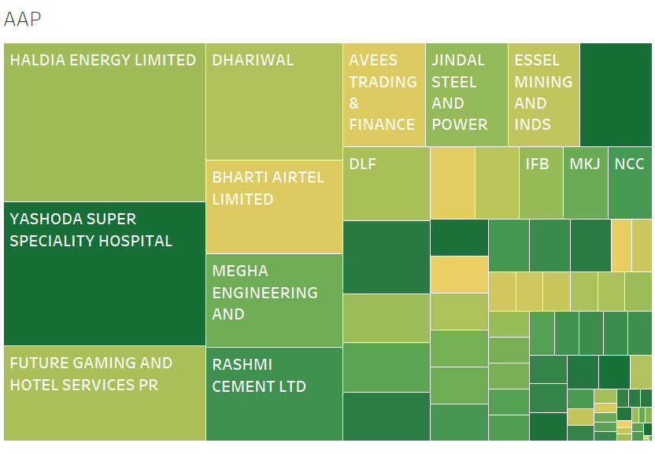
Fig :- Doners of AAP

Slide 20
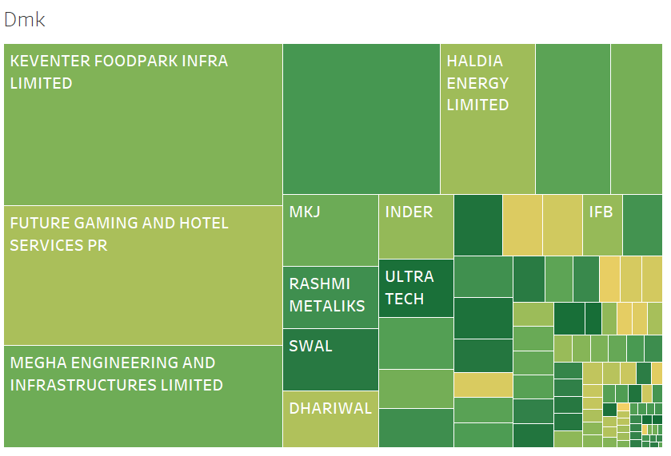
Fig :- Doners of DMK

Slide 21
Insights from doner and political data
Not all data was given over a year worth of data was missing thus leading to not good enough to gain a clear picture of politics in India .
More than half electoral bonds are give to three BJP,TMC and the INC gaining more than 50% of total share
Top doner Were Future gaming ,Megha engineering ,Qwiksupplychain ,Vedanta ,
Insights from matched data
BJP:-Top doners are Megha Engineering 420 cr, Future gaming 408 Cr, Vedanta 221 Cr, qwiksupplychain 121 Cr
TMC:- Megha Engineering 220 cr, Future gaming 202 Cr, Vedanta 85 Cr ,Haldia energy 71 Cr , Madanlal ltd 70 Cr
INC :- Future gaming 272 Cr , qwiksupplychain 100Cr , Madanlal ltd 67 Cr , Megha Engineering 66 Cr ,Western up 58 Cr BRS:- Megha Engineering 84 Cr, Future gaming 200 Cr, Western up 98 cr ,Haldia energy 71 Cr , qwiksupplychain 65 Cr AAP:- Megha Engineering 12 Cr, Future gaming 18 Cr, Yashoda hosp 27 Cr ,Haldia energy 30 Cr , Dhariwal infra 15 Cr

Slide 22
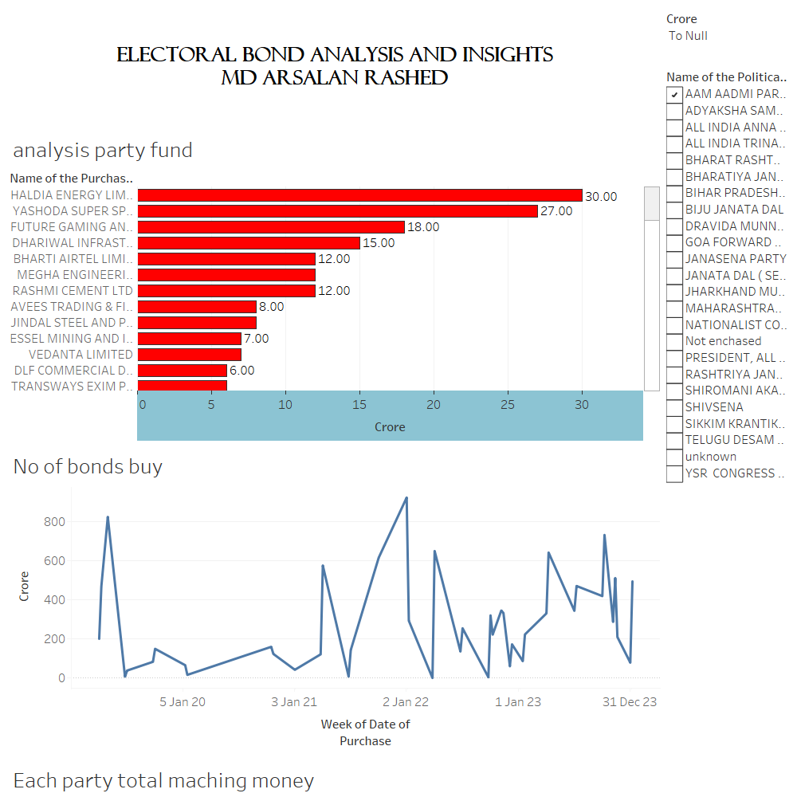
Interactive dashboard
Eb dashboard was made to understand the doner and party relationship which company are giving to party how much and more informative to gain good understanding of relationships of political party in india
With better and more data from we can get a clear picture of ed
Link

