Slide 1
Watermelon Leaf Disease Detection Using Transfer Learning And EX-AI
M.A.B.Siddique Sanjan ID: 19201068 | Ibrahim Sakib ID: 19201083 | Md Fuad Islam 20101060 | Md Minhazul Islam Rimon ID: 20101078
RA: Humaion Kabir Mehedi ST: FARAH BINTA HAQUE

Slide 2
Topics
Introduction
Related Work
Dataset
Methodology
Result
Limitation
Future Work
Conclusion
Reference

Slide 3
Introduction
During summer, one of the most demanded fruits in not only Bangladesh but all across the globe is watermelon. It’s harvest can be improved if farmers were able to detect plant disease sooner and treat them. There is already some work being done in this area to automate the process of detecting disease among plants using machine learning, transfer learning, and deep learning approaches. Some common transfer learning models like Inception had 98.01% accuracy in detecting plant diseases. There are also other models like ResNet50 with 98.93% accuracy in some cases. Our goal is to use different transfer learning techniques and explainable AI models to detect watermelon leaf diseases.

Slide 4
Related Work
Orchi et al.[1] did an extensive comparative study where he found Inception V3 outperforms other models such as VGG19, VGG16, ResNet50, CNN, SVM, LDA, KNN, RF, NB in detecting crop disease.
Uguz et al.[2] compared the accuracy of the VGG transfer learning models with their own proposed model according to the change of optimization algorithms.
AARIZOU et al.[3] in their study demonstrates the application of transfer learning to the identification of plant diseases on intricate photos through the use of CNN. They concluded that DenseNet121 gave the best accuracy for them.
Arshad et al.[5] did a study where researchers me­asured the success of Re­sNet50 against VGG16 and MCNN.According to the researchers, ResNet50 tops the­ list in terms of effective­ness.

Slide 5
Dataset
Name: Watermelon Disease Recognition Dataset
Size: Number of original images in the dataset is 1155, number of augmentation images is 5775.
4 different categories of leaf images exists which are healthy, anthracnose, downy mildew, mosaic virus.
We used 3 out of 4 categories in augmented images for training our models.

Slide 6
Methodology
The experiment was divided into two phases. In our first phase, we tried to find the best model among the chosen transfer learning models which are DenseNet201, Inception V3, ResNet50, EfficientNet and lastly MobileNet. After finding the one we combined it with Grad-CAM to see if there were any improvement.

Slide 7
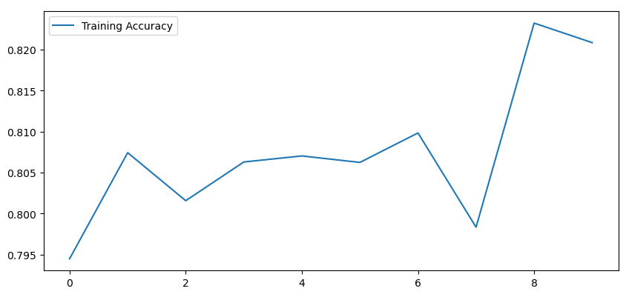
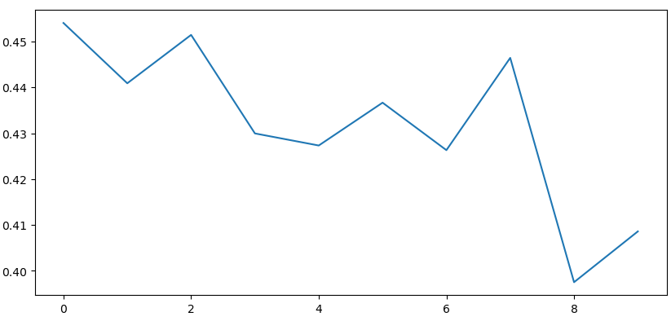
Results
Figure : DenseNet201 accuracy and loss.

Slide 8
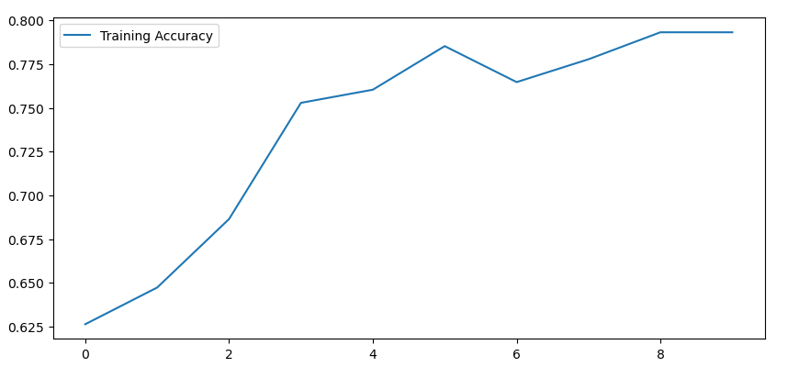
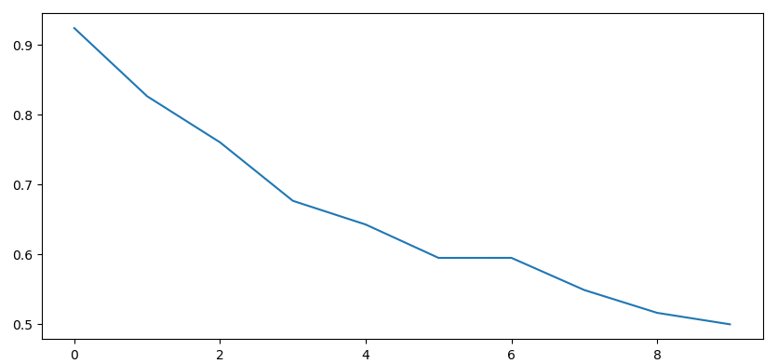
Results
Figure : EfficientNet accuracy and loss.

Slide 9
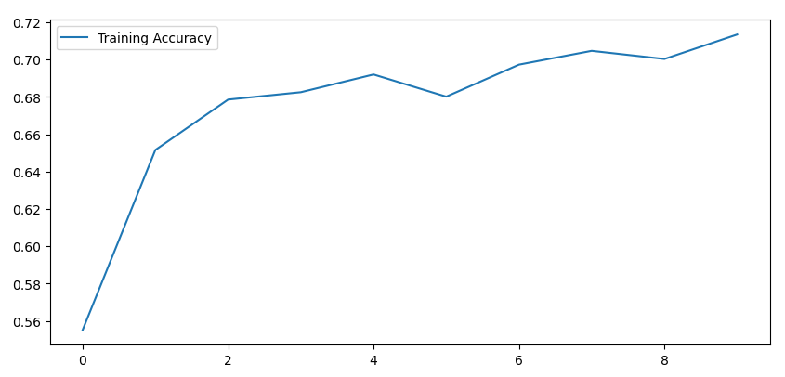
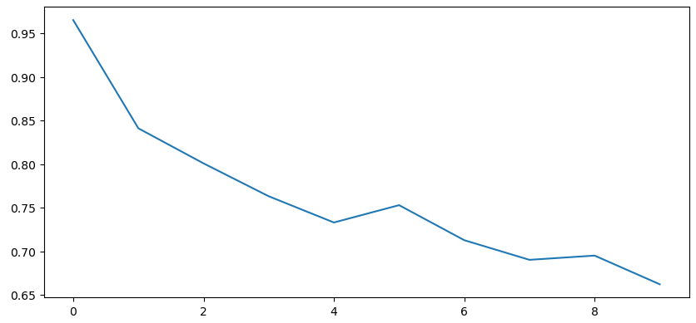
Results
Figure : InceptionV3 accuracy and loss.

Slide 10
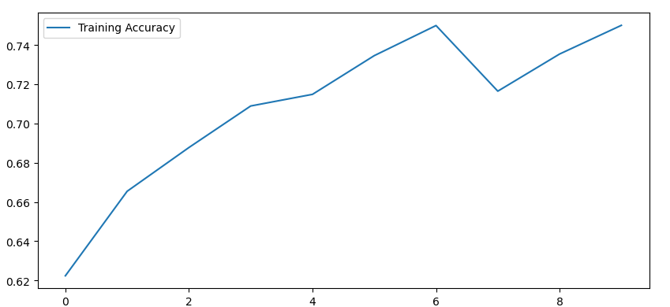
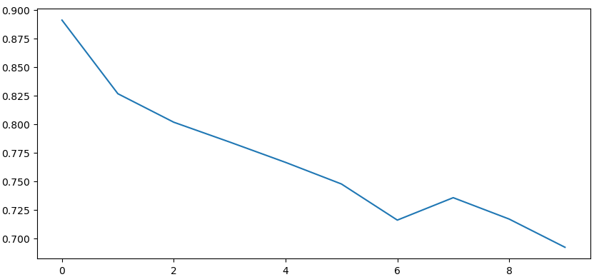
Results
Figure : ResNet50 accuracy and loss.

Slide 11
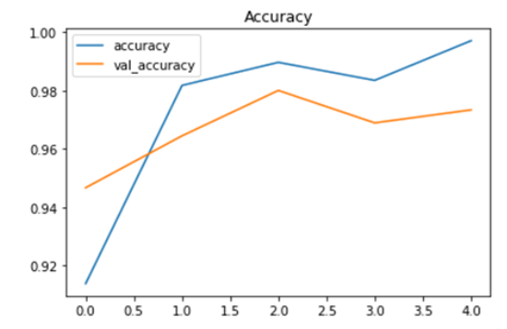
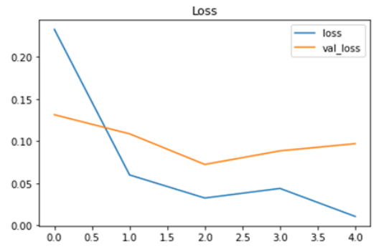
Results
Figure : MobileNetV2 accuracy and loss.

Slide 12
Results
Model Name | Accuracy
DenseNet201 | 95.62%
InceptionV3 | 92.83%
ResNet50 | 78.49%
EfficientNet | 98.80%
MobileNetV2 | 99.46%
MobileNet+Grad-CAM | 99.46%
MobileNet had the best accuracy out of all the Models.
Now, MobileNet with or Without Grad-CAM had same accuracy.
That is because Grad-CAM does not actually help in training the model
but helps the model more in decision making.

Slide 13
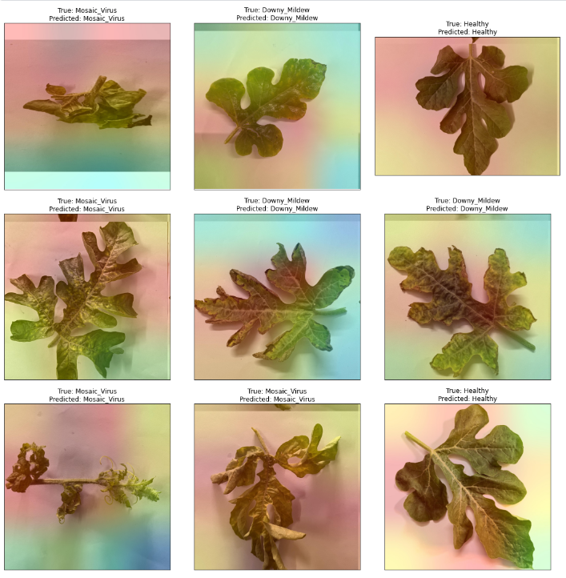
Results
Figure : GradCAM visualization on MobileNetV2 model.

Slide 14
Limitation
Dataset original image count low
Only three categories
Only one optimization algorithm applied

Slide 15
Future Work
Compare different optimization algorithms and see which ones are significantly improves
Add learning from this experiment to other leaf diseases
Add different types of fruit or vegetable leafs and apply the learning of this model there and see the difference it makes

Slide 16
Conclusion
From our findings we can conclude that MobileNet being a light model can be run on various categories of devices and its accuracy is also above par and if run in combination with Grad-CAM the effectiveness increases as well. This technology can be easily modified to not only detect watermelon leaf disease but any and all kinds of plant disease in the future.For future work, this technology can be embedded into mobile applications for ease of access so anybody can capture an image to test and find if their crops are unhealthy and what sort of remedy to use.

Slide 17
Reference
Orchi, H., Sadik, M., Khaldoun, M., & Sabir, E. (2023). Automation of Crop Disease Detection through Conventional Machine Learning and Deep Transfer Learning Approaches. Agriculture, 13(2), 352. https://doi.org/10.3390/agriculture13020352
Uğuz, S., & Uysal, N. (2020). Classification of olive leaf diseases using deep convolutional neural networks. Neural Computing and Applications, 33(9), 4133–4149. https://doi.org/10.1007/s00521-020-05235-5
Aarizou, A., & Merah, M. (2022). Transfer learning for plant disease detection on complex images. 2022 7th International Conference on Image and Signal Processing and Their Applications (ISPA). https://doi.org/10.1109/ispa54004.2022.9786306
Arshad, M. S., Rehman, U. A., & Fraz, M. M. (2021). Plant disease identification using transfer learning. 2021 International Conference on Digital Futures and Transformative Technologies (ICoDT2). https://doi.org/10.1109/icodt252288.2021.9441512

Slide 18
Thank You!!

