Slide 1
WATERMELON LEAF DISEASES DETECTION USING TRANSFER LEARNING AND EX-AI
M.A.B.Siddique Sanjan ID: 19201068 | Ibrahim Sakib ID: 19201083 | Md Fuad Islam 20101060 | Md Minhazul Islam Rimon ID: 20101078
RA: Humaion Kabir Mehedi ST: FARAH BINTA HAQUE

Slide 2
Topics
Introduction
Literature Review 1
Literature Review 2
Literature Review 3
Literature Review 4
Reference

Slide 3
Introduction:
During summer, one of the most demanded fruits in not only Bangladesh but all across the globe is watermelon. It’s harvest can be improved if farmers were able to detect plant disease sooner and treat them. There is already some work being done in this area to automate the process of detecting disease among plants using machine learning, transfer learning, and deep learning approaches. Some common transfer learning models like Inception had 98.01% accuracy in detecting plant diseases. There are also other models like ResNet50 with 98.93% accuracy in some cases. Our goal is to use different transfer learning techniques and explainable AI models to detect watermelon leaf diseases.

Slide 4
Literature Review 1
Paper Title: Automation of Crop Disease Detection through Conventional Machine Learning and Deep Transfer Learning Approaches[1]
Did an extensive comparative study to find the difference between traditional machine learning approach and deep transfer learning approach for detecting crop disease.
For machine learning approach chosen models are: SVM, KNN , Linear Discriminant Analysis, Classification and Regression Trees, NB, and RF.
For transfer learning approach chosen models are: VGG19, VGG16, ResNet50, CNN and Inception.
Models RF, CART, CNN, ResNet50 had accuracy of 97.54%, 94.45%, 93.89% and 93.57%.
The highest classifier accuracy was of the model Inception V3 with accuracy of 98.01%.

Slide 5
What did we learn:
As the researchers approach was to detect crop disease, we can easily modify the model to detect disease from plant leafs and expect similar result.
The Inception V3 models showed promising result, thus it can be considered to be used for our experiments.

Slide 6
Literature Review 2
Paper title: Classification of olive leaf diseases using deep convolutional neural
Networks [2]
Did a comparative study of the existing Deep Learning Technologies and CNN architectures in detection technology
Identified the challenges and problems of the present models and their possible solutions
The solution that they worked on is to optimize the loss function to get better result
Detailed analysis of the VGG16 and VGG19 model and their own suggested model
Implemented Adam, AdaGrad, SDG, RMSProp optimization algorithms
Showed result of the models on olive leaf dataset
Results were complex as different optimization worked differently per model

Slide 7
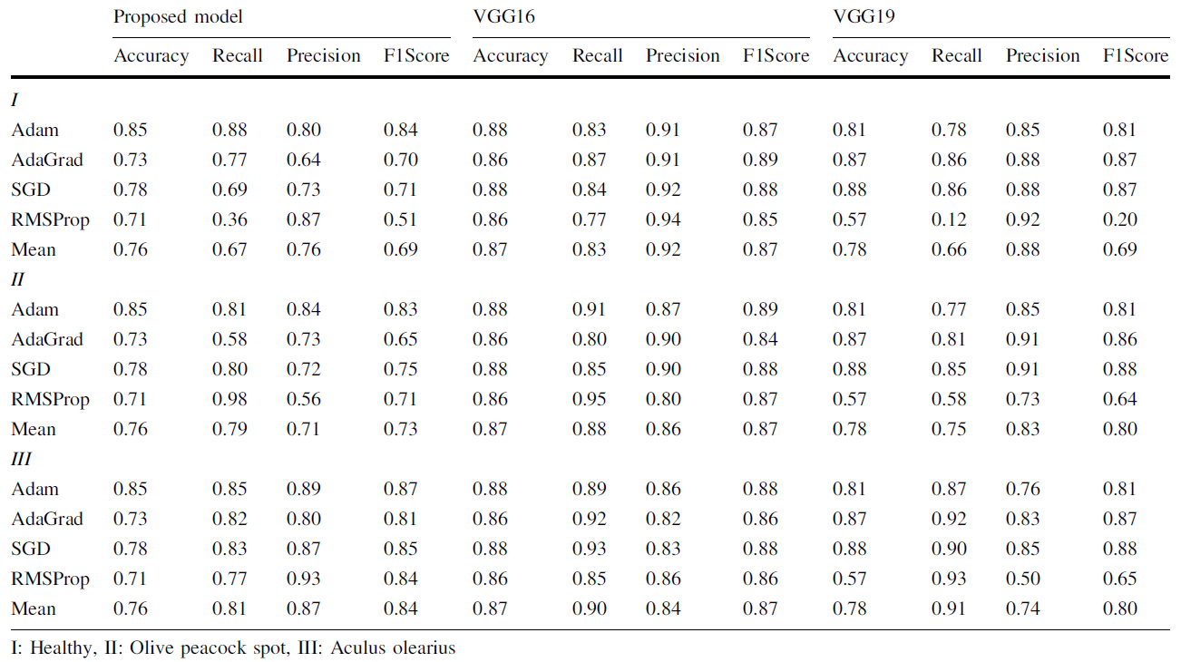
Result
Fig: Performance Evaluation [2]

Slide 8
What did we learn
Convolution layers increase the performance of the model but decreases efficiency
Different optimization algorithm can increase or decrease the performance depending on the synergy with the model

Slide 9
Literature Review 3
Paper title: Transfer learning for plant disease detection on complex images[3]
Their study demonstrates the application of transfer learning to the identification of plant diseases on intricate photos through the use of CNN
Their combined lab images and real images two public dataset into one dataset by labeling into two classes ‘Healthy’ and ‘Unhealthy’
Their three selected models was DenseNet121, ResNet 34 and AlexNet.
They trained three times using lab images, real images and combined images using which they tested into either same image type or combined test set.
They got less than 60% accuracy when using one type train set and testing into other type test set.
However, when trained using combined dataset they got 99.76%, 99.85% and 99.43% for lab images test set, and 97.46%, 97.02% and 98.65% for field images test set.

Slide 10
What did we learn:
When doing disease detection for plants we should use both lab and field images while training.
From all of the models they trained using DenseNet performed best for them.

Slide 11
Literature Review 4
Paper title: Plant Disease Identification Using Transfer Learning[4]
The extensive comparative study aimed to find the difference in performance between different deep learning models.
For transfer learning,The chosen model were VGG16 and ResNet50.
For machine learning, the chosen model is MCNN (Multilayer Convolutional Neural Network).
The models MCNN, VGG16, ResNet50 achieved the accuracies of 93.7%, 98.3% and 98.93%.
The model with the highest classifier accuracy in the study was ResNet50, which achieved an accuracy of 98.93% for plant disease identification

Slide 12
What did we learn:
The study highlighted the importance of early disease identification and treatment for maintaining crop yield and plant health, emphasizing the significance of computer vision techniques in plant disease identification.
Transfer learning, specifically using the pre-trained ResNet50 model with ImageNet weights, proved to be effective for plant disease identification, achieving the highest accuracy of 98.93% among the models evaluated.
Image preprocessing techniques, including resizing, normalization, and data augmentation, were applied to the dataset to enhance model performance.

Slide 13
Proposed methodology:
In our work, we will compare and contrast between different transfer learning models like ResNet50, Inception, MobileNet, DenseNet. Upon training the models with our dataset, the one with best accuracy will be combined with Grad-CAM to further improve results.

Slide 14
Reference:
Orchi, H., Sadik, M., Khaldoun, M., & Sabir, E. (2023). Automation of Crop Disease Detection through Conventional Machine Learning and Deep Transfer Learning Approaches. Agriculture, 13(2), 352. https://doi.org/10.3390/agriculture13020352
Uğuz, S., & Uysal, N. (2020). Classification of olive leaf diseases using deep convolutional neural networks. Neural Computing and Applications, 33(9), 4133–4149. https://doi.org/10.1007/s00521-020-05235-5
Aarizou, A., & Merah, M. (2022). Transfer learning for plant disease detection on complex images. 2022 7th International Conference on Image and Signal Processing and Their Applications (ISPA). https://doi.org/10.1109/ispa54004.2022.9786306
Arshad, M. S., Rehman, U. A., & Fraz, M. M. (2021). Plant disease identification using transfer learning. 2021 International Conference on Digital Futures and Transformative Technologies (ICoDT2). https://doi.org/10.1109/icodt252288.2021.9441512

Slide 15
Thank You!

