Slide 1
WATERMELON LEAF DETECTION USING TRANSFER LEARNING AND EX-AI
M.A.B.Siddique Sanjan ID: 19201068 | Ibrahim Sakib ID: 19201083 | Md Fuad Islam 20101060 | Md Minhazul Islam Rimon ID: 20101078
RA: Humaion Kabir Mehedi ST: FARAH BINTA HAQUE

Slide 2
Topics
Introduction
Motivation
Existing Work
Our Goal
Dataset
Proposed Methodology
Limitation
Reference

Slide 3
Introduction:
Transfer learning has been utilized to train networks for accurate plant disease identification, while EX-AI methods have been employed to improve the detection process. The use of EX-AI and transfer learning for watermelon leaf disease detection can be introduced as a promising approach for early detection and diagnosis of plant diseases, ultimately contributing to better crop management and yield.

Slide 4
Motivation
Our aim is to explore the transfer learning models and implement it in watermelon leaf disease detection and compare it. We also aim to implement ex-ai in this case to accurately deduce what our model is targeting on when running the dataset. By accurate running this, we will be able to detect watermelon disease much earlier and accurately as it is a Deep learning model. Also with transfer learning technology, we can shift it to other similar study as well.
Keyword: Transfer Learning, Ex-AI

Slide 5
Existing works:
In a comparative study between different models like SVM, KNN , LDA, CART, NB, RF, VGG19, VGG16, ResNet50, CNN and Inception, the model Inception yielded an accuracy of 98.01%[1].
In another study to detect plant disease, DenseNet yielded the most accuracy of 98.46 % [2].

Slide 6
Our Goal:
We want to use different transfer learning models and experimental AI models to detect watermelon disease.
We will compare and contrast between this models individually and in combination with one another to find the best solution for the given scenario.

Slide 7
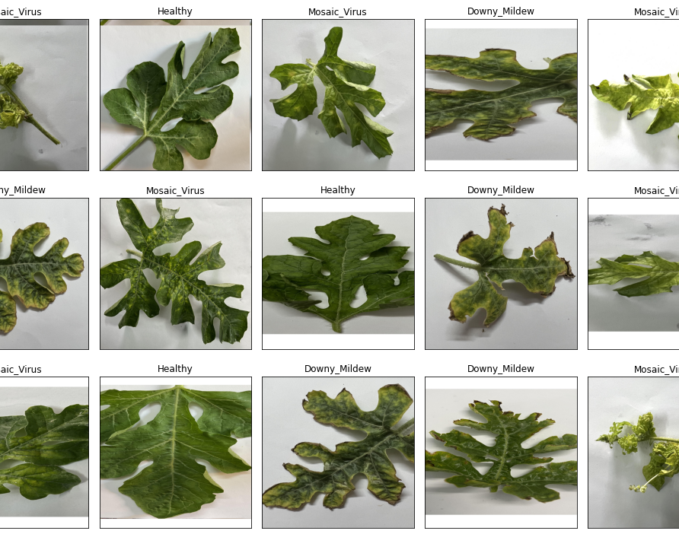
Dataset:
Name: Watermelon Disease Recognition Dataset
It contains 5775 augmented images of four different classes: Mosaic Virus, Healthy, Anthracnose, and Downy Mildew.
URL: https://data.mendeley.com/datasets/ntzym554jp/1
Notes:
Say we are looking to use only three categories and exclude Anthracnose.

Slide 8
Proposed methodology:
Compare and contrast between transfer learning models like MobileNetV2, EfficientNet-V3, ResNet50, Inception_V3, DenseNet201
to find the best one, which will be combined with Grad-CAM
to improve classifier accuracy.

Slide 9
Limitation:
Number of data in the original dataset is only 1155.

Slide 10
Reference:
Orchi, H., Sadik, M., Khaldoun, M., & Sabir, E. (2023). Automation of Crop Disease Detection through Conventional Machine Learning and Deep Transfer Learning Approaches. Agriculture, 13(2), 352. https://doi.org/10.3390/agriculture13020352
Aarizou, A., & Merah, M. (2022). Transfer learning for plant disease detection on complex images. 2022 7th International Conference on Image and Signal Processing and Their Applications (ISPA). https://doi.org/10.1109/ispa54004.2022.9786306

Slide 11
Thank You !!!
Be sure to like and subscribe!!

