Slide 1
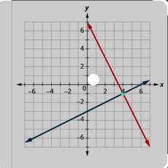
SOFTWARE PROJECT LAB-1
Project Name: Equation Solver
Presented by: Supervised by:
Sakib Al Hasan Dr. Naushin Nower
Roll: BSSE1209 Associate professor

Slide 2
Motivation of the project
Equation is the part of educational life.
Solving the large equation is very tough for humans.
Higher power polynomial equation is very troublesome
Three or upper number variable can’t solve graphically in linear programming

Slide 3
Overview
This project solve three types of equation.
Linear algebra
Linear programming
Polynomial equation

Slide 4

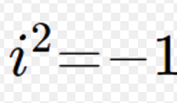
Scope
Find a maximum and minimum value for linear programming and also find critical points.
Solve the polynomial equation and print all real and rational roots.
Users can Input the whole equation or input coefficient of the equation.
Input linear equation and it will find the solution if exists.
Also, detect if infinitely many solutions or no solution exists.

Slide 5
Why efficient (user perspective)
No need to arrange equations in standard form.
No need to count the number of variables.
It can detect is there no solution or infinitely many solutions.
No need to input a fixed variable name.

Slide 6
Linear algebra
Create Matrix
Row reduction
Determinant of Matrix
Unique solution of Linear algebra
Det = 0
Infinite/No solution
Cramer’s rule

Slide 7
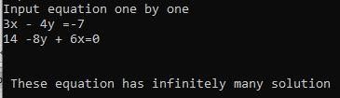
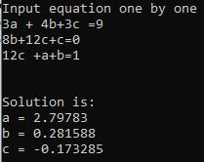
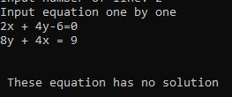
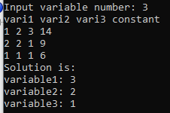
Some output
Linear algebra

Slide 8
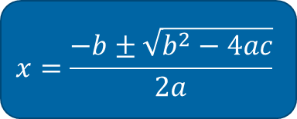
Polynomial Equation Bairstow’s algorithm
a1(x)^n + a2(x)^n-1 +…………..+a(n-1)x + an / (x^2 + mx + n)
Remainder = 0
x^2 + mx + n
Quotient
$$x=\frac{−b±\sqrt{b^{2}−4ac}}{2a}$$
a1(x)^n-2 + a2(x)^n-3 +…………..+a(n-3)x + a(n-2)
Two roots

Slide 9
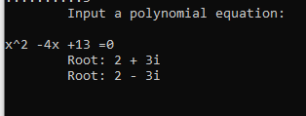
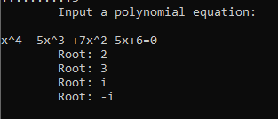
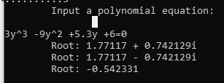

Output
Polynomial Equation

Slide 10
Linear programming
Standard Form
Simplex Method
Max/Min value

Slide 11
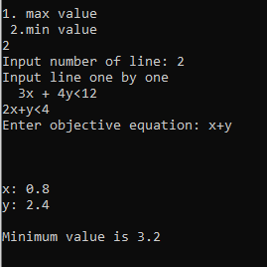
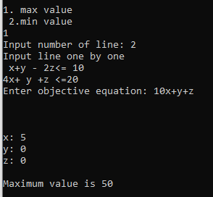
Output
Linear programming
Max value
Min value

Slide 12

What are the challenges?
Separate variable and number
Create matrix from equations
Implementing simplex, bairstow’s algorithm
Handle big data

Slide 13

Tools used
Language: C++
Github link: https://github.com/mdSakibAlHasan/SPL-1

Slide 14
Thank You

