Slide 1
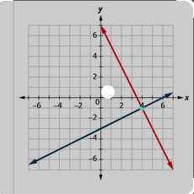
SOFTWARE PROJECT LAB-1
Project Name: Equation Solver
Presented by: Supervised by:
Sakib Al Hasan Dr. Naushin Nower
Roll: 60931 Associate professor

Slide 2
Overview
This project solve three types of equation.
Linear algebra
Linear programming
Polynomial equation

Slide 3

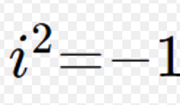
Scope
Find a maximum and minimum value for linear programming and also find critical points.
Solve the polynomial equation and print all real and rational roots.
Users can Input the whole equation or input coefficient of the equation.
Input linear equation and it will find the solution if exists.
Also, detect if infinitely many solutions or no solution exists.

Slide 4
Linear algebra
Input linear equation
Create Matrix
Determinant of matrix
(row reduction method)
Det = 0
Infinite / No solution
yes
No
Unique Solution
(Cramer’s rule)

Slide 5
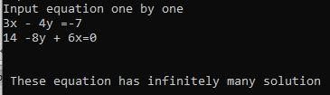
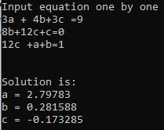
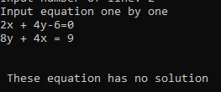
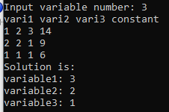
Some output
Linear algebra

Slide 6
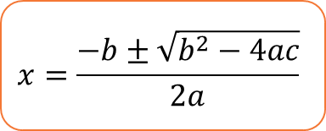
Polynomial Equation Bairstow’s algorithm
Input Equation
A₁X^{n}+A₂X^{n-1}+……..+A_{n-1}X + A_{n}
Divide polynomial equation by a quadratic equation
(A₁X^{n}+A₂X^{n-1}+……..+A_{n-1}X + A_{n} ) / (aX²+bX+c)
Remainder=0
aX²+bX+c
No
yes
yes
$$x=\frac{−b±\sqrt{b^{2}−4ac}}{2a}$$
A₁X^{n-2}+A₂X^{n-3}+……..+A_{n-3}X + A_{n-2}
Two roots

Slide 7
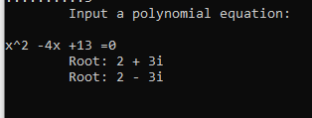
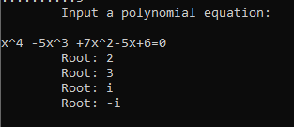
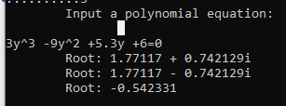

Output
Polynomial Equation

Slide 8
Linear programming
Standard Form
Simplex Method
Max/Min value

Slide 9
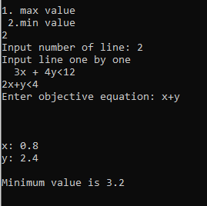
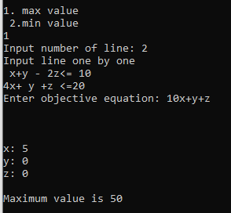
Output
Linear programming
Max value
Min value

Slide 10

What are the challenges?
Separate variable and number
Create matrix from equations
Implementing simplex, bairstow’s algorithm

Slide 11

Tools used
Line of code:
Language: C++
1450+
Github link: https://github.com/mdSakibAlHasan/SPL-1

Slide 12
Thank You

