Slide 1
LawLite – Smart Legal Consultation & Case Management Platform
Md. Farhan Mahmud
ID :221-15-5439
Department : CSE
Daffodil International University
Soroar Jahan
ID :221-15-5665
Department : CSE
Daffodil International University

Slide 2
Outline
Introduction
Objective
Background Study
Gap Analysis
Methodology
Results & Analysis
Novelty of the Work
Conclusion
References

Slide 3
Introduction
LawLite is a web-based platform designed to bridge the gap between legal professionals and clients.
It serves as a comprehensive marketplace where users can search for lawyers, book appointments,
and communicate instantly.
The system streamlines the legal process by integrating:
Real-time Audio/Video calling.
Secure document/attachment sharing.
AI-driven features to assist both lawyers and clients.

Slide 4
Objective
To Develop a user-friendly web interface for booking and managing legal appointments.
To Implement secure real-time communication channels (Audio/Video calls) directly within the browser.
To Facilitate digital case management, allowing users to send case files and lawyers to review them centrally.
To Integrate AI capabilities that:
Assist users in categorizing their legal issues.
Help lawyers summarize case details and attachments efficiently.

Slide 5
Background Study
Traditional Legal Systems:
Rely on physical visits, phone directories, and manual paperwork, causing delays and miscommunication.
Existing Platforms:
Most legal websites work only as directories without integrated booking, calling, or case-management features.
AI Adoption in Bangladesh:
Use of AI in legal services is still minimal, with almost no automated analysis or smart legal assistance tools.
The Need:
A unified platform that combines lawyer booking, online consultation, case management, and AI assistance in one workflow.

Slide 6
Gap Analysis
Feature | Traditional Methods | Common Legal Directories | LawLite (Proposed)
Booking System | Manual / Phone | Basic Listing | Instant Online Booking
Communication | External (Phone/Zoom) | External | In-App Audio/Video Call
File Sharing | Physical / Email | Email | Secure Case Attachment
AI Assistance | None | None | AI for Users & Lawyers

Slide 7
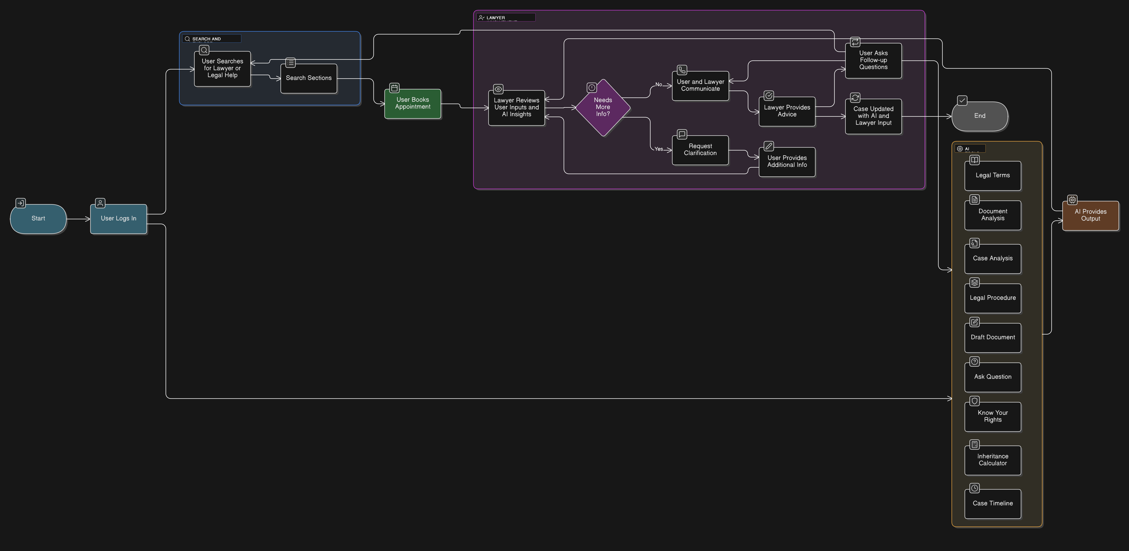
Methodology
Fig: Flow Chart

Slide 8
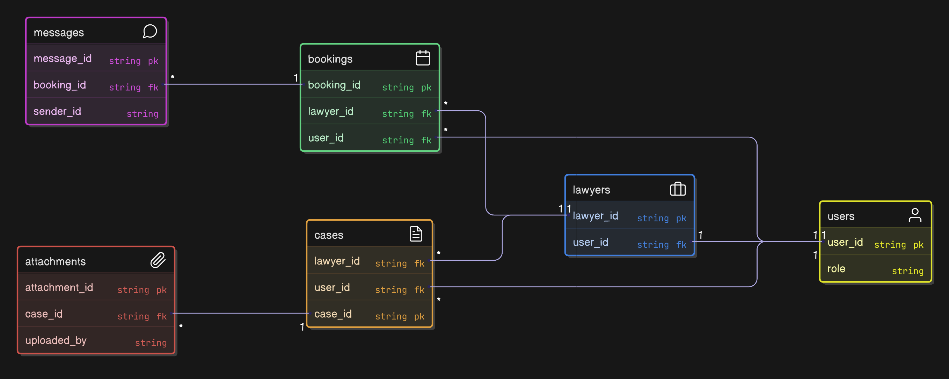
Methodology
Fig: ER Diagram

Slide 9
Result and Analysis
Lawyer booking works smoothly
Real-time call & chat improves communication
Case updates handled efficiently by lawyers
Users benefit from AI tools for self-learning
Clear separation of consultation vs. AI modules prevents confusion

Slide 10
Novelty of the Work
Online lawyer consultation platform
Separate and structured AI assistance tools
Clear user–lawyer communication workflow
Bilingual accessibility
Secure document sharing and tracking

Slide 11
Conclusion
LawLite provides a modern digital solution for online legal consultation.The platform connects users with lawyers, supports direct communication, and allows lawyers to update cases.AI tools work as optional helpers for users but do not interfere with actual case records.This system enhances accessibility, efficiency, and user empowerment in legal services.

Slide 12
References
Bangladesh Law Portal
LegalTech Research Papers
System Requirement Specifications
Online Consultation Platforms Literature

Slide 13
THANK YOU

