Slide 1
Case-studies
B.F.J. Manly, Multivariate Statistical Methods: A Primer, Chapman & Hall, 1986.
Orientation: introduce various analysis methods.
In Les Cahiers de l’Analyse des Données XVIII, no. 4, 1993, a number of articles proposed instead to use the common geometrical framework of correspondence analysis to analyze all data sets.

Slide 2
Case-studies
Example 1: Thai goblets
Example 2: Employment by sector
Example 3: Protein consumption
Example 4: Protein consumption and employment by sector
Example 5: Voting by US congressmen

Slide 3
Correspondence analysis component parts
Corr. Analysis proper – projections, correlations, contributions on factorial axes; plus quality of representation, weights, inertia.
Foregoing for I, J, supplementary I’, suppl. J’.
Hierarchical clustering.
Possibly deriving of partition.
FACOR: clusters of observations on factors.
VACOR: clusters of observations and clusters of variables.

Slide 4
To install and run… (1/2)
From http://astro.u-strasbg.fr/~fmurtagh/mda-sw
Download: (i) All classes. (A Java *.class file is in compiled bytecode.) (ii) Some data sets.
You will need JRE (Java Runtime Environment) 1.4 on your system. Get this from Sun Microsystems and install it.
Let’s say that you have put the class files in directory lisbon\classes, and the data files in directory lisbon\data.
In the command prompt window, go to lisbon\classes, and type: java DataAnalysis
You are then prompted for the input data set.

Slide 5
To install and run… (2/2)
A set of text windows is created with (i) the results of the corr. Analysis proper, (ii) plot of axes (1,2), (iii) plot of axes (1,3), (iv) plot of axes (2,3), (v) hierarchical clustering, (vi) FACOR, (vii) VACOR, and (viii) a control window.
All windows can be resized, and the contents saved to file.
Projections, correlations and contributions are, in addition, saved to text files.
Any window may be closed at any time. Closing the control window causes termination of the program and the closing of any remaining open windows.

Slide 6
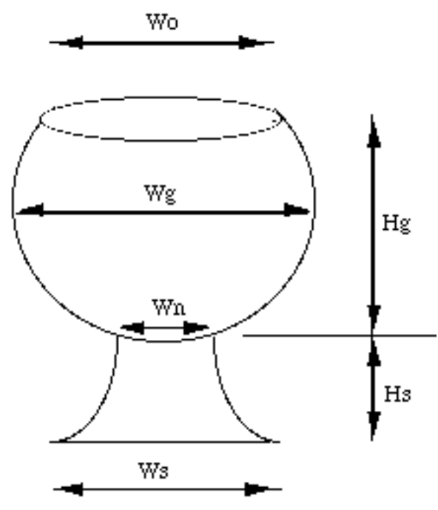
The shape of prehistoric goblets, studied by C.F.W. Higham (University of Otago),
is described by six measurements, {Wo Wg Ht Ws Wn Hs}, with
Wo = width, or diameter, of the opening at the top;
Wg = maximum width of the globe;
Ht = total height of the goblet;
Ws = width, or diameter, of the stem;
Wn = Width of the stem at its top extremity,
or neck, by which it is attached to the cup;
Hs = Height of the stem; and
Hg = Height, from the top of the stem to the
horizontal plane of the top opening;
this height is the difference, (Ht-Hs), between
the total height and the height of the stem.
Used: set I of 25 goblets.
6 measurements, {Wo, Wg, Ht, Ws, Wn, Hs}
Ht is supplementary.

Slide 7
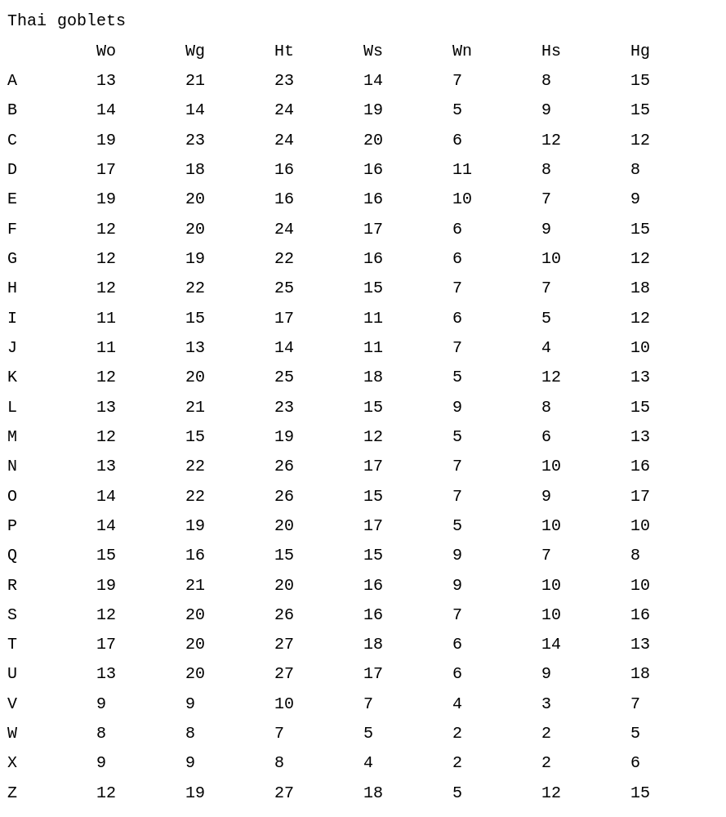

Slide 8
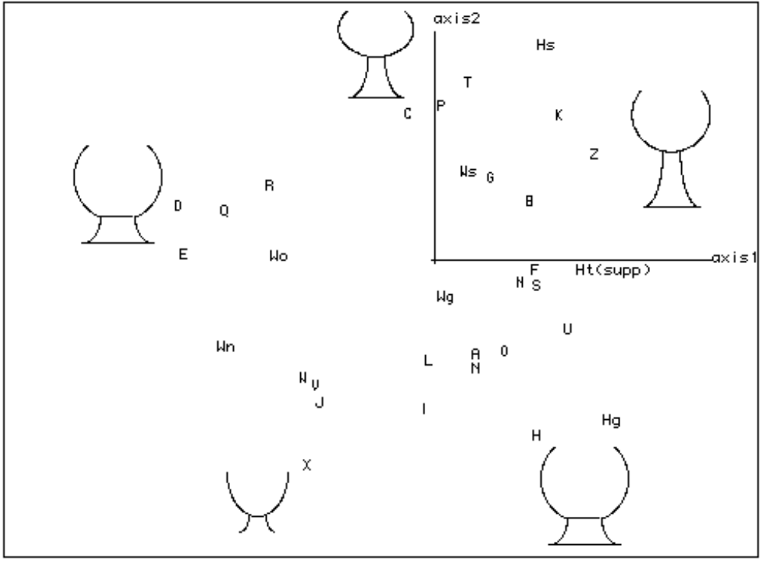
Thai goblets:
trace : 2.8e-2
rank : 1 2 3 4 5
lambda : 133 84 37 19 6 e-4
rate : 4784 3024 1318 673 201 e-4
cumul : 4784 7808 9126 9799 10000 e-4

Slide 9
___________________________________________________________________________
|SYMJ| QLT MAS INR| F 1 CO2 CTR| F 2 CO2 CTR| F 3 CO2 CTR| F 4 CO2 CTR|
___________________________________________________________________________
| Wo| 996 183 208| -150 717 313| 4 0 0| -91 262 414| 23 17 52|
| Wg| 930 246 49| 6 6 1| -29 155 25| -10 19 7| -65 750 550|
| Ws| 914 201 77| 27 70 11| 74 520 133| 30 87 51| 50 236 272|
| Wn| 993 88 214| -201 598 268| -71 75 53| 147 320 519| 0 0 0|
| Hs| 966 112 183| 101 224 86| 181 719 435| 14 4 6| -29 19 51|
| Hg| 994 170 268| 159 575 322| -132 398 353| -8 1 3| 29 19 75|
supplementary element
| Ht| 967 282 194| 136 962 391| -8 3 2| 1 0 0| 6 2 5|
___________________________________________________________________________
F # = projections on factors
CO2 = correlations with factors
CTR = contributions to factors
QLT, MAS, INR = quality of respresentation, mass, inertia

Slide 10
Thai goblets: Interpretation - I
  Axis 1 accounts for ≈ half the total inertia.
  Tot. ht., Ht, highly correlated with axis 1.
  Ht = barycentre of {Hs,Hg}. So barycentre of other main vbes. {Wo,Wg,Ws,Wn} is also approx. on axis 1 but on side F1<0. (Lever principle.)
  Main contrast is between {Hs,Hg} and {Wo,Wn}. Resp.: slender shapes with a closed-up globe (Wo small) on a tapering stem (Wn small), on side F1>0; versus on F1<0 widening cups, on an ≈ cylandrical shape.

Slide 11
Thai goblets: Interpretation - II
  Axis 2: contrast between Hs and Hg. For F2>0, ht. of stem ≈ that of globe. For F2<0, ht. of stem ≈ 1/3 of cup depth.
  Goblet “X” is enigmatic. But on axis 3, explained by contrast between Wn and Wo, “X” is associated with former. Clustering will help further in this interpretation…

Slide 12
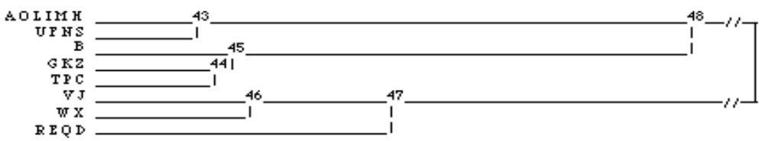
Clustering and FACOR
FACOR results show that i48 is correlated strongly with
F1>0 (slender shapes), and i47 with F1<0.
Internally, i48 is divided on F2<0 with i43 (low ht. of the
stem); and F2>0 with i45 (ht. of stem ≈ depth of cup: cf.
“Z” and “C”).

Slide 13
____________________________________________________________________________________________________
|CLAS AINE BNJM| QLT PDS INR| F 1 CO2 CTR| F 2 CO2 CTR| F 3 CO2 CTR| F 4 CO2 CTR| F 5 CO2 CTR|
___________________________________________________________________________________________________
repr sur les axes factoriels des 7 noeuds choisis
| 49 48 47| 01000 0| 0 0 0| 0 0 0| 0 0 0| 0 0 0| 0 0 0|
| 48 43 45|1000 740 102| 61 990 211| 5 7 2| 2 1 1| -3 2 3| -1 0 1|
| 47 46 42|1000 260 290| -175 990 601| -15 7 7| -5 1 2| 7 2 7| 2 0 3|
| 46 34 32|1000 87 113| -114 360 85| -123 420 157| -86 203 174| 24 16 27| 3 0 1|
| 45 2 44|1000 313 170| 58 223 79| 106 744 419| -20 27 35| 9 6 15| -3 0 4|
| 44 37 41|1000 271 162| 53 171 58| 115 792 425| -20 24 30| -15 13 31| -3 0 4|
| 43 40 36|1000 427 142| 64 444 132| -68 508 239| 18 35 38| -11 14 29| 0 0 0|
repr sur les axes fact des 8 classes de la partition choisie
| 40 39 8|1000 247 105| 39 128 28| -99 829 289| 14 16 13| -18 26 41| 3 1 5|
| 36 21 30|1000 181 71| 98 882 131| -27 66 15| 24 51 27| -3 1 1| -3 1 3|
| 2 |1000 42 57| 89 209 25| 50 65 12| -22 13 6| 164 712 602| -1 0 0|
| 37 7 31|1000 130 97| 107 553 112| 94 425 136| 14 10 7| -16 12 17| -3 0 2|
| 41 20 28|1000 141 106| 4 1 0| 134 861 302| -52 129 104| -13 9 14| -3 0 2|
| 34 22 10|1000 52 53| -109 424 47| -114 463 82| 14 7 3| 54 104 82| 8 2 5|
| 32 23 24|1000 34 112| -122 163 38| -137 207 77| -238 625 531| -22 5 8| -5 0 1|
| 42 18 35|1000 173 281| -206 938 552| 39 34 32| 35 28 59| -1 0 0| 2 0 1|
___________________________________________________________________________________________________
__________________________________________________________________________________________________
|CDIP AINE BNJM| QLD PDS IND| D 1 COD CTD| D 2 COD CTD| D 3 COD CTD| D 4 COD CTD| D 5 COD CTD|
___________________________________________________________________________________________________
repr sur les axes factoriels des 7 dipoles choisis
| 49 48 47|10001000 392| 237 990 812| 20 7 9| 7 1 2| -10 2 10| -3 0 3|
| 48 43 45|1000 740 211| 6 1 0| -174 940 655| 38 45 72| -21 13 41| 3 0 3|
| 47 46 42|1000 260 104| 91 167 36| -163 528 182| -121 292 231| 26 13 20| 1 0 0|
| 46 34 32|1000 87 52| 12 2 0| 23 7 1| 252 907 359| 76 82 63| 13 2 6|
| 45 2 44|1000 313 49| 35 34 3| -65 114 18| -2 0 0| 178 852 617| 2 0 0|
| 44 37 41|1000 271 41| 103 636 54| -41 99 13| 66 265 82| -2 0 0| 0 0 0|
| 43 40 36|1000 427 34| -59 384 27| -72 576 65| -10 10 3| -15 24 12| 7 5 8|
___________________________________________________________________________________________________

Slide 14
Clustering and FACOR (cont’d)
Division of i47 into i46 and {R,E,Q,D} takes place in the plane (2,3), mainly in the direction of axis 2.
{R,E,Q,D} (cf. D which has been displayed) is a class concentrated around its centre, close to axis 1.
i46 splits into {V,J} and {W,X}; this division is well correlated with axis 3.
For the very similar {W,X} F3<0, Wn is small vis-à-vis Wo, and the stem is negligible.
For {V,J}, the stem is like a flattened cone pastille of non-negligible width compared to width of opening, Wo.

Slide 15
Conclusion on Thai goblets
B.F.J. Manly problem: What are similarities and differences? Obvious groupings? Graphical display of relationships? Anomalous cases?
Influence of shape vs. size? (Aka scale invariance).
Could apply standardization: e.g. remove size differences by dividing all variables by total height, or by sum of variables for that goblet.
Latter is implicit in profile analysis – correspondence analysis.
Conclude: weighting and standardization is crucial in correspondence analysis, but it may well be catered for implicitly.

Slide 16
Employment by sector in European countries
Data from Manly (1985), taken from: Euromonitor Pubs., London: European Marketing Data and Statistics, 1979.
Cross-tabulation of a set I of 26 European countries (incl. Turkey and USSR), and a set J of 9 sectors.
Data are per mil (e.g. 276 = 27.6%).
Sectors: AGR = agriculture, MIN = mining, MAN = manufacturing, PS = power supplies, CON = construction, SER = service industries, FIN = finance, SPS = social and personal services, TC = transport and communications.

Slide 17
_____________________________________________________________________________________________
Country AGR MIN MAN PS CON SER FIN SPS TC
_____________________________________________________________________________________________
Belgium 33 9 276 9 82 191 62 266 72
Denmark 92 1 218 6 83 146 65 322 71
France 108 8 275 9 89 168 60 226 57
W.Germ. 67 13 358 9 73 144 50 223 61
Ireland 232 10 207 13 75 168 28 208 61
Italy 159 6 276 5 100 181 16 201 57
Lux. 77 31 308 8 92 185 46 192 62
Neth. 63 1 225 10 99 180 68 285 68
UK 27 14 302 14 69 169 57 283 64
Austria 127 11 302 14 90 168 49 168 70
Finland 130 4 259 13 74 147 55 243 76
Greece 414 6 176 6 81 115 24 110 67
Norway 90 5 224 8 86 169 47 276 94
Portugal 278 3 245 6 84 133 27 167 57
Spain 229 8 285 7 115 97 85 118 55
Sweden 61 4 259 8 72 144 60 324 68
Switz. 77 2 378 8 95 175 53 154 57
Turkey 668 7 79 1 28 52 11 119 32
Bulgaria 236 19 323 6 79 80 7 182 67
CZ 165 29 355 12 87 92 9 179 70
E.Germ. 42 29 412 13 76 112 12 221 84
Hungary 217 31 296 19 82 94 9 172 80
Poland 311 25 257 9 84 75 9 161 69
Romania 347 21 301 6 87 59 13 117 50
USSR 237 14 258 6 92 61 5 236 93
Yugo. 487 15 168 11 49 64 113 53 40

Slide 18
Employment – Some problems
Cf. TC = transport and communications. Norway: 9.4%, USSR: 9.3%. Worrying!
{SER,FIN,SPS} appear to constitute a tertiary sector.
FIN (finance) for Spain was originally 14.7%, but was reduced to “more reasonable figure” of 8.5% (cf. CAD XVIII 1993) to account for Spanish banking crisis of 1977.
Initial analysis: 26x9 table with all elements of I and J as principal elements.

Slide 19
BFJManly:Employment pattern in European countries:
Raw table of percentages: 26x9.
(Values of lambda, proportion, and cumulative
are in thousandths, e-4.)
trace: 2.1e-1
order: 1 2 3 4 5 6 7 8
Lamb : 1537 272 156 67 36 24 12 5
Prop : 7295 1288 742 317 169 112 55 22
Cum. : 7295 8583 9325 9642 9811 9923 9978 10000

Slide 20
Employment: Findings
Axis 1 is created mainly by agriculture, CTR(AGR) = 790. Associated mainly with Turkey, CTR(TURK) = 356. Overly large preponderance ⇒ we will take Turkey as a supplementary element.
All other sectors are opposed to AGR on axis 1. Closest is MIN. This is alright, but a clearer distinction between primary (agricultural), secondary (industrial) and tertiary (services) would be helpful. To look for this, {SER,FIN,SPS} will be combined into TER.
TER will be principal, and {SER,FIN,SPS} supplementary.

Slide 21
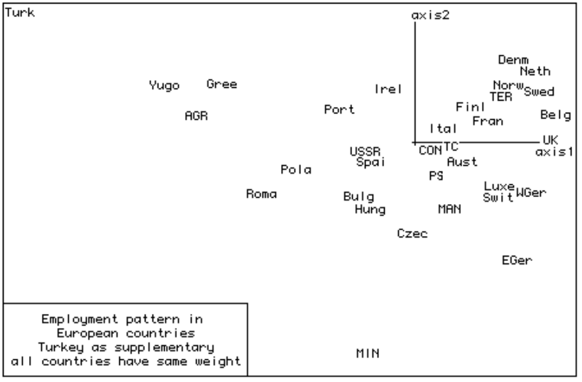

Slide 22
Employment pattern in European countries
TERtiary cumulated; TURK as supplementary;
trace: 1.393e-1
order: 1 2 3 4 5 6
lambda: 1096 215 41 22 13 7 e-4
propn: 7863 1540 295 157 94 51 e-4
cumulated: 7863 9404 9699 9855 9949 10000 e-4
|SIGJ| QLT PDS INR| F 1 CO2 CTR| F 2 CO2 CTR| F 3 CO2 CTR|
_____________________________________________________________
| AGR|1000 172 613| -700 989 771| 73 11 43| 0 0 0|
| MIN| 959 13 52| -168 49 3| -588 606 205| -416 304 538|
| MAN| 982 278 88| 86 169 19| -184 766 438| 45 46 137|
| PS| 426 9 9| 56 24 0| -92 65 4| -209 336 100|
| CON| 327 84 13| 27 34 1| -21 20 2| 77 273 120|
| TC| 277 67 16| 65 130 3| -19 11 1| -67 136 72|
| TER| 995 377 209| 243 764 203| 132 227 308| -19 5 33|
ci dessous element(s) supplementaire(s)
| SER| 703 133 100| 244 568 72| 116 127 83| 29 8 28|
| FIN| 320 41 131| 118 32 5| 354 281 240| 57 7 32|
| SPS| 808 203 154| 267 676 133| 98 92 92| -66 41 215|
_____________________________________________________________

Slide 23
_____________________________________________________________
|SIGI| QLT PDS INR| F 1 CO2 CTR| F 2 CO2 CTR| F 3 CO2 CTR|
_____________________________________________________________
|Belg| 998 40 48| 401 960 59| 76 34 11| -25 4 6|
|Denm| 993 40 36| 273 595 27| 224 398 94| -6 0 0|
|Fran| 956 40 12| 192 858 14| 61 85 7| 24 13 6|
|WGer| 940 40 27| 271 782 27| -116 143 25| 38 15 14|
|Irel| 962 40 13| -125 356 6| 153 534 44| -56 71 30|
|Ital| 835 40 4| 45 162 1| 43 150 3| 80 523 63|
|Luxe| 859 40 26| 233 612 20| -117 154 25| -91 94 81|
|Neth| 979 40 45| 339 732 42| 197 247 72| 8 0 1|
| UK| 972 40 50| 409 951 61| 11 1 0| -60 20 35|
|Aust| 829 40 5| 111 707 4| -43 108 3| 15 14 2|
|Finl| 867 40 10| 140 586 7| 97 279 17| -9 3 1|
|Gree| 995 40 122| -630 933 145| 162 61 49| 18 1 3|
|Norw| 906 40 29| 254 638 23| 159 249 47| -43 18 18|
|Port| 996 40 25| -267 831 26| 91 96 15| 77 69 57|
|Spai| 875 40 15| -173 587 11| -33 22 2| 116 266 132|
|Swed| 984 40 41| 345 841 43| 142 143 38| -12 1 1|
|Swit| 979 40 29| 236 548 20| -125 155 29| 167 276 272|
|Bulg| 970 40 19| -207 641 16| -145 317 39| 29 12 8|
|Czec| 997 40 20| -43 27 1| -257 957 123| -30 13 9|
|EGer| 987 40 55| 282 412 29| -331 567 204| -40 8 16|
|Hung| 937 40 23| -170 366 11| -174 382 56| -122 189 146|
|Pola| 991 40 49| -402 942 59| -74 32 10| -56 18 30|
|Roma| 994 40 82| -509 914 95| -142 71 37| 51 9 25|
|USSR| 706 40 15| -192 699 14| -18 6 1| -6 1 0|
|Yugo| 981 40 202| -812 939 241| 160 36 47| -67 6 43|
ci dessous element(s) supplementaire(s)
|Turk| 982 40 500|-1258 906 576| 361 75 243| -48 1 22|
_____________________________________________________________

Slide 24
Interpretation of output listings
After cumulating the tertiary sector into TER, the succession primary/secondary/tertiary is found on axis 1: {AGR, MIN, (CON, PS, TC, MAN), TER}.
On axis 2, TER contrasts with {MAN, MIN}. But MIN is separated from MAN on axis 3.
Highest percentages of TER are in quadrant F1>0, F2>0.
MAN and MIN are located on F2<0. But although {Swit, Lxbg, WGer} are in this half-plane, MIN is very high for Lxbg and Wger; but low for Swit. However MAN is high or very high for all three.
“High” and “low” here related to number of jobs. Productivity may be different.

Slide 25
A weighted analysis
We have treated USSR in the same way as Luxembourg. Is this right?
Let us try the following weighting: UK-5, EGer-3, WGer-3, Fr-5, Ital-5, Roma-2, Pol-3, Sp-3.
Here we use the population, expressed in units of 10 million.
Luxembourg-1, USSR-10.

Slide 26
Distribution by professions in Europe:
TERtiary cumulated; TURK as supplementary; countries WEIGHTED.
trace: 1.206e-1
order: 1 2 3 4 5 6
lambda: 983 136 38 34 10 4 e-4
propn: 8156 1125 313 285 84 37 e-4
cumulated: 8156 9281 9594 9879 9963 10000 e-4
From clustering, the topmost branches are i47 and i48.
In i47, the tertiary jobs are numerous, and agricultural jobs rare.
In i48, it is the contrary.
Class i47 comprises only western Europe, with EGer.
Class i48 comprises Ireland, Iberia, Balkans and eastern Europe.
VACOR helps to explain the differences between i47 and i48.
It is confirmed that AGR and TER are separated from other jobs.
Special character of MIN ⇒ redo analysis with this as supplementary.
Differences are minor: e.g. ROM, PL agglomerate with GR, YU; but
before they aggregated only as BG, CZ, H, CCCP, IRL, P, E in cluster
i48.

Slide 27
Protein consumption in Europe
Data from Manly (1985), and K.R. Gabriel (1981), Biplot display of multivariate matrices for inspection of data and diagnosis, in Interpreting Multivariate Data, Ed. V. Barnett, Wiley, and oringally from: A. Weber, Agrarpolitik im Spannungsfeld der internationalen Ernärhungspolitik, Institut für Agrarpolitik und Martklehre, Kiel, 1973.
25 x 9 table, 25 countries, 9 food categories, daily average per capita protein consumption expressed in grams.
Variables:
Bov = red meat; Prk = white meat; Ova = eggs; Lac = milk; Fsh = fish; Wht = cereals; Str = starchy foods; Nux = Nuts, oilseeds; Vgt = fruit, vegetables
The data was analyzed as such – hence differences in profiles were taken into consideration, and not differences in levels of total protein consumption.

Slide 28
Bov Prk Ova Lac Fsh Wht Str Nux Vgt
Albania 101 14 5 89 2 423 6 55 17
Austria 89 140 43 199 21 280 36 13 43
Belgium 135 93 41 175 45 266 57 21 40
Bulgaria 78 60 16 83 12 567 11 37 42
Czech. 97 114 28 125 20 343 50 11 40
Denmark 106 108 37 250 99 219 48 7 24
EGermany 84 116 37 111 54 246 65 8 36
Finland 95 49 27 337 58 263 51 10 14
France 180 99 33 195 57 281 48 24 65
Greece 102 30 28 176 59 417 22 78 65
Hungary 53 124 29 97 3 401 40 54 42
Ireland 139 100 47 258 22 240 62 16 29
Italy 90 51 29 137 34 368 21 43 67
Nether. 95 136 36 234 25 224 42 18 37
Norway 94 47 27 233 97 230 46 16 27
Poland 69 102 27 193 30 361 59 20 66
Portugal 62 37 11 49 142 270 59 47 79
Romania 62 63 15 111 10 496 31 53 28
Spain 71 34 31 86 70 292 57 59 72
Sweden 99 78 35 247 75 195 37 14 20
Switz. 131 101 31 238 23 256 28 24 49
UK 174 57 47 206 43 243 47 34 33
USSR 93 46 21 166 30 436 64 34 29
WGermany 114 125 41 188 34 186 52 15 38
Yugosl. 44 50 12 95 6 559 30 57 32
________________________________________________________________________________

Slide 29
Protein consumption in Europe; dgr/day
trace : 1.7e-1
rang : 1 2 3 4 5 6 7 8
lambda : 865 390 200 107 54 38 27 9 e-4
taux : 5118 2309 1182 632 321 225 160 53 e-4
cumul : 5118 7428 8609 9242 9563 9788 9947 10000 e-4
___________________________________________________________________________
|SIGJ| QLT PDS INR| F 1 CO2 CTR| F 2 CO2 CTR| F 3 CO2 CTR| F 4 CO2 CTR|
___________________________________________________________________________
| Bov| 863 115 65| -176 322 41| 37 14 4| -64 42 23| 216 485 502|
| Prk| 964 92 116| -223 234 53| 231 249 126| 316 468 461| -52 13 24|
| Ova| 793 34 28| -284 590 32| 82 50 6| 104 79 19| 101 74 32|
| Lac| 970 199 173| -315 679 229| 105 75 56| -171 199 291| -51 17 48|
| Fsh| 984 50 198| -355 188 73| -720 774 663| -3 0 0| -124 23 72|
| Wht| 991 376 235| 318 956 438| 32 10 10| -20 4 8| -48 22 81|
| Str| 575 50 44| -203 276 24| -115 88 17| 165 183 68| -65 28 20|
| Nux| 837 36 87| 507 625 106| -218 115 44| -72 13 9| 186 84 116|
| Vgt| 745 48 54| 77 32 3| -246 322 75| 224 266 121| 154 125 107|
___________________________________________________________________________

Slide 30
___________________________________________________________________________
|SIGI| QLT PDS INR| F 1 CO2 CTR| F 2 CO2 CTR| F 3 CO2 CTR| F 4 CO2 CTR|
___________________________________________________________________________
|Alba| 960 33 74| 531 744 108| 86 19 6| -243 156 98| 124 40 47|
|Ostr| 907 40 24| -149 222 10| 213 454 47| 148 218 44| -35 12 5|
|Belg| 822 41 10| -159 581 12| 20 9 0| 53 65 6| 85 167 28|
|Bulg| 919 42 76| 517 881 130| 93 29 9| -11 0 0| -52 9 11|
|Czec| 821 39 16| 43 27 1| 147 316 21| 178 467 62| -28 12 3|
|Denm| 935 42 48| -387 777 72| -107 60 12| -27 4 1| -135 94 71|
|EGer| 857 35 25| -151 189 9| -30 7 1| 274 621 133| -70 40 16|
|Finl| 970 42 58| -312 421 47| 43 8 2| -313 423 206| -165 117 107|
|Fran| 823 46 20| -167 372 15| -31 13 1| 35 16 3| 178 421 136|
|Gree| 847 46 35| 221 376 26| -171 226 34| -147 165 49| 101 79 44|
|Hung| 884 39 43| 294 470 39| 163 145 27| 221 265 96| -31 5 3|
|Irel| 928 43 32| -281 617 39| 185 267 37| -44 15 4| 61 29 15|
|Ital| 728 39 16| 198 561 18| -54 43 3| -18 5 1| 91 120 30|
|Neth| 902 39 30| -263 530 32| 202 313 41| 84 54 14| -26 5 2|
|Norw| 992 38 41| -286 452 36| -228 287 51| -178 175 60| -119 78 51|
|Pola| 482 43 12| 14 4 0| 61 82 4| 102 229 23| -88 168 31|
|Port| 994 35 128| 70 8 2| -757 933 518| 174 50 54| -43 3 6|
|Roma| 987 41 51| 440 911 91| 96 44 10| -32 5 2| -76 27 22|
|Spai| 881 36 43| 157 122 10| -367 667 125| 91 41 15| 101 50 34|
|Swed| 958 37 37| -367 795 58| -60 21 3| -131 101 32| -84 42 25|
|Swit| 831 41 20| -178 390 15| 154 293 25| -42 21 4| 101 127 40|
| UK| 898 41 28| -191 320 17| 6 0 0| -126 139 33| 223 438 192|
|USSR| 650 43 18| 182 463 16| 21 6 0| -91 116 18| -69 66 19|
|WGer| 988 37 30| -309 694 41| 122 108 14| 148 160 41| 60 26 12|
|Yugo| 997 41 85| 570 934 155| 81 19 7| -42 5 4| -116 39 52|
_________________________________________________________________________

Slide 31
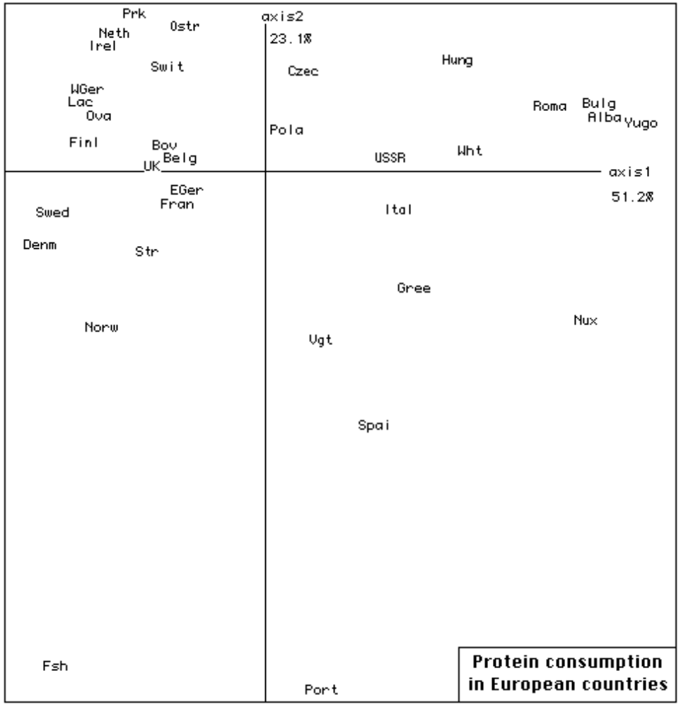

Slide 32
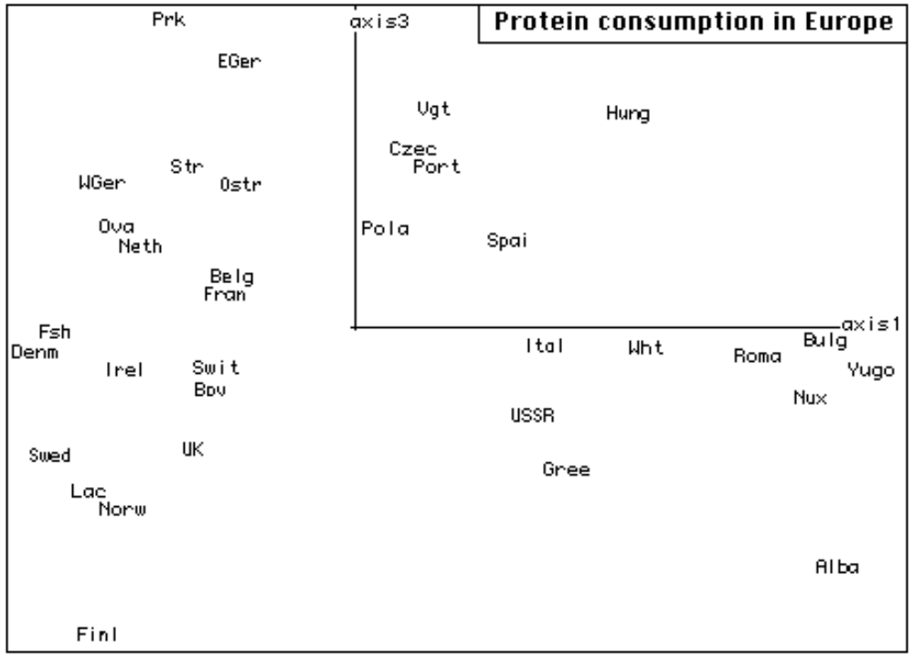

Slide 33
Interpretation
Eigenvalues roughly each decrease by ½. Hence interest in examing quite a few of them.
Axis 1: foods of vegetable origin {Nux, Wht, Vgt} are on F1>0. Foods of animal origin, with starchy foods (Str) are on F1<0.
Axis 1 arranges countries in terms of economy.
Axis 2: Fish, associated in particular with Portugal, is opposed to white meat. Included in latter are {Irld, Ndrl}.
Milk is correlated with axis 1. Differentiated only on axis 3. For F1<0, F3<0 we have countries with daily protein consumption > 20g (except Ndrl).
Finland, with max consumption of 34g, is an extreme point.
Red meat (Bov) is in F1<0,F4>0 with {Frnc,UnKg} as leading consumers, followed by {Irld, Belg}.

Slide 34
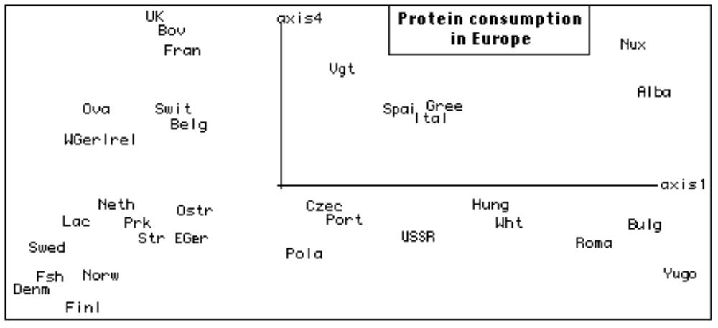
Cf. red meat, Bov, in F1<0, F4>0.

Slide 35
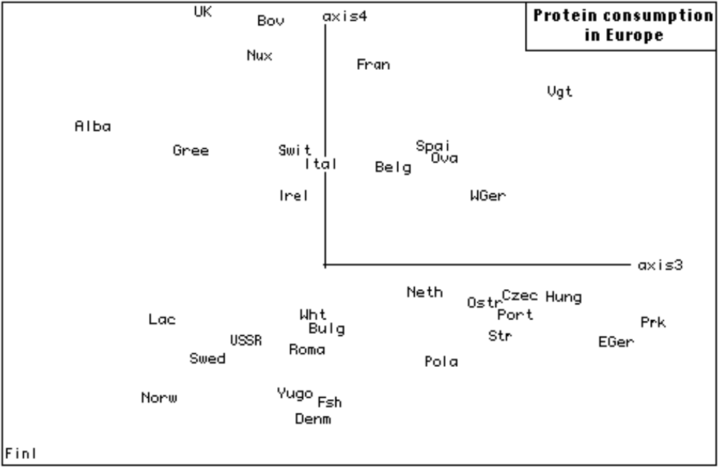

Slide 36
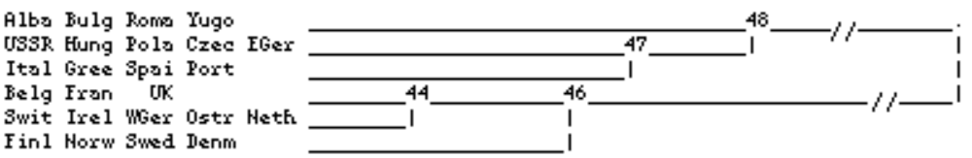
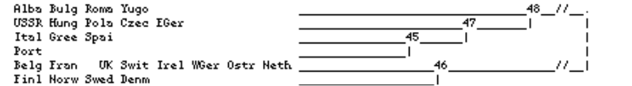
{Balkans, East Europe, Mediterranean,
West Europe (subdivided), Scandinavia}
are seen clearly in this cluster analysis.
We could specify top nodes, therefore leading to a sinuous cut of the hierarchy:

Slide 37
Analysis of protein consumption and employment patterns
Same set of 24 countries in both cases.
Table cross-classifies I = 24 countries with the union of Ja = 9 food groups, and Jt = 9 sectors of exployment. I x (Ja ∪ Jt).
Ought to express Ja as percentages, just as Jt are. But totals of Ja across countries are between 756 and 982, and totals across countries of Jt are exactly 1000. Close enough!
We use a supplementary column TER, cumulating {SRV, FIN, SPS}, as before.
We also use an overall supplementary column eat for block Ja, and an overall column mil for block Jt.

Slide 38
Employment pattern and protein consumption in European countries, BFJManly
trace : 1.5e-1
rang : 1 2 3 4 5 6 7 8 9 10 e-4
lambda : 882 222 147 73 52 39 28 19 14 10 e-4
taux : 5885 1481 979 485 348 258 185 125 95 66 e-4
cumul : 5885 7366 8345 8830 9178 9436 9621 9746 9842 9907 e-4
|SIGJ| QLT PDS INR| F 1 CO2 CTR| F 2 CO2 CTR| F 3 CO2 CTR| F 4 CO2 CTR|
___________________________________________________________________________
| Bov| 554 53 38| -223 464 30| 4 0 0| 38 13 5| -90 76 59|
| Prk| 822 44 53| -196 211 19| -265 387 139| 29 5 3| 199 219 239|
| Ova| 651 16 12| -252 585 12| -64 38 3| 37 13 2| 42 16 4|
| Lac| 930 94 93| -265 471 74| 80 43 27| 246 408 387| 36 9 17|
| Fsh| 951 24 92| -231 92 14| 590 603 375| -372 239 225| 95 16 29|
| Wht| 950 171 122| 294 808 168| -78 57 47| 20 4 5| -93 81 203|
| Str| 553 24 18| -117 123 4| 36 12 1| -98 86 16| 193 333 122|
| Nux| 772 16 44| 494 592 44| 144 50 15| -125 38 17| -194 91 83|
| Vgt| 503 23 26| 126 93 4| 76 34 6| -253 374 99| 20 2 1|
| AGR| 996 95 294| 653 916 457| 139 42 82| 86 16 48| 102 22 135|
| MIN| 766 6 25| 282 136 6| -549 517 88| -159 43 11| 201 70 36|
| MAN| 843 148 52| -67 84 7| -156 463 163| -125 295 158| 3 0 0|
| PS| 382 5 5| -72 38 0| -171 216 7| 48 17 1| 122 110 10|
| CON| 245 45 7| -23 22 0| 0 0 0| -74 222 17| -5 1 0|
| TC| 204 36 9| -75 158 2| -17 8 0| -27 20 2| 26 19 3|
| TER| 928 201 111| -263 836 158| 72 62 47| 20 5 5| -45 25 57|
ci dessous element(s) supplementaire(s)
| SER| 705 70 50| -261 637 54| 68 43 14| 6 0 0| -52 25 26|
| FIN| 221 22 69| -155 51 6| 240 122 57| 130 36 25| -74 12 16|
| SPS| 756 109 82| -286 729 102| 41 15 8| 6 0 0| -35 11 19|
| eat| 518 464 4| 8 40 0| 1 1 0| 25 434 19| -8 43 4|
| mil| 518 536 4| -6 40 0| -1 1 0| -21 434 17| 7 43 3|

Slide 39
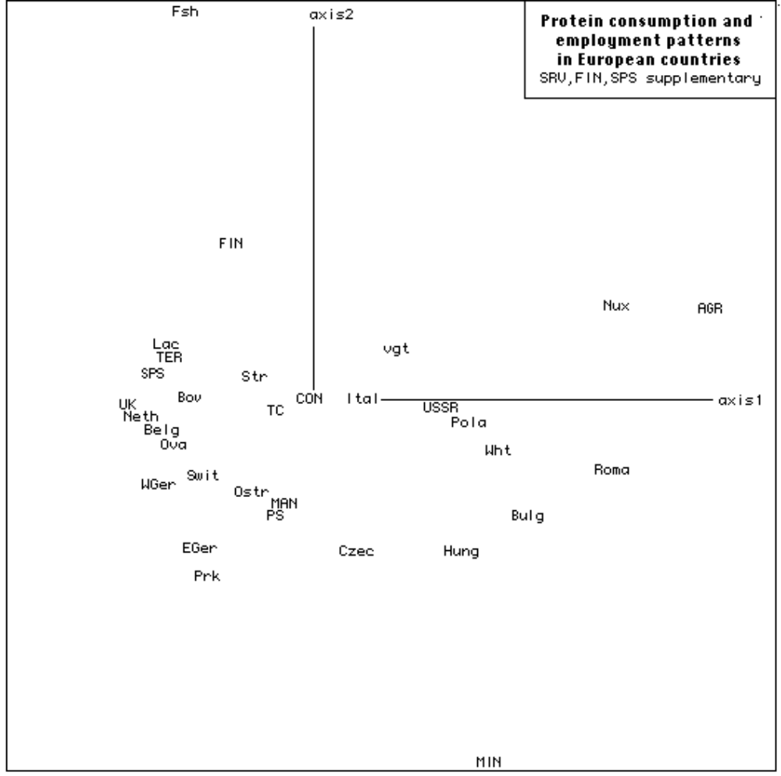

Slide 40
Interpretation
On axis 1, primary sectors {AGR,MIN} associated with vegetable proteins, F1>0, are opposed to TER (followed by secondary), associated with animal proteins and starchy foods (Str), F1<0.
On axis 2, fish consumption is opposed to MIN.
On axis 3, Fsh is opposed to Lac (milk).
Also on axis 3, eat and mil are, to some extent, opposed (more so than on other axes). Profiles of these columns, as noted, are nearly constant.
Look at correlations between {eat, mil} with axis 3 – the only axis worthy of consideration among 1, 2, 3. Note though that F3 does not express any major socio-economic differences.
Hence protein consumption is not related to economic reasons (from this data).

Slide 41
Agreements between votes of 15 congressmen
Data from Manly (1985) and H.C. Romesburg, Cluster Analysis for Researchers, Lifetime Learning, Belmont, 1984.
Set I = 15 New Jersey congressmen, House of Representatives.
k(i,i’) = voting disagreements = no. of bills on which the congressmen did not adopt the same attitude (e.g. vote against vs. abstain).
Far better would be table of original votes.
We will use (19 – score) to provide a sort of correspondence or contingency table; voting agreements.

Slide 42
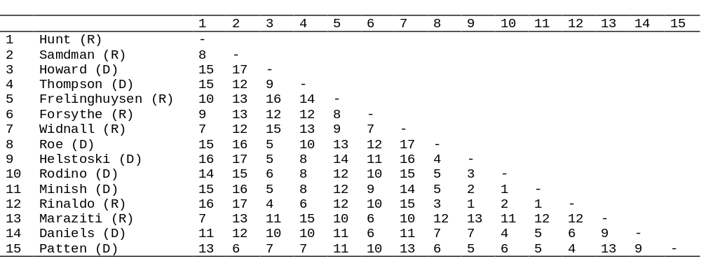
The data: The 'distances' between 15 Congressmen from
New Jersey in the United States House of Representatives.
The numbers in the table show the number of times that the
congressmen voted differently on 19 environmental bills.
Party allegiances are indicated (R = Republican, D = Democrat).

Slide 43
New Jersey Congressmen
Voting agreements, obtained from the original data of disagreements by
subtracting from 19
trace : 2.1e-1
rang : 1 2 3 4 5 6 7 8 9 10
lambda : 1517 273 121 84 53 32 19 13 9 4
taux : 7123 1281 569 393 250 148 90 59 44 20
cumul : 7123 8404 8974 9367 9617 9765 9855 9914 9958 9978
The (1,2) plane is similar to Manly’s multidimensional scaling,
including scaling based on ranks.
Axis 1 contrasts Republicans (R) and Democrats (D). Different
fonts used for these.
Democrats are closely clustered. Republicans are more dispersed.
Exception of Rin, R, who voted D.
On axis 2, San (R) and Tho (D) are isolated. They were known for
frequent abstentions.
Correspondence analysis could be used to have both voters and
preferences simultaneously displayed; and clustering could be
useful if there were several dimensions involved.

Slide 44
