Slide 1
Image & Information
F. Murtagh, Queen’s University Belfast
Pattern recognition – from remote comet, to biomass in the Gulf of Aden
Hubble Space Telescope’s myopia problem in the early 1990s
Large image compression and delivery
The importance of “Infoimaging”

Slide 2
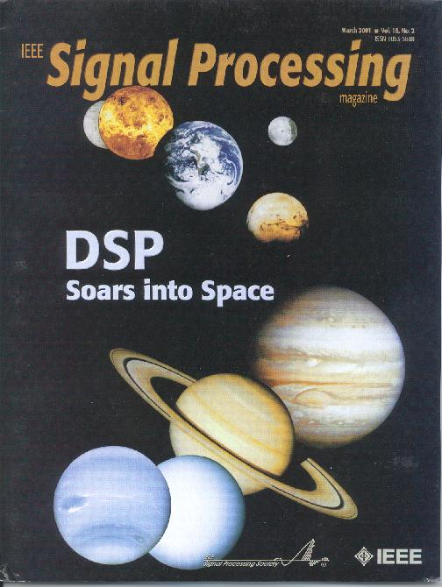
Recent special
issue, edited and
with contributions
by QUB, on
multiresolution
image and signal
analysis – filtering,
deconvolution,
compression, …

Slide 3
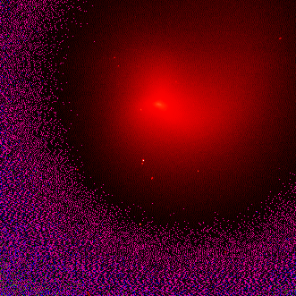
Periodic comet P/Swift-Tuttle observed with the 1.2m telescope at Calar Alto Observatory in Spain in October and November 1992. (Data from K Birkle, Max-Planck-Institut für Astronomie, Heidelberg).
Irregularity of nucleus is indicative of the presence of jets in in the coma.

Slide 4
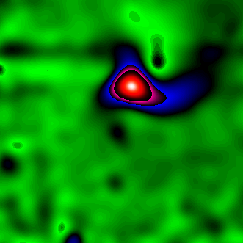
Wavelet (B₃-spline à trous) transform,
resolution scale 5, indicating direction
and strength of ejection of gases.

Slide 5
Hubble Space Telescope – Algorithms for Tackling Myopia
Concept of space telescope advanced by Lyman Spitzer Jr. (Princeton) in 1940s.
First official mention by NASA in 1962, four years after NASA founded. Science team established by NASA in 1973. From 1975 ESA involved. Congress approved in 1978. Marshall (Huntsville) – construction, Goddard (Greenbelt) – science and ground control.
Lockheed – basic spacecraft, Perkin-Elmer – primary mirror, ESA (BAe) – solar panels.
1986/1/26 – Challenger disaster.
HST deployed in low Earth orbit – 600 km – by Discovery (STS-31) on 1990/4/25.
First refurbishment mission Endeavour STS-61 in December 1993.

Slide 6
Hubble Space Telescope –Tackling Myopia
Between 1990 and 1993, all that could be done with HST images was based on deconvolution.
Most commonly used approach – Richardson-Lucy (Richardson – optics literature 1972, Lucy – astronomy literature 1974, Shepp and Vardi – medical literature 1982, also known as: maximum likelihood, EM).
Wavelet-based denoising of the residual (or error image) at each iteration leads to very worthwhile regularization.
Example follows, based on SN 1987a, a supernova and its ring of ejected material (in fact, a shell). First we will show the typical – ugly – HST point spread function.

Slide 7
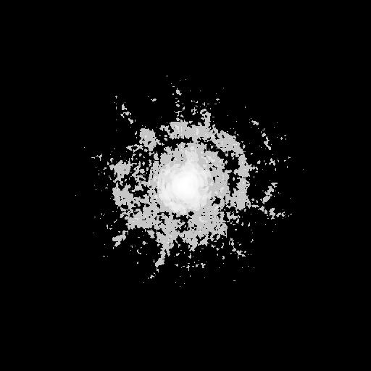

Slide 8
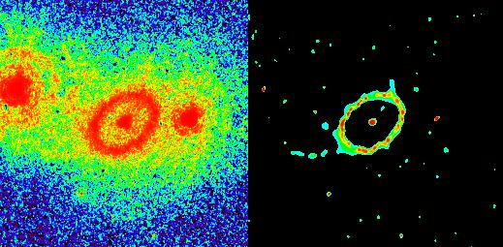

Slide 9
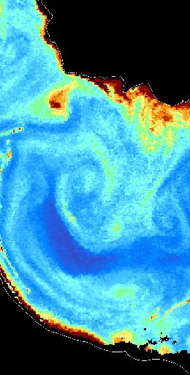
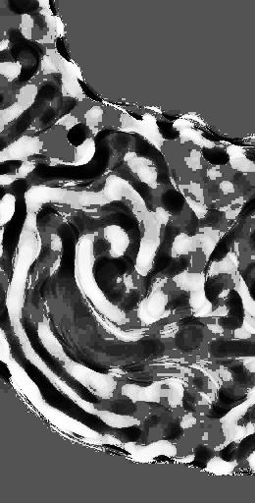
Ocean color data
Gulf of Aden
SeaWiFS image
Find: eddies,
currents
Right: one scale
from a
multiresolution
median
transform

Slide 10
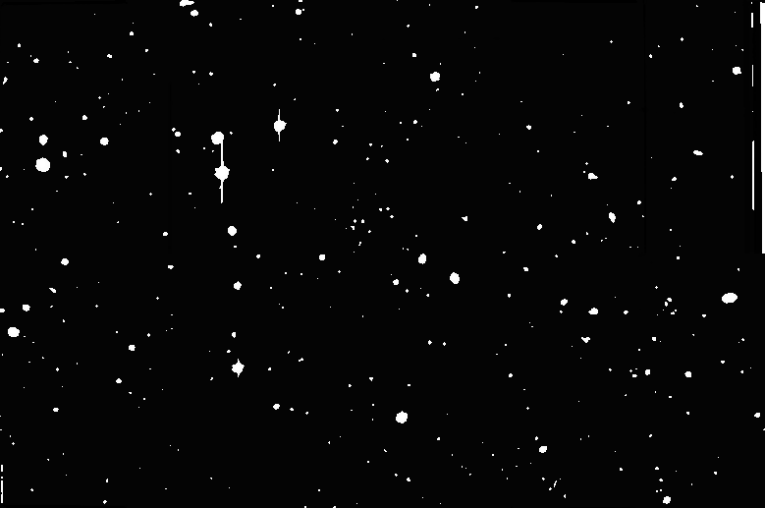

Slide 11
Lossy and lossless large astronomy image compression
Image just shown is a12,451 x 8268 CFH12K image (Canada-France-Hawaii Telescope, Hawaii). 412 MB grayscale image file.
Various astronomical detectors are now moving towards 16000 x 16000 image dimensions – the UK’s VISTA telescope, for example, which will be built over the next few years.
Many future image databases in astronomy will have image databases where each image is between 1 and 2 GB in size.
We have been developing visually-lossless compression algorithms, with about 200:1 compression ratio, and real-time decompression to specified resolution scale and block size.

Slide 12
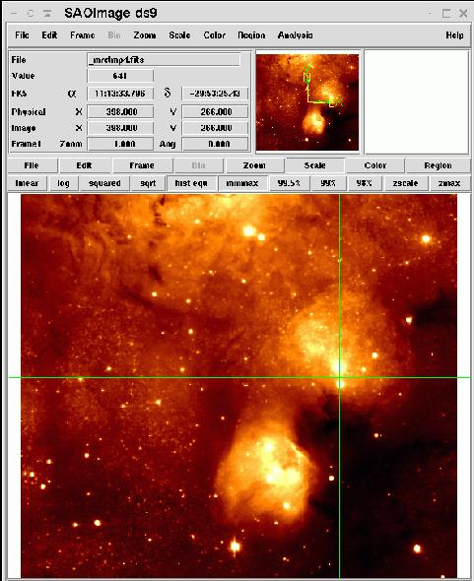
XLIVE, “Large Image Visualization
Environment”,
multiresolution and noise modeling based plug-in to
SAOimage-ds9
image viewer.
Image (original > 1 GB in size) shows
a rich star formation
region of our Galaxy.

Slide 13
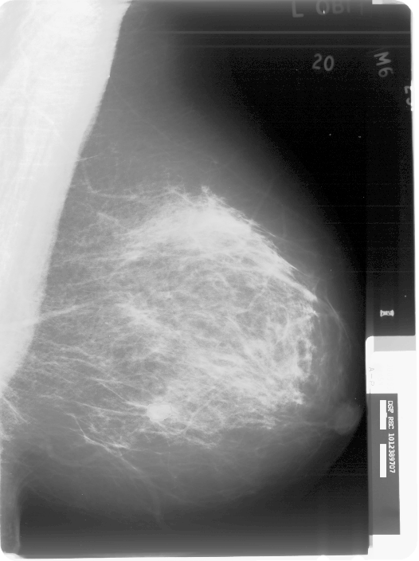
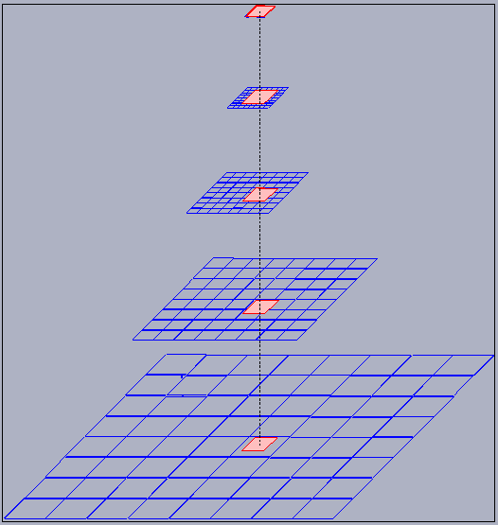
Digital
Mammography
A film, digitized at 42 microns, yields approx. a 4240 x 5670 16-bits-per-pixel image ≈ 50 MB.
We use a wavelet pyramidal representation to support lossless compression, with very fast decompression by resolution level and by block.

Slide 14
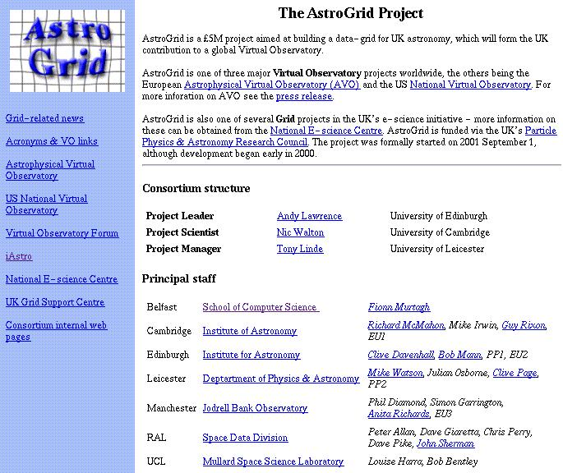

Slide 15
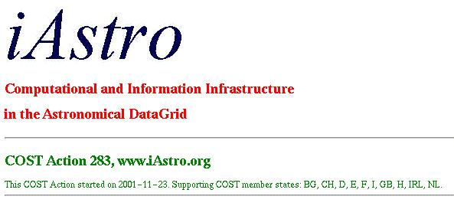
AstroGrid in the UK, and iAstro, a European COST
project are just two new projects which will use
the Grid – the Internet of the future – to handle
the processing of vast numbers of very large
images in astronomy.

Slide 16
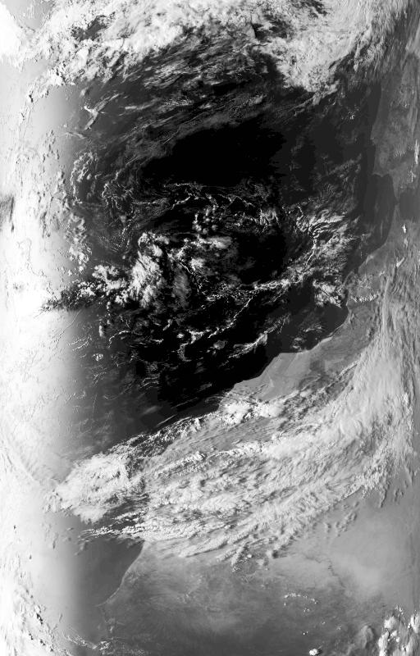
Example:
Multispectral data analysis
AVHRR data from NOAA,
showing Atlantic over
Canary Islands.
Each image band is 54 MB
in size.
So a 5-band visual and infrared
image set is 270 MB.
We want to segment these
multispectral data sets
efficiently and effectively, in
order to study cloud cover.
We are using Markov spatial
modeling, wavelet transforms
to provide features, and Bayes
Factors for model selection.

Slide 17
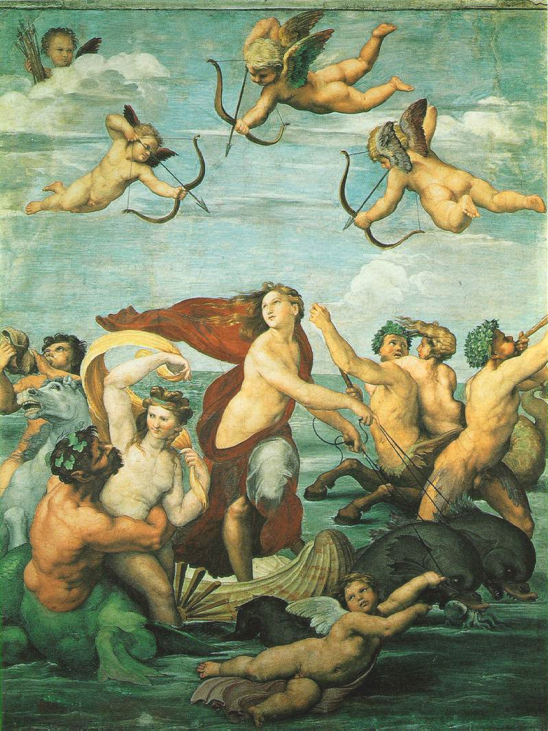
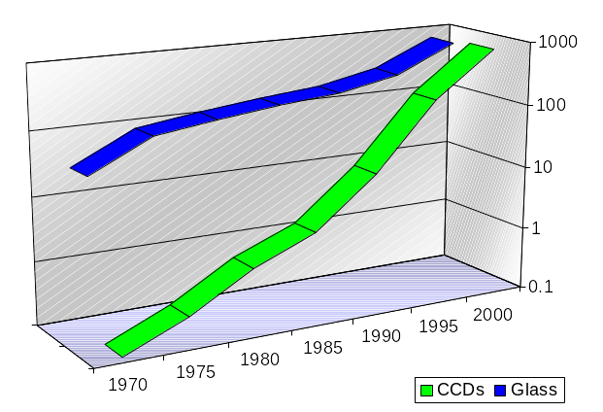
The iAstro people believe that:
Massive data mining
Massive data sets
Distributed computing
Hardware breakthrough:
wide field imaging with CCD Mosaics enables digital surveys
Discoveries
The sky covers 40.000 sq. deg.
With 0.6 arcsec sampling: 2 x 10¹² pxl
8 TB for band (10/100 TB/survey)
Ca. 10 PB keeping temporal resolution
(Δτ ca. 24 h for 1 yr …need for 20 yrs)
Notes:
NoEs in sensor fusion and information retrieval: former dead, latter now seems to be dead. Others – still alive. Medicine one has hearings in Brussels on June 5.

Slide 18
From Traditional to Survey Science
Traditional:
Survey-Based:
Another Survey/Archive?
Telescope
Survey
Telescope
Follow-Up
Telescope
Archive
Target Selection
Data Mining
Data Analysis
Results
Results
Highly successful and increasingly prominent, but inherently limited by the information content of individual surveys …
What comes next, beyond survey science is distributed (V.O.) science
Courtesy of G. Djorgovski

Slide 19
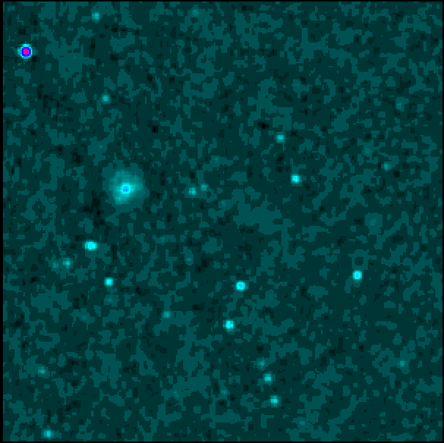
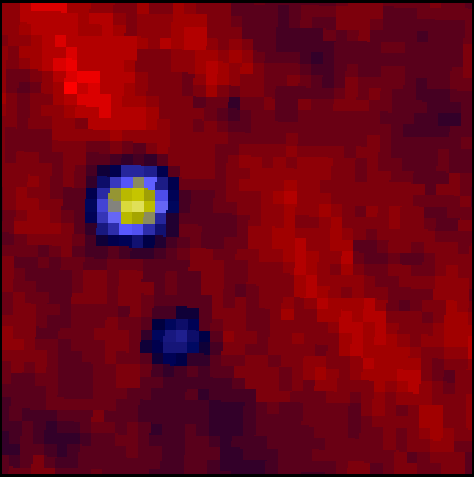
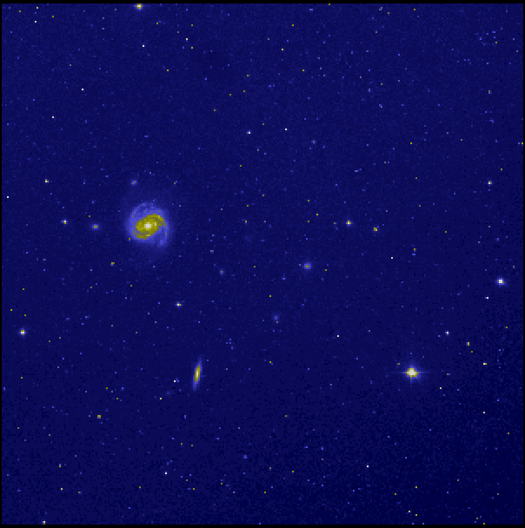
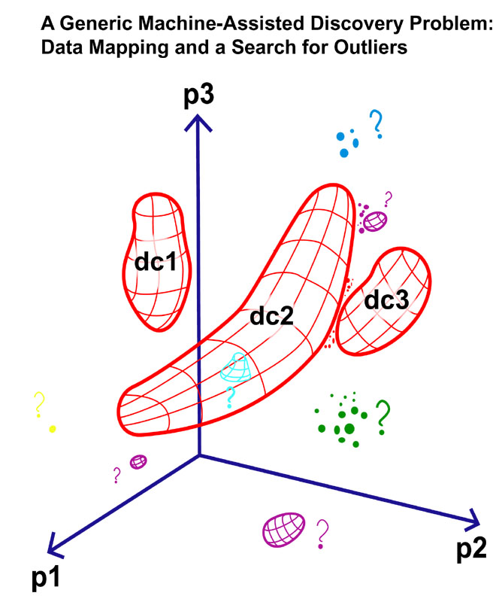
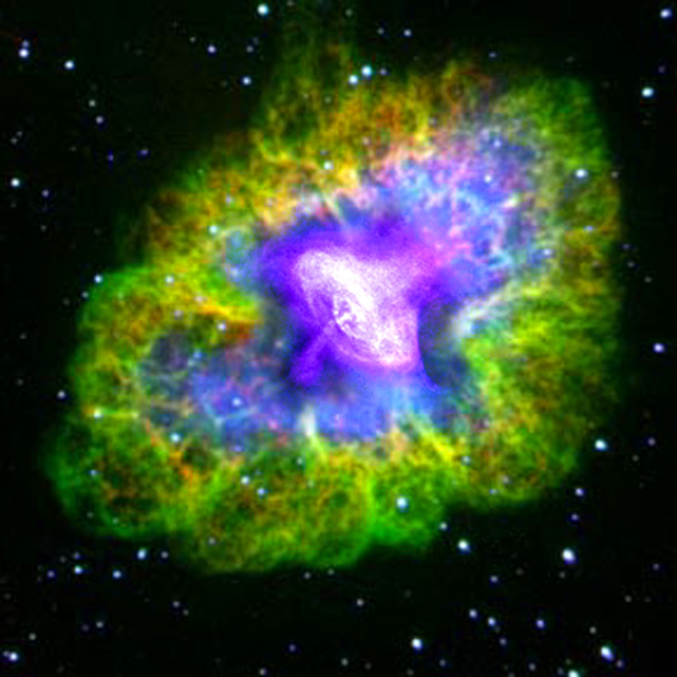
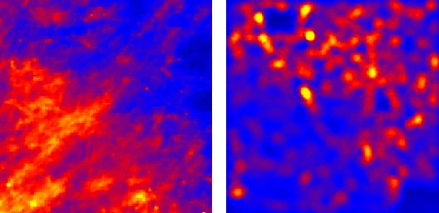
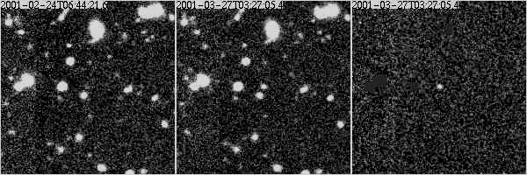
Panchromatic view of the Universe:
Radio
Far-Infrared
Visible
Visible + X-ray
Dust Map
Density Map
New domains of the parameter space: cf. time
Search for the unknown
Offers:
Different physics
Global understanding
Comparison with theory
New discoveries
Faint, Fast Transients (Tyson et al.)

Slide 20
Conclusion - I
Our research work uses:
Wavelets and multiresolution methods,
Noise modeling,
Integration of appropriate pattern recognition pipelines,
Compression
Our global objectives – optimized information delivery:
Account taken of:
platform and environment,
visual perception,
compression and classification facets of human understanding and interpretation

Slide 21
Conclusion - II
Infoimaging – a $225 billion industry (Kodak).
In e-commerce – 67% of new car buyers shop first on the web before visiting a showroom. Document archiving and storage. Medical and health support. Visual communication – the next mega trend. And… displays, entertainment, Earth observation – deforestation, floods, etc.
Many grand challenges exist in this field for our society’s health, transport, entertainment, production, and communications systems.

Slide 22
Multiscale Analysis Methods
Fionn Murtagh
www.cs.qub.ac.uk/~F.Murtagh
Jean-Luc Starck
jstarck.free.fr
(1) Image and Vision Systems,
Computer Science, Queen's University Belfast
(2) Astrophysical Service, CEA Saclay, France
Notes:
Click to add notes

Slide 23
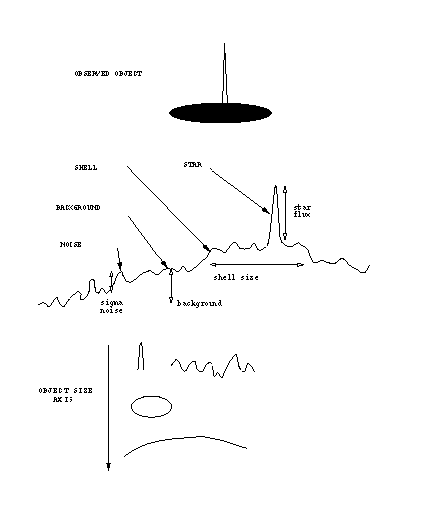
WHY MULTIRESOLUTION ?
Notes:
Click to add notes

Slide 24
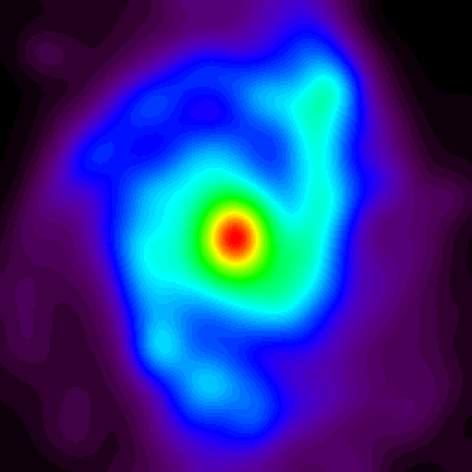
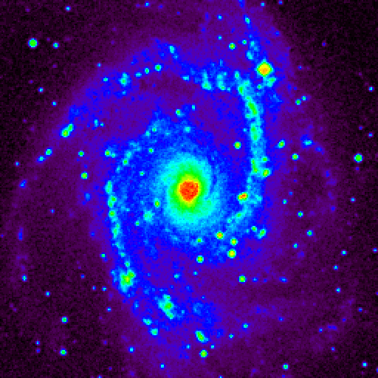
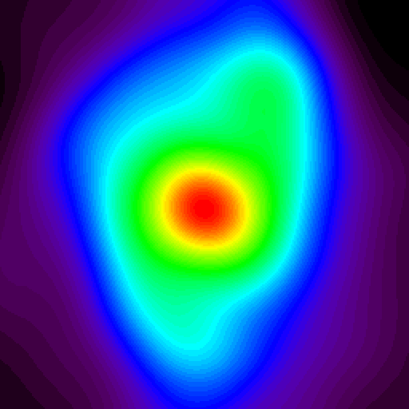
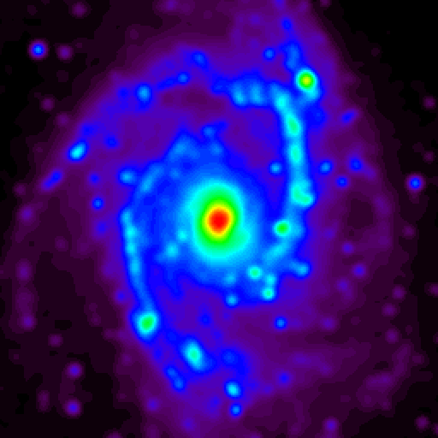
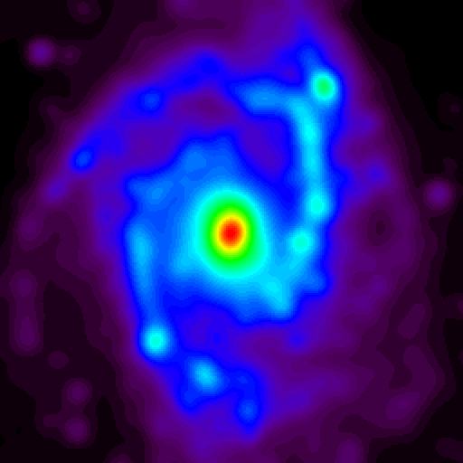
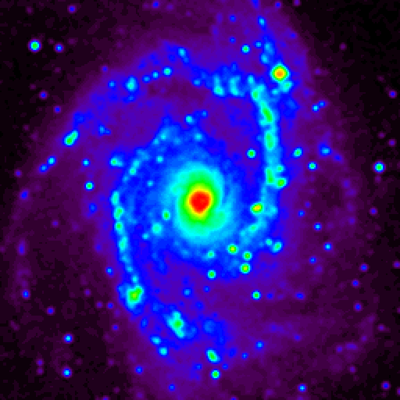
NGC2997
Notes:
Click to add notes

Slide 25
Notes:
Click to add notes

Slide 26
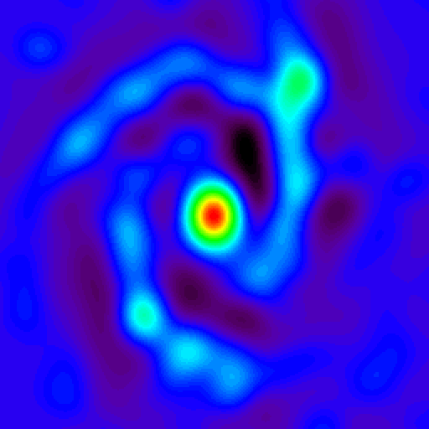
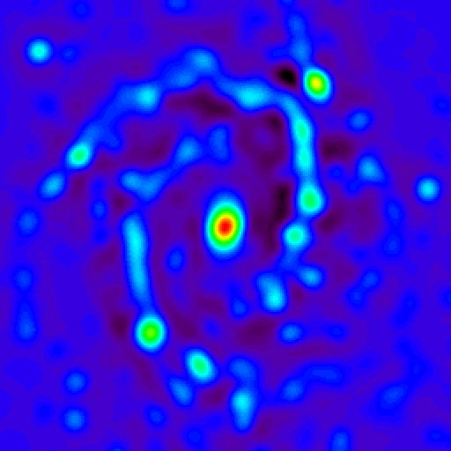
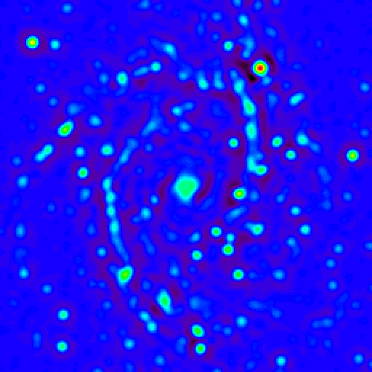
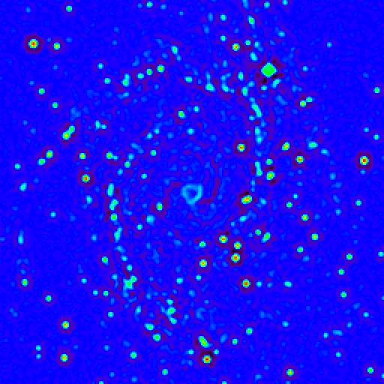
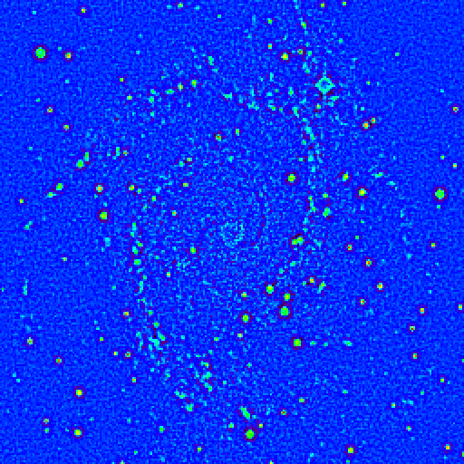
Scale 5
Scale 4
Scale 3
Scale 2
Scale 1
Notes:
Click to add notes

Slide 27
Notes:
Click to add notes

Slide 28
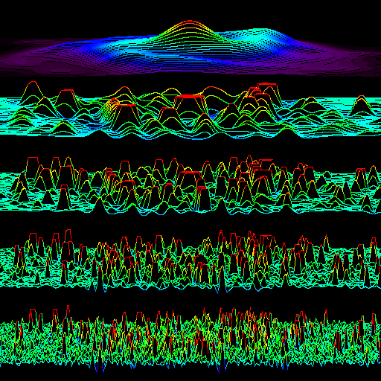
Notes:
Click to add notes

Slide 29
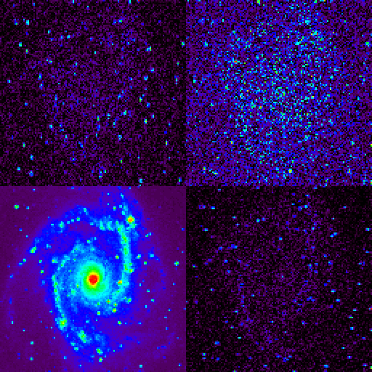
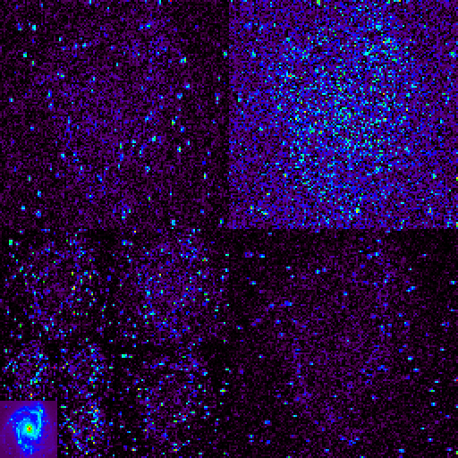
Notes:
Click to add notes

Slide 30
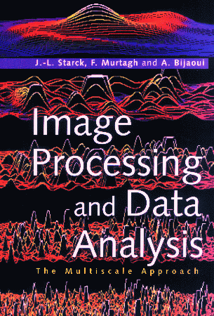
J.-L. Starck, F. Murtagh, and A. Bijaoui, "Image Processing and Data Analysis: The Multiscale Approach", Cambridge University Press,
Cambridge (GB), 1998.
And - new: J.-L. Starck and F. Murtagh, Astronomical Image and Data Analysis, Springer-Verlag, 2002.
Notes:
Click to add notes

Slide 31
A range of pattern recognition applications
Next:
Pattern recognition –
comets,
ecstasy tablets,
SEM images of concrete,
biomass in the Gulf of Aden,
retinal vessel tracking,
financial prediction

Slide 32
Find the galaxy, separate from the stars

Slide 33
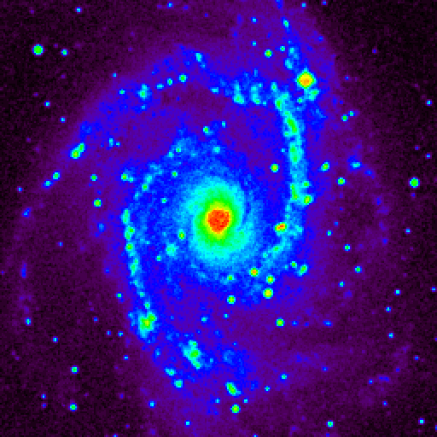
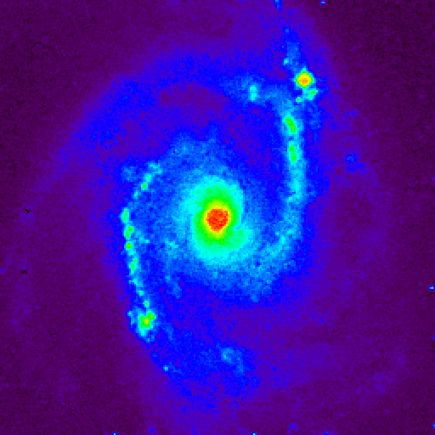
Notes:
Click to add notes

Slide 34
Intelligent “background” removal

Slide 35
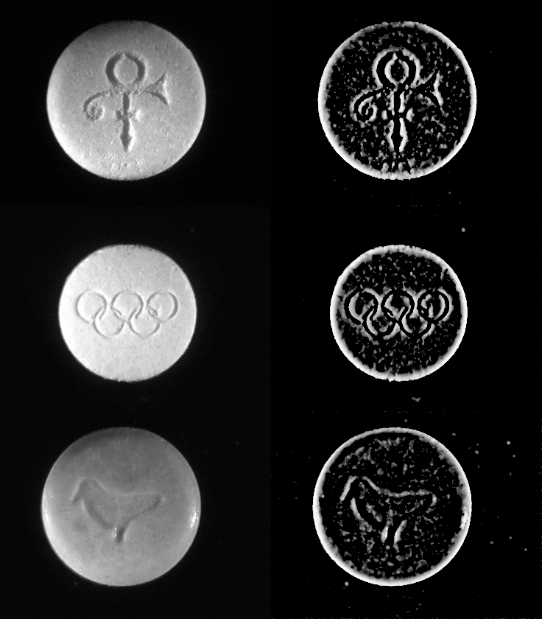

Slide 36
Speckle removal
Cross-sections of concrete using Scanning electron microscope

Slide 37
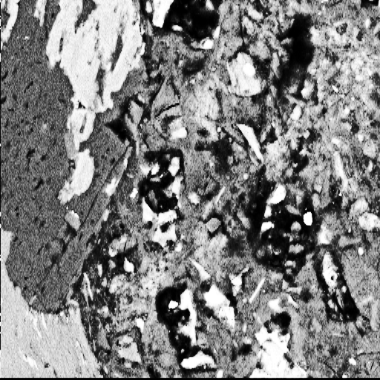
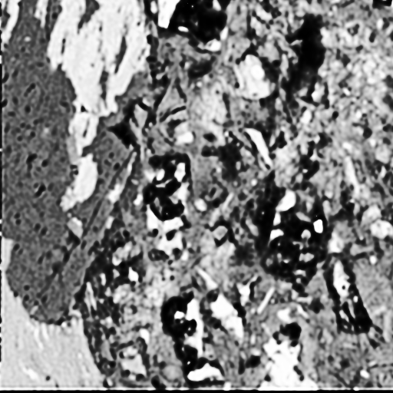



Slide 38
Tracking blood vessels in the retina
Based on:
Product of wavelet scales to show up edges,
Stochastic starting points for robustness,
Track following, and mathematical morphological clean-up

Slide 39
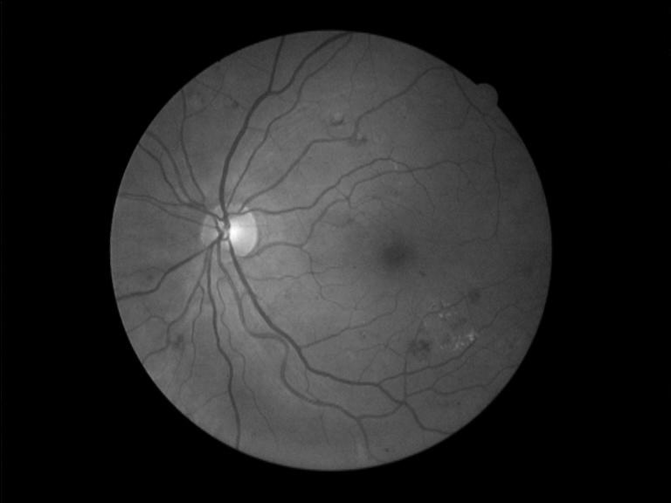

Slide 40
On the web…
Financial modeling, nowcasting, forecasting

Slide 41
